Slide 1
Deep Learning for Vision:
Tricks of the Trade
Marc'Aurelio Ranzato
Facebook, AI Group
www.cs.toronto.edu/~ranzato
BAVM Friday, 4 October 2013

Slide 2
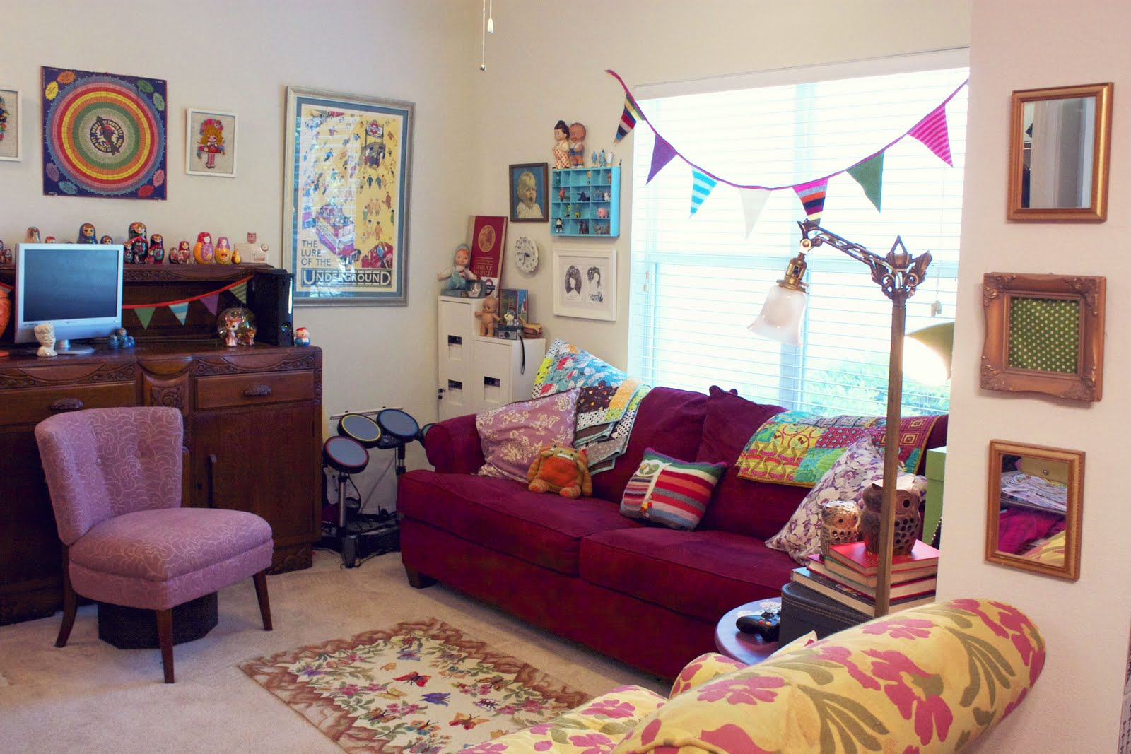
Ideal Features
- window, right
- chair, left
- monitor, top of shelf
- carpet, bottom
- drums, corner
- …
- pillows on couch
Ideal
Feature
Extractor
Q.: What objects are in the image? Where is the lamp?
What is on the couch? ...
Ranzato

Slide 3
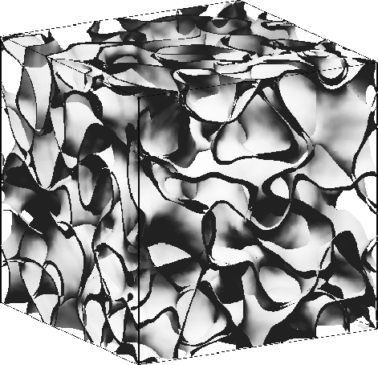
The Manifold of Natural Images

Slide 4
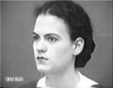
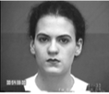
Ideal Feature Extraction
Pixel n
Pose
Ideal
Feature
Extractor
Pixel 2
Expression
Pixel 1
Ranzato

Slide 5
Learning Non-Linear Features
Given a dictionary of simple non-linear functions:
Proposal #1: linear combination
+
Proposal #2: composition
Ranzato

Slide 6
Learning Non-Linear Features
Given a dictionary of simple non-linear functions:
Proposal #1: linear combination
Kernel learning
Boosting
...
S h a l l o w
Proposal #2: composition
Deep learning
Scattering networks (wavelet cascade)
S.C. Zhou & D. Mumford “grammar”
D e e p
Ranzato

Slide 7
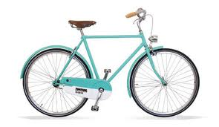
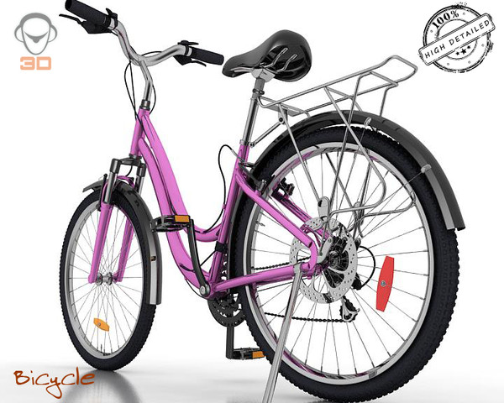
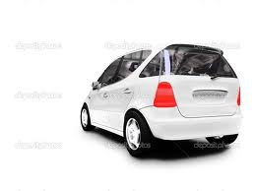
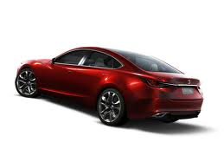
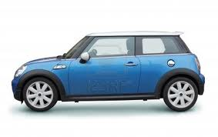
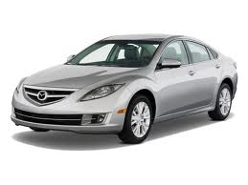
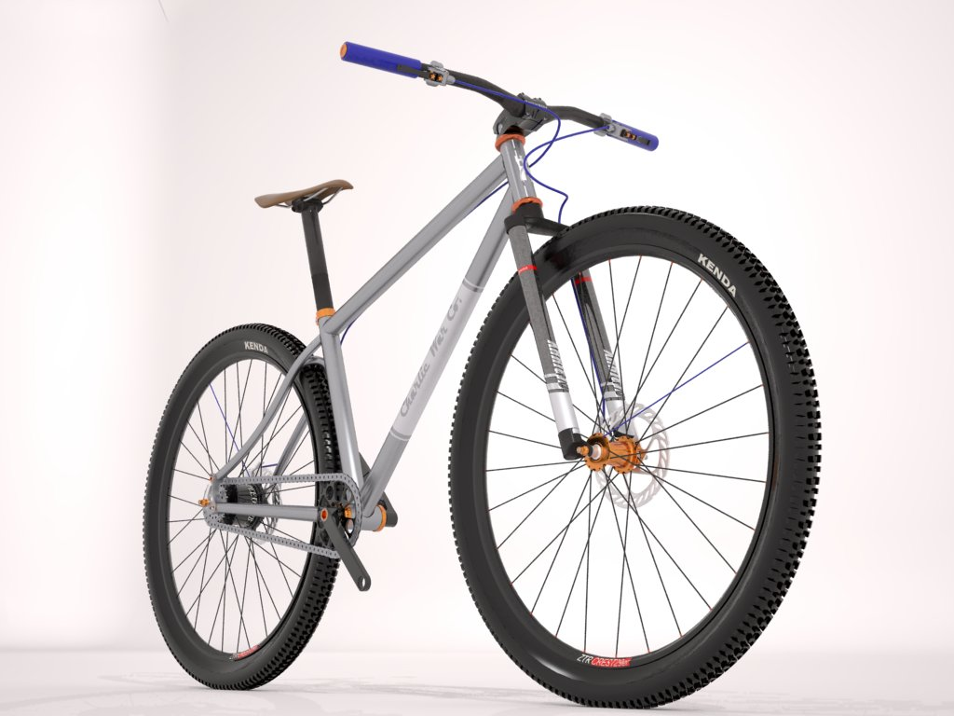
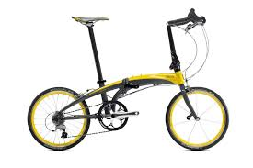
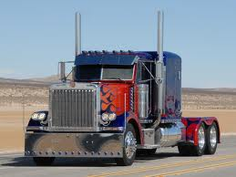
Linear Combination
prediction of class
+
...
templete matchers
BAD: it may require an exponential nr. of templates!!!
Input image
Ranzato

Slide 8
Composition
...
prediction of class
high-level parts
mid-level parts
reuse intermediate parts
distributed representations
low level parts
GOOD: (exponentially) more efficient
Input image
Lee et al. “Convolutional DBN's ...” ICML 2009, Zeiler & Fergus
Ranzato

Slide 9
A Potential Problem with Deep Learning
Optimization is difficult: non-convex, non-linear system
Ranzato

Slide 10
A Potential Problem with Deep Learning
Optimization is difficult: non-convex, non-linear system
k-Means
Pooling
Classifier
SIFT
Solution #1: freeze first N-1 layer (engineer the features)
It makes it shallow!
- How to design features of features?
- How to design features for new imagery?
Ranzato

Slide 11
A Potential Problem with Deep Learning
Optimization is difficult: non-convex, non-linear system
Solution #2: live with it!
It will converge to a local minimum.
It is much more powerful!!
Given lots of data, engineer less and learn more!!
Just need to know a few tricks of the trade...
Ranzato

Slide 12
Deep Learning in Practice
Optimization is easy, need to know a few tricks of the trade.
Q: What's the feature extractor? And what's the classifier?
A: No distinction, end-to-end learning!
Ranzato

Slide 13
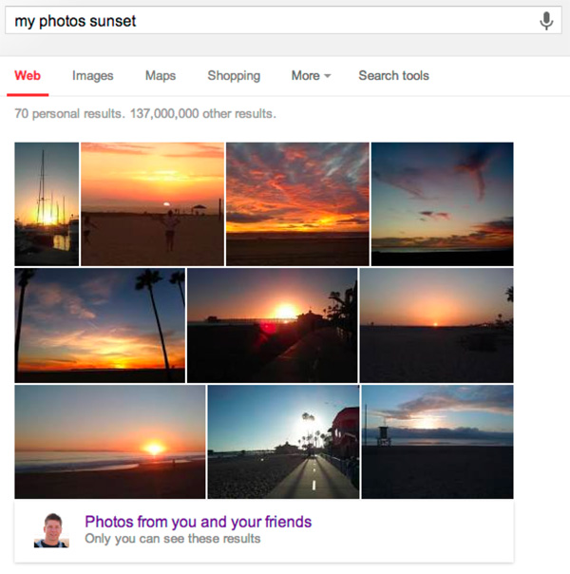
Deep Learning in Practice
It works very well in practice:
Ranzato

Slide 14
KEY IDEAS: WHY DEEP LEARNING
We need non-linear system
We need to learn it from data
Build feature hierarchies
Distributed representations
Compositionality
End-to-end learning
Ranzato

Slide 15
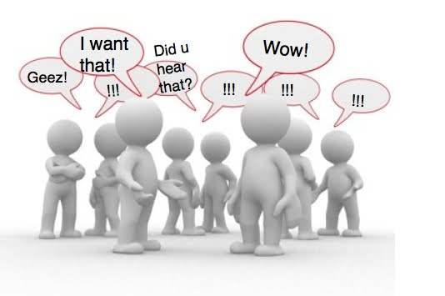
What Is Deep Learning?
Ranzato

Slide 16
Buzz Words
It's a Convolutional Net
It's a Contrastive Divergence
It's a Feature Learning
It's a Unsupervised Learning
It's just old Neural Nets
It's a Deep Belief Net
Ranzato

Slide 17
(My) Definition
A Deep Learning method is: a method which makes predictions by using a sequence of non-linear processing stages. The resulting intermediate representations can be interpreted as feature hierarchies and the whole system is jointly learned from data.
Some deep learning methods are probabilistic, others are loss-based, some are supervised, other unsupervised...
It's a large family!
Ranzato

Slide 18
Perceptron
1957
Rosenblatt
THE SPACE OF
MACHINE LEARNING METHODS

Slide 19
Neural Net
Perceptron
80s
back-propagation & compute power
AutoencoderNeural Net

Slide 20
Recurrent Neural Net
Convolutional Neural Net
Neural Net
Perceptron
90s
LeCun's CNNs
AutoencoderNeural Net
Sparse Coding
GMM

Slide 21
Recurrent Neural Net
Boosting
Convolutional Neural Net
Neural Net
Perceptron
SVM
00s
SVMs
AutoencoderNeural Net
Sparse Coding
GMM
Restricted BM

Slide 22
Recurrent Neural Net
Boosting
Convolutional Neural Net
Neural Net
Perceptron
SVM
2006
Hinton's DBN
AutoencoderNeural Net
Sparse Coding
GMM
Deep Belief Net
Restricted BM
BayesNP

Slide 23
2009
Recurrent Neural Net
Boosting
Convolutional Neural Net
Neural Net
Perceptron
2009
ASR (data + GPU)
SVM
Deep (sparse/denoising) Autoencoder
AutoencoderNeural Net
Sparse Coding
ΣΠ
GMM
Deep Belief Net
Restricted BM
BayesNP

Slide 24
Recurrent Neural Net
Boosting
Convolutional Neural Net
Neural Net
Perceptron
2012
CNNs (data + GPU)
SVM
Deep (sparse/denoising) Autoencoder
AutoencoderNeural Net
Sparse Coding
ΣΠ
GMM
Deep Belief Net
Restricted BM
BayesNP

Slide 25
Recurrent Neural Net
Boosting
Convolutional Neural Net
Neural Net
Perceptron
SVM
Deep (sparse/denoising) Autoencoder
AutoencoderNeural Net
Sparse Coding
ΣΠ
GMM
Deep Belief Net
Restricted BM
BayesNP

Slide 26
Convolutional Neural Net 2012
TIME
Convolutional Neural Net 1998
Convolutional Neural Net 1988
Q.: Did we make any prgress since then?
A.: The main reason for the breakthrough is: data and GPU, but we have also made networks deeper and more non-linear.

Slide 27
ConvNets: History
- Fukushima 1980: designed network with same basic structure but did not train by backpropagation.
- LeCun from late 80s: figured out backpropagation for CNN, popularized and deployed CNN for OCR applications and others.
- Poggio from 1999: same basic structure but learning is restricted to top layer (k-means at second stage)
- LeCun from 2006: unsupervised feature learning
- DiCarlo from 2008: large scale experiments, normalization layer
- LeCun from 2009: harsher non-linearities, normalization layer, learning unsupervised and supervised.
- Mallat from 2011: provides a theory behind the architecture
- Hinton 2012: use bigger nets, GPUs, more data
LeCun et al. “Gradient-based learning applied to document recognition” IEEE 1998

Slide 28
ConvNets: till 2012
Common wisdom: training does not work because we “get stuck in local minima”
Loss
parameter

Slide 29
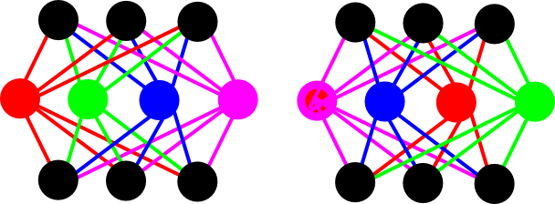
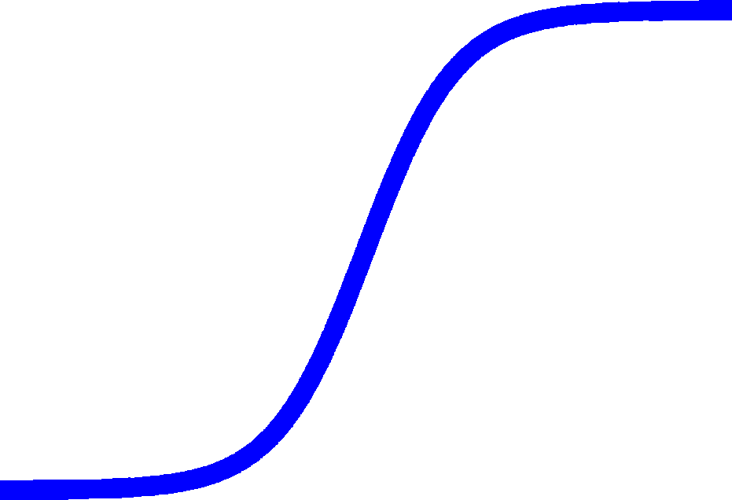
ConvNets: today
Local minima are all similar, there are long plateaus,
it can take long time to break symmetries.
Loss
w
w
breaking ties
between parameters
Saturating units
input/output invariant to permutations
parameter

Slide 30
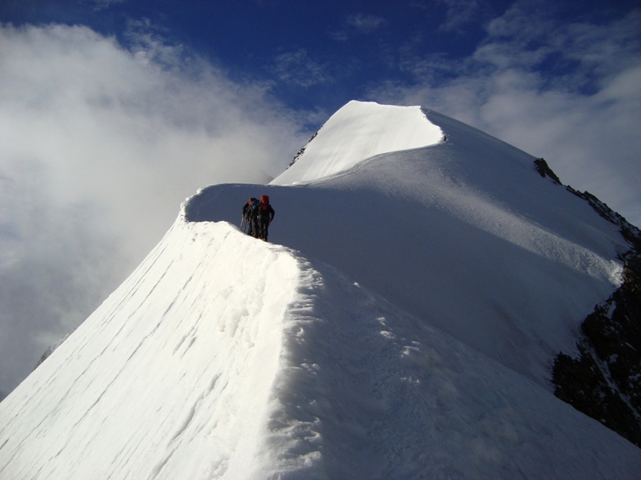
Like walking on a ridge between valleys

Slide 31
ConvNets: today
Local minima are all similar, there are long plateaus, it can take long to break symmetries.
Optimization is not the real problem when:
– dataset is large
– unit do not saturate too much
– normalization layer
Loss
parameter

Slide 32
ConvNets: today
Today's belief is that the challenge is about:
– generalization
How many training samples to fit 1B parameters?
How many parameters/samples to model spaces with 1M dim.?
– scalability
Loss
parameter

Slide 33
Recurrent Neural Net
Boosting
Convolutional Neural Net
Neural Net
Perceptron
SHALLOW
SVM
Deep (sparse/denoising) Autoencoder
AutoencoderNeural Net
Sparse Coding
ΣΠ
GMM
Deep Belief Net
Restricted BM
BayesNP
DEEP

Slide 34
Recurrent Neural Net
Boosting
Convolutional Neural Net
Neural Net
Perceptron
SHALLOW
SUPERVISED
SVM
UNSUPERVISED
Deep (sparse/denoising) Autoencoder
AutoencoderNeural Net
Sparse Coding
ΣΠ
GMM
Deep Belief Net
Restricted BM
BayesNP
DEEP

Slide 35
Deep Learning is a very rich family!
I am going to focus on a few methods...
Ranzato

Slide 36
Recurrent Neural Net
CNN
Boosting
Neural Net
Perceptron
SHALLOW
SUPERVISED
SVM
UNSUPERVISED
Deep (sparse/denoising) Autoencoder
AutoencoderNeural Net
Sparse
Coding
ΣΠ
GMM
DBN
Restricted BM
BayesNP
DEEP

Slide 37
Deep Gated MRF
Layer 1:
pair-wise MRF
Ranzato et al. “Modeling natural images with gated MRFs” PAMI 2013

Slide 38
Deep Gated MRF
Layer 1:
pair-wise MRF
Ranzato et al. “Modeling natural images with gated MRFs” PAMI 2013

Slide 39
Deep Gated MRF
Layer 1:
gated MRF
Ranzato et al. “Modeling natural images with gated MRFs” PAMI 2013

Slide 40
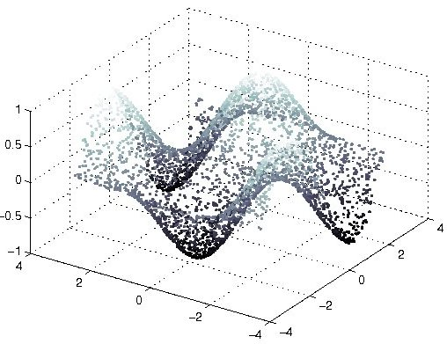
Deep Gated MRF
Layer 1:
gated MRF
Ranzato et al. “Modeling natural images with gated MRFs” PAMI 2013

Slide 41
Deep Gated MRF
Layer 1:
Inference of latent variables:
just a forward pass
Training:
requires approximations
(here we used MCMC methods)
Ranzato et al. “Modeling natural images with gated MRFs” PAMI 2013

Slide 42
Deep Gated MRF
Layer 1
Layer 2
input
Ranzato et al. “Modeling natural images with gated MRFs” PAMI 2013

Slide 43
Deep Gated MRF
Layer 1
Layer 2
Layer 3
input
Ranzato et al. “Modeling natural images with gated MRFs” PAMI 2013

Slide 44
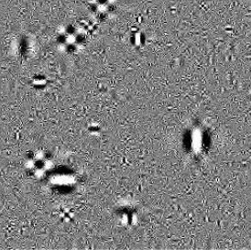
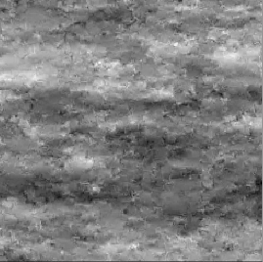
Sampling High-Resolution Images
Gaussian model
marginal wavelet
from Simoncelli 2005
Pair-wise MRF
FoE
from Schmidt, Gao, Roth CVPR 2010

Slide 45
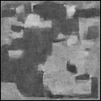
Sampling High-Resolution Images
Gaussian model
marginal wavelet
gMRF: 1 layer
from Simoncelli 2005
Pair-wise MRF
FoE
Ranzato et al. PAMI 2013
from Schmidt, Gao, Roth CVPR 2010

Slide 46
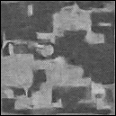
Sampling High-Resolution Images
Gaussian model
marginal wavelet
gMRF: 1 layer
from Simoncelli 2005
Pair-wise MRF
FoE
Ranzato et al. PAMI 2013
from Schmidt, Gao, Roth CVPR 2010

Slide 47
Sampling High-Resolution Images
Gaussian model
marginal wavelet
gMRF: 1 layer
from Simoncelli 2005
Pair-wise MRF
FoE
Ranzato et al. PAMI 2013
from Schmidt, Gao, Roth CVPR 2010

Slide 48
Sampling High-Resolution Images
Gaussian model
marginal wavelet
gMRF: 3 layers
from Simoncelli 2005
Pair-wise MRF
FoE
Ranzato et al. PAMI 2013
from Schmidt, Gao, Roth CVPR 2010

Slide 49
Sampling High-Resolution Images
Gaussian model
marginal wavelet
gMRF: 3 layers
from Simoncelli 2005
Pair-wise MRF
FoE
Ranzato et al. PAMI 2013
from Schmidt, Gao, Roth CVPR 2010

Slide 50
Sampling High-Resolution Images
Gaussian model
marginal wavelet
gMRF: 3 layers
from Simoncelli 2005
Pair-wise MRF
FoE
Ranzato et al. PAMI 2013
from Schmidt, Gao, Roth CVPR 2010

Slide 51
Sampling High-Resolution Images
Gaussian model
marginal wavelet
gMRF: 3 layers
from Simoncelli 2005
Pair-wise MRF
FoE
Ranzato et al. PAMI 2013
from Schmidt, Gao, Roth CVPR 2010

Slide 52
Sampling After Training on Face Images
unconstrained samples
Original
Input
1st layer
2nd layer
3rd layer
4th layer
10 times
conditional (on the left part of the face) samples
Ranzato et al. PAMI 2013

Slide 53
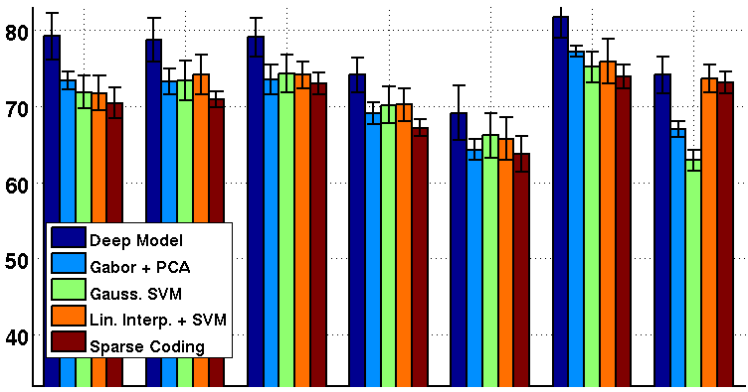
Expression Recognition Under Occlusion
Ranzato et al. PAMI 2013

Slide 54
Pros
Cons
Feature extraction is fast
Unprecedented generation quality
Advances models of natural images
Trains without labeled data
Training is inefficient
Slow
Tricky
Sampling scales badly with dimensionality
What's the use case of generative models?
Conclusion
If generation is not required, other feature learning methods are more efficient (e.g., sparse auto-encoders).
What's the use case of generative models?

Slide 55
Recurrent Neural Net
CNN
Boosting
Neural Net
Perceptron
SHALLOW
SUPERVISED
SVM
UNSUPERVISED
Deep (sparse/denoising) Autoencoder
AutoencoderNeural Net
SPARSE CODING
ΣΠ
GMM
DBN
Restricted BM
BayesNP
DEEP

Slide 56
CONV NETS: TYPICAL ARCHITECTURE
One stage (zoom)
Convol.
LCN
Pooling
Whole system
Input Image
Class
Labels
Fully Conn.
Layers
1st stage
2nd stage
3rd stage
Ranzato

Slide 57
CONV NETS: TYPICAL ARCHITECTURE
One stage (zoom)
Convol.
LCN
Pooling
Conceptually similar to:
SIFT → K-Means → Pyramid Pooling → SVM
Lazebnik et al. “...Spatial Pyramid Matching...” CVPR 2006
SIFT → Fisher Vect. → Pooling → SVM
Sanchez et al. “Image classifcation with F.V.: Theory and practice” IJCV 2012
Ranzato

Slide 58
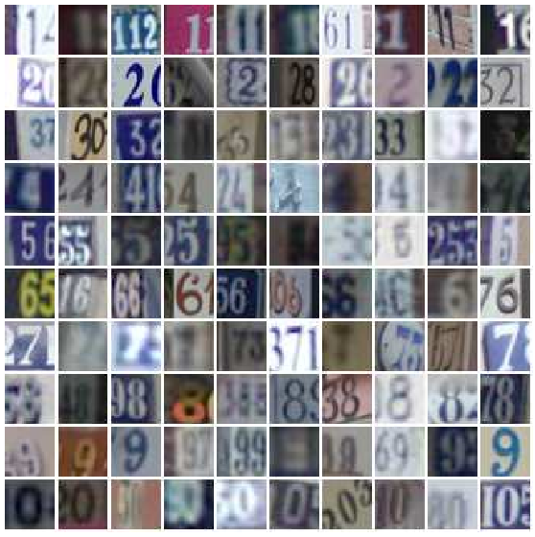
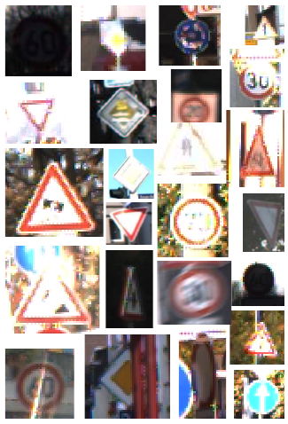
CONV NETS: EXAMPLES
- OCR / House number & Traffic sign classification
Ciresan et al. “MCDNN for image classification” CVPR 2012
Wan et al. “Regularization of neural networks using dropconnect” ICML 2013

Slide 59
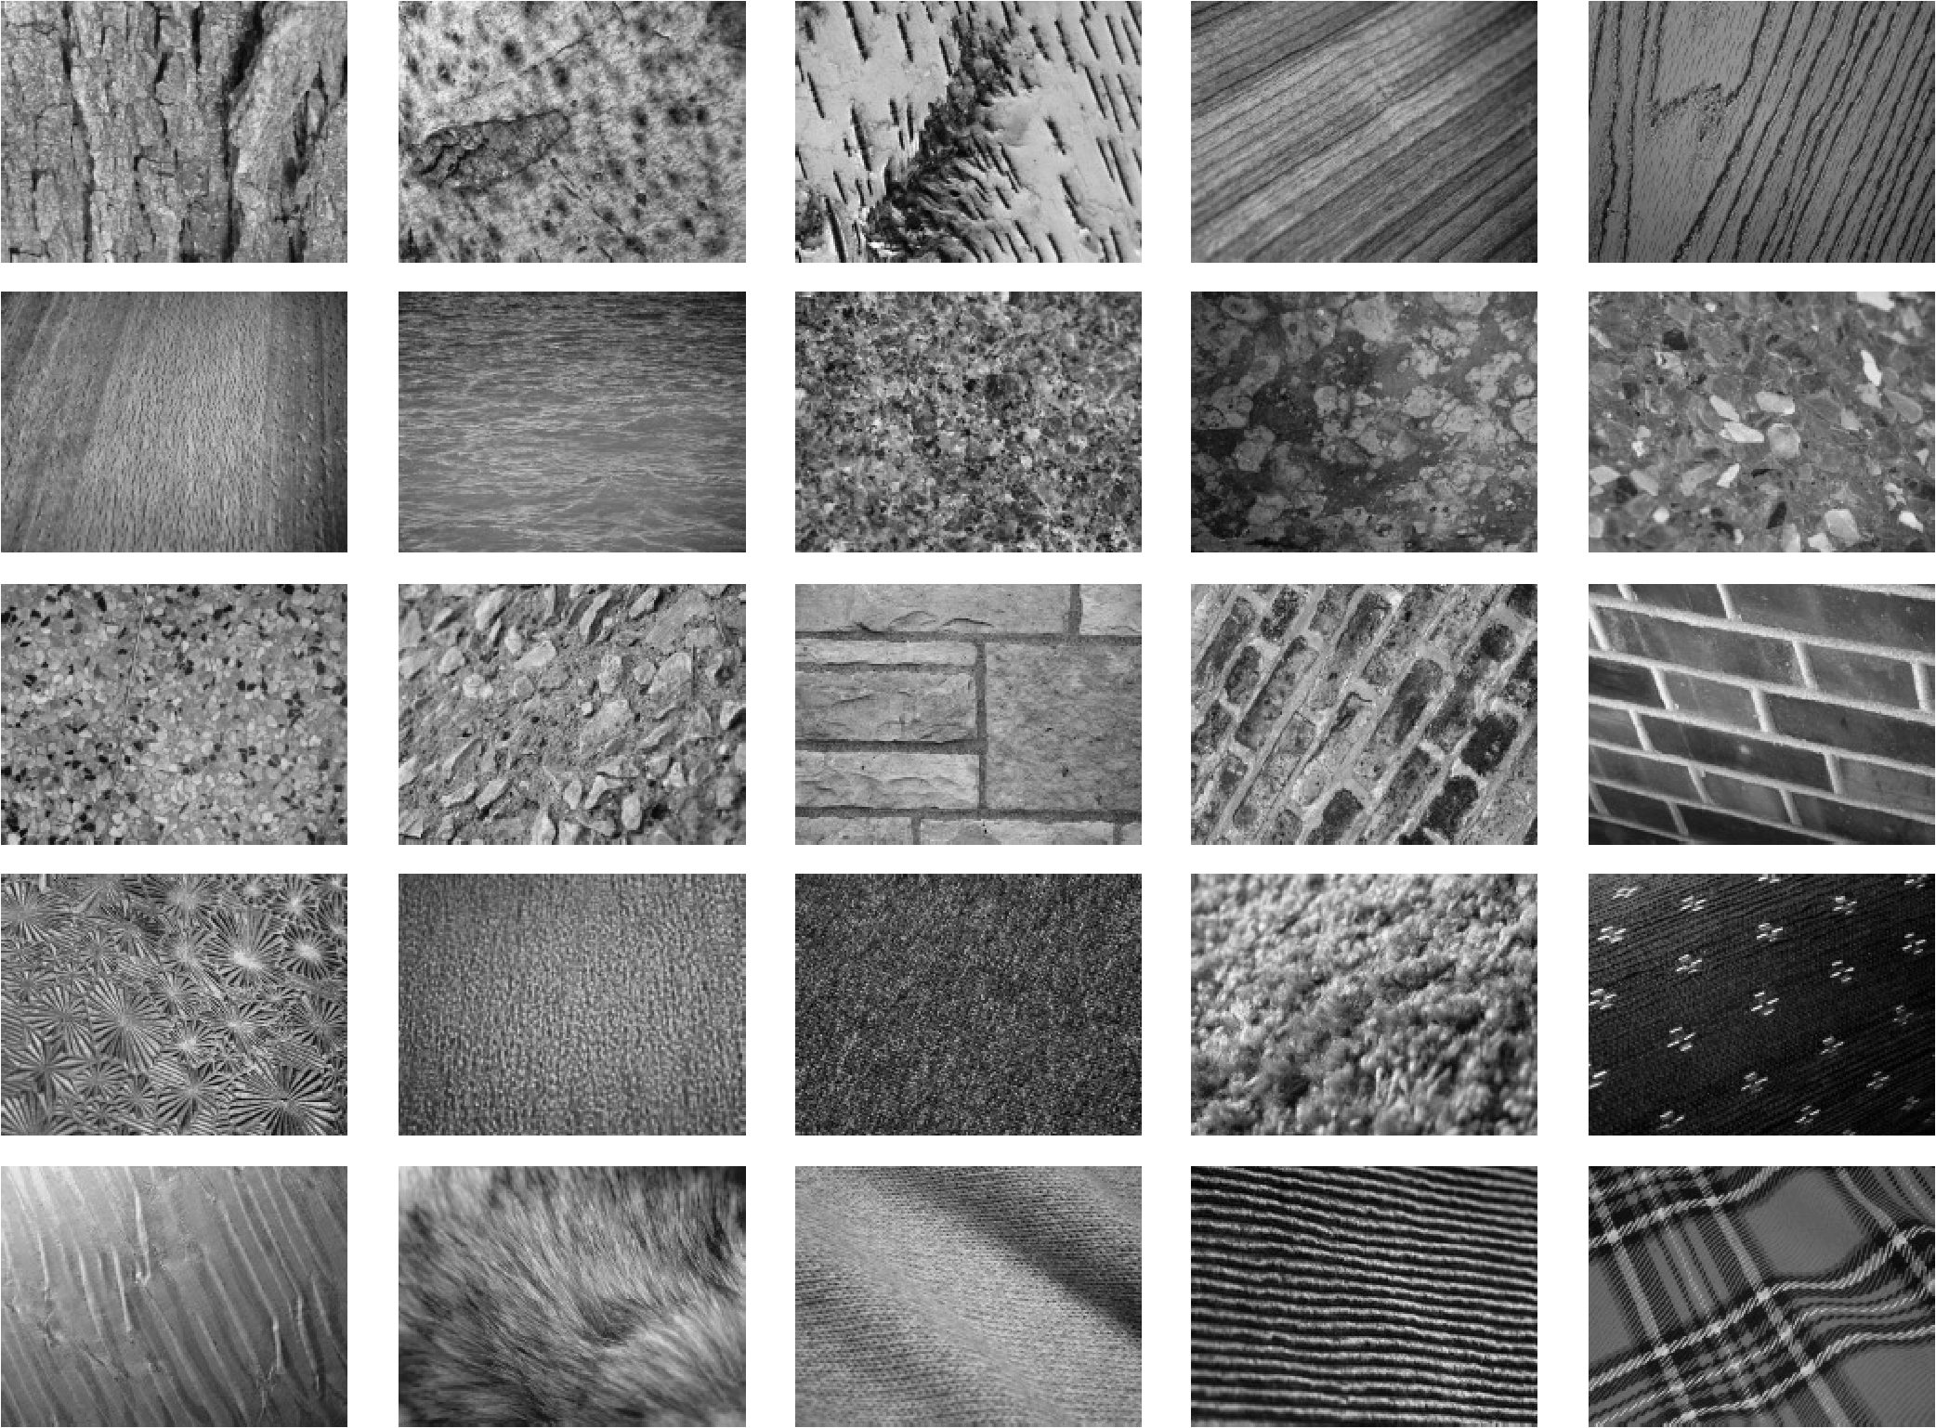
CONV NETS: EXAMPLES
- Texture classification
Sifre et al. “Rotation, scaling and deformation invariant scattering...” CVPR 2013

Slide 60
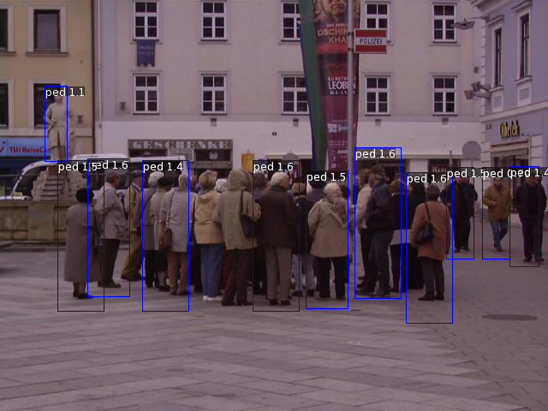
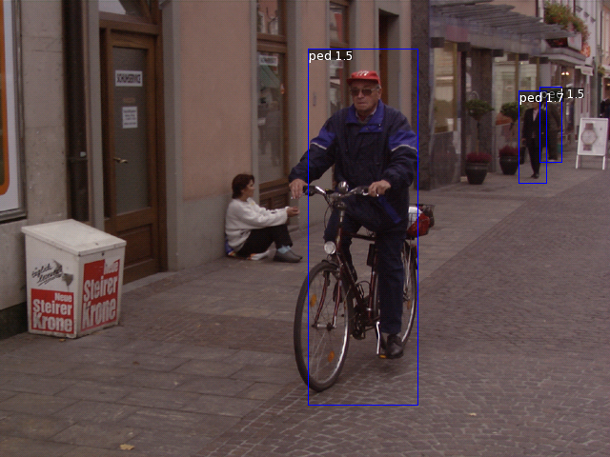
CONV NETS: EXAMPLES
- Pedestrian detection
Sermanet et al. “Pedestrian detection with unsupervised multi-stage..” CVPR 2013

Slide 61
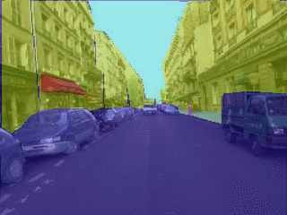
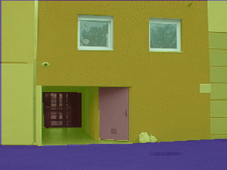
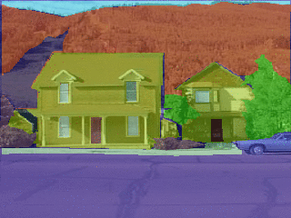
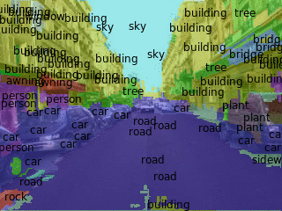
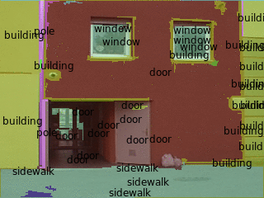
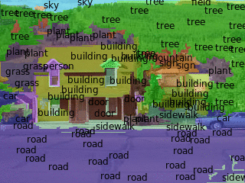
CONV NETS: EXAMPLES
- Scene Parsing
Farabet et al. “Learning hierarchical features for scene labeling” PAMI 2013
Ranzato

Slide 62
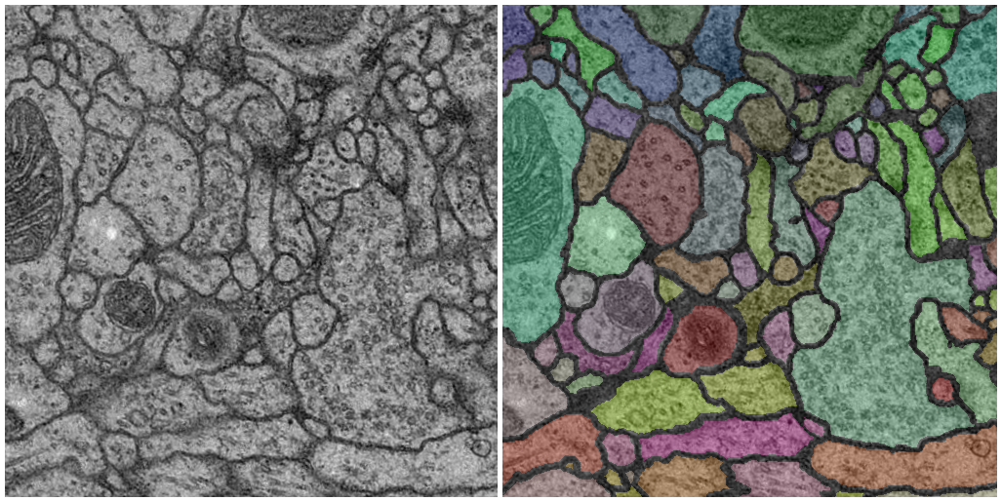
CONV NETS: EXAMPLES
- Segmentation 3D volumetric images
Ciresan et al. “DNN segment neuronal membranes...” NIPS 2012
Turaga et al. “Maximin learning of image segmentation” NIPS 2009
Ranzato

Slide 63
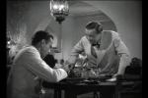
CONV NETS: EXAMPLES
- Action recognition from videos
Taylor et al. “Convolutional learning of spatio-temporal features” ECCV 2010

Slide 64
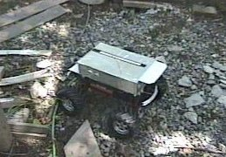
CONV NETS: EXAMPLES
- Robotics
Sermanet et al. “Mapping and planning ...with long range perception” IROS 2008

Slide 65
CONV NETS: EXAMPLES
- Denoising
original
noised
denoised
Burger et al. “Can plain NNs compete with BM3D?” CVPR 2012
Ranzato

Slide 66
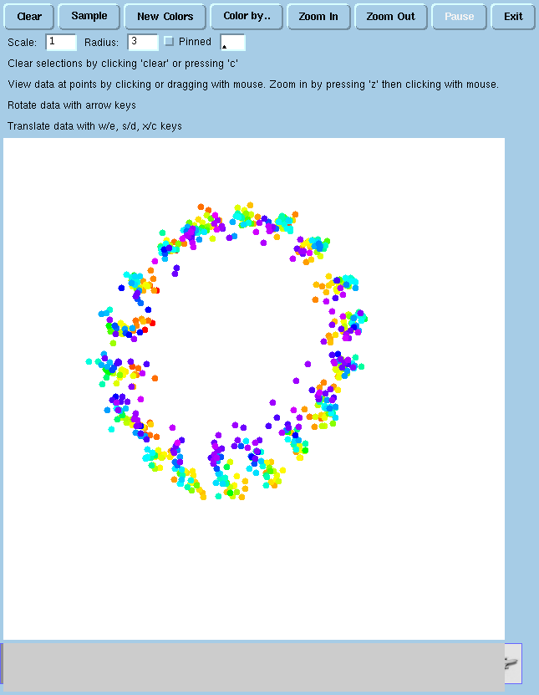
CONV NETS: EXAMPLES
- Dimensionality reduction / learning embeddings
Hadsell et al. “Dimensionality reduction by learning an invariant mapping” CVPR 2006

Slide 67
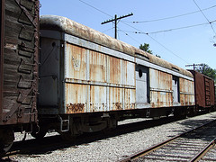
CONV NETS: EXAMPLES
- Image classification
Object
Recognizer
railcar
Krizhevsky et al. “ImageNet Classification with deep CNNs” NIPS 2012
Ranzato

Slide 68
CONV NETS: EXAMPLES
- Deployed in commercial systems (Google & Baidu, spring 2013)
Ranzato

Slide 69
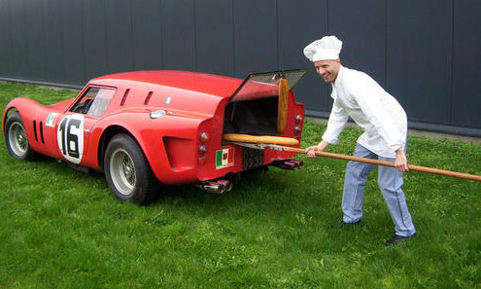
How To Use ConvNets...(properly)

Slide 70
CHOOSING THE ARCHITECTURE
Task dependent
Cross-validation
[Convolution → LCN → pooling]* + fully connected layer
The more data: the more layers and the more kernels
Look at the number of parameters at each layer
Look at the number of flops at each layer
Computational cost
Be creative :)
Ranzato

Slide 71
HOW TO OPTIMIZE
SGD (with momentum) usually works very well
Pick learning rate by running on a subset of the data
Bottou “Stochastic Gradient Tricks” Neural Networks 2012
Start with large learning rate and divide by 2 until loss does not diverge
Decay learning rate by a factor of ~100 or more by the end of training
Use non-linearity
Initialize parameters so that each feature across layers has similar variance. Avoid units in saturation.
Ranzato

Slide 72
HOW TO IMPROVE GENERALIZATION
Weight sharing (greatly reduce the number of parameters)
Data augmentation (e.g., jittering, noise injection, etc.)
Dropout
Hinton et al. “Improving Nns by preventing co-adaptation of feature detectors” arxiv 2012
Weight decay (L2, L1)
Sparsity in the hidden units
Multi-task (unsupervised learning)
Ranzato

Slide 73
OTHER THINGS GOOD TO KNOW
Check gradients numerically by finite differences
Visualize features (feature maps need to be uncorrelated) and have high variance.
samples
hidden unit
Good training: hidden units are sparse across samples
and across features.
Ranzato

Slide 74
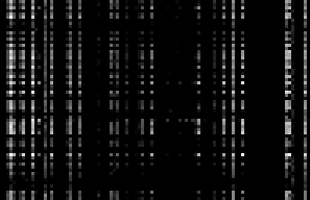
OTHER THINGS GOOD TO KNOW
Check gradients numerically by finite differences
Visualize features (feature maps need to be uncorrelated) and have high variance.
samples
hidden unit
Bad training: many hidden units ignore the input and/or
exhibit strong correlations.
Ranzato

Slide 75
OTHER THINGS GOOD TO KNOW
Check gradients numerically by finite differences
Visualize features (feature maps need to be uncorrelated) and have high variance.
Visualize parameters
GOOD
BAD
BAD
BAD
too noisy
too correlated
lack structure
Good training: learned filters exhibit structure and are uncorrelated.
Ranzato

Slide 76
OTHER THINGS GOOD TO KNOW
Check gradients numerically by finite differences
Visualize features (feature maps need to be uncorrelated) and have high variance.
Visualize parameters
Measure error on both training and validation set.
Test on a small subset of the data and check the error → 0.
Ranzato

Slide 77
WHAT IF IT DOES NOT WORK?
Training diverges:
Learning rate may be too large → decrease learning rate
BPROP is buggy → numerical gradient checking
Parameters collapse / loss is minimized but accuracy is low
Check loss function:
Is it appropriate for the task you want to solve?
Does it have degenerate solutions?
Network is underperforming
Compute flops and nr. params. → if too small, make net larger
Visualize hidden units/params → fix optmization
Network is too slow
Compute flops and nr. params. → GPU,distrib. framework, make net smaller
Ranzato

Slide 78
SUMMARY
Deep Learning = Learning Hierarchical representations.
Leverage compositionality to gain efficiency.
Unsupervised learning: active research topic.
Supervised learning: most successful set up today.
Optimization
Don't we get stuck in local minima? No, they are all the same!
In large scale applications, local minima are even less of an issue.
Scaling
GPUs
Distributed framework (Google)
Better optimization techniques
Generalization on small datasets (curse of dimensionality):
Input distortions
weight decay
dropout
Ranzato

Slide 79
THANK YOU!
NOTE: IJCV Special Issue on Deep Learning.
Deadline: 9 Feb. 2014.
Ranzato

Slide 80
SOFTWARE
Torch7: learning library that supports neural net training
http://www.torch.ch
http://code.cogbits.com/wiki/doku.php (tutorial with demos by C. Farabet)
Python-based learning library (U. Montreal)
- http://deeplearning.net/software/theano/ (does automatic differentiation)
C++ code for ConvNets (Sermanet)
– http://eblearn.sourceforge.net/
Efficient CUDA kernels for ConvNets (Krizhevsky)
– code.google.com/p/cuda-convnet
More references at the CVPR 2013 tutorial on deep learning: http://www.cs.toronto.edu/~ranzato/publications/ranzato_cvpr13.pdf
Ranzato

