Slide 1
CSC 2231: Parallel Computer Architecture and Programming GPUs
Prof. Gennady Pekhimenko
University of Toronto
Fall 2017
The content of this lecture is adapted from the slides of
Tor Aamodt (UBC)

Slide 2
Project Progress Report
Due next week Friday (Nov. 3rd)
Ask questions after the class

Slide 3
Review #7
GPUs and the Future of Parallel Computing Steve Keckler et al., IEEE Micro 2011
Due Nov. 10

Slide 4
Review #5 Results

Slide 5
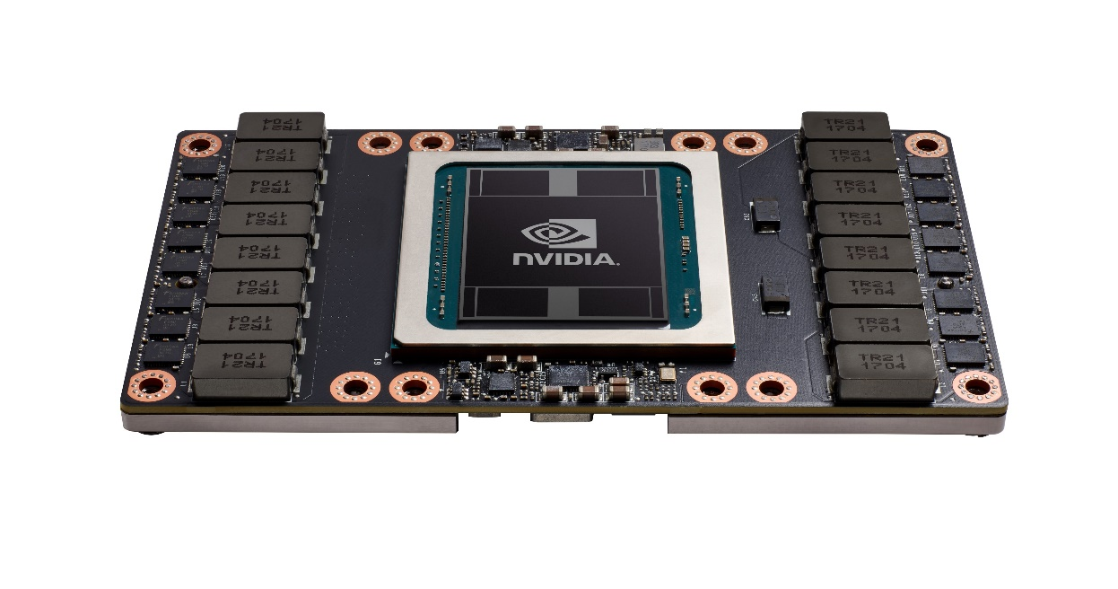
What is a GPU?
GPU = Graphics Processing Unit
Accelerator for raster based graphics (OpenGL, DirectX)
Highly programmable (Turing complete)
Commodity hardware
100’s of ALUs; 10’s of 1000s of concurrent threads
NVIDIA Volta: V100

Slide 6
The GPU is Ubiquitous
+
[APU13 keynote]

Slide 7
“Early” GPU History
1981: IBM PC Monochrome Display Adapter (2D)
1996: 3D graphics (e.g., 3dfx Voodoo)
1999: register combiner (NVIDIA GeForce 256)
2001: programmable shaders (NVIDIA GeForce 3)
2002: floating-point (ATI Radeon 9700)
2005: unified shaders (ATI R520 in Xbox 360)
2006: compute (NVIDIA GeForce 8800)
Notes:
GPGPU
Origins
Use in supercomputing
CUDA => OpenCL => C++AMP, OpenACC, others
Use in Smartphones (e.g., Imagination PowerVR)
Cars (e.g., NVIDIA DRIVE PX)

Slide 8
GPU: The Life of a Triangle
+
process commands
Host
/
Front End
/
Vertex Fetch
transform vertices
Vertex Processing
to screen
-
space
generate per
-
Primitive Assembly
,
Setup
triangle equations
r
e
l
l
generate pixels
o
,
delete pixels
Rasterize
&
Zcull
r
t
that cannot be seen
n
o
C
Pixel Shader
r
e
f
f
u
determine the colors
transparencies
B
,
Texture
e
and depth of the pixel
m
a
r
F
do final hidden surface test,
blend
Pixel Engines
and write out color and new depth
(
ROP
)
[David Kirk / Wen-mei Hwu]

Slide 9
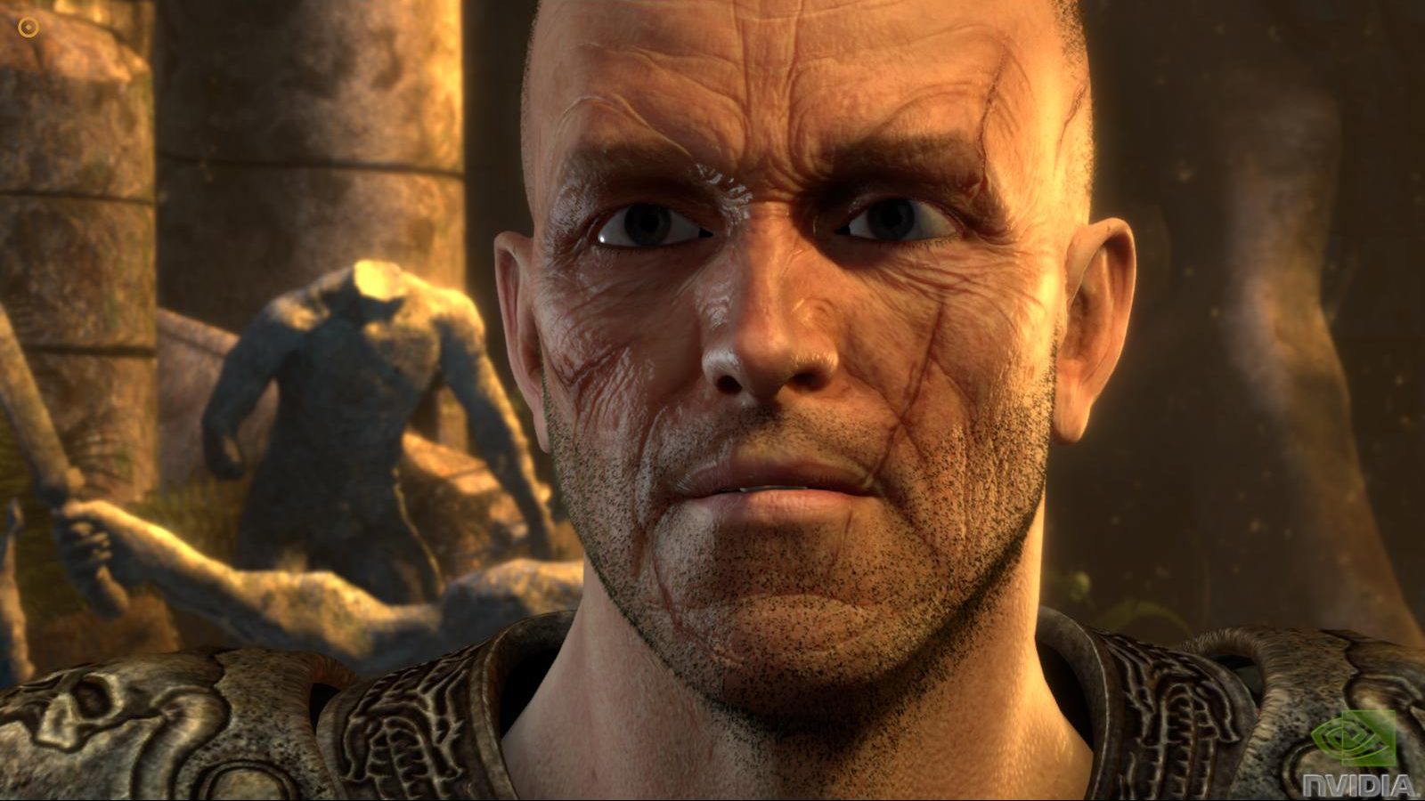
pixel color result of running “shader” program
+
Notes:
Each pixel the result of a single thread run on the GPU

Slide 10
Why use a GPU for computing?
GPU uses larger fraction of silicon for computation than CPU.
At peak performance GPU uses order of magnitude less energy per operation than CPU.
CPU
2nJ/op
GPU
200pJ/op
Rewrite Application
Order of Magnitude More Energy Efficient
However….
Application must perform well

Slide 11
GPU uses larger fraction of silicon for computation than CPU?
+
Control
ALU
ALU
ALU
ALU
Cache
DRAM
DRAM
CPU
GPU
[NVIDIA]

Slide 12
CSC 2231: Parallel Computer Architecture and Programming GPUs
Prof. Gennady Pekhimenko
University of Toronto
Fall 2017
The content of this lecture is adapted from the slides of
Tor Aamodt (UBC)

