Slide 1
CSC 2231: Parallel Computer Architecture and Programming Main Memory Fundamentals
Prof. Gennady Pekhimenko
University of Toronto
Fall 2017
The content of this lecture is adapted from the slides of
Vivek Seshadri, Donghyuk Lee, Yoongu Kim,
and lectures of Onur Mutlu @ ETH and CMU

Slide 2
Why Is Memory So Important? (Especially Today)

Slide 3
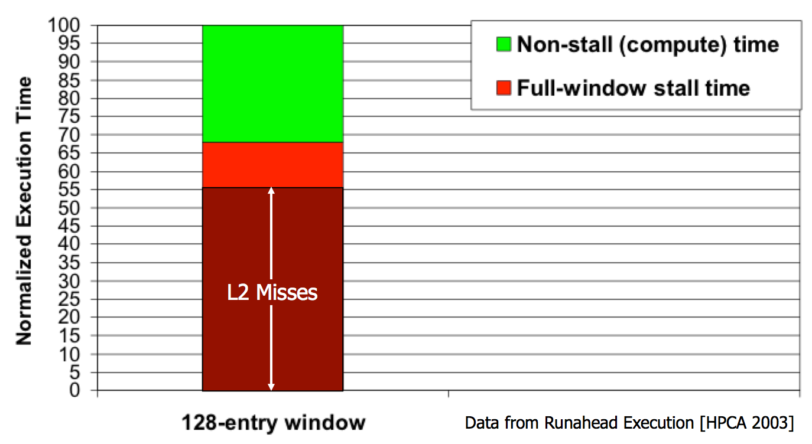
The Performance Perspective
“It’s the Memory, Stupid!” (Richard Sites, MPR, 1996)
Mutlu+, “Runahead Execution: An Alternative to Very Large Instruction Windows for Out-of-Order Processors,” HPCA 2003.

Slide 4
The Energy Perspective
Dally, HiPEAC 2015

Slide 5
The Energy Perspective
Dally, HiPEAC 2015
A memory access consumes ~1000X
the energy of a complex addition

Slide 6
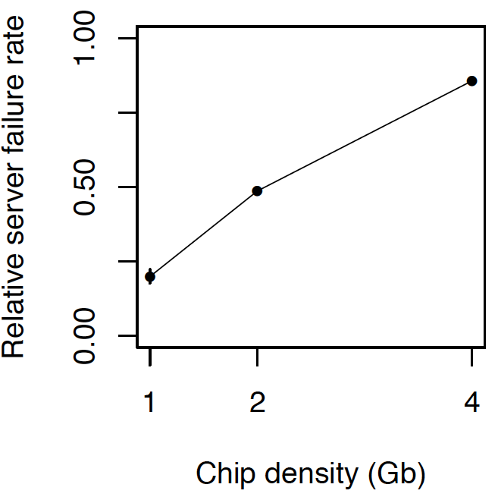
The Reliability Perspective
Data from all of Facebook’s servers worldwide
Meza+, “Revisiting Memory Errors in Large-Scale Production Data Centers,” DSN’15.
Intuition: quadratic increase in capacity

Slide 7
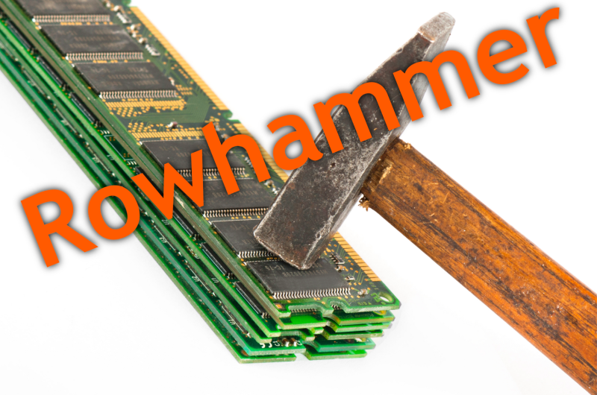
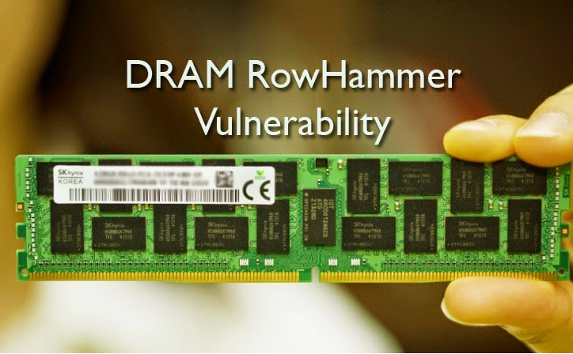
The Security Perspective

Slide 8
Why Is DRAM So Slow?

Slide 9
Motivation (by Vivek Seshadri)
Conversation with a friend from Stanford
Why is DRAM so slow?!
Really?
50 nanoseconds to serve one request? Is that a fundamental limit to DRAM’s access latency?
Him
Vivek

Slide 10
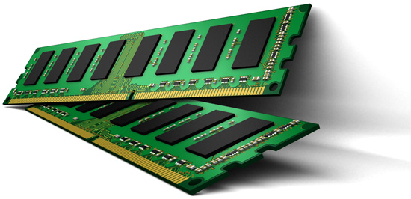
Understanding DRAM
What is in here?
DRAM
Problems related to today’s DRAM design
Solutions proposed by our research

Slide 11
Outline
What is DRAM?
DRAM Internal Organization
Problems and Solutions
Latency (Tiered-Latency DRAM, HPCA 2013)
Parallelism (Subarray-level Parallelism, ISCA 2012)

Slide 12
What is DRAM?
DRAM – Dynamic Random Access Memory
Array of Values
READ address
3455434
43543
WRITE address, value
98734
Accessing any location takes the same amount of time
0
847
42
Data needs to be constantly refreshed
873909
1729

Slide 13
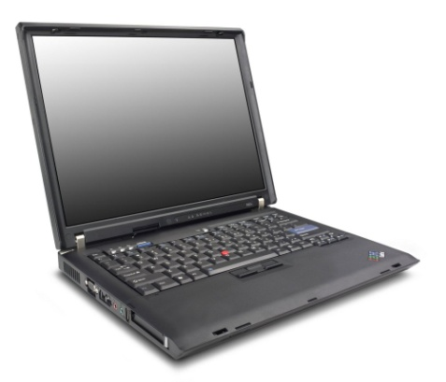
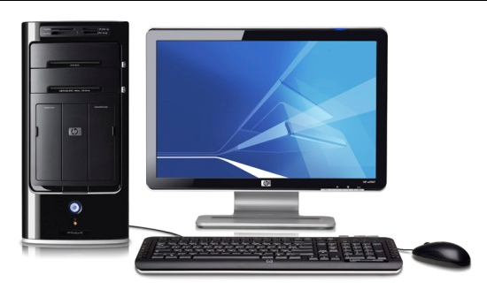
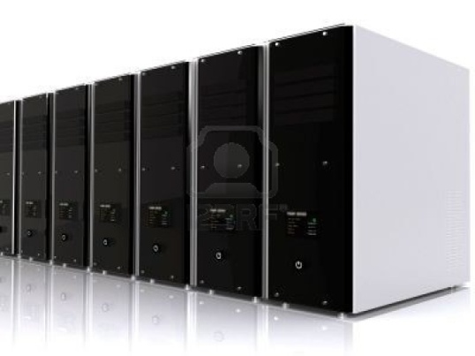
DRAM in Today’s Systems
Why DRAM? Why not some other memory?

Slide 14
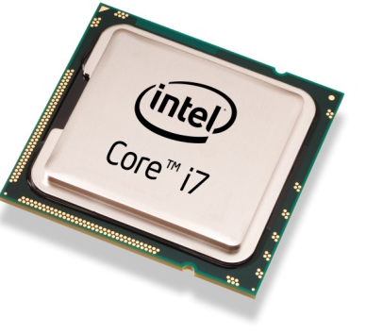
Von Neumann Model
Processor
Memory
Program
Data
4 instruction accesses +
3 data accesses
T1 = Read Data[1]
T1 = Read Data[1]
3
T2 = Read Data[2]
4
4
T3 = T1 + T2
8
Write Data[3], T3
2
Memory performance is important

Slide 15
Factors that Affect Choice of Memory
Speed
Should be reasonably fast compared to processor
Capacity
Should be large enough to fit programs and data
Cost
Should be cheap

Slide 16
Why DRAM?
Flip-flops
Higher Cost
Favorable point in the trade-off spectrum
SRAM
Cost
DRAM
Higher access latency
Disk
Flash
Access Latency

Slide 17
Is DRAM Fast Enough?
Processor
Commodity DRAM
Core
Core
Core
Core
Latency
3 GHz, 2 Instructions / cycle
50ns
300 Instructions
Parallelism
Request
300 Instructions
Request
300 Instructions
Request
300 Instructions
Request
Independent programs
Served in parallel?

Slide 18
Outline
What is DRAM?
DRAM Internal Organization
Problems and Solutions
Latency (Tiered-Latency DRAM, HPCA 2013)
Parallelism (Subarray-level Parallelism, ISCA 2012)

Slide 19
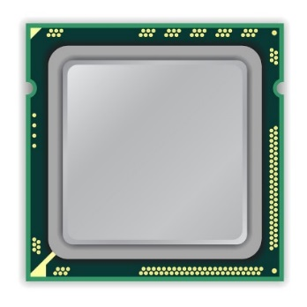
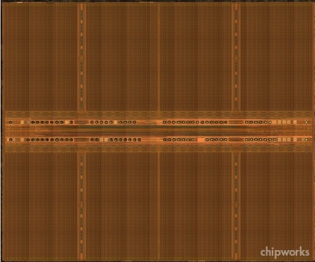
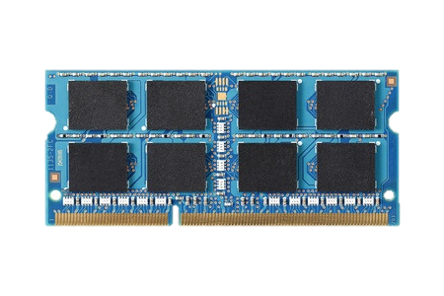
DRAM Organization
mat
processor
peripheral logic
bank
main memory
high latency

Slide 20
DRAM Cell Array: Mat
mat
bitline
mat
cell
peripheral logic
cell
wordline driver
wordline
sense amplifier

Slide 21
Cell Array (Mat): High Latency

Slide 22
DRAM Cell Array: High Latency
Inside mat
Narrow poly wire
Large resistance
Large capacitance
→ Slow
Small cell
Difficult to detect data in small cell
→ Slow
Outside mat
Thick metal wire
Small resistance
Small capacitance
→ Fast

Slide 23
Memory Element (Cell)
Component that can be in at least two states
0
1
Can be electrical, magnetic, mechanical, etc.
DRAM → Capacitor

Slide 24
Capacitor – Bucket of Electric Charge
“Charged”
“Discharged”
V_{max}
Voltage level indicator. Not part of the actual circuit
0
0
0
Charge

Slide 25
DRAM Chip
DRAM Chip
Contains billions of capacitors (also called cells)
?
0

Slide 26
Divide and Conquer
DRAM Bank
?
Challenges
Weak
Reading destroys state

Slide 27
Sense-Amplifier
V_{max}
V_{x}+δ
V_{x}
V_{x}+δ
V_{x}
Amplify the difference
V_{x} > V_{y}
Stable state
V_{y}
0
V_{y}-δ
V_{y}

Slide 28
Outline
What is DRAM?
DRAM Internal Organization
DRAM Cell
DRAM Array
DRAM Bank
Problems and Solutions
Latency (Tiered-Latency DRAM, HPCA 2013)
Parallelism (Subarray-level Parallelism, ISCA 2012)

Slide 29
DRAM Cell Read Operation
V_{max}
V_{max}
V_{max}/2 + δ
V_{max}/2
V_{max}/2 + δ
DRAM
Cell
0
Amplify the difference
Restore Cell Data
Cell loses charge
Access data
2
Sense-Amplifier
1
V_{max}/2
0

Slide 30
DRAM Cell Read Operation
Control Signal
Address
DRAM
Cell
DRAM
Cell
0
Sense-Amplifier

Slide 31
Outline
What is DRAM?
DRAM Internal Organization
DRAM Cell
DRAM Array
DRAM Bank
Problems and Solutions
Latency (Tiered-Latency DRAM, HPCA 2013; Adaptive-Latency DRAM, HPCA 2015)
Parallelism (Subarray-level Parallelism, ISCA 2012)

Slide 32
Problem
Control Signal
Address
DRAM
Cell
Much larger than a cell
Sense-Amplifier

Slide 33
Cost Amortization
Bitline
Wordline

Slide 34
DRAM Array Operation
n
Restore
Sense-Amplifier
Wordline Disable
Sensing & Amplification
Charge Restoration
Row Decoder
Charge Sharing
Wordline Enable
m
m
1
?
0
?
0
?
1
?
1
?
0
?
1
1
?
0
?
0
?
1
?
0
?
1
Row Address
?
½
↑½
1
½
½↓
0
½
½↓
0
½
↑½
1
½
↑½
1
½
½↓
0
½
↑½
1
½
½↓
0
½
½↓
0
½
↑½
1
½
½↓
0
½
↑½
1
Sense-Amplifiers
Access Data (column n)

Slide 35
Outline
What is DRAM?
DRAM Internal Organization
DRAM Cell
DRAM Array
DRAM Bank
Problems and Solutions
Latency (Tiered-Latency DRAM, HPCA 2013 Adaptive-Latency DRAM, HPCA 2015)
Parallelism (Subarray-level Parallelism, ISCA 2012)

Slide 36
DRAM Bank
How to build a DRAM bank from a DRAM array?

Slide 37
DRAM Bank: Single DRAM Array?
Long bitline
Difficult to sense data in far away cells
Row Decoder
1
0
0
1
1
0
0
1
Row Address
10000+ rows

Slide 38
DRAM Bank: Collection of Arrays
Row Decoder
1
0
0
1
1
0
0
1
Subarray
Row Decoder
Data
Row Address
Column Read/Write

Slide 39
DRAM Operation: Summary
Row Decoder
1
0
0
1
1
0
0
1
Row Decoder
Row m, Col n
1. Enable row m
2. Access col n
3. Close row
m
Row Address
Column Read/Write
m
n

Slide 40
DRAM Chip Hierarchy
Collection of Banks
Row Decoder
1
0
0
1
1
0
0
1
Row Decoder
Row Address
Column Read/Write
Collection of Subarrays

Slide 41
Outline
What is DRAM?
DRAM Internal Organization
Problems and Solutions
Latency (Tiered-Latency DRAM, HPCA 2013; Adaptive-Latency DRAM, HPCA 2015)
Parallelism (Subarray-level Parallelism, ISCA 2012)

Slide 42
Factors That Affect Performance
Latency
How fast can DRAM serve a request?
Parallelism
How many requests can DRAM serve in parallel?

Slide 43
DRAM Chip Hierarchy
Collection of Banks
Row Decoder
Parallelism
1
0
0
1
1
0
0
1
Row Decoder
Latency
Row Address
Column Read/Write
Collection of Subarrays

Slide 44
Outline
What is DRAM?
DRAM Internal Organization
Problems and Solutions
Latency (Tiered-Latency DRAM, HPCA 2013; Adaptive-Latency DRAM, HPCA 2015)
Parallelism (Subarray-level Parallelism, ISCA 2012)

Slide 45
Subarray Size: Rows/Subarray
Number of rows in subarray
Latency
Chip Area

Slide 46
Subarray Size vs. Access Latency
Shorter Bitlines => Faster access
Smaller subarrays => lower access latency

Slide 47
Subarray Size vs. Chip Area
Large Subarray
Smaller Subarrays
Area
Cost
Smaller subarrays => larger chip area

Slide 48
Chip Area vs. Access Latency
32 rows/subarray
Commodity DRAM
(512 rows/subarray)
Why is DRAM so slow?

Slide 49
Chip Area vs. Access Latency
32 rows/subarray
Commodity DRAM
(512 rows/subarray)
?
How to enable low latency without high area overhead?

Slide 50
Our Proposal
Low area cost
Large Subarray
Our Proposal
Small Subarray

Slide 51
Tiered-Latency DRAM
- Higher access latency
- Higher energy/access
Far Segment
Near Segment
+ Lower access latency
+ Lower energy/access
Map frequently accessed data to near segment

Slide 52
Results Summary
Commodity DRAM
Tiered-Latency DRAM
12%
23%

Slide 53
Tiered-Latency DRAM: A Low Latency and Low Cost DRAM Architecture
Donghyuk Lee, Yoongu Kim, Vivek Seshadri, Jamie Liu, Lavanya Subramanian, Onur Mutlu
Published in the proceedings of 19th IEEE International Symposium on
High Performance Computer Architecture 2013

Slide 54
DRAM Stores Data as Charge
DRAM cell
Three steps of charge movement
1. Sensing
2. Restore
3. Precharge
Sense amplifier

Slide 55
DRAM Charge over Time
cell
cell
Data 1
charge
Sense amplifier
Sense amplifier
Data 0
Timing Parameters
Sensing
Restore
time
In theory
margin
In practice
Why does DRAM need the extra timing margin?

Slide 56
Two Reasons for Timing Margin
1. Process Variation
DRAM cells are not equal
Leads to extra timing margin for cell that can store small amount of charge
1. Process Variation
DRAM cells are not equal
Leads to extra timing margin for cells that can store large amount of charge
1. Process Variation
DRAM cells are not equal
Leads to extra timing margin for cell that can store small amount of charge;
2. Temperature Dependence
DRAM leaks more charge at higher temperature
Leads to extra timing margin when operating at low temperature

Slide 57
DRAM Cells are Not Equal
Ideal
Real
Smallest cell
Largest cell
Same size →
Different size →
Large variation in cell size →
Same charge →
Different charge →
Large variation in charge →
Same latency
Different latency
Large variation in access latency

Slide 58
Two Reasons for Timing Margin
1. Process Variation
DRAM cells are not equal
Leads to extra timing margin for cells that can store large amount of charge
2. Temperature Dependence
DRAM leaks more charge at higher temperature
Leads to extra timing margin when operating at low temperature
2. Temperature Dependence
DRAM leaks more charge at higher temperature
Leads to extra timing margin when operating at low temperature
2. Temperature Dependence
DRAM leaks more charge at higher temperature
Leads to extra timing margin when operating at low temperature

Slide 59
Charge Leakage $∝$ Temperature
Room Temp.
Hot Temp. (85°C)
Cells store small charge at high temperature
and large charge at low temperature
→ Large variation in access latency
Small leakage
Large leakage

Slide 60
DRAM Timing Parameters
DRAM timing parameters are dictated by the worst case
The smallest cell with the smallest charge in all DRAM products
Operating at the highest temperature
Large timing margin for the common case
Can lower latency for the common case

Slide 61
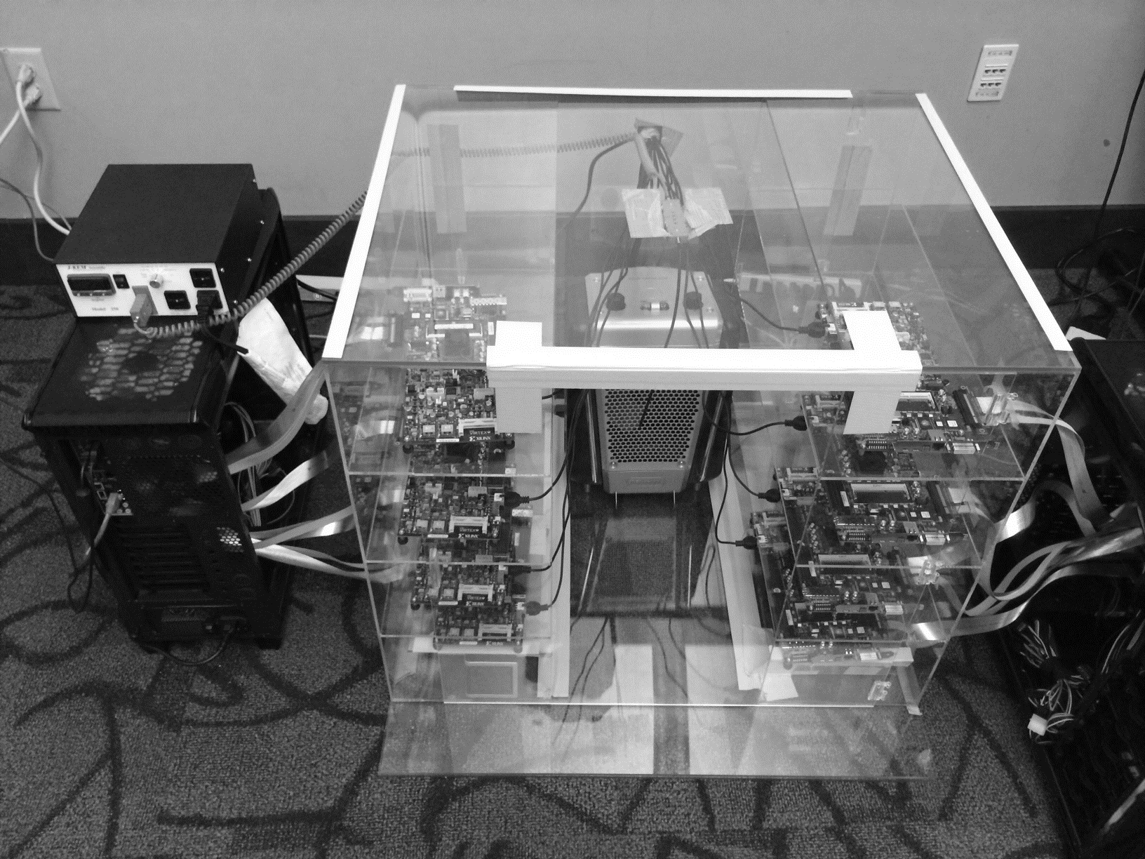
DRAM Testing Infrastructure
Temperature
Controller
FPGAs
Heater
FPGAs
PC

Slide 62
Obs 1. Faster Sensing
Timing
(tRCD)
17% ↓
No Errors
Typical DIMM at
Low Temperature
115 DIMM
characterization
More charge
Strong charge
flow
Faster sensing
Typical DIMM at Low Temperature
→ More charge → Faster sensing

Slide 63
Obs 2. Reducing Restore Time
115 DIMM
characterization
Typical DIMM at
Low Temperature
Read (tRAS)
37% ↓
Write (tWR)
54% ↓
No Errors
Larger cell &
Less leakage ➔
Extra charge
No need to fully
restore charge
Typical DIMM at lower temperature
→ More charge → Restore time reduction

Slide 64
Obs 3. Reducing Precharge Time
Typical DIMM at
Low Temperature
Sensing
Half
Precharge
Empty (0V)
Full (Vdd)
Bitline
Sense amplifier
Precharge ?
– Setting bitline to half-full charge

Slide 65
Obs 3. Reducing Precharge Time
Access full cell
Access empty cell
Timing
(tRP)
35% ↓
No Errors
115 DIMM
characterization
Not fully precharged
More charge
→ strong sensing
Half
Empty (0V)
Full (Vdd)
bitline
Typical DIMM at Lower Temperature
→ More charge → Precharge time reduction

Slide 66
Adaptive-Latency DRAM
Key idea
Optimize DRAM timing parameters online
Two components
DRAM manufacturer profiles multiple sets of
reliable DRAM timing parameters at different temperatures for each DIMM
System monitors DRAM temperature & uses appropriate DRAM timing parameters
reliable DRAM timing parameters
DRAM temperature

Slide 67
Real System Evaluation
Average
Improvement
14.0%
10.4%
Performance Improvement
2.9%
all-35-workload
AL-DRAM provides high performance improvement, greater for multi-core workloads

Slide 68
Summary: AL-DRAM
Observation
DRAM timing parameters are dictated by the worst-case cell (smallest cell at highest temperature)
Our Approach: Adaptive-Latency DRAM (AL-DRAM)
Optimizes DRAM timing parameters for the common case (typical DIMM operating at low temperatures)
Analysis: Characterization of 115 DIMMs
Great potential to lower DRAM timing parameters (17 – 54%) without any errors
Real System Performance Evaluation
Significant performance improvement (14% for memory-intensive workloads) without errors (33 days)

Slide 69
Adaptive-Latency DRAM: Optimizing DRAM Timing for the Common-Case
Donghyuk Lee, Yoongu Kim,
Gennady Pekhimenko, Samira Khan, Vivek Seshadri, Kevin Chang, and Onur Mutlu
Published in the proceedings of 21st
International Symposium on High Performance Computer Architecture 2015

Slide 70
Outline
What is DRAM?
DRAM Internal Organization
Problems and Solutions
Latency (Tiered-Latency DRAM, HPCA 2013;
Adaptive-Latency DRAM, HPCA 2015)
Parallelism (Subarray-level Parallelism, ISCA 2012)

Slide 71
Parallelism: Demand vs. Supply
Demand
Supply
Out-of-order Execution
Multi-cores
Multiple
Banks
Prefetchers

Slide 72
Increasing Number of Banks?
Adding more banks → Replication of shared structures
Replication → Cost
How to improve available parallelism within DRAM?

Slide 73
Our Observation
Local to a subarray
1. Wordline enable
4. Charge restoration
2. Charge sharing
5. Wordline disable
3. Sense amplify
6. Restore sense-amps
Data Access
Time

Slide 74
Subarray-Level Parallelism
Row Decoder
Row Address
1
0
0
1
1
0
0
1
Time share
Replicate
Row Decoder
Row Address
Row Address
Column Read/Write

Slide 75
Subarray-Level Parallelism: Benefits
Two requests to different subarrays in same bank
Commodity DRAM
Data Access
Data Access
Time
Data Access
Data Access
Saved Time
Subarray-Level Parallelism

Slide 76
Results Summary
Commodity DRAM
Subarray-Level Parallelism
17%
19%

Slide 77
A Case for Exploiting Subarray-Level Parallelism (SALP) in DRAM
Yoongu Kim, Vivek Seshadri, Donghyuk Lee, Jamie Liu, Onur Mutlu
Published in the proceedings of 39th
International Symposium on Computer Architecture 2012

Slide 78
Review #5
RowClone: Fast and Energy-Efficient In-DRAM Bulk Data Copy and Initialization Vivek Seshadri et al., MICRO 2013

Slide 79
Review #3 Results

Slide 80
CSC 2231: Parallel Computer Architecture and Programming Main Memory Fundamentals
Prof. Gennady Pekhimenko
University of Toronto
Fall 2017
The content of this lecture is adapted from the slides of
Vivek Seshadri, Donghyuk Lee, Yoongu Kim,
and lectures of Onur Mutlu @ ETH and CMU

