Slide 1
CSC 2231: Parallel Computer Architecture and Programming
Parallel Processing, Multicores
Prof. Gennady Pekhimenko
University of Toronto
Fall 2017
The content of this lecture is adapted from the lectures of
Onur Mutlu @ CMU

Slide 2
Summary
Parallelism
Multiprocessing fundamentals
Amdahl’s Law
Why Multicores?
  Alternatives
  Examples

Slide 3
Flynn’s Taxonomy of Computers
Mike Flynn, “Very High-Speed Computing Systems,” Proc. of IEEE, 1966
SISD: Single instruction operates on single data element
SIMD: Single instruction operates on multiple data elements
  Array processor
  Vector processor
MISD: Multiple instructions operate on single data element
  Closest form: systolic array processor, streaming processor
MIMD: Multiple instructions operate on multiple data elements (multiple instruction streams)
  Multiprocessor
  Multithreaded processor

Slide 4
Why Parallel Computers?
Parallelism: Doing multiple things at a time
Things: instructions, operations, tasks
Main Goal: Improve performance (Execution time or task throughput)
    Execution time of a program governed by Amdahl’s Law
Other Goals
  Reduce power consumption
    (4N units at freq F/4) consume less power than (N units at freq F)
    Why?
  Improve cost efficiency and scalability, reduce complexity
    Harder to design a single unit that performs as well as N simpler units

Slide 5
Types of Parallelism & How to Exploit Them
Instruction Level Parallelism
  Different instructions within a stream can be executed in parallel
  Pipelining, out-of-order execution, speculative execution, VLIW
  Dataflow
Data Parallelism
  Different pieces of data can be operated on in parallel
  SIMD: Vector processing, array processing
  Systolic arrays, streaming processors
Task Level Parallelism
  Different “tasks/threads” can be executed in parallel
  Multithreading
  Multiprocessing (multi-core)

Slide 6
Task-Level Parallelism
Partition a single problem into multiple related tasks (threads)
  Explicitly: Parallel programming
    Easy when tasks are natural in the problem
    Difficult when natural task boundaries are unclear
  Transparently/implicitly: Thread level speculation
    Partition a single thread speculatively
Run many independent tasks (processes) together
  Easy when there are many processes
    Batch simulations, different users, cloud computing
  Does not improve the performance of a single task

Slide 7
Multiprocessing Fundamentals

Slide 8
Multiprocessor Types
Loosely coupled multiprocessors
  No shared global memory address space
  Multicomputer network
    Network-based multiprocessors
  Usually programmed via message passing
    Explicit calls (send, receive) for communication

Slide 9
Multiprocessor Types (2)
Tightly coupled multiprocessors
  Shared global memory address space
  Traditional multiprocessing: symmetric multiprocessing (SMP)
    Existing multi-core processors, multithreaded processors
  Programming model similar to uniprocessors (i.e., multitasking uniprocessor) except
    Operations on shared data require synchronization

Slide 10
Main Issues in Tightly-Coupled MP
Shared memory synchronization
  Locks, atomic operations
Cache consistency
  More commonly called cache coherence
Ordering of memory operations
  What should the programmer expect the hardware to provide?
Resource sharing, contention, partitioning
Communication: Interconnection networks
Load imbalance

Slide 11
Metrics of Multiprocessors

Slide 12
Parallel Speedup
Time to execute the program with 1 processor
  divided by
Time to execute the program with N processors

Slide 13
Parallel Speedup Example
a₄x⁴ + a₃x³ + a₂x² + a₁x + a₀
Assume each operation 1 cycle, no communication cost, each op can be executed in a different processor
How fast is this with a single processor?
  Assume no pipelining or concurrent execution of instructions
How fast is this with 3 processors?

Slide 14
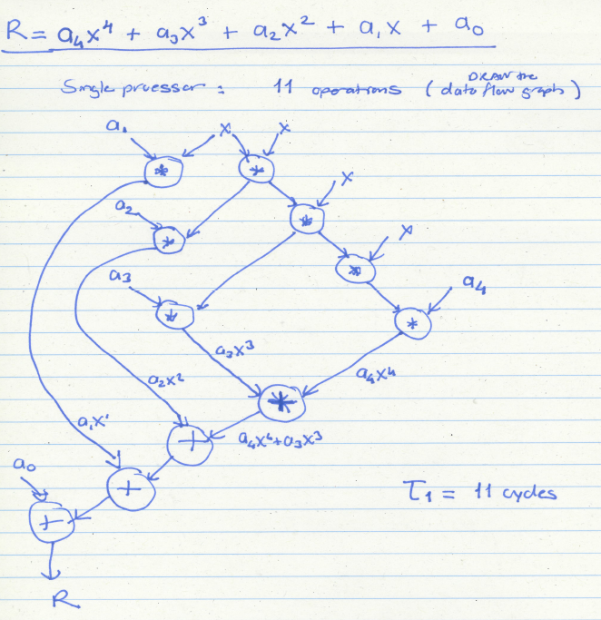

Slide 15
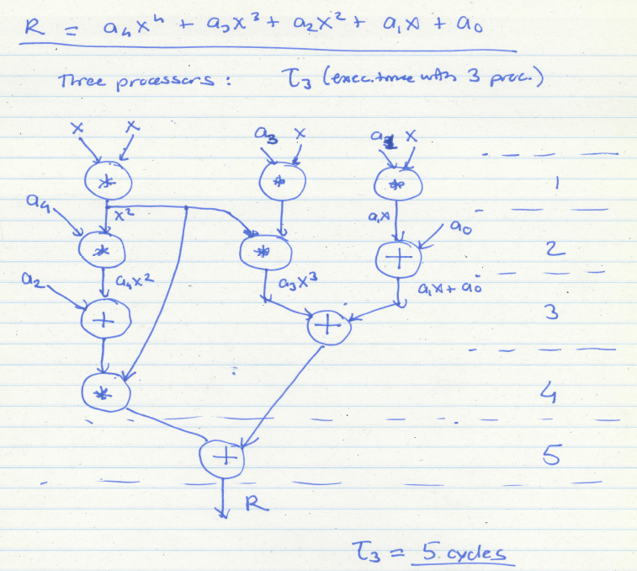

Slide 16
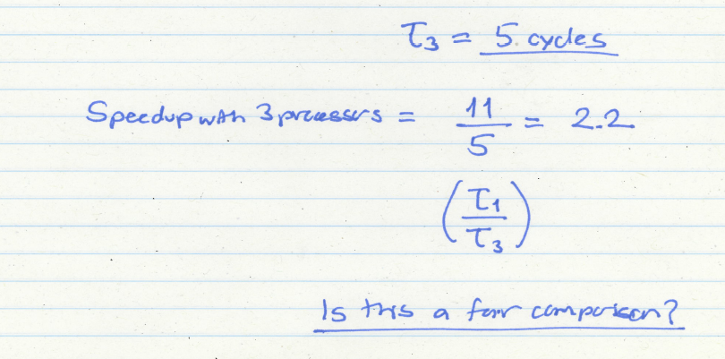
Speedup with 3 Processors

Slide 17
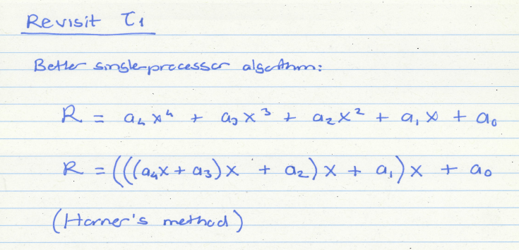
Revisiting the Single-Processor Algorithm
Horner, “A new method of solving numerical equations of all orders, by continuous
approximation,” Philosophical Transactions of the Royal Society, 1819.

Slide 18
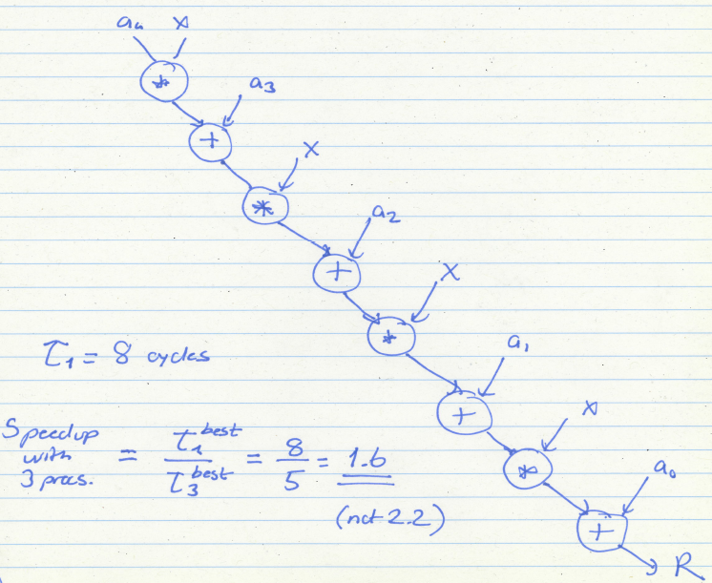

Slide 19
Takeaway
To calculate parallel speedup fairly you need to use the best known algorithm for each system with N processors
If not, you can get superlinear speedup

Slide 20
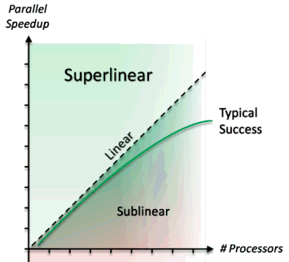
Superlinear Speedup
Can speedup be greater than P with P processing elements?
Consider:
  Cache effects
  Memory effects
  Working set
Happens in two ways:
  Unfair comparisons
  Memory effects

Slide 21
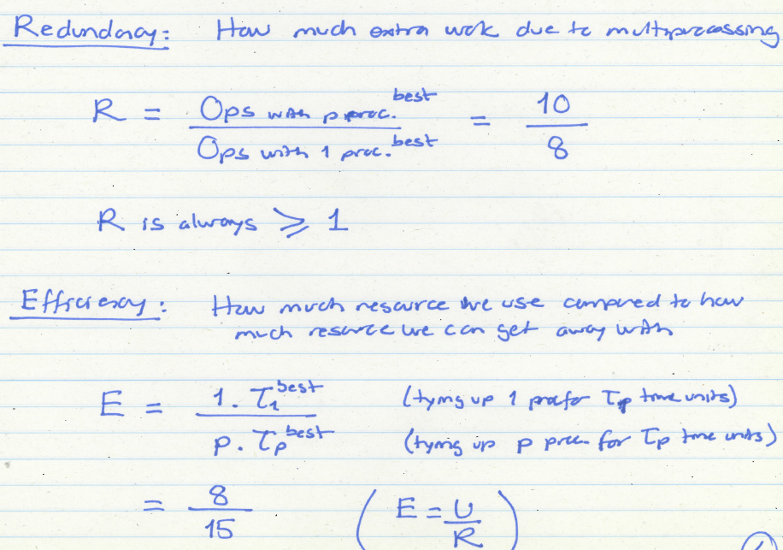

Slide 22
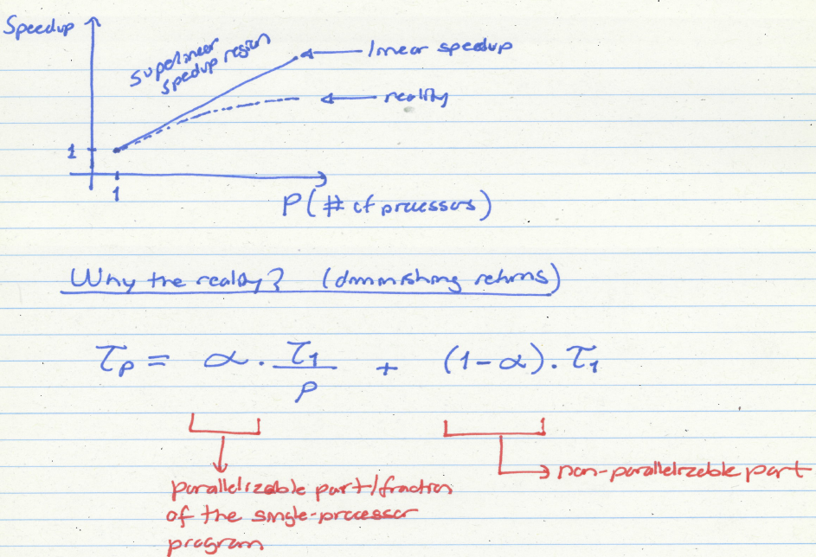
Caveats of Parallelism (I)

Slide 23
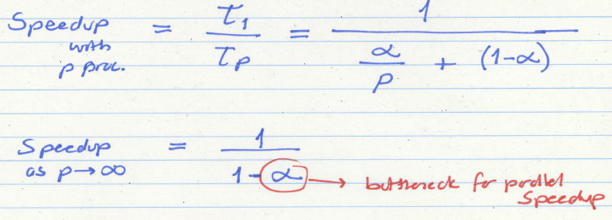
Amdahl’s Law
  Amdahl, “Validity of the single processor approach to achieving large scale computing capabilities,” AFIPS 1967.

Slide 24
Amdahl’s Law
  f: Parallelizable fraction of a program
  P: Number of processors
Maximum speedup limited by serial portion:
Serial bottleneck
1
Speedup =
1 - f
+
f
P

Slide 25
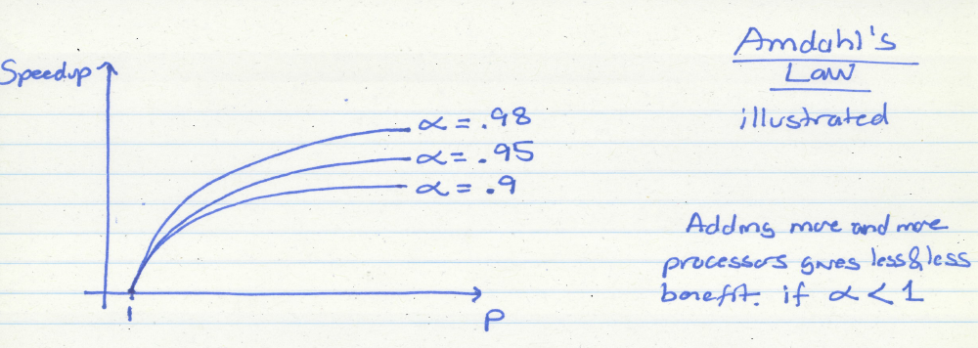
Amdahl’s Law Implication 1

Slide 26
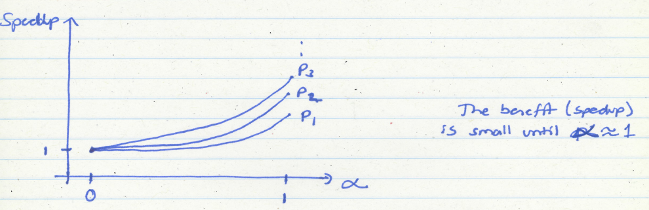
Amdahl’s Law Implication 2

Slide 27

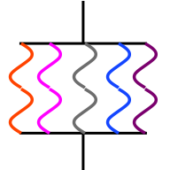
Why the Sequential Bottleneck?
Parallel machines have the sequential bottleneck
Main cause: Non-parallelizable operations on data (e.g. non-parallelizable loops)
  for ( i = 0 ; i < N; i++)
  A[i] = (A[i] + A[i-1]) / 2
Single thread prepares data and spawns parallel tasks

Slide 28
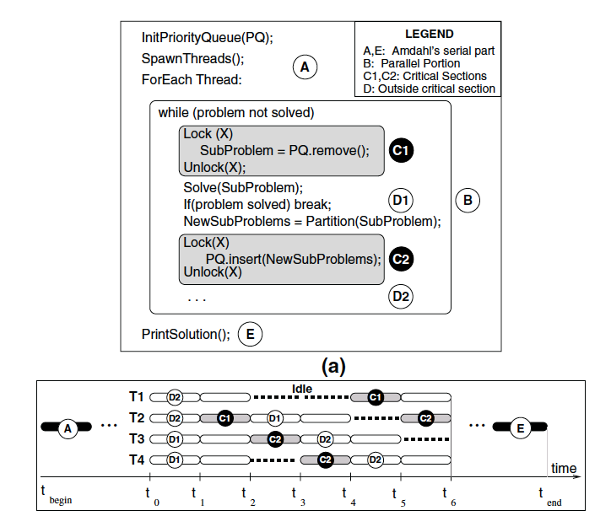
Another Example of Sequential Bottleneck

Slide 29
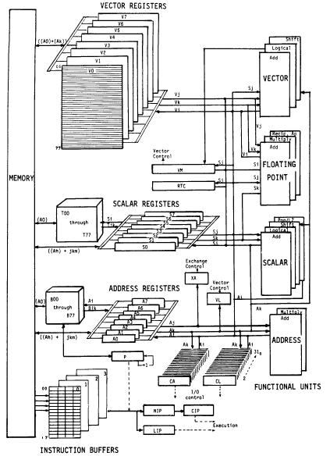
Implications of Amdahl’s Law on Design
CRAY-1
Russell, “The CRAY-1 computer system,” CACM 1978.
Well known as a fast vector machine
  8 64-element vector registers
The fastest SCALAR machine of its time!
  Reason: Sequential bottleneck!

Slide 30
Caveats of Parallelism (II)
Amdahl’s Law
  f: Parallelizable fraction of a program
  P: Number of processors
Parallel portion is usually not perfectly parallel
  Synchronization overhead (e.g., updates to shared data)
  Load imbalance overhead (imperfect parallelization)
  Resource sharing overhead (contention among N processors)
1
Speedup =
1 - f
+
f
P

Slide 31
Bottlenecks in Parallel Portion
Synchronization: Operations manipulating shared data cannot be parallelized
  Locks, mutual exclusion, barrier synchronization
  Communication: Tasks may need values from each other
Load Imbalance: Parallel tasks may have different lengths
  Due to imperfect parallelization or microarchitectural effects
  Reduces speedup in parallel portion
Resource Contention: Parallel tasks can share hardware resources, delaying each other
  Replicating all resources (e.g., memory) expensive
  Additional latency not present when each task runs alone

Slide 32
Difficulty in Parallel Programming
Little difficulty if parallelism is natural
  “Embarrassingly parallel” applications
  Multimedia, physical simulation, graphics
  Large web servers, databases?
Big difficulty is in
  Harder to parallelize algorithms
  Getting parallel programs to work correctly
  Optimizing performance in the presence of bottlenecks
Much of parallel computer architecture is about
  Designing machines that overcome the sequential and parallel bottlenecks to achieve higher performance and efficiency
  Making programmer’s job easier in writing correct and high-performance parallel programs

Slide 33
Parallel and Serial Bottlenecks
How do you alleviate some of the serial and parallel bottlenecks in a multi-core processor?
We will return to this question in future lectures
Reading list:
  Annavaram et al., “Mitigating Amdahl’s Law Through EPI Throttling,” ISCA 2005.
  Suleman et al., “Accelerating Critical Section Execution with Asymmetric Multi-Core Architectures,” ASPLOS 2009.
  Joao et al., “Bottleneck Identification and Scheduling in Multithreaded Applications,” ASPLOS 2012.
  Ipek et al., “Core Fusion: Accommodating Software Diversity in Chip Multiprocessors,” ISCA 2007.

Slide 34
Multicores

Slide 35
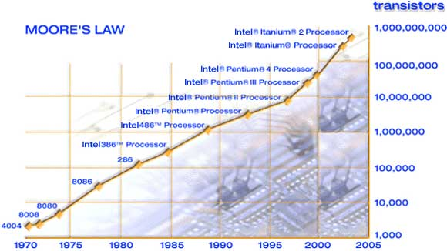
Moore’s Law
Moore, “Cramming more components onto integrated circuits,”
Electronics, 1965.

Slide 36
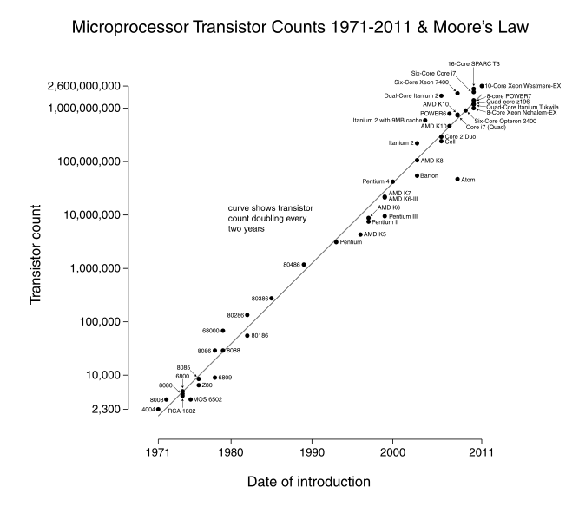

Slide 37
Multi-Core
Idea: Put multiple processors on the same die
Technology scaling (Moore’s Law) enables more transistors to be placed on the same die area
What else could you do with the die area you dedicate to multiple processors?
  Have a bigger, more powerful core
  Have larger caches in the memory hierarchy
  Simultaneous multithreading
  Integrate platform components on chip (e.g., network interface, memory controllers)
  …

Slide 38
Why Multi-Core?
Alternative: Bigger, more powerful single core
  Larger superscalar issue width, larger instruction window, more execution units, large trace caches, large branch predictors, etc
  + Improves single-thread performance transparently to programmer, compiler

Slide 39
Why Multi-Core?
Alternative: Bigger, more powerful single core
  - Very difficult to design (Scalable algorithms for improving single-thread performance elusive)
  - Power hungry – many out-of-order execution structures consume significant power/area when scaled. Why?
  - Diminishing returns on performance
  - Does not significantly help memory-bound application performance (Scalable algorithms for this elusive)

Slide 40
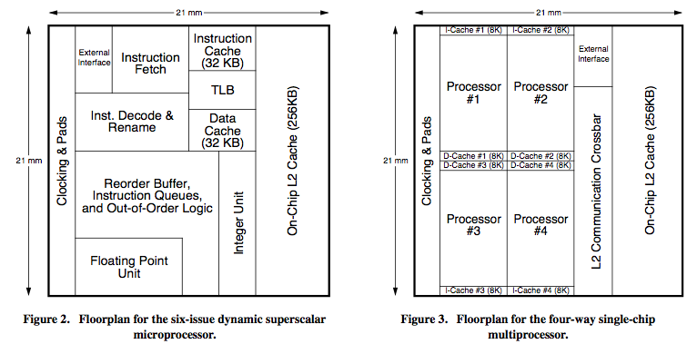
Large Superscalar+OoO vs. MultiCore
Olukotun et al., “The Case for a Single-Chip Multiprocessor,” ASPLOS 1996.

Slide 41
Multi-Core vs. Large Superscalar+OoO
Multi-core advantages
  + Simpler cores → more power efficient, lower complexity, easier to design and replicate, higher frequency (shorter wires, smaller structures)
  + Higher system throughput on multiprogrammed workloads → reduced context switches
  + Higher system performance in parallel applications

Slide 42
Multi-Core vs. Large Superscalar+OoO
Multi-core disadvantages
  - Requires parallel tasks/threads to improve performance (parallel programming)
  - Resource sharing can reduce single-thread performance
  - Shared hardware resources need to be managed
  - Number of pins limits data supply for increased demand

Slide 43
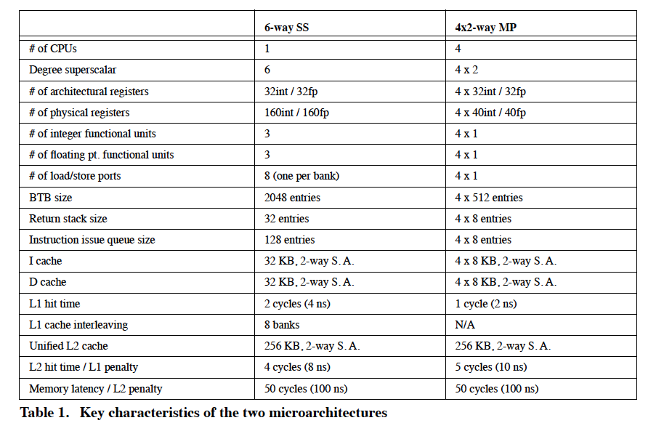
Comparison Points…

Slide 44
Why Multi-Core?
Alternative: Bigger caches
  + Improves single-thread performance transparently to programmer, compiler
  + Simple to design
  - Diminishing single-thread performance returns from cache size. Why?
  - Multiple levels complicate memory hierarchy

Slide 45
Cache vs. Core

Slide 46
Why Multi-Core?
Alternative: (Simultaneous) Multithreading
  + Exploits thread-level parallelism (just like multi-core)
  + Good single-thread performance with SMT
  + No need to have an entire core for another thread
  + Parallel performance aided by tight sharing of caches

Slide 47
Why Multi-Core?
Alternative: (Simultaneous) Multithreading
  - Scalability is limited: need bigger register files, larger issue width (and associated costs) to have many threads → complex with many threads
  - Parallel performance limited by shared fetch bandwidth
  - Extensive resource sharing at the pipeline and memory system reduces both single-thread and parallel application performance

Slide 48
Why Multi-Core?
Alternative: Integrate platform components on chip instead
  + Speeds up many system functions (e.g., network interface cards, Ethernet controller, memory controller, I/O controller)
  - Not all applications benefit (e.g., CPU intensive code sections)

Slide 49
Why Multi-Core?
Alternative: Traditional symmetric multiprocessors
  + Smaller die size (for the same processing core)
  + More memory bandwidth (no pin bottleneck)
  + Fewer shared resources → less contention between threads

Slide 50
Why Multi-Core?
Alternative: Traditional symmetric multiprocessors
  - Long latencies between cores (need to go off chip) → shared data accesses limit performance → parallel application scalability is limited
  - Worse resource efficiency due to less sharing → worse power/energy efficiency

Slide 51
Why Multi-Core?
Other alternatives?
  Clustering?
  Dataflow? EDGE?
  Vector processors (SIMD)?
  Integrating DRAM on chip?
  Reconfigurable logic? (general purpose?)

Slide 52
Review next week
“Exploiting ILP, TLP, and DLP with the polymorphous TRIPS architecture”, K. Sankaralingam, ISCA 2003.

Slide 53
Summary: Multi-Core Alternatives
Bigger, more powerful single core
Bigger caches
(Simultaneous) multithreading
Integrate platform components on chip instead
More scalable superscalar, out-of-order engines
Traditional symmetric multiprocessors
And more!

Slide 54
Multicore Examples

Slide 55

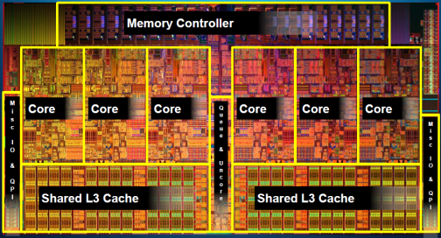
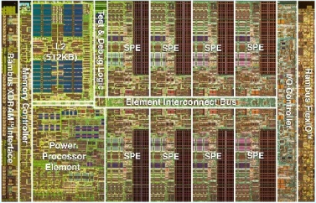
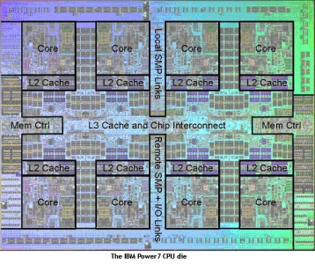
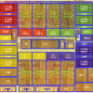
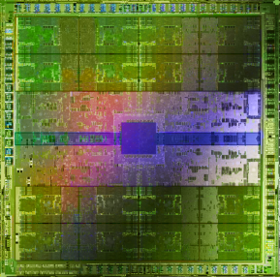
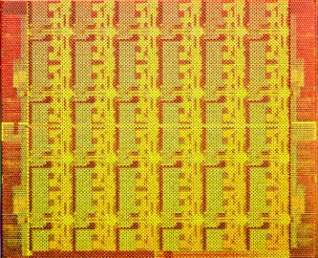
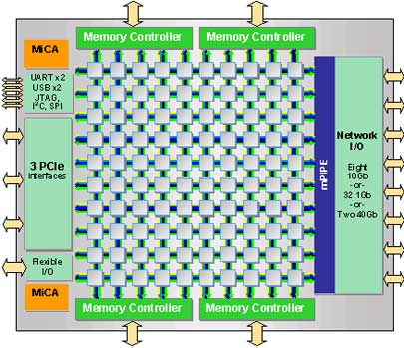
Multiple Cores on Chip
Simpler and lower power than a single large core
Large scale parallelism on chip
Intel Core i7
8 cores
IBM Cell BE
8+1 cores
IBM POWER7
8 cores
AMD Barcelona
4 cores
Nvidia Fermi
448 “cores”
Intel SCC
48 cores, networked
Tilera TILE Gx
100 cores, networked
Sun Niagara II
8 cores

Slide 56
With Multiple Cores on Chip
What we want:
  N times the performance with N times the cores when we parallelize an application on N cores
What we get:
  Amdahl’s Law (serial bottleneck)
  Bottlenecks in the parallel portion

Slide 57
The Problem: Serialized Code Sections
Many parallel programs cannot be parallelized completely
Causes of serialized code sections
  Sequential portions (Amdahl’s “serial part”)
  Critical sections
  Barriers
  Limiter stages in pipelined programs
Serialized code sections
  Reduce performance
  Limit scalability
  Waste energy

Slide 58
Demands in Different Code Sections
What we want:
In a serialized code section → one powerful “large” core
In a parallel code section → many wimpy “small” cores
These two conflict with each other:
  If you have a single powerful core, you cannot have many cores
  A small core is much more energy and area efficient than a large core

Slide 59
“Large” vs. “Small” Cores
Large
Core
Small
Core
Out-of-order
Wide fetch e.g. 4-wide
Deeper pipeline
Aggressive branch predictor (e.g. hybrid)
Multiple functional units
Trace cache
Memory dependence speculation
In-order
Narrow Fetch e.g. 2-wide
Shallow pipeline
Simple branch predictor (e.g. Gshare)
Few functional units
Large Cores are power inefficient:
e.g., 2x performance for 4x area (power)

Slide 60
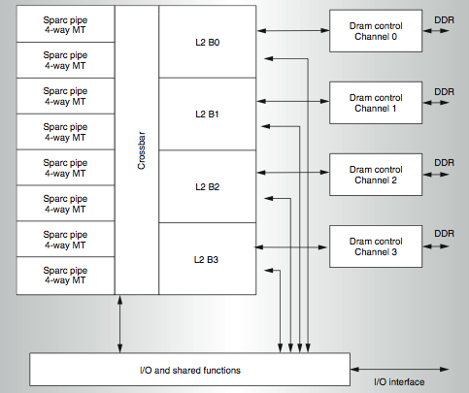
Meet Small: Sun Niagara (UltraSPARC T1)
Kongetira et al., “Niagara: A 32-Way Multithreaded SPARC Processor,” IEEE Micro 2005.

Slide 61
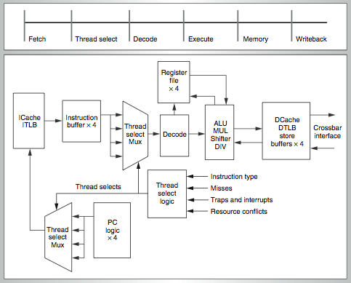
Niagara Core
4-way fine-grain multithreaded, 6-stage, dual-issue in-order
Round robin thread selection (unless cache miss)
Shared FP unit among cores

Slide 62
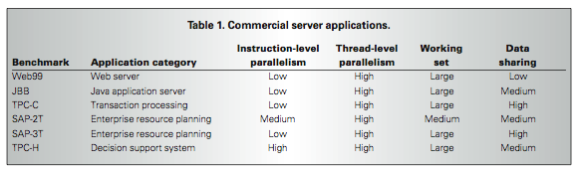
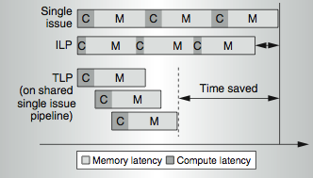
Niagara Design Point

Slide 63
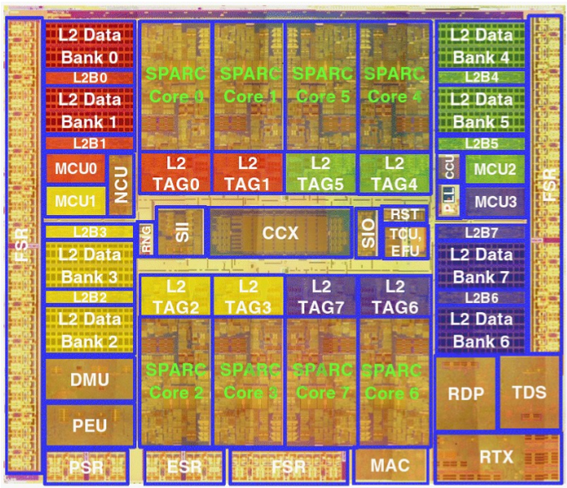
Meet Small: Sun Niagara II (UltraSPARC T2)
8 SPARC cores, 8 threads/core. 8 stages. 16 KB I$ per Core. 8 KB D$ per Core. FP, Graphics, Crypto, units per Core.
4 MB Shared L2, 8 banks, 16-way set associative.
4 dual-channel FBDIMM memory controllers.
X8 PCI-Express @ 2.5 Gb/s.
Two 10G Ethernet ports @ 3.125 Gb/s.

Slide 64
Meet Small, but Larger: Sun ROCK
Chaudhry et al., “Simultaneous Speculative Threading: A Novel Pipeline Architecture Implemented in Sun's ROCK Processor,” ISCA 2009
Goals:
  Maximize throughput when threads are available
  Boost single-thread performance when threads are not available and on cache misses
Ideas:
  Runahead on a cache miss → ahead thread executes miss-independent instructions, behind thread executes dependent instructions
  Branch prediction (gshare)

Slide 65
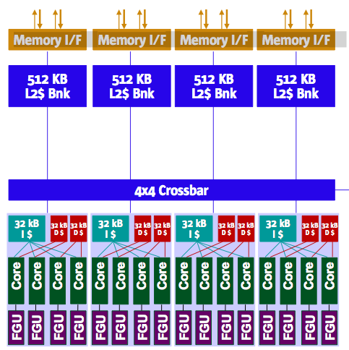
Sun ROCK
16 cores, 2 threads per core (fewer threads than Niagara 2)
4 cores share a 32KB instruction cache
2 cores share a 32KB data cache
2MB L2 cache (smaller than Niagara 2)

Slide 66
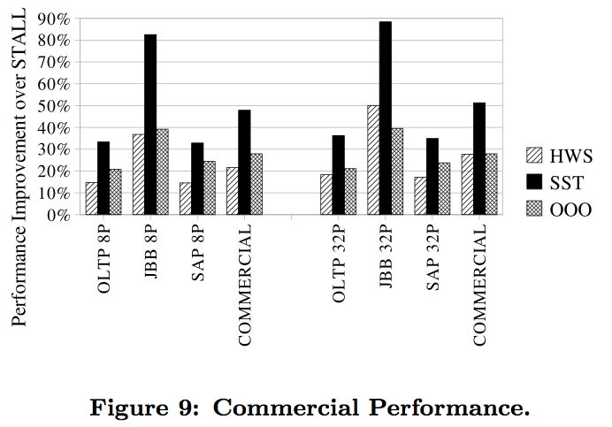
More Powerful Cores in Sun ROCK

Slide 67
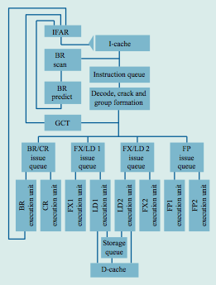
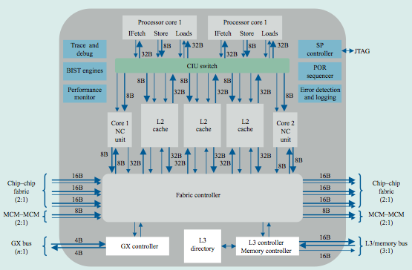
Meet Large: IBM POWER4
Tendler et al., “POWER4 system microarchitecture,” IBM J R&D, 2002.
Another symmetric multi-core chip…
But, fewer and more powerful cores

Slide 68
IBM POWER4
2 cores, out-of-order execution
100-entry instruction window in each core
8-wide instruction fetch, issue, execute
Large, local+global hybrid branch predictor
1.5MB, 8-way L2 cache
Aggressive stream based prefetching

Slide 69
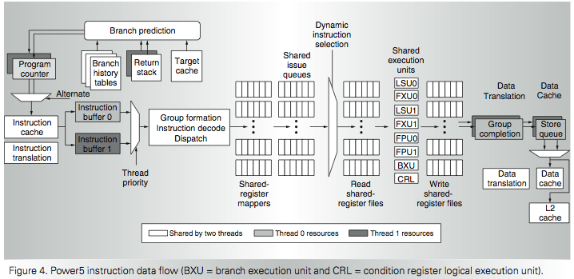
IBM POWER5
  Kalla et al., “IBM Power5 Chip: A Dual-Core Multithreaded Processor,” IEEE Micro 2004.

Slide 70
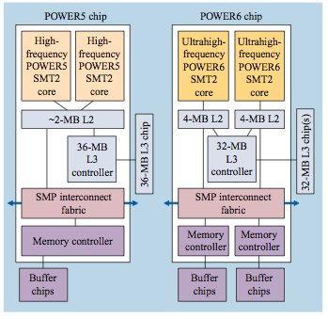
Large, but Smaller: IBM POWER6
Le et al., “IBM POWER6 microarchitecture,” IBM J R&D, 2007.
2 cores, in order, high frequency (4.7 GHz)
8 wide fetch
Simultaneous multithreading in each core
Runahead execution in each core
  Similar to Sun ROCK

Slide 71
Many More…
Wimpy nodes: Tilera
Asymmetric multicores
DVFS

Slide 72
Computer Architecture Today
Today is a very exciting time to study computer architecture
Industry is in a large paradigm shift (to multi-core, hardware acceleration and beyond) – many different potential system designs possible
Many difficult problems caused by the shift
  Power/energy constraints → multi-core?, accelerators?
  Complexity of design → multi-core?
  Difficulties in technology scaling → new technologies?
  Memory wall/gap
  Reliability wall/issues
  Programmability wall/problem → single-core?

Slide 73
Computer Architecture Today (2)
These problems affect all parts of the computing stack – if we do not change the way we design systems
Problem
Algorithm
Program/Language
User
Runtime System
(VM, OS, MM)
ISA
Microarchitecture
Logic
Circuits
Electrons

Slide 74
Computer Architecture Today (3)
You can revolutionize the way computers are built, if you understand both the hardware and the software
You can invent new paradigms for computation, communication, and storage
Recommended book: Kuhn, “The Structure of Scientific Revolutions” (1962)
  Pre-paradigm science: no clear consensus in the field
  Normal science: dominant theory used to explain things (business as usual); exceptions considered anomalies
  Revolutionary science: underlying assumptions re-examined

Slide 75
… but, first …
Let’s understand the fundamentals…
You can change the world only if you understand it well enough…
  Especially the past and present dominant paradigms
  And, their advantages and shortcomings -- tradeoffs

Slide 76
CSC 2231: Parallel Computer Architecture and Programming
Parallel Processing, Multicores
Prof. Gennady Pekhimenko
University of Toronto
Fall 2017
The content of this lecture is adapted from the lectures of
Onur Mutlu @ CMU

Slide 77
Asymmetric Multi-Core

Slide 78
Asymmetric Chip Multiprocessor (ACMP)
Provide one large core and many small cores
+ Accelerate serial part using the large core (2 units)
+ Execute parallel part on small cores and large core for high throughput (12+2 units)
Large
core
Large
core
Small
core
Small
core
Small
core
Small
core
Large
core
Small
core
Small
core
Small
core
Small
core
Small
core
Small
core
Small
core
Small
core
Large
core
Large
core
Small
core
Small
core
Small
core
Small
core
Small
core
Small
core
Small
core
Small
core
Small
core
Small
core
Small
core
Small
core
Small
core
Small
core
Small
core
Small
core
“Tile-Large”
“Tile-Small”
ACMP

