Slide 1
CSC 2231:
Special Topics in Computer Systems: Parallel Computer Architecture and Programming
Prof. Gennady Pekhimenko
University of Toronto
Fall 2017
The content of this lecture is adapted from the lectures of
Onur Mutlu, Hadi Esmaeilzadeh, and Samira Khan

Slide 2
CSC 2231: Parallel Computer Architecture and Programming
Introduction, Logistics
Prof. Gennady Pekhimenko
University of Toronto
Fall 2017

Slide 3
Summary
Syllabus
  Course Introduction, Logistics, Grading
Information Sheet
  Getting to know each other
Paper Reviews and Presentation
  How to handle these beasts
Project
  Team formation, Proposal, Milestones
And Some Technical Details

Slide 4
Syllabus: Who Are We?

Slide 5
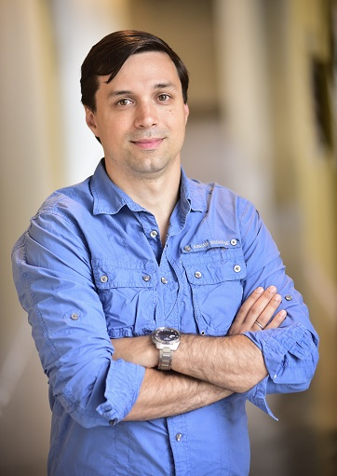
Gennady (Gena) Pekhimenko
Assistant Professor, Instructor
pekhimenko@cs.toronto.edu
http://www.cs.toronto.edu/~pekhimenko/
Office: BA 5232
PhD from Carnegie Mellon
Worked at Microsoft Research, Nvidia, IBM
Research interests: computer architecture, systems, machine learning, compilers, hardware acceleration, bioinformatics
Computer Systems and Networking Group (CSNG)
EcoSystem Group

Slide 6
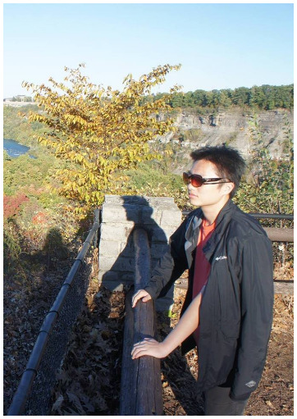
Hongyu Zhu
PhD Student, TA
serailhydra@cs.toronto.edu
Office: BA 5214 D02
MSc. from McGill
Worked at Microsoft Research Asia
Research interests: systems, machine learning
Computer Systems and Networking Group (CSNG)
EcoSystem Group

Slide 7
Course Information: Where to Get?
Course Website: http://www.cs.toronto.edu/~pekhimenko/courses/csc2231-f17/
  Announcements, Syllabus, Course Info, Lecture Notes, Reading List and Reviews, Project Information
Piazza: https://piazza.com/utoronto.ca/fall2017/csc2231/home
  Questions/Discussions, Syllabus, Searching for Teammates
Blackboard
  Emails/announcements
Your email

Slide 8
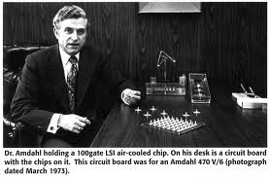
What is Computer Architecture?
Computer Architecture:
The science and art of designing, selecting, and interconnecting hardware components and designing the hardware/software interface to create a computing system that meets functional, performance, energy consumption, cost, and other specific goals.
Traditional definition:
The term architecture is used here to describe the attributes of a system as seen by the programmer, i.e., the conceptual structure and functional behavior as distinct from the organization of the dataflow and controls, the logic design, and the physical implementation.” Gene Amdahl, IBM Journal of R&D, April 1964

Slide 9

Level of Transformations
Problem
Operating System
Interface between Software and Hardware
Architecture
Circuits

Slide 10
The Power of Abstraction
Isolation
  A higher level only needs to know about the interface to the lower level, not how the lower level is implemented
  For example, high-level language programmer does not really need to know about the architecture
Productivity
  No need to worry about decisions made in underlying levels
  For example, programming in Java vs. C vs. assembly vs. binary vs. by specifying control signals of each transistor every cycle

Slide 11
Crossing the Abstraction Layers
Should we always focus on our own layer?
As long as everything goes well, not knowing what happens in the underlying level (or above) is not a problem
What if
  One of the layers reach a limit, there is no way to improve
  There is a new disruptive change in technology that cannot be contained in a layer
  New Applications that are too slow for today’s system

Slide 12
Scope of this Course
Broad view of processor and memory design
  Beyond the ISA+microarchitecture levels
  E.g., system-architecture interfaces and interactions
  E.g., application-architecture interfaces and interactions
Out-of-the-box thinking is greatly encouraged
  E.g., research projects and readings on architectures that challenge the current dominant paradigms
    processing in memory, approximate systems, persistent memory, neuromorphic computing, …
  E.g., readings on topics that are traditionally covered less in computer architecture courses

Slide 13
What Will You Learn?
Hardware/software interface, major components, and programming models of a modern computing platform
  State-of-the-art as well as research proposals (lots of them)
  Tradeoffs and how to make them
  Emphasis on cutting-edge (research & state-of-the-art)
Hands-on research in a computer architecture topic
  Semester-long research project
  Focus: How to design better architectures (not an intro course)
Broaden your research vision
  Will read papers not only from computer architecture
  But, possibly, from circuits, programming language, operating systems, graphics, networking, …

Slide 14
Course Goals
Goal 1: Rethink and redesign our computing model focusing on minimizing data movement and storage
  Understand the importance of cross layer research
  Gain new insight from VLSI circuits, architecture design, systems, programming languages, and new application domains
  Strong emphasis on critical analysis of research papers (through reading and literature review assignments)
Goal 2: To provide the necessary background and experience to advance the state-of-the-art in computer architecture by performing cutting-edge research
  Strong emphasis on developing new mechanisms that advance the state-of-the-art (through the course research project)

Slide 15
Advanced Graduate-Level Class
Required background:
  basic architecture
  basic compilers
  basic OS
  programming skills
  spirit, excitement, and dedication for deep exploration of a topic in computer architecture

Slide 16
CSC 2231: Parallel Computer Architecture and Programming
Grading, Policies, Course Work
Prof. Gennady Pekhimenko
University of Toronto
Fall 2017

Slide 17
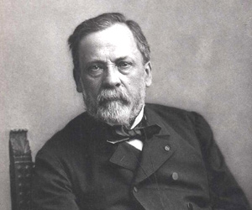
What Do I Expect from You?
Work hard
Ask questions, think critically, participate in discussion
Critically review the assigned research papers & readings
  Discuss/critique them online with peers and us
Use Piazza and Write good reviews
Start the research project early and focus
Remember “Chance favors the prepared
mind.” (Pasteur)

Slide 18
Course Work
Project (50%):
  Groups of 2, sometimes 3
  Proposal, Progress Report, Final Presentation and Final Report
  Scaled down version of the real research projects
Paper Reviews (20%):
  1-2 papers per week
  3-4 paragraphs

Slide 19
Course Work (2)
Paper Presentation (20%):
  Related works in your project area
Class Participation (10%)
  Very important

Slide 20
Grading
Grading will be back-end heavy
Most of your grade will be determined late
  How you prepare and manage your time is important
  But grades should not be the reason for taking this course

Slide 21
Paper Review: How to Handle
Brief summary
  What is the problem the paper is trying to solve?
  What are the key ideas of the paper? Key insights?
  What is the key contribution to literature at the time it was written?
  What are the most important things you take out from it?
Strengths (most important ones)
  Does the paper solve the problem well?

Slide 22
Paper Reviews (2)
3. Weaknesses (most important ones)
  This is where you should think critically. Every paper/idea has a weakness. This does not mean the paper is necessarily bad. It means there is room for improvement and future research can accomplish this.
4. Can you do (much) better? Present your thoughts/ideas.
5. What have you learned/enjoyed/disliked in the paper? Why?
Review should be short and concise (~ ½ a page to 1 page maximum)

Slide 23
Advice on Reviewing
When doing the reviews, be very critical
Always think about better ways of solving the problem or related problems
Do background reading
  Reviewing a paper/talk is the best way of learning about a research problem/topic
Think about forming a literature survey topic or a research proposal based on the paper (for future studies)

Slide 24
How to Submit?
Email PDF with your review to csc2231.arch@gmail.com
Due Friday 2pm each week
Next week: “Dark Silicon and the End of Multicore Scaling”, Hadi Esmaeilzadeh, ISCA 2011.

Slide 25
Research Project
Your chance to explore in depth a computer architecture topic that interests you
Perhaps even publish your innovation in a top computer architecture/systems/ML conference
Start thinking about your project topic from now!
Interact with me and Hongyu
Use Piazza to discuss ideas, form teams based on interests, research areas

Slide 26
Research Project (2)
Goal: Develop (new) insight
  Solve a problem in a new way or evaluate/analyze systems/ideas
  Type 1:
    Develop new ideas to solve an important problem
    Rigorously evaluate the benefits and limitations of the ideas
  Type 2:
    Derive insight from rigorous analysis and understanding of existing systems or previously proposed ideas
    Propose potential new solutions based on the new insight
The problem and ideas need to be concrete
Problem and goals need to be very clear

Slide 27
Research Proposal: Key Questions
What is the problem?
Why is it hard?
How is it solved today?
What is the new technical idea?
Why can we succeed now?
What is the impact if successful?
http://en.wikipedia.org/wiki/George_H._Heilmeier

Slide 28
Where to Get Ideas?
Read a lot of papers; find focused problem areas to survey papers on
We will provide some ideas for projects
A good way of finding topics to survey or do projects on is:
  Examining the provided project ideas and papers
  Reading assigned papers in lectures and related/followup work
  Examining papers from recent conferences (ISCA, MICRO, HPCA, ASPLOS, …)

Slide 29
Project: Major Milestones
Project Proposal (1–2 pages) - Oct. 1st
Progress Report (2–3 pages) - Nov. 3rd
Project Presentation - Dec. 1st (tentative)
Project Report (6–8 pages) - Dec. 10th

Slide 30
Presentation
After the project topic is selected, identify the key related works (1-3 papers)
Signup for the day to present your related work (25-30 minutes)
The exact schedule of the talks will be posted after project groups are formed

Slide 31
Presentation: What to Cover
Summary of the Work
  Problem, key ideas or insights, detailed mechanisms, and results
Strengths and Weaknesses
  Detailed discussion on both sides
Discussion
  Future research directions
  Alternative ways of solving the problem
  Importance of the problem
  Anything interesting about the research direction
  What did you like? What did you not like?

Slide 32
CSC 2231: Parallel Computer Architecture and Programming
Why Computer Architecture Matters
Prof. Gennady Pekhimenko
University of Toronto
Fall 2017

Slide 33




What has made computing pervasive?
What is the backbone of computing industry?

Slide 34
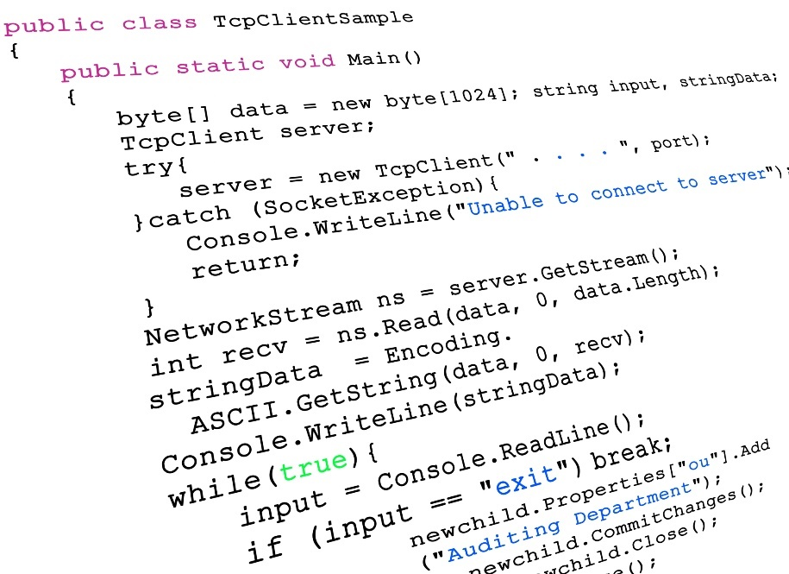

Programmability
Networking

Slide 35
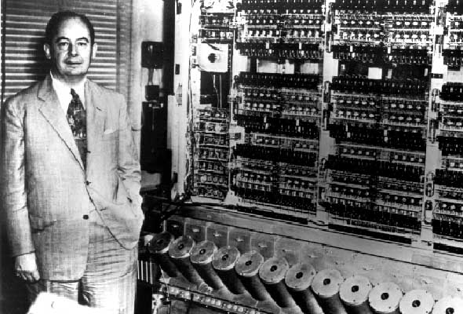
What makes computers programmable?

Slide 36
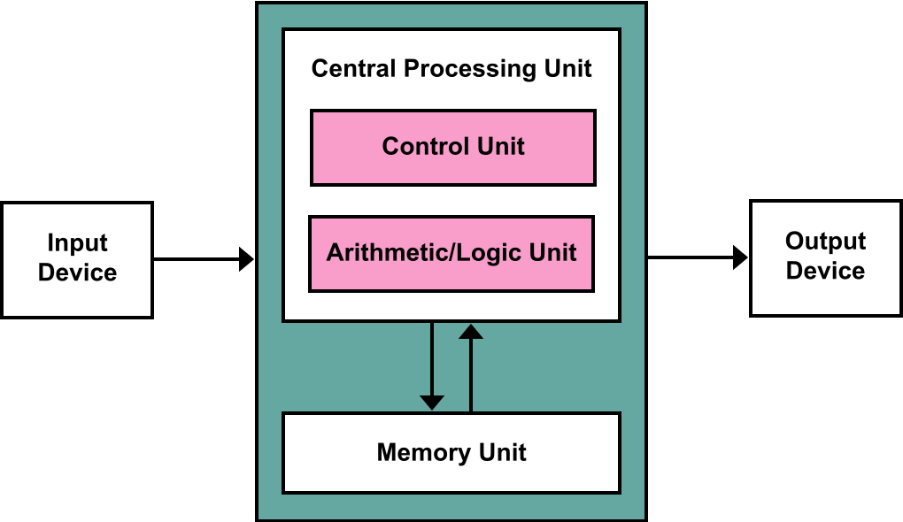
von Neumann architecture
General-purpose processors
Components
  Memory (RAM)
  Central processing
  unit (CPU)
    Control unit
    Arithmetic logic unit (ALU)
  Input/output system
Memory stores program and data
Program instructions execute sequentially

Slide 37
Programmability versus Efficiency

Slide 38
Programmability versus Efficiency
General-Purpose Processors
SIMD Units
Programmability
GPUs
FPGAs
ASICs
Efficiency

Slide 39


What is the difference between the computing industry and the paper towel industry?

Slide 40

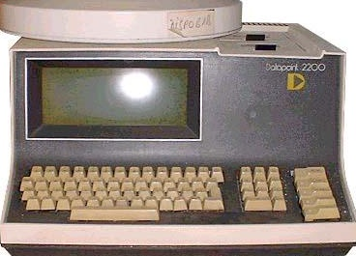
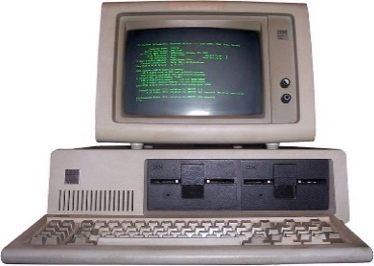



Industry of replacement
1971
2017
?
Industry of new possibilities

Slide 41
Can we continue being an industry of new possibilities?
Personalized
healthcare
Virtual
reality
Real-time
translators

Slide 42
Moore’s Law
Or, how we became an industry of new possibilities
Every 2 Years
Double the number of transistors
Build higher performance
general-purpose processors
  Make the transistors available to masses
  Increase performance (1.8×↑)
  Lower the cost of computing (1.8×↓)

Slide 43
What is the catch?
Powering the transistors without melting the chip
Moore’s Law
W
W

Slide 44
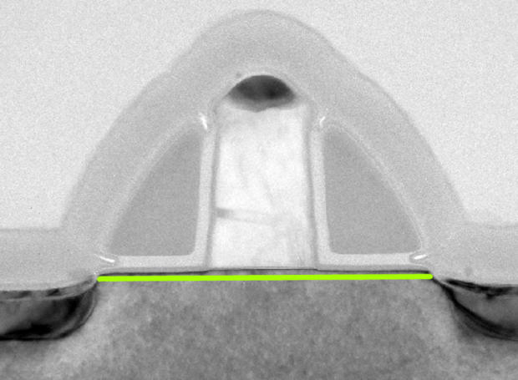
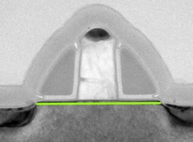
Dennard scaling:
Doubling the transistors; scale their power down
Transistor: 2D Voltage-Controlled Switch
Dimensions
Voltage
×0.7
Doping
Concentrations
Area
0.5×↓
Capacitance
0.7×↓
Frequency
1.4×↑
Power = Capacitance × Frequency × Voltage²
Power
0.5×↓

Slide 45
Dennard scaling broke:
Double the transistors; still scale their power down
Transistor: 2D Voltage-Controlled Switch
Dimensions
Voltage
×0.7
Doping
Concentrations
Area
0.5×↓
Capacitance
0.7×↓
Frequency
1.4×↑
Power = Capacitance × Frequency × Voltage²
Power
0.5×↓

Slide 46
Dark silicon
If you cannot power them, why bother making them?
Area
0.5×↓
Power
0.5×↓
Dark Silicon
Fraction of transistors that need to be
powered off at all times
due to power constraints

Slide 47
Looking back
Evolution of processors
Dennard scaling
broke
Single-core Era
Multicore Era
3.4 GHz
3.5 GHz
740 KHz
1971
2003
2013
2004

Slide 48
How about Memory/DRAM?
Does it also have scaling issues?
What was DRAM trend over the last 30-40 years?

Slide 49
DRAM Scaling Challenge
Technology
Scaling
DRAM Cells
DRAM Cells
DRAM scaling enabled high capacity

Slide 50
DRAM Scaling Trend
2X/1.5 YEARS
2X/3 YEARS
DRAM scaling is getting difficult
Source: Flash Memory Summit 2013, Memcon 2014

Slide 51
DRAM Scaling Challenge
Technology
Scaling
DRAM Cells
DRAM Cells
Manufacturing reliable cells at low cost
is getting difficult

Slide 52


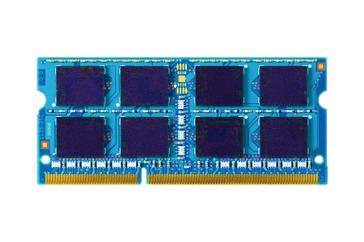
Traditional Approach
Make
DRAM
Reliable
Unreliable
DRAM Cells
Reliable
DRAM Cells
Reliable System
Manufacturing Time
System
in the Field
DRAM has strict reliability guarantee

Slide 53
New Approach
Make
DRAM
Reliable
Unreliable
DRAM Cells
Reliable
DRAM Cells
Reliable System
Manufacturing Time
Manufacturing Time
System
in the Field
System
in the Field
Shift the responsibility to systems

Slide 54
System-Level Detection & Mitigation
Detect
and
Mitigate
Unreliable
DRAM Cells
Reliable System
Detect and mitigate errors after
the system has become operational
ONLINE PROFILING
Reduces cost, increases yield,
and enables scaling

Slide 55
Breaking the Abstraction
Problem
OS needs to know about testing and
tested pages
Need to implement the testing
in the hardware
Operating System
Need to know the circuit-level
characteristics of the failures
Architecture
Circuits
Samira Khan+, "The Efficacy of Error Mitigation Techniques for DRAM Retention Failures: A Comparative Experimental Study”, SIGMETRICS 2014

Slide 56
CSC 2231: Parallel Computer Architecture and Programming
Advice on Doing Research
Prof. Gennady Pekhimenko
University of Toronto
Fall 2017

Slide 57
Advancing Research & Development
We will talk a lot about this in this course
Learning by example
  Reading and evaluating strong and seminal papers
Learning by doing
  Semester-long research project
Learning by open, critical discussions
  Online discussion of papers & ideas on Piazza and Paper Reviews

Slide 58
What is the Goal of Research?
To generate new insight
  that can enable what previously did not exist
Research (in engineering) is a hunt for insight that can eventually impact the world

Slide 59
Basic Advice for Good RESEARCH
Choose great problems to solve: Have great taste
  Difficult
  Important
  High impact
Read heavily and critically
Think big (out of the box)
  Do not restrain yourself to tweaks
Aim high
Write and present really well

Slide 60

Looking here for lost keys

Slide 61
Lost keys here
Looking here

Slide 62

Current Architecture Practice

Slide 64
Aim Here
5-10 years

Slide 65
Enable this point
5-10 years

Slide 66
The Research Formula

Slide 67
Reward
If you are wildly successful, what difference will it make?

Slide 68
Effort
Learn as much as possible with as little work as possible

Slide 69
Effort
Do the minimum analysis and experimentation necessary to make a point

Slide 70

Research is a
hunt for insight
Need to get off the beaten path to find new insights

Slide 71
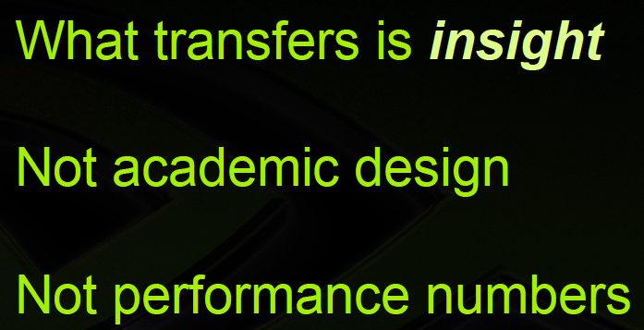

Recommended Talk
Bill Dally, Moving the needle: Effective Computer Architecture Research in Academy and Industry
ISCA 2010 Keynote Talk.
Acknowledgment: Past few slides are from this talk

Slide 72
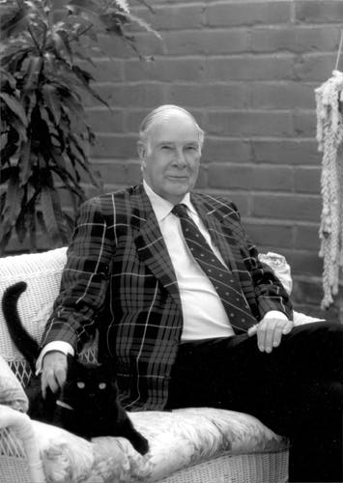
More Good Advice
“The purpose of computing is insight, not numbers”
Richard Hamming

Slide 73
CSC 2231: Parallel Computer Architecture and Programming
Introduction, Logistics
Prof. Gennady Pekhimenko
University of Toronto
Fall 2017

