Slide 1
Professor: Eyal de Lara
Alaa Abdulaal Jacqueline Bermudez Jyotheeswar Arvind Manickavasagar
Notes:
Introduce names, Alaa

Slide 2
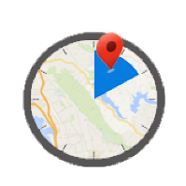
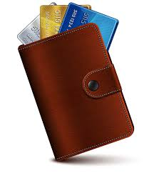
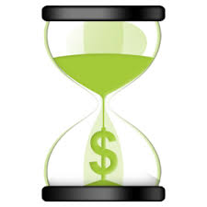
Motivation
Lose Track of time
Waste time locating membership cards
Time is Money
Notes:
Alaa

Slide 3
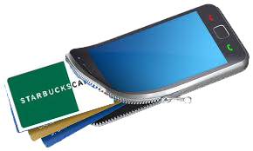
Continuously context-aware shopping assistant.
Creation of a digital wallet.
Our Solution
Prediction of user shopping at a particular shop.
Track time user spends in the store
Notes:
Alaa

Slide 4
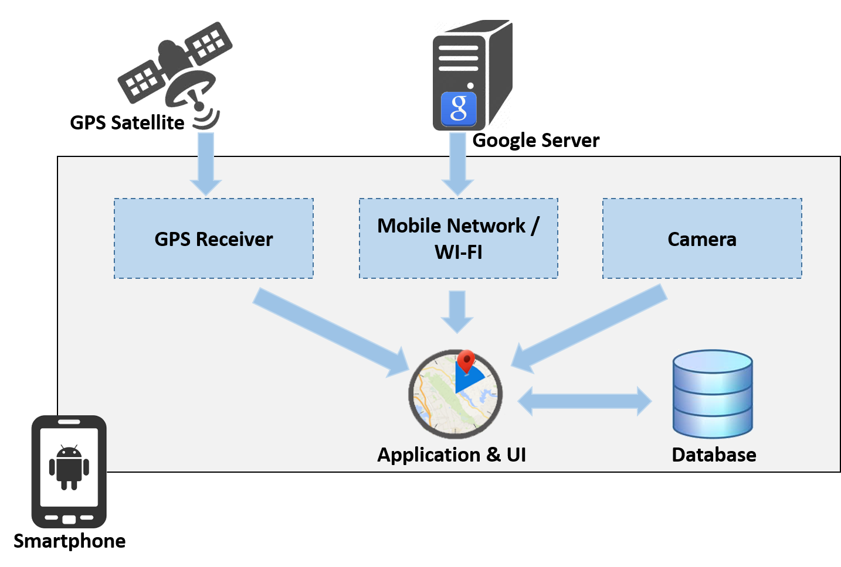
Overview
Notes:
Alaa

Slide 5
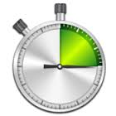
Core modules
Card Module
Track Module
Timer Module
Notification Module
Notes:
Alaa

Slide 6
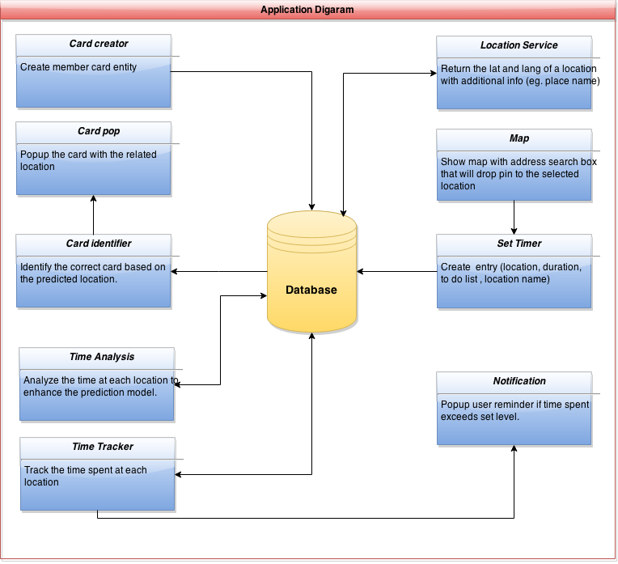
Architecture
Notes:
Alaa

Slide 7
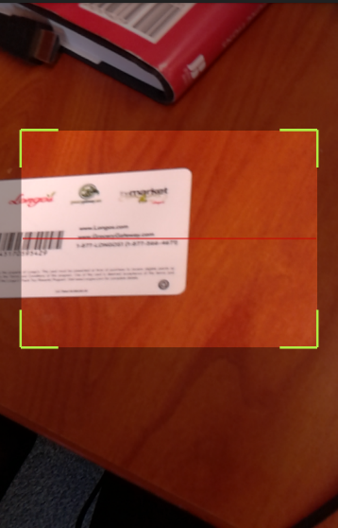
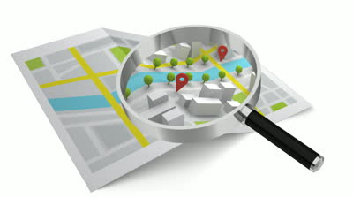
Implementation
Candy shop
The app tracks user’s location and tries associating the name of the location with the stored cards
User scans the membership card
User saves the barcode with the name of the store
Card stored in the database
Notes:
Jackie

Slide 8
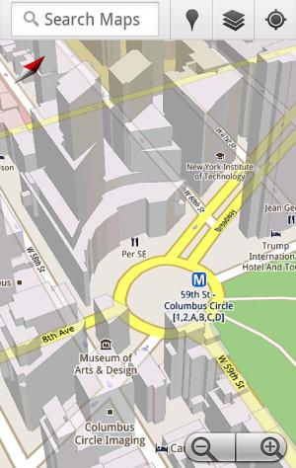
Implementation contd..
Detect name of the place and associate with name of the stored cards
$$≅$$
Latitude, Longitude
The corresponding card pop-ups
Notes:
Jackie

Slide 9
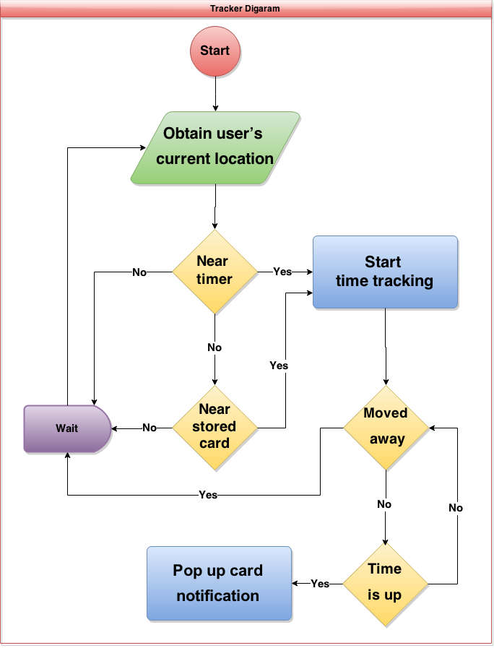
Implementation contd..
Notes:
Arvind

Slide 10
Optimization
Lazy pre-population of locations at time of card creation to create custom geo-fences.
Reduces API calls (expensive) and computation complexity that allows more fine-grained location tracking.
# API calls made per 12 hours: w/o Optimization : 4325 w Optimization: 5
Notes:
Arvind

Slide 11
Optimization contd..
1
3
Starbucks
2
Latitude, Longitude, and name of the addresses obtained were stored in the database
Starbucks
Starbucks, Queen St
Starbucks, University Ave
Starbucks, Bathurst
Starbucks, Dundas St E.
Get a list of existing Starbucks nearby the city
Notes:
Jyo

Slide 12
Demo
Notes:
Alaa

Slide 13
Evaluation
User study
Battery consumption
Network usage
Radius threshold
Timer accuracy
Notes:
Jackie

Slide 14
User study
10 participants.
Participants from Toronto ON and Lincoln ON.
Participants aged b/w 23 to 61 years.
Participants were in a wide-range of professions.
Qualitative study.
Notes:
Jackie

Slide 15
User study – Reminders & Cards
Notes:
Jackie

Slide 16
User study
Notes:
Jackie

Slide 17
User study - Use the app
Notes:
Jackie

Slide 18
Apparatus used for evaluation
Nexus 5 smartphone
Android 5.0
Qualcomm Snapdragon 800 processor
Wi-Fi 802.11 a/b/g/n/ac, dual-band, Wi-Fi Direct
A-GPS
Motorola G (1st Generation)
Android 5.0
Qualcomm Snapdragon 400 processor
Wi-Fi 802.11 b/g/n
A-GPS
Power Tutor 1.4
ONAVO COUNT v 2.2.2-3
Notes:
Jyo

Slide 19
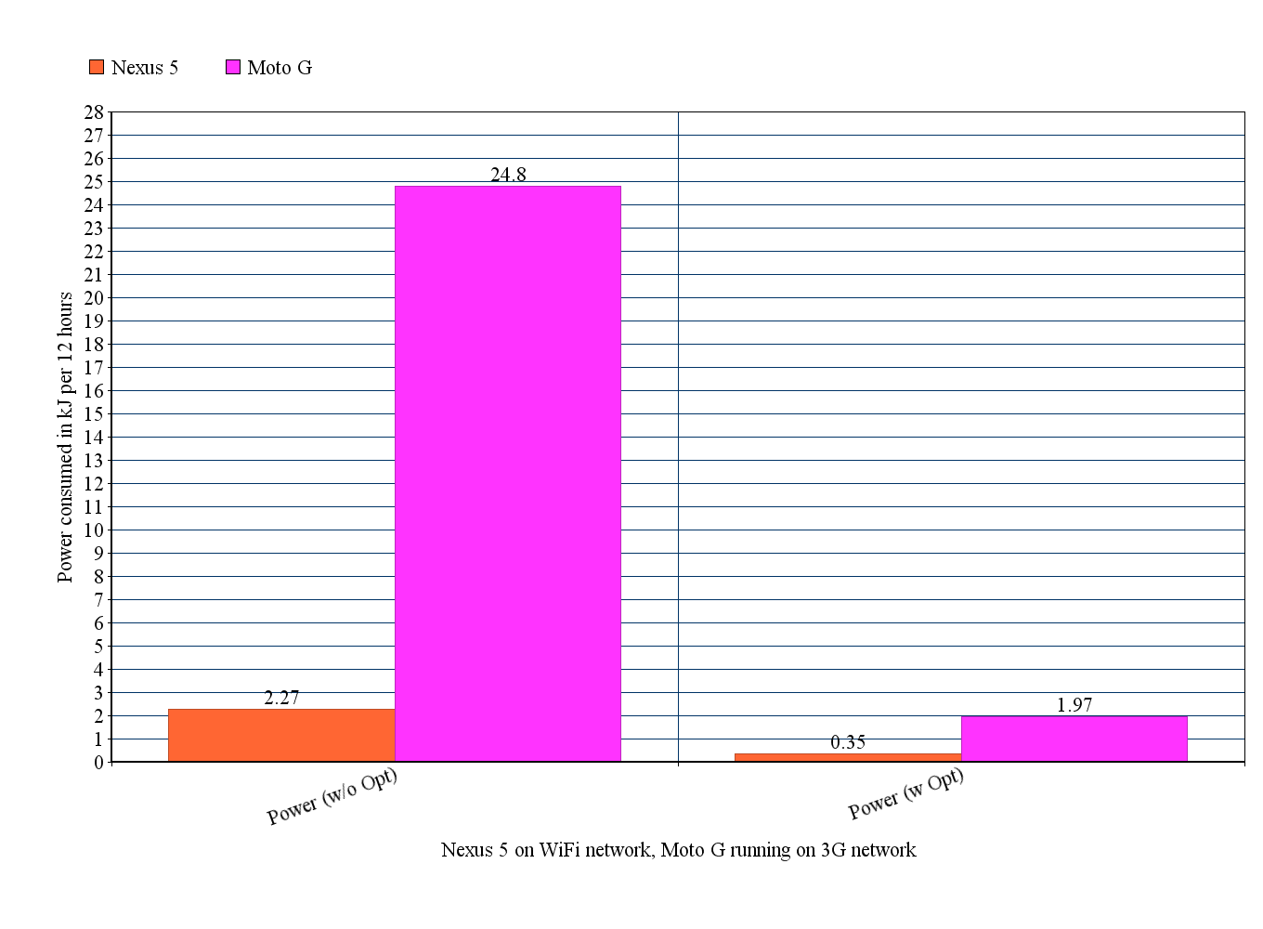
Battery consumption
Nexus 5
Moto G
Power Consumed in kJ per 12 hours
Nexus 5 on WiFi, Moto G running on 3G
Notes:
Jyo

Slide 20
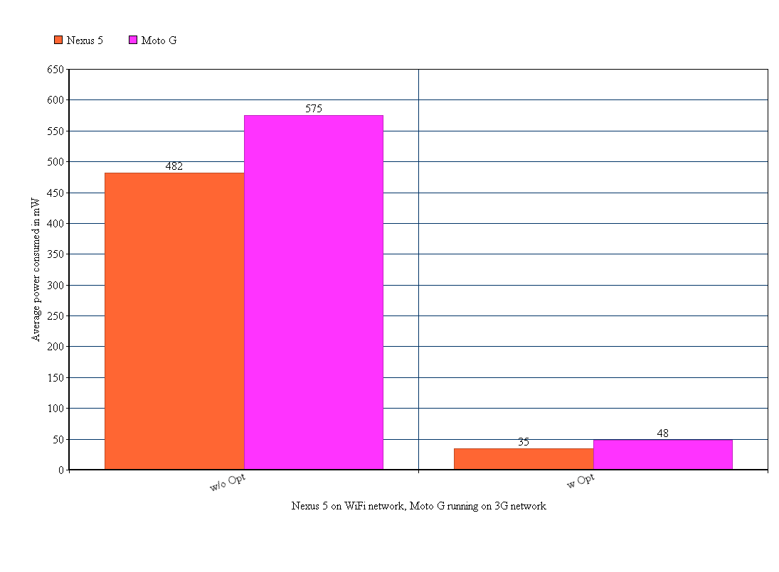
Battery consumption contd..
Nexus 5
Moto G
Average Power Consumed in mW
Nexus 5 on WiFi, Moto G running on 3G

Slide 21
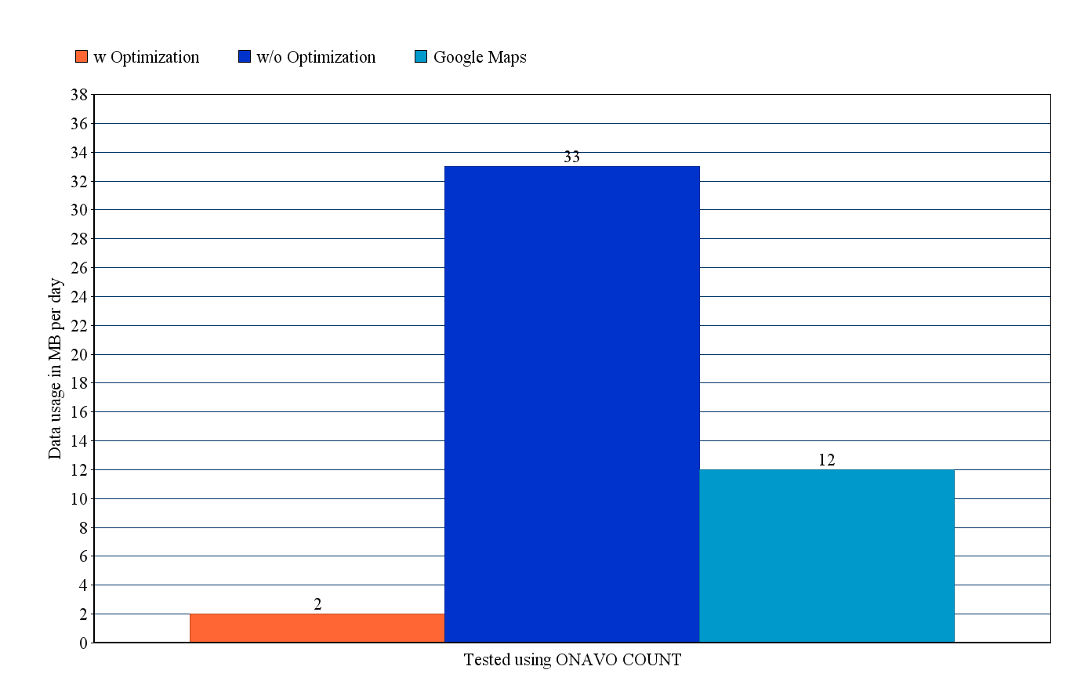
Network usage
w Optimization
w/o Optimization
Google Maps
Data Usage in MB per Day

Slide 22
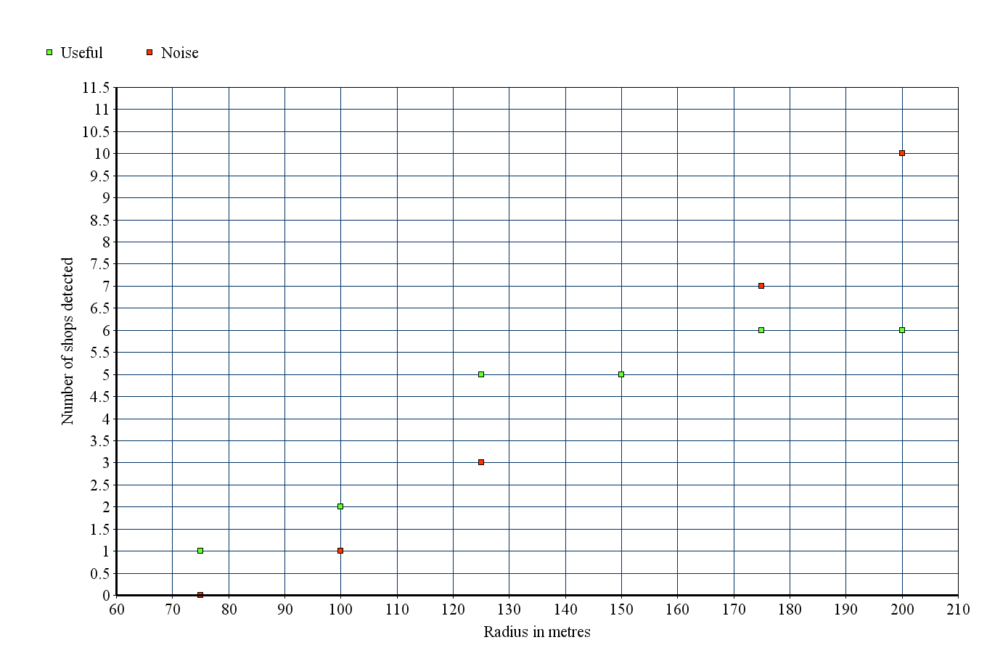
Radius threshold
Useful
Noise
Number of Shops Detected
Radius in Meters
when tested in Downtown Toronto

Slide 23
Timer accuracy
Directly proportional to the detection based on the radius and the particular store.
Further testing needs to be done to identify correlations between the radii of different stores and the timer accuracy.

Slide 24
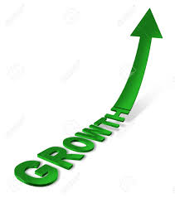
Limitations
Google’s APIs.
Prediction model is linear.
Radius threshold is static for all locations.
No indoor localizations, so cannot currently use in multi-storey shopping malls.
Notes:
Jackie

Slide 25
Future work
Dynamically modify the radius threshold based on type of establishment and using architecture information from TSA databases.
Push information to a web server to model and predict user behavior better.
Notes:
Jyo

Slide 26
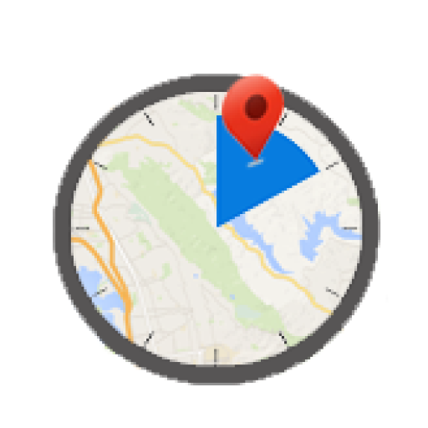
Thank You

Slide 27
?
Q & A

