Slide 1
Cosmic Rays Don’t Strike Twice:
Understanding the Nature of DRAM Errors and the Implications for System Design
Andy A. Hwang, Ioan Stefanovici, Bianca Schroeder
Presented at ASPLOS 2012

Slide 2
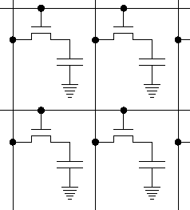
Why DRAM errors?
Why DRAM?
  One of the most frequently replaced components [DSN’06]
  Getting worse in the future?
DRAM errors?
  A bit is read differently
  from how it was written
0
1

Slide 3
What do we know about DRAM errors?
Soft errors
  Transient
  Cosmic rays, alpha particles, random noise
Hard errors
  Permanent hardware problem
Error protection
  None → machine crash / data loss
  Error correcting codes
    E.g.: SEC-DED, Multi-bit Correct, Chipkill
  Redundancy
    E.g.: Bit-sparing

Slide 4
What don’t we know about DRAM errors?
Some open questions
  What does the error process look like? (Poisson?)
  What is the frequency of hard vs. soft errors?
  What do errors look like on-chip?
  Can we predict errors?
  What is the impact on the OS?
  How effective are hardware and software level error protection mechanisms?
    Can we do better?

Slide 5
Previous Work
Accelerated laboratory testing
  Realistic?
  Most previous work focused specifically on soft errors
Current field studies are limited
  12 machines with errors [ATC’10]
  Kernel pages on desktop machines only [EuroSys’11]
  Error-count-only information from a homogenous population [Sigmetrics’09]

Slide 6
The data in our study
Error events detected upon [read] access and corrected by the memory controller
Data contains error location (node and address), error type (single/multi-bit), timestamp information.
DIMM
CPU
Memory
Controller
DIMM
DIMM

Slide 7
The systems in our study
System | DRAM Technology | Protection Mechanisms | Time (days) | DRAM (TB)
LLNL BG/L | DDR | Multi-bit Correct, Bit Sparing | 214 | 49
ANL BG/P | DDR2 | Multi-bit Correct, Chipkill, Bit Sparing | 583 | 80
SciNet GPC | DDR3 | SEC-DED | 211 | 62
Google | DDR[1-2], FBDIMM | Multi-bit Correct | 155 | 220
Wide range of workloads, DRAM technologies, protection mechanisms.
Memory controller physical address mappings
In total more than 300 TB-years of data!

Slide 8
How common are DRAM errors?
System | Total # of Errors in System | Nodes With Errors | Average # Errors per Node / Year | Median # Errors per Node / Year
LLNL BG/L | 227 x 10⁶ | 1,724 (5.32%) | 3,879 | 19
ANL BG/P | 1.96 x 10⁹ | 1,455 (3.55%) | 844,922 | 14
SciNet GPC | 49.3 x 10⁶ | 97 (2.51%) | 263,268 | 464
Google | 27.27 x 10⁹ | 20,000 (N/A %) | 880,179 | 303
Errors happen at a significant rate
Highly variable number of errors per node

Slide 9
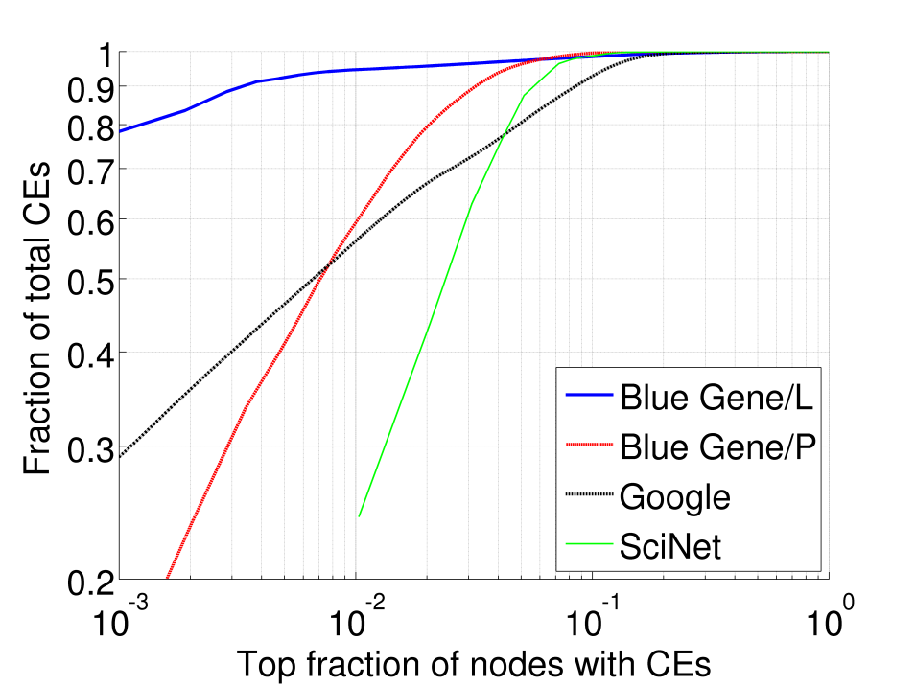
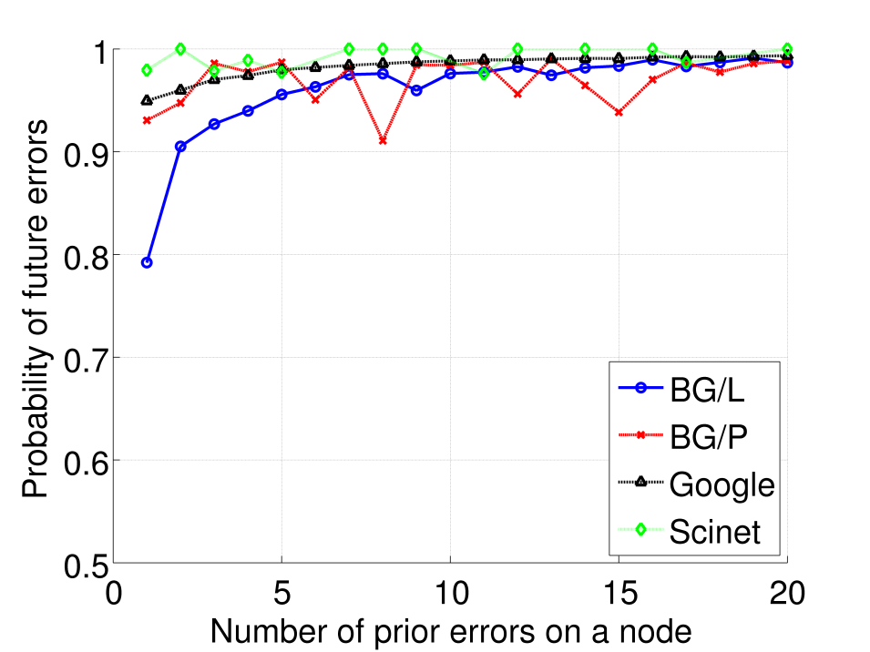
How are errors distributed in the systems?
Only 2-20% of nodes with errors experience a single error
Top 5% of nodes with errors experience > 1 million errors
Distribution of errors is highly skewed
  Very different from a Poisson distribution
Could hard errors be the dominant failure mode?
Top 10% of nodes with CEs make up
~90% of all errors
After 2 errors, probability of future
errors > 90%

Slide 10
What do errors look like on-chip?
Error Mode | BG/L Banks | BG/P Banks | Google Banks
Repeat address | 80.9% | 59.4% | 58.7%
Repeat row | 4.7% | 31.8% | 7.4%
Repeat column | 8.8% | 22.7% | 14.5%
Whole chip | 0.53% | 3.20% | 2.02%
1
2
row
Single Event | 17.6% | 29.2% | 34.9%
column

Slide 11
What do errors look like on-chip?
Error Mode | BG/L Banks | BG/P Banks | Google Banks
Repeat address | 80.9% | 59.4% | 58.7%
Repeat row | 4.7% | 31.8% | 7.4%
Repeat column | 8.8% | 22.7% | 14.5%
Whole chip | 0.53% | 3.20% | 2.02%
1
2
row
Single Event | 17.6% | 29.2% | 34.9%
column

Slide 12
What do errors look like on-chip?
Error Mode | BG/L Banks | BG/P Banks | Google Banks
Repeat address | 80.9% | 59.4% | 58.7%
Repeat row | 4.7% | 31.8% | 7.4%
Repeat column | 8.8% | 22.7% | 14.5%
Whole chip | 0.53% | 3.20% | 2.02%
1
row
2
Single Event | 17.6% | 29.2% | 34.9%
column

Slide 13
What do errors look like on-chip?
Error Mode | BG/L Banks | BG/P Banks | Google Banks
Repeat address | 80.9% | 59.4% | 58.7%
Repeat row | 4.7% | 31.8% | 7.4%
Repeat column | 8.8% | 22.7% | 14.5%
Whole chip | 0.53% | 3.20% | 2.02%
4
1
row
2
5
3
Single Event | 17.6% | 29.2% | 34.9%
column

Slide 14
What do errors look like on-chip?
Error Mode | BG/L Banks | BG/P Banks | Google Banks
Repeat address | 80.9% | 59.4% | 58.7%
Repeat row | 4.7% | 31.8% | 7.4%
Repeat column | 8.8% | 22.7% | 14.5%
Whole chip | 0.53% | 3.20% | 2.02%
1
row
Single Event | 17.6% | 29.2% | 34.9%
column

Slide 15
What do errors look like on-chip?
The patterns on the majority of banks can be linked to hard errors.
Error Mode | BG/L Banks | BG/P Banks | Google Banks
Repeat address | 80.9% | 59.4% | 58.7%
Repeat row | 4.7% | 31.8% | 7.4%
Repeat column | 8.8% | 22.7% | 14.5%
Whole chip | 0.53% | 3.20% | 2.02%
Single Event | 17.6% | 29.2% | 34.9%

Slide 16
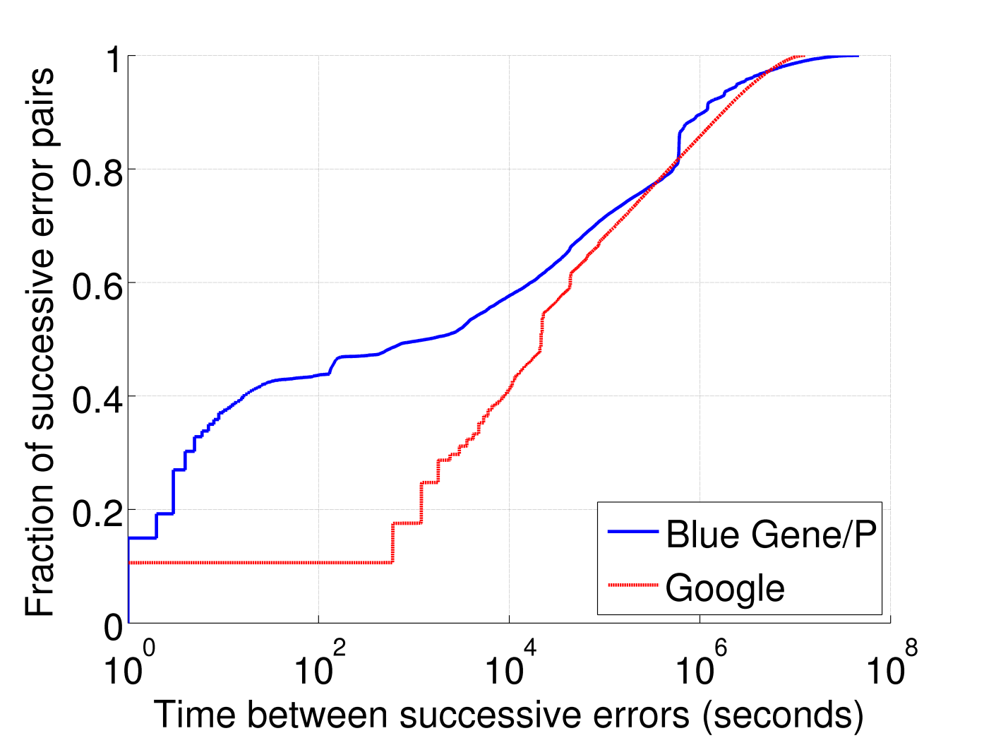
What is the time between repeat errors?
Repeat errors happen quickly
  90% of errors manifest themselves within less than 2 weeks
2 weeks

Slide 17

When are errors detected?
Error detection
  Program [read] access
  Hardware memory scrubber: Google only
Hardware scrubbers may not shorten the time until a repeat error is detected
1 day

Slide 18
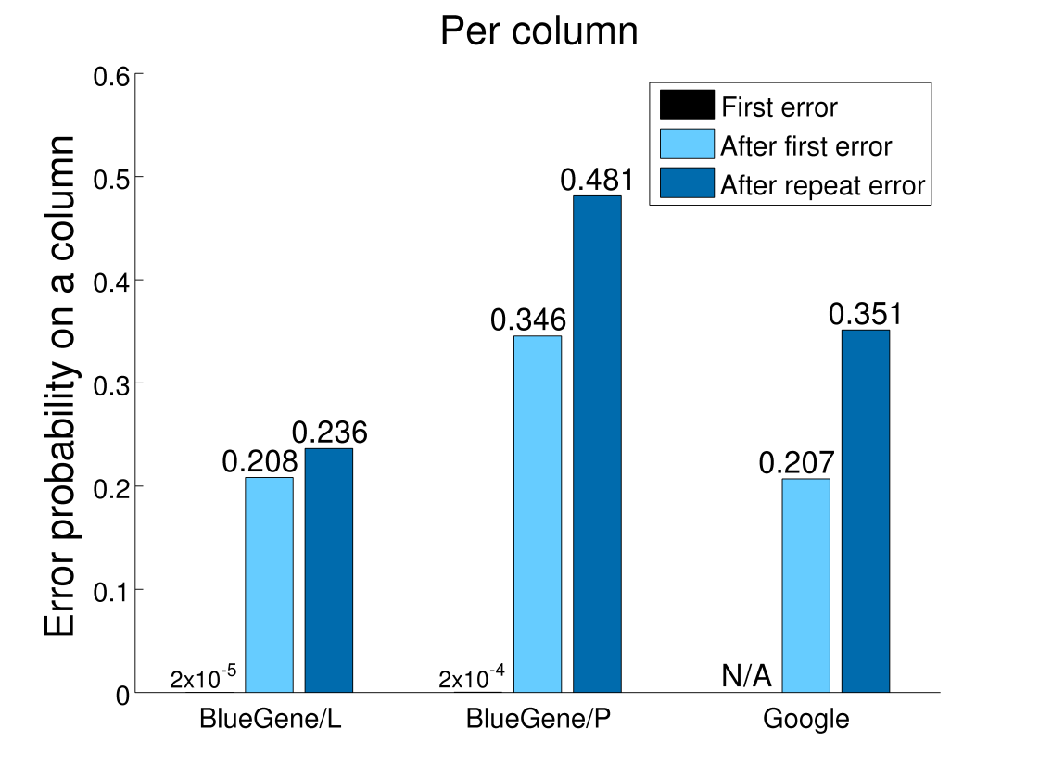
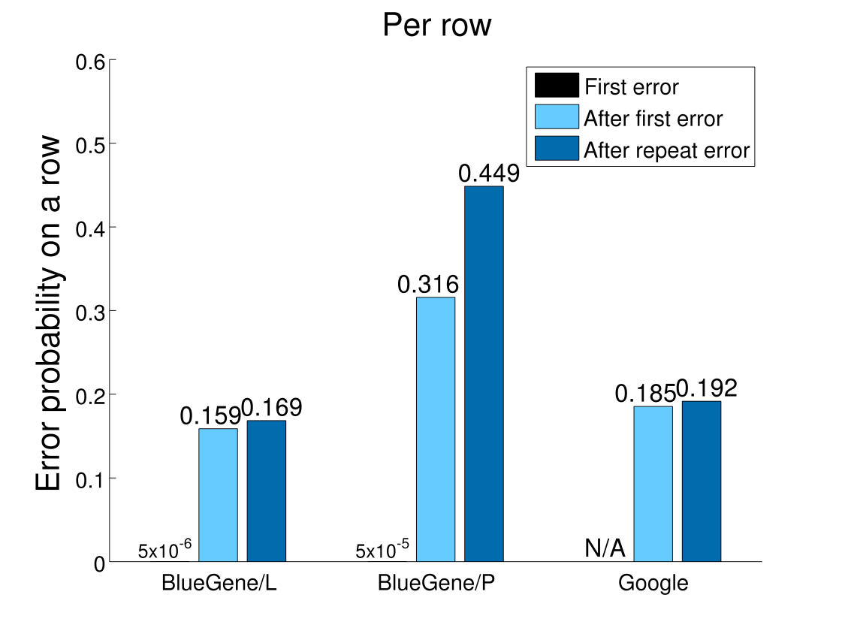
How does memory degrade?
  1/3 – 1/2 of error addresses develop additional errors
    Top 5-10% develop a large number of repeats
3-4 orders of magnitude increase in probability once an error occurs, and even greater increase after repeat errors.
For both columns and rows

Slide 19
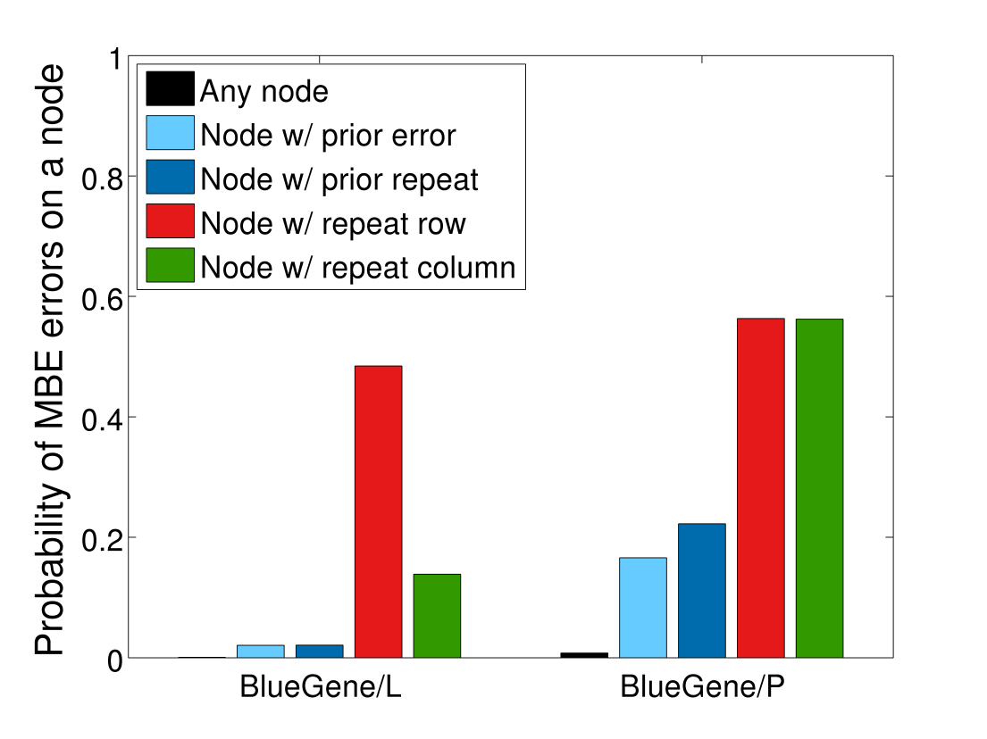
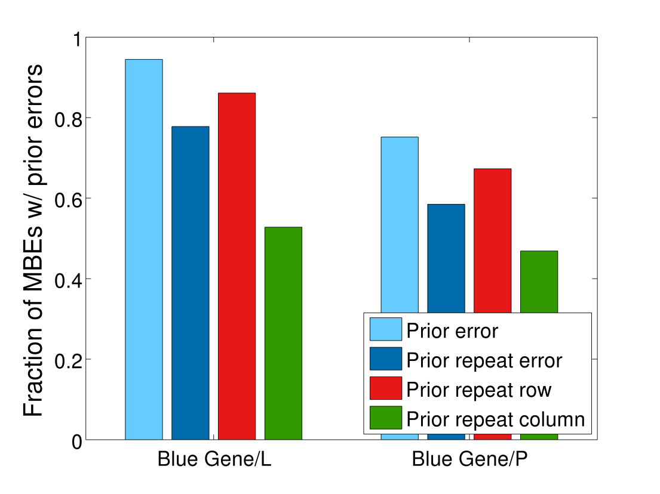
How do multi-bit errors impact the system?
In the absence of sufficiently powerful ECC, multi-bit errors can cause data corruption / machine crash.
Can we predict multi-bit errors?
> 100-fold increase in MBE probability after repeat errors
50-90% of MBEs had prior warning

Slide 20
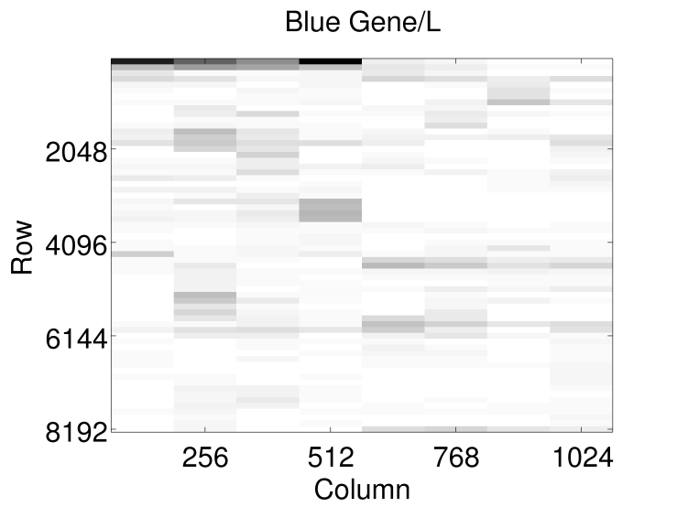
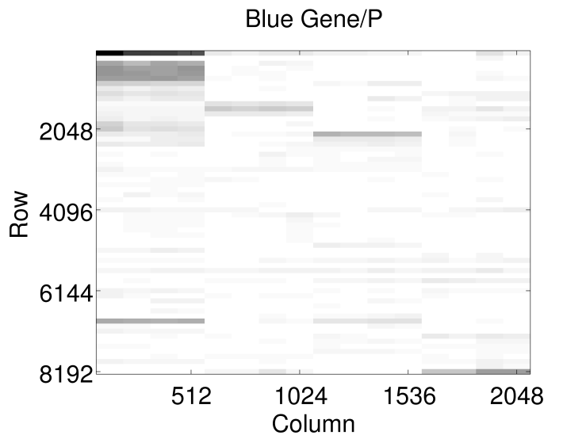
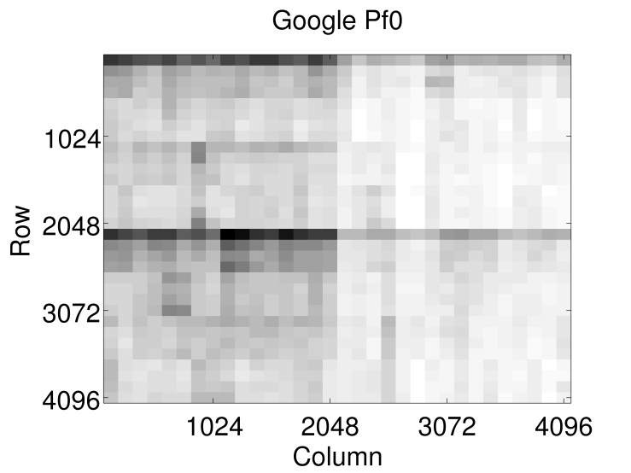
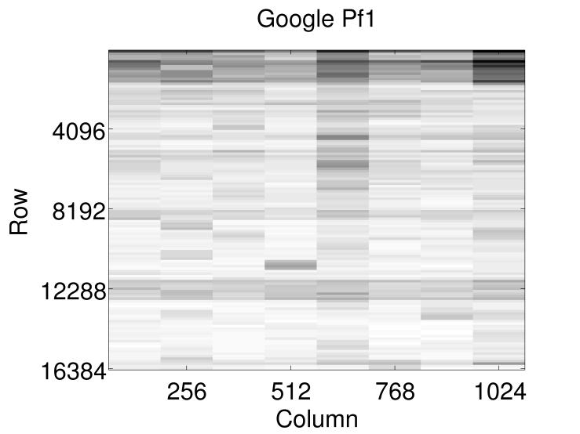
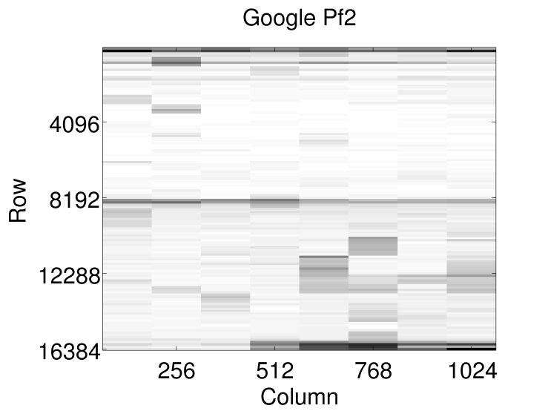
Are some areas of a bank more likely to fail?
Errors are not uniformly distributed
Some patterns are consistent across systems
  Lower rows have higher error probabilities

Slide 21
Summary so far
Similar error behavior across ~300TB-years of DRAM from different types of systems
Strong correlations (in space and time) exist between errors
On-chip errors patterns confirm hard errors as dominating failure mode
Early errors are highly indicative warning signs for future problems
What does this all mean?

Slide 22
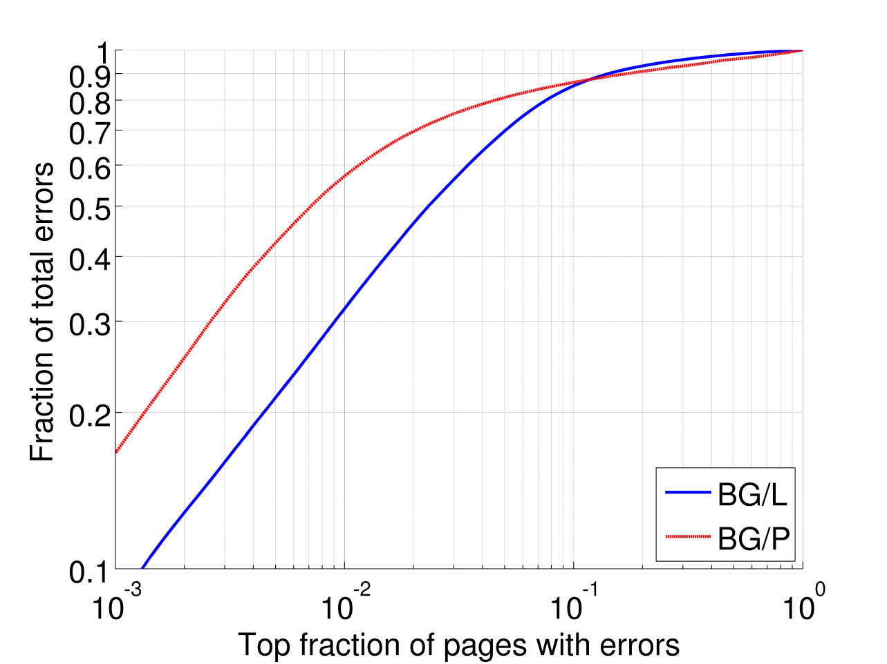
What do errors look like from the OS’ p.o.v.?
Errors are highly localized on a small number of pages
  ~85% of errors in the system are localized on 10% of pages impacted with errors
For typical 4Kb pages:

Slide 23
Can we retire pages containing errors?
Page Retirement
  Move page’s contents to different page and mark it as bad to prevent future use
Some page retirement mechanisms exist
  Solaris
  BadRAM patch for Linux
  But rarely used in practice
No page retirement policy evaluation on realistic error traces

Slide 24
What sorts of policies should we use?
Physical address space
Retirement policies:
  Repeat-on-address
  1-error-on-page
  2-errors-on-page
  Repeat-on-row
  Repeat-on-column
1
2

Slide 25
What sorts of policies should we use?
Physical address space
Retirement policies:
  Repeat-on-address
  1-error-on-page
  2-errors-on-page
  Repeat-on-row
  Repeat-on-column
1

Slide 26
What sorts of policies should we use?
Physical address space
Retirement policies:
  Repeat-on-address
  1-error-on-page
  2-errors-on-page
  Repeat-on-row
  Repeat-on-column
1
2

Slide 27
What sorts of policies should we use?
Physical address space
Retirement policies:
  Repeat-on-address
  1-error-on-page
  2-errors-on-page
  Repeat-on-row
  Repeat-on-column
On-chip
1
1
2
1
2
row
2
column

Slide 28
What sorts of policies should we use?
Physical address space
Retirement policies:
  Repeat-on-address
  1-error-on-page
  2-errors-on-page
  Repeat-on-row
  Repeat-on-column
On-chip
1
1
1
row
2
2
column
2

Slide 29
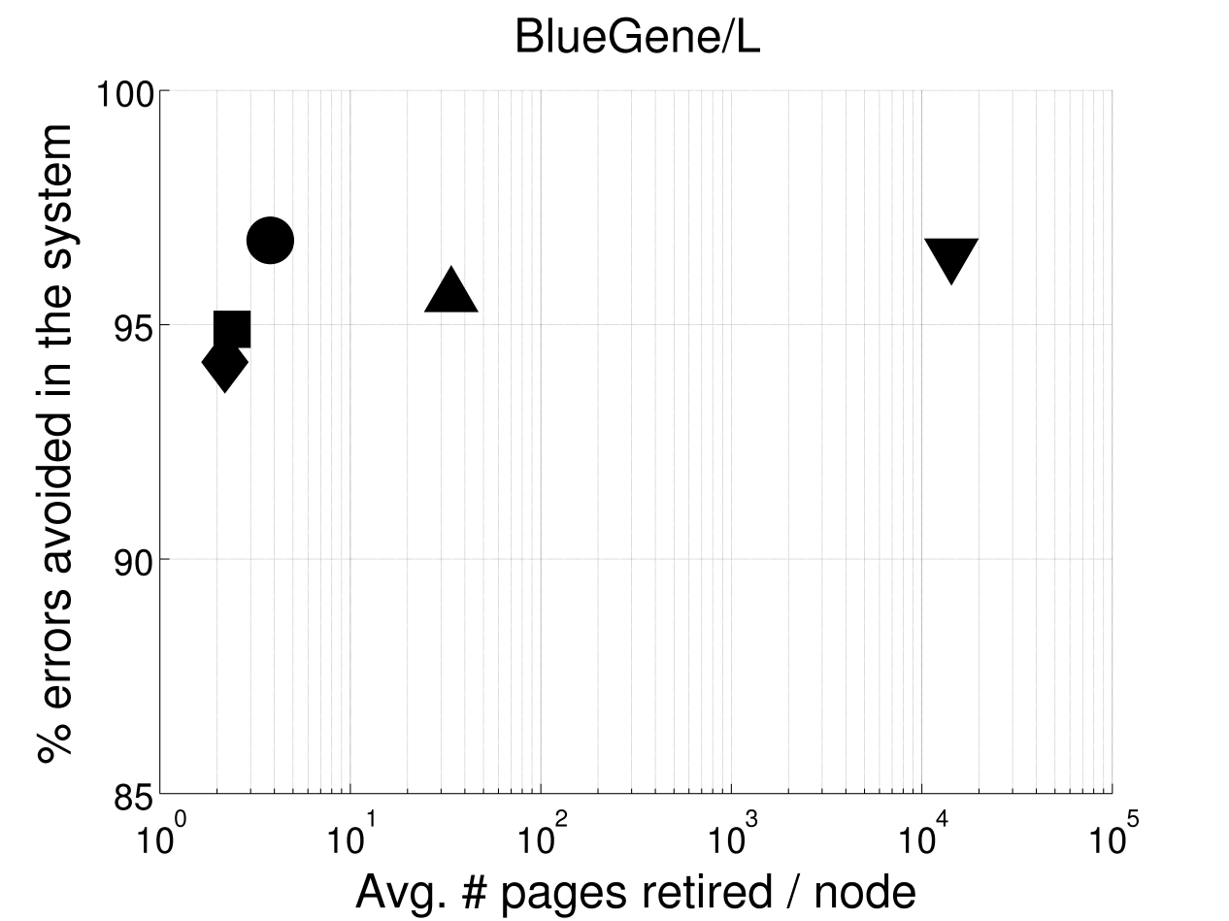
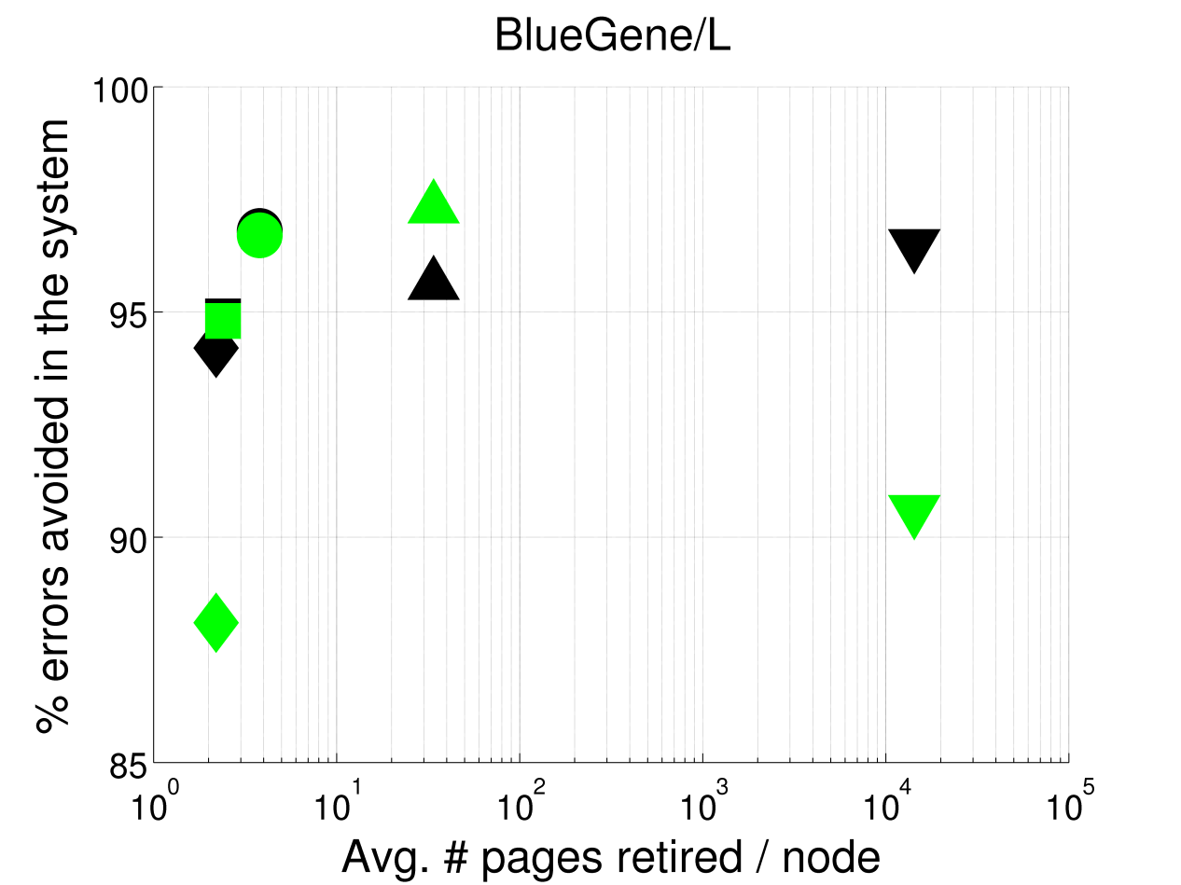
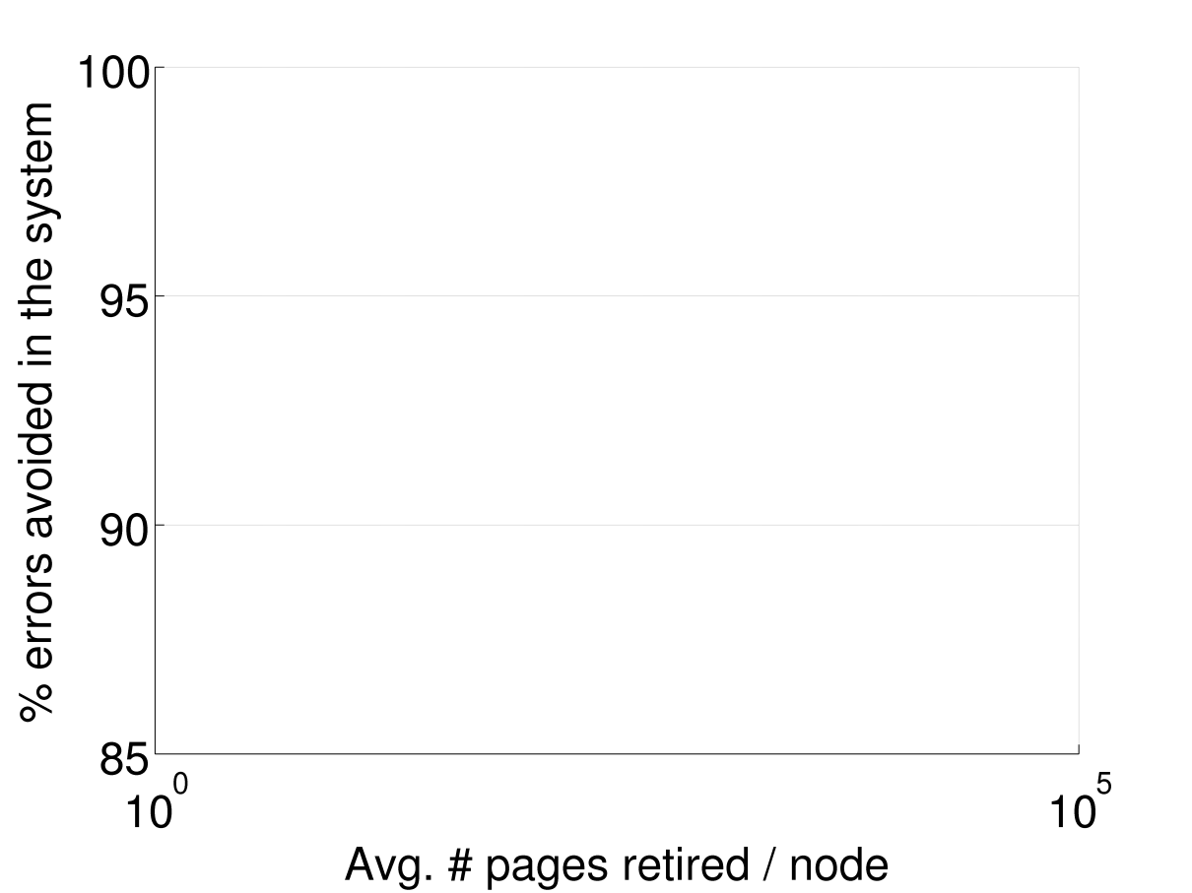
How effective is page retirement?
For typical 4Kb pages:
More than 90% of errors can be prevented with < 1MB sacrificed per node
  Similar for multi-bit errors
(MBE)
1-error-on-page
1-error-on-page
Repeat-on-row
Repeat-on-column
Repeat-on-row
2-errors-on-page
2-errors-on-page
Effective policy
Repeat-on-address
Repeat-on-address
Repeat-on-column
1MB

Slide 30
Implications for future system design
OS-level page retirement can be highly effective
Different areas on chip are more susceptible to errors than others
  Selective error protection
Potential for error prediction based on early warning signs
Memory scrubbers may not be effective in practice
  Using server idle time to run memory tests (eg: memtest86)
Realistic DRAM error process needs to be incorporated into future reliability research
  Physical-level error traces have been made public on the Usenix Failure Repository

Slide 31
Thank you!
Please read the paper for more results! ☺
Questions ?

