Slide 1
What Does an Aberrated Photo Tell Us About the Lens and the Scene?
Huixuan Tang
Kyros Kutulakos
University of Toronto

Slide 2
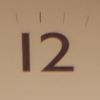

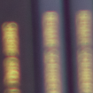


Slide 3
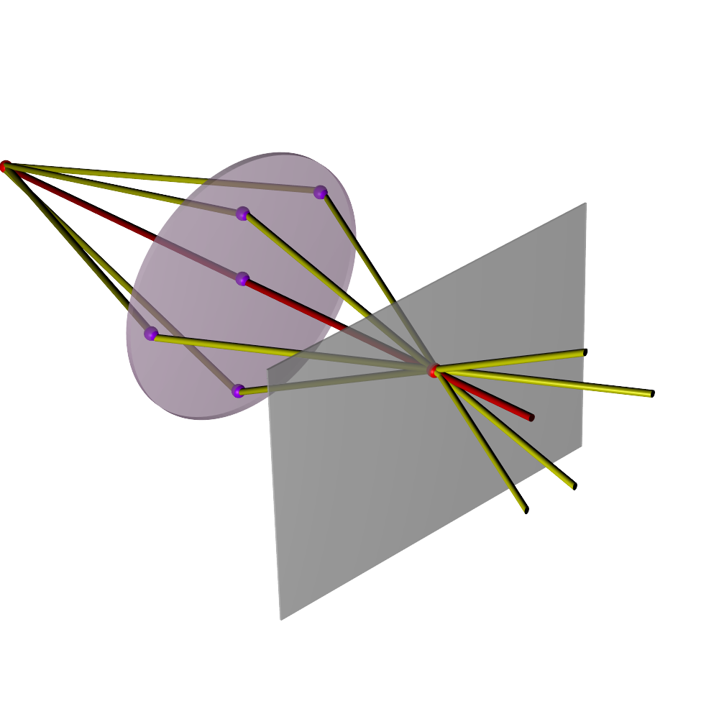

pupil plane
scene
point
sensor plane
2D image
(perfect focus)

Slide 4
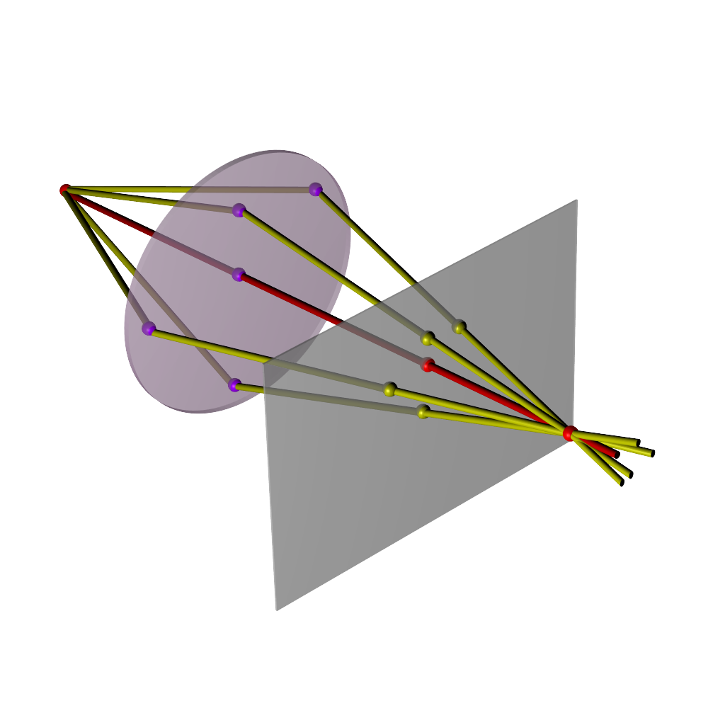
pupil plane
scene
point
sensor plane
2D image
(defocus)

Slide 5
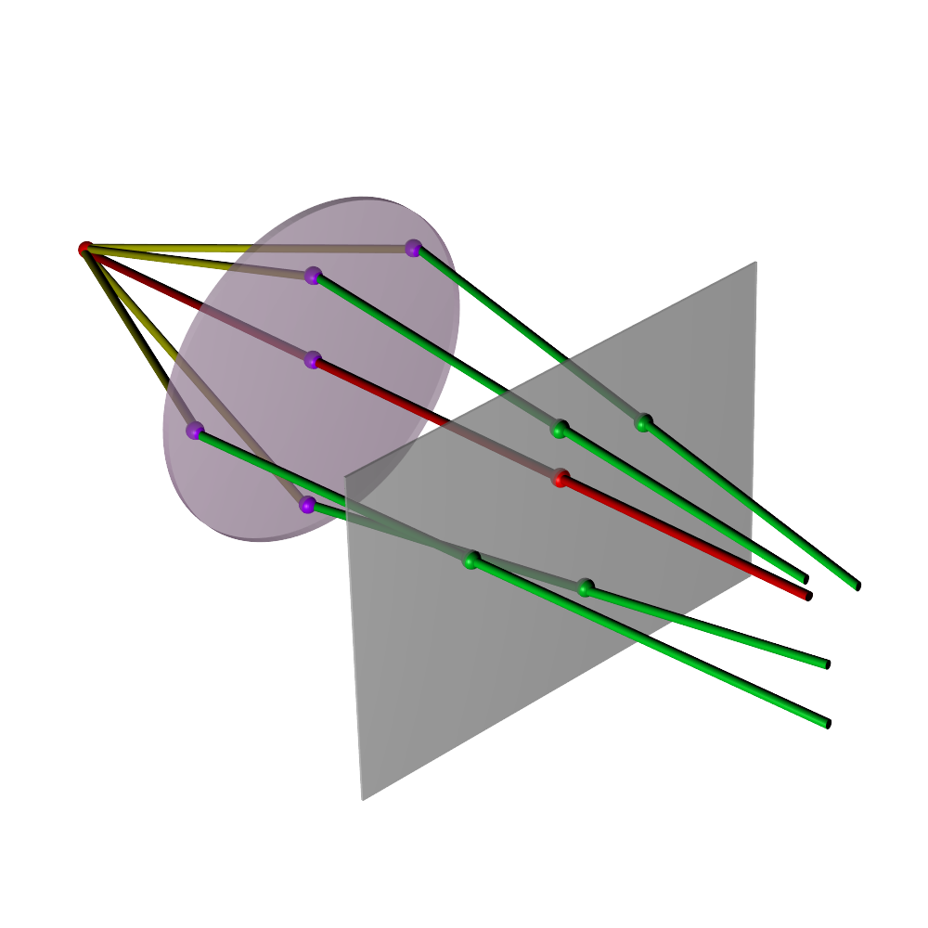
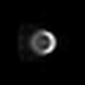
pupil plane
scene
point
sensor plane
2D image
(defocus + aberrations)
aberrated rays

Slide 6
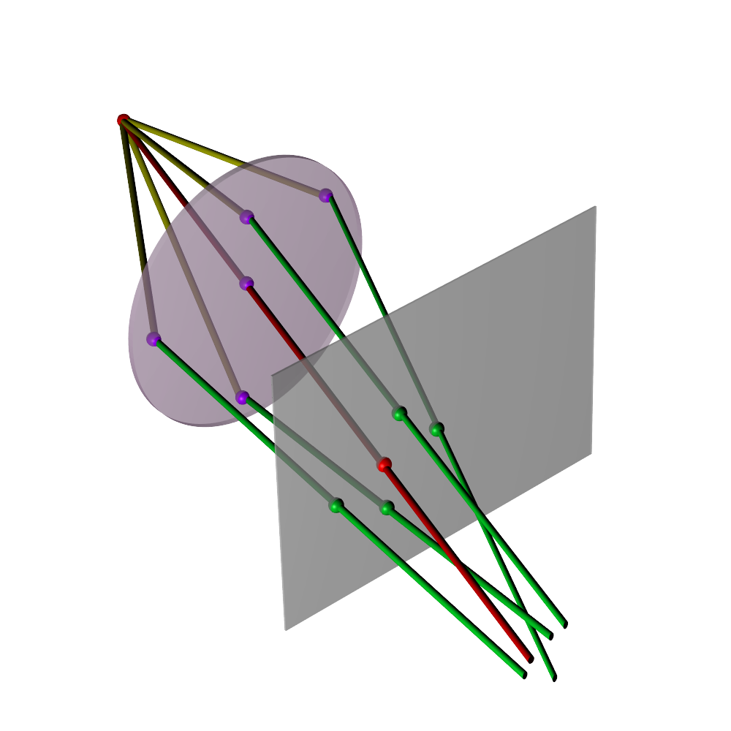
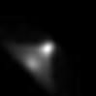
scene
point
pupil plane
sensor plane
2D image
(defocus + aberrations)
aberrated rays

Slide 7
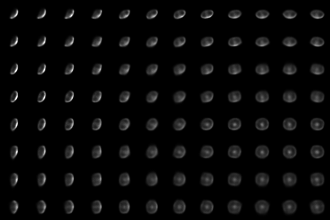
depth plane
sensor plane
Notes:
Because of this, the point spread function of aberrated lenses is in general a five dimensional function.
Given a 2D position on the sensor and the depth(**CLICK**) of a scene point, this function returns the point's blurry image
(**CLICK**), also known as the blur kernel. This kernel can change quite a bit for different positions on the sensor (**CLICK**)

Slide 8
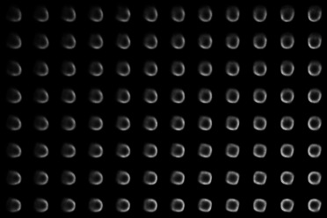
depth plane
sensor plane
Notes:
and can change quite dramatically for points at different depths

Slide 9
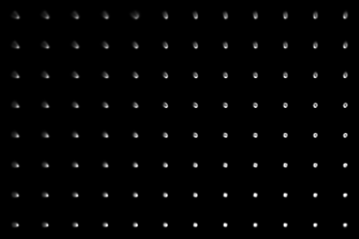
depth plane
sensor plane
Notes:
, as you can see here with data for a Canon SLR.

Slide 10
depth plane
sensor plane
Notes:
The high dimensions …

Slide 11
depth plane
sensor plane
depends on depth & lens
1 photo 4D scene-dependent slice of PSF
hard to capture
hard to invert
Notes:
of this function and its complexity might suggest that the function is difficult to capture, and even more difficult to invert,
in order to recover depth and lens properties.
Little is known though about whether or not this is the case. Here…

Slide 12
depth plane
sensor plane
depends on depth & lens
1 photo 4D scene-dependent slice of PSF
hard to capture
hard to invert
Notes:
we focus on analyzing precisely this problem

Slide 13
given K≥1 blur kernels from one photo ...
observed
blur kernels
Notes:
by asking three basic questions---
first, suppose we are given the blur kernel at one (**CLICK**) or more positions in a photo;

Slide 14
... can we infer depth?
observed
blur kernels
Notes:
is it possible to recover the depths of the corresponding scene points?

Slide 15
... can we infer the full 5D PSF?
inferred PSF
Notes:
second, is it possible to use those kernels to extrapolate the blur kernels at other positions in the photo

Slide 16
... can we infer the full 5D PSF?
inferred PSF
Notes:
or for depths that were not observed?

Slide 17
... and can we infer the lens parameters?
Key assumptions
3rd order Seidel aberrations
geometric optics
rotationally-symmetric lens
≥1 unknown lens elements
known optical center
inferred PSF
Notes:
and finally, can we recover the parameters of the lens corresponding to these kernels?
Here we will look (**CLICK**) at these questions for the case of a rotationally-symmetric lens that may contain multiple elements and exhibits 3rd
order Seidel aberrations.

Slide 18
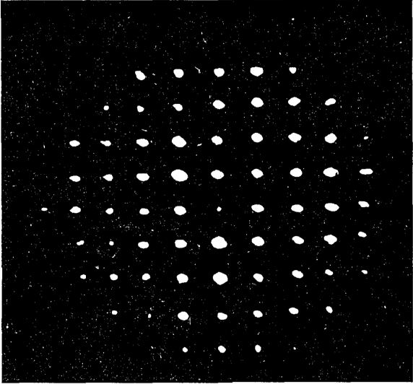
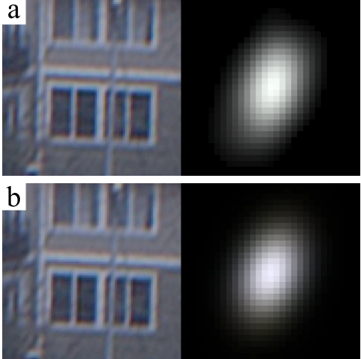
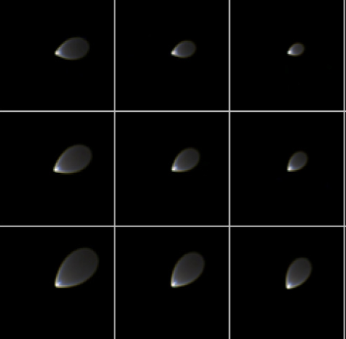
related work
direct aberration
measurement
empirical PSF
modeling
blind/non-blind
aberration correction
[Liang et al 94][Ng & Hanrahan 06]
[Joshi et al 08][Kee et al 11]
[Shih et al 12][Schuler et al 12]
requires physical
access to camera
significant data acquisition,
limited inference power
interaction w/ defocus
not well understood
Notes:
Of course modeling, analyzing, and correcting lens aberrations have been studied for decades. But techniques such as wave-front sensing direct physical access to the lens which we don't have here. In computational photography,
empirical models for spatially varying PSFs have been proposed but they have limited predictive power because they are not physically based. Moreover,
post-processing techniques for aberration correction usually assume that there is little or no defocus blur and do not consider the interaction between aberration and defocus, or how to untangle their effects.

Slide 19
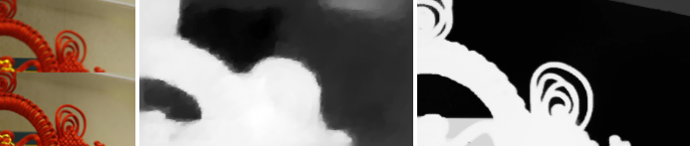
related work
direct aberration
measurement
empirical PSF
modeling
blind/non-blind
aberration correction
[Liang et al 94][Ng & Hanrahan 06]
[Joshi et al 08][Kee et al 11]
[Shih et al 12][Schuler et al 12]
depth from defocus
assumes aberration-free imaging
[Favaro 10]
Notes:
Work on depth from defocus, on the other hand, assumes aberration-free images and does not consider how aberrations may affect depth computations.

Slide 20
related work
direct aberration
measurement
empirical PSF
modeling
blind/non-blind
aberration correction
[Liang et al 94][Ng & Hanrahan 06]
[Joshi et al 08][Kee et al 11]
[Shih et al 12][Schuler et al 12]
requires physical
access to camera
significant data acquisition,
limited inference power
interaction w/ defocus
not well understood
inference from 1
aberrated photo
physics-based model
of 5D PSF formation
unified analysis of
aberration & defocus
Notes:
Here we focus on inference from very limited input, we use a physically based model that is derived from basic aberration optics, and we take both defocus blur and aberration blur into account.

Slide 21
three main results
single-point inference
1 blur kernel known exactly
3D ambiguity in Seidel coefs,
defocus level & 5D PSF
regardless of deblurring quality, cannot predict lens blur at other depths/image locations
multi-point inference
K ≥ 3 blur kernels known exactly
unambiguous 5D PSF, 1D scale ambiguity
in Seidel coefs & K defocus levels
reconstruction of depth & 5D PSF may be possible from just 1 shot
practical modeling/inference of 5D PSFs
5 lens parameters are enough when mechanical vignetting not significant
instead of modeling the PSF directly,
model the aberrated rays
Notes:
Now let me give you a high-level overview of our three results before going into the details--
first of all, we show that if we have perfect information about blur at a single point, this restricts the space of compatible depth and lens parameters to a
three-dimensional family. This is both good news and bad news--the good news is that even very local information is enough to eliminate several of the
unknowns. the bad news (**CLICK**), of course, is that not all of them can be eliminated, and generally cannot extrapolate the lens PSF outside the
neighbhorhood where the PSF is known, no matter how good our local deblurring algorithm is.
knowing (**CLICK**) blur kernels at more than two points though provides very powerful constraints--in theory, this may be enough to restrict the space of feasible depth and lens paramters to a discrete set. so we at least have
Theoretical (**CLICK**) *possibility* of reconstructing depth and 5D PSFs from one shot---but we have not fully validated this experimentally.
that being said, (**CLICK**) we *do* show that it is possible to predict lens behavior reasonably well by analyzing just a few blur kernels from one photo.
And the key here, as we will see later, (**CLICK**) is to model the underlying cause of the blur---the imperfect rays---rather than the PSF itself.
To get these results…

Slide 22
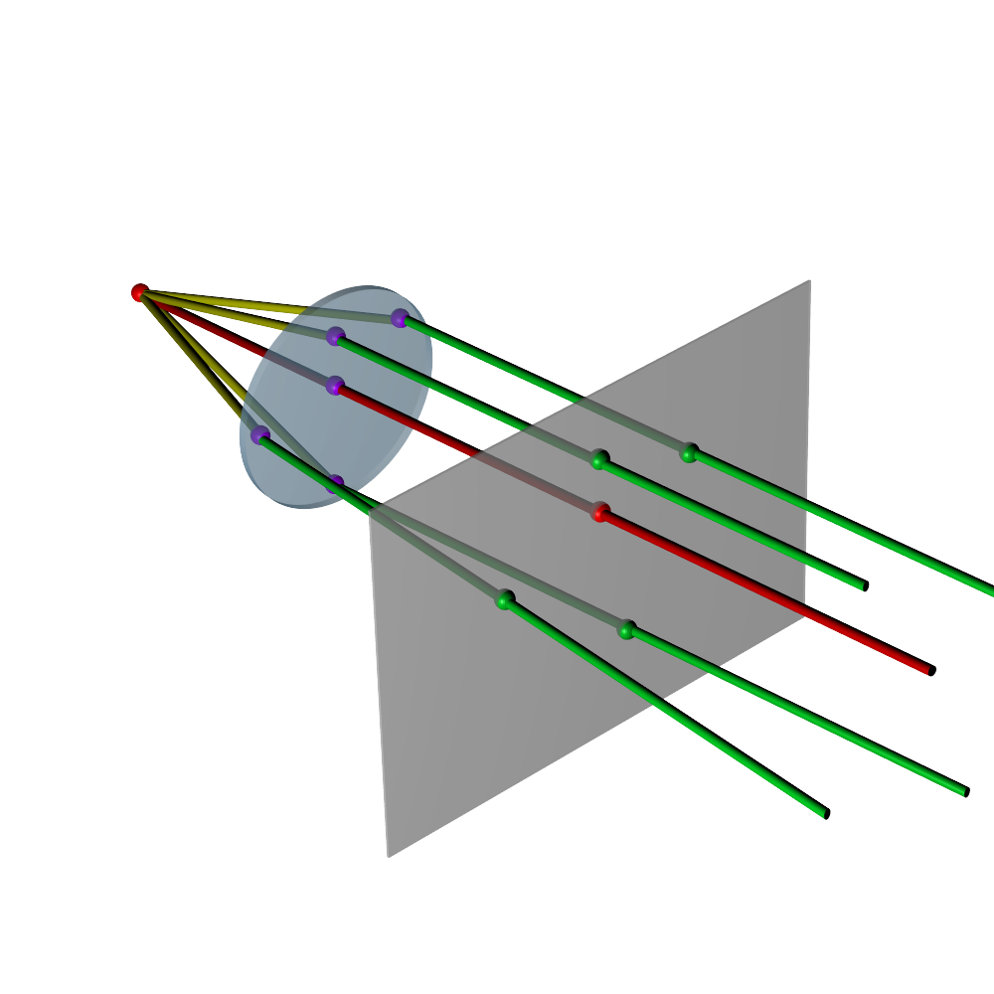

blur-equivalent arrangements
point-lens arrangements that send aberrated rays to identical pixels
point at
depth
point at
depth
lens B
lens A
ray-sensor intersections
Notes:
we formalize a kind of ambiguity that we call blur consistency.
imagine that we have two lenses A and B and two points at depths D and D'.
If the aberrated rays from these points (**CLICK**) intersect the sensor exactly the same way,
we would get exactly the same blurry image in both cases.

Slide 23
Blur-consistent arrangements
point-lens arrangements that send aberrated rays to identical pixels
point at
depth
point at
depth
lens B
lens A
blur kernel
Notes:
So if all we had was the blur kernel at this one position on the sensor, we would not be able to tell if that blur was caused by viewing a point at depth D using the lens on the left or a point at depth D' using the one on the right.
We call …

Slide 24
Blur-consistent arrangements
point-lens arrangements that send aberrated rays to identical pixels
point at
depth
point at
depth
lens B
lens A
approach: we characterize the space of blur-equivalent arrangements
Notes:
these point-lens arrangements blur consistent, and study the equivalence class of blur-consistent solutions to prove our results.

Slide 25
i. the PSF integral
ii. the ray intersection function
iii. single-source inference
iv. multi-source inference
iv. preliminary experiments
Notes:
So for the rest of my talk, I will first describe how we model the PSF of an aberrated lens, then define the ray intersection function, which is what really
controls the shape of the blur kernel when aberrations are present, and then briefly describe how we use this model to prove our reconstructibility results.

Slide 26
blur formation model
blur
kernel
ray-sensor
intersections
vignetting
function
complex function of
lens params & defocus
simple 3rd order
polynomial
intersection
of discs
Notes:
our starting point is a parametric model for blur that describes how the blur kernels themselves are formed.
**SLOW**
our model is basically a ray-counting integral: radiance from a point in the scene is transported along aberrated rays, and deposited at their intersection with the sensor plane, unless of course it is blocked internally by the lens
the blurry image is then just the integral of these intersections, modulated by a binary vignetting function that tells us which rays are blocked and which ones are not.
the main advantange of this particular model is that the function that describes ray-sensor intersections is actually very simple and can be represented parametrically with very few parameters. So *this* is the function that we represent parametrically, rather than the blur kernel, and we use numerical integration to compute blur kernels when needed.
Moreover for technical reasons that I do not have time to explain, vignetting cannot affect the blur consistency of differnt point-lens arrangements. For this reason I will ignore it here and concentrate (**CLICK**) on the ray intersection function, which (**CLICK**) maps points on the pupil to their correspdonging ray intersections (**CLICK**) on the sensor plane.

Slide 27
the ray intersection function
(for 3rd order Seidel aberrations)
Notes:
so let's give this function a closer look, for the important case of Seidel aberrations, which are the dominant form of aberration in general circularly-symmetric lenses, which includes most lenses used in photography

Slide 28
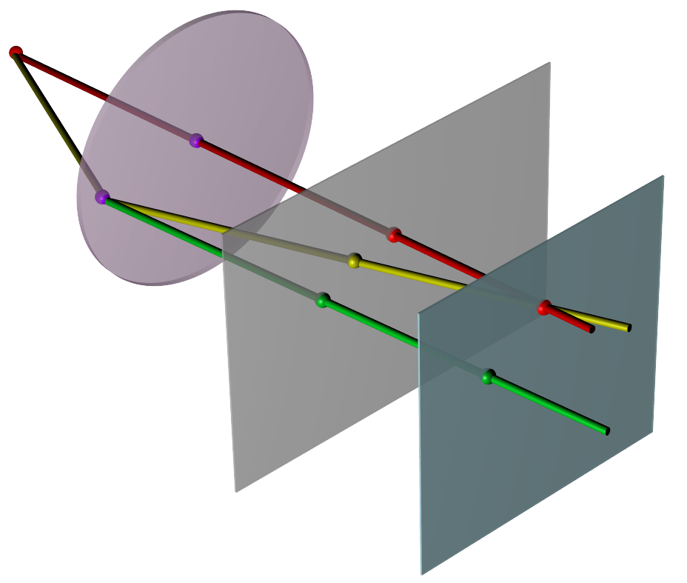
sensor plane
in-focus plane
ray intersection = perspective + defocus + aberration
Notes:
in general, we can express the intersection of an aberrated ray and the sensor
plane as a sum of two displacements from (***CLICK***) a point's perspective projection.
The first displacement (***CLICK***) is the defocus term of an ideal thin lens,
whereas the second one (***CLICK***) is really the one that models aberrations. Both these
displacements are…

Slide 29
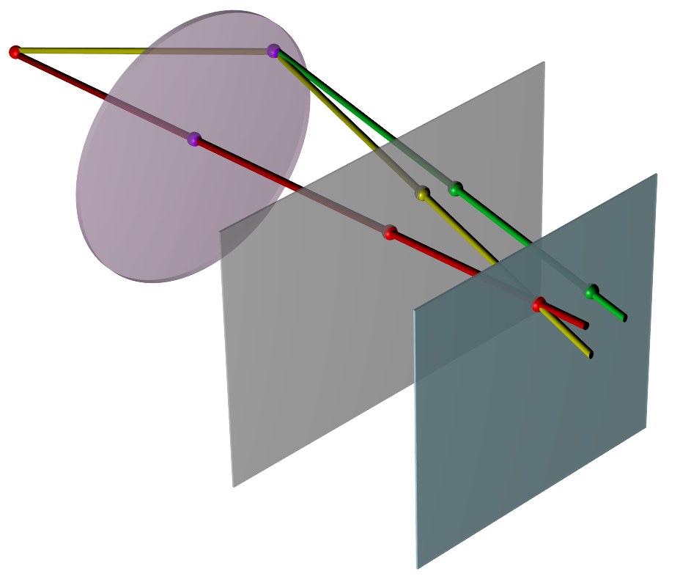
sensor plane
in-focus plane
ray intersection = perspective + defocus + aberration
Notes:
… functions of the pupil position and can be visualized as vector fields.
(***CLICK***) What makes these vector fields particularly special is that they are both
simple and highly constrained.

Slide 30
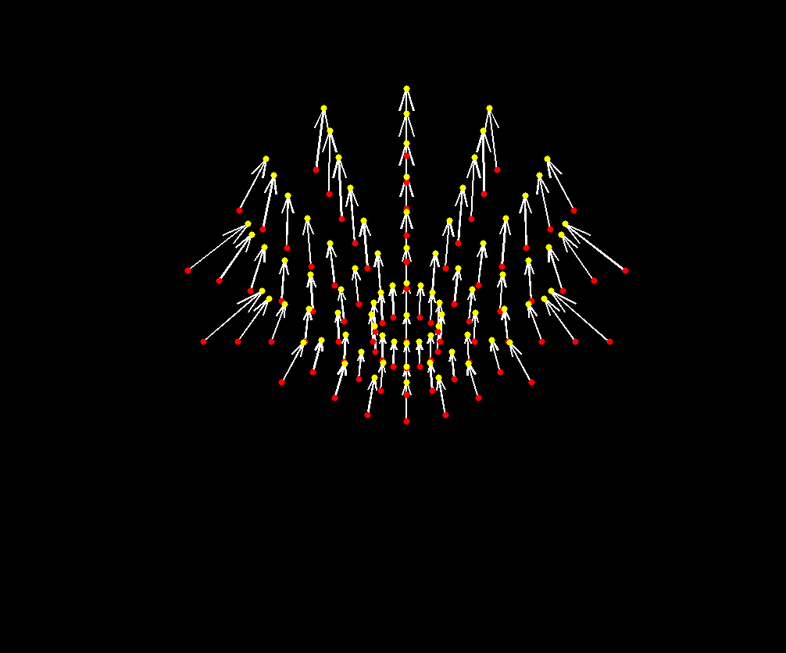
the Seidel displacement field
3rd order polynomial of pupil coordinates,
perspective projection & defocus
fully determined by 5 lens-specific aberration parameters
ray intersection = perspective + defocus + aberration
Notes:
The Seidel displacement field, in particular, is a third degree polynomial that is controlled by five lens parameters.

Slide 31
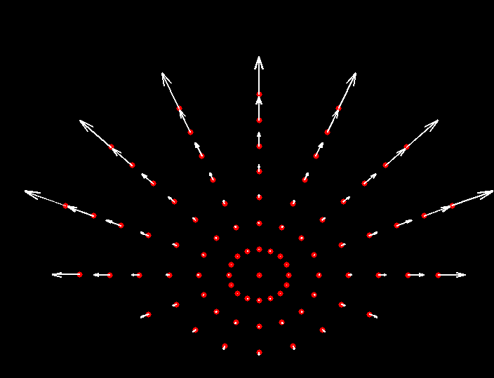
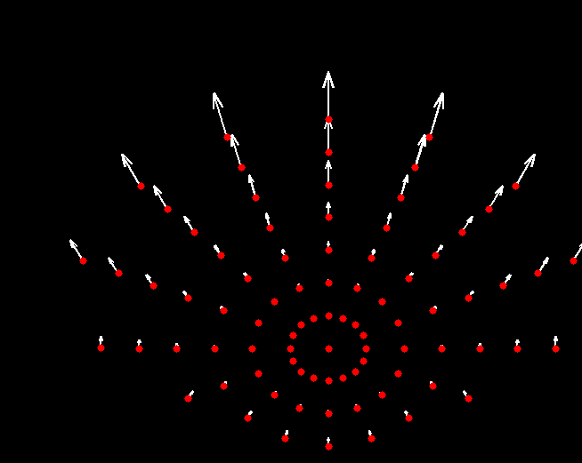
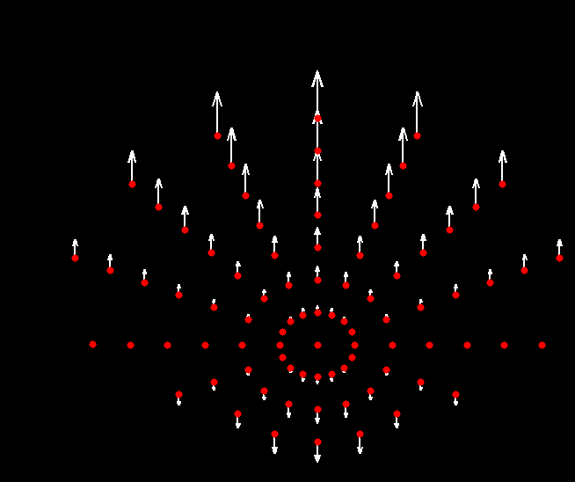
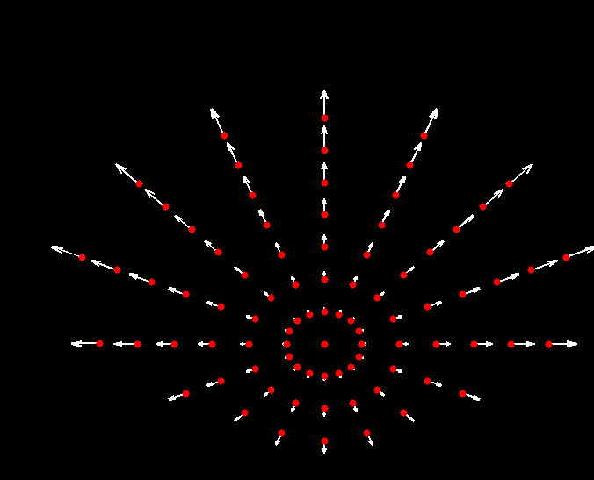
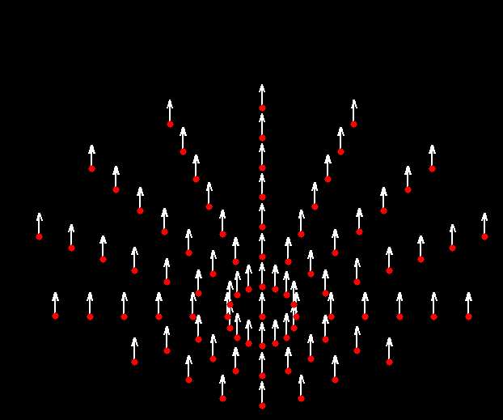
the Seidel displacement field
spherical
coma
astigmatism
field curvature
field distortion
ray intersection = perspective + defocus + aberration
Notes:
each of which describes the contribution of one kind of Seidel aberrations -- spherical, coma, astigmatism, field curvature and distortion aberrations---to the lens PSF.

Slide 32
the ray intersection polynomial
perspective & defocus
aberrations
pupil coords
specific
to point
pupil
radius
aberration
parameters
ray intersection = perspective + defocus + aberration
Notes:
this makes the ray intersection function dependent on eight quantities in total:
(**CLICK**) two that depend on the scene point and (**CLICK**) six more that are specific to the lens.
its final expression is actually quite complicated... and the only thing that matters here is that can be expressed in terms of three matrices---one that
involves only the aberration parameters (**CLICK**) , one that depends on defocus and perspective (**CLICK**) and one that depends on the pupil coordinates (**CLICK**) only.
So now that we have a complete model of the behavior of an aberrated lens (**CLICK**):

Slide 33
single-source inference
Notes:
(**CLICK**)we can finally begin to answer the central question in this work:

Slide 34
limits of local inference
what does 1 blur kernel in 1 photo tell us about the lens & the scene?
Notes:
what can we say about the lens and about the scene if all we've got are one or more blur kernels coming from just one photo.
Let's first look at what we can infer from just one blur kernel in our photo.

Slide 35
limits of local inference
what does 1 blur kernel in 1 photo tell us about the lens & the scene?
?
Notes:
More formally, given the eight quantities that describe the true lens and true scene point whose blurry image we observe, we ask whether if there is an
arrangement of a different point and a different lens that produce the same image and, by extension, (**CLICK**) the same ray intersection function.

Slide 36
pupil radius ambiguity
Lemma: there is a blur-compatible solution for every
Notes:
And the answer is that there is actually a three-paramater family of arrangements that can do this. The first parameter of this family (**CLICK**) is
the radius of the pupil: basically, no matter what radius we choose for the pupil of the lens, we can always find an alterative arrangement in which the
defocus and aberration paramaters are adjusted to compensate for the radius we chose.

Slide 37
depth & projection ambiguity
Lemma: there is a blur-compatible solution for every
Notes:
The other two parameters of the family are the point's perspective projection and defocus. Again, we can choose any arbitrary value for these parameters and there will always be another lens and another point whose blur consistency with the true lens and the true point is guaranteed.
Proving these facts…

Slide 38
depth & projection ambiguity
Lemma: there is a blur-compatible solution for every
Notes:
basically boils down to finding the degrees of freedom of a system of polynomial equations derived from the ray intersection function.

Slide 39
multi-point inference
Notes:
Even though it should come as no surprise …

Slide 40
multi-local inference
what do K blur kernels in 1 photo tell us about the lens & the scene?
Notes:
that we can't get complete information about the lens from just one blur kernel, the situation is *much* more interesting when we know several of them.

Slide 41
multi-local inference
what do K blur kernels in 1 photo tell us about the lens & the scene?
5 lens unknowns
2K scene unknowns
?
Notes:
[**SLOW**]
Since all these blur kernels come from the same lens and the same photo, they share the same lens parameters (**CLICK**) and differ only by the fact that they are produced by different points at potentially different depths(**CLICK**) . If we ignore the pupil radius which is always ambiguous, the inference problem now amounts to solving for 5 lens unknowns and 2K scene unknowns. ... And this brings us to
our main result: ....

Slide 42
power of multi-local inference
Lemma: space of blur-consistent arrangements is discrete for K≥3
?
Notes:
[**SLOW**]
... that this problem does not have any degrees of freedom when the number of points is at least 3. To get this result we again analyze the system of
polynomial equations that describes all the available multi-point constraints,
and you can find the details in the paper

Slide 43
preliminary experiments
Notes:
Now I’ll show some preliminary experiments to illustrate how our theory works in practice.

Slide 44
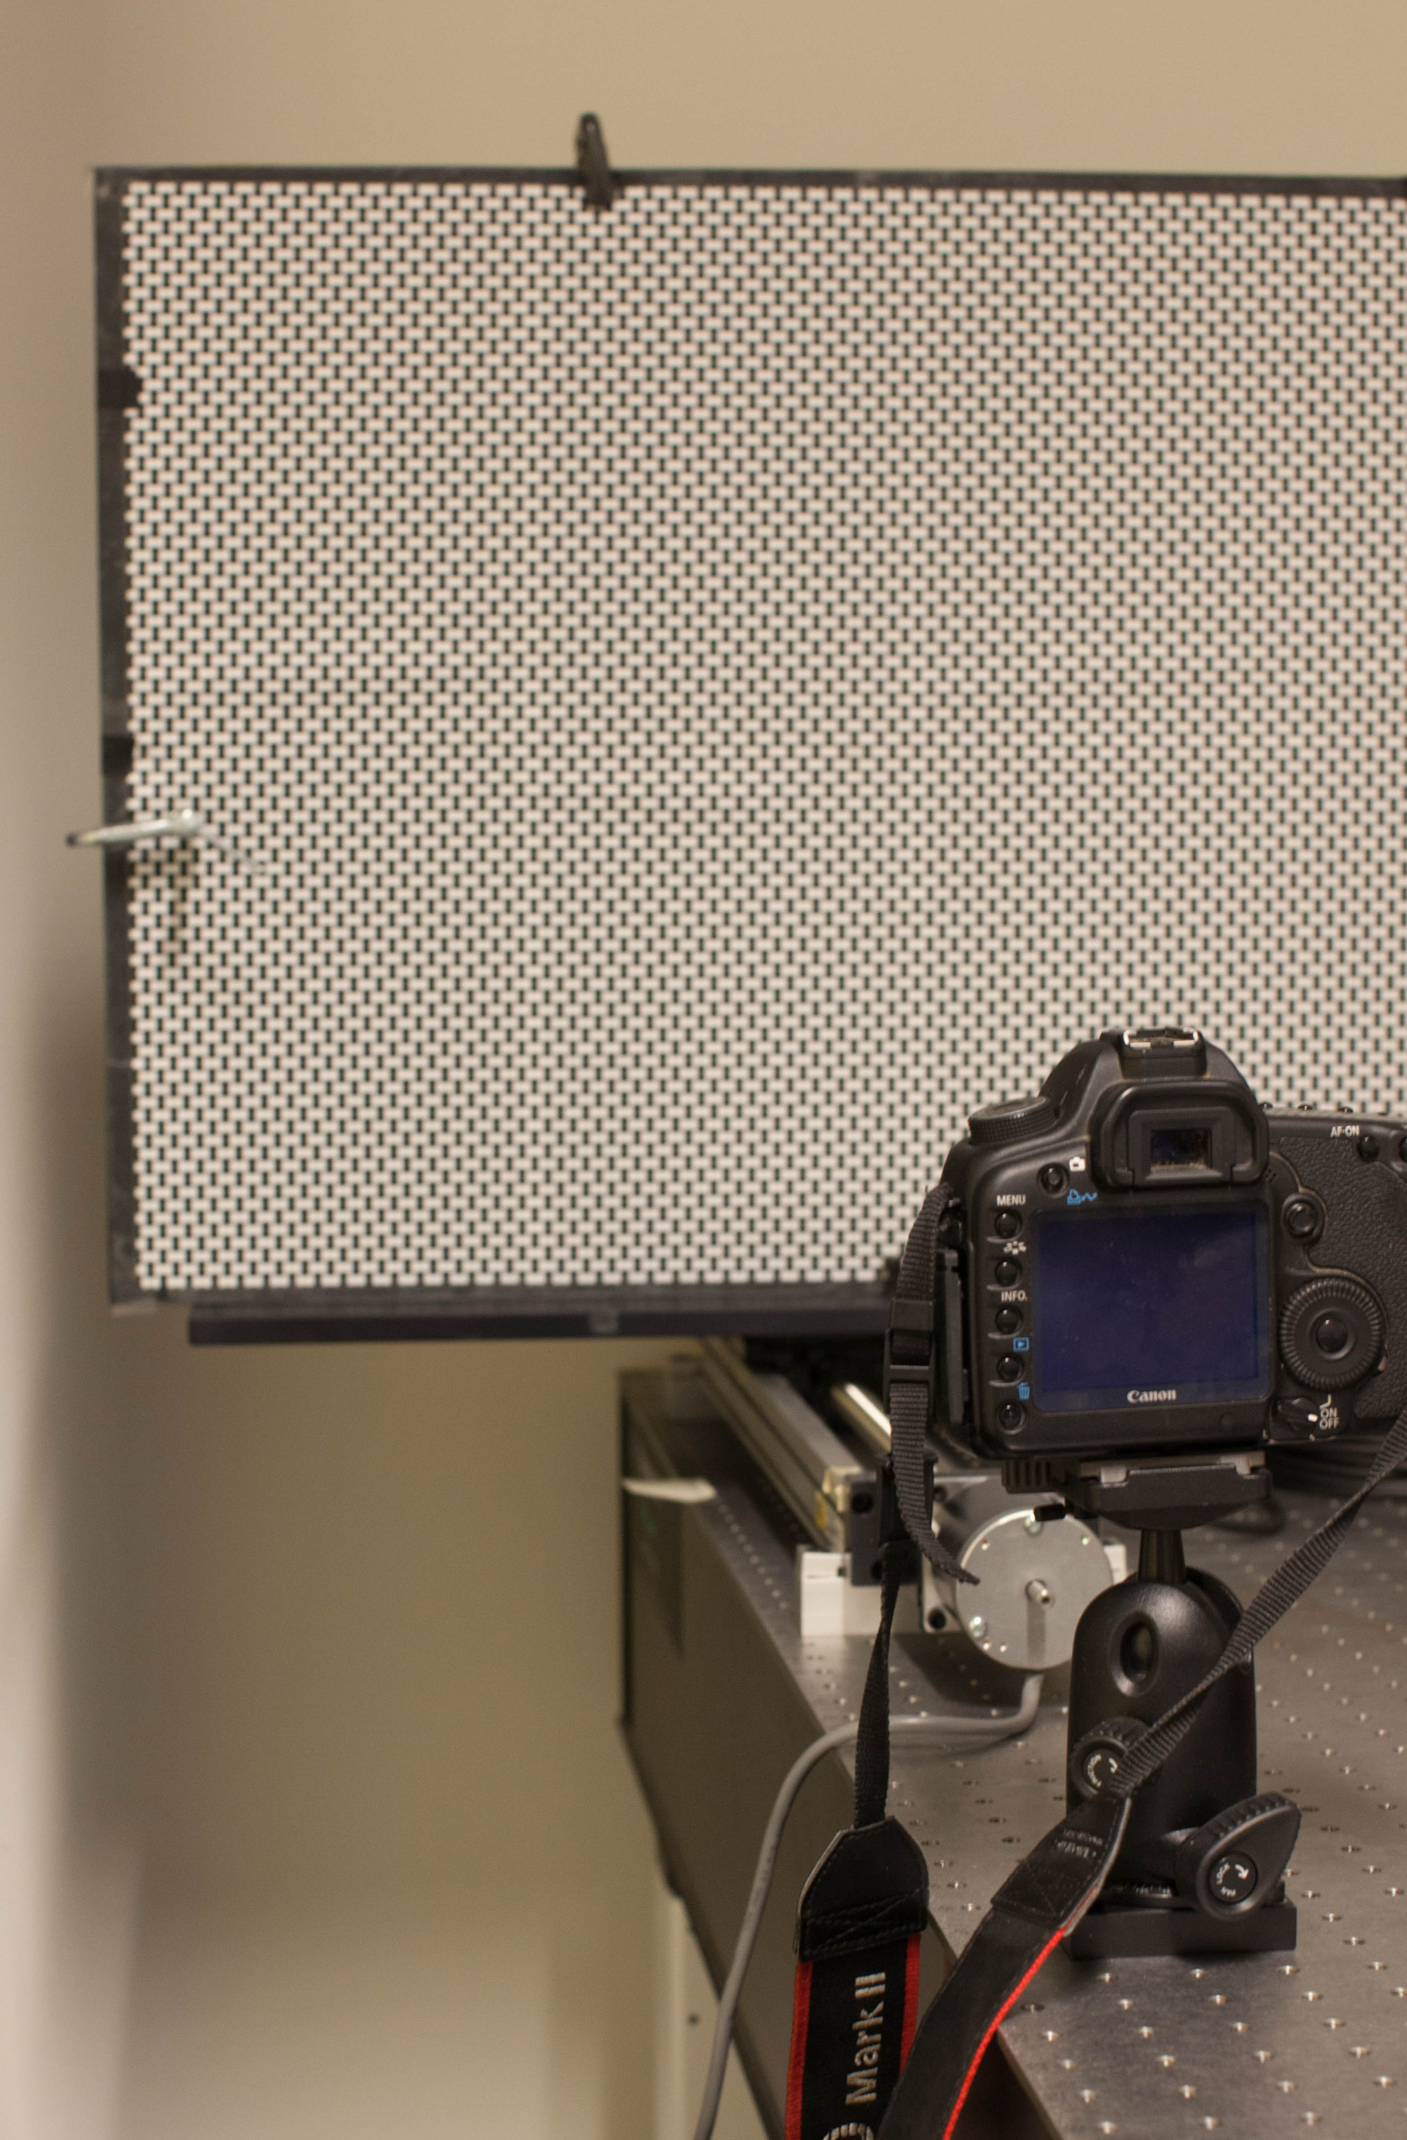
single-point & multi-point inference
ground-truth acquisition of 5D PSF
1. focus at depth
2. for
take narrow & wide-aperture shots
estimate local blur kernels [Joshi 08]
3. repeat
Planar target
Canon EOS 5D MkII
135/F2.8 soft focus
F/2.8 aperture
inference
1. choose the shot for a pair
2. choose K blur kernels from that shot
3. estimate
4. predict blur kernels for all depths
mechanical
translational stage
evaluation
compare predicted &
ground-truth blur kernels
Notes:
We perform our experiments with a Canon SLR camera with a lens that exhibits significant aberration at three different focus settings.
We capture the PSF with a planar target mounted on a linear translational stage. We move the target to 41 different locations to produce blur kernels of 41 different defocus levels.
[**CLICK**]
We fit the PSFs by estimate the depth and aberration parameters for the scene and predict the blur kernel for all depths.
[**CLICK**]
Finally we measure the quality of the predicted kernel by comparing it with the ground truth.

Slide 45
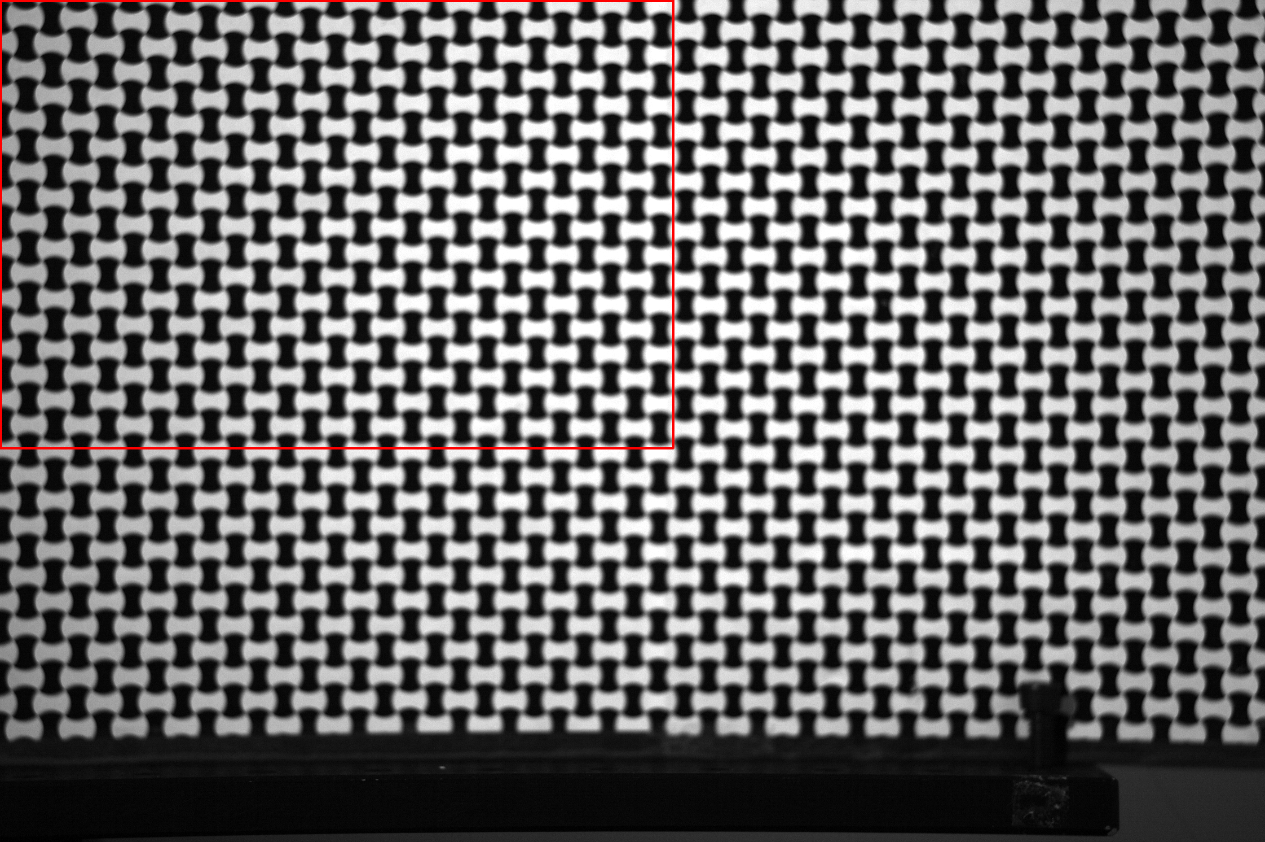
single-point & multi-point inference
ground-truth acquisition of 5D PSF
1. focus at depth
2. for
take narrow & wide-aperture shots
estimate local blur kernels [Joshi 08]
3. repeat
Planar target
Canon EOS 5D MkII
135/F2.8 soft focus
F/2.8 aperture
41 target positions
mechanical
translational stage
Notes:
For each position we take a photo at large aperture like this one and another one at smaller aperture to predict the sharp appearance of the photo.
We use the top-left quadrant of the photo which is completely covered by the known texture.

Slide 46
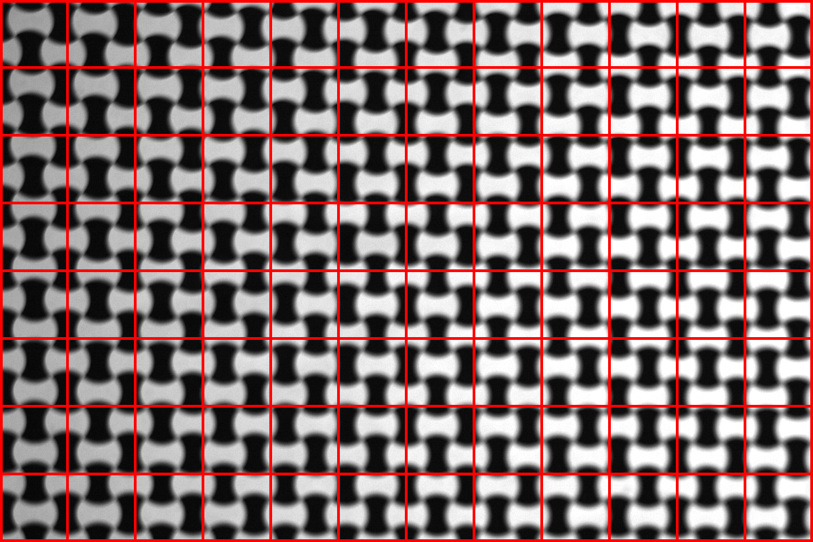
single-point & multi-point inference
ground-truth acquisition of 5D PSF
1. focus at depth
2. for
take narrow & wide-aperture shots
estimate local blur kernels [Joshi 08]
3. repeat
Planar target
Canon EOS 5D MkII
135/F2.8 soft focus
F/2.8 aperture
12x8 spatial position samples in ¼ field of view
mechanical
translational stage
Notes:
We divide the quadrant into 12x8 regions

Slide 47
single-point & multi-point inference
ground-truth acquisition of 5D PSF
1. focus at depth
2. for
take narrow & wide-aperture shots
estimate local blur kernels [Joshi 08]
3. repeat
Planar target
Canon EOS 5D MkII
135/F2.8 soft focus
F/2.8 aperture
12x8x41 blur kernels
mechanical
translational stage
Notes:
to acquire 12x8 blur kernels for each of the 41 defocus levels.

Slide 48
single-point & multi-point inference
ground-truth acquisition of 5D PSF
1. focus at depth
2. for
take narrow & wide-aperture shots
estimate local blur kernels [Joshi 08]
3. repeat
Planar target
Canon EOS 5D MkII
135/F2.8 soft focus
F/2.8 aperture
inference (K=1)
1. choose the shot for a pair
2. choose K blur kernels from that shot
3. estimate
4. predict blur kernels for all depths
mechanical
translational stage
optimization
Notes:
We first infer the parameters from a single source.
Because single source estimation is unconstrained, we regularize the solution assuming the defocus is known and set it to the ground-truth and there is no field distortion. We have also tried to use ground-truth field distortion as input, and the results are almost the same.
[**CLICK**]
We fit the model by maximizing over the cross-correlation between the fitted and observed kernel.
Here I’ll go through an example where the input depth…

Slide 49

fitted depth = -20 DoF
predicted depth = -20 DoF
Notes:
Is 20 DoF further away from the in-focus plane. At this particular depth, …

Slide 50
fitted depth = -20 DoF
predicted depth = -20 DoF
fitted
ground truth
predicted
ground truth
Notes:
We get reasonable fitting in the corner though we cannot perfectly reproduce the ground-truth because we have completely ignored vignetting.
(**CLICK**)
However, our estimation in the center of the photo does not produce the ringing structure well. This is probably because numericaly spherical aberration is unstable near the groundtruth.

Slide 51
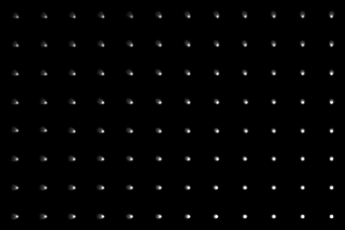
fitted depth = -20 DoF
predicted depth = 0 DoF
predicted
ground truth
Notes:
And this bias propagates to the prediction in other depths,

Slide 52


fitted depth = -20 DoF
predicted depth = 20 DoF
predicted
ground truth

Slide 53
multi-point inference
ground-truth acquisition of 5D PSF
1. focus at depth
2. for
take narrow & wide-aperture shots
estimate local blur kernels [Joshi 08]
3. repeat
Planar target
Canon EOS 5D MkII
135/F2.8 soft focus
F/2.8 aperture
inference (K>1)
1. choose the shot for a pair
2. choose K blur kernels from that shot
3. estimate
4. predict blur kernels for all
mechanical
translational stage
Notes:
When we estimate from multi-points,
[**CLICK**]
we don’t apply any prior on the parameters.
Although the blur kernels belong to a single plane, we don’t assume constant depth when we do the estimation. So we estimate K defocus plus 5 aberration parameters.

Slide 54
fitted depth = -20 DoF
Notes:
Here’s an example where we use 5 blur kernels as input.

Slide 55
fitted depth = -20 DoF
predicted depth = -20 DoF
fitted
ground truth
fitted
ground truth
Notes:
With regard to fitting quality, we get reasonably good fitting for the corner PSF, but the center PSF is not well fitted, because the aberration is more complex than what Seidel aberration can model.

Slide 56
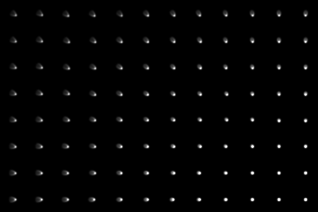
fitted depth = -20 DoF
predicted depth = 0 DoF
predicted
ground truth
Notes:
This is the prediction for blur kernels of points on the other side of the in-focus plane.

Slide 57

fitted depth = -20 DoF
predicted depth = 20 DoF
predicted
ground truth
Notes:
We can see multi-source calibration constrain the spherical aberration better in practice.

Slide 58
quantitative evaluation (K=5)
1
20
0.9
in-focus
region
defocus level of fitted kernel
0.8
0
0.7
-20
0
20
0.6
defocus level of predicted kernel
0.5
Notes:
We performed this experiment with different inputs using blur kernels due to 41 different depths.
For each input, we evaluate the quality of prediction for 41 different depth. So we end up getting this square matrix with each element expressing the mean correlation between predicted PSF and groundtruth.
Generallly we get very good fitting results, but the quality degrades when the kernel has small sizes, because inverting PSF to the ray intersection function is numerically unstable there.

Slide 59
Quantitative results for 3 different focus settings
1
1
0.9
0.8
# of sources
3
0.7
5
0.6
1.3m
1.6m
2m
0.5
In-focus depth
Notes:
We observe this situation throughout different focus settings and with different number of sources.
This indicates nearly in-focus blur kernels are not reliable for recovering lens parameters in practice.

Slide 60
concluding remarks
aberration & defocus blur give a great deal of info about the
lens & scene
one-shot recovery of depth map & 5D lens PSF may be possible
modeling ray-sensor intersections easier & more general than modeling blur kernels directly
open problems
  blind estimation of blur kernels, depth & 5D PSF
  modeling mechanical vignetting
  accounting for changes in focus setting & zoom
Notes:
To conclude, this work is just a very early attempt to understand the problem of inferring scene and lens information from aberrated photos. This is a very hard problem, and all we can say right now is that there at least *some* hope that practical one-shot algorithms could be designed for aberration correction, lens self-calibration and reconstruction.
On the practical side, we believe that optics-derived PSF models like the one presented here are a potentially very useful tool because they rely on fewer
parameters and have a predictive power that other models do not have.
Thank you

