Slide 1
Guiding Combinatorial Search with UCT
Ashish Sabharwal, Horst Samulowitz, Chandra Reddy

Slide 2
Talk Outline
Brief Introduction to UCT
  A promising “new” AI search technique which we apply to OR/Constraints
  Tremendous success in automatic AI game playing, e.g., Go
UCT for Combinatorial Search and Optimization
  Challenges
  Our Approach
Experimental Results
Summary
[see paper for references]

Slide 3
Brief Introduction to UCT

Slide 4
Upper Confidence bounds for Trees (UCT)
An extension to trees of the Upper Confidence Bounds (UCB) method
for multi-armed bandit problems
  A search tree where each internal node is a
  multi-armed bandit (a “slot machine” at a casino)
  Each arm has a hidden payoff distribution
  Goal: find optimal (highest expected payoff) path
  in the tree: most payoff in any number M of arm-pulls
Fact #1: for 1 bandit, the UCB policy is the best possible [O(log(M)) regret]
  Any sub-optimal arm is pulled exponentially fewer times than optimal arm(s)
  Optimally balances exploration with exploitation!
Fact #2: for a tree of bandits, UCT converges to the optimal
  Any sub-optimal choice is made exponentially fewer times than optimal ones

Slide 5
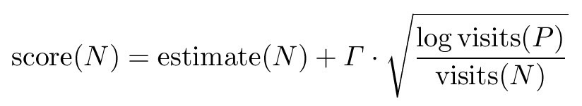
UCT: A form of Monte Carlo Tree Search
P
N
A tree search method akin to DFS, best first, etc.
  Goal: balance exploration with exploitation
  Keep a list of open nodes; expand promising one with children
Initial estimate typically through random leaf sampling
Updates done by averaging: stable yet eventually converges to max/min
optimistic
bound
current estimate,
refined with upward
averaging updates
“visits term”:
higher if N visited
fewer than its siblings
(from Chernoff’s ineq.)
obtain
estimate
update
visit count
& estimate
from leaf
to root

Slide 6
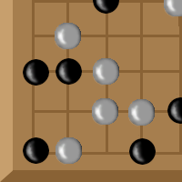

UCB and UCT: Typical Application Settings
Success of UCB:
  Provably optimal way of balancing exploration with exploitation
  Guarantees hold in an Online fashion: for any large enough arm-pulls
  Applications such as wireless network channel selection
Success of UCT:
  Multi-agent search and game playing, e.g., Go
    First method able to compete with human players
    Relatively large fan-out (~200 - 300) challenge for Minimax based approaches
    Does not rely on strong initial heuristic evaluations: random playouts often sufficient
  Limited information contexts, e.g., General Game Playing
    Rules of the game revealed shortly before playing
    Heuristics very hard to design
  Other games: Kriegspiel, Mancala, etc.

Slide 7
UCT and Combinatorial Search

Slide 8
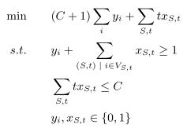

Can UCT Help Guide Combinatorial Optimization?
Same high level goal!
Find a path that leads to
a “leaf” with the highest “payoff”
Specifically, UCT for node selection
for MIP Optimization? (MIP ≡ MILP for this talk)
Perhaps, but several challenges:
  Biggest success of UCT so far: two-agent game tree search
  “Random playout” estimates are (a) costly to implement in MIP search and
  (b) not as useful!
  Exploitation isn’t very meaningful after true value of a node is revealed
  Averaging backups may not be the best strategy!
    Will not converge to min/max without exploitation
  Implementation: no easy access to CPLEX’s internal data structures; must maintain a “shadow tree” for exploring UCT strategies – additional overhead

Slide 9

Aside: UCT + MIP is at Least More Promising than UCT + SAT !
Solvers such as CPLEX already maintain a generic
Frontier of Open Nodes
  SAT solvers use enhancements of basic DFS
  CPLEX is “better” even though does not store the whole explored tree explicitly
Have a strong notion of Estimates, e.g., LP relaxation
Number of nodes per second is “reasonable”
  Can afford additional work at each node with relatively little overhead
  SAT solvers often process 2000-5000 nodes per second
  ⇒ Not much time for analysis to make “smart” choices

Slide 10
UCT for Node Selection in MIP Search
Expand open nodes in the order UCT would expand them
Maintain full shadow search tree, not just open nodes
  Can remove sub-trees that have no open nodes left
  Requires roughly twice the space as open nodes, assuming binary branching
At each node, maintain:
  Parent Pointer, Visit Count, Current Estimate
Initial estimate: use LP objective value rather than random playouts
Estimate update: use Max-backup rule rather than Averaging-backup
  Works because LP objective value is a guaranteed bound on the true objective
Exploitation: mark visited nodes so that they are never visited again

Slide 11
Experimental Results

Slide 12
Experimental Setup
Baseline: “default” CPLEX 12.3 ≡ cplex with an empty Callback
  The only way to enhance CPLEX with a custom node selection strategy
  CPLEX 12.3 adds more cuts during search than previous versions
    Without additional cuts during search, no. of Nodes is minimized by
    Best First greedy node selection
    Performance on 12.2 and earlier will differ
Benchmark: Starting with 1,028 publically available MIP instances:
  Keep those solved by default CPLEX in 10-900 seconds
  Not too easy, not too hard; total 170, spanning a variety of domains
  One goal was to not limit evaluation to any particular instance family
  (e.g., TSP instances, set covering, etc.)

Slide 13
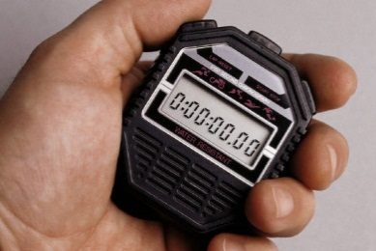

Experimental Setup
Evaluation Measures
  Runtime (in sec)
  No. of simplex iterations
  No. of search nodes
Hardware
  Intel Xeon CPU E5410, 2.33GHz, 8 cores, 32GB RAM, running Ubuntu
  Time limit: 600 sec
  Caution for “runtime” measure: Must perform a single run per machine since multiple concurrent CPLEX runs often significantly interfere with each other
    The difference in runtime can be 30-40% !

Slide 14
Comparison
UCT Guided Node Selection
  Found it most effective near the TOP of the search tree
  Reported numbers are for UCT guidance in selecting 128 nodes,
  then reverting to CPLEX’s default heuristics
“default” CPLEX 12.3
Best First search: greedily expand the node with best LP objective
  Pure exploitation
Breadth First search
  Pure exploration
Depth First (was not competitive)

Slide 15
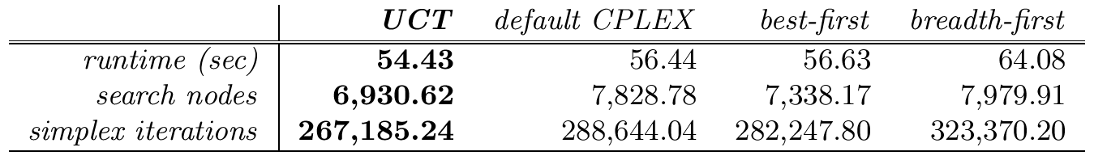
Results
(geometric averages)
Obtaining a generic improvement over default CPLEX isn’t easy
Nonetheless, UCT guided search better in all considered measures
  Runtime: small (3.6%) but positive reduction despite the overhead
  of maintaining a shadow search tree
  No. of search nodes: 11.5% reduction
    Best-First better than default CPLEX
    Best-First would be provably “best” without additional cuts during search
  No. of simplex iterations: 7.4% reduction

Slide 16
Summary

Slide 17
Conclusion and Perspectives
Search is a common theme in several disciplines / sub-areas
  Yet often approached with a different mindset, different angle
  E.g., very different in general AI vs. SAT vs. CP vs. MIP
UCT Guided search appears promising in Combinatorial Optimization
  E.g., as a Node Selection strategy for MIP search
  So far, was used mainly in adversarial Game Tree and Stochastic settings
Further work:
  Time to feasibility, time to optimal solution, etc.
  Comparison with Chinneck et al.’s work
Ongoing: UCT for generating a set of diverse columns for a column generation approach to a Steel Industry application

