Slide 1
Collaborative Expert Portfolio Management
David Stern
Ralf Herbrich
Thore Graepel
Microsoft Research
Cambridge, UK
Horst Samulowitz
National ICT Australia
University of Melbourne
Melbourne, Australia
Luca Pulina
Armando Tacchella
Universita di Genova
Genova, Italy

Slide 2


Expert Portfolios
Stream of Problems
Solve Problem
using recommended Expert
Expert Portfolio
Experts:
Expert 1
Expert 2
...
Expert n
Submit Problem Characterization
(e.g., Feature Vector)
Recommend Expert
Query Model
e.g., SATZilla
[Xu et al., 07]
Update Model
Report Utility
Expert changes
e.g., AQME
[Pulina et al., 08],
CPHydra [O’Mahony et al., 08]
Applications:

Slide 3
Adaptive Expert Portfolios
Requirements:
  Model must be trained online so it can immediately take account of each outcome to improve future decisions.
  Computation cost should not depend on the number of previously seen problems [Pulina, 2008].
  The system should select a specific scheduling strategy for each task (based on task features) [Streeter and Smith, 2008].
  Model should adapt continuously over time, tracking domain and changing expert characteristics.
  Support different forms of feedback (to support different problem domains)
Cannot be addressed by previously presented approach
Model based on Collaborative Filtering fulfills all requirements.

Slide 4
Map Features To ‘Trait’ Space
234566
34
456457
User ID
345
Item ID
13456
64
654777
5474
Male
Gender
Horror
Female
Drama
Movie Genre
UK
Comedy
Country
USA
Documentary

Slide 5
Learning Feature Contributions
234566
34
456457
User ID
345
Item ID
13456
64
654777
5474
Male
Gender
Horror
Female
Drama
Movie Genre
UK
Comedy
Country
USA
Documentary

Slide 6
User/Item Trait Space
User-User, Item-Item similarity measure.
Solves Cold Start Problem
Single Pass
Flexible Feedback
Parallelisable by two methods
  Implicit
  Explicit
‘Preference Cone’ for user 145035

Slide 7
Adaptive Algorithm Expert Portfolios
Trait Space
Task
Features
U
Time to
complete task
(or other objective)
Algorithm
Performance
Feedback
Model
P(r)
P(t)
u(t)
E(u)
Inner
Product
Algorithm
Features
V
u
t
Utility Function

Slide 8
Test Data
QBF Solvers Competition Data
  11 State-of-the-art solvers.
  Run times (600 sec time-out).
  5000 tasks.
Microsoft Solver Foundation Performance Data
  Linear Programming Daily test runs.
  6 Simplex Solvers.
  7 Interior Point Method (IPM) Solvers.
  Run times.

Slide 9
Task Features Allow Generalisation
QBF Features
  103 Basic Features: #Clauses, #Variables, etc. 69
  Combined Features: Ratio Universal/Existential, ...
LP Model Features
  Number Variables.
  Number Rows.
  Number Zeros.
Goal: to predict solver performance on
unseen tasks

Slide 10
Threshold Feedback Model
r
q
>
<
a
b
Time-Out
Slow
Fast

Slide 11
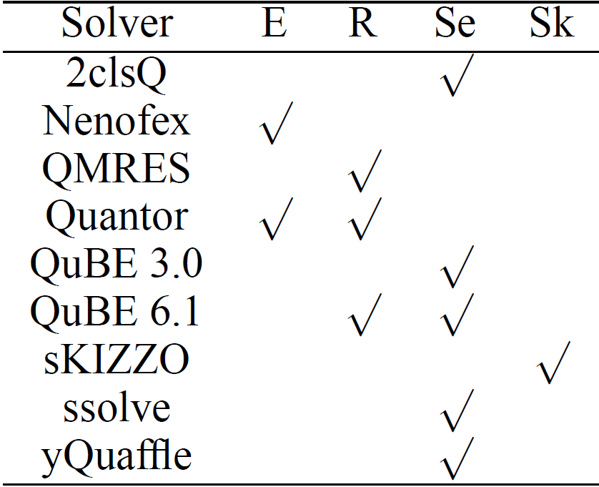
QBF Time Trait Space
Properties

Slide 12
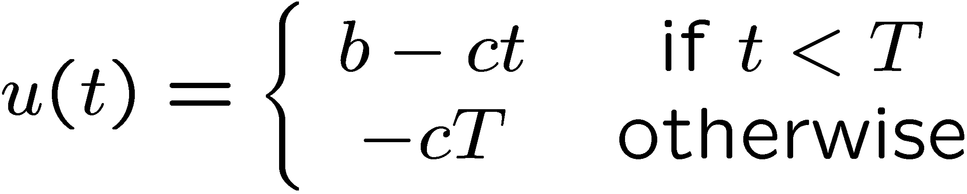
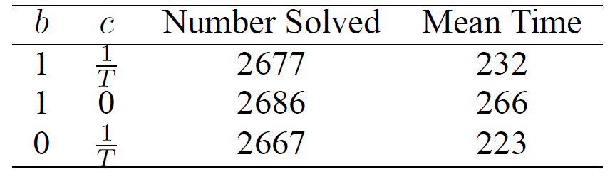
User-Defined Algorithm Utility
Example:

Slide 13


QBF Portfolio Performance
Features
Features

Slide 14
Comparison to other Approaches for QBF
Approach | Problems Solved | Average Time used per problem (in seconds)
AQME [Pulina, Tacchella, 2009] (Adaptive Portfolio that retrains offline + other limitations) | 2155 | 18.0
Collaborative Expert Portfolio Manager | 2169 | 16.6
Oracle | 2240 | 12.8

Slide 15
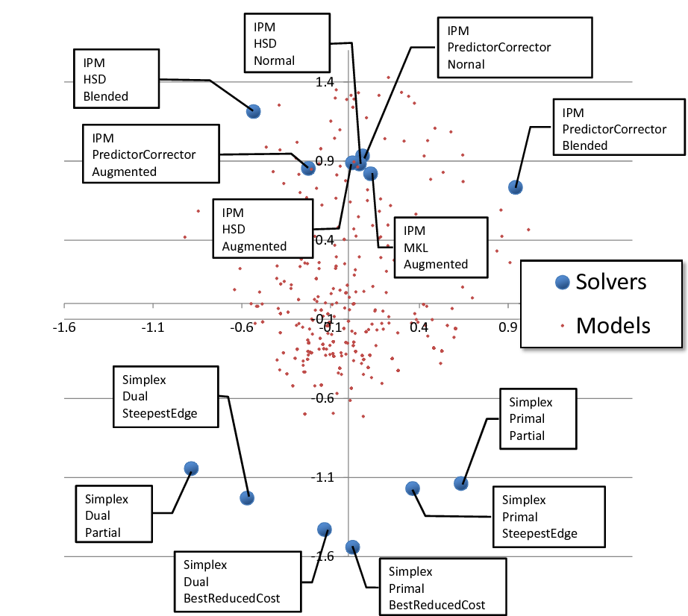
Interior Point Method
Dual
Primal
Simplex Method

Slide 16
Conclusions
  Presented adaptive portfolio manager based on ‘Collaborative Filtering’
  Approach supports:
    Online adaption of portfolio at a negligible cost
    Tracking of domain as well as expert changes
    User-Defined feedback model
  Can be applied in other domains as well:
    e.g., Yahoo Question-Answer

