Slide 1
Positional targets for lingual consonants defined using electromagnetic articulography
Yana Yunusova, Jeffrey S. Rosenthal, Krista Rudy, Melanie Baljko, & John Daskalogiannakis
Rojin Majd Zarringhalam
CSC2518 Fall 2014
Department of Computer science, University of Toronto

Slide 2
Purpose
Examine tongue positions during lingual consonants defined using a point parameterized approach with wave
Identifying which consonants have unique locations in the vocal tract

Slide 3
Introduction
Articulation
The movement of the tongue, lips, jaw, and other speech organs to make speech sounds
Manner of articulation
How speech organs involved in making a sound make contact
Place of articulation
Positions of speech organs to create distinctive speech sounds
It is an essential parameter in the description of the patterns of control movement for consonants

Slide 4
Introduction
English Lingual consonant
From front to back are divided to:
Alveolar /d, t, s, z/
Postalveolars / ʃ, ʧ /
Share their place of articulation ,
differences in the manner of production
Differ by voicing
Velar

Slide 5
Introduction
Cognates ( i.e., pairs /d-t/,/s-z/,and /k-g/)
Share the place and manner of articulation
Differ by voicing

Slide 6
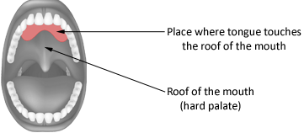
Previous research
Different patterning of lingua-palatal contact for stops and fricative (Dart,1998)
The pattern have been qualified with electropalatography (EGB)
The similarities of tongue contact patterns producing the same consonants and cognates
The differences in tongue-palate contact between consonant classes

Slide 7
Previous research
The positional targets have been defined in two-or three- dimensional space (Guenther, 1995; Keating, 1990; Parkel and Klatt, 1986 )
The directions into velocity of articulation model (Guenther 1995; Guenther et al., 2006)
Variability of the tongue positions has been influenced by contextual and
speaker related factors (Brunner et al., 2009; Dembowski et al., 1998)
Extent of the tongue position variability during a consonant based on its ability to co-articulatory influences of the adjacent vowels (Recasents and Espinosa, 2009)
Locations for tongue tip showed different target regions for /t,s,/ as compered to regions for the /n, d, l/ with highly overlapping. (Mooshammer et al, 2007)

Slide 8
Methods
Participates
19 speaker (F=9,M=10)
Average age = 28.5
Native speakers of Canadian English
No history of speech, language, or hearing abnormality
No major abnormalities of mouth
Passed a standard hearing screening

Slide 9
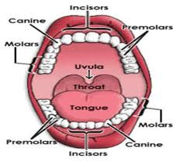
Methods
Landmarks on the palate cast
Incisive papilla (IP)
molar right (MR)
molar left (ML)
Midpoint (M)

Slide 10
Methods
Palate morphology
Group | Palate Curvature | Palate slope | Palate length(mm) | Palate Width(mm) | Palate Height(mm)
Males | 1. 68(0.19) | 0.33(0.21) | 3521(2.82) | 3499(2.35) | 1398(2.08)
Females | 1.85(0.21) | 0.39(0.28) | 3079(4.55) | 3199(3.87) | 1145(1.68)

Slide 11
Methods
Speaking tasks
Read symmetrical VCV syllables specified into a phrase “It’s VCV game”
Three corner vowels (/i, u, a/)
Nine consonants (/t, d, s, z, k, g, ʃ, ʧ / )
Every consonant is repeated 10 times ( consonant* 3 vowels * 10 repetition)
The phrase is produced at habitual speaking rate (R)

Slide 12
Methods
Data collection
Using wave articulography system (NDI)
Sampling movements of sensors at 100 HZ in three dimension
Using Sensors
Tongue front (M=1.3cm,SD=0.3)
Alveolar and palatal consonants
Tongue back (M=2.1cm,SD=0.4)
Velar consonants
Bridge of the nose
Head movement

Slide 13
Methods
Measurement
Distance (D) the measure of the distance between the centers of the two target regions .
D1 is Euclidian distance between the mean of each contextual target and mean of the consonant target region computed through three context
D2 is the distance between the mean of two different consonants targets
Overlap (O) is the measure of the extent of similarity between the possibility distribution of X, Y, Z data for pairs of target regions.
O1 is the overlaps between densities for individual consonants in different context.
O2 is an overlap between pairs of consonants.

Slide 14
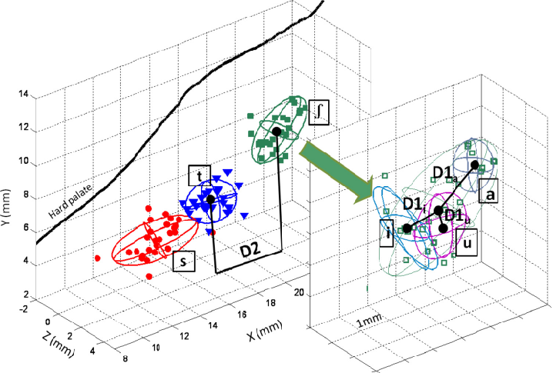
Methods
Point clouds representing positions of the tongue front sensor for /s/, /t/, /ʃ/ produced by a single speaker

Slide 15
Methods
Statistical analysis
Could different pairs of consonants be considered to come from distinct point clouds?
D2 > D1 pair of consonant have distinct target regions
D2 < D1 target regions of consonant pairs can be the same
O2 < O1 pair of consonant have distinct target regions
O2 > O1 target regions of consonant pairs can be the same

Slide 16
Methods
Statistical analysis
once a consonant pair shares a common location, the pair could be regarded as a unit in further comparisons.
In homorganic pairs, they consider the combined of /d/, /t/, /z/ and /s/ , all four pairs d-z, d-s, t-s, and t-z as a unit.
They used a non-parametric statistical test for comparison
1.Ranks all the distances in the two samples in numerical order
2.Compute a rank-sum statistic “U”
3-Produce p-value for the null hypothesis using U

Slide 17
Methods
Statistical analysis
p-value < 0.05 distinction between the consonants
p-value > 0.05 no distinction can be concluded
Between-talker variability are considered in measuring D2 and O2
age
sex
dialect
speaking rate
Palatal size

Slide 18
Results
Analysis of cognates
(a) Summary statistics for two distance measures computed for each cognates pair.
(a)
Pair | D1 | D2 | N1 | N2 | U statistic | p-value
/d/-/t/ | 1.52(0.80) | 1.37(0.77) | 114 | 19 | 958 | 0.790
/z/-/s/ | 1.36(0.90) | 1.46(0.86) | 114 | 19 | 1166 | 0.300
/g/-/k/ | 2.14(1.03) | 1.23(0.50) | 102 | 19 | 318 | 0.999

Slide 19
Results
Analysis of cognates
(b) Summery statistics for two overlap measures computed for each cognates pair
(b)
Pair | O1 | O2 | N1 | N2 | U | p-value
/d/-/t/ | 0.39(0.13) | 0.35(0.17) | 114 | 19 | 878 | 0.0994
/z/-/s/ | 0.37(0.16) | 0.31(0.19) | 114 | 19 | 848 | 0.066
/g/-/k/ | 0.34(0.13) | 0.47(0.13) | 102 | 17 | 1306 | 0.999

Slide 20
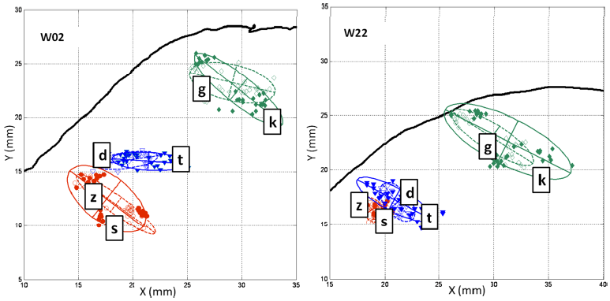
Results
Analysis of cognates
Cognates pairs for 2 talker and the overlapping target regions
Fricatives are shown in circle, alveolar stops in triangle, velar, in rhombuses

Slide 21
Results
Analysis of cognates
Not significant differences between D1 and D2, O1 and O2 for alveolar pairs so Cognates have shared positional targets and were regarded as a single unit in future comparison.

Slide 22
Results
Analysis of homorganic consonants
(a) Summery statistics for two distance measures computed for each homorganic pair ( alveolar pairs are collapsed)
(a)
Pair | D1 | D2 | N1 | N2 | U statistic | p-value
d-z, d-s, t-s, t-z | 1.44(0.85) | 2.72(2.09) | 228 | 76 | 12646 | 0.001
ʃ-ʧ | 1.27(0.74) | 1.47(0.99) | 114 | 19 | 1174 | 0.280

Slide 23
Results
Analysis of homorganic consonants
(b) Summery statistics for two overlap measures computed for each homorganic pair ( alveolar pairs are collapsed)
(b)
Pair | O1 | O2 | N1 | N2 | U statistic | p-value
d-z, d-s, t-s, t-z | 0.38 (0.85) | 0.23 (0.19) | 228 | 76 | 4618 | 0.001
ʃ-ʧ | 0.43 (0.015) | 0.42 (0.18) | 114 | 19 | 1113 | 0.577

Slide 24
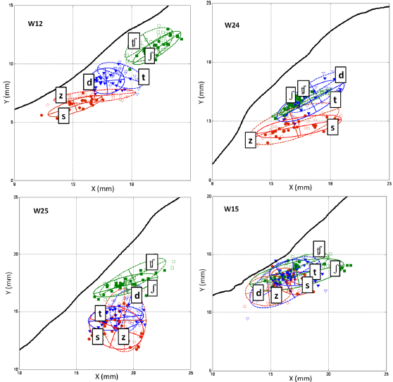
Results
Six consonants
4 talkers
alveolar fricatives in circle
alveolar stops in triangles
postalveolar in squares
Boundary of voiceless are
specified with solid line

Slide 25
Results
Analysis of homorganic consonants
Significant differences between D1 and D2 for alveolar pairs
(d-z, d-s, t-s, t-z)
Not significant differences between D1 and D2 for postalveolar pairs
The consonants /d/ and /t/ had distinct location from /s/ and /z/
were not distinct and were regarded as a single unit

Slide 26
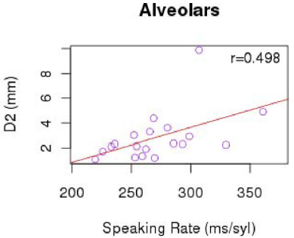
Results
Analysis of homorganic consonants
For alveolar pairs, talkers with slower habitual speaking rate produce larger distances between the consonants targets

Slide 27
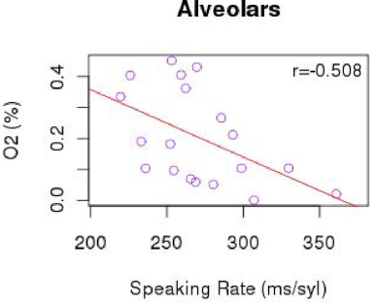
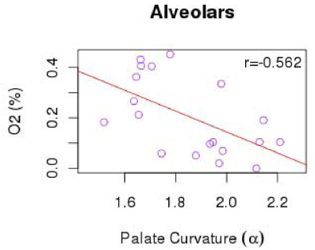
Results
Analysis of homorganic consonants
talkers who had flatter palates and spoke slowly showed less overlap between consonants targets

Slide 28
Results
Analysis of alveolar and postalveolars
(a) Summery statistics for two distance measures computed for postalveolar-alveolar stops and fricatives (collapsed)
(a)
Pair | D1 | D2 | N1 | N2 | U statistic | p-value
d-ʃ, t-ʃ, d-tʃ, t-tʃ | 1.38(0.78) | 2.93(1.4) | 228 | 76 | 14446 | 0.001
s-ʃ, z-ʃ, s-tʃ, z-tʃ | 1.31(0.82) | 4.32(1.75) | 228 | 76 | 16606 | 0.001

Slide 29
Results
Analysis of alveolar and postalveolars
(b) Summery statistics for two overlap measures computed for postalveolar-alveolar stops and fricatives (collapsed)
(b)
Pair | O1 | O2 | N1 | N2 | U statistic | p-value
d-z, d-s, t-s, t-z | 0.41(0.14) | 0.19(0.15) | 228 | 76 | 2508 | 0.001
t-ʧ | 0.40(0.015) | 0.08(0.09) | 228 | 76 | 567 | 0.001

Slide 30
Results
Six consonants
4 talkers
alveolar fricatives in circle
alveolar stops in triangles
postalveolar in squares
Boundary of voiceless are
specified with solid line

Slide 31
Results
Analysis of alveolar and postalveolars
Significant distances for alveolar stops –postalveolar consonants and alveolar fricatives –postalveolar consonants

Slide 32
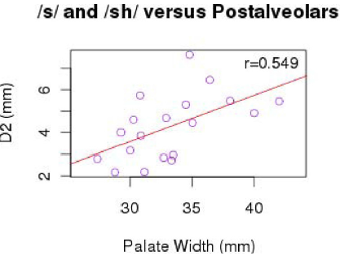
Results
Analysis of alveolar and postalveolars
For D2, the significant correlation for these consonant was in the alveolar fricatives and post alveolar comparison with palate width

Slide 33
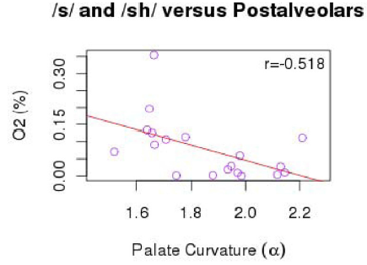
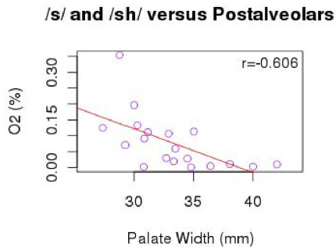
Results
Analysis of alveolar and postalveolars
For O2, the variation in the alveolar fricatives and postalveolar comparison were palate width and palate curvature

Slide 34
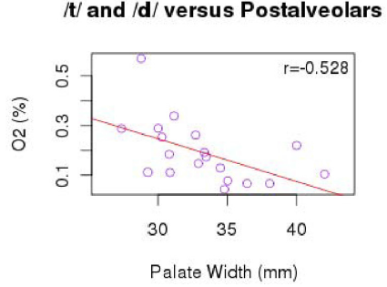
Results
Analysis of alveolar and postalveolars
In the alveolar stops vs. postalveolar consonant comparison, O2 was explained by palate width and sex

Slide 35
Conclusions
The finding of this study confirmed the general expectation for consonant tongue position observed with point-parameterized method
They considered the extent of the variability between talkers in consonant target regions, missing from the existing studies with small number of talkers.
This study clearly found that tongue positions(at least as measure by a single sensor) are not completely unique for a talker
They found that cognates pairs and homorganic postalveolars shared the location of their positional targets
Identification the individuals characteristic of palate and the habitual speaking rate are important variables for such variations.

Slide 36
Future work
In Future work, they look into the speaking rate’s effect on target regions to identify a mode in which the localization of target region characteristics could be better.

Slide 37
Thanks

