Slide 1
Reconstructing Speech from Human Auditory Cortex
Alex Francois-Nienaber
CSC2518 Fall 2014
Department of Computer Science, University of Toronto

Slide 2
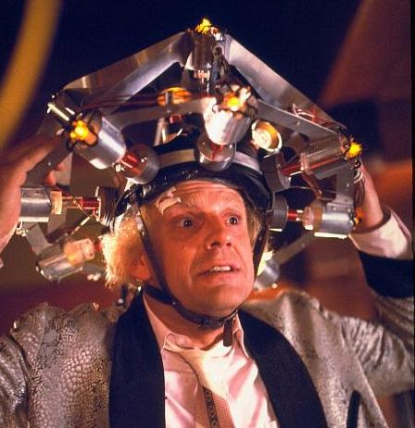
Introduction to Mind Reading

Slide 3
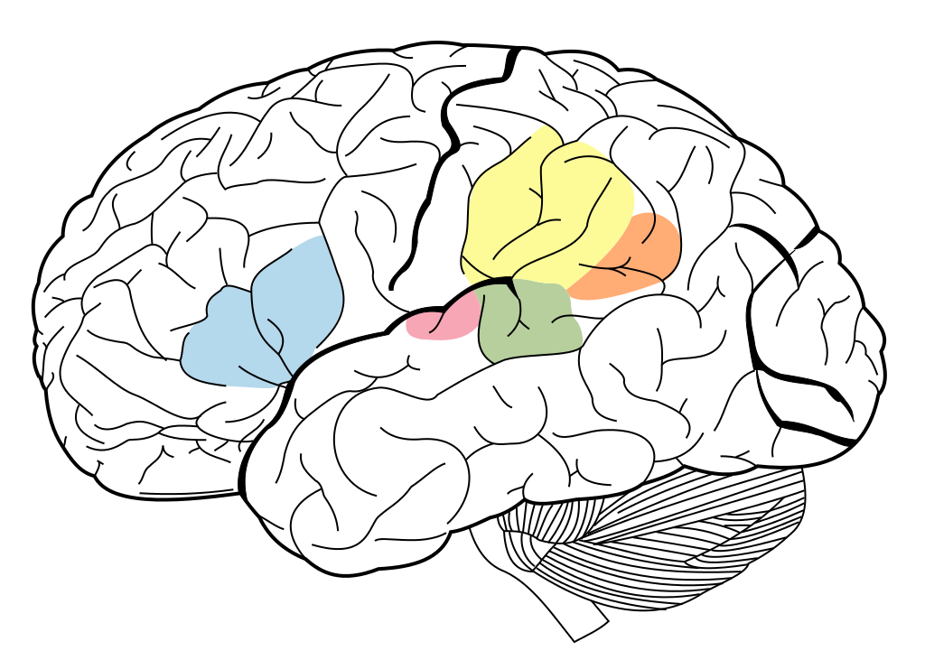
Introduction to Mind Reading
Acoustic information from the auditory nerve is preprocessed in the Primary Auditory Cortex.

Slide 4
Introduction to Mind Reading
Extracted features are relayed to the posterior Superior Temporal Gyrus (pSTG).

Slide 5
Introduction to Mind Reading
The decoded speech features are then sent to Wernicke’s area for semantic processing.

Slide 6
Introduction to Mind Reading
Finally signals are sent to the TemporoParietal Junction, where they are processed with information from
other modalities.

Slide 7
Introduction to Mind Reading
We believe pSTG is involved in an intermediate stage of audio processing: interesting spectrotemporal features are extracted while nonessential acoustic features (i.e. noise) are filtered.
These features are then converted to phonetic/lexical information.

Slide 8
That's why we would be interested in monitoring that area.
BUT how?

Slide 9
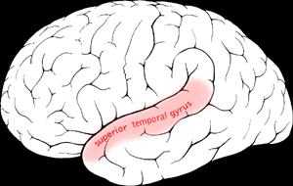
Electrocorticography
Neurons are densely packed in cortical convolutions (gyri), e.g. pSTG.

Slide 10
Electrocorticography
We can record the summed-up synaptic current flowing extracellularly - the surface field potentials - by embedding very small electrodes directly into nerve tissue.
By placing all the electrodes in a grid-like pattern, we can monitor an entire brain area!

Slide 11
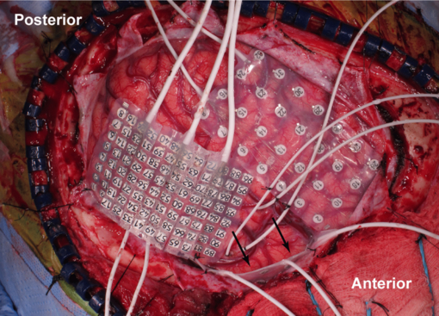
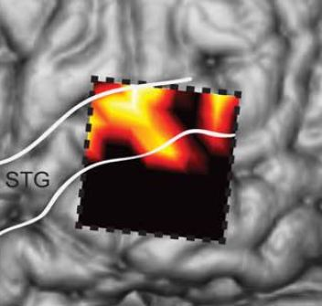
Electrocorticography
The grid density will influence the precision of the results.

Slide 12
Electrocorticography
15 patients undergoing neurosurgery for tumors/epilepsy volunteered for this invasive experiment.

Slide 13
So how do we transform those cortical surface potentials into words?

Slide 14
So how do we transform those cortical surface potentials into words?
This will depend on how the recorded field potentials represent the acoustic information.

Slide 15
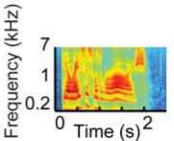
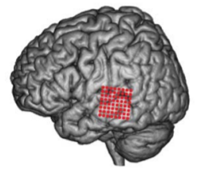
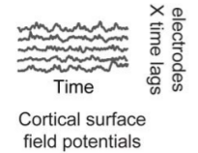
Linear Model
An approach so far has been to assume a linear mapping between the field potentials and the stimulus spectogram.
Reconstruction Model

Slide 16
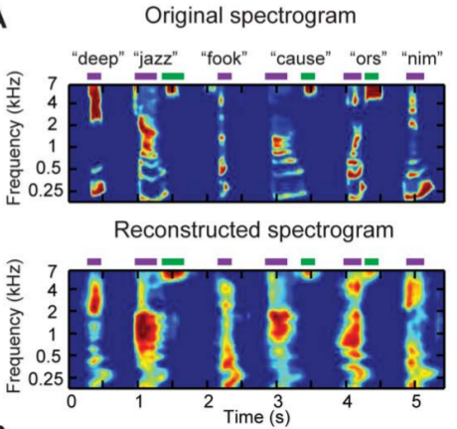
Linear Model
This approach captures some major spectrotemporal features:

Slide 17
Linear Model
This approach captures some major spectrotemporal features:
Vowel harmonics

Slide 18
Linear Model
This approach captures some major spectrotemporal features:
Fricative consonants

Slide 19
Linear Model
The model revealed that the most informative neuronal populations were confined to pSTG.
The distribution of the electrode weights in the reconstruction model

Slide 20
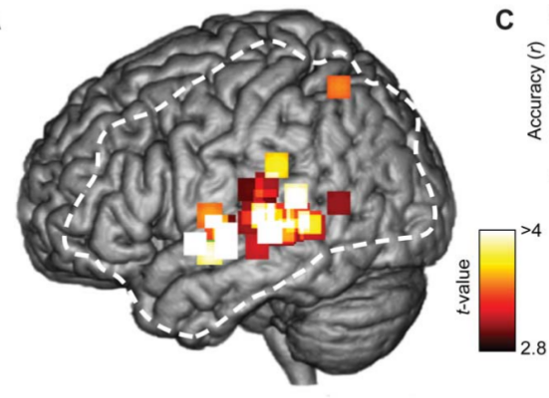
Linear Model
The model revealed that the most informative neuronal populations were confined to pSTG.
Electrode weights in the linear model, averaged across all 15 participants

Slide 21
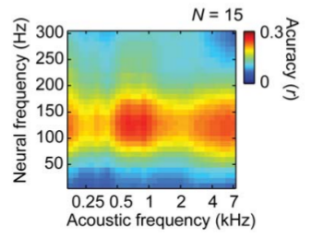
Linear Model
The reconstruction model also revealed that the most useful field potential frequencies were those in the high gamma band 70-170Hz.

Slide 22
Linear Model
Hz
Gamma
Beta
Alpha
Theta
Delta
32
16
8
4
0.1

Slide 23
Linear Model
Is this surprising?
Gamma wave activity has been correlated with feature binding across modalities.
pSTG is just anterior to the TemporoParietal Junction, a critical area of the brain responsible for integrating all modal information (among many other roles).

Slide 24
Linear Model
Why does the linear model (i.e. assuming a linear mapping between stimulus spectogram and neural signals) work at all?
The high gamma frequencies must encode at least some spectrotemporal features.

Slide 25
Linear Model
Indeed, what made the mapping possible is that neurons in the pSTG behaved well:
They segregated stimulus frequencies: as the acoustic frequencies changed, so did the recorded field potential amplitude of certain neuronal populations.

Slide 26
Linear Model
Interestingly, the full range of the acoustic speech spectrum was encoded in a distributed way across pSTG.
This differs from the neural nets in the primary visual cortex, which are organized retinotopically.

Slide 27
Linear Model
Indeed, what made the mapping possible is that neurons in the pSTG behaved well:
They responded relatively well to fluctuations in the stimulus spectogram. And especially well to slow temporal modulation rates (which correspond to syllable rate for instance).

Slide 28
But the Linear Model failed to encode fast modulation rates (such as syllable onset)...

Slide 29
Energy-based Model
The linear model was ‘time-locked’ to the stimulus spectogram, which did not permit encoding of the full complexity of its (esp. rapid) temporal modulations.
To lift this constraint, we want a model that doesn't treat time so ‘linearly’.

Slide 30
Energy-based Model
Consider visual perception. It is well known that, even in the first stages of preprocessing (rods and cones, thalamic relay), encoded visual stimuli is robust to the point of view.

Slide 31
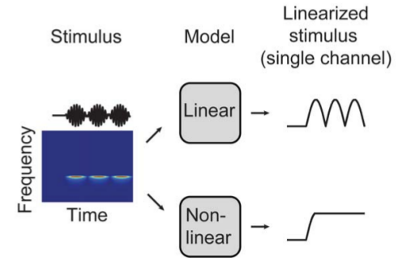
Energy-based Model
If we can allow the model some (phase) invariance with respect to time, then we might be able to capture those fleeting rapid modulations.
We don't want to track time linearly, we want phase-invariance to capture the more subtle features of complex sounds

Slide 32
Energy-based Model
Quickly: look over there without moving your head and look back.
Did you notice that some of your neurons did not fire while others did? But seriously, those who didn't fire kept a 'still' model of space (so you could hold your head up for example).

Slide 33
Energy-based Model
Why would this intuition about local space invariance and visual stimuli hold for local time invariance and acoustic stimuli?
In other words, why would phase invariance help represent fast modulation rates better?

Slide 34
Energy-based Model
It might be that tracking exact syllable onset is not necessary for word segregation (just as not tracking every detail of space would help segregate the motionless background from rapid visual stimuli).
Recall that pSTG is an intermediate auditory processing area.

Slide 35
Energy-based Model
So instead of a spectrotemporal stimulus representation at this intermediate stage, it could be that neuronal populations in pSTG (via the field potentials they emit) focus on encoding the 'energy' (amplitude) of these (higher-order) modulation-based features.

Slide 36
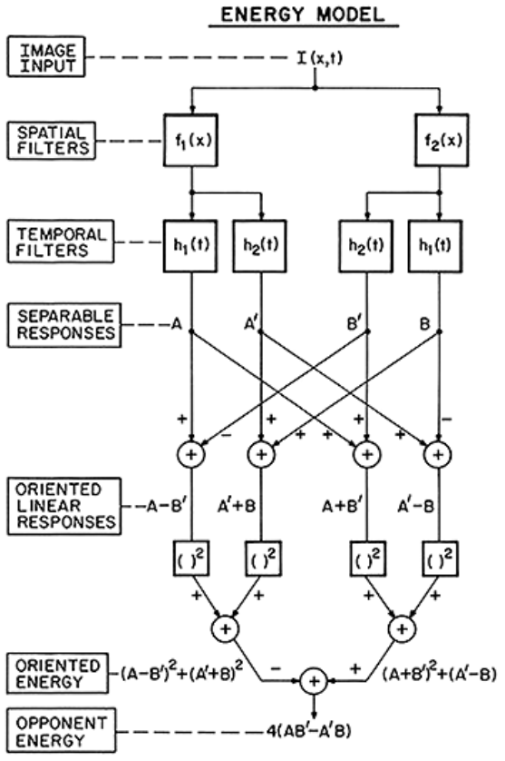
Energy-based Model
Energy-based models have been around for decades, and have been used extensively for modeling nonlinear, abstract aspects of visual perception.
The Adelson-Bergen energy model (Adelson and Bergen 1985)

Slide 37
Energy-based Model
Chi et al. 2005 proposed a model that represents modulations (temporal and spectral) explicitly as multi-resolution features.
Their nonlinear (phase invariant) transformation of the stimulus spectogram involves complex modulation-selective filters that extract the modulation energy concentrated at different rates and scales.

Slide 38
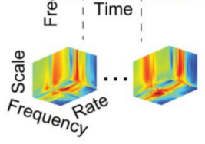
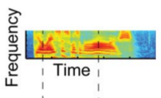
Energy-based Model
Feature extraction in the energy-based model:
The input representation is the two-dimensional spectrogram S(f,t) across frequency f and time t.
The output is the four-dimensional modulation energy representation M(s,r,f,t) across spectral modulation scale s, temporal modulation rate r, frequency f, and time t.

Slide 39
Energy-based Model
The energy-based model thus achieves invariance to local fluctuations in the spectogram.
This is in par with neural responses in the pSTG: very rapid fluctuations in the stimulus spectogram did not induce the 'big' changes the linear model was expecting.

Slide 40
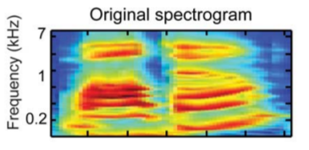
Energy-based Model
Consider the word “WAL-DO” whose spectogram is given below:
Notice the rapid fluctuation in the spectogram along this axis (300ms into the word Wal-do)

Slide 41
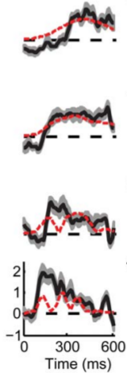
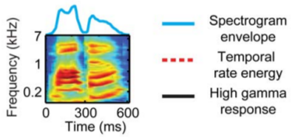
Energy-based Model
On the right: Field Potentials (in the high gamma range) recorded at 4 electrode sites:
None of these rise and fall as quickly as the Wal-do spectogram does at around 300ms (actually no linear combination of them can be used to track this fast change)

Slide 42
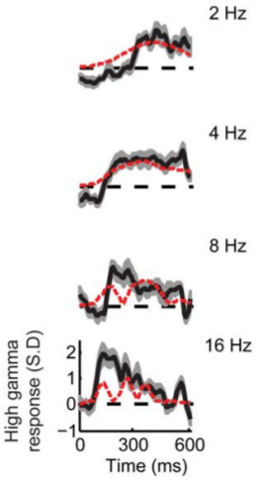
Energy-based Model
Superimposed, in red, are the temporal rate energy curves (computed from the new representation of the stimulus, for 2, 4, 8 and 16Hz temporal modulations):
Notice that for fast temporal fluctuations (>8Hz), the red curves 'behave more informatively' at around 300ms

Slide 43
Energy-based Model
Given the new (4D) representation of the stimulus, the model can now capture these variations in temporal energy (fast vs. slow fluctuations) from the neural field potentials more reliably.

Slide 44
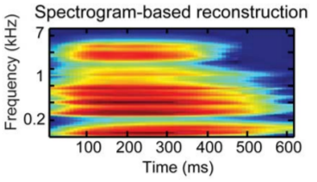
Energy-based Model
The linear model was too concerned with time, that it wasn't paying attention to time variation.
The linear model cannot segregate time variations at the scale of syllable onset

Slide 45
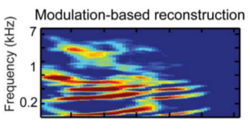
Energy-based Model
Thanks to local temporal invariance, the energy-based model can now encode more sophisticated features.
The energy-based model can decode field potentials in more detail

Slide 46
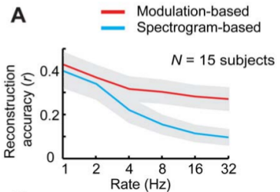
Energy-based Model
Plotted below is the reconstruction accuracy of spectrotemporal features of the stimulus.
Reconstruction of fast temporal energy is much better in the energy-based model.

Slide 47
But is this enough to let us decode words from reconstructed spectograms?

Slide 48
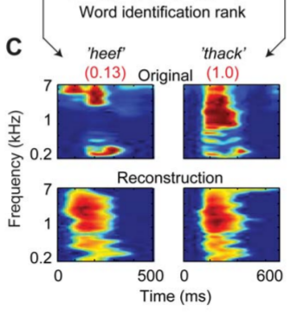
Mind reading in practice
Pasley et al. tested the energy-based model on a set of 47 words and pseudowords (e.g. below).

Slide 49
Mind reading in practice
They used a generic speech recognition algorithm to convert reconstructed spectograms into words.
In general, reconstruction was of poor quality.

Slide 50
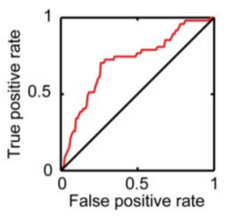
Mind reading in practice
But on the 47 word set, they achieved better word recognition than would be expected by just coin flipping.

Slide 51
Mind reading in practice
So it seems that we are far from being able to read minds.
What can we do about it?

Slide 52
Mind reading in practice
The results coming from Pasley et al.’s incredible study of pSTG field potential gives us hope.
We know that those field potentials don’t encode spectrotemporal features of speech information linearly. Pasley and colleagues point out a plausible dual encoding: spectogram-based for slow temporal rates, modulation-based for faster ones.

Slide 53
Mind reading in practice
But how would we measure cortical field potentials extracranially?
Is it possible to expect intrusive cybernetic implants on the cortex of aphasic patients in the future?

Slide 54
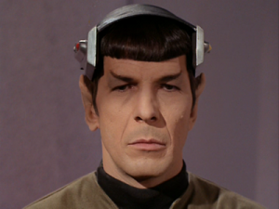
Mind reading in practice
Or is it more likely that we could extrapolate a (more powerful) model to convert neural signals recordable from a simple scalp implant or headset?

Slide 55
Mind reading in practice
The entire ventral pathway of speech recognition could be monitored to allow for better feature detection.

Slide 56
Mind reading in practice
But we still have a long way to go.
Although…

Slide 57
Mind reading in practice
I don’t need to read your minds to know that you are hungry by now…

Slide 58
So Thank You!

Slide 59
Credits
Pasley et al. (conducted the study)
Back to the Future (doc Brown)
Wikipedia user Rocketooo (brain svgs)
Futurama (Zoidberg meme)
University of Toronto ML group (example from CSC321)
Adelson and Bergen 1985 (energy model diagram)
Where’s Waldo (comic strips)
Star Trek (Spock’s brain)

Slide 60
Extra slide
Because without this slide, this presentation would have 59 slides.

