Slide 1
The Potential of Dwell-Free Eye-Typing for Fast Assistive Gaze Communication
PO Kristensson and K Vertanen
ACM 2012

Slide 2
Outline
Hands-free typing
Traditional dwell-based gaze typing
Dasher (adaptive dwell-time)
A dwell-free method
Brief project update

Slide 3
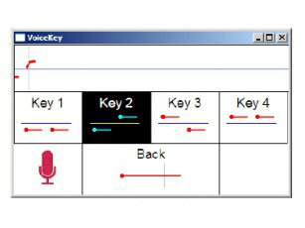
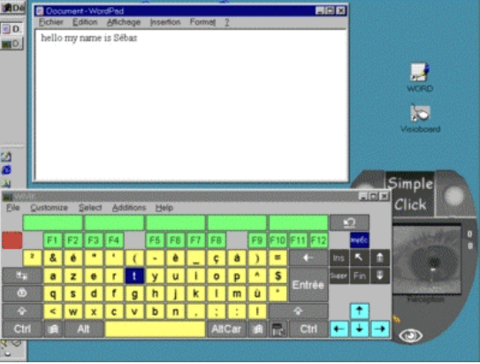
Hands-free typing
EEG
voice
eye

Slide 4
Gaze/eye typing
Typically keyboard-based
Require event demarcation, which is slow:
dwell-time (most common)
special region
special gesture
Appear to have approached limit: ~20 wpm
Fastest traditional eye-typing method (Majaranta, 2009):
allows user to adjust dwell-time
19.8 wpm, 282 ms dwell-time

Slide 5
Dasher
Adaptive dwell-time
No explicit demarcation
16-26 wpm

Slide 6
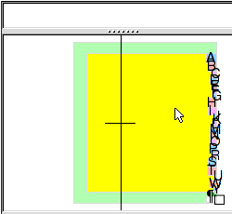
Dasher

Slide 7
Dasher
Muscle memory impossible

Slide 8
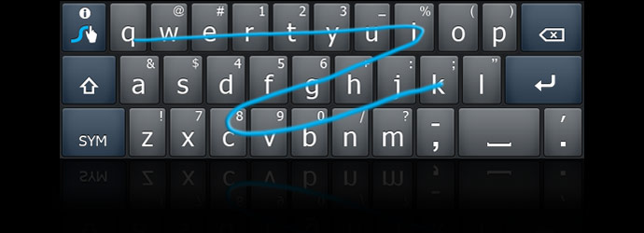
potential of dwell-free methods?

Slide 9
"Ideal" performance
8 participants (4m, 4f)
Tobii P10, 40Hz, 0.5°
QWERTY keyboard, 15 x 6 cm
500 phrases, word = 5 chars
5 x 10 min sessions
Read phrase, press SPACE, start
Must be within 1 key of correct letter before moving on

Slide 10
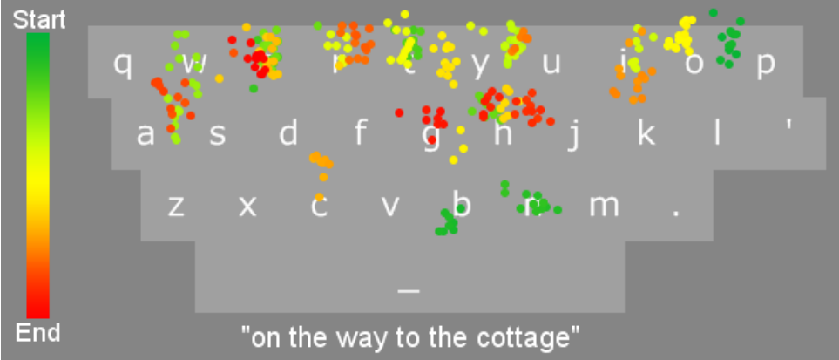

Slide 11
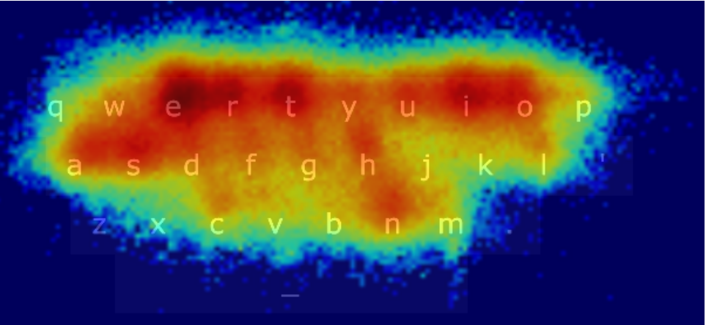

Slide 12
Results
37-54 wpm by last session (mean 46 wpm)
counted spaces in wpm (~29-37 wpm w/o)
~50% of the time, participants never went inside actual key

Slide 13
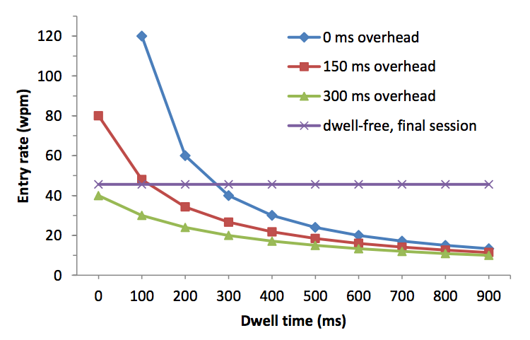
To dwell or not to dwell

Slide 14
Future work
Memorize beforehand
Allow missed letters
Incorporate error correction

Slide 15
Summary
Current dwell-based methods seem to have peaked
Dwell-free methods could speed up by 2x
These speeds not theoretically achievable with dwell-based methods

