Slide 1
Eulerian Video Magnification for Revealing Subtle Changes in the World
Hao-Yu Wu, Michael Rubinstein, Eugene Shih, John Guttag, Frédo Durand, William Freeman
SIGGRAPH 2012

Slide 2
Outline
Video magnification
Lagrangian vs. Eulerian perspective
Lagrangian video magnification
Eulerian video amplification
Project idea

Slide 3
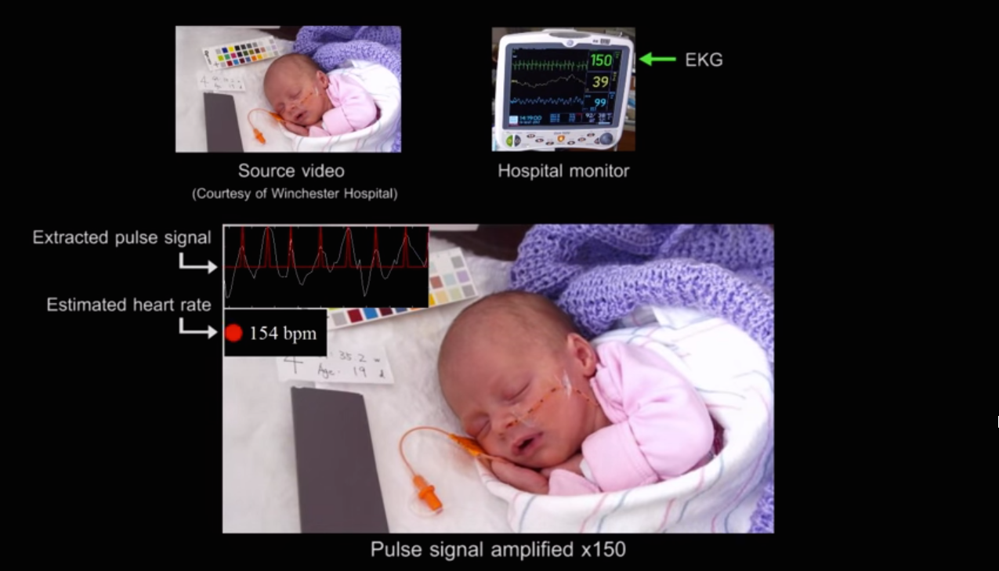
Contact-free heartbeat detection
http://www.youtube.com/watch?v=e9ASH8IBJ2U&t=1m19s

Slide 4
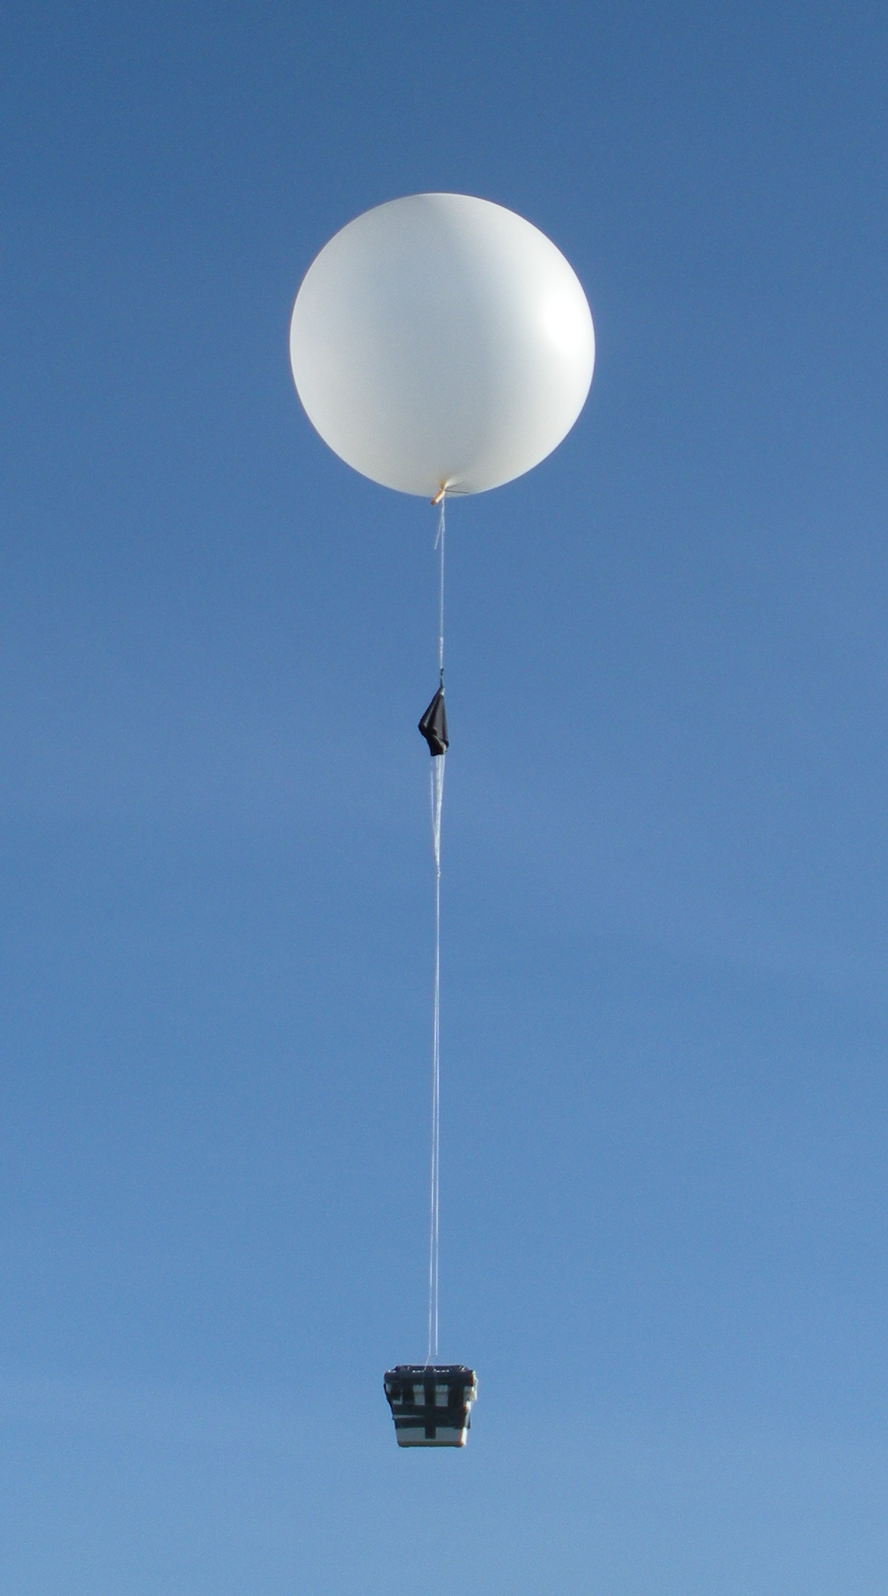
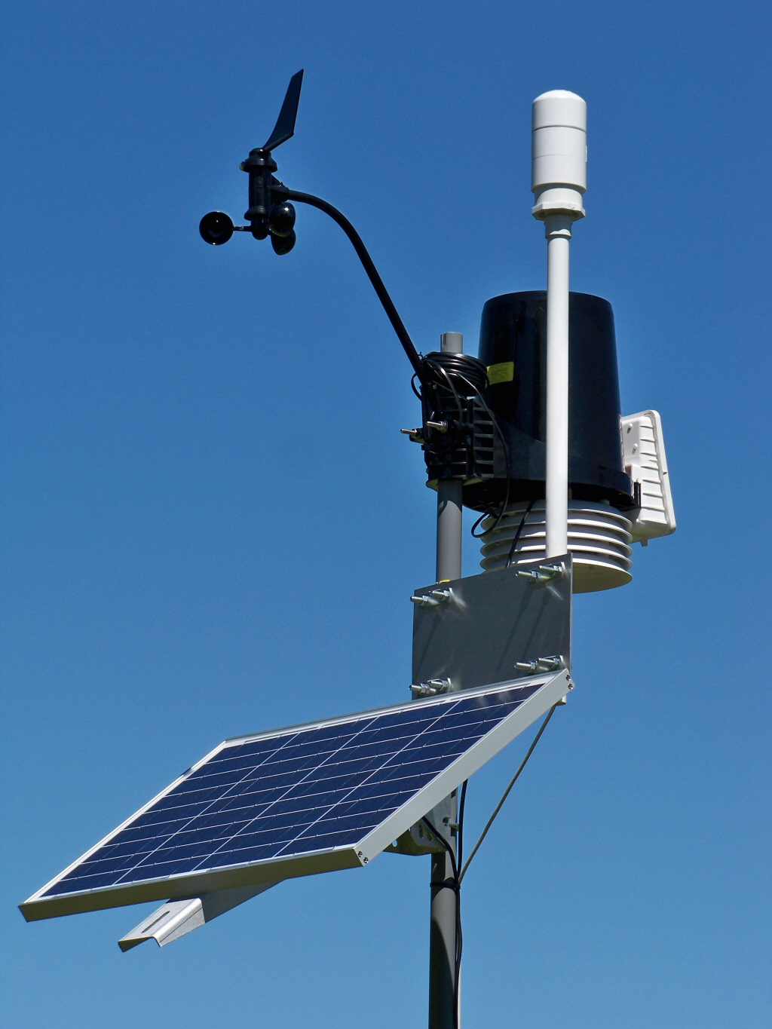
Lagrange
vs
Euler

Slide 5
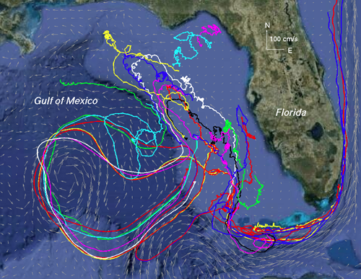

Slide 6
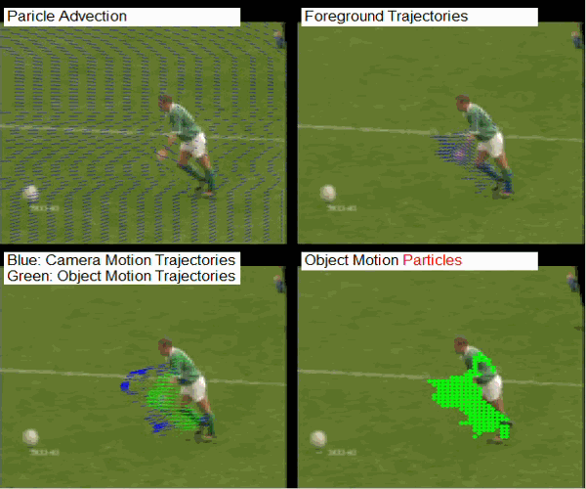
Lagrangian video processing
Notes:
Computationally intensive
Feature tracking as additional source of error

Slide 7
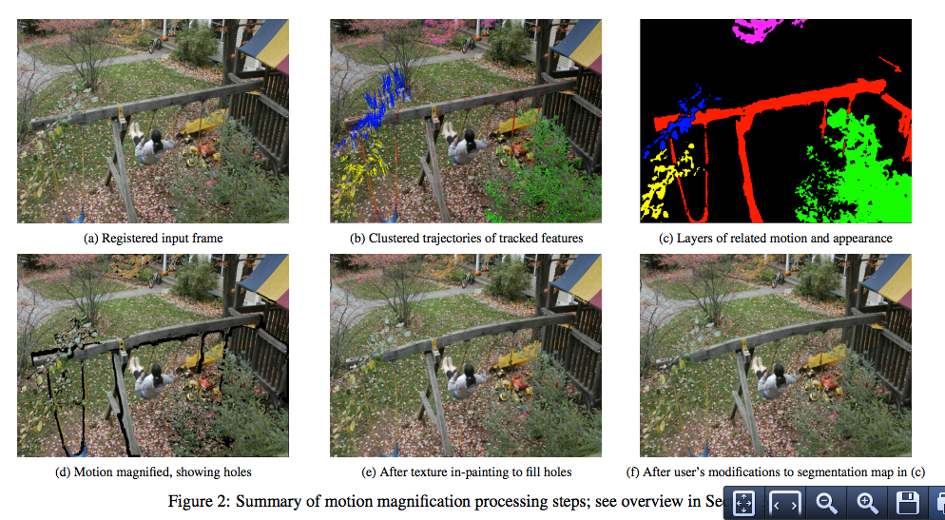
Lagrangian motion amplification
Notes:
Computationally intensive
Feature tracking as additional source of error

Slide 8
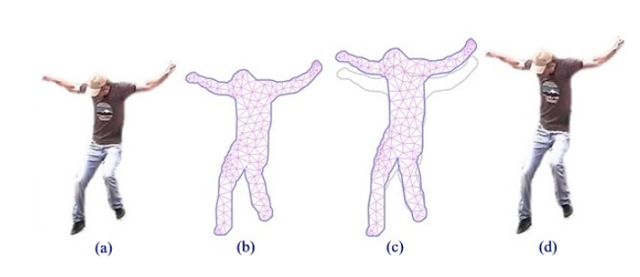
Lagrangian motion amplification
Notes:
Computationally intensive
Feature tracking as additional source of error

Slide 9
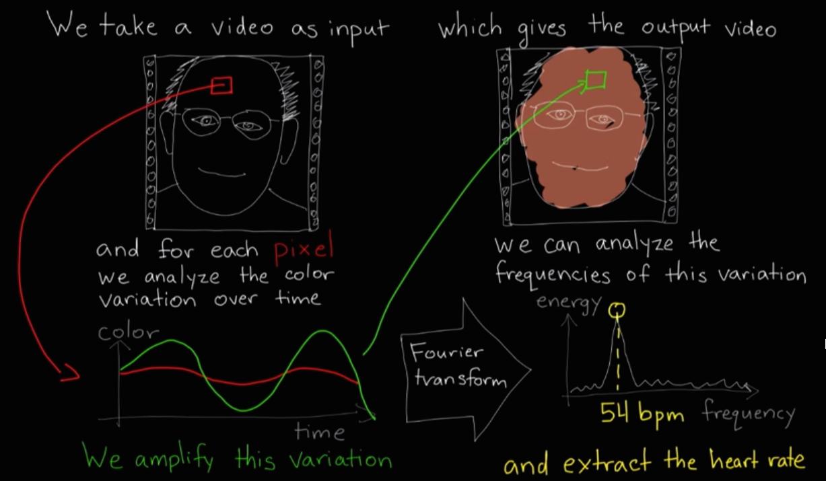
Eulerian video processing

Slide 10
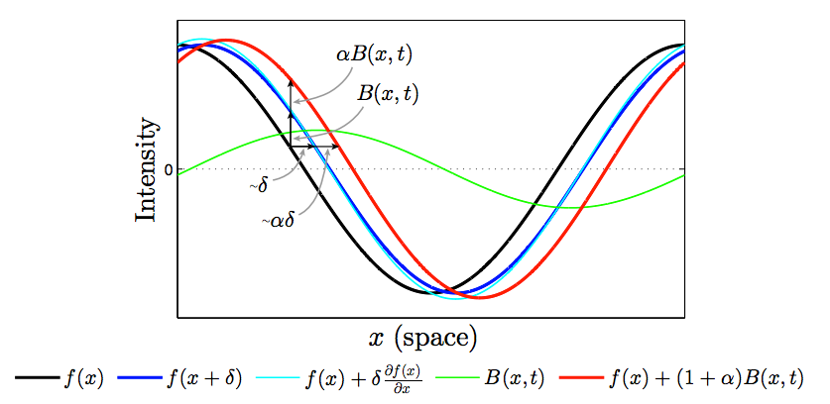
Eulerian motion amplification
http://www.youtube.com/watch?v=e9ASH8IBJ2U&t=2m16s

Slide 11
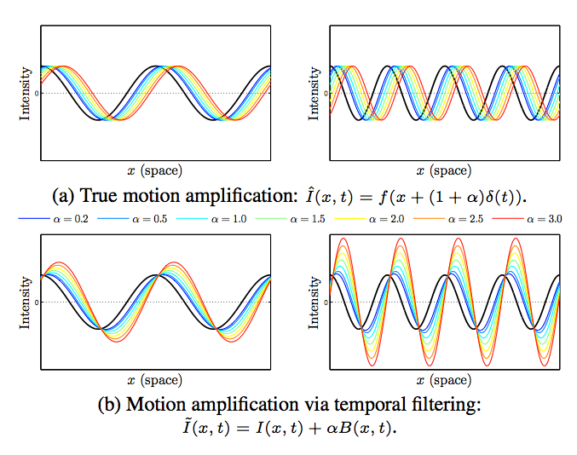
http://www.youtube.com/watch?v=ONZcjs1Pjmk&t=3m30s

Slide 12
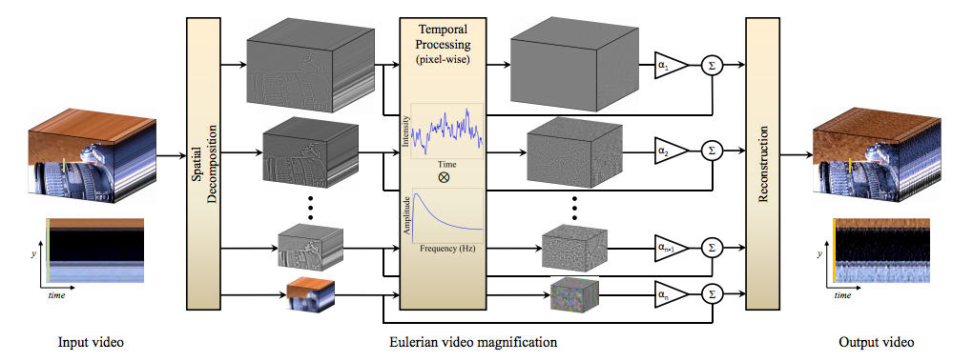

Slide 13
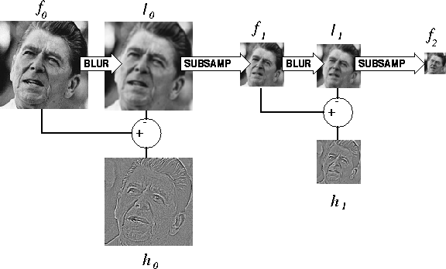
Spatial decomposition (Laplacian pyramid)

Slide 15
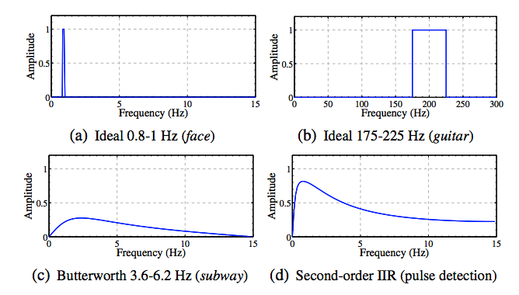
Temporal filtering
http://www.youtube.com/watch?v=ONZcjs1Pjmk&t=2m57s

Slide 16
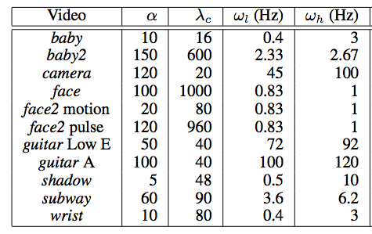
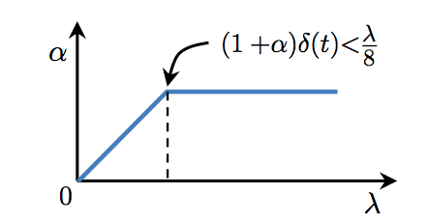

Slide 18
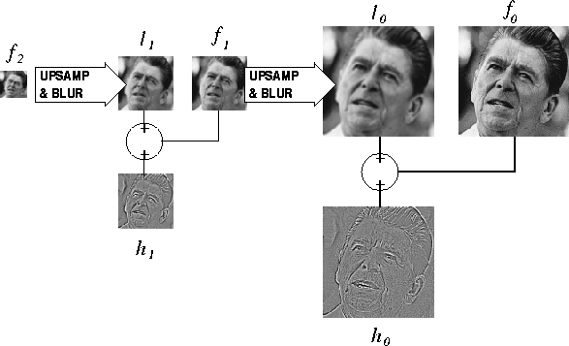
Reconstruction

Slide 19
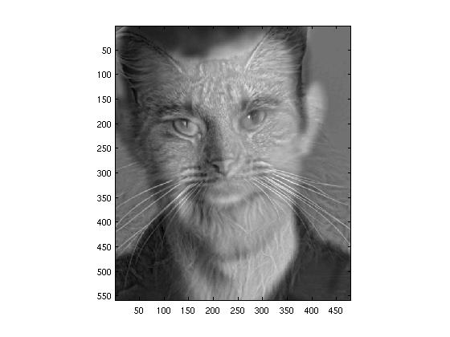

Slide 21
Summary
Real-time
Amplifies intensity changes
Special case: can amplify small motions
Large artifacts when amplifying motion

Slide 22
Project idea?
(Kain et al, 2007)

Slide 23
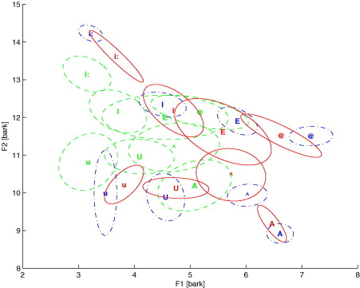

Slide 25
Transform to increase intelligibility

Slide 26
Transform to increase reproducible variance

Slide 27
?

Slide 28
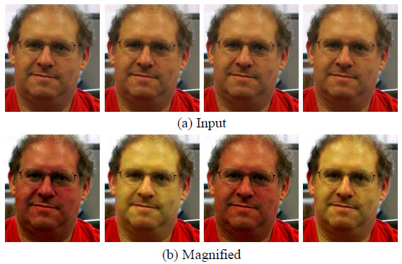

Slide 29
