Slide 1
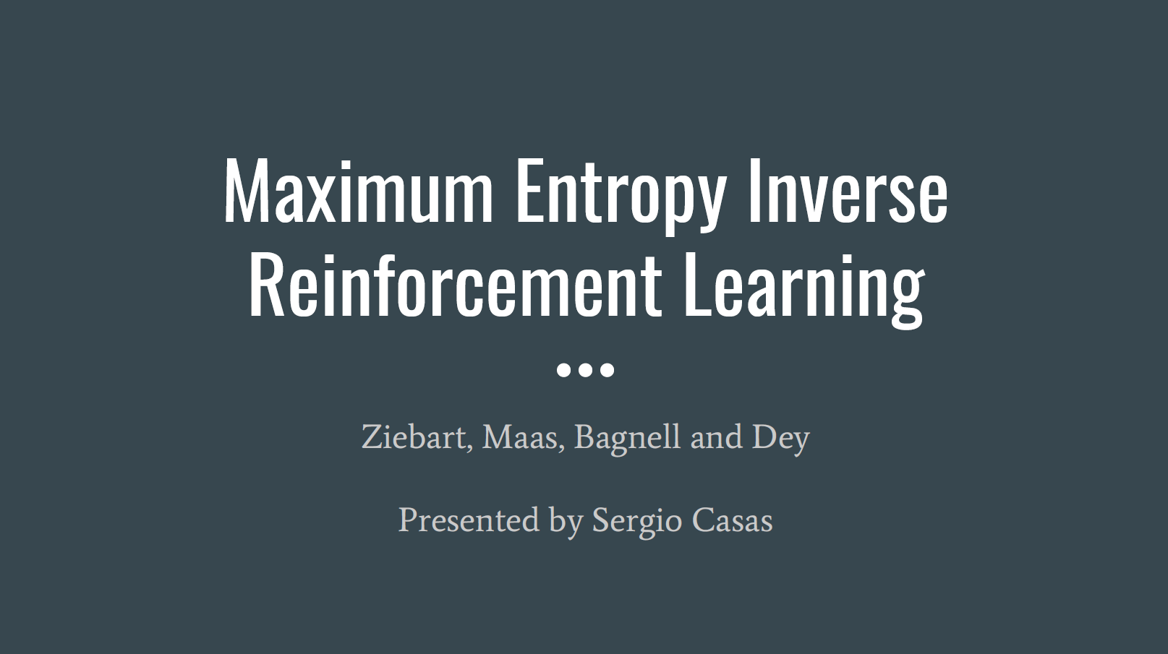

Slide 26
Large scale cost function learning for path planning using deep inverse reinforcement learning Wulfmeier et. al (IJRR 2017)
Sean Liu

Slide 27
Motivation for IRL
Difficult to handcraft cost/reward functions
Mapping between sensory input data and cost very complex
IRL tries to best model underlying reward based on learning from demonstration (LfD)

Slide 28
Motivation for Maximum Entropy Deep Inverse Reinforcement Learning (MEDIRL)
Non-parametric state-of-the-art IRL methods do not scale well
Gaussian Processes based IRL (GPIRL) have runtimes that scale with the size of the dataset
Maximum Entropy IRL assumes linearity, which is usually not sufficient and limiting
Goal: design a model tractable for large-scale, real-world autonomous vehicle traversal

Slide 29
Maximum Entropy (MaxEnt)
Entropy$: H\left(X\right)=−\sum_{i=1}^{n}{P_{i}\log_{2}{(P}_{i})}$
Principle of Maximum Entropy: best model of current state of knowledge is the one with largest entropy
Example: Bag with 3 marbles (red, green, blue) with probabilities $p_{r}$, $p_{b}$, $p_{g}$
Scenario A → $p_{r}$, $p_{b}$, $p_{g}$ all unknown:
Maximum entropy: $p_{r}=p_{b}=p_{g}=\frac{1}{3}$
Scenario B → $p_{r}=\frac{1}{2};$ $p_{b} and$ $p_{g}$ unknown
Maximum entropy: $p_{r}=\frac{1}{2}, p_{b}=p_{g}=\frac{1}{4}$

Slide 30
Principle of Maximum Entropy for Trajectories
Trajectory:
$$ϛ =\left\{\left(s,a\right)\right\}$$
State Feature Vector:
$$f_{s}$$
Feature Count:
$$f_{ϛ}=\sum_{s∈ϛ}{f_{s}}$$

Slide 31
Principle of Maximum Entropy for Trajectories
Result (Principle of Maximum Entropy):
$${P\left(ϛ | R\right)}^{∗}=\frac{e^{R(ϛ)}}{Z}$$
(Probability for user preference along any given trajectory is proportional to the exponential to the reward along its path)

Slide 32
Maximum Entropy Inverse Reinforcement Learning (MaxEnt IRL)
$$D=\{ϛ_{1},ϛ_{2},…,ϛ_{N}\}$$
$$ϛ=\{(s,a)\}$$
$$R=r(f_{ϛ},θ)$$
Goal: Maximize log-likelihood of the demonstrated trajectories
$$θ^{∗}={argmax}_{θ}L\left(θ\right)$$
$$={argmax}_{θ}\log{P\left(D,θ | R(θ)\right)}={argmax}_{θ}\frac{1}{N}\sum_{ϛ}{R(ϛ)}−\log{Z}={argmax}_{θ}\log{P\left(D | R(θ)\right)}+\log{P(θ)}$$
$$={argmax}_{θ}{(L}_{D}−L_{R})$$
(Loss function $L\left(θ\right)$ is split into a demonstration term and regularization term)
(only consider demonstration term for gradient calculation)

Slide 33
Linear MaxEnt IRL vs. MEDIRL
Gradient of loss function:
$$\frac{∂L_{D}}{∂θ}=\frac{∂L_{D}}{∂r}\frac{∂r}{∂θ}$$
Linear MaxEnt IRL
Assumption:
$$R(ϛ)=r\left(f_{ϛ},θ\right)=θ^{T}f_{ϛ}$$
$$\frac{∂L_{D}}{∂θ}=[insert image]$$
MaxEnt Deep IRL (MEDIRL)
Assumption:
$$R\left(ϛ\right)=FCN$$
(fully convolutional NN)
$$\frac{∂L_{D}}{∂θ}=[insert more image]$$

Slide 34
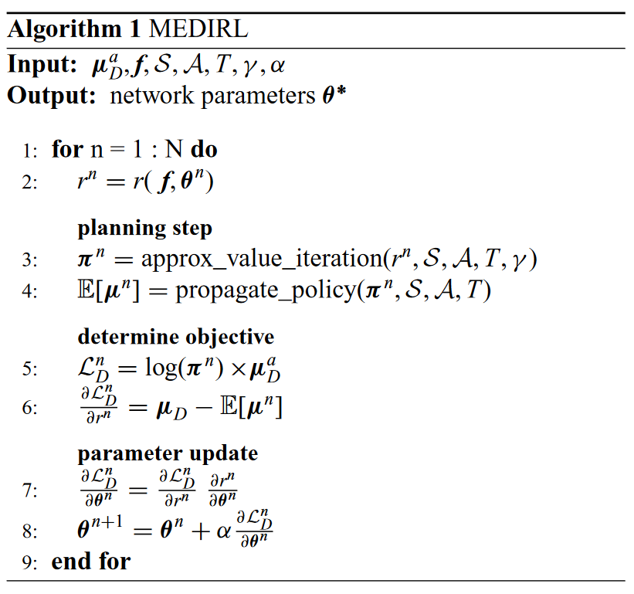
MEDIRL Main Algorithm

Slide 35
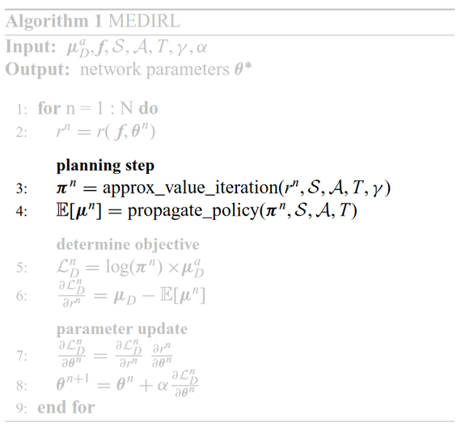
MEDIRL Main Algorithm

Slide 36
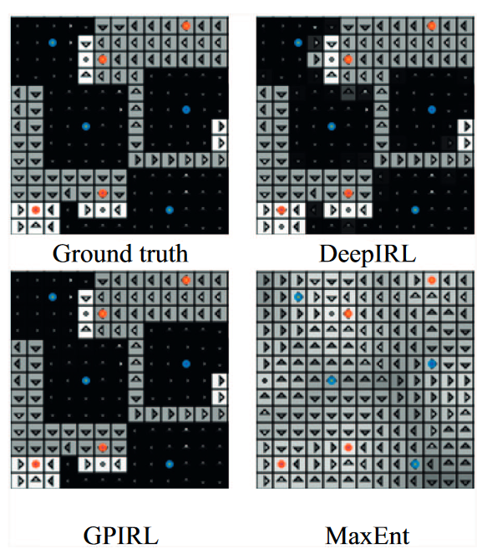
Benchmarking
Reward function FCN:
Two hidden layers
ReLU activation
1x1 filter weights
Evaluation metric: expected value difference
Compared against Linear MaxEnt, GPIRL, NPB-FIRL
ObjectWorld

Slide 37
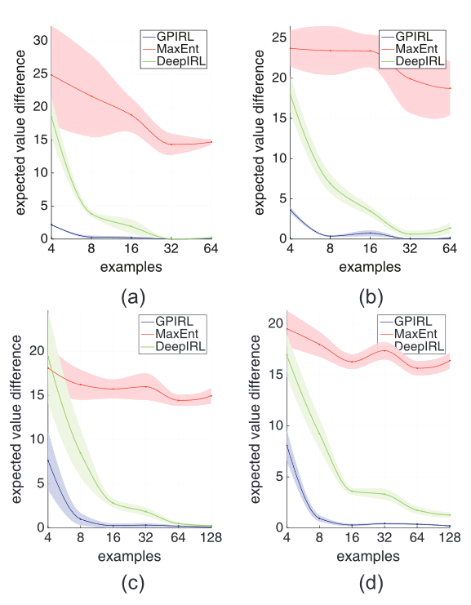
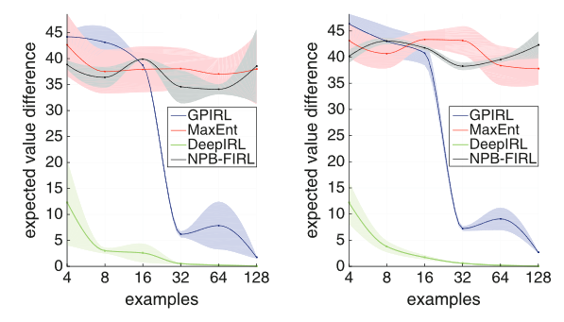
Benchmarking
BinaryWorld
ObjectWorld

Slide 38
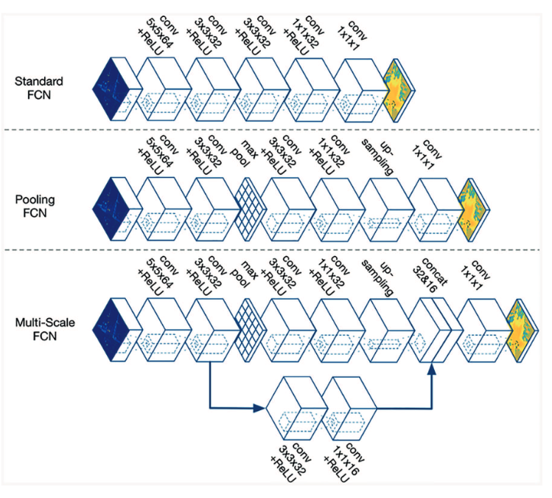
Proposed Network Architectures

Slide 39
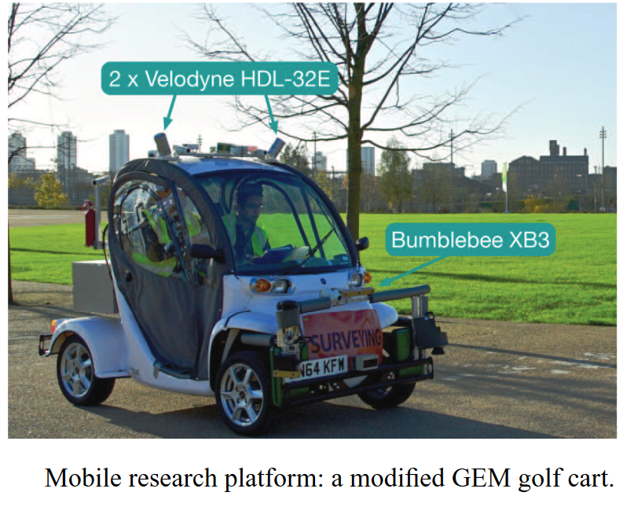
Large-scale Demonstration
13 drivers
>25,000 trajectories 12m-15m long
Goal: reward map given features
Steepness
Corner cases (underpasses, stairs)

Slide 40
Network Input Data

Slide 41
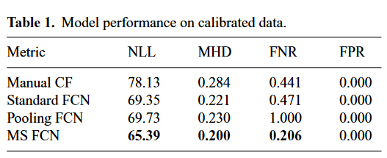
Evaluation
No absolute ground truth
Compared against manual cost functions
Metrics:
NLL – negative log-likelihood
MHD – Hausdorff distance
FNR – False negative rate
FPR – False positive rate

Slide 42
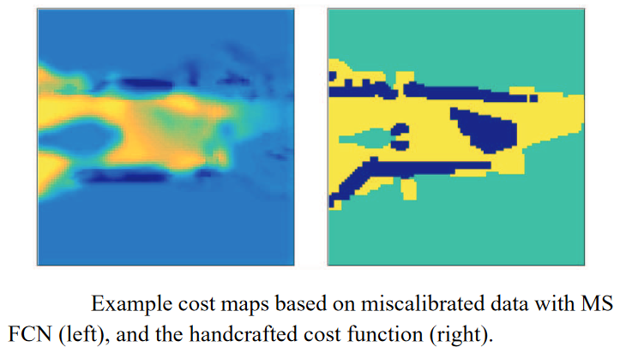
Robustness to Systematic Noise

Slide 43
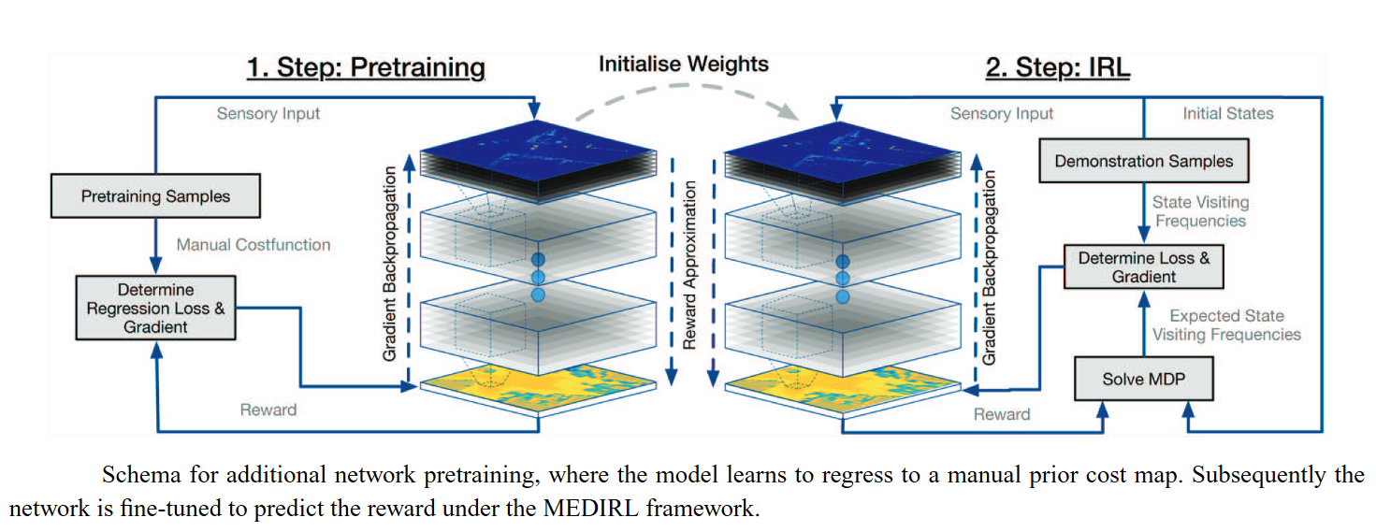
Pretraining

Slide 44
Limitations
Does not address velocity profiles
Does not consider temporal consistency between consecutive cost maps
Possibly introduce RNNs or temporal convolutions

Slide 45
Active Preference-Based Learning of Reward Functions
By: Dorsa Sadigh, Anca D. Dragan, Shankar Sastry, and Sanjit A. Seshia
Presented By: Jacky Liao

Slide 46
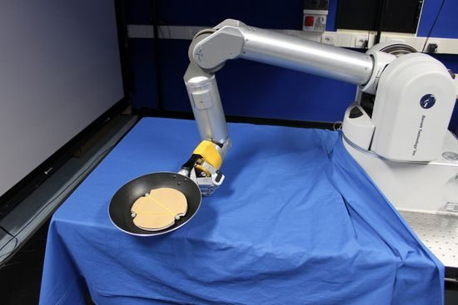
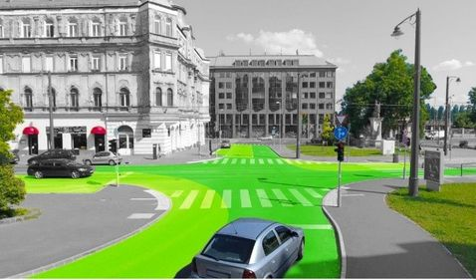
Solving For Rewards
How to obtain rewards?
Sometimes given (e.g. games)
Non trivial for complex tasks
Inverse RL solves rewards using expert demonstrations
Expert data not always available
Problem is too complex or too big
A new approach: preference based learning

Slide 47
Preference Based Learning
Get Reward Function
Generate Candidate Trajectories
Update
Ask For Preference
Learn rewards from expert preference
Have an estimate of reward function
Pick two candidate trajectories
Ask the human which trajectory is preferred
Use preference as feedback to update reward function
Preference based learning is active
Rewards updated directly
No inner RL loop
No probability estimation required
Preference Based Learning Diagram
Get Reward Function
Solve Optimal Policy
Update
Solve State Visitation Frequencies
Expert Data
Inverse RL Diagram

Slide 48
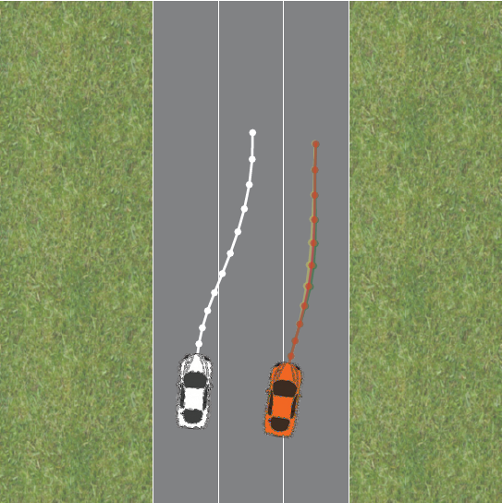
Problem Statement: Autonomous Driving
2 Vehicles on the road:
Our orange vehicle denoted $H$
Other white vehicle/robot denoted $R$
States: $\left(x_{H},x_{R}\right)$
Inputs: $\left(u_{H}, u_{R}\right)$
Dynamics: $x^{t+1 }=f_{HR}(x^{t},u_{H},u_{R})$
Finite Trajectories: $ξ=$ $\{\left(x^{0},u_{H}^{0},u_{R}^{0}\right),…,$ $\left(x^{N},u_{H}^{N},u_{R}^{N}\right)\}$
Feasible Trajectories: $ξ∈Ξ$

Slide 49
Reward Function
Linear Reward Function
Features $φ\left(x,{u_{H},u}_{R}\right)∈ℝ^{d}$
E.g. matching speed, distance to road boundary, staying within lane
Weights $w∈ℝ^{d}$
Reward per time instance:
$r_{H}(x^{t},$ ${u_{H}^{t},u}_{R}^{t})=w^{T}φ\left(x^{t},{u_{H}^{t},u}_{R}^{t}\right)$
Sum of rewards over a finite trajectory:
$$R_{H}\left(ξ\right)=R_{H}\left(x_{0},u_{H},u_{R}\right)=\sum_{t=0}^{N}{r_{H}\left(x^{t}, {u_{H}^{t},u}_{R}^{t}\right)} \\ =w^{T}Φ(ξ)$$

Slide 50
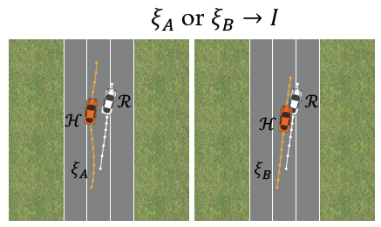
Preference
Get Reward Function
Generate Candidate Trajectories
Update
Ask For Preference
Given 2 trajectories $ξ_{A}$ and $ξ_{B}$
Preference variable $I$
$$I=\left\{\begin{aligned}+1, if ξ_{A} is preferred \\ −1, if ξ_{B} is preferred\end{aligned}\right.$$
Preference Based Learning Diagram

Slide 51
Weight Update
Get Reward Function
Generate Candidate Trajectories
Update
Ask For Preference
Assume probabilistic model: weights come from a distribution
Preference is noisy:
$$P\left(I | w\right)=\left\{\begin{aligned}\frac{\exp{{(R}_{H}(ξ_{A}))}}{\exp{{(R}_{H}(ξ_{A}))}+\exp{{(R}_{H}(ξ_{B}))}}, if I=+1 \\ \\ \frac{\exp{{(R}_{H}(ξ_{B}))}}{\exp{{(R}_{H}(ξ_{A}))}+\exp{{(R}_{H}(ξ_{B}))}}, if I=−1\end{aligned}\right.$$
Some simplification:
$$φ=R_{H}\left(ξ_{A}\right)−R_{H}\left(ξ_{B}\right), P\left(I | w\right)=\frac{1}{1+\exp{(Iw^{T}φ)}}$$
Bayesian update:
$$P(w|I)∝P\left(w\right)P(I|w)$$
Preference Based Learning Diagram

Slide 52
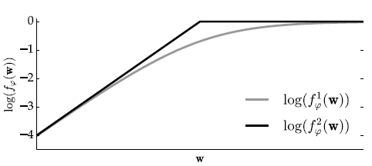
Obtaining Weights
Get Reward Function
Generate Candidate Trajectories
Update
Ask For Preference
$P(w|I)∝P\left(w\right)P(I|w)$ is often intractable
Sample using Adaptive Metropolis Algorithm
Some more simplifications:
$$P\left(I | w\right)=\frac{1}{1+\exp{(Iw^{T}φ)}}≈\min\left(1,\exp\left(Iw^{T}φ\right)\right)$$
Allows log sampling starting at 0
$$P\left(w\right)≈\frac{1}{M}\sum_{i=0}^{M}{δ(w_{i})}$$
Preference Based Learning Diagram

Slide 53
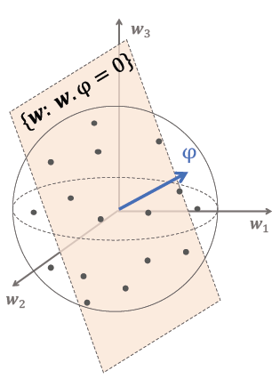
Generate Trajectories
Get Reward Function
Generate Candidate Trajectories
Update
Ask For Preference
Split the trajectory into 2 parts:
Scenario $\left(x^{0},u_{R}\right)$
Human inputs $u_{H}$
Two feasible trajectories: $u_{H}^{A}, u_{H}^{B}$
Want each update to give most information
Maximize volume removed:
$$\max_{u_{H}^{A}, u_{H}^{B}}{\min{(𝔼_{w}[1−f_{φ}\left(w\right)],𝔼_{w}[1−f_{−φ}\left(w\right)])}}$$
Trajectories lie on hyperplane $w^{T}φ=0$
Similar to binary search, find side of hyperplane to update
Solve the optimization problem using Newton-based methods
Preference Based Learning Diagram

Slide 54
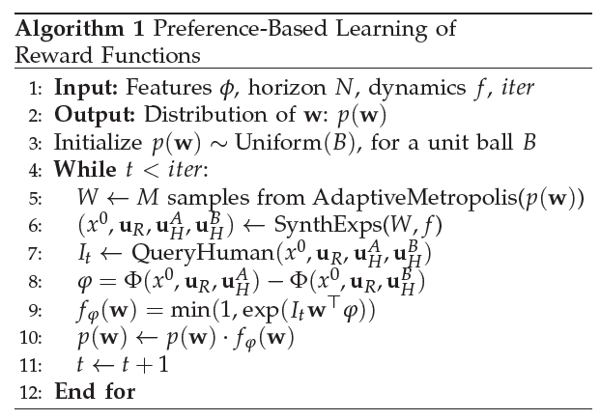
Algorithm Summary
Initialize Uniform Weights

Slide 55
Algorithm Summary
Get Reward Function

Slide 56
Algorithm Summary
Generate Candidate Trajectories

Slide 57
Algorithm Summary
Ask For Preference

Slide 58
Algorithm Summary
Update

Slide 59
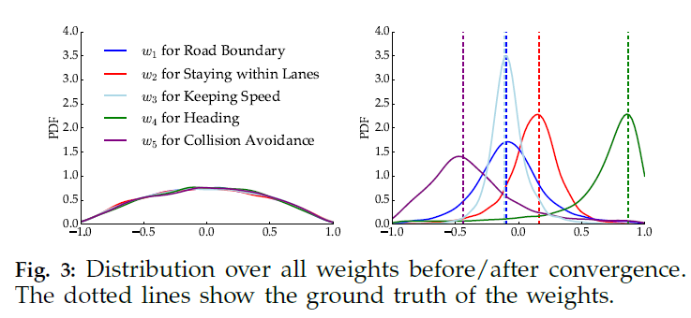
Results
Weights begin with uniform probability
Convergence after 200 iterations

Slide 60
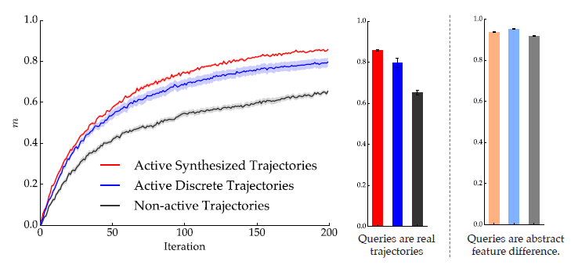
Results
Rate of convergence, active synthesis is faster!
Blue curve: generated feasible trajectories not optimized for weight updates
Black curve: non active trajectories, equivalent to expert dataset
Lighter colours: training on non feasible trajectories

Slide 61
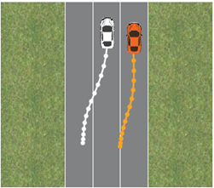
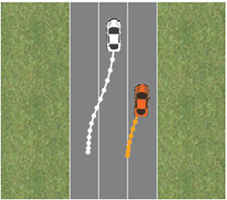
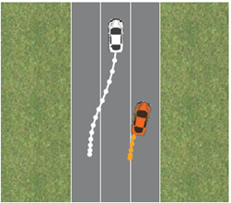
Results
$$w^{∗}$$
Perturbation of weights
Learned weights: $w^{∗}$
Slightly perturbed weights: $w^{1}$
Largely perturbed weights: $w^{2}$
Users prefer $w^{∗}$
$$w^{1}$$
$$w^{2}$$
$$w^{∗}$$

Slide 62
Limitations
Only 1 other agent
Linear model: assumes features known
Humans may act differently, no guarantee of rationality
No guarantee that behavior can be customized
i.e. algorithm converges to a reward function, but not the one the user wants
e.g. driving slowly but safely vs faster and aggressive, but more optimal

Slide 63
Direct Loss Minimization Inverse Optimal Control
02/15/2019

Slide 64
What is the most compact representation to specify a task?

Slide 65
What is the most compact representation to specify a task?
Cost Function

Slide 66
What is the usual cost function in reinforcement learning?

Slide 67
What is the usual cost function in reinforcement learning?
Human-Designed (Reach goal, get most points, avoid obstacles, etc.)

Slide 68
Two views in imitation learning
Supervised learning
on actions
Match the
expert distribution
(e.g. Dagger, usually deterministic policy)
(stochastic policy)

Slide 69
Two views in imitation learning
Supervised learning
on actions
Match the
expert distribution
(e.g. Dagger, usually deterministic policy)
(stochastic policy)

Slide 70
Direct Loss Minimization Inverse Optimal Control?
Use both!
Key insight: When viewing Imitation Learning as an inverse optimal control problem with the goal of matching an expert distribution, we can leverage reinforcement learning and solve the problem as a policy search problem

Slide 71
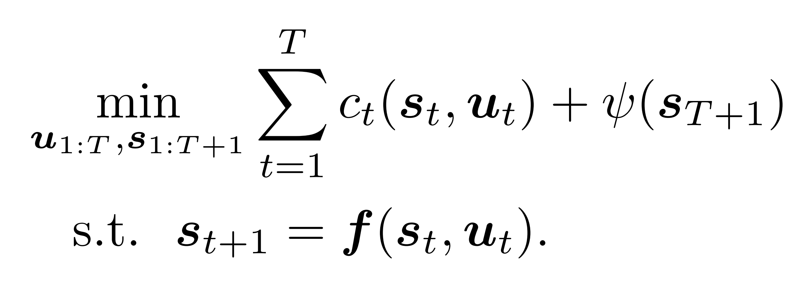
Optimal Control
Cost(state, input)
Cost(terminal state)
Deterministic Physics Model
Inverse Optimal Control: What do we optimize? Advance Robotics Lecture 8 Notes – Nathan Ratliff

Slide 72
Optimal Control
Cost(state, input)
Cost(terminal state)
How to parameterize cost function?
Deterministic Physics Model
Inverse Optimal Control: What do we optimize? Advance Robotics Lecture 8 Notes – Nathan Ratliff

Slide 73
Optimal Control
Linear combination of non-linear costs
Costs(state, input)
Deterministic Physics Model
Inverse Optimal Control: What do we optimize? Advance Robotics Lecture 8 Notes – Nathan Ratliff

Slide 74
Optimal Control
Linear combination of non-linear costs
Expressive, but large number of parameters: how to determine coefficients?
Costs(state, input)
Deterministic Physics Model
Inverse Optimal Control: What do we optimize? Advance Robotics Lecture 8 Notes – Nathan Ratliff

Slide 75
Inverse Optimal Control
Expressive, but large number of parameters: how to determine coefficients?
Inverse Optimal Control
Linear combination of non-linear costs
Costs(state, input)
Deterministic Physics Model

Slide 76
Inverse Optimal Control
Expressive, but large number of parameters: how to determine coefficients?
Inverse Optimal Control
Structured Prediction Problem
Linear combination of non-linear costs
Costs(state, input)
coefficients
costs
Trajectory
(sequence of state action pairs)
Deterministic Physics Model

Slide 77
Direct Loss Update Rule
Find the trajectory that has a bad score and bad loss
Penalize features in the worst trajectory defined as high score and high loss that are different from the example

Slide 78
Direct Loss Minimization Inverse Optimal Control?
Use both!
Key insight: When viewing Imitation Learning as an inverse optimal control problem with the goal of matching an expert distribution, we can leverage reinforcement learning and solve the problem as a policy search problem

Slide 79
Direct Loss Minimization Inverse Optimal Control?
Use both!
IL to regularize RL
Noisy and partial expert Examples

Slide 80
Example
Maximum Likelihood Gradient
Policy Search Gradient

Slide 81
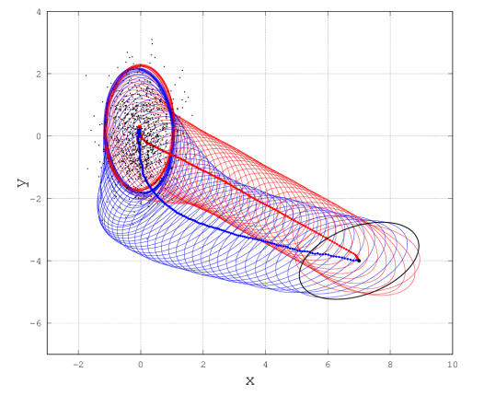
Example
Policy Search Gradient

Slide 82
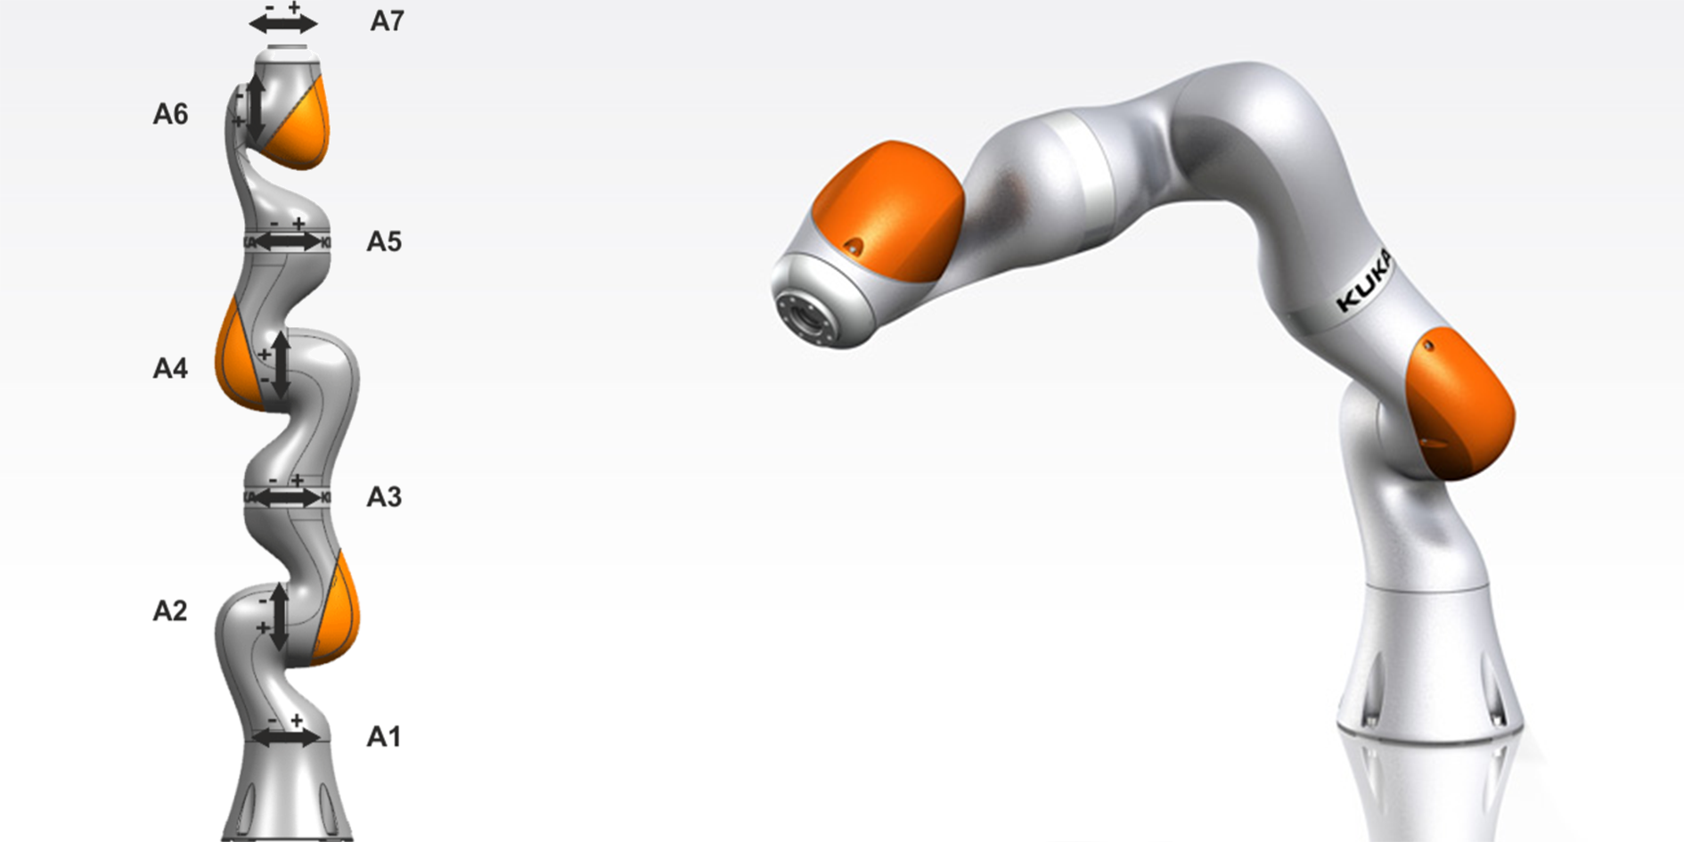
Experiments
State: 11 DOF (joints), 11 velocities, 11 accelerations
Cost Function: 25 penalties, several constraints
Imitation Loss:

Slide 83
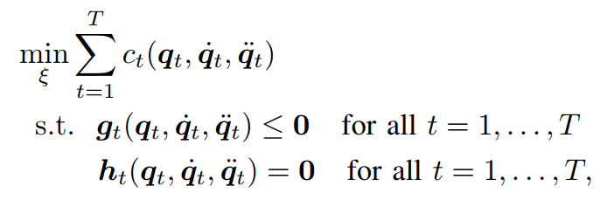
Pipeline
RIEMMO Optimization
CMA-ES
Genetic Algorithm for
Continuous Optimization
Population sampled from multivariate Gaussian distribution
Inverse Optimal Control: What do we optimize? Advance Robotics Lecture 8 Notes – Nathan Ratliff

Slide 84
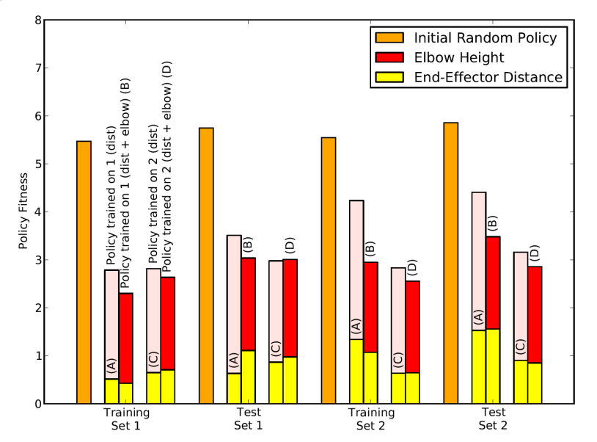
Results
A: Motion Type 1, Imitation Loss
B: Motion Type 1, Combined Loss
C: Motion Type 2, Imitation Loss
D: Motion Type 2, Combined Loss
Training Set 1: High obstacle avoidance
Training Set 2: Low obstacle avoidance

Slide 85
Paper Flaws
No results for non-IL loss objective
Reproducibility: Experimental Design vague and unclear

Slide 86
Future Work
Determining additional objectives
Time-dependent objectives
Imitation Loss Metric
Dynamic loss weighting over training time (decay IL loss)

