Slide 1
DRAT Proof of Unsatisfiability for SAT Modulo Monotonic Theories
Nick Feng¹, Alan J. Hu², Sam Bayless³, Syed M. Iqbal³, Patrick Trentin³,
Mike Whalen³, Lee Pike³, and John Backes³
¹ Dept. of Computer Science, University of Toronto
² Dept. of Computer Science, University of British Columbia
³ Amazon Web Services
Notes:
Add footnote for affiliations

Slide 2
Satisfiability and Automated Reasoning
SAT, satisfying solution
Constraint Satisfaction Problem
Problem:
Verification,
Synthesis,
Model Checking
….
Solver
UNSAT
Notes:
Try not sounds like reading off script
Point to the grid when it appears.

Slide 3
Proof of UNSAT
Plug-in and check
SAT, satisfying solution
Constraint Satisfaction Problem
Problem:
Verification,
Synthesis,
Model Checking
….
Solver
UNSAT
How to check the correctness of the solver?
Proof of UNSAT

Slide 4
Proof of UNSAT - Applications
Plug-in and check
SAT, satisfying solution
Constraint Satisfaction Problem
Problem:
Verification,
Synthesis,
Model Checking
….
Solver
UNSAT
1. Trust Solver’s Result
Proof of UNSAT
2. Compute UNSAT core and Interpolants
3. Debugging

Slide 5
UNSAT Proof for Propositional Logic
SAT, satisfying solution
Constraint Satisfaction Problem
Problem:
Verification,
Synthesis,
Model Checking
….
Solver
UNSAT
Proof of UNSAT

Slide 6
UNSAT Proof for Propositional Logic
SAT, satisfying solution
Propositional Logic constraints in CNF
Problem:
Verification,
Synthesis,
Model Checking
….
Solver
UNSAT
Proof of UNSAT
Notes:
Two changes effect,
Make it smooth with one change at a time

Slide 7
UNSAT Proof for Propositional Logic
SAT, satisfying solution
Propositional Logic constraints in CNF
Problem:
Verification,
Synthesis,
Model Checking
….
Solver
UNSAT
Proof of UNSAT
Notes:
Two changes effect,
Make it smooth with one change at a time

Slide 8
UNSAT Proof for Propositional Logic
SAT, satisfying solution
Propositional Logic constraints in CNF
Problem:
Verification,
Synthesis,
Model Checking
….
SAT
Solver
UNSAT
Proof of UNSAT

Slide 9
UNSAT Proof for Propositional Logic
SAT, satisfying solution
Propositional Logic constraints in CNF
Problem:
Verification,
Synthesis,
Model Checking
….
SAT
Solver
UNSAT
Proof of UNSAT

Slide 10
UNSAT Proof for Propositional Logic
SAT, satisfying solution
Propositional Logic constraints in CNF
Problem:
Verification,
Synthesis,
Model Checking
….
SAT
Solver
UNSAT
DRAT proof certificate
Notes:
Practice on how to introduce the headline:
DRAT is good, a lot of success!
It will appear later, and I will explain DRAT later!

Slide 11
UNSAT Proof for Propositional Logic
SAT, satisfying solution
Propositional Logic constraints in CNF
Problem:
Verification,
Synthesis,
Model Checking
….
SAT
Solver
UNSAT
DRAT proof certificate
Proof can be checked by checker (e.g., DRAT-trim)
Heule, Marijn JH, Oliver Kullmann, and Victor W. Marek. "Solving and verifying the boolean pythagorean triples problem via cube-and-conquer."
Lamb, Evelyn. "Maths proof smashes size record: supercomputer produces a 200-terabyte proof--but is it really mathematics?." Nature 534.7605 (2016): 17-19.
Notes:
Practice on how to introduce the headline:
DRAT is good, a lot of success!
Mature scalable, lightweight

Slide 12
UNSAT Proof for SAT Modulo Theories (SMT)
SAT, satisfying solution
Propositional Logic constraints in CNF
Problem:
Verification,
Synthesis,
Model Checking
….
Solver
UNSAT
Proof of UNSAT

Slide 13
UNSAT Proof for SAT Modulo Theories (SMT)
SAT, satisfying solution
Propositional Logic constraints in CNF
Problem:
Verification,
Synthesis,
Model Checking
….
Solver
UNSAT
+ First-order theories
Proof of UNSAT
Notes:
2:46

Slide 14
UNSAT Proof for SAT Modulo Theories (SMT)
SAT, satisfying solution
Propositional Logic constraints in CNF
Problem:
Verification,
Synthesis,
Model Checking
….
Solver
UNSAT
+ First-order theories
Proof of UNSAT

Slide 15
UNSAT Proof for SAT Modulo Theories (SMT)
SAT, satisfying solution
Propositional Logic constraints in CNF
Problem:
Verification,
Synthesis,
Model Checking
….
SMT
Solver
UNSAT
+ First-order theories
Proof of UNSAT

Slide 16
UNSAT Proof for SAT Modulo Theories (SMT)
SAT, satisfying solution
Propositional Logic constraints in CNF
Problem:
Verification,
Synthesis,
Model Checking
….
SMT
Solver
UNSAT
+ First-order theories
Proof of UNSAT

Slide 17
UNSAT Proof for SAT Modulo Theories (SMT)
SAT, satisfying solution
Propositional Logic constraints in CNF
Problem:
Verification,
Synthesis,
Model Checking
….
SMT
Solver
UNSAT
+ First-order theories
Q1: Proof certificate?
Proof of UNSAT
Theory dependent!
Q2: How to efficiently check the proof certificate?
Notes:
They are theory dependent! Assertive

Slide 18
UNSAT Proof for Finite-Domain SAT Modulo Monotonic Theories (SMMT)
SAT, satisfying solution
Propositional Logic constraints in CNF
Problem:
Verification,
Synthesis,
Model Checking
….
Solver
UNSAT
Proof of UNSAT
Notes:
ANote: Highlight the difference

Slide 19
UNSAT Proof for Finite-Domain SAT Modulo Monotonic Theories (SMMT)
SAT, satisfying solution
Propositional Logic constraints in CNF
Problem:
Verification,
Synthesis,
Model Checking
….
Solver
UNSAT
+ Finite Domain Monotonic Theories
Proof of UNSAT

Slide 20
UNSAT Proof for Finite-Domain SAT Modulo Monotonic Theories (SMMT)
SAT, satisfying solution
Propositional Logic constraints in CNF
Problem:
Network Reachability,
Circuit layout Synthesis,
…
Solver
UNSAT
+ Finite Domain Monotonic Theories
Proof of UNSAT
Notes:
Used extensively in industrial,
SMMT -> reachability -> Amazon

Slide 21
UNSAT Proof for Finite-Domain SAT Modulo Monotonic Theories (SMMT)
SAT, satisfying solution
Propositional Logic constraints in CNF
Problem:
Network Reachability,
Circuit layout Synthesis,
…
Solver
UNSAT
+ Finite Domain Monotonic Theories
Proof of UNSAT
Notes:
Used extensively in industrial,
SMMT -> reachability -> Amazon

Slide 22
UNSAT Proof for Finite-Domain SAT Modulo Monotonic Theories (SMMT)
SAT, satisfying solution
Propositional Logic constraints in CNF
Problem:
Network Reachability,
Circuit layout Synthesis,
…
SMMT
Solver
UNSAT
+ Finite Domain Monotonic Theories
Proof of UNSAT

Slide 23
UNSAT Proof for Finite-Domain SAT Modulo Monotonic Theories (SMMT)
SAT, satisfying solution
Propositional Logic constraints in CNF
Problem:
Network Reachability,
Circuit layout Synthesis,
…
SMMT
Solver
UNSAT
+ Finite Domain Monotonic Theories
Q1: Proof certificate?

Slide 24
UNSAT Proof for Finite-Domain SAT Modulo Monotonic Theories (SMMT)
SAT, satisfying solution
Propositional Logic constraints in CNF
Problem:
Network Reachability,
Circuit layout Synthesis,
…
SMMT
Solver
UNSAT
+ Finite Domain Monotonic Theories
Q1: Proof certificate?
Q2: How to efficiently check the proof certificate?

Slide 25
Contributions
Practical aspect:
Efficient and scalable DRAT proof generation method for SMMT
Theoretical aspect:
Introduce one-sided proposition definitions for refutation proof
Show SMMT theories expressed in Horn theory
Propose on-the-fly transformation to over-approximate CNF definition of theory predicates into Horn definitions
Present efficient definitions for monotonic theories used in practice: (1) graph reachability, (2) bit-vector summation & (3) comparison, and (4) maximum flow

Slide 26
Contributions
Practical aspect:
Efficient and scalable DRAT proof generation method for SMMT
Theoretical aspect:
Introduce one-sided proposition definitions for refutation proof
Show SMMT theories expressed in Horn theory
Propose on-the-fly transformation to over-approximate CNF definition of theory predicates into Horn definitions
Present efficient definitions for monotonic theories used in practice: (1) graph reachability, (2) bit-vector summation & (3) comparison, and (4) maximum flow

Slide 27
Contributions
Practical aspect:
Efficient and scalable DRAT proof generation method for SMMT
Theoretical aspect:
Introduce one-sided proposition definitions for refutation proof
Show SMMT theories expressed in Horn theory
Propose on-the-fly transformation to over-approximate CNF definition of theory predicates into Horn definitions
Present efficient definitions for monotonic theories used in practice: (1) graph reachability, (2) bit-vector summation & (3) comparison, and (4) maximum flow
Notes:
SMMT careful

Slide 28
Contributions
Practical aspect:
Efficient and scalable DRAT proof generation method for SMMT
Theoretical aspect:
Introduce one-sided proposition definitions for refutation proof
Show SMMT theories expressed in Horn theory
Propose on-the-fly transformation to over-approximate CNF definition of theory predicates into Horn definitions
Present efficient definitions for monotonic theories used in practice: (1) graph reachability, (2) bit-vector summation & (3) comparison, and (4) maximum flow
For DRAT proof
Notes:
Text build for the focus
Show all text, but use focus box to focus the current pointer

Slide 29
Contributions
Practical aspect:
Efficient and scalable DRAT proof generation method for SMMT
Theoretical aspect:
Introduce one-sided proposition definitions for refutation proof
Show SMMT theories expressed in Horn theory
Propose on-the-fly transformation to over-approximate CNF definition of theory predicates into Horn definitions
Present efficient definitions for monotonic theories used in practice: (1) graph reachability, (2) bit-vector summation & (3) comparison, and (4) maximum flow
For DRAT proof

Slide 30
Contributions
Practical aspect:
Efficient and scalable DRAT proof generation method for SMMT
Theoretical aspect:
Introduce one-sided proposition definitions for refutation proof
Show SMMT theories expressed in Horn theory
Propose on-the-fly transformation to over-approximate CNF definition of theory predicates into Horn definitions
Present efficient definitions for monotonic theories used in practice: (1) graph reachability, (2) bit-vector summation & (3) comparison, and (4) maximum flow
For DRAT proof
Efficient

Slide 31
Contributions
Practical aspect:
Efficient and scalable DRAT proof generation method for SMMT
Theoretical aspect:
Introduce one-sided proposition definitions for refutation proof
Show SMMT theories expressed in Horn theory
Propose on-the-fly transformation to over-approximate CNF definition of theory predicates into Horn definitions
Present efficient definitions for monotonic theories used in practice: (1) graph reachability, (2) bit-vector summation & (3) comparison, and (4) maximum flow
For DRAT proof
Efficient
Notes:
Practice on the over-apprixim

Slide 32
Contributions
Practical aspect:
Efficient and scalable DRAT proof generation method for SMMT
Theoretical aspect:
Introduce one-sided proposition definitions for refutation proof
Show SMMT theories expressed in Horn theory
Propose on-the-fly transformation to over-approximate CNF definition of theory predicates into Horn definitions
Present efficient definitions for monotonic theories used in practice: (1) graph reachability, (2) bit-vector summation & (3) comparison, and (4) maximum flow
For DRAT proof
Efficient
Scalable

Slide 33
Contributions
Practical aspect:
Efficient and scalable DRAT proof generation method for SMMT
Theoretical aspect:
Introduce one-sided proposition definitions for refutation proof
Show SMMT theories expressed in Horn theory
Propose on-the-fly transformation to over-approximate CNF definition of theory predicates into Horn definitions
Present efficient definitions for monotonic theories used in practice: (1) graph reachability, (2) bit-vector summation & (3) comparison, and (4) maximum flow
For DRAT proof
Efficient
Scalable

Slide 34
Contributions
Practical aspect:
Efficient and scalable DRAT proof generation method for SMMT
Theoretical aspect:
Introduce one-sided proposition definitions for refutation proof
Show SMMT theories expressed in Horn theory
Propose on-the-fly transformation to over-approximate CNF definition of theory predicates into Horn definitions
Present efficient definitions for monotonic theories used in practice: (1) graph reachability, (2) bit-vector summation & (3) comparison, and (4) maximum flow
For DRAT proof
Efficient
Scalable
Practical

Slide 35
Contributions
Practical aspect:
Efficient and scalable DRAT proof generation method for SMMT
Theoretical aspect:
Introduce one-sided proposition definitions for refutation proof
Show SMMT theories expressed in Horn theory
Propose on-the-fly transformation to over-approximate CNF definition of theory predicates into Horn definitions
Present efficient definitions for monotonic theories used in practice: (1) graph reachability, (2) bit-vector summation & (3) comparison, and (4) maximum flow
For DRAT proof
Efficient
Scalable
Practical
Notes:
Too long, objective to reduce:

Slide 36
Outline
Background: SAT Modular Monotonic Theories
Approach:
Proof Certificate for SMMT
Check SMMT Proof Certificate
Check SMMT Theory Lemmas
Evaluation

Slide 37
Outline
Background: SAT Modular Monotonic Theories (SMMT)
Approach:
Proof Certificate for SMMT
Check SMMT Proof Certificate
Check SMMT Theory Lemmas
Evaluation

Slide 38
Background: SAT Modular Monotonic Theories (SMMT)
SAT, satisfying solution
Propositional Logic constraints in CNF
Problem:
Network Reachability,
Circuit layout Synthesis,
…
SMMT
Solver
UNSAT

Slide 39
Background: SAT Modular Monotonic Theories (SMMT)
SAT, satisfying solution
Propositional Logic constraints in CNF
Problem:
Network Reachability,
Circuit layout Synthesis,
…
SMMT
Solver
UNSAT
+ Finite Domain Monotonic Theories
Notes:
Anote: Speaker Practice!
Let me give an example of SMMT

Slide 40
Background: SMMT – Monotonic Predicate
Positive monotonic predicate $p$:
$p\left(v_{1},v_{2}…,0,…v_{n}\right)⇒p\left(v_{1},v_{2}…,1,…v_{n}\right)$
Notes:
Monotonic theories consistent of finite domain monotonic functions and predicates
Assuming predicates, input are Boolean
Anote: Hide example, use animation for the graph and example instead

Slide 41
Background: SMMT – Monotonic Predicate
Positive monotonic predicate $p$:
$p\left(v_{1},v_{2}…,0,…v_{n}\right)⇒p\left(v_{1},v_{2}…,1,…v_{n}\right)$
Notes:
Monotonic theories consistent of finite domain monotonic functions and predicates
Assuming predicates, input are Boolean
Anote: Hide example, use animation for the graph and example instead

Slide 42
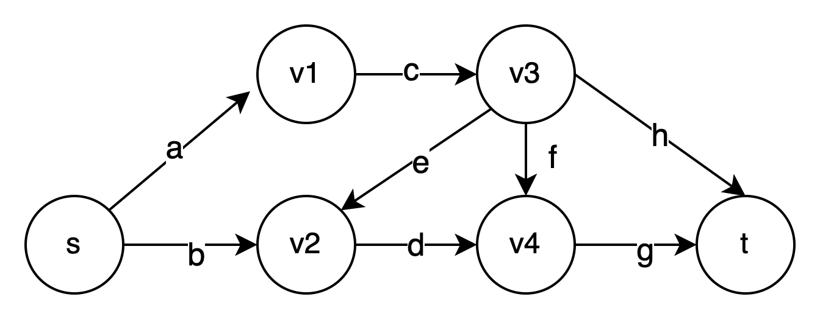
Background: SMMT – Monotonic Predicate
Positive monotonic predicate $p$:
$p\left(v_{1},v_{2}…,0,…v_{n}\right)⇒p\left(v_{1},v_{2}…,1,…v_{n}\right)$
Example graph s-t reachability:
Notes:
Monotonic theories consistent of finite domain monotonic functions and predicates
Assuming predicates, input are Boolean

Slide 43
Background: SMMT – Monotonic Predicate
Positive monotonic predicate $p$:
$p\left(v_{1},v_{2}…,0,…v_{n}\right)⇒p\left(v_{1},v_{2}…,1,…v_{n}\right)$
Example graph s-t reachability:
If edge a is present in the graph
Input: a, b, c … h
Output: exists a path from s to t
Notes:
Monotonic theories consistent of finite domain monotonic functions and predicates
Assuming predicates, input are Boolean
Anote:
“The edge exists or doesn’t edge depends on the input”
Enabled -> exists

Slide 44
Background: SMMT – Monotonic Predicate
Positive monotonic predicate $p$:
$p\left(v_{1},v_{2}…,0,…v_{n}\right)⇒p\left(v_{1},v_{2}…,1,…v_{n}\right)$
Example graph s-t reachability:
If edge a is present in the graph
Input: a, b, c … h
Output: exists a path from s to t
Notes:
Monotonic theories consistent of finite domain monotonic functions and predicates
Assuming predicates, input are Boolean
Need polish on the speech!
Predicate -> graph -> input -> output -> monotonicyt -> example
Use build to not overwhelm

Slide 45
Background: SMMT – Monotonic Predicate
Positive monotonic predicate $p$:
$p\left(v_{1},v_{2}…,0,…v_{n}\right)⇒p\left(v_{1},v_{2}…,1,…v_{n}\right)$
Example graph s-t reachability:
If edge a is present in the graph
Input: a, b, c … h
Output: exists a path from s to t
Monotonic:
Enabling an edge won’t make target less reachable
Notes:
Monotonic theories consistent of finite domain monotonic functions and predicates
Assuming predicates, input are Boolean

Slide 46
Background: SMMT – Monotonic Predicate
Positive monotonic predicate $p$:
$p\left(v_{1},v_{2}…,0,…v_{n}\right)⇒p\left(v_{1},v_{2}…,1,…v_{n}\right)$
Example graph s-t reachability:
If edge a is present in the graph
Input: a, b, c … h
Output: exists a path from s to t
Monotonic:
Enabling an edge won’t make target less reachable
Example: $Rea{ch}_{s→t }∧\overline{Reach_{v1→v4}}$
Notes:
Monotonic theories consistent of finite domain monotonic functions and predicates
Assuming predicates, input are Boolean
Anote: make it clearer: “This is an example where SMMT solver can solve”
The type of constraints (query) that SMMT theories can do, is this true or not

Slide 47
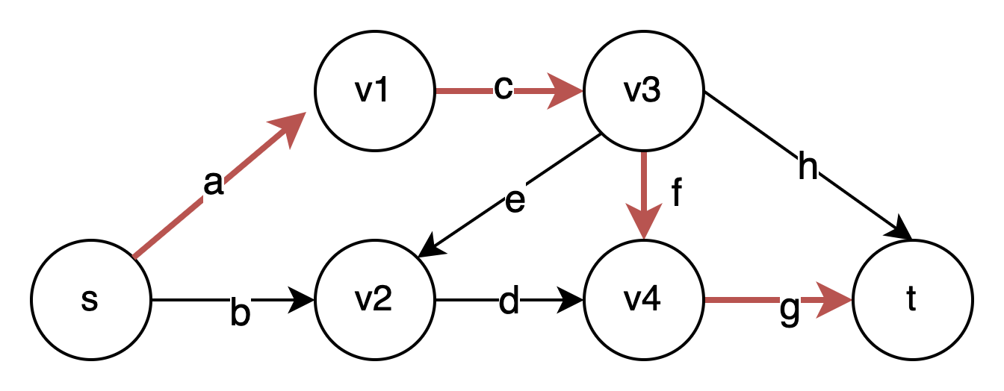
Background: SMMT – Clause Learning (1)
$$p ≔Rea{ch}_{s→t }$$
$a ,c , f, g, ¬b, ¬e, ¬h… ⇒p (Learned Clause)$
$a ,c , f, g ⇒p (Theory Lemma)$
Monotonic strengthening
Horn clause
Notes:
11:08, maybe too late.
Lemmas are Horn clauses -> because of monotonicity
Anote: propagate $Rea{ch}_{s→t }$
Use …. for the dotted for (not b) ..

Slide 48
Background: SMMT – Clause Learning (1)
$$p ≔Rea{ch}_{s→t }$$
$a ,c , f, g, ¬b, ¬e, ¬h… ⇒p (Learned Clause)$
$a ,c , f, g ⇒p (Theory Lemma)$
Monotonic strengthening
Horn clause
Notes:
11:08, maybe too late.
Lemmas are Horn clauses -> because of monotonicity
Anote: propagate $Rea{ch}_{s→t }$

Slide 49
Background: SMMT – Clause Learning (1)
$$p ≔Rea{ch}_{s→t }$$
$a ,c , f, g, ¬b, ¬e, ¬h… ⇒p (Learned Clause)$
$a ,c , f, g ⇒p (Theory Lemma)$
Monotonic strengthening
Horn clause
Notes:
11:08, maybe too late.
Lemmas are Horn clauses -> because of monotonicity
Anote: propagate $Rea{ch}_{s→t }$

Slide 50
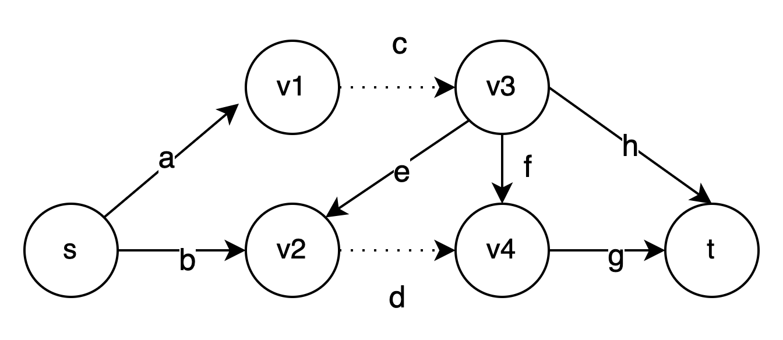
Background: SMMT – Clause Learning (2)
$$p ≔Rea{ch}_{s→t }$$
$¬c , ¬d, a, b, e,f,g,h… ⇒¬p (Learned Clause)$
$¬c, ¬d ⇒¬p (Theory Lemma)$
Monotonic strengthening
Dual-Horn clause
Notes:
11:08, maybe too late.
Lemmas are Horn clauses -> because of monotonicity
Anote: propagate $Rea{ch}_{s→t }$
The theory lemma is a Horn clause

Slide 51
Background: SMMT – Clause Learning (2)
$$p ≔Rea{ch}_{s→t }$$
$¬c , ¬d, a, b, e,f,g,h… ⇒¬p (Learned Clause)$
$¬c, ¬d ⇒¬p (Theory Lemma)$
Monotonic strengthening
Dual-Horn clause
Notes:
11:08, maybe too late.
Lemmas are Horn clauses -> because of monotonicity
Anote: propagate $Rea{ch}_{s→t }$

Slide 52
Background: SMMT – Clause Learning (2)
$$p ≔Rea{ch}_{s→t }$$
$¬c , ¬d, a, b, e,f,g,h… ⇒¬p (Learned Clause)$
$¬c, ¬d ⇒¬p (Theory Lemma)$
Monotonic strengthening
Dual-Horn clause
Notes:
11:08, maybe too late.
Lemmas are Horn clauses -> because of monotonicity
Anote: propagate $Rea{ch}_{s→t }$

Slide 53
Background: SMMT - Clause Learning (2)
$p ≔$ s-t reachability
Theory constraints
$¬c , ¬d, a, b, e,f,g,h… ⇒¬p (Underapproxation)$
$¬c, ¬d ⇒¬p (Theory Lemma)$
1
2
Monotonic strengthening
Dual-Horn clause

Slide 54
Background: SMMT Theories Used in Practice
Graph theories
Reachability
Cyclicity
Shortest distance
Max-flow
Bit-vector arithmetic
Comparison
Addition (no wrap-around)
….
Notes:
Commonly used a lot in practice, and we support them!!
Other theories: FSM, PB ….

Slide 55
Outline
Background: SAT Modular Monotonic Theories
Approach:
Proof Certificate for SMMT
Check SMMT Proof Certificate
Check SMMT theory Lemmas
Evaluation

Slide 56
Outline
Background: SAT Modular Monotonic Theories
Approach:
Proof Certificate for SMMT
Check SMMT Proof Certificate
Check SMMT theory Lemma
Evaluation
Notes:
Transition from background to approach 1

Slide 57
Background: SAT Modular Monotonic Theories (SMMT)
SAT, satisfying solution
Propositional Logic constraints in CNF
Problem:
Network Reachability,
Circuit layout Synthesis,
…
SMMT
Solver
UNSAT
+ Finite Domain Monotonic Theories

Slide 58
Background: SAT Modular Monotonic Theories (SMMT)
SAT, satisfying solution
Propositional Logic constraints in CNF
Problem:
Network Reachability,
Circuit layout Synthesis,
…
SMMT
Solver
UNSAT
+ Finite Domain Monotonic Theories
Q1: Proof certificate?
We extend DRAT

Slide 59
DRAT Proof Certificate
Clause Database
C1,
C2,
…,
L1,
L2,
…..
Ln
UNSAT
SAT solver
Notes:
Introduce DRAT first

Slide 60
DRAT Proof Certificate
Clause Database
C1,
C2,
…,
L1,
L2,
…..
Ln
UNSAT
SAT solver
Clause learning
Notes:
Introduce DRAT first

Slide 61
DRAT Proof Certificate
Clause Database
C1,
C2,
…,
L1,
L2,
…..
Ln
UNSAT
SAT solver
Clause learning
Notes:
Introduce DRAT first

Slide 62
DRAT Proof Certificate
L1 is redundant:
adding L1 does not affect satisfiability
Clause Database
C1,
C2,
…,
L1,
L2,
…..
Ln
UNSAT
L1 propositional lemmas:
$$v_{1}∨v_{2} …v_{i}$$
SAT solver
Clause learning
Redundancy can be checked via RAT w.r.t
the accumulated clause database
Notes:
Introduce DRAT first

Slide 63
DRAT Proof Certificate
L1 is redundant:
adding L1 does not affect satisfiability
Clause Database
C1,
C2,
…,
L1,
L2,
…..
Ln
UNSAT
L1 propositional lemmas:
$$v_{1}∨v_{2} …v_{i}$$
SAT solver
Clause learning
Redundancy can be checked via RAT w.r.t
the accumulated clause database
Notes:
Introduce DRAT first

Slide 64
DRAT Proof Certificate
L1 is redundant:
adding L1 does not affect satisfiability
Clause Database
C1,
C2,
…,
L1,
L2,
…..
Ln
UNSAT
L1 propositional lemmas:
$$v_{1}∨v_{2} …v_{i}$$
SAT solver
Clause learning
Redundancy can be checked via RAT w.r.t
the accumulated clause database
Notes:
Introduce DRAT first

Slide 65
DRAT Proof Certificate
L1 is redundant:
adding L1 does not affect satisfiability
Clause Database
C1,
C2,
…,
L1,
L2,
…..
Ln
UNSAT
L1 propositional lemmas:
$$v_{1}∨v_{2} …v_{i}$$
SAT solver
Clause learning
Redundancy can be checked via RAT w.r.t
the accumulated clause database
Notes:
Introduce DRAT first

Slide 66
DRAT Proof Certificate
L1 is redundant:
adding L1 does not affect satisfiability
Clause Database
C1,
C2,
…,
L1,
L2,
…..
Ln
UNSAT
L1 propositional lemmas:
$$v_{1}∨v_{2} …v_{i}$$
SAT solver
Clause learning
Redundancy can be checked via RAT w.r.t
the accumulated clause database
Notes:
Introduce DRAT first

Slide 67
DRAT Proof Certificate
L1 is redundant:
adding L1 does not affect satisfiability
Clause Database
C1,
C2,
...,
L1,
L2,
…..
Ln
UNSAT
L1 propositional lemmas:
$$v_{1}∨v_{2} …v_{i}$$
SAT solver
Clause learning
Redundancy can be checked via RAT w.r.t
the accumulated clause database
A sequence of clause additions and deletions (D)
Notes:
Introduce DRAT first

Slide 68
DRAT Proof Certificate
L1 is redundant:
adding L1 does not affect satisfiability
Clause Database
C1,
C2,
…,
L1,
L2,
…..
Ln
UNSAT
L1 propositional lemmas:
$$v_{1}∨v_{2} …v_{i}$$
SAT solver
Clause learning
Redundancy can be checked via RAT w.r.t
the accumulated clause database
A sequence of clause additions and deletions (D)
light-weight and easy to generate
Notes:
Introduce DRAT first

Slide 69
DRAT Proof Certificate
L1 is redundant:
adding L1 does not affect satisfiability
Clause Database
C1,
C2,
…,
L1,
L2,
…..
Ln
UNSAT
L1 propositional lemmas:
$$v_{1}∨v_{2} …v_{i}$$
SAT solver
Clause learning
Redundancy can be checked via RAT w.r.t
the accumulated clause database
A sequence of clause additions and deletions (D)
light-weight and easy to generate
Notes:
Introduce DRAT first

Slide 70
DRAT-like Proof Certificate for SMMT
L1 is redundant:
adding L1 does not affect satisfiability
Clause Database
C1,
C2,
…,
L1,
L2,
…..
Ln
UNSAT
L1 propositional lemmas:
$$v_{1}∨v_{2} …v_{i}$$
SMMT solver
Clause learning
Redundancy can be checked via RAT w.r.t
the accumulated clause database
A sequence of clause additions and deletions (D)
light-weight and easy to generate
Notes:
Introduce DRAT first

Slide 71
DRAT-like Proof Certificate for SMMT
L1 is redundant:
adding L1 does not affect satisfiability
Clause Database
C1,
C2,
…,
L1,
T1,
L2,
…..
Ti,
….
Ln
UNSAT
L1 propositional lemmas:
$$v_{1}∨v_{2} …v_{i}$$
SMMT solver
Clause learning
Redundancy can be checked via RAT w.r.t
the accumulated clause database
Ti Theory lemmas:
$${¬e}_{1}, ¬e_{2} …. ⇒¬reach_{s}^{t}$$
A sequence of clause additions and deletions (D)
light-weight and easy to generate
Notes:
Introduce DRAT first

Slide 72
DRAT-like Proof Certificate for SMMT
L1 is redundant:
adding L1 does not affect satisfiability
Clause Database
C1,
C2,
…,
L1,
T1,
L2,
…..
Ti,
….
Ln
UNSAT
L1 propositional lemmas:
$$v_{1}∨v_{2} …v_{i}$$
SMMT solver
Clause learning
Redundancy can be checked via RAT w.r.t
the accumulated clause database
Ti Theory lemmas:
$${¬e}_{1}, ¬e_{2} …. ⇒¬reach_{s}^{t}$$
Ti should be implied from SMMT theories
A sequence of clause additions and deletions (D)
light-weight and easy to generate
Notes:
Introduce DRAT first

Slide 73
DRAT-like Proof Certificate for SMMT
L1 is redundant:
adding L1 does not affect satisfiability
Clause Database
C1,
C2,
…,
L1,
T1,
L2,
…..
Ti,
….
Ln
UNSAT
L1 propositional lemmas:
$$v_{1}∨v_{2} …v_{i}$$
SMMT solver
Clause learning
Redundancy can be checked via RAT w.r.t
the accumulated clause database
Ti Theory lemmas:
$${¬e}_{1}, ¬e_{2} …. ⇒¬reach_{s}^{t}$$
Ti should be implied from SMMT theories
A sequence of clause additions and deletions (D)
light-weight and easy to generate
Notes:
Introduce DRAT first

Slide 74
Outline
Background: SAT Modular Monotonic Theories
Approach:
Proof Certificate for SMMT
Check SMMT Proof Certificate
Check SMMT theory Lemma
Evaluation
Notes:
Transition from background to approach 1

Slide 75
Outline
Background: SAT Modular Monotonic Theories
Approach:
Proof Certificate for SMMT
Check SMMT Proof Certificate
Check SMMT theory Lemma
Evaluation

Slide 76
Background: SAT Modular Monotonic Theories (SMMT)
SAT, satisfying solution
Propositional Logic constraints in CNF
Problem:
Network Reachability,
Circuit layout Synthesis,
…
SMMT
Solver
UNSAT
+ Finite Domain Monotonic Theories
Notes:
Do a transition from prime SMT slides!

Slide 77
Background: SAT Modular Monotonic Theories (SMMT)
SAT, satisfying solution
Propositional Logic constraints in CNF
Problem:
Network Reachability,
Circuit layout Synthesis,
…
SMMT
Solver
UNSAT
+ Finite Domain Monotonic Theories
DRAT-like certificate
Notes:
Do a transition from prime SMT slides!

Slide 78
Background: SAT Modular Monotonic Theories (SMMT)
SAT, satisfying solution
Propositional Logic constraints in CNF
Problem:
Network Reachability,
Circuit layout Synthesis,
…
SMMT
Solver
UNSAT
+ Finite Domain Monotonic Theories
DRAT-like certificate
We want to make the entire proof pure DRAT
Q2: How to check the proof certificate?
Notes:
Do a transition from prime SMT slides!

Slide 79
Check DRAT-like Certificate
L1 is redundant:
adding L1 does not affect satisfiability
Clause Database
C1,
C2,
…..
L1,
T1,
L2,
…..
Ti,
….
Ln
UNSAT
L1 propositional lemmas:
$$v_{1}∨v_{2} …v_{i}$$
SMMT solver
Clause learning
Redundancy can be checked via RAT w.r.t
the accumulated clauses
Ti Theory lemmas:
$${¬e}_{1}, ¬e_{2} …. ⇒¬reach_{s}^{t}$$
Ti should be implied from SMMT theories
Notes:
Introduce DRAT first

Slide 80
Check DRAT-like Certificate
L1 is redundant:
adding L1 does not affect satisfiability
Clause Database
C1,
C2,
…..
L1,
T1,
L2,
…..
Ti,
….
Ln
UNSAT
L1 propositional lemmas:
$$v_{1}∨v_{2} …v_{i}$$
SMMT solver
Clause learning
Redundancy can be checked via RAT w.r.t
the accumulated clauses
Ti Theory lemmas:
$${¬e}_{1}, ¬e_{2} …. ⇒¬reach_{s}^{t}$$
Ti should be implied from SMMT theories
Notes:
Introduce DRAT first

Slide 81
Check DRAT-like Certificate
L1 is redundant:
adding L1 does not affect satisfiability
Clause Database
C1,
C2,
…..
L1,
T1,
L2,
…..
Ti,
….
Ln
UNSAT
L1 propositional lemmas:
$$v_{1}∨v_{2} …v_{i}$$
SMMT solver
Clause learning
Redundancy can be checked via RAT w.r.t
the accumulated clauses
Ti Theory lemmas:
$${¬e}_{1}, ¬e_{2} …. ⇒¬reach_{s}^{t}$$
Ti should be implied from SMMT theories
Notes:
Introduce DRAT first

Slide 82
Check DRAT-like Certificate
L1 is redundant:
adding L1 does not affect satisfiability
Clause Database
C1,
C2,
…..
L1,
T1,
L2,
…..
Ti,
….
Ln
UNSAT
L1 propositional lemmas:
$$v_{1}∨v_{2} …v_{i}$$
SMMT solver
Clause learning
Redundancy can be checked via RAT w.r.t
the accumulated clauses
How to show the logcal implication using DRAT!
Ti Theory lemmas:
$${¬e}_{1}, ¬e_{2} …. ⇒¬reach_{s}^{t}$$
Ti should be implied from SMMT theories
Challenge: How to verify theory lemmas are logically implied?
Notes:
Introduce DRAT first

Slide 83
Outline
Background: SAT Modular Monotonic Theories
Approach:
Proof Certificate for SMMT
Check SMMT Proof Certificate
Check SMMT theory Lemma
Evaluation

Slide 84
Outline
Background: SAT Modular Monotonic Theories
Approach:
Proof Certificate for SMMT
Check SMMT Proof Certificate
Check SMMT theory Lemma
Evaluation

Slide 85
Verifying SMMT theory Lemmas: Propositional Definitions
$$p ≔Rea{ch}_{s→t }$$
$$⊨$$

Slide 86
Verifying SMMT theory Lemmas: Propositional Definitions
$$p ≔Rea{ch}_{s→t }$$
$p$ lemmas
$$a ,c , f, g ⇒p$$
$$⊨$$
Notes:
Two different kinds of lemma (instead of sets)

Slide 87
Verifying SMMT theory Lemmas: Propositional Definitions
$$p ≔Rea{ch}_{s→t }$$
$p$ lemmas
$$a ,c , f, g ⇒p$$
$$⊨$$
$$∧$$
$$¬c, ¬d ⇒¬p$$
$\overline{p}$ lemmas
Notes:
Two different kinds of lemmas

Slide 88
Verifying SMMT theory Lemmas: Propositional Definitions
$$p ≔Rea{ch}_{s→t }$$
$p$ lemmas
$$a ,c , f, g ⇒p$$
$$⊨$$
$$∧$$
$$¬c, ¬d ⇒¬p$$
$\overline{p}$ lemmas

Slide 89
Verifying SMMT theory Lemmas: Propositional Definitions
$p ≔s→t$reachability
$p$ lemmas
$$a ,c , f, g ⇒p$$
CNF $Σ$
$$⊨$$
$$∧$$
$$¬c, ¬d ⇒¬p$$
$\overline{p}$ lemmas
Notes:
Practice. Bit-blasting, and why it is not good

Slide 90
Verifying SMMT theory Lemmas: One-sided Propositional Definitions
$p$ lemmas
$$Σ_{p}$$
$$a ,c , f, g ⇒p$$
$$⊨$$
$$∧$$
$$∧$$
$$¬c, ¬d ⇒¬p$$
$$Σ_{\overline{p}}$$
$\overline{p}$ lemmas

Slide 91
Verifying SMMT theory Lemmas: One-sided Propositional Definitions
For every $p$ lemma
$p$ lemmas
$$Σ_{p}$$
$$⊨$$
$$a ,c , f, g ⇒p$$
$$⊨$$
$$∧$$
$$∧$$
$$¬c, ¬d ⇒¬p$$
$$Σ_{\overline{p}}$$
In the theory of $\overline{p}$

Slide 92
Verifying SMMT theory Lemmas: One-sided Propositional Definitions
For every $p$ lemma
$p$ lemmas
$$Σ_{p}$$
$$⊨$$
$$a ,c , f, g ⇒p$$
$$⊨$$
$$∧$$
$$∧$$
$$¬c, ¬d ⇒¬p$$
$$Σ_{\overline{p}}$$
In the theory of $\overline{p}$

Slide 93
Verifying SMMT theory Lemmas: One-sided Propositional Definitions
If edge a is enabled
v1 is reachable
$$Σ_{p} ≔ a⇒v1, b⇒v2,$$
$$v1∧c⇒v3, v2∧d⇒v4\text{,}$$
$$v3∧e ⇒v2, v3∧h⇒vt,$$
$v3∧f⇒v4$, $v4∧g⇒t$
$$t⇒p$$
For every $p$ lemma
$p$ lemmas
$$⊨$$
$$a ,c , f, g ⇒p$$
$$⊨$$
$$∧$$
$$∧$$
Predicate p holds
If t is reachable
$$¬c, ¬d ⇒¬p$$
$$Σ_{\overline{p}}$$
In the theory of $\overline{p}$
Notes:
Take some time to conclude Sigma_p and introduce sigma_not_p
Having unproven not p lemma is okay, because we have sigma not p.

Slide 94
Verifying SMMT theory Lemmas: One-sided Propositional Definitions
$$Σ_{p} ≔ a⇒v1, b⇒v2,$$
$$v1∧c⇒v3, v2∧d⇒v4\text{,}$$
$$v3∧e ⇒v2, v3∧h⇒vt,$$
$v3∧f⇒v4$, $v4∧g⇒t$
$$t⇒p$$
For every lemma in the theory of $p$
In the theory of $p$
$$⊨$$
$$a ,c , f, g ⇒p$$
$$⊨$$
$$∧$$
$$∧$$
$$Σ_{\overline{p}}$$
$$⊨$$
$$¬c, ¬d ⇒¬p$$
For every$\overline{ p}$ lemma
$\overline{p}$ lemmas
Notes:
It turns

Slide 95
Verifying SMMT theory Lemmas: One-sided Propositional Definitions
$$Σ_{p} ≔ a⇒v1, b⇒v2,$$
$$v1∧c⇒v3, v2∧d⇒v4\text{,}$$
$$v3∧e ⇒v2, v3∧h⇒vt,$$
$v3∧f⇒v4$, $v4∧g⇒t$
$$t⇒p$$
For every lemma in the theory of $p$
In the theory of $p$
$$⊨$$
$$a ,c , f, g ⇒p$$
$$⊨$$
$$∧$$
$$∧$$
$$⊨$$
$Σ_{\overline{p}} ≔$ step-wise unreachability
$$¬c, ¬d ⇒¬p$$
For every$\overline{ p}$ lemma
$\overline{p}$ lemmas
Notes:
It turns out to be much messier, we have a way aroud.
Later in the talk, we can do an apprixomation

Slide 96
Verifying SMMT theory Lemmas: One-sided Propositional Definitions
$$Σ_{p} ≔ a⇒v1, b⇒v2,$$
$$v1∧c⇒v3, v2∧d⇒v4\text{,}$$
$$v3∧e ⇒v2, v3∧h⇒vt,$$
$v3∧f⇒v4$, $v4∧g⇒t$
$$t⇒p$$
For every $p$ lemma
$p$ lemmas
$$⊨$$
$$a ,c , f, g ⇒p$$
$$⊨$$
$Σ_{\overline{p}} ≔$step-wise unreachability
$$¬c, ¬d ⇒¬p$$
$\overline{p}$ lemmas
For every$\overline{ p}$ lemma
Notes:
For a fixd input and output, one will be SAT and other is UNSAT

Slide 97
Verifying SMMT theory Lemmas: One-sided Propositional Definitions
$$Σ_{p} ≔ a⇒v1, b⇒v2,$$
$$v1∧c⇒v3, v2∧d⇒v4\text{,}$$
$$v3∧e ⇒v2, v3∧h⇒vt,$$
$v3∧f⇒v4$, $v4∧g⇒t$
$$t⇒p$$
For every $p$ lemma
$p$ lemmas
$$⊨$$
$$a ,c , f, g ⇒p$$
Contribution 1: Introduce one-sided proposition definitions for refutation proof
Duality
$$∧$$
$$⊨$$
$$∧$$
$$⊨$$
$Σ_{\overline{p}} ≔$step-wise unreachability
$$¬c, ¬d ⇒¬p$$
$\overline{p}$ lemmas
For every$\overline{ p}$ lemma
Notes:
For the reminder of the talk, I will describe things for the theory of unreachability, but it also applies reachability.

Slide 98
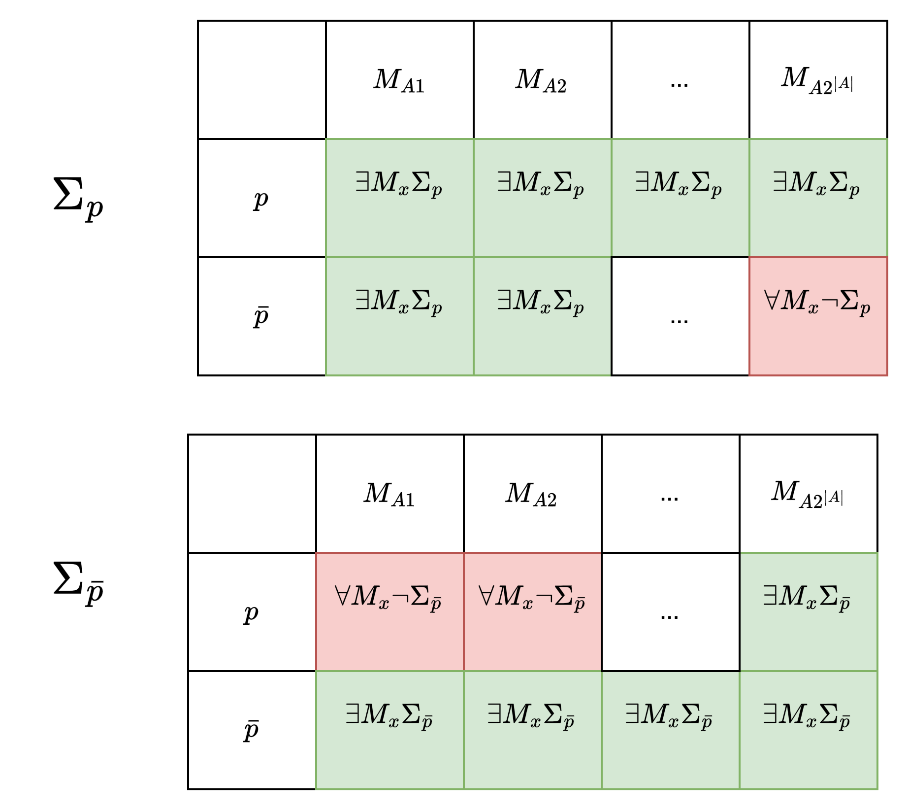
Verifying SMMT theory Lemmas: One-sided Propositional Definitions - Intuition
$Σ_{p}$ ${∧ Σ}_{\overline{p}}$ ($Σ$) defines the predicate exactly
SAT for $Σ_{p}$ iff UNSAT for $Σ_{\overline{p}} ,$
and vise-versa
We can transform $Σ$ into $Σ_{p}$ or $Σ_{\overline{p}}$

Slide 99
Verifying SMMT theory Lemmas: Propositional Definitions
Propositional Logic Constraints in CNF
We can provide the propositional definitions for the predicate
+ Finite Domain Monotonic Theories

Slide 100
Verifying SMMT theory Lemmas: One-sided Propositional Definitions
v1 is reachable
$$Σ_{p} ≔$$
$$a⇒v1$$
$$v1∧c⇒v3$$
$$v3∧h⇒t$$
$t⇒p$…
Propositional Logic Constraints in CNF
Definition for positive predicate $p$: $Σ_{p}$
If edge a is enabled
If t is reachable
Predicate p holds
+ Finite Domain Monotonic Theories
$Σ_{p}$ verifies all positive lemmas via refutation:
$Σ_{p}⊨ \left(a∧c∧h\right)⇒p$
(i.e., $Σ_{p}∧a∧c∧h∧\overline{p}$is UNSAT)
Contribution 1: Introduce one-sided proposition definitions for refutation proof
Notes:
Formal first then example
→ Make multiple path and brancing … in the middle

Slide 101
Verifying SMMT theory Lemmas: One-sided Propositional Definitions (2)
$Σ_{\overline{p}} ≔$ step-wise reachability
Propositional Logic Constraints in CNF
Definition for negative predicate $\overline{p}$: $Σ_{\overline{p}}$
+ Finite Domain Monotonic Theories
$Σ_{\overline{p}}$ verifies all positive lemmas via refutation:
$Σ_{p}⊨ \left(a∧c∧h\right)⇒p$
(i.e., $Σ_{p}∧a∧c∧h∧\overline{p}$is UNSAT)
Notes:
As a side … cycle makes sigma_p doesn’t make it

Slide 102
Verifying SMMT theory Lemmas: Horn Propositional Definitions
$$Σ_{p} ≔ a⇒v1, b⇒v2,$$
$$v1∧c⇒v3, v2∧d⇒v4\text{,}$$
$$v3∧e ⇒v2, v3∧h⇒vt,$$
$v3∧f⇒v4$, $v4∧g⇒t$
$$t⇒p$$
For every $p$ lemma
$$⊨$$
$$a ,c , f, g ⇒p$$
$$⊨$$
$Σ_{\overline{p}} ≔$ step-wise unreachability
$$¬c, ¬d ⇒¬p$$
For every$\overline{ p}$ lemma

Slide 103
Verifying SMMT theory Lemmas: Horn Propositional Definitions
$$Σ_{p} ≔ a⇒v1, b⇒v2,$$
$$v1∧c⇒v3, v2∧d⇒v4\text{,}$$
$$v3∧e ⇒v2, v3∧h⇒vt,$$
$v3∧f⇒v4$, $v4∧g⇒t$
$$t⇒p$$
For every lemma in the theory of $p$
$$⊨$$
$$a ,c , f, g ⇒p$$
Expensive (NP-complete)
$$⊨$$
$Σ_{\overline{p}} ≔$ step-wise unreachability
$$¬c, ¬d ⇒¬p$$
For every$\overline{ p}$ lemma
Notes:
This check is expensive

Slide 104
Verifying SMMT theory Lemmas: Horn Propositional Definitions
$$Σ_{p} ≔ a⇒v1, b⇒v2,$$
$$v1∧c⇒v3, v2∧d⇒v4\text{,}$$
$$v3∧e ⇒v2, v3∧h⇒vt,$$
$v3∧f⇒v4$, $v4∧g⇒t$
$$t⇒p$$
For every lemma in the theory of $p$
$$⊨$$
$$a ,c , f, g ⇒p$$
If it is Horn
Expensive (NP-complete)
$$⊨$$
$Σ_{\overline{p}}^{h} ≔$ step-wise unreachability
$$¬c, ¬d ⇒¬p$$
For every$\overline{ p}$ lemma

Slide 105
Verifying SMMT theory Lemmas: Horn Propositional Definitions
$$Σ_{p} ≔ a⇒v1, b⇒v2,$$
$$v1∧c⇒v3, v2∧d⇒v4\text{,}$$
$$v3∧e ⇒v2, v3∧h⇒vt,$$
$v3∧f⇒v4$, $v4∧g⇒t$
$$t⇒p$$
For every lemma in the theory of $p$
$$⊨$$
$$a ,c , f, g ⇒p$$
If it is Horn
$$⊢_{1}$$
$Σ_{\overline{p}}^{h} ≔$ step-wise unreachability
$$¬c, ¬d ⇒¬p$$
For every$\overline{ p}$ lemma

Slide 106
Verifying SMMT theory Lemmas: Horn Propositional Definitions
$$Σ_{p} ≔ a⇒v1, b⇒v2,$$
$$v1∧c⇒v3, v2∧d⇒v4\text{,}$$
$$v3∧e ⇒v2, v3∧h⇒vt,$$
$v3∧f⇒v4$, $v4∧g⇒t$
$$t⇒p$$
For every lemma in the theory of $p$
$$⊨$$
$$a ,c , f, g ⇒p$$
If it is Horn
Unit Propagation, efficient!
$$⊢_{1}$$
$Σ_{\overline{p}}^{h} ≔$ step-wise unreachability
$$¬c, ¬d ⇒¬p$$
For every$\overline{ p}$ lemma

Slide 107
Verifying SMMT theory Lemmas: Horn Propositional Definitions
$$Σ_{p} ≔ a⇒v1, b⇒v2,$$
$$v1∧c⇒v3, v2∧d⇒v4\text{,}$$
$$v3∧e ⇒v2, v3∧h⇒vt,$$
$v3∧f⇒v4$, $v4∧g⇒t$
$$t⇒p$$
For every lemma in the theory of $p$
Contribution 2:
Yes, $Σ_{\overline{p}}$ can always be rewritten as $Σ_{\overline{p}}^{h}$
$$⊨$$
$$a ,c , f, g ⇒p$$
If it is Horn
Unit Propagation, efficient!
$$⊢_{1}$$
$Σ_{\overline{p}}^{h} ≔$ step-wise unreachability
$$¬c, ¬d ⇒¬p$$
For every$\overline{ p}$ lemma
Notes:
Practice!
Rewritten practice is easy because of one sidedness

Slide 108
Verifying SMMT theory Lemmas: Horn Propositional Definitions
$$Σ_{p} ≔ a⇒v1, b⇒v2,$$
$$v1∧c⇒v3, v2∧d⇒v4\text{,}$$
$$v3∧e ⇒v2, v3∧h⇒vt,$$
$v3∧f⇒v4$, $v4∧g⇒t$
$$t⇒p$$
For every lemma in the theory of $p$
But $Σ_{\overline{p}}^{h}$ can be large (exponential)
Contribution 2:
Yes, $Σ_{\overline{p}}$ can always be rewritten as $Σ_{\overline{p}}^{h}$
$$⊨$$
$$a ,c , f, g ⇒p$$
If it is Horn
Unit Propagation, efficient!
$$⊢_{1}$$
$Σ_{\overline{p}}^{h} ≔$ step-wise unreachability
$$¬c, ¬d ⇒¬p$$
For every$\overline{ p}$ lemma
Notes:
Practice more

Slide 109
Verifying SMMT theory Lemmas: Horn Propositional Definitions
$$Σ_{p} ≔ a⇒v1, b⇒v2,$$
$$v1∧c⇒v3, v2∧d⇒v4\text{,}$$
$$v3∧e ⇒v2, v3∧h⇒vt,$$
$v3∧f⇒v4$, $v4∧g⇒t$
$$t⇒p$$
For every lemma in the theory of $p$
$$⊨$$
$$a ,c , f, g ⇒p$$
If it is Horn
Unit Propagation, efficient!
$$⊢_{1}$$
$Σ_{\overline{p}}^{h} ≔$ step-wise reachability
$$¬c, ¬d ⇒¬p$$
For every lemma in the theory of $\overline{p}$

Slide 110
Verifying SMMT theory Lemmas: Horn Propositional Definitions
Problem: Checking $⊨$ is generally expensive (NP-complete). Inefficient for verifying lemmas
$Σ_{p}$ for verifying all positive lemmas via refutation:
$Σ_{p}⊨ \left(a∧c∧h\right)⇒p$
(i.e., $Σ_{p}∧a∧c∧h∧\overline{p}$is UNSAT)
Contribution 2
Good news: Definition for monotonic predicates can be expressed in Horn $Σ_{p}^{h}$. Efficient lemma verification
If $Σ_{p}$ is a set of Horn clauses ($Σ_{p}^{h}$), then
$Σ_{p}^{h}⊢_{1} \left(a∧c∧h\right)⇒p$
(i.e., $Σ_{p}∧a∧c∧h∧\overline{p}$can reach UNSAT
via unit propagation)
But size of $Σ_{p}^{h}$ might be exponential!

Slide 111
Verifying SMMT theory Lemmas: Horn upper-bound
Observation: A small portion of $Σ_{\overline{p}}$ can verify a given theory lemma $L$!
$$⊨$$
$$Σ_{\overline{p}}$$
every$\overline{ p}$ lemma
$$⊨$$
$$¬c, ¬d ⇒¬p$$

Slide 112
Verifying SMMT theory Lemmas: Horn upper-bound
Observation: A small portion of $Σ_{\overline{p}}$ can verify a given theory lemma $L$!
$$⊨$$
$$Σ_{\overline{p}}$$
every$\overline{ p}$ lemma
We can weaken $Σ_{\overline{p}}$
$$⊨$$
$$¬c, ¬d ⇒¬p$$

Slide 113
Verifying SMMT theory Lemmas: Horn upper-bound
Observation: A small portion of $Σ_{\overline{p}}$ can verify a given theory lemma $L$!
$$⊨$$
$$Σ_{\overline{p}}$$
every$\overline{ p}$ lemma
1. over-approximation
$$⊨$$
$$⊨$$
$$Σ_{\overline{p}}^{↑}$$
$$¬c, ¬d ⇒¬p$$

Slide 114
Verifying SMMT theory Lemmas: Horn upper-bound
Observation: A small portion of $Σ_{\overline{p}}$ can verify a given theory lemma $L$!
$$⊨$$
$$Σ_{\overline{p}}$$
every$\overline{ p}$ lemma
1. over-approximation
$$⊨$$
$$⊨$$
$$⊨$$
$$Σ_{\overline{p}}^{↑}$$
$$¬c, ¬d ⇒¬p$$
2. sufficient

Slide 115
Verifying SMMT theory Lemmas: Horn upper-bound
Observation: A small portion of $Σ_{\overline{p}}$ can verify a given theory lemma $L$!
$$⊨$$
$$Σ_{\overline{p}}$$
every$\overline{ p}$ lemma
1. over-approximation
$$⊨$$
$$⊨$$
$$⊨$$
$$Σ_{\overline{p}}^{↑}$$
$$¬c, ¬d ⇒¬p$$
3. Small (linear)
2. sufficient

Slide 116
Verifying SMMT theory Lemmas: Horn upper-bound
Observation: A small portion of $Σ_{\overline{p}}$ can verify a given theory lemma $L$!
$$⊨$$
$$Σ_{\overline{p}}$$
every$\overline{ p}$ lemma
1. over-approximation
$$⊨$$
4. Horn
$$⊨$$
$$⊨$$
$$Σ_{\overline{p}}^{h↑}$$
$$¬c, ¬d ⇒¬p$$
3. Small (linear)
2. sufficient

Slide 117
Verifying SMMT theory Lemmas: Horn upper-bound
Contribution 3: on-the-fly transformation to over-approximate predicate definition into Horn definitions
Observation: A small portion of $Σ_{\overline{p}}$ can verify a given theory lemma $L$!
Over-approximate $Σ_{\overline{p}}$ by instantiating $Σ_{p}$ with appriropate witness (duality between $Σ_{\overline{p}}$ and $Σ_{\overline{p}}$)
$$⊨$$
$$Σ_{\overline{p}}$$
every$\overline{ p}$ lemma
1. over-approximation
$$⊨$$
4. Horn
$$⊨$$
$$⊢_{1}$$
$$Σ_{\overline{p}}^{h↑}$$
$$¬c, ¬d ⇒¬p$$
3. Small (linear)
2. sufficient
Unit Propagation, efficient!
Notes:
Don’t apologize,
It will not work in a talk!

Slide 118
Verifying SMMT theory Lemmas: Horn upper-bound – Main Result
$Σ_{p} {\left.​\right|}_{\overline{p} ∪M_{X} }⇒\overline{p}$ is a Horn upper-bound of $Σ_{\overline{p}}$
$M_{X}$ is a witness assignment over auxiliary variables
$$Σ_{p} ≔ a⇒v1, b⇒v2,$$
$$v1∧c⇒v3, v2∧d⇒v4\text{,}$$
$$v3∧e ⇒v2, v3∧h⇒v_{4},$$
$v3∧f⇒v4$, $v4∧g⇒t$
$$t⇒p$$

Slide 119
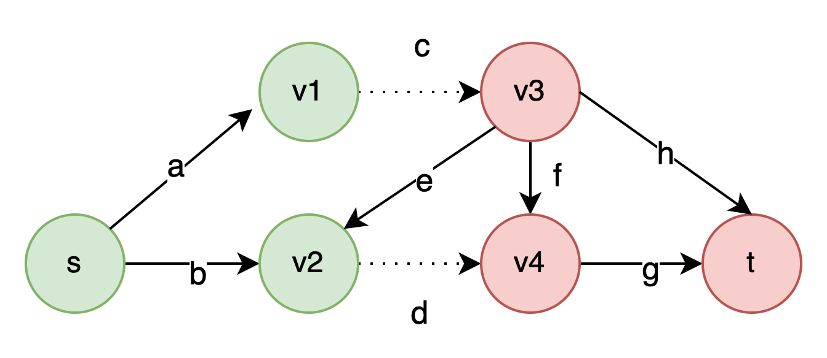
Verifying SMMT theory Lemmas: Horn upper-bound – Main Result
$Σ_{p} {\left.​\right|}_{\overline{p} ∪M_{X} }⇒\overline{p}$ is a Horn upper-bound of $Σ_{\overline{p}}$
$M_{X}$ is a witness assignment over auxiliary variables
$$Σ_{p} ≔ a⇒v1, b⇒v2,$$
$$v1∧c⇒v3, v2∧d⇒v4\text{,}$$
$$v3∧e ⇒v2, v3∧h⇒v_{4},$$
$v3∧f⇒v4$, $v4∧g⇒t$
$$t⇒p$$

Slide 120
Verifying SMMT theory Lemmas: Horn upper-bound – Main Result
$Σ_{p} {\left.​\right|}_{\overline{p} ∪M_{X} }⇒\overline{p}$ is a Horn upper-bound of $Σ_{\overline{p}}$
$M_{X}$ is a witness assignment over auxiliary variables
$$Σ_{p}{\left.​\right|}_{v1} ≔ a⇒⊤, b⇒v2,$$
$$v1∧c⇒v3, v2∧d⇒v4\text{,}$$
$$v3∧e ⇒v2, v3∧h⇒v_{4},$$
$v3∧f⇒v4$, $v4∧g⇒t$
$$t⇒p$$

Slide 121
Verifying SMMT theory Lemmas: Horn upper-bound – Main Result
$Σ_{p} {\left.​\right|}_{\overline{p} ∪M_{X} }⇒\overline{p}$ is a Horn upper-bound of $Σ_{\overline{p}}$
$M_{X}$ is a witness assignment over auxiliary variables
$$Σ_{p}{\left.​\right|}_{M_{X}∪\overline{p}} ≔ a⇒⊤, b⇒⊤,$$
$$⊤∧c⇒⊥, ⊤∧d⇒⊥\text{,}$$
$$⊥ ∧e ⇒⊤, ⊥∧h⇒ ⊥,$$
$⊥ ∧f⇒⊥$, $⊥ ∧g⇒t$
$⊥ ⇒⊥$

Slide 122
Verifying SMMT theory Lemmas: Horn upper-bound – Main Result
$Σ_{p} {\left.​\right|}_{\overline{p} ∪M_{X} }⇒\overline{p}$ is a Horn upper-bound of $Σ_{\overline{p}}$
$M_{X}$ is a witness assignment over auxiliary variables
$$Σ_{p}{\left.​\right|}_{M_{X}∪\overline{p}} ≔⊤, b⇒⊤,$$
$$⊤∧c⇒⊥, ⊤∧d⇒⊥\text{,}$$
$$⊥ ∧e ⇒⊤, ⊥∧h⇒ ⊥,$$
$⊥ ∧f⇒⊥$, $⊥ ∧g⇒t$
$⊥ ⇒⊥$

Slide 123
Verifying SMMT theory Lemmas: Horn upper-bound – Main Result
$Σ_{p} {\left.​\right|}_{\overline{p} ∪M_{X} }⇒\overline{p}$ is a Horn upper-bound of $Σ_{\overline{p}}$
$M_{X}$ is a witness assignment over auxiliary variables
$$Σ_{p}{\left.​\right|}_{M_{X}∪\overline{p}} ≔ \overline{c}∧\overline{d}$$

Slide 124
Verifying SMMT theory Lemmas: Horn upper-bound – Main Result
$Σ_{p} {\left.​\right|}_{\overline{p} ∪M_{X} }⇒\overline{p}$ is a Horn upper-bound of $Σ_{\overline{p}}$
$M_{X}$ is a witness assignment over auxiliary variables
$$Σ_{p}{\left.​\right|}_{M_{X}∪\overline{p}} ≔ \overline{c}∧\overline{d}$$
$Σ_{p}{\left.​\right|}_{M_{X}∪\overline{p}}⇒\overline{p} ≔ \overline{c}∧\overline{d}⇒\overline{p}$

Slide 125
Verifying SMMT theory Lemmas: Horn upper-bound – Main Result
$Σ_{p} {\left.​\right|}_{\overline{p} ∪M_{X} }⇒\overline{p}$ is a Horn upper-bound of $Σ_{\overline{p}}$
$M_{X}$ is a witness assignment over auxiliary variables
O(E * N log(N)), Non-horn
$$Σ_{p}{\left.​\right|}_{M_{X}∪\overline{p}} ≔ \overline{c}∧\overline{d}$$
O(N), Horn
$Σ_{p}{\left.​\right|}_{M_{X}∪\overline{p}}⇒\overline{p} ≔ \overline{c}∧\overline{d}⇒\overline{p}$
$Σ_{\overline{p}} ≔$ step-wise reachability

Slide 126
Outline
Background: SAT Modular Monotonic Theories
Approach:
Proof Certificate for SMMT
Check SMMT Proof Certificate
Check SMMT theory Lemma
Evaluation

Slide 127
Outline
Background: SAT Modular Monotonic Theories
Approach:
Proof Certificate for SMMT
Check SMMT Proof Certificate
Check SMMT theory Lemmas
Evaluation

Slide 128
Evaluation
We implement a MonoProof (Solving + proof checking) based on MonoSAT
We would like to measure
MonoProof’s runtime overhead for proofs generation
End-to-end Performance of MonoProof vs. :
Pure bit-blasting (BB)
Lemma-specific bit-blasting (LSBB)
We evaluate MonoProof, BB and LSBB on:
Network Reachability Benchmark (24 instances)
BGA escape routing problems (24 instances)
Bit-blast and then solve with SAT solver
Solve with SMMT, and use SAT solver to prove theory lemmas
Notes:
Do the highlighting style when covering each point, especially for BB and LSBB
2:30 -> reduce

Slide 129
Evaluation Result: Runtime Overhead
MonoProof runtime overhead:
average (geometric mean): 7.41%, worst: 28.8%
On Network Reachability instances: average (geometric mean): 14.10%, worst: 28.8%
On BGA Routing instances:
average (geometric mean): 1.11%, worst: 5.71%
Mostly I/O for emitting proof certificate and witness
Notes:
Talking too fast, practice
Okay number, do not go over the numbers

Slide 130
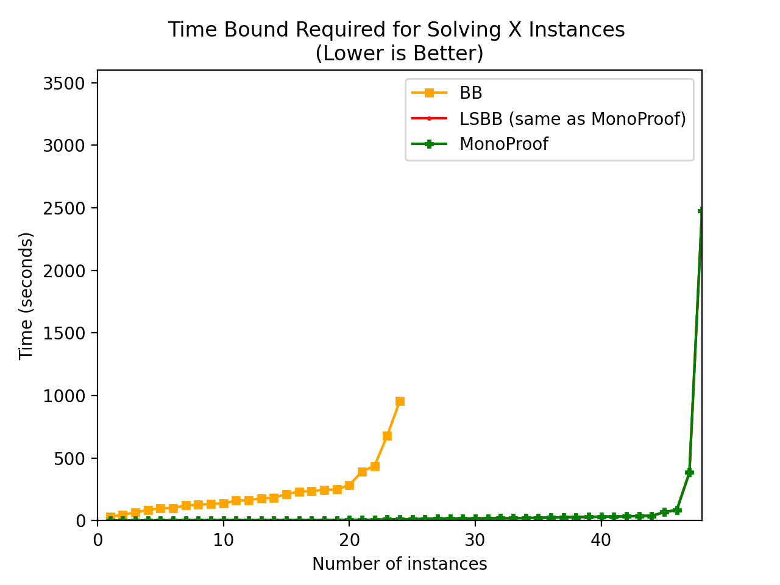
Evaluation Result: End-to-end Performance
MonoProof performance comparison with BB and LSBB:
MonoProof and LSBB solved all (using the same solver)
BB Solved 24 network reachability instances
Pure-blasting is not effective, we need theory reasoning
Notes:
Rushed, hit the key point
Let’s take a quick look and the solving time, BB blows up ….

Slide 131
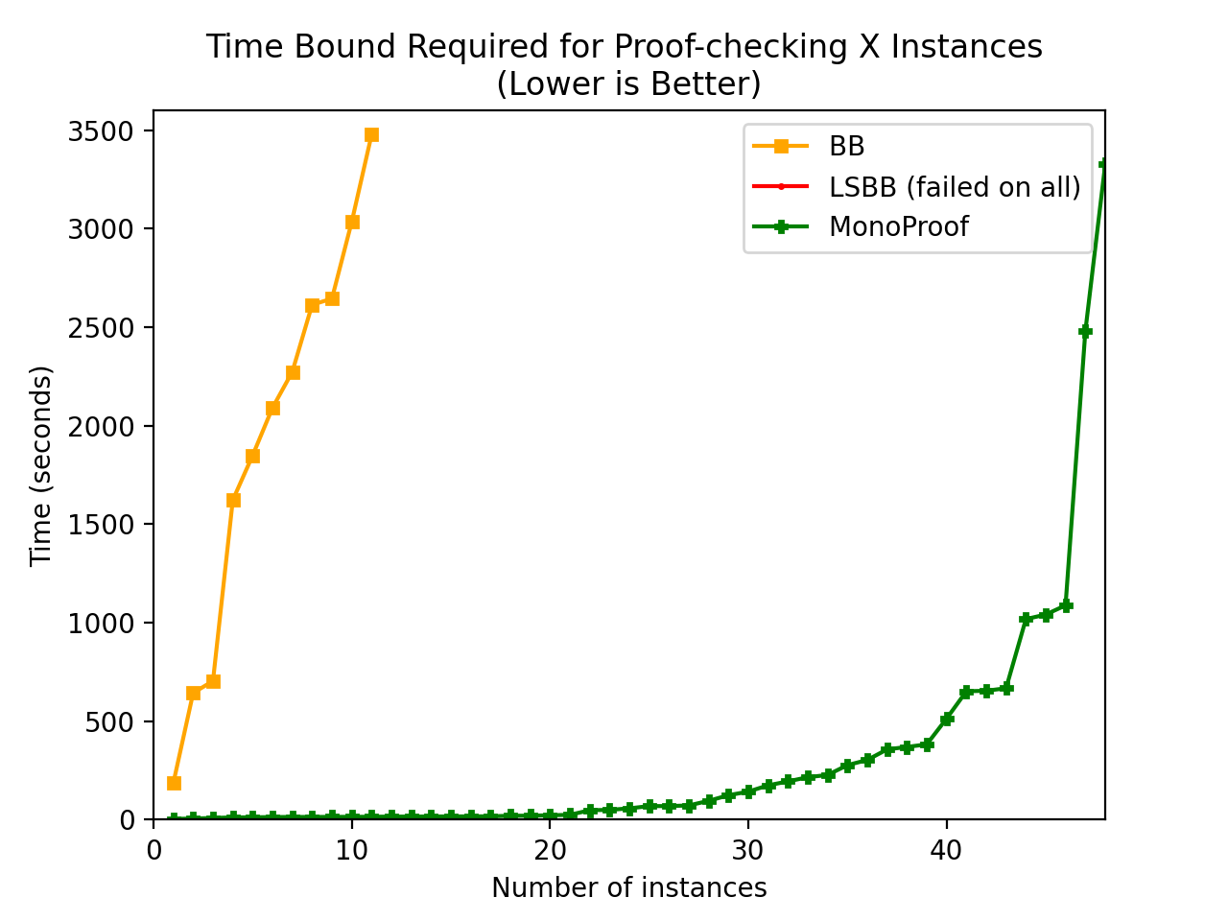
Evaluation Result: End-to-end Performance
MonoProof performance comparison with BB and LSBB:
MonoProof proved all instances (48/48)
BB proved 14/24 instances
Pure-blasting is not effective, we need theory reasoning
LSB timed out on all instances
(0 /48)
Benefit of Horn and Over-approximating

Slide 132
Conclusion
Practical aspect:
Efficient and scalable DRAT proof generation method for SMMT
Theoretical aspect:
Introduce one-sided proposition definitions for refutation proof
Show SMMT theories expressed in Horn theory
Propose on-the-fly transformation to over-approximate CNF definition of theory predicates into Horn definitions
Present efficient definitions for monotonic theories used in practice: (1) graph reachability, (2) bit-vector summation & (3) comparison, and (4) maximum flow
Notes:
Too long, objective to reduce:
Pracital aspect: re-explain
Theoretical: just mention they have a lot of things going on, but not to go through them.
Thank you!

Slide 133
Background: SMMT – Monotonic Predicate
Positive monotonic predicate:
$p\left(v_{1},v_{2}…¬v_{i} …v_{n}\right)⇒p\left(v_{1},v_{2}…v_{i} …v_{n}\right)$
Example graph s-t reachability:
If edge a is presented in the graph
Input: a, b, c … h
Output: exists a path from s to t
Example: $Rea{ch}_{s→t }∧\overline{Reach_{v1→v4}}$
Enabling an edge won’t make target less reachable
Disabling an edge won’t make target more reachable
Notes:
Monotonic theories consistent of finite domain monotonic functions and predicates
Assuming predicates, input are Boolean

Slide 134
Future Work
Practical aspect:
Enable SMMT proof generation for more efficient and expressive proof framework such LRAT, FRAT and DPR
Theoretical aspect:
Connect our witness-based lemma-specific Horn approximation to propagation redundancy (and PR proof system)
Extend our witness-based approximation beyond finite domain theories

Slide 135
Check Proof Certificate: Backward Check
Causal Proof
L1,
L2,
T3,
T4,
…..
Ti
….
Ln
UNSAT
Starts from UNSAT backwards, check dependent lemmas:
Propositional lemmas can be checked via RAT
L propositional lemmas:
$$v_{1}∨v_{2} …v_{i}$$
Theory lemmas are assumed valid. To be verified later
T Theory lemmas:
$${¬e}_{1}, ¬e_{2} …. ⇒¬reach_{s}^{t}$$
The focus of the talk
How to verify monotonic theory lemmas (e.g. graph reachability lemmas)?

Slide 136
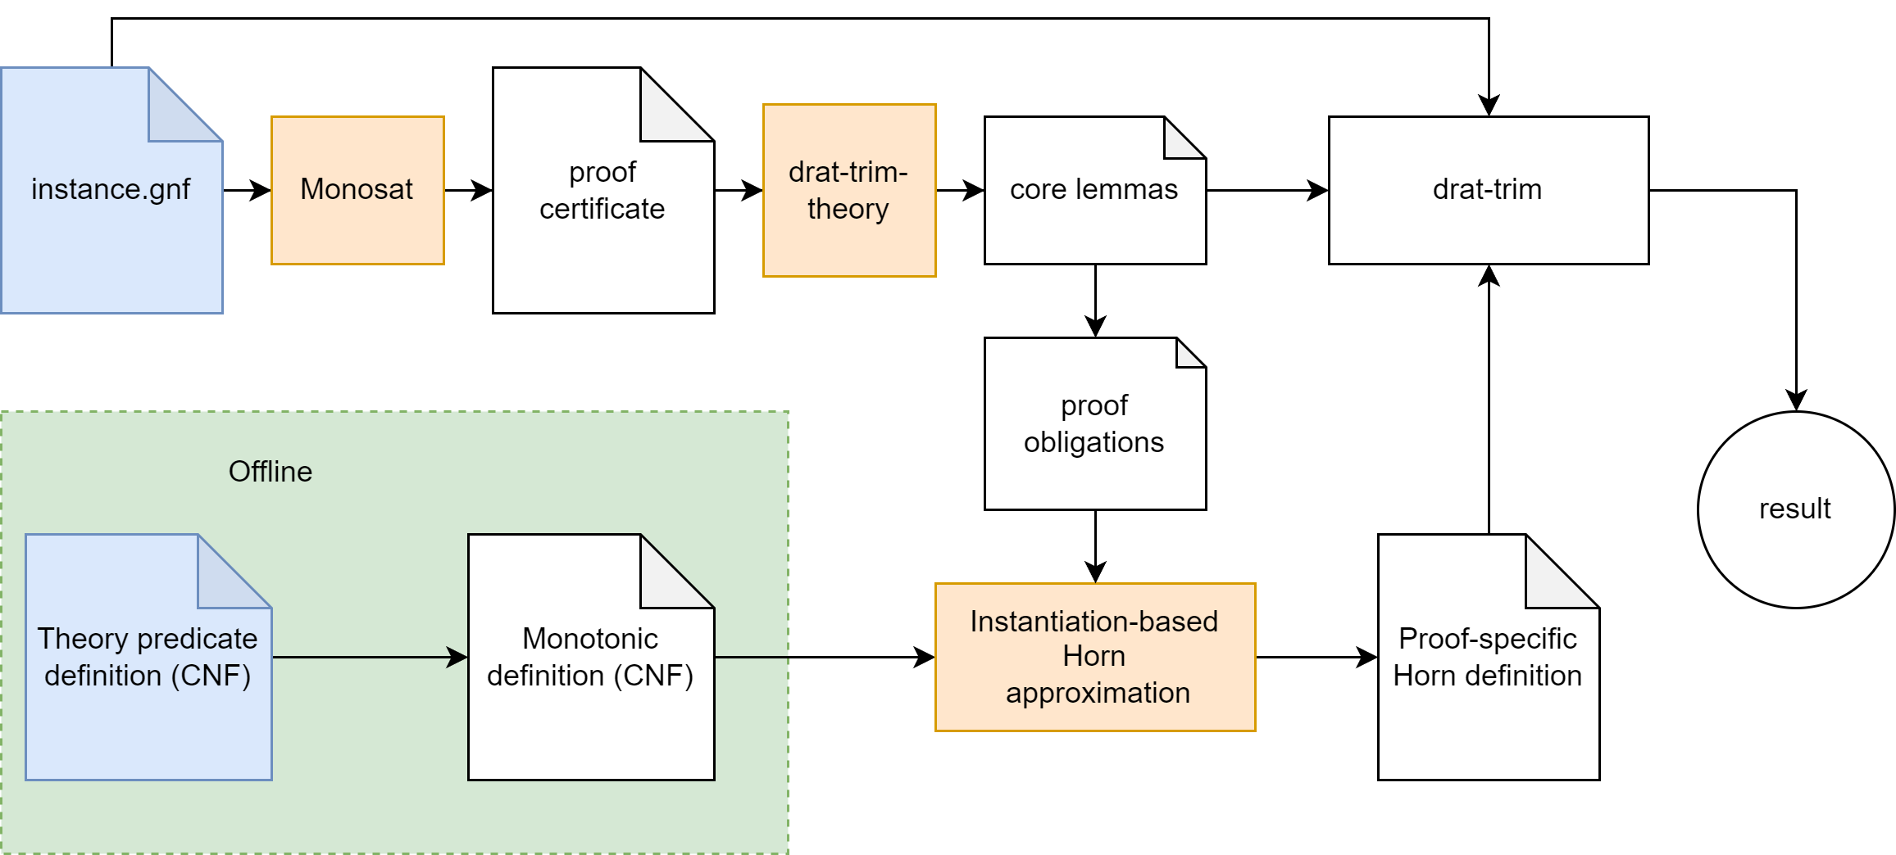
Thank you!

Slide 137
Verifying SMMT theory Lemmas: One-sided Propositional Definitions
Check our paper for extracting $Σ_{p}∪Σ_{\overline{p} }$ from $Σ$
Propositional Logic Constraints in CNF
$Σ_{p}$ for verifying all positive lemmas via refutation:
$Σ_{p}⊨ \left(a∧c∧h\right)⇒p$
(i.e., $Σ_{p}∧a∧c∧h∧\overline{p}$is UNSAT)
Encode predicate definitions
into CNF $Σ≔Σ_{p}∪Σ_{\overline{p} }$
$$Σ_{p} ≔ a⇒v1$$
$$v1∧c⇒v3$$
$$v3∧h⇒t$$
$t⇒p$…
+ Finite Domain Monotonic Theories
$Σ_{\overline{p} }$for verifying all negative lemmas via refutation:
$Σ_{\overline{p} }⊨ \left(\overline{c}∧\overline{d}\right)⇒\overline{p}$
(i.e.,$Σ_{\overline{p} }∧\overline{c}∧\overline{d}∧p$ is UNSAT)

Slide 138
Instantiation-Based, Lemma Specific Horn Definition (1)
We aim to find a $Σ_{\overline{p}}^{h↑}$ for a predicate $p$ and lemma $M_{Ai}⇒¬p$
Duality: For input assignment $M_{A}:$
$Σ_{p}∧M_{A}∧\overline{p}$ is satisfiable
if and only if
$Σ_{\overline{p}}∧M_{A}∧p$ is UNSAT
X are auxiliary variables
$p$is a deterministic predicate

Slide 139
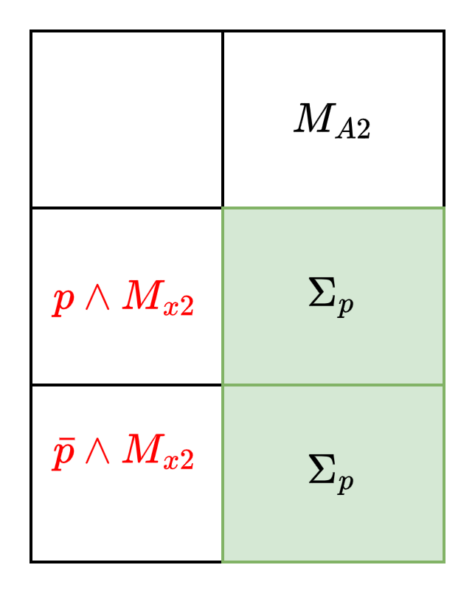
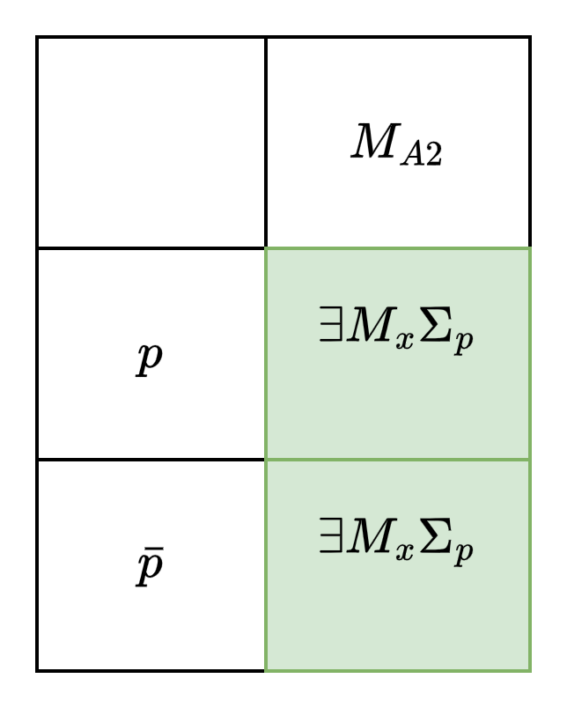
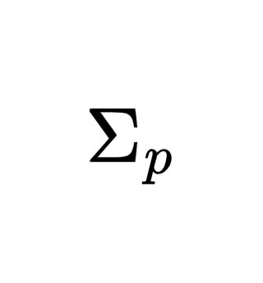
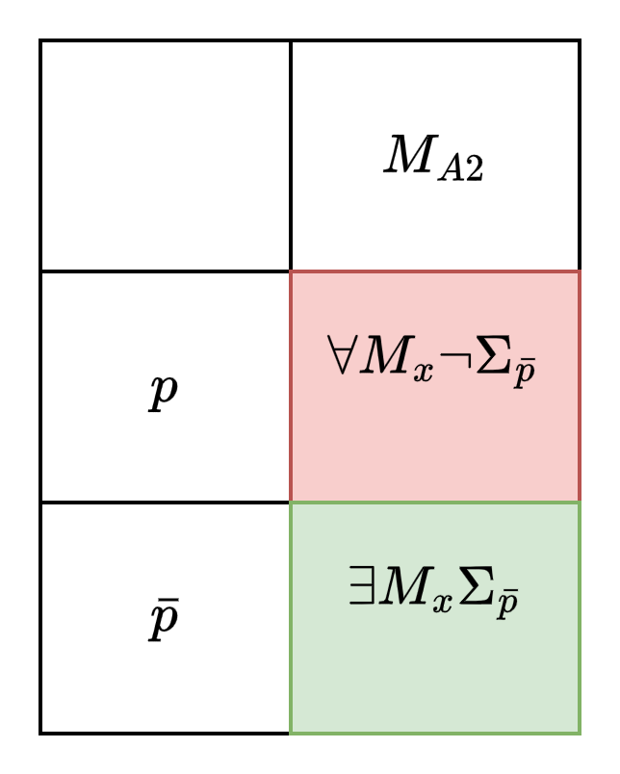
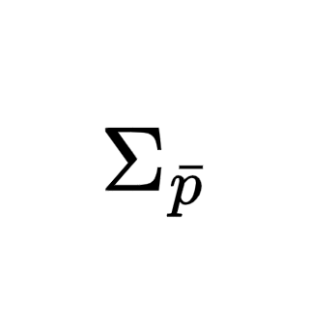
Instantiation-Based, Lemma Specific Horn Definition (2)
We aim to find a $Σ_{\overline{p}}^{h↑}$ for a predicate $p$ and lemma${ M}_{A2}⇒¬p$
A$ssert M_{x2}$
Find such $M_{x2}$
For every $M_{Ai}$,
If $Σ_{p}∧M_{x2}∧M_{Ai}∧\overline{p}$
is$⊤$ then
$Σ_{\overline{p}}∧M_{A}∧p$
is UNSAT
However, If $Σ_{p}∧M_{x2}∧M_{Ai}∧\overline{p}$Is $⊥$ DOES NOT imply $Σ_{\overline{p}}∧M_{A}∧p$
is satisfiable

Slide 140
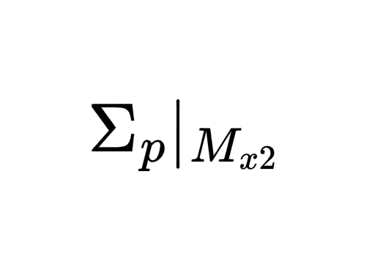
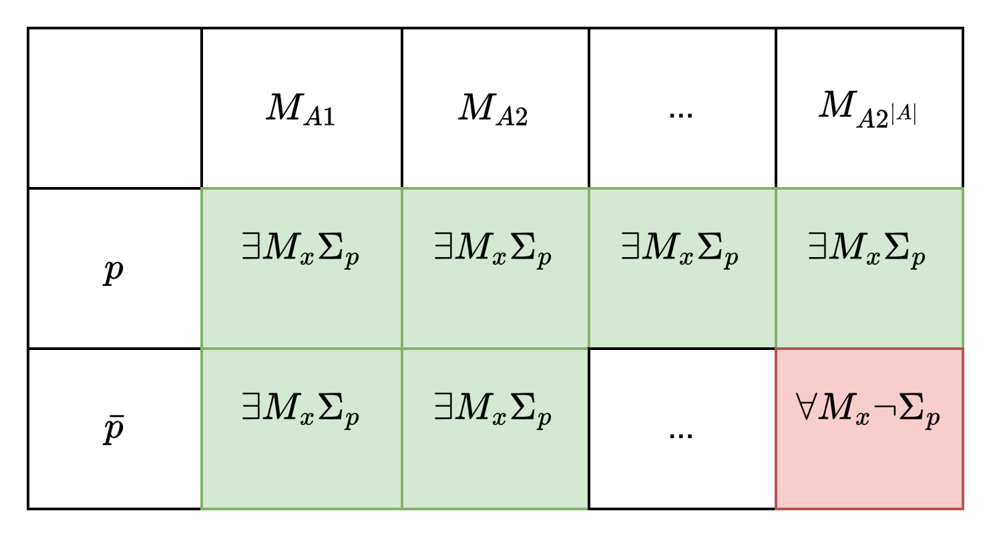
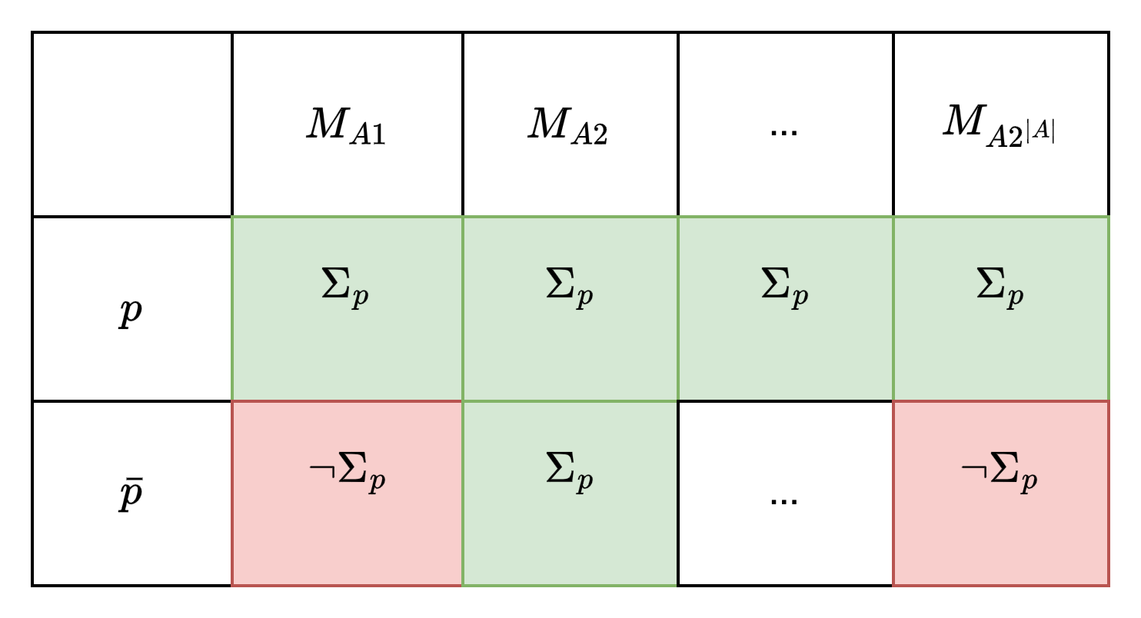
Instantiation-Based, Lemma Specific Horn Definition (3)
The size of reduced formula is linear to $Σ_{p}$ (small)
Reduce $Σ_{p}$ by $M_{x2}$
It does not cover for other assignment $M_{Ai}$
$M_{x2}$ guarantees $M_{p}{\left.​\right|}_{M_{x2}}$ is True (sufficient)

Slide 141
Instantiation-Based, Lemma Specific Horn Definition (4)
We aim to find a $Σ_{\overline{p}}^{h↑}$ for a predicate $p$ and lemma${ M}_{A2}⇒¬p$
For every $M_{Ai}$,
If $Σ_{p}∧M_{x2}∧M_{Ai}∧\overline{p}$
is$⊤$ then
$Σ_{\overline{p}}∧M_{A}∧p$
is UNSAT
$Imply(Σ_{p}{\left.​\right|}_{M_{x2}} , \overline{p})$ is logically implied by $Σ_{\overline{p}}$(upper-bound)

Slide 142
Instantiation-Based, Lemma Specific Horn Definition (4)
For ${ M}_{A2}⇒¬p$, we encode $Imply(Σ_{p}{\left.​\right|}_{M_{x2}} , \overline{p})$ as the Horn upper-bound $Σ_{\overline{p}}^{h↑}$
The size of $Σ_{\overline{p}}^{h↑}$is linear to $Σ_{p}$ (Small)
$Σ_{\overline{p}}^{h↑}$is logically implied by $Σ_{p}$ (Upper-bound)
$Σ_{\overline{p}}^{h↑}$is a set of Horn clauses (Horn)
$Σ_{\overline{p}}^{h↑}$is sufficient to imply the target theory lemma $L$ (Sufficient)
$Σ_{\overline{p}}^{h↑}$is lemma specific Horn definition of $p$ such that $Σ_{p}^{h↑}⊢_{1}{ M}_{A2}⇒¬p$
Please check our paper

Slide 143
Lemma Specific Horn Definition: Graph Reachability
Naive Definition $Σ_{\overline{p}}$:
Vertex t is reachable from s within 4 steps!
Size O(N^2 E)
$$Σ_{p} ≔ a⇒v1$$
$$v1∧c⇒v3$$
$$v3∧h⇒t,$$
$t⇒p$…
Theory Lemma $¬c, ¬d ⇒¬p$
Lemma Specific Definition $Σ_{\overline{p}}^{h↑}$: Imply($Σ_{p}{\left.​\right|}_{v1∧v2∧\overline{v3}∧\overline{v4}∧\overline{t}}, \overline{p})$
Size O(E)
Witnesses can be obtained via SAT solving, but are often available in SMMT solver (e.g., node reachability info under a cut)
$v1∧v2∧\overline{v3}∧\overline{v4}∧\overline{t}$ is the witness for the lemma

Slide 144
MonoProof
Our main contributions!

Slide 145
Lemma Specific Horn Definition: Horn upper-bound – Example (3)
Naive Definition $Σ_{\overline{p}}$:
Vertex t is reachable from s within 4 steps!
Size O(N^2 E)
$$Σ_{p} ≔ a⇒v1$$
$$v1∧c⇒v3$$
$$v3∧h⇒t,$$
$t⇒p$…
Theory Lemma $¬c, ¬d ⇒¬p$
Lemma Specific Definition $Σ_{\overline{p}}^{h↑}$: Imply($Σ_{p}{\left.​\right|}_{v1∧v2∧\overline{v3}∧\overline{v4}∧\overline{t}}, \overline{p})$
Size O(E)
Witnesses can be obtained via SAT solving, but are often available in SMMT solver (e.g., node reachability info under a cut)
$v1∧v2∧\overline{v3}∧\overline{v4}∧\overline{t}$ is the witness for the lemma

Slide 146
Lemma Specific Horn Definition: Intuition
We aim to find a $Σ_{\overline{p}}^{h↑}$ for a predicate $p$ and lemma${ M}_{A2}⇒¬p$
A$ssert M_{x2}$
Find such $M_{x2}$
For every $M_{Ai}$,
If $Σ_{p}∧M_{x2}∧M_{Ai}∧\overline{p}$
is$⊤$ then
$Σ_{\overline{p}}∧M_{A}∧p$
is UNSAT
However, If $Σ_{p}∧M_{x2}∧M_{Ai}∧\overline{p}$Is $⊥$ DOES NOT imply $Σ_{\overline{p}}∧M_{A}∧p$
is satisfiable

Slide 147
Verifying SMMT theory Lemmas: Horn upper-bound – Main Result
$Σ_{p} {\left.​\right|}_{\overline{p} ∪M_{X} }⇒\overline{p}$ is a Horn upper-bound of $Σ_{\overline{p}}$
$M_{X}$ is a witness assignment over auxiliary variables
O(N), Horn
$$Σ_{p}{\left.​\right|}_{M_{X}∪\overline{p}} ≔ \overline{c}∧\overline{d}$$
$Σ_{\overline{p}} ≔$ step-wise reachability
O(E * N log(N)), Non-horn

Slide 148
Verifying SMMT theory Lemmas: Horn upper-bound – Intuition
$Σ_{p} {\left.​\right|}_{\overline{p} ∪M_{X} }⇒\overline{p}$ is a Horn upper-bound of $Σ_{\overline{p}}$
$M_{X}$ is a witness assignment over auxiliary variables
Upper-bound of $Σ_{\overline{p}}$ is computed from $Σ_{p}$???
If we can find $M_{X}$ for $Σ_{p}$, then …

Slide 149
Verifying SMMT theory Lemmas: Horn upper-bound – Example (1)
$$Σ_{p} ≔$$
$$a⇒v1$$
$$v1∧c⇒v3$$
$$v3∧h⇒t$$
$$t⇒p$$
…
Theory Lemma $¬c, ¬d ⇒¬p$
$Σ_{p} {\left.​\right|}_{\overline{p} ∪M_{X} }⇒\overline{p}$ is a Horn upper-bound of $Σ_{\overline{p}}$

Slide 150
Verifying SMMT theory Lemmas: Horn upper-bound – Example (2)
$$Σ_{p} ≔$$
$$a⇒v1$$
$$v1∧c⇒v3$$
$$v3∧h⇒t$$
$$t⇒p$$
…
Obtain witness $M_{X }:$
$$v1, v2, \overline{v3}, \overline{v4 }, \overline{t}$$
Theory Lemma to check $¬c, ¬d ⇒¬p$
Let’s assume all unassigned inputs are $⊤$: edges $a, b, f, g,h$are present
Witness $M_{X}$: node’s reachability under
$$a, b, f, g,h ¬c, ¬d$$
Is often available in SMMT solver
$Σ_{p} {\left.​\right|}_{\overline{p} ∪M_{X} }⇒\overline{p}$ is a Horn upper-bound of $Σ_{\overline{p}}$

Slide 151
Verifying SMMT theory Lemmas: Horn upper-bound – Example (3)
$$Σ_{p} ≔$$
$$a⇒v1$$
$$v1∧c⇒v3$$
$$v3∧h⇒t$$
$$t⇒p$$
…
Obtain witness $M_{X }:$
$$v1, v2, \overline{v3}, \overline{v4 }, \overline{t}$$
Theory Lemma to check $¬c, ¬d ⇒¬p$
$Σ_{p} {\left.​\right|}_{\overline{p} ∪M_{X} }⇒\overline{p}$ :
$$\overline{c }⇒l_{1}∧\overline{d }⇒l_{2}∧ \left(l_{1}∧l_{2}\right)⇒\overline{p}$$
$Σ_{p} {\left.​\right|}_{\overline{p} ∪M_{X} }⇒\overline{p}$ is a Horn upper-bound of $Σ_{\overline{p}}$

Slide 152
Verifying SMMT theory Lemmas: Horn upper-bound – Example (4)
Size O(E * N log(N))
$$Σ_{\overline{p}} ≔$$
$t$is not reachable within 5 steps $⇒\overline{p}$
$t$is not reachable within 5 steps $⇒$
(v3 is not reachable within 4 steps $∨\overline{h}$) $∧$
(v4 is not reachable within 4 steps $∨\overline{g}$)
…
$s$ is reachable in 0 step
Theory Lemma to check $¬c, ¬d ⇒¬p$
Size O(E)
$Σ_{p} {\left.​\right|}_{\overline{p} ∪M_{X} }⇒\overline{p}$ :
$$\overline{c }⇒l_{1}∧\overline{d }⇒l_{2}∧ \left(l_{1}∧l_{2}\right)⇒\overline{p}$$
$Σ_{p} {\left.​\right|}_{\overline{p} ∪M_{X} }⇒\overline{p}$ is a Horn upper-bound of $Σ_{\overline{p}}$

Slide 153
Instantiation-Based, Lemma Specific Horn Definition (4)
For ${ M}_{A2}⇒¬p$, we encode $Imply(Σ_{p}{\left.​\right|}_{M_{x2}} , \overline{p})$ as the Horn upper-bound $Σ_{\overline{p}}^{h↑}$
The size of $Σ_{\overline{p}}^{h↑}$is linear to $Σ_{p}$ (Small)
$Σ_{\overline{p}}^{h↑}$is logically implied by $Σ_{p}$ (Upper-bound)
$Σ_{\overline{p}}^{h↑}$is a set of Horn clauses (Horn)
$Σ_{\overline{p}}^{h↑}$is sufficient to imply the target theory lemma $L$ (Sufficient)
$Σ_{\overline{p}}^{h↑}$is lemma specific Horn definition of $p$ such that $Σ_{p}^{h↑}⊢_{1}{ M}_{A2}⇒¬p$
Please check our paper

Slide 154
Propositional Definition: Common Theories
Bit-vector Sum & Compare :
Constructed from ripple-carry adder network and comparator
(e.g, a + b > c)
$Σ_{p}:$ there exists bit-vectors a’ , b’, c’ such that a’ + b’ > c’ and a>= a’ …
$Σ_{\overline{p}} :$ there exists bit-vectors a*, b*, c*, such that a*+ b* <= c* and a<= a*
Maxflow:
$Σ_{p}:$ There exists a flow assignment… (max flow)
$Σ_{\overline{p}}$: There exists a cut …. (min cut)
Contribution 4: efficient definitions for monotonic theories used in practice:

