Slide 1
Automatic Inference of Code Transforms for Patch Generation
Fan Long, Peter Amidon*, and Martin Rinard
MIT EECS
UCSD*

Slide 2





Generate And Validate Patching
…
if (str != 0) return;
if (str_len) {
…
=
Positive
Inputs
=
=
=
Negative
Inputs
=
≠
Validate each candidate patch against the test suite
Notes:
And then validate each candidate patch against the test suite

Slide 3
Generate And Validate Patching
…
if (str_len
&& ht != 0) {
…
=
Positive
Inputs
=
≠
=
Negative
Inputs
=
Validate each candidate patch against the test suite

Slide 4
Generate And Validate Patching
…
if (str_len
|| str != 0) {
…
=
Positive
Inputs
=
=
=
Negative
Inputs
=
Collect all of the patches that validate
Notes:
The system collects all candidate patches that

Slide 5







Generate And Validate Patching
What kind of modifications do previous patch generation systems apply?
  Search Space
Apply
Modifications
…
Validate with Test Suite
Notes:
Here is the summary about

Slide 6
Generate And Validate Patching
1. Tighten a condition with a clause checking a variable against a constant. (Prophet [POPL’16])
2. Add if-guarded return to check null value. (PAR [ICSE’13])
3. Copy a statement from the same file. (GenProg [ICSE’09])
  Search Space
Apply
Modifications
…
Validate with Test Suite
Notes:
Here is the summary about

Slide 7
Generate And Validate Patching
A set of mutation rules manually crafted by developers of the patch generation system
  Search Space
Apply
Modifications
…
Validate with Test Suite
Notes:
Here is the summary about

Slide 8
Can we learn how developers write patches in the first place?
Notes:
When I was working on prophet, I was always thinking can we learn how developer write patches in the first place?

Slide 9
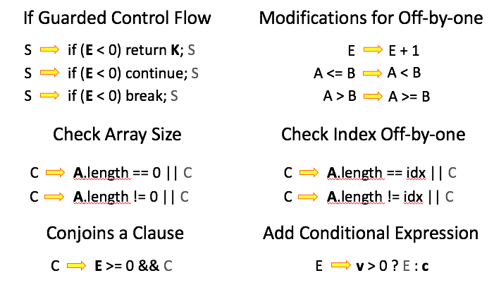
Genesis
Code Transforms
  Infer Code Transforms
  Flexibility
  More productive search space
  Search Space
Apply
Transforms
…
Validate with Test Suite
Notes:
Here is the summary about

Slide 10
Genesis Overview
Candidate Transforms
Training Human Patches
Transform 1
Step 1:
Abstraction and Generalization
Transform 2
…
Transform …

Slide 11
Example: Transforms for Fixing Null Pointer Exception (NPE)
Candidate Transforms
Training Human Patches
Transform 1
Step 1:
Abstraction and Generalization
Transform 2
…
Transform …
if (mapperTypeElement == null ||
MapperPrism.getInstanceof(
mapperTypeElement) == null) { … }
C
(E op₁ null) op₂ C
op₁: {==, !=}
op₂: { ||, && }
A transform with the program-specific aspects abstracted away
An NPE human patch

Slide 12
Example: Transforms for Fixing Null Pointer Exception (NPE)
Candidate Transforms
Training Human Patches
Transform 1
Step 1:
Abstraction and Generalization
Transform 2
…
Transform …
C
(E op₁ null) op₂ C
op₁: {==, !=}
op₂: { ||, && }
C
E == null || C
S
if (E != null) { S; }
Conjoins or disjoins an additional clause to check null value.
Add an if statement to guard an existing statement.

Slide 13
Genesis Overview
Candidate Transforms
Training Human Patches
Transform 1
Step 1:
Abstraction and Generalization
Transform 2
…
Transform …
Patch Generation
Selected Transforms
Step 2:
Navigate the Tradeoff Between Coverage and Tractability

Slide 14

Observed Past Human Patches
C
(E op₁ null) op₂ C
Code Transforms
op₁: {==, !=}
op₂: { ||, && }
S
if (E != null) { S; }
S
if (E == null) return K; S
Goal: Infer a set of transforms to cover the dense areas of the space
Possible Patch Space
Notes:
Here is an intuitive diagram. If we assume a space of all possible patches, there are points in the space correspond to observed past human patches. The hypothesis is that these points will not be uniformed distributed in the space. There will be repetitive patterns so that some areas in the space will be more dense. The goal of Genesis here is to infer a set of transforms that can cover the dense areas of the space.

Slide 15
Step 1: How to obtain each transform via abstraction?
Observed Past Human Patches
C
(E op₁ null) op₂ C
Code Transforms
op₁: {==, !=}
op₂: { ||, && }
S
if (E != null) { S; }
S
if (E == null) return K; S
Possible Patch Space

Slide 16
How to obtain code transforms?
Solution: Generalize transforms from sets of relevant patches.
Notes:
The high level idea here is that a good transform will be used by many human patches, not just a single patch.

Slide 17
How to Determine the Abstraction Granularity?
A.F(E) == null
(E == null) || A.F(E) == null
An NPE human patch
if (mapperTypeElement == null ||
MapperPrism.getInstanceof(
mapperTypeElement) == null) { … }
C
(E == null) || C
C
(E op₁ null) op₂ C
C₁
C₂
C
E || C
op₁: {==, !=}
op₂: { ||, && }
Solution: Generalize transforms from sets of relevant patches.
Notes:
One challenge here is how to determine the abstraction granularity. For example, given the previous NPE patch, if we apply the most natural or intuitive abstraction, here is the transform we will get. It corresponds to the high level action of disjoins an additional clause to check against null value. But we will get different transforms if we operate with different granularity. If we perform abstractions at a coarser granularity, we may get transforms like simply replacing the boolean condition completely. If we operate with finer granularity, we may get more restrictive transforms like only adding the clause for certain parameter expression. There are also possibilities like considering multiple operators.
How to find promising abstraction granularities?

Slide 18
Observed Past Human Patches
Code Transforms
Compute a transform that covers the three patches which it derives from
Possible Patch Space

Slide 19
Original code:
Patched code:
if (mapperTypeElement == null ||
MapperPrism.getInstanceof(
mapperTypeElement) == null) { … }
if (MapperPrism.getInstanceof(
mapperTypeElement) == null) { … }
return subject != null &&
type.isAssignableFrom(
subject.getClass());
return type.isAssignableFrom(
subject.getClass());
if (Material.getMaterial(getTypeId()).
getData() != null) { … }
if (Material.getMaterial(getTypeId()) != null
&& Material.getMaterial(getTypeId()).
getData() != null) { … }
These patches are from three different projects:
  mapstruct, modelmapper, and Bukki

Slide 20
Generalization
Original code:
Patched code:
if (mapperTypeElement == null ||
MapperPrism.getInstanceof(
mapperTypeElement) == null) { … }
if (MapperPrism.getInstanceof(
mapperTypeElement) == null) { … }
return subject != null &&
type.isAssignableFrom(
subject.getClass());
return type.isAssignableFrom(
subject.getClass());
if (Material.getMaterial(getTypeId()).
getData() != null) { … }
if (Material.getMaterial(getTypeId()) != null &&
Material.getMaterial(getTypeId()).
getData() != null) { … }
Notes:
I won’t have time to talk about details for the generalization operator. The high level idea is to use a systematic AST matching algorithm on a set of concrete AST trees to obtain pairs of template ASTs.

Slide 21
Generalization
Original code:
Patched code:
if (mapperTypeElement == null ||
MapperPrism.getInstanceof(
mapperTypeElement) == null) { … }
MapperPrism.getInstnaceof(mapperTypeElement)
bop
==
null
return subject != null &&
type.isAssignableFrom(
subject.getClass());
type.isAssignableFrom(subject.getClass());
if (Material.getMaterial(getTypeId()) != null &&
Material.getMaterial(getTypeId()).
getData() != null) { … }
Material.getMaterial(
getTypeId()).getData()
bop
!=
null
Notes:
I won’t have time to talk about details for the generalization operator. The high level idea is to use a systematic AST matching algorithm on a set of concrete AST trees to obtain pairs of template ASTs.

Slide 22
Generalization
Original code:
Patched code:
MapperPrism.getInstnaceof(mapperTypeElement)
mapperTypeElement
bop
==
null
bop
==
bop
||
MapperPrism.getInstnaceof(mapperTypeElement)
null
bop
==
null
subject
type.isAssignableFrom(subject.getClass());
bop
!=
null
bop
&&
type.isAssignableFrom(subject.getClass());
Material.getMaterial(
getTypeId())
Material.getMaterial(
getTypeId()).getData()
bop
!=
null
bop
!=
bop
&&
Material.getMaterial(
getTypeId()).getData()
null
bop
!=
null

Slide 23
Generalization
Original code:
Patched code:
mapperTypeElement
bop
==
null
bop
||
MapperPrism.getInstnaceof(mapperTypeElement)
C
bop
==
null
C: Expr
subject
bop
!=
null
bop
&&
type.isAssignableFrom(subject.getClass());
Material.getMaterial(
getTypeId())
bop
!=
null
bop
&&
Material.getMaterial(
getTypeId()).getData()
bop
!=
null

Slide 24
Generalization
Original code:
Patched code:
E
bop
Op1
null
C
bop
Op2
C
C: Expr
C: Expr
E: Expr
Op1: {==, !=}
Op2: { ||, && }

Slide 25
Generalized Code Transform
Keep elements that are common for all training patches
E contains at most 1 variable and 2 calls that appear in the original code
E
bop
Op1
null
C
bop
Op2
C
C: Expr
E: Expr
Op1: {==, !=}
Op2: { ||, && }
Abstract away elements that are different across training patches
Syntactic details such as variable/method names are abstracted away to enable program-independent transforms!

Slide 26
Generalized Code Transform
Keep elements/structures that are common for all training patches
E contains at most 1 variable and 2 calls that appear in the original code
C
(E op₁ null) op₂ C
C: Expr
E: Expr
Op1: {==, !=}
Op2: { ||, && }
Two nested binary operator expressions
Constant null value

Slide 27
Generalized Code Transform
Keep elements/structures that are common for all training patches
E contains at most 1 variable and 2 calls that appear in the original code
C
(E op₁ null) op₂ C
C: Expr
E: Expr
Op1: {==, !=}
Op2: { ||, && }
Abstract away elements that are different across training patches
Syntactic details such as variable/method names are abstracted away to enable program-independent transforms!

Slide 28
Generalized Code Transform
E contains at most 1 variable and 2 calls that appear in the original code
C
(E op₁ null) op₂ C
C: Expr
E: Expr
Op1: {==, !=}
Op2: { ||, && }
Transform: Conjoins or disjoins an additional clause to check null value.
Infer proper constraints for the generation of new code for E, op₁, and op₂.

Slide 29
Generalized Code Transform
E contains at most 1 variable and 2 calls that appear in the original code
C
(E op₁ null) op₂ C
C: Expr
E: Expr
Op1: {==, !=}
Op2: { ||, && }

Slide 30

Tradeoff between Coverage and Tractability
A Useful Transform:
E contains at most 1 variable and 2 calls that appear in the original code
C
(E op₁ null) op₂ C
C: Expr
E: Expr
Op1: {==, !=}
Op2: { ||, && }
1. Generate correct patches for many errors
2. Generate tractable number of candidate patches

Slide 31
Observed Past Human Patches
C
(E op₁ null) op₂ C
Code Transforms
op₁: {==, !=}
op₂: { ||, && }
Obtained a useful transform from the three patches.
Possible Patch Space

Slide 32
Observed Past Human Patches
Code Transforms
What if we generalize transforms from these two patches?
Possible Patch Space

Slide 33
Another Set of Training Patches
Original code:
Patched code:
if (mapperTypeElement == null ||
MapperPrism.getInstanceof(
mapperTypeElement) == null) { … }
if (MapperPrism.getInstanceof(
mapperTypeElement) == null) { … }
if (sos != null) {
sos.close(); }
sos.close();

Slide 34
Another Set of Training Patches
Original code:
Patched code:
MapperPrism.getInstnaceof(mapperTypeElement)
mapperTypeElement
bop
==
null
bop
==
bop
||
MapperPrism.getInstnaceof(mapperTypeElement)
null
bop
==
null
sos
bop
!=
null
sos.close();
if
sos.close();

Slide 35
A Not Very Useful Transform
A
B
B enumerates all possible AST subtrees with less than 10 nodes.
A: Expr/Stmt
B: Expr/Stmt

Slide 36
Tradeoff between Coverage and Tractability
A Not Very Useful Transform:
A
B
B enumerates all possible AST subtrees with less than 10 nodes.
A: Expr/Stmt
B: Expr/Stmt
…
Intractable number of candidate patches:
1. Unable to find correct patches in time
2. Unable to rank correct patches ahead

Slide 37
A
B
Observed Past Human Patches
B is a new AST subtree with less than 10 nodes.
Code Transforms
Obtained a not very useful transform
Possible Patch Space

Slide 38
We can obtain many candidate transforms via generalization.
Observed Past Human Patches
Code Transforms
Step 2: How to select a set of transforms as the final search space?
Possible Patch Space

Slide 39
Observed Past Human Patches
Code Transforms
Selected Transforms
Step 2: How to select a set of transforms as the final search space?
Possible Patch Space

Slide 40
Reserve Validation Patches
Training Human Patches
Validation Patches

Slide 41
Reserve Validation Patches
Validation Patches
…
Training Human Patches
…

Slide 42
Evaluate a Transform
Coverage: Does the transform generate the correct patch?
…
A Transform
C
(E op₁ null) op₂ C
C: Expr
E: Expr
op₁: {==, !=}
op₂: { ||, && }
E contains at most 1 variable and 2 calls that appear in C
…
Tractability: How many candidate patches the transform generates in total?

Slide 43
Evaluate Transforms
# of Candidate Patches
Transforms
Validation Cases
C
(E op₁ null) op₂ C
…
op₁: {==, !=}
op₂: { ||, && }
400
C
E == null || C
200
S
if (E != null) { S; }
S
S’
100
S’ is a new statement with less than 10 AST nodes.
…
Notes:
This part can be faster

Slide 44
Evaluate Transforms
# of Candidate Patches
Transforms
Validation Cases
C
(E op₁ null) op₂ C
…
op₁: {==, !=}
op₂: { ||, && }
100
C
E == null || C
50
S
if (E != null) { S; }
S
S’
25
S’ is a new statement with less than 10 AST nodes.
…

Slide 45
Evaluate Transforms
# of Candidate Patches
Transforms
Validation Cases
C
(E op₁ null) op₂ C
…
op₁: {==, !=}
op₂: { ||, && }
20
C
E == null || C
5
S
if (E != null) { S; }
S
S’
10
S’ is a new statement with less than 10 AST nodes.
…

Slide 46
Evaluate Transforms
# of Candidate Patches
Transforms
Validation Cases
C
(E op₁ null) op₂ C
…
op₁: {==, !=}
op₂: { ||, && }
>10⁵
C
E == null || C
>10⁵
S
if (E != null) { S; }
S
S’
>10⁵
S’ is a new statement with less than 10 AST nodes.
…

Slide 47
Goal: Select a Set of Transforms Respecting the Tradeoff
# of Candidate Patches
Transforms
Validation Cases
C
(E op₁ null) op₂ C
…
op₁: {==, !=}
op₂: { ||, && }
400 + 20 = 420
C
E == null || C
200 + 5 = 205
S
if (E != null) { S; }
S
S’
100 + 10 = 110
S’ is a new statement with less than 10 AST nodes.
…

Slide 48
Another Candidate Set
# of Candidate Patches
Transforms
Validation Cases
C
(E op₁ null) op₂ C
…
op₁: {==, !=}
op₂: { ||, && }
100 + 20 = 120
C
E == null || C
50 + 5 = 55
S
if (E != null) { S; }
S
S’
25 + 10 = 35
S’ is a new statement with less than 10 AST nodes.
…

Slide 49
A Suboptimal Set
# of Candidate Patches
Transforms
Validation Cases
C
(E op₁ null) op₂ C
…
op₁: {==, !=}
op₂: { ||, && }
400+100 = 500
C
E == null || C
200 + 50 = 250
S
if (E != null) { S; }
S
S’
100 + 25 = 125
S’ is a new statement with less than 10 AST nodes.
…

Slide 50
Another Suboptimal Set
# of Candidate Patches
Transforms
Validation Cases
C
(E op₁ null) op₂ C
…
op₁: {==, !=}
op₂: { ||, && }
>10⁵
C
E == null || C
>10⁵
S
if (E != null) { S; }
S
S’
>10⁵
S’ is a new statement with less than 10 AST nodes.
…

Slide 51
Integer Linear Program
For i-th validation case and j-th transform
  G_{i,j}: coverage, 0 or 1
  C_{i,j}: # of candidates
Variables
  x_{i}: the selected set covers i-th case?
  y_{j}: select the j-th transform?
  x_{i} and y_{j} are 0 or 1
Objective:
Coverage constraints:
Tractability constraints:

Slide 52
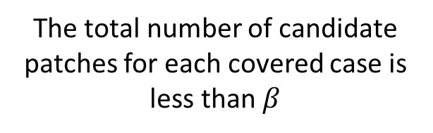
Integer Linear Program
Objective:
Coverage constraints:
Tractability constraints:
Maximize the number of covered validation cases
At least one of the selected transform generates correct patches for each covered case
The total number of candidate patches for each covered case is less than $β$
C_{i,j}: # of candidates
x_{i}: validation coverage var
G_{i,j}: coverage
y_{j}: transform selection var

Slide 53
Observed Past Human Patches
C
(E op₁ null) op₂ C
Code Transforms
op₁: {==, !=}
op₂: { ||, && }
Selected Transforms
S
if (E != null) { S; }
S
if (E == null) return K; S
ILP solver returns a set of transforms respecting the tradeoff between the coverage and tractability.
Possible Patch Space

Slide 54
Greedy Sampling Algorithm
Work List of
Candidate Subsets
Training Human Patches
Generalization
Transform 1
Iterative Greedy Sampling
Transform 2
…
…
Transform …
Evaluate with
Validation Patches
Notes:
Start with subsets of size 2.
2. Iteratively maintain a
worklist of promising candidate subsets.
3. Fitness function is roughly the ratio between the number of covered case and the number of generated candidate patches.

Slide 55
Greedy Sampling Algorithm
Work List of
Candidate Subsets
Training Human Patches
Generalization
Transform 1
Iterative Greedy Sampling
Transform 2
…
…
Transform …
Evaluate with
Validation Patches
Produce a ranked list of promising subsets and transforms!
Notes:
Start with subsets of size 2.
2. Iteratively maintain a
worklist of promising candidate subsets.
3. Fitness function is roughly the ratio between the number of covered case and the number of generated candidate patches.

Slide 56
Select Transforms as Search Space
Ranked List of Candidate Transforms
Integer Linear Program
Transform 1
Search Space as Selected Transforms
Transform 2
…
Transform k

Slide 57
Genesis Results

Slide 58
Dataset Collection
Filter out revisions we cannot compile.
Scan keyword in commit logs to identify null pointer exception (NPE) bugs, out of bound (OOB) bugs, and class cast error (CCE) bugs.
All Revisions in Top 1000 Github Java Projects & MUSE Java Corpus
503 NPE bugs
212 OOB bugs
303 CCE bugs
20 NPE bugs with testcases
13 OOB bugs with testcases
16 CCE bugs with testcases
Run JUnit testcases in the repository.
Identify bugs that can be exposed with the testcases
The rest of 483 NPE bugs
The rest of 199 OOB bugs
The rest of 287 CCE bugs

Slide 59
Dataset Collection
All Revisions in Top 1000 Github Java Projects & MUSE Java Corpus
The result dataset is from more than 350 different projects!
503 NPE bugs
212 OOB bugs
303 CCE bugs
20 NPE bugs with testcases
13 OOB bugs with testcases
16 CCE bugs with testcases
Testing
Benchmark
The rest of 483 NPE bugs
The rest of 199 OOB bugs
The rest of 287 CCE bugs
Training
Dataset

Slide 60
Run Genesis
We implemented Genesis for Java programs
Apply Genesis to infer a combined search space for NPE, OOB, and CCE errors with:
  483 NPE, 199 OOB, and 287 CCE training patches
Run Genesis with the inferred space to generate patches for:
  20 NPE, 13 OOB, and 16 CCE benchmark errors
Compare Genesis results with the results of manual transforms in PAR [ICSE’13]
Notes:
NPE: 24 hours, OOB: 20h, and CCE: 14h

Slide 61
Results for 20 NPE Errors
Repository | Revision | Result | Repository | Revision | Result
caelum-stella | 2ec5459 | ✔ | jongo | f46f658
caelum-stella | 2d2dd9c | ✔★ | Dataflow JavaSDK | c06125d | ✔★
caelum-stella | e73113f | ✔★ | webmagic | ff2f588
HikariCP | ce4ff92 |  | javapoet | 70b38e5
nuts | 80e85d0 |  | closure-compiler | 9828574 | ✔★
spring-data-rest | aa28aeb | ✔★ | truth | 99b314e
checkstyle | 8381754 | ✔★ | error-prone | 3709338 | ✔★
checkstyle | 536bc20 | ✔★ | javaslang | faf9ac2 | ✔★
checkstyle | aaf606e |  | Activiti | 3d624a5 | ✔
checkstyle | aa829d4 | ✔★ | spring-hateoas | 48749e7 | ✔★
✔: Generate correct patch
★: One of the top 3 generated patches is correct
Notes:
HikariCP: 11
For 11/13, it is ranked first

Slide 62
Results for 13 OOB Errors
Repository | Revision | Result | Repository | Revision | Result
Bukkit | a91c4c6 | ✔★ | named-regexp | 82bdfeb
RoaringBitmap | 29c6d59 |  | jgit | 929862f | ✔★
commons-lang | 52b46e7 |  | jPOS | df400ac | ✔★
HdrHistogram | db18018 |  | httpcore | dd00a9e | ✔
spring-hateoas | 29b4334 |  | vectorz | 2291d0d | ✔★
wicket | b708e2b | ✔★ | maven-shared | 77937e1
coveralls-maven-plugin | 20490f6
✔: Generate correct patch
★: One of the top 3 generated patches is correct
Notes:
For 3/6, it is ranked first
Wicket: 8
Vectorz: 40

Slide 63
Results for 16 CCE Errors
Repository | Revision | Result | Repository | Revision | Result
jade4j | dd47397 | ✔★ | htmlelements | bf3f275 | ✔★
jade4j | 114e886 | ✔★ | spring-cloud-connectors | 56c6eca
HdrHistogram | 030aac1 | ✔ | joinmo | a5ee885
pdfbox | 93c0b69 |  | buildergenerator | d9d73b3
tree-root | fef0f36 |  | mybatis-3 | 809c35d
spoon | 48d3126 |  | antlr4 | 9e7b131
pebble | 942aa6e |  | hamcrest-bean | 84586d9 | ✔★
fastjson | c886874 |  | raml-java-parser | 49aab8f
✔: Generate correct patch
★: One of the top 3 generated patches is correct
Notes:
3/5 are ranked 1
HdrHistogram: 33
htmlelements : 7

Slide 64
Comparison with PAR
# of Cases with Correct Patches
Notes:
Validated patch for cases:
NPE: 15
OOB: 8
CCE: 7
Total validated patches:
NPE: 232, only correct cases 228
OOB: 807, only correct cases 255
CCE: 93, only correct cases 88
Genesis outperforms humans
Genesis operates on a more productive and targeted search space
The inferred transforms capture useful software engineering patterns used by human developers
Many correct patches generated by Genesis are beyond the capability of previous patch generation systems for Java like PAR (ICSE’13)
PAR misses certain templates: if-throw, if-break, conjoins-disjoins, try-catch, …
PAR uses sub-optimal parameters (bounds) to synthesize new patches

Slide 65
Comparison with PAR
# of Cases with Correct Patches
*This assumes a straightforward translation of Prophet transforms to Java.
*It only counts coverage of Prophet transforms.
Notes:
Validated patch for cases:
NPE: 15
OOB: 8
CCE: 7
Total validated patches:
NPE: 232, only correct cases 228
OOB: 807, only correct cases 255
CCE: 93, only correct cases 88
Genesis outperforms humans
Genesis operates on a more productive and targeted search space
The inferred transforms capture useful software engineering patterns used by human developers
Many correct patches generated by Genesis are beyond the capability of previous patch generation systems for Java like PAR (ICSE’13)
PAR misses certain templates: if-throw, if-break, conjoins-disjoins, try-catch, …
PAR uses sub-optimal parameters (bounds) to synthesize new patches

Slide 66
Inferred NPE Transform Examples
Conjoins or Disjoins a Clause
Add Conditional Expression
C
E != null && C
A.B
(A == null) ? c : A.B;
C
E == null || C
If Guarded Exception Throw
Switch Invocation Order
S
if (E == null) throw new Ex(); S
A.equals(B)
B.equals(A)
If Guarded Control Flow
Guard Existing Statements
S
if (E == null) return K; S
S
if (E != null) { S; }
S
if (E == null) continue; S
S1; …; Sn;
if (E != null) { S1; …; Sn; }

Slide 67
PAR NPE Transforms
Conjoins or Disjoins a Clause
Add Conditional Expression
C
E != null && C
A.B
(A == null) ? c : A.B;
C
E == null || C
If Guarded Exception Throw
Switch Invocation Order
S
if (E == null) throw new Ex(); S
A.equals(B)
B.equals(A)
If Guarded Control Flow
Guard Existing Statements
S
if (E == null) return K; S
S
if (E != null) { S; }
S
if (E == null) continue; S
S1; …; Sn;
if (E != null) { S1; …; Sn; }
Notes:
Manually designing those transform rules are hard. There are so many different design choices you can make. For example, let’s consider the transform that add an if-guarded return. If you are manually designing transforms, you have to answer questions like ”what’s the constraints for synthesizing the checked expression E?”, "Should we also try continue and break statements?”, etc.
Those design choices all have their own implications on the search space tradeoff between coverage and tractability. It is extremely difficult to ask a human to optimally design and select a set of code transforms as the search space.
The philosophy of PAR manual transforms is to include only most common patterns to avoid the search space explosion. Therefore, it misses many useful templates.

Slide 68
Inferred OOB Transform Examples
If Guarded Control Flow
Modifications for Off-by-one
S
if (E < 0) return K; S
E
E + 1
S
if (E < 0) continue; S
A <= B
A < B
S
if (E < 0) break; S
A > B
A >= B
Check Array Size
Check Index Off-by-one
C
A.length == 0 || C
C
A.length == idx || C
C
A.length != 0 || C
C
A.length != idx || C
Conjoins a Clause
Add Conditional Expression
C
E >= 0 && C
E
v > 0 ? E : c

Slide 69
PAR OOB Transforms
If Guarded Control Flow
Modifications for Off-by-one
S
if (E < 0) return K; S
E
E + 1
S
if (E < 0) continue; S
A <= B
A < B
S
if (E < 0) break; S
A > B
A >= B
S
if (E >= A.length) return K; S
Guard Existing Statements
S
if (E >= 0) { S; }
S
if (E < A.length) { S; }
Conjoins a Clause
Add Conditional Expression
C
E >= 0 && C
E
v > 0 ? E : c

Slide 70
Inferred CCE Transform Examples
Change Variable Type
Change Cast Type
T1 v
T2 v
v = ((T1) E).func()
v = ((T2) E).func()
for (T1 v : E)
for (T2 v : E)
where T2 is a super class of T1
where T2 is a super class of T1
Call Function to Convert Expression
E
E.func()
Add “instanceof"
E
func(E)
C
E instanceof T && C
Add Try-catch Block
C
!(E instanceof T) || C
S
try { S; } catch (…) { }
S1; …; Sn;
try { S1; …; Sn; } catch (...) { }

Slide 71
PAR CCE Transforms
Change Variable Type
Change Cast Type
T1 v
T2 v
v = ((T1) E).func()
v = ((T2) E).func()
for (T1 v : E)
for (T2 v : E)
where T2 is a super class of T1
where T2 is a super class of T1
Call Function to Convert Expression
E
E.func()
Add “instanceof"
E
func(E)
S
if (E instanceof T) return K; S
Add Try-catch Block
S
if (E instanceof T) { S; }
S
try { S; } catch (…) { }
S1; …; Sn;
try { S1; …; Sn; } catch (...) { }

Slide 72
Related Work
Dynamic patching: ClearView [SOSP’09]
Genetic search: GenProg [ICSE’09’12]
Standard Generate and Validate Systems
Random search: RSRepair [ICSE’14]
Large Program with Test Suite
Manual transforms: PAR [ICSE’13]
Solver-based search: SemFix, Angelix [ICSE’13’16]
Condition Synthesis: SPR [FSE’15]
Learning from Human Patches
Prophet [POPL’16], HDR[FASE’16], ACS [ICSE’17]
Genesis
Function or Small Program with Specification
Feedback generation for MOOC [PLDI’13]
Deductive program repair [CAV’16]
AutoFixE [TSE’14]
Notes:
Automatic patch generation has been an active research topic in programming language and software engineering community. Here is a table showing how Prophet and Genesis sit in the context of related work. People have developed techniques for fixing both small programs (typically less than one hundred lines of code) and large real-world programs (with up to 1m lines of code). Prophet and Genesis are of course designed to handle large real-world programs. For such programs, specifications are not available and we only have test suites. A key difference between my research and other people’s research is that we look at the problem at a different perspective. The standard perspective is that the test suite is the only information we have, while our perspective is that the test suite is one source of information and we can learn additional information from past human patches to significantly enhance the patch generation process. Prophet and Genesis are pioneer systems operating with this new perspective and I am happy know that there are now many people now following this direction.

Slide 73
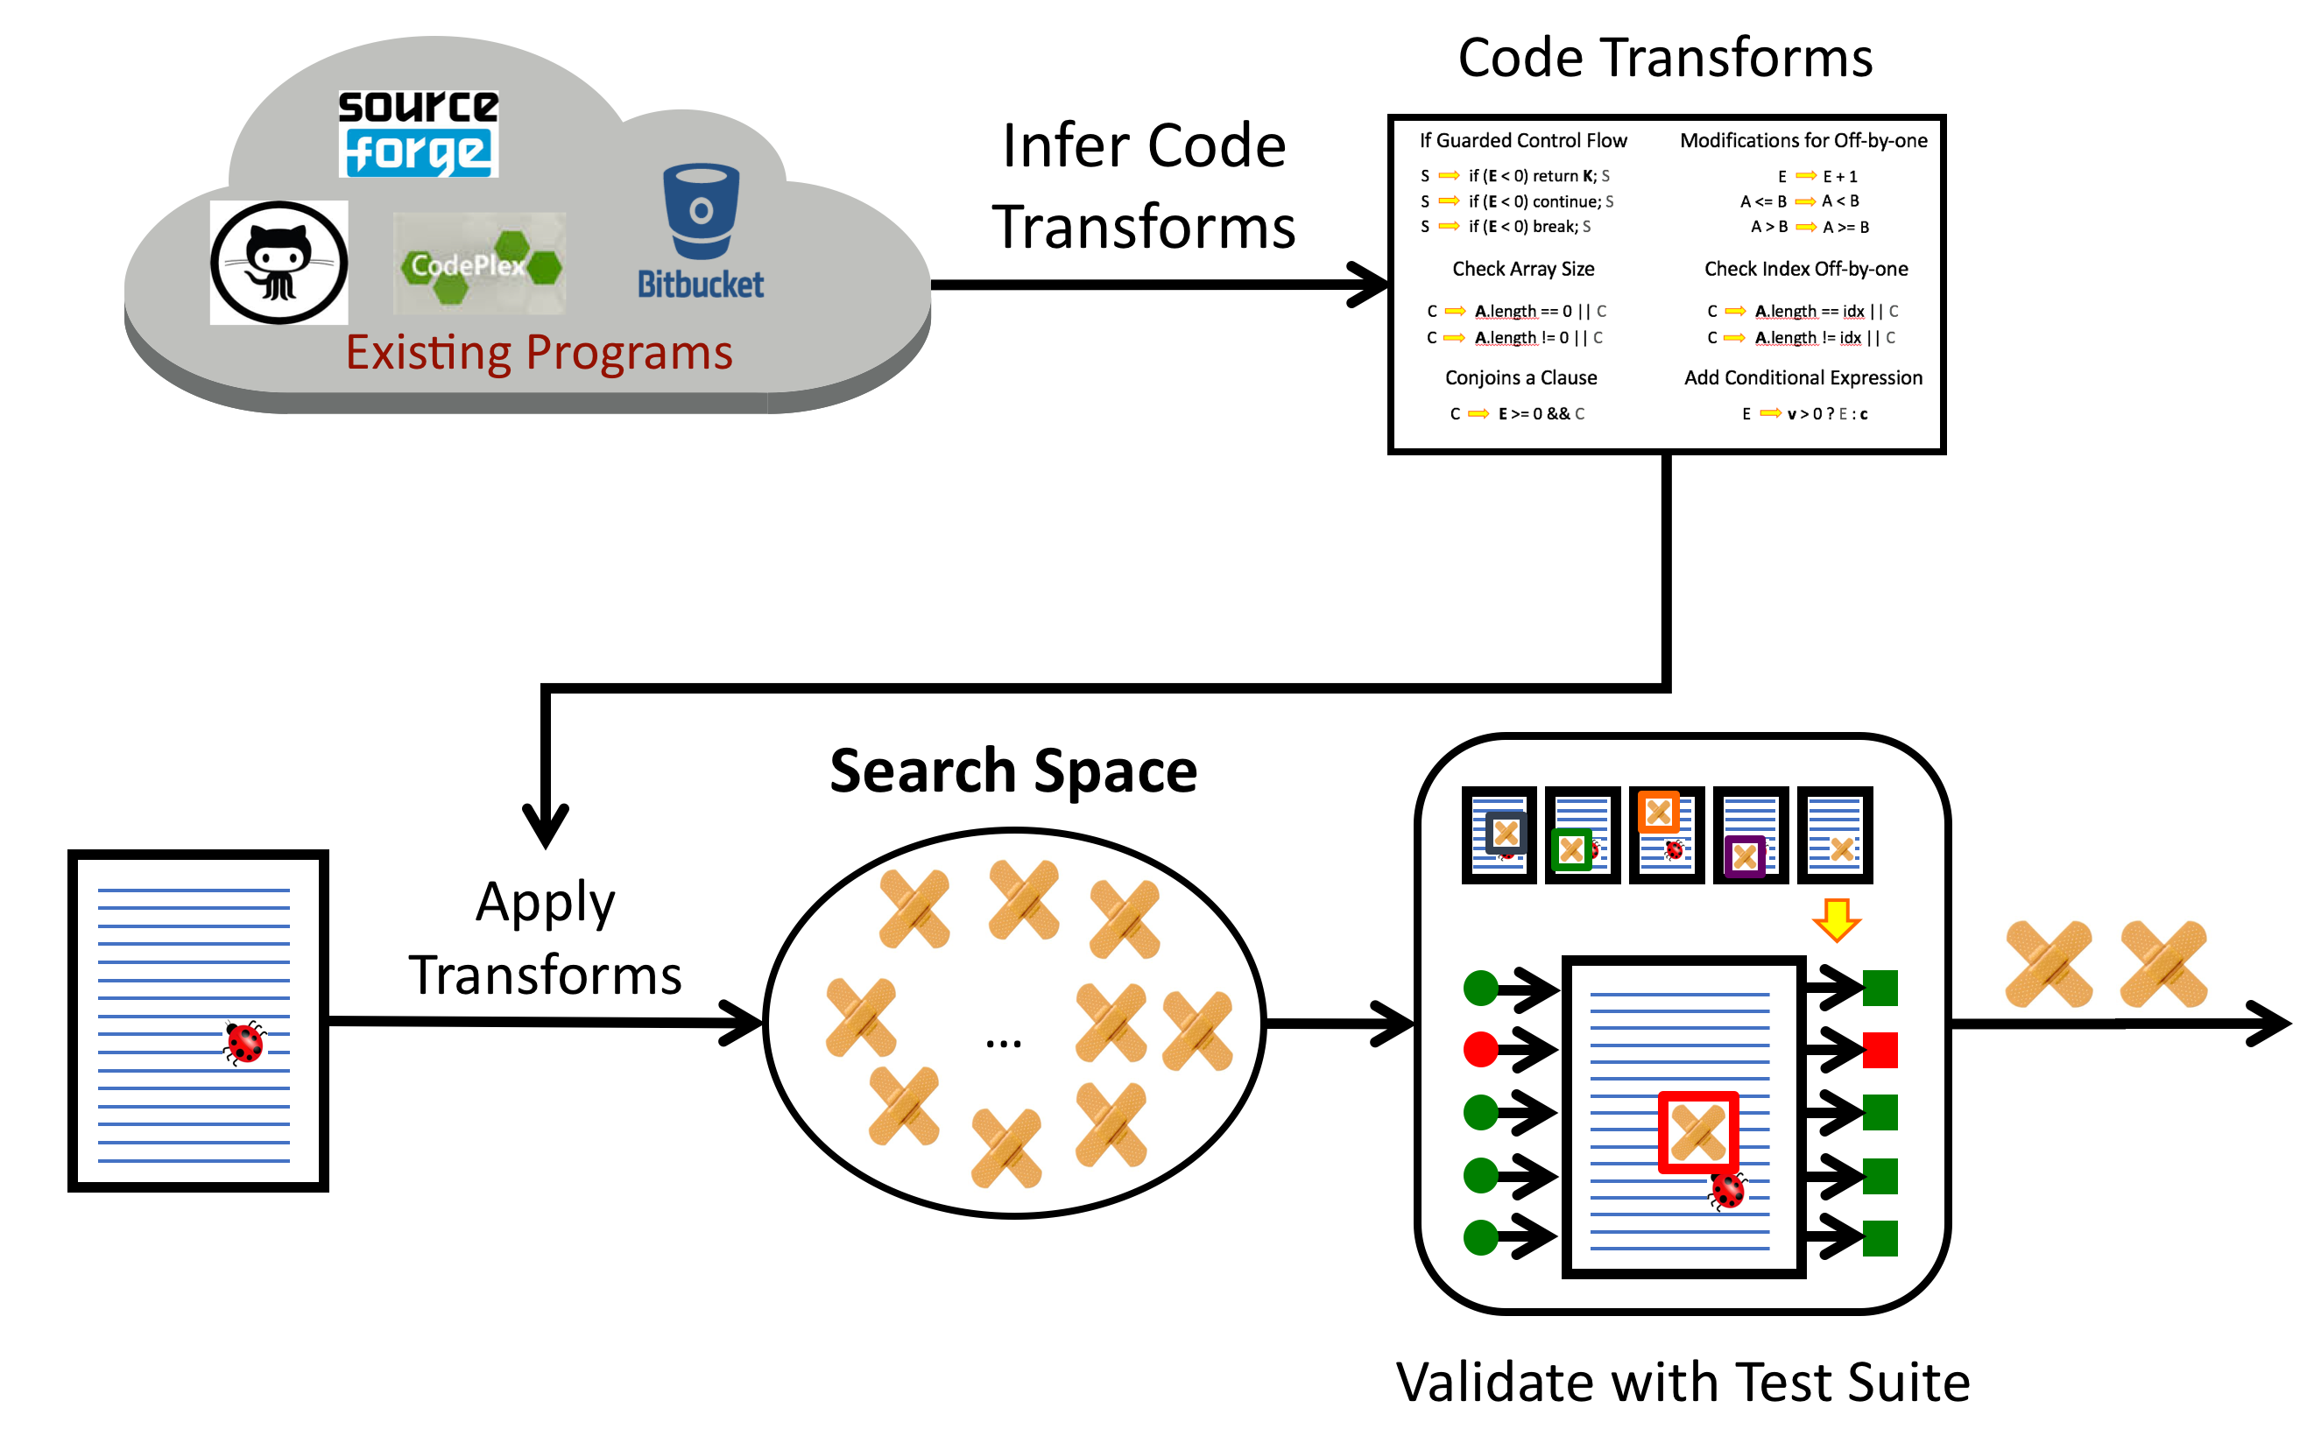
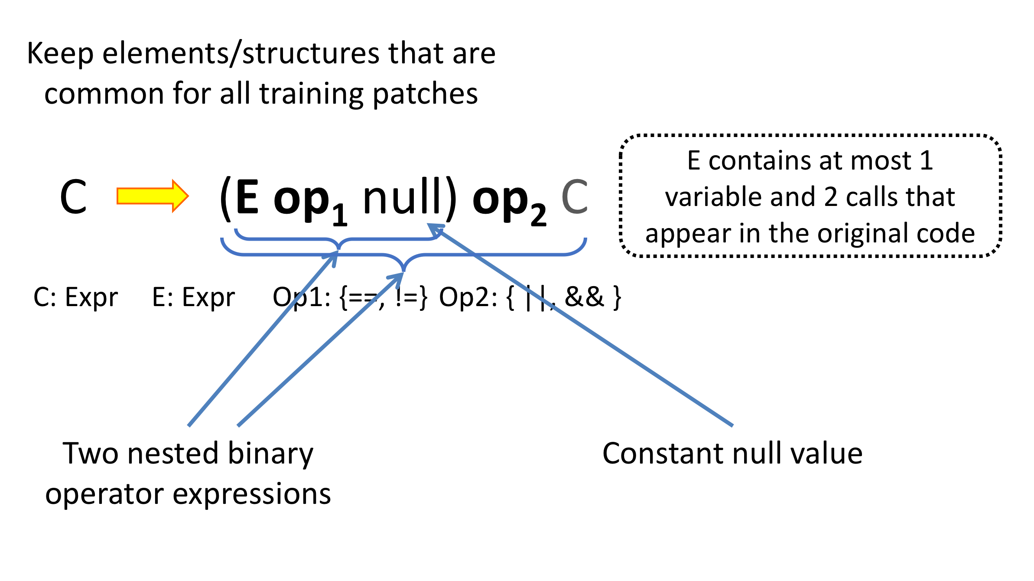
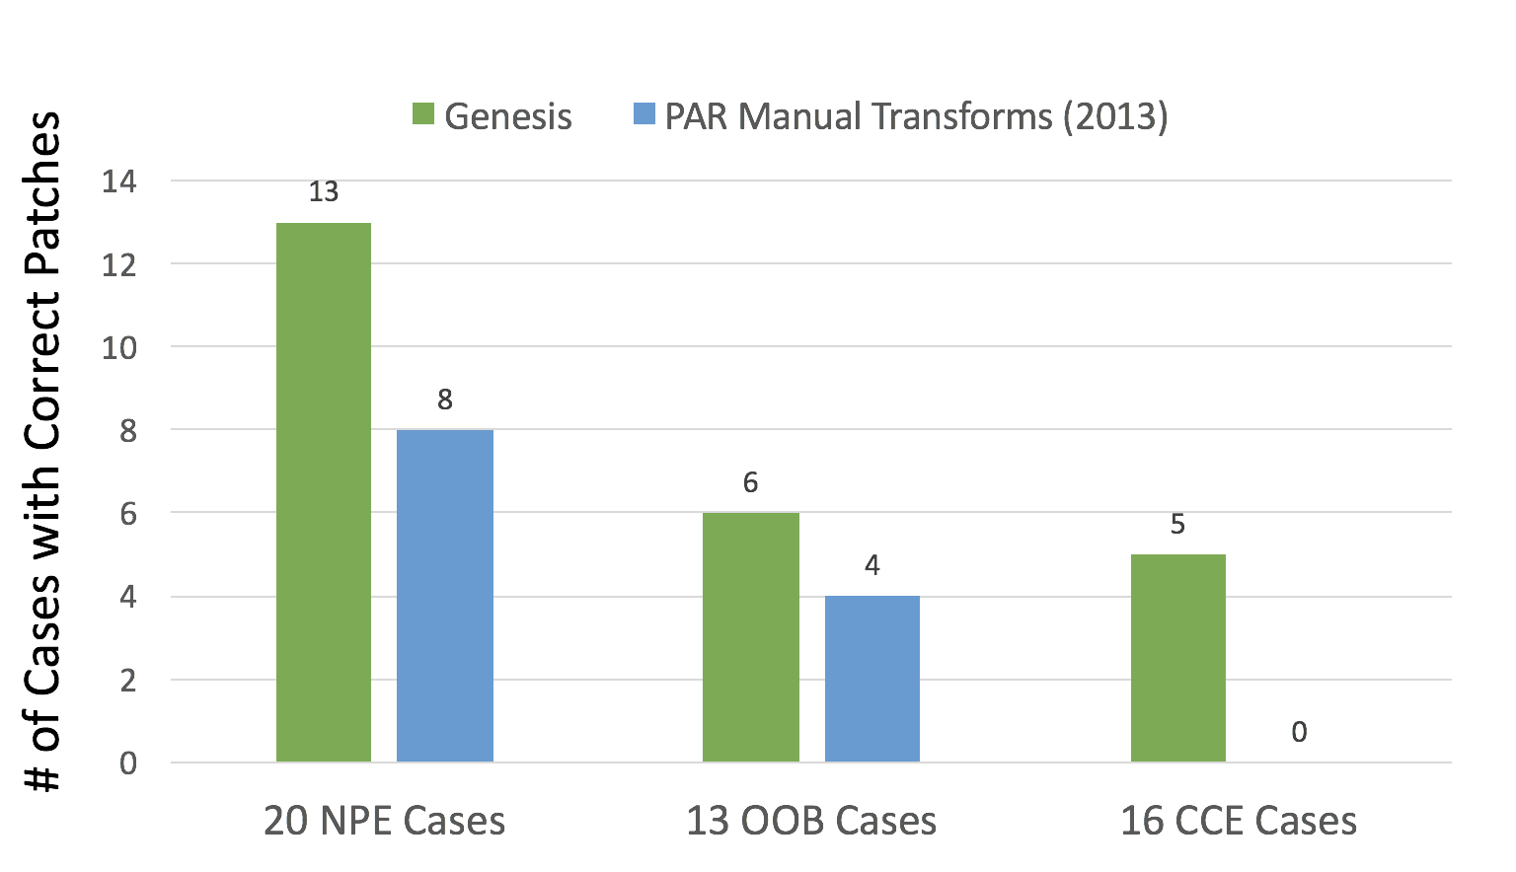
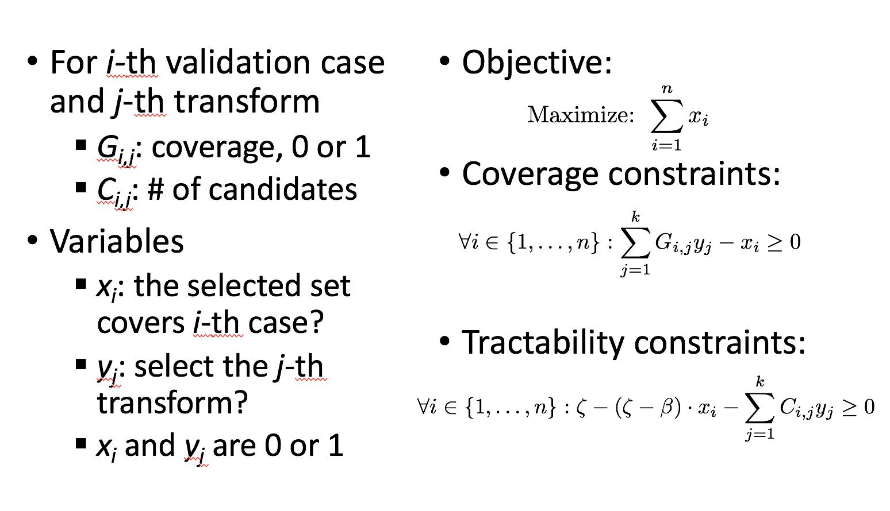
Conclusion
http://groups.csail.mit.edu/pac/patchgen/

Slide 74
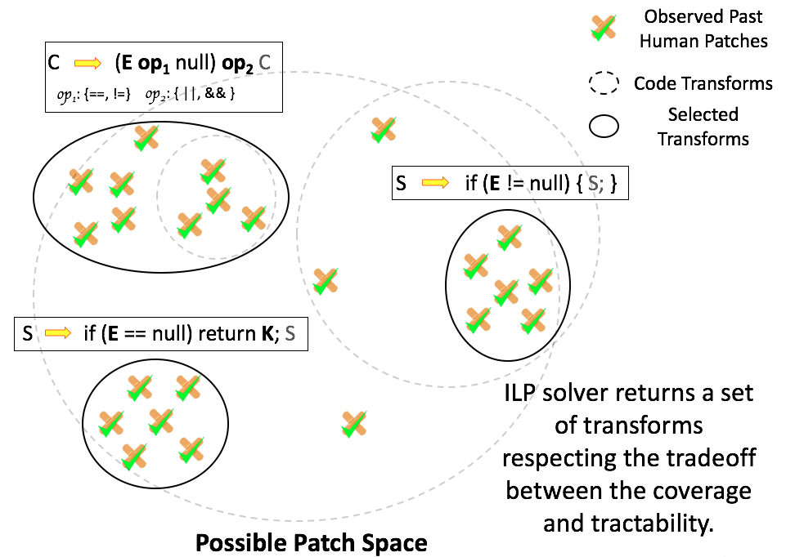
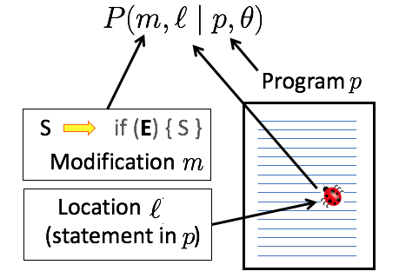
Summary of Two Systems
Genesis
Prophet
Inferred Transforms
Learned Model
  Search Space of Candidate Patches
  Patch Prioritization Order
…
…
0.4
0.2
0.1
0.001
Notes:
Now I have talked about two patch generation systems I built. Let’s view them from a higher level. The common thing of these two systems is that they both learn from past development efforts, namely human patches, to guide the patch generation process.
Today I introduced two automatic patch generation systems I built, Prophet and Genesis. These two systems operate with large sets of past human patches to learn how to recognize correct patches how developers write patches and. They, in turn, use the learned information to enhance patch prioritization order and search space for patch generation. Our results show that the learned information consistently outperforms corresponding manual rules for patch prioritization and manual transforms for patch search space. These systems are examples of what we can do to automate part of the software development process.
Outperforms heuristic rules developed by human.
Standard techniques: Operate with one program at a time.
Emerging techniques: Operate with multiple programs.
Extract useful human knowledge from existing programs
Build automated systems that combines machine computational power and human expert knowledge

Slide 75
Summary of Two Systems
Genesis
Prophet
Learning & Inference
Program Analysis
Automatic Patch Generation
Notes:
The experimental results of these two systems demonstrate the power of the idea of combining program analysis with learning and inference techniques. Automatic patch generation is just one examples of applying this idea to automate the software development process. I believe we can do much more besides patch generation.

Slide 76
My Research: Automated Techniques to Make Programs Better
Input Filtering and Rectification
[NDSS’15, POPL’14, ICSE’12]
Program Recovery
[PLDI’14]
Code Transfer &
Program Synthesis from Text
[PLDI’15, ACL’13]
Bug finding, Security Attack,
Record and Replay
[CCS’15, ASPLOS’15, ATC’11, FSE’10, NSDI’09]
Notes:
Automatic patch generation is one part of my research.
The big picture of my research focuses on automated techniques that combines program analysis, runtime systems, and machine learning to improve software programs. (Besides patch generation,) Examples of my past projects include input filtering and rectification. The techniques protect a vulnerable program by identifying potentially malicious inputs that may exploit vulnerabilities of the program. The techniques then discard or change the identified inputs. I developed on a program recovery system, which enables off-the-shelf binary programs to recover from otherwise fatal runtime errors. I worked on code transfer techniques, which transfers useful code such as security checks from a donor application to a recipient application. I also worked on many diagnosis techniques for automatic bug finding and record and replay.

Slide 77
Looking into the Future
Automated programming techniques will be more and more important.
The growing volume of existing programs is not just a challenge but also a great opportunity.
Notes:
Looking into the future, I believe as the number of software programs and our dependence on these programs continue to grow, automated programming techniques will be more and more important. My research on Prophet, Genesis, as well as code transfer techniques also demonstrate that the growing volume of existing programs is not just a challenge for us, but also a great opportunity.
Exploiting this opportunity is a key for solving future software engineering problems.

Slide 78
Dynamic Analysis
Static Analysis
Machine Learning
Notes:
To exploit this opportunity, we need a set of new analysis and inference techniques that can extract useful human knowledge from databases of existing source code, patches, inputs, or even meta-info such as stackoverflow pages. The key challenge of designing such techniques is how to unify standard program analysis based on formal reasoning and new machine learning techniques. To move forward, we need new abstraction frameworks to convert program analysis results into models that are amenable for statistical inference. We also need new machine learning models that capture deep semantic properties of software programs, such as data flow and control flow.
across multiple programs, usually from a database of inputs, source code, .

Slide 79
Formal reasoning of one program
Dynamic Analysis
Static Analysis
Machine Learning
Statistical inference of a large dataset
Notes:
To exploit this opportunity, we need a set of new analysis and inference techniques that can extract useful human knowledge from databases of existing source code, patches, inputs, or even meta-info such as stackoverflow pages. The key challenge of designing such techniques is how to unify standard program analysis based on formal reasoning and new machine learning techniques. To move forward, we need new abstraction frameworks to convert program analysis results into models that are amenable for statistical inference. We also need new machine learning models that capture deep semantic properties of software programs, such as data flow and control flow.
across multiple programs, usually from a database of inputs, source code, .

Slide 80
Formal reasoning of one program
Dynamic Analysis
Static Analysis
Abstraction
&
Modeling
Machine Learning
Statistical inference of a large dataset
Notes:
To exploit this opportunity, we need a set of new analysis and inference techniques that can extract useful human knowledge from databases of existing source code, patches, inputs, or even meta-info such as stackoverflow pages. The key challenge of designing such techniques is how to unify standard program analysis based on formal reasoning and new machine learning techniques. To move forward, we need new abstraction frameworks to convert program analysis results into models that are amenable for statistical inference. We also need new machine learning models that capture deep semantic properties of software programs, such as data flow and control flow.
across multiple programs, usually from a database of inputs, source code, .

Slide 81
Future Directions
Specify
Functionality
Ask Help
Candidate
Solution
Transfer
Code
Patch Generation
Code Transfer
Bug Finding
Program Synthesis
Anomaly Detection
Notes:
If our research becomes successful, it will completely change the software development process and software industry. For example, we will be able to leverage development efforts worldwide to improve software reliability and security, using vulnerability reports and bug fixing of one program to enhance other programs. Developers will be able to focus only on the interesting part of the development and skip the implementation details of any functionality that have been done before. Automated code transfer and synthesis techniques will assemble such implementation code from existing sources, significantly improving developer productivity.

Slide 82
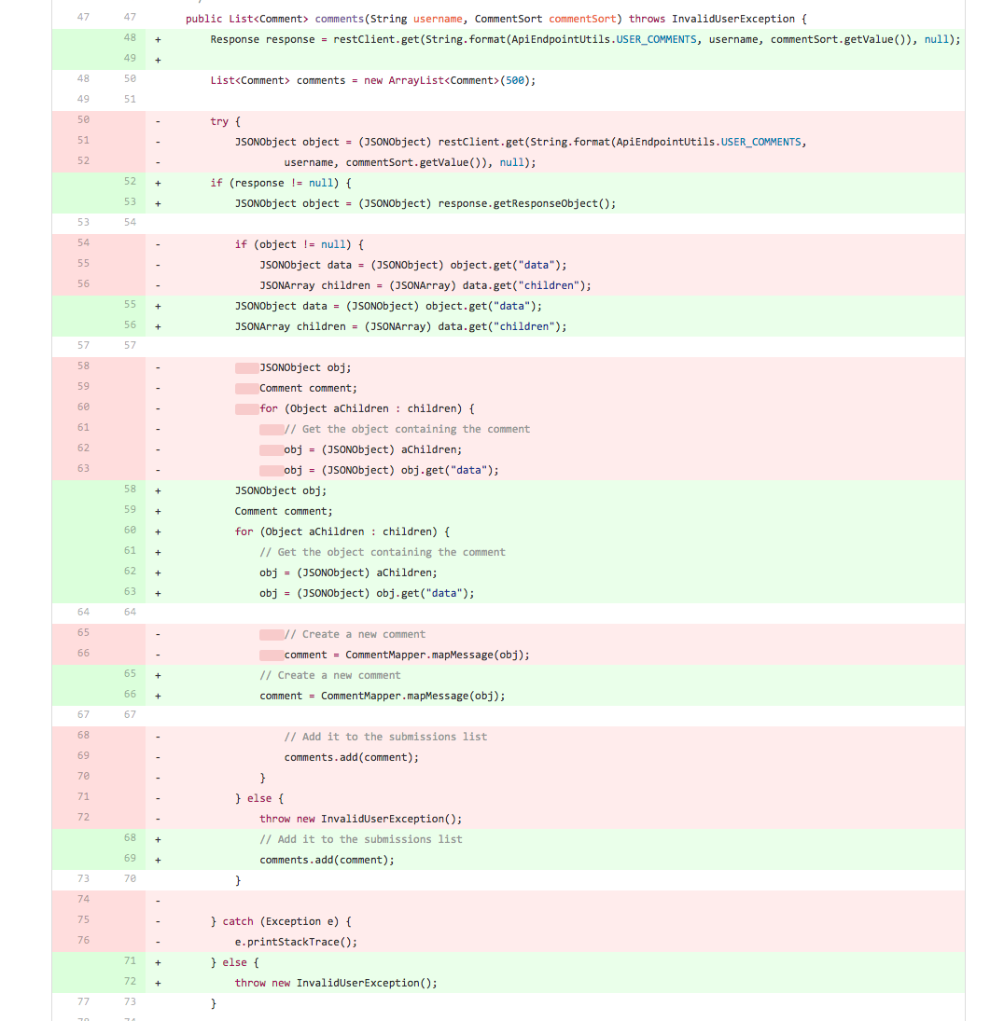
Outside the Scope
A CCE patch which rewrites a function
Not possible for any search-based techniques
~50% of Errors

Slide 83
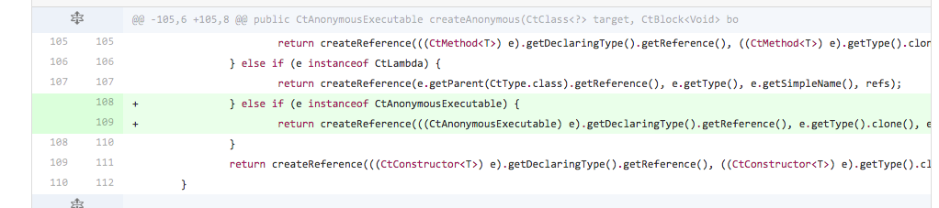
Possible with Improved Systems
A patch to fix a CCE error
Too complicated to directly synthesize
But there are parallel structures around!
~20% of Errors

