Slide 1
Leakage Resilient Key Proxy
Ali Juma, Charles Rackoff, Yevgeniy Vahlis

Slide 2
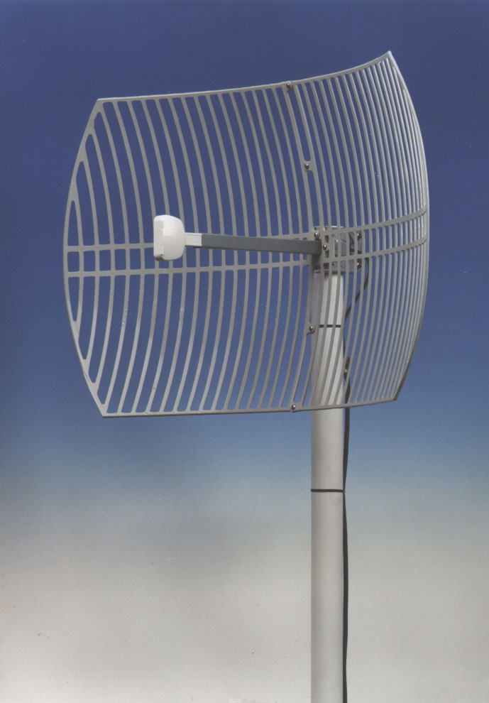

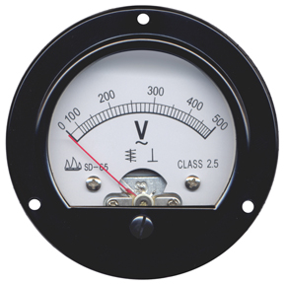
Side Channels In Cryptography
Classic assumption: Cryptography happens on black box devices
Many ways to obtains security
In reality: side-channel attacks can break security
Main solution until recently: design better hardware
Notes:
remove the word vacuum

Slide 3
Leakage Resilient Cryptography
In recent years:
  Design schemes that are secure even if an arbitrary* shrinking function of the state is leaked
* usually additional restrictions are needed
  f is applied to a subset of the bits
  f is an AC0 circuit
  Only active part of state leaks
  state=(state_{A},state_{B}) and f(state)=(f_{A}(state_{A}), f_{B}(state_{B}))
State
f(state)
Adversary
Notes:
mention Micali here

Slide 4
Bounded vs Continuous Leakage
Two points of view:
  The adversary obtains a large but bounded amount of information about the key (memory attack/bounded)
  Adversary obtains small amount of leakage each time the key is used (leakage/continuous)
In continuous setting even leakage of 1 bit can be fatal
  Key needs to be encrypted and refreshed
We work in the continuous model
Notes:
what is leaked is chosen adversarially
“can be fatal”

Slide 5
Our Contribution
Define and construct Leakage Resilient Key Proxy
  Initialized with a key K
  Allows arbitrary computation on K through a proxy algorithm
  Leakage on proxy computation reveals no information
Key K
State’
Evaluation
State
Initialization
Circuit C
F(K)

Slide 6
Our Contribution
Leakage model:
  Two states A and B that leak separately at every invocation
  Communication between A and B public
  B needs to perform post-hoc randomization assuming no leakage.
Our leak-free component:
  No memory
  Fixed complexity (independent from F)
  Used twice per invocation
In essence: reduce arbitrary complexity stateful computation to fixed complexity stateless computation
Notes:
size of leak free component depends on the key

Slide 7
Our Contribution
Underlying assumption: there exists a Fully Homomorphic Public Key Encryption scheme [Gentry 09]
Theorem: there exists an LRKP in the continuous split-state leakage model (with leak free component) that allows log(n) leakage per round.
Notes:
n is the length of the key

Slide 8
Agenda
Existing work
Definitions
Construction
Proof
The end

Slide 9
Existing Work 1/2
[Goldreich, Ostrovsky 96] Oblivious RAMs
  Complete leakage of memory assuming CPU is secure
[Ishai, Sahai, Wagner 03] Private circuits
  Protect against leakage of fixed number of bits
[Goldwasser, Kalai, Rothblum 08] One-time programs
  Entire computation is leaked except unused part of one-time memory
  Can run an a-priori bounded number of times
[Faust, Reyzin, Tromer 09] Computationally bounded leakage
  Protect against AC0 leakage functions
  Input-less leak-free component is needed
Notes:
GO: adv sees which parts of memory are accessed. easy if all memory is accessed but we want efficiency
FRT: doesn’t need an input

Slide 10
Existing Work 2/2
[Micali, Reyzin 04] Physically Observable Cryptography
  Introduce axioms, framework for formal treatment of leakage
  Axiom: computation and only computation leaks
[Dziembowksi, Pietrzak 08] Leakage resilient stream cipher
  No leak free components
  Split state. Proof assuming only active state leaks.
  Actually works even if both halves leak separately
    state=(state_{A},state_{B}), adversary sees f(state)=(f_{A}(state_{A}), f_{B}(state_{B}))
Why “modular leakage” is good:
  In an OS, no control over actual computation and swapping
  Some memory chips need to be constantly refreshed
  Adversary may attach probes to inactive memory
Notes:
MR04: what’s the result?

Slide 11
Leakage Resilient Key Proxy
Goal:
  Compute on a key K while treating it as a black box even given leakage
A Key Proxy is a pair of PPT algorithms Init, Eval
  Init(K) outputs an initial state S
  Eval(S,C) output F(K) and a new state S`

Slide 12
Leakage Resilient Key Proxy
Goal:
  Compute on a key K while treating it as a black box even given leakage
A Key Proxy is a pair of PPT algorithms Init, Eval
Security: Real/Ideal
  Adversary submits key K
  Repeats poly-many times:
    Submit circuit F
    Obtain leakage on computation
    of Eval(S,F)
  Adversary outputs a bit b
Adversary
K
Init
S₁
F₁
Adversary
Eval
Leakage
S₂
F₂
Adversary
Eval
Leakage
S₃
:
:
:
:
b
Adversary
Notes:
say that every box is different phase in the exp

Slide 13
Leakage Resilient Key Proxy
Security: Real/Ideal ∃simulator Sim
  Adversary submits key K (not shown to Sim)
  Repeats poly-many times:
    Submit circuit F, Sim is given F,F(K)
    Adversary interacts with Sim for leakage
  Adversary outputs a bit b
K
Adversary
Challenger
Adversary
F
Challenger
F(K)
Leakage
Simulator

Slide 14
Leakage Resilient Key Proxy
Security: Real
  Adversary submits key K
  Repeats poly-many times:
    Submit circuit F
    Obtain leakage on computation
    of Eval(S,F)
  Adv outputs a bit b
Security: Ideal
  Adversary submits key K (not shown to Sim)
  Repeats poly-many times:
    Submit circuit F, Sim is given F(K)
    Adversary interacts with Sim for leakage
  Adv outputs a bit b
A key proxy KP is leakage* resilient if no PPT adversary can distinguish Real/Ideal
Notes:
Adversary outputs a bit b. Adversary can’t distinguish between the two worlds

Slide 15
Leakage Model
Need to define leakage on a single invocation of Eval
Model “only computation leaks”
  For simplicity: consider only 2-round split state constructions
CPU A
CPU B
MemA
MemB
F
M_{AB}
EvalA₁
EvalB₁
MemB`
M_{BA}
Post-hoc Randomization
EvalA₂
F(K)
MemA`
MemB``
Notes:
say that for proof we only do computation leaks

Slide 16
Leakage Model
CPU A
CPU B
MemA
MemB
C
M_{AB}
R_{A}
EvalA₁
EvalB₁
R_{B}
MemA`
MemB`
M_{BA}
Post-hoc Randomization
EvalA₂
R`_{B}
F(K)
MemA``
MemB``
Three rounds of leakage
  Choose f₁, obtain f₁(MemA,R_{A}) and M_{AB}
  Choose f₂, obtain f₂(MemB,R_{B},MemB``) and M_{BA}
  Choose f₃, obtain f₃(MemA`)
  The randomness R`_{B} is not leaky
Non-trivial:
|MemB|,|MemB`| ≤ n^{d}
F of arbitrary size

Slide 17
Construction
Basic tool: Fully Homomorphic Encryption (FHE)
  Recently constructed by Gentry (STOC 09)
  Previous restricted constructions are known (e.g. [BGN05], [MGH08])
What is FHE?
  As classic public key encryption: KeyGen, Enc, Dec
  In addition: EncEval_{pub}(encryption of M, circuit F) outputs encryption C` of F(M)
    To avoid trivial constructions, C` restricted in length
  We also need: given C` produce a random encryption of F(M)
    Gentry has this property
Notes:
F is not an input to the randomization
randomization produces encryption of same thing

Slide 18
Initial Attempt
Let (KeyGen, Enc, Dec, EncEval, Randomize) be an FHE
Initialization given K:
  Run KeyGen(1^{n}) to obtain pri, pub
  Compute C=Enc_{pub}(K)
  Set MemA=pri and MemB=C
K
R_{init}
Init
MemA
pri
Enc_{pub}(K)
MemB

Slide 19
Key Proxy Construction
CPU A
CPU B
pri
MemB
F
M_{AB}
R_{A}
EvalA₁
EvalB₁
MemB`
M_{BA}
Post-hoc Randomization
EvalA₂
F(K)
MemA``
MemB``
EvalA₁(pri,R_{A}):
  Run KeyGen to obtain (pri`,pub`)
  Compute M_{AB}=Enc_{pub`}(pri) and send to B
  Set MemA=pri`
Notes:
correct inputs to EvalA1

Slide 20
Key Proxy Construction
CPU A
CPU B
pri
C=Enc_{pub}(K)
F
M_{AB}=Enc_{pub’}(pri)
EvalA₁
EvalB₁
pri`
C`, C_{res}
M_{BA}
Post-hoc Randomization
EvalA₂
F(K)
MemA``
MemB``
EvalB₁(C,F,R_{B}):
  Run EncEval_{pub`}(M_{AB},F(Dec[ ](C))) to get C_{res}=Enc_{pub`}(F(K))
  Run EncEval_{pub`}(M_{AB},Dec[ ](C)) to get C`=Enc_{pub’}(K)
  Set MemB`=(C`, C_{res})
Notes:
change C to memB
prime is not visible
memB=…
new state of A
have everything there initially

Slide 21
Initial Attempt
CPU A
CPU B
pri
C
F
M_{AB}=Enc_{pub`}(pri)
EvalA₁
EvalB₁
pri`
(C`, C_{res})
M_{BA}
Post-hoc Randomization
EvalA₂
F(K)
MemA``
MemB``
Randomization(C`,C_{res},R`_{B}):
  Our initial attempt: do nothing.
  Send C_{res} to A and set MemB``=C`
  The problem: FHE ciphertexts carry history

Slide 22
Ciphertexts in FHE
The algorithm EncEval_{pub}(C,G( )) homomorphically applies G to the plaintext M of C
The new ciphertext C` is not a random encryption of G(M)
  Given pri can potentially learn about intermediate values of G
  In our case G(M) = F(Dec_{M}(C)), m=pri
  Intermediate value is Dec_{M}(C)=K !
  Leakage function f₃(pri`) can leak bits of K
Gentry’s FHE allows post-hoc randomization
  Given C` can produce a random encryption of G(M)
  New ciphertext cannot be homomorphically computed on
    But that’s OK.

Slide 23
Key Proxy Construction
CPU A
CPU B
pri
C
F
M_{AB}=Enc_{pub`}(pri)
EvalA₁
EvalB₁
pri`
(C`, C_{res})
M_{BA}
Post-hoc Randomization
EvalA₂
F(K)
MemA``
MemB``
Randomization(C`,C_{res},R`_{B}):
  Run Randomize(C`) to get C`` and set MemB``=C``
  Compute M_{BA}=Randomize(C_{res}) and send M_{BA} to A

Slide 24
Key Proxy Construction
CPU A
CPU B
pri
C
F
M_{AB}=Enc_{pub`}(pri)
EvalA₁
EvalB₁
pri`
(C`, C_{res})
M_{BA}=Enc_{pub`}(F(K))
Post-hoc Randomization
EvalA₂
F(K)
MemA``
C``=Enc_{pub`}(K)
EvalA₂(pri`,M_{BA}):
  Set MemA``=pri`
  Compute and output Dec_{pri`}(M_{BA})

Slide 25
Key Proxy - Security
Observations
  At the beginning of each round MemA=pri, MemB=Enc_{pub}(K) for fresh pri, pub
  Clearly secure without leakage – but uninteresting
Recall “real” leakage experiment
Adversary
K
Init
S₁
C₁
Adversary
Eval
Leakage
S₂
C₂
Adversary
Eval
Leakage
S₃
:
:
:
:
b
Adversary

Slide 26
Security
Claim 1: security of n rounds reduces to security of 2 rounds
Proof:
  Step 1: replace all messages M_{BA} by random encryptions of F_{i}(K)
EvalA₁
EvalB₁
EvalA₂
Randomize
EvalA₁
EvalB₁
EvalA₂
Randomize
EvalA₁
EvalB₁
EvalA₂
Randomize

Slide 27

Security
Claim 1: security of n rounds reduces to security of 2 rounds
Proof:
  Step 1: replace all messages M_{BA} by random encryptions of F_{i}(K)
  Change purely conceptual
EvalA₁
EvalB₁
EvalA₂
Randomize
EvalA₁
EvalB₁
EvalA₂
Randomize
EvalA₁
EvalB₁
EvalA₂
Randomize

Slide 28



Security – Proof of Claim 1
Step 2:
  Replace all ciphertexts with random encryptions of
  In actual experiment
  In modified experiment
EvalA₁
EvalB₁
EvalA₂
Randomize
EvalA₁
EvalB₁
EvalA₂
Randomize
EvalA₁
EvalB₁
EvalA₂
Randomize

Slide 29
Security – Proof of Claim 1
Step 2:
  Replace all ciphertexts with random encryptions of
  In actual experiment
  In modified experiment
EvalA₁
EvalB₁
EvalA₂
Randomize
EvalA₁
EvalB₁
EvalA₂
Randomize
EvalA₁
EvalB₁
EvalA₂
Randomize

Slide 30
Security – Proof of Claim 1
Step 3:
  Suppose the adversary can distinguish between
  and
  by standard hybrid Adv distinguishes between
  and
  affects both rounds i and i+1
EvalA₁
EvalB₁
EvalA₂
Randomize
EvalA₁
EvalB₁
EvalA₂
Randomize
EvalA₁
EvalB₁
EvalA₂
Randomize

Slide 31




Security
Due to Randomize the contents of are a random encryption of 0…0, independent from
But, needed to simulate rounds i+2,…,n

Slide 32
Security
1
2
EvalA₁
EvalB₁
3
Post-hoc Randomization
EvalA₂
4
EvalA₁
EvalB₁
5
Post-hoc Randomization
EvalA₂
6 Get pri_{i+2}

Slide 33
Security
1
2
Guess leakage 4 and squeeze 5, 6 into 3
Then given MemB_{i+1} verify that the guess was correct
EvalA₁
EvalB₁
3
Post-hoc Randomization
EvalA₂
4
EvalA₁
EvalB₁
5
Post-hoc Randomization
EvalA₂
6 Get pri_{i+2}
4`
Get MemB_{i+1}

Slide 34
Security
1
2
Guess leakage 2 and squeeze 3 into 1
Then given MemB_{i+1} verify that the guess was correct
EvalA₁
EvalB₁
3
Post-hoc Randomization
EvalA₂
EvalA₁
EvalB₁
Post-hoc Randomization
EvalA₂
4`
Get MemB_{i+1}

Slide 35
Security
We reduced the problem to:
  pri, pri` are generated
  Adversary sees leakage on pri, pri`
  Adversary sees
  and
  Leakage can be guessed and tested
    No adversary can distinguish encryption of K from encryption of 0

Slide 36
Applications
Surprise: public key applications are easier than private key
  Signatures: initialize LRKP with signing key
    To sign a message m set F(K)=Sign_{K}(m)
  CCA-PKE: initialize with private key
    All CCA1 decryption queries can now leak information
  In both cases only one copy of the key is protected
Private key encryption
  Many parties share a key K and leak information
  Adversary can adaptively coordinate leakage

Slide 37
Applications
Observation: LRKPs remain secure under concurrent composition
To get secure private key encryption, initialize an LRKP independently for each party
More generally: any functionality where the secret is fixed from start can be made leakage resilient

Slide 38
Open Questions
Get rid of the leak-free component
Base LRKP on other assumptions
Increase granularity of leakage

Slide 39
Thank you!

