Slide 1
Dynamic Tree Block Coordinate Ascent
Daniel Tarlow¹, Dhruv Batra²
Pushmeet Kohli³, Vladimir Kolmogorov⁴
1: University of Toronto 3: Microsoft Research Cambridge
2: TTI Chicago 4: University College London
International Conference on Machine Learning (ICML), 2011

Slide 2
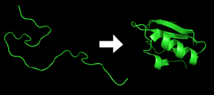
MAP in Large Discrete Models
Many important problems can be expressed as a discrete Random Field (MRF, CRF)
MAP inference is a fundamental problem
Inpainting
Stereo
Object Class Labeling
Protein Design / Side Chain Prediction

Slide 3
Primal and Dual
Primal
Dual
- Dual is a lower bound: less constrained version of primal
- is a reparameterization, determined by messages
- h_{A}* is height of unary or pairwise potential
- Definition of reparameterization:
LP-based message passing: find reparameterization to maximize dual

Slide 4
Standard Linear Program-based Message Passing
Max Product Linear Programming (MPLP)
Update edges in fixed order
Sequential Tree-Reweighted Max Product (TRW-S)
Sequentially iterate over variables in fixed order
Tree Block Coordinate Ascent (TBCA) [Sontag & Jaakkola, 2009]
Update trees in fixed order
Key: these are all energy oblivious
Can we do better by being energy aware?

Slide 5
Example
TBCA with Static Schedule:
630 messages needed
TBCA with Dynamic Schedule:
276 messages needed
Notes:
Key point: dynamic schedules can get to global optimum with fewer messages. How do we do it while keeping overhead low?

Slide 6
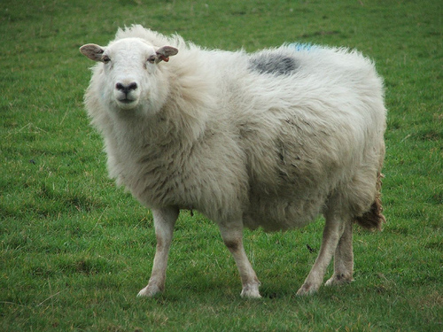
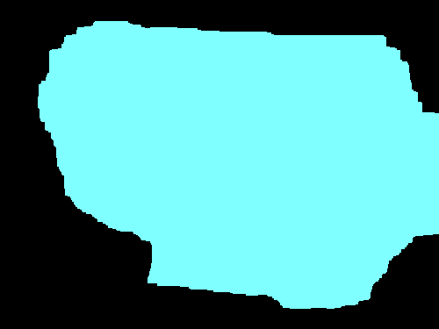
Benefit of Energy Awareness
Static settings
Not all graph regions are equally difficult
Repeating computation on easy parts is wasteful
Dynamic settings (e.g., learning, search)
Small region of graph changes.
Computation on unchanged part is wasteful
Harder region
Easy region
Unchanged
Changed
Image
Previous Optimum
Change Mask

Slide 7
References and Related Work
[Elidan et al., 2006], [Sutton & McCallum, 2007]
Residual Belief Propagation. Pass most different messages first.
[Chandrasekaran et al., 2007]
Works only on continuous variables. Very different formulation.
[Batra et al., 2011]
Local Primal Dual Gap for Tightening LP relaxations.
[Kolmogorov, 2006]
Weak Tree Agreement in relation to TRW-S.
[Sontag et al., 2009]
Tree Block Coordinate Descent.
Notes:
Show quickly.
Say, "See paper for related work and pointers to background material. We made use of related work that we don't have time to fully review here."

Slide 8
Visualization of reparameterized energy
States for each variable: red (R), green (G), or blue (B)
"Good" local settings: (can assume "good" has cost 0, otherwise cost 1)
G
G-G, B-B
G
G-G, B-B
G
G-B, B-B
B
x₁
x₂
x₃
x₄
R
G
B

Slide 9
Visualization of reparameterized energy
States for each variable: red (R), green (G), or blue (B)
"Good" local settings:
G
G-G, B-B
G
G-G, B-B
G
G-B, B-B
B
"Don't be R or B"
"Don't be R or B"
"Don't be R or G"
x₁
x₂
x₃
x₄
"Don't be R or B"
"Don't be R or B"
"Don't be R"
R
G
B
Hypothetical messages that e.g. residual max-product would send.
Notes:
Hypothetically, the messages that would be sent. But we're at WTA, so we don't need to send them.

Slide 10
Visualization of reparameterized energy
States for each variable: red (R), green (G), or blue (B)
"Good" local settings:
G
G-G, B-B
G
G-G, B-B
G
G-B, B-B
B
x₁
x₂
x₃
x₄
R
G
B
But we don't need to send any messages. We are at the global optimum.
Our scores (see later slides) are 0, so we wouldn't send any messages here.

Slide 11
Visualization of reparameterized energy
States for each variable: red (R), green (G), or blue (B)
"Good" local settings:
B
G-G, B-B
B
G-G, B-B
B
G-B, B-B
B
x₁
x₂
x₃
x₄
R
G
B
Change unary potentials (e.g., during learning or search)

Slide 12
Visualization of reparameterized energy
States for each variable: red (R), green (G), or blue (B)
"Good" local settings:
B
G-G, B-B
B
G-G, B-B
B
G-B, B-B
B
x₁
x₂
x₃
x₄
R
G
B
Locally, best assignment for some variables change.

Slide 13
Visualization of reparameterized energy
States for each variable: red (R), green (G), or blue (B)
"Good" local settings:
B
G-G, B-B
B
G-G, B-B
B
G-B, B-B
B
"Don't be R or G"
"Don't be R or G"
"Don't be R or G"
x₁
x₂
x₃
x₄
"Don't be R or G"
"Don't be R or G"
"Don't be R"
R
G
B
Hypothetical messages that e.g. residual max-product would send.
Notes:
New hypothetical messages. Again, we don't have to send them, because we're provably at the optimum, which we can determine just by looking locally.

Slide 14
Visualization of reparameterized energy
States for each variable: red (R), green (G), or blue (B)
"Good" local settings:
B
G-G, B-B
B
G-G, B-B
B
G-B, B-B
B
x₁
x₂
x₃
x₄
R
G
B
But we don't need to send any messages. We are at the global optimum.
Our scores (see later slides) are 0, so we wouldn't send any messages here.

Slide 15
Visualization of reparameterized energy
"Good" local settings:
B
G-G, B-B
B
G-G, B-B
B
G-B, B-B
B
x₁
x₂
x₃
x₄
Possible fix: look at how much sending messages on edge would improve dual.
Would work in above case, but incorrectly ignores e.g. the subgraph below:
"Good" local settings:
B
B-B
G, B
G-G
R, G
R-R
R
x₁
x₂
x₃
x₄
R
G
B
Notes:
Verbally cite Sontag UAI 2008.

Slide 16
Key Slide
B
B-B
G, B
B-B
R,G
R-R
R
x₁
x₂
x₃
x₄
Locally, everything looks optimal

Slide 17
Key Slide
B
B-B
G, B
B-B
R,G
R-R
R
x₁
x₂
x₃
x₄
Try assigning a value to each variable

Slide 18
Key Slide
Our main contribution
Use primal (and dual) information to choose regions on which to pass messages
B
B-B
G, B
B-B
R,G
R-R
R
x₁
x₂
x₃
x₄
Suboptimal
Suboptimal
Try assigning a value to each variable

Slide 19
Our Formulation
Measure primal-dual local agreement at edges and variables
Local Primal Dual Gap (LPDG).
Weak Tree Agreement (WTA).
Choose forest with maximum disagreement
Kruskal's algorithm, possibly terminated early
Apply TBCA update on maximal trees
Important! Minimize overhead.
Use quantities that are already computed during inference, and carefully cache computations

Slide 20
Local Primal-Dual Gap (LPDG) Score
Difference between primal and dual objectives
Given primal assignment x^{p} and dual variables (messages) defining , primal-dual gap is
Primal-dual
gap
primal
dual
Primal cost of node/edge
Dual bound at node/edge
e: “local disagreement” measure:
Notes:
Key idea: attribute suboptimality to local regions of the graph. Suboptimality = PDG.
Some obvious properties: sum LPDG = PDG. LPDG = 0 => optimality.

Slide 21
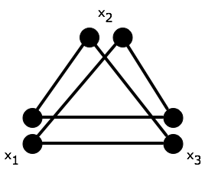
Shortcoming of LPDG Score: Loose Relaxations
LPDG > 0,
but dual optimal
Filled circle means
, black edge means
Notes:
Termination condition for TRW; equivalent to Virtual Arc Consistency

Slide 22
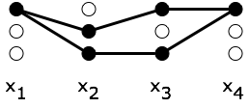
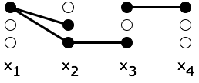
Weak Tree Agreement (WTA) [Kolmogorov 2006]
Reparameterized potentials are said to satisfy WTA if
there exist non-empty subsets for each node i
such that
Filled circle means
Black edge means
labels
labels
At Weak Tree Agreement
Not at Weak Tree Agreement
Notes:
Termination condition for TRW; equivalent to Virtual Arc Consistency

Slide 23
Weak Tree Agreement (WTA) [Kolmogorov 2006]
Reparameterized potentials are said to satisfy WTA if
there exist non-empty subsets for each node i
such that
Filled circle means
Black edge means
labels
labels
At Weak Tree Agreement
Not at Weak Tree Agreement
D₁={0}
D₂={0,2}
D₂={0,2}
D₃={0}
D₁={0}
D₂={2}
D₂={0,2}
D₃={0}
Notes:
Termination condition for TRW; equivalent to Virtual Arc Consistency

Slide 24
Weak Tree Agreement (WTA) [Kolmogorov 2006]
Reparameterized potentials are said to satisfy WTA if
there exist non-empty subsets for each node i
such that
Filled circle means
Black edge means
labels
labels
At Weak Tree Agreement
Not at Weak Tree Agreement
D₁={0}
D₂={2}
D₂={0,2}
D₃={0}
Notes:
Termination condition for TRW; equivalent to Virtual Arc Consistency

Slide 25
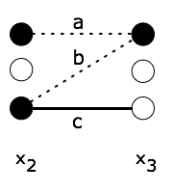
WTA Score
e: “local disagreement” measure
D₂={0,2}
D₃={0,2}
Costs:
solid – low
dotted – medium
else – high
Filled circle means
, black edge means
Notes:
Termination condition for TRW; equivalent to Virtual Arc Consistency

Slide 26
WTA Score
e: “local disagreement” measure
D₂={0,2}
D₃={0,2}
Costs:
solid – low
dotted – medium
else – high
Filled circle means
, black edge means
Notes:
Termination condition for TRW; equivalent to Virtual Arc Consistency

Slide 27
WTA Score
e: “local disagreement” measure
D₂={0,2}
D₃={0,2}
Costs:
solid – low
dotted – medium
else – high
Filled circle means
, black edge means
Notes:
Termination condition for TRW; equivalent to Virtual Arc Consistency

Slide 28
WTA Score
e: “local disagreement” measure
D₂={0,2}
D₃={0,2}
Costs:
solid – low
dotted – medium
else – high
Filled circle means
, black edge means
Notes:
Termination condition for TRW; equivalent to Virtual Arc Consistency

Slide 29
WTA Score
e: “local disagreement” measure: node measure
Notes:
Termination condition for TRW; equivalent to Virtual Arc Consistency

Slide 30
Single Formulation of LPDG and WTA
Set a max history size parameter R.
Store most recent R labelings of variable i in label set D_{i}
R=1: LPDG score. R>1: WTA score.
Combine scores into undirected edge score:
Notes:
Edge score is directed. This then gives us a real-valued measure of how much local disagreement there is.

Slide 31
Properties of LPDG/WTA Scores
LPDG measure gives upper bound on possible dual improvement from passing messages on forest
LPDG may overestimate "usefulness" of an edge e.g., on non-tight relaxations.
WTA measure addresses overestimate problem: is zero shortly after normal message passing would converge.
Both only change when messages are passed on nearby region of graph.
LPDG > 0
WTA = 0

Slide 32
Experiments
Computer Vision:
Stereo
Image Segmentation
Dynamic Image Segmentation
Protein Design:
Static problem
Correlation between measure and dual improvement
Dynamic search application
Algorithms
TBCA: Static Schedule, LPDG Schedule, WTA Schedule
MPLP [Sontag and Globerson implementation]
TRW-S [Kolmogorov Implementation]

Slide 33
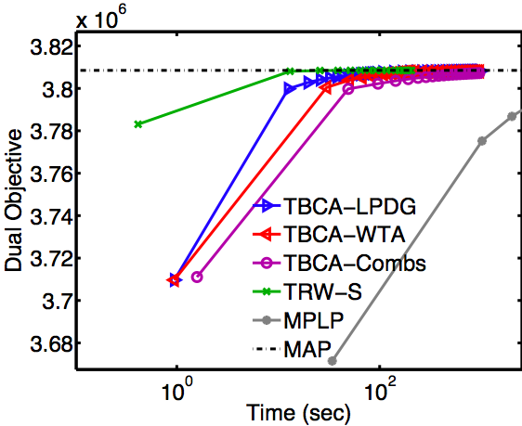
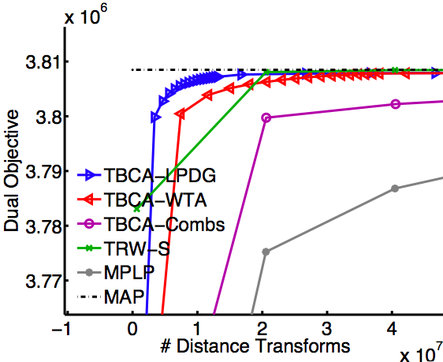
Experiments: Stereo
383x434 pixels, 16 labels. Potts potentials.
Notes:
More in paper. We show a couple here.

Slide 34
Experiments: Image Segmentation
375x500 pixels, 21 labels. General potentials based on label co-occurence.
Notes:
TODO: cut?

Slide 35
Experiments: Dynamic Image Segmentation
Sheep
Previous Opt
Modify White Unaries
Sheep
Heatmap of Messages
Warm-started DTBCA vs Warm-started TRW-S
New Opt
375x500 pixels, 21 labels. Potts potentials.

Slide 36
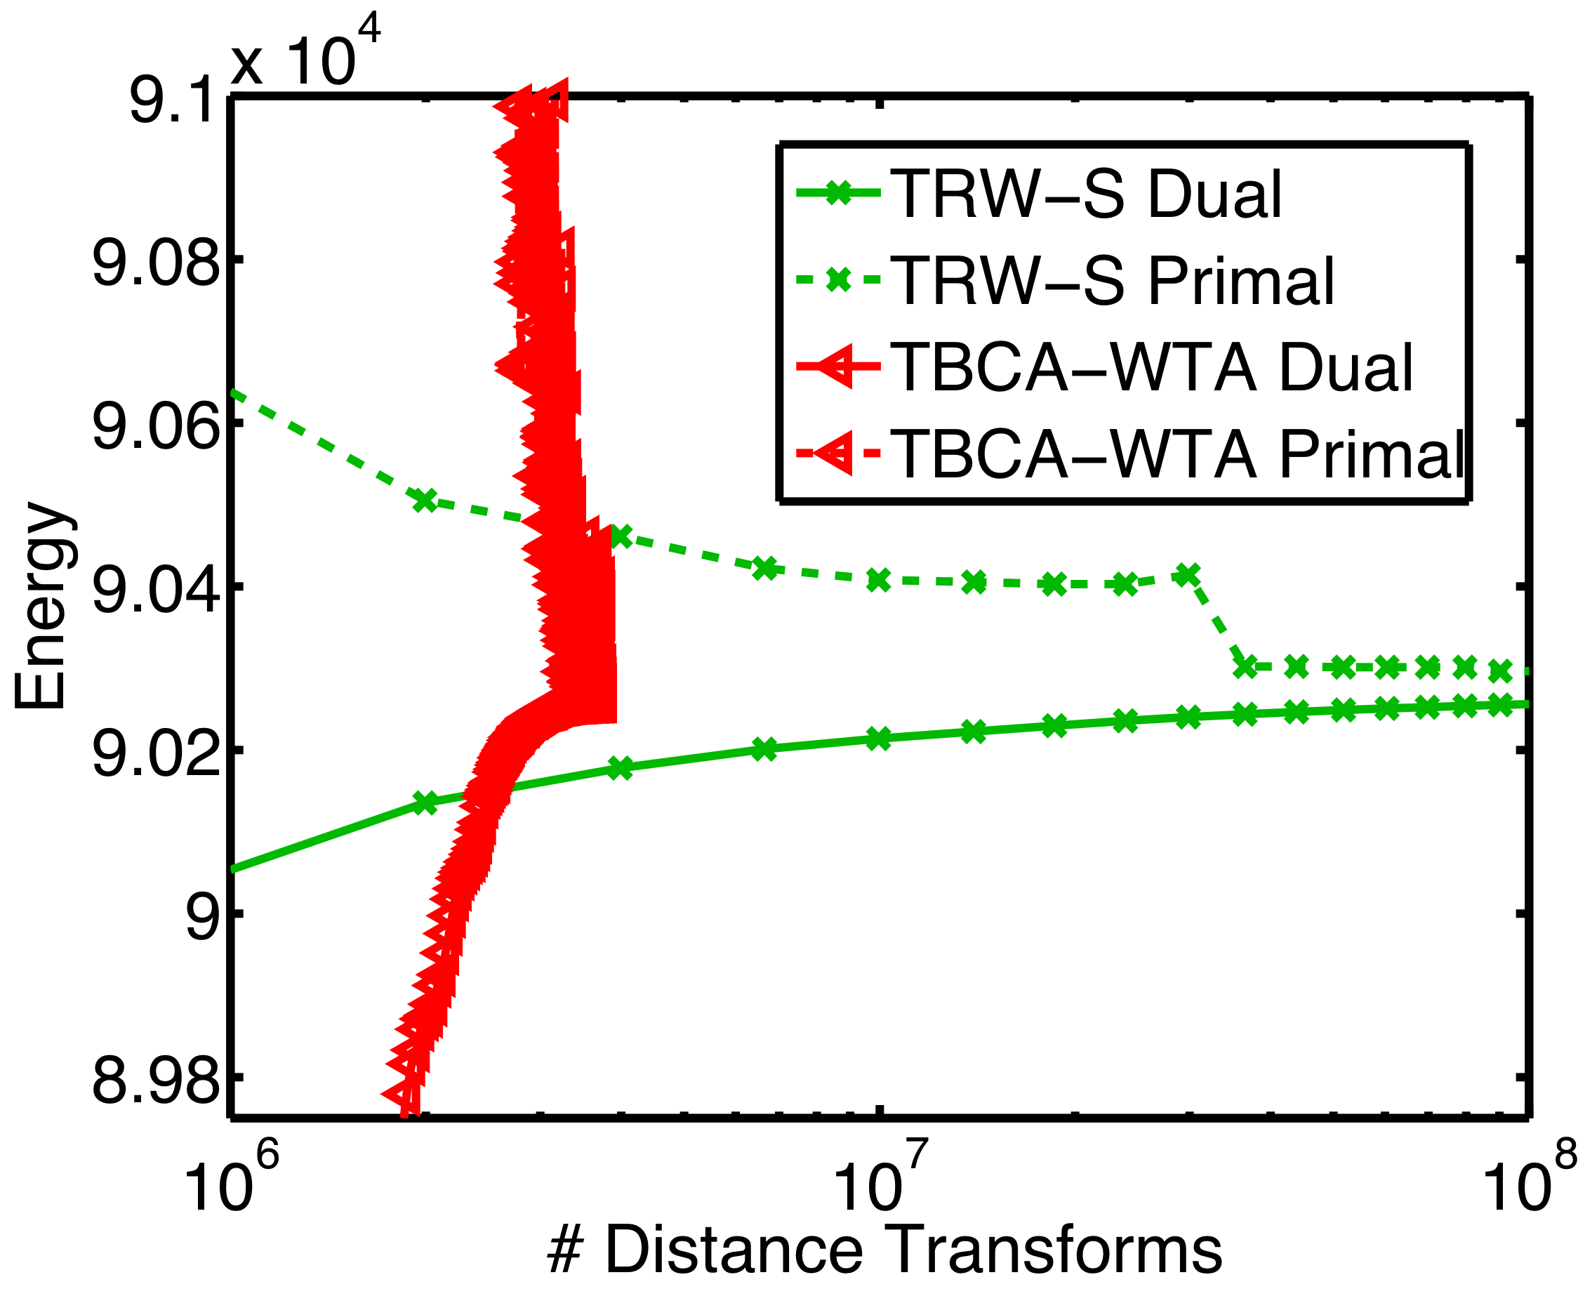
Experiments: Dynamic Image Segmentation
Airplane
Previous Opt
Modify White Unaries
Heatmap of Messages
Warm-started DTBCA vs Warm-started TRW-S
New Opt
375x500 pixels, 21 labels. Potts potentials.

Slide 37
Experiments: Protein Design
Dual Improvement vs. Measure on Forest
Other protein experiments: (see paper)
- DTBCA vs. static "stars" on small protein
DTBCA converges to optimum in .39s vs TBCA in .86s
- Simulating node expansion in A* search on larger protein
Similar dual for DTBCA in 5s as Warm-started TRW-S in 50s.
Protein Design from Yanover et al.

Slide 38
Discussion
Energy oblivious schedules can be wasteful.
For LP-based message passing, primal information is useful for scheduling.
We give two low-overhead ways of including it
Biggest win comes from dynamic applications
Exciting future dynamic applications: search, learning, ...

Slide 39
Discussion
Energy oblivious schedules can be wasteful.
For LP-based message passing, primal information is useful for scheduling.
We give two low-overhead ways of including it
Biggest win comes from dynamic applications
Exciting future dynamic applications: search, learning, ...
Thank You!

Slide 40
Unused slides

Slide 41
Schlesinger's Linear Program (LP)
exact
Real-valued
Marginal polytope
approx
LOCAL polytope
(see next slide)
Notes:
Given any 0-1 assignment of x_i=k, we can see that the objectives are equal. The crux is defining constraints on the real-valued mu's. Doing it properly takes exponentially many constraints, which motivates the local polytope.

Slide 42
Primal
-
Dual

Slide 43
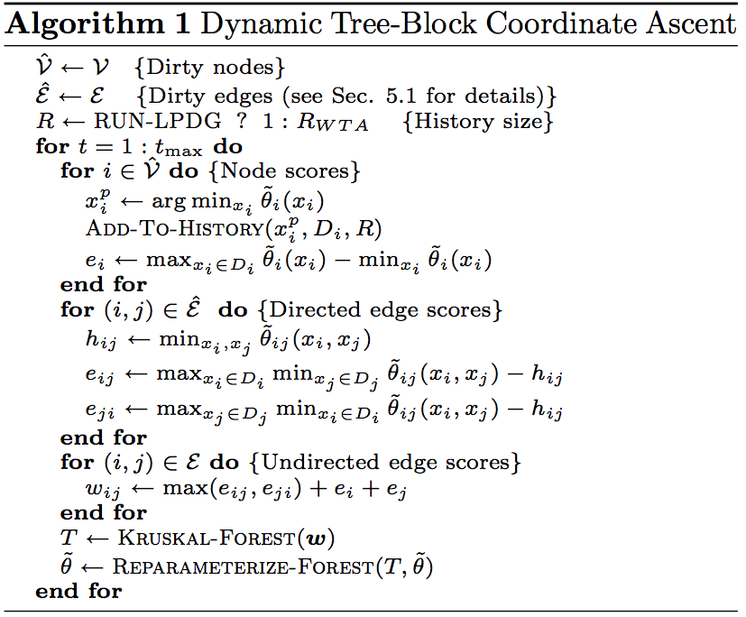
Notes:
Maybe shorten this. Leave out details of dirtyness?

Slide 44
WTA Score
e: “local disagreement” measure
D₂={0,2}
D₃={0}
Filled circle means
, black edge means
Notes:
Termination condition for TRW; equivalent to Virtual Arc Consistency

