Slide 1
CSC373
Algorithms, Analysis & complexity

Slide 2
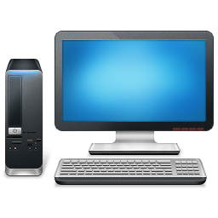
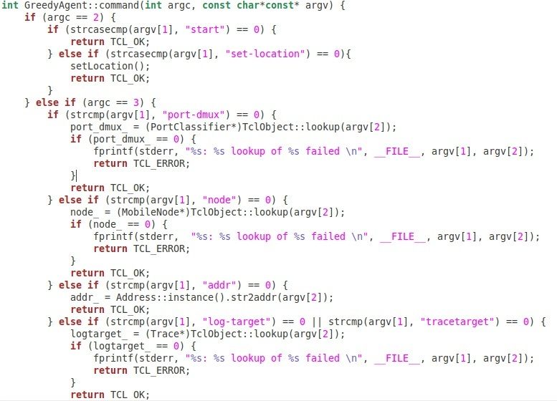
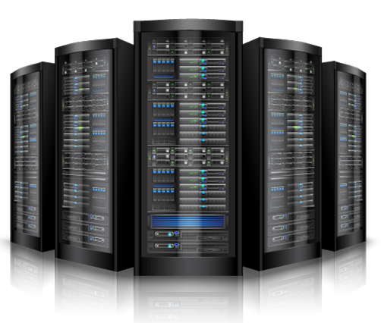
Computers, programming: modern view

Slide 3
Goal of this lecture
Expand the view of computers and programming
Convince computational process is a part of nature
Demonstrate some unconventional computing devices
Show the power of theoretical (scientific) approach

Slide 4
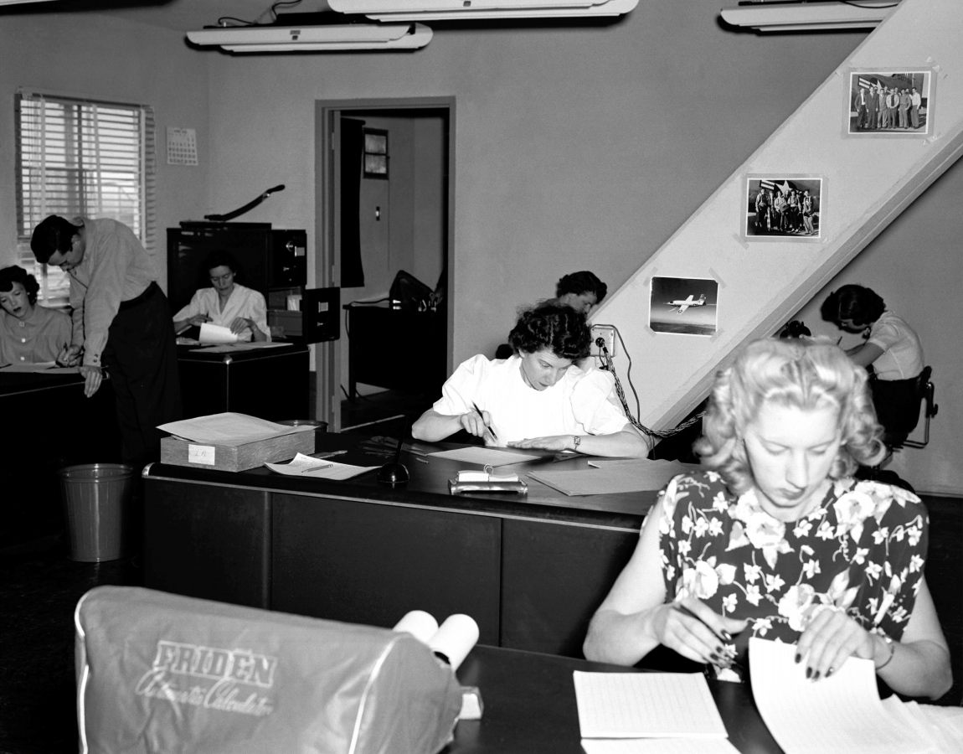
Computers in 1949

Slide 5
Human computers
Interesting account is presented in the autobiography of Richard Feynman “Surely You’re Joking, Mr. Feynman!”
Insect colonies also form a type of a computer – finite state automaton
Finite state automaton is like a regular computer, but without the dynamic memory

Slide 6
Biological computing
“Biocomputers use systems of biologically derived molecules—such as DNA and proteins—to perform computational calculations involving storing, retrieving, and processing data.”
- Wikipedia

Slide 7
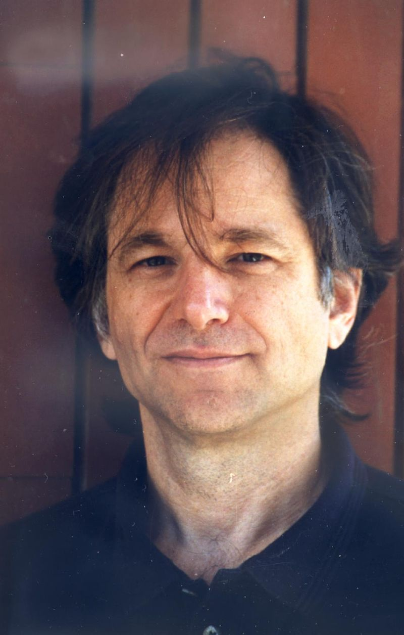
DNA COMPUTING
Invented by Leonard Adleman in 1994
1994 – solved Hamiltonian Path in a graph with 7 vertices
2002 – solved 3SAT with 20 variables
2013 – learnt to store JPEG photographs

Slide 9
DNA Computing from theoretical point of view
Just massively parallel classical computers
Do not solve NP-hard problems in polynomial time
To solve larger and larger instances of NP-hard problems requires exponentially more DNA material
For hard instances of 3SAT with 1000 variables, you would need to convert the entire Earth into DNA, and it won’t be enough

Slide 10
Computing using soap bubbles

Slide 11
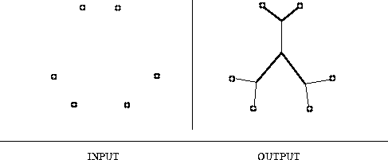
Euclidean Steiner tree problem (STP)
INPUT: N points in the plane
OUTPUT: minimum length tree spanning all N points, but you are allowed to introduce new points
THIS PROBLEM IS NP-HARD

Slide 12
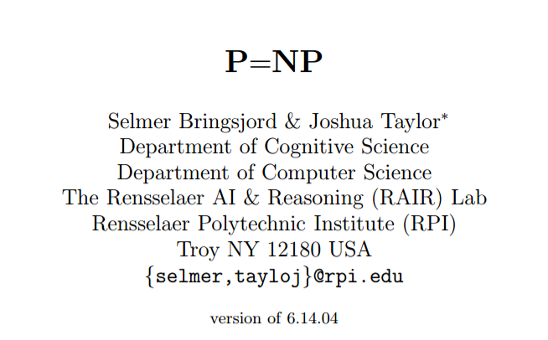

Slide 14
What’s the problem with this “proof”?
“Long story short, I went to the hardware store, bought some glass plates, liquid soap, etc., and found that, while Nature does often find a minimum Steiner tree with 4 or 5 pegs, it tends to get stuck at local optima with larger numbers of pegs. Indeed, often the soap bubbles settle down to a configuration which is not even a tree (i.e. contains “cycles of soap”), and thus provably can’t be optimal.”
- Scott Aaronson

Slide 15
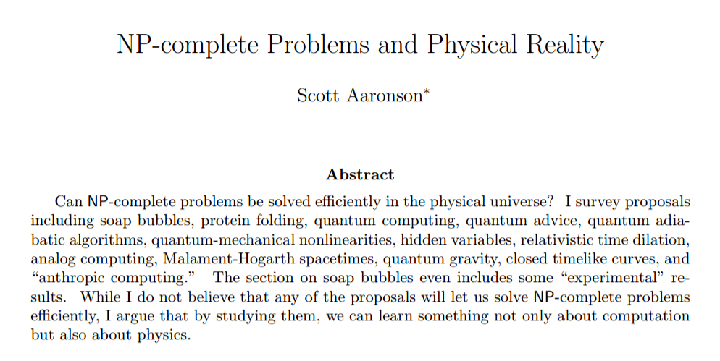

Slide 16
nature gives a polytime approximation algorithm for steiner tree problem
Interesting open problem: what’s the approximation ratio?
Thus, a purely mathematical conjecture led to
a refutation of an assumption in physics!

Slide 17
PROTEIN FOLDING problem

Slide 18
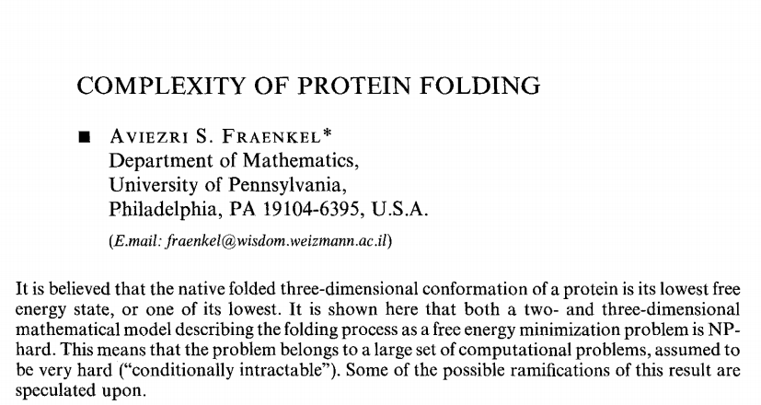

Slide 19
Does nature solve protein folding in polytime?
Proteins in living things seem to fold into states of lowest energy
The nature had millions of years of evolution to find proteins that are “easy” to fold
When proteins mutate or are created artificially – they do not fold into the state of lowest energy, just a local minimum

Slide 20
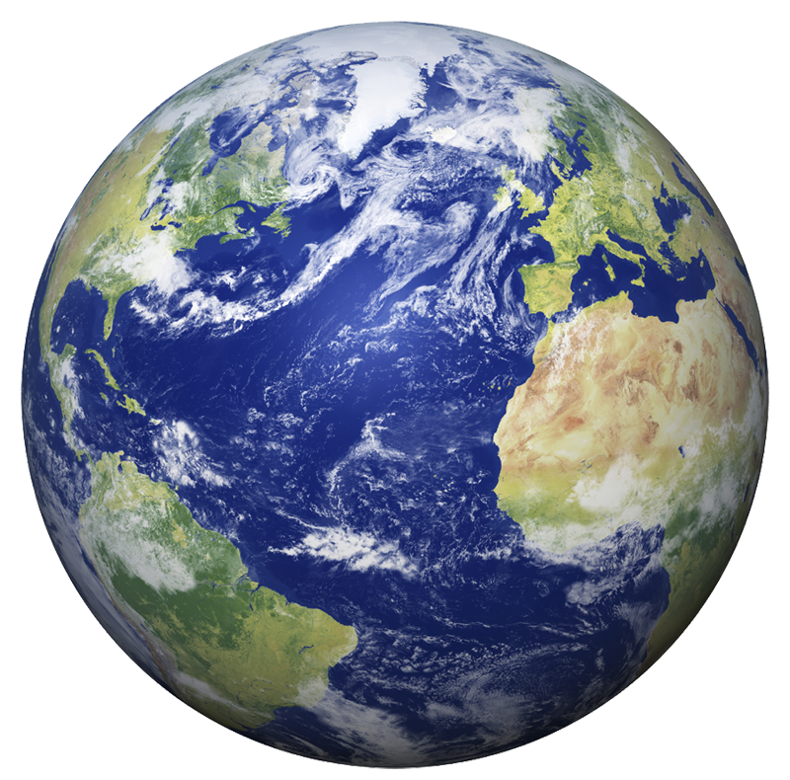
Relativity computer
Running brute-
force on
NP-hard
problem
Travel with speed approx. =
speed of light

Slide 21
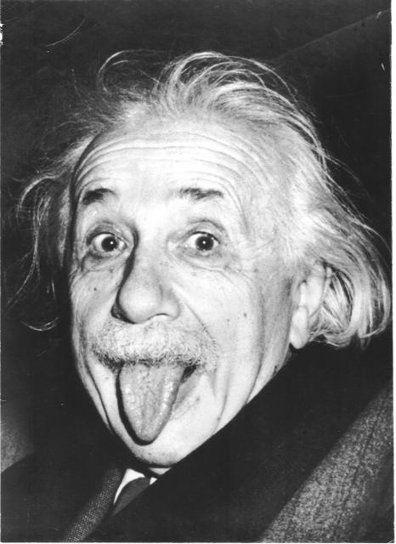
What goes wrong?
To get exponential speed-up need to travel exponentially close to the speed of light
Accelerating to such speed requires exponential amount of energy.
You will have to spend exponential amount of time to build the exponentially large tank.

Slide 22
Church-turing thesis
Every function computable in the physical world is computable by a standard computer
Not a theorem: impossible to prove, but possible to refute
To refute: create a new weird computer that computes something other than what our modern computers can.
There are no candidates to challenge this thesis. Most people believe it is a law of nature. Reason: our modern computers can simulate physics and whatever we discover in physics.

Slide 23
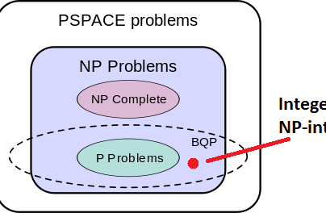
Strong church-turing thesis
All sufficiently powerful computers are polytime equivalent.
This statement has been recently challenged by quantum computers.
WARNING: existence of quantum computers does not mean every problem in NP can be solved in quantum polynomial time (NP subset of BQP). In fact, most complexity theoreticians believe this statement to be false!

Slide 24
“Computer science is no more about computers than astronomy is about telescopes.”
Folklore

