Slide 1
Software Engineering Challenges of Deep Learning
A paper of Anders Arpteg, Björn Brinne, Luka Crnkovic-Friis, Jan Bosch
Presented by Yilin Han

Slide 2
Procedure
Compared ML/DL to software engineering and database technologies.
7 projects
12 main challenges are identified and classified into 3 areas:Development, Productions and organizational Challenges.
Mapping the projects to challenges.
Notes:
Fist, They compared ML/DL to software engineering and database technologies. It is still immature and in need of further work to facilitate development of the high quality system.
Then, Applied interpretive research approach on these companies. Discussed how and why they applied to the specific projects.

Slide 3
ML and SE
SE is writing hard code rules.
ML/DL is dependent on data from external world
Notes:
Difference is ML use data to generate code. Apparently this suggest the data should be tested as thoroughly as code. However, a lack of the best practices for how to do so.
Your ml model testing score may lie to you when it runs on production, since we use the testing data. Reliability is a concern.

Slide 4
ML and Big Data
Many big data technologies can be used in ML.
Volume: large data need big data technologies
Variety: how to integrate and transform multiple data sources is the main challenge. Maybe hard to build such data pipelines.
Velocity: ML may need big data techniques to support real-time or low latency environment, such as streaming processing.
Requires distributed training algorithms or parallelism.
Notes:
Big data technologies is combined with ML. especially on infrastructure level.
Variety and data integration is usually underestimated.

Slide 5
Technical Debt
ML create a new type of technical debt, since it relates to the changes to the external world.
Debt from “transfer learning”: add external dependencies on the data, but also training on external model separately may change the configuration over time.
Debt from pipelines change: add and remove field is a costly work to keep a ML system up to date. Hard to monitor and log.
Configuration management: usually ML system can hardly given same quality control as software code. Configuration changes should be supervised and tested.
Notes:
Technical debt is a concept in software development that reflects the implied cost of additional rework caused by choosing an easy solution now instead of using a better approach that would take longer.
Transfer learning is reuse other models or a set of sub models to build new model.
Data integration: being underestimated.
Configuration management is usually not as concerned as other

Slide 6
Project EST: Real Estate Valuation
NN project used by Swedish banks for more than 10 years.
Supporting loan issuing decision that sales price is reasonably close to the market value.
Data: historial sales. Information about individual properties, demographics, and geography.
Team: 4 data scientists, and two backend developers.

Slide 7
Project OIL
Predicting Oil and Gas Recovery Potentials (EUR)
DL model to predicting EUR base on geological information
Data:high resolution geological maps, and oil/gas wells information.
Team: two data scientist/developers
Notes:
Estimated ultimate recovery is an approximation of the quantity of oil or gas that is potentially recoverable or has already been recovered from a reserve or well.

Slide 8
Project RET: Predicting User Retention
A median-streaming service company analyze percentage of users will remain active two weeks after registration
Difficulty is each user only have small amount of available data.
Predictions are tracked on dashboard.
Data: media consumption, client interaction, and user demographics. Big data problem with terabytes of data to process.
Team: multiple teams, 4-10 people each.

Slide 9
Project WEA: Weather Forecasting
Government project. The goal is to building better wind turbine generator predictions.
Requires supercomputers. Expensive to make a prediction, and inaccurate.
Data: > 1 TB. 12 years of data. consisted of satellite images, meteorological observations and topological maps. Some data is hard to access (tape).
Team: 3 data scientist. two developers and a number of meteorologists.
Notes:
physical transport of data tapes

Slide 10
Project CCF: Credit Card Fraud Detection
Detecting credit card fraud to against money laundering.
Significant time was spent on improving the model efficiency.
Data: payment request data (method, amount location, etc.) and customer details (CRM, payment history, activity history). Post payment activities.
Team: small dedicated analysis team in cooperate with different departments for data integration.
Notes:
ML Heavily implemented area.
the efficiency on faud detection, reducin g the levels the blocked, and risky payment, much better performance than traditional hand-craft rules.

Slide 11
Project BOT: Poker Bot Identification
It is used to against automate game-playing bots.
The project is abandoned due to unpredictability of efficiency.
Data: game play activities, client technical details (IP)
Team: 2-3 consultant and 1-2 internal experts.

Slide 12
Project REC: Media Recommandations
It focused on the problem: how to give recommendations when only few people have seen or rated a newly released content.
Hybrid methods: Deep convolutional network and filtering techniques (when sufficient user data exist). Choose the best of two methods.
Data: raw media data to learn user preferences without having any user usage data.
Team: a team of data scientists and large number of engineers.

Slide 13
Selected Challenges
Challenges in the intersection between ML and SE.
Development Challenges
Production Challenges
Organizational Challenges

Slide 14
Development Challenges
Experiment Management
Limited Transparency
Troubleshooting
Resource Limitations
Testing
Notes:
Background: Key difference between ML and SE is programs is generated automatically in ML, but hard coded in SE.
Performance of ML project is unknown till it has been tested with given data.
In addition, model transparency is bad in ML. We basically can’t understand large and complicated models. It is difficult to debug a ML system.
Experiment management: training a ML model, we usually conduct large number of experiments. However it is hard to make sure the result of each experiments is reproducible. (such as parameter, training data, model structure.
Different data may gives different results.
In this case, version control of ML system becomes challenging. You data may need to be versioned as well. Cost of storing versioned data is very high.
In addition, hard to manage ML system versions as well. Same data but hundreds of models with different configuration parameters.
Limited Transparency: difficult to understand the model, and its component. Hard to identify a specific functional area .
Troubleshooting: hard to estimate ML system or result before it is trained or tested, We got only error estimation, even if there is a bug,hard to identify. Also hard to view since millions of parameters are involved. Some model also takes days to train, no way to know or tuning the performance .
In big data aspect, The distributed manner with tensorflow or spark makes it hard to debug with existing SE tools.
Resource Limitations: Eg. GPU memory limitations. Need special algo or techniques to split the model across multiple GPUs. Extra time and knowledge to work on distributed system.
Testing: Not only the model testing, but also testing on the data. Data also need to be tested,since ML Model is highly dependent on data. However, only few data tool existing in the market.
Also, Sampling from full dataset used for testing is challenging. Such as edge cases are hard to guarantees. Also prone to changes of external work.

Slide 15
Production Challenges
Dependency Management
Monitoring and Logging
Unintended Feedback Loops
Glue Code and Supporting System
Notes:
Dependency Management:
As the training of DL is long,we have Strong motivation to use the latest technologies, both software and hardware. DL is primarily trained on GPUs (40-100x) faster. As the hardware developed, software is strongly tight to it. Such at a new GPU may change the software code to adapt it. So both software and hardware are continuously changing in a short period of time. -> changing the hardware and software may affect reproducible results. It is also expensive engineering costs to keep updating software and hardware.
Monitoring and Logging:.People failed to recognize the effort needed to maintain a deployed ML system over time. It is hard to cover all the edge cases that may occur, once the model is deployed to production.
ML model is constantly retrained as the data changes. The behavior of the ML system can suddenly change that out of human’s control. We need to monitoring the performanc e and logging the behaviours, however choosing metrics to monitor can be challenging.
Unintended Feedback Loops:No matter how you carefully developed and verified the model. The final performance is still dependent on external data. -> we may face the case, the real-world systems adapt the model rather than the other way around. Such that example: real estate pricing system-> when its popular, its predicted value affect the true market value.
Glue Code and Supporting System:
Glue code:interacts with supporting systems and glues libraries and system together. Which occupies 95% of the total code. Keeping the glue code update to date on cloud service is challenging.

Slide 16
Organizational Challenges
Effort Estimation
Privacy and Data Safety
Cultural Differences
Notes:
Effort Estimation: SE, easy to estimate time and resources and cost and performance and so . ML project is hard such as unknown performance, unknown iterations to reach the goal. Hard to know how long to build such system or training. Since lack of transparency, hard to modify to reach better result -> also hard to estimate effort.
Privacy and Data Safety:
Keep data safety and privacy is important, but it makes to build ML system harder.
Anonymous data -> reduce the performance, also makes data exploration and troubleshooting difficult.
Cultural Difference: Data scientists, engineers UX designers, etc. They have different working culture, they focused on different aspects which introduce the challenges. ??? Any cooperation between people is hard, Idk why it mention that.

Slide 17
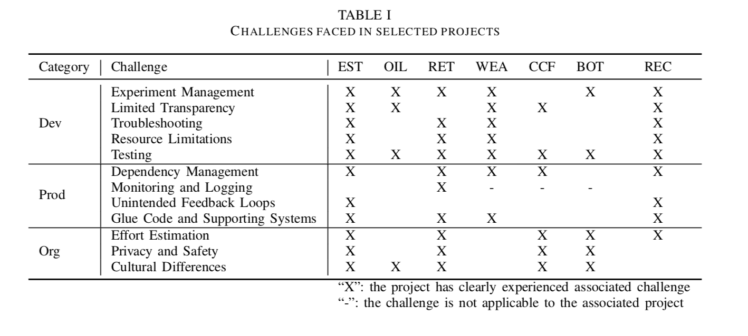
Project Challenge Mapping
Notes:
Experiment management:
EST:(Real Estate Estimation) They did lots of experiments where try to improve the model. They made a mistake that data shuffle flag was toggled from false to true, where the performance get reduced dramatically. It takes them several days to realize and resolve this problem. This shows That understanding differences between experiments is hard and it is influential on model performance.
Limited Transparency:
OIL Project since the data is noisy and system is not perfect. Engineering tried to know why NN made such weird decisions. But it is very hard to find a reasonable explanation. When you don’t know the problem, you will depends on experience/guess to resolve it. Especially their decision may end up cost 1M dollars to drilling a well a hole. It is hard for them to actually make such decision.
Troubleshooting:
Weather prediction system(WEA): they use autoencoder to compressed weather data. In their early testing stage, it data quality was poor. There is not obvious explanation. They’ve tried hundreds of NN in 2 weeks. Because the lack of easy to use debugging tools for deep neural network. It tooks them long time to identify the error. The actually error is pooling error is too aggressive where loss the resolution before data is encoded.
Resource Limitations:
Media recommandation(REC):it needs Distributed data processing in order pre-process data before training the model. It takes hybrid approach. The DL approach recommended video only been viewed few times, and it is row media data. This requires it can process data at petabyte scale. Meanwhile, training a CNN is expensive. This demands lots of machines. This involves both big data problem and distributed DL training problem.
Effort Estimation:
Poker Bot Identification(BOT): one big reason make its project got cancelled is they can;t estimate the time and resources required during the project. The management lost patience, and eventually cancelled the project. Until the working model is trained, it is hard to convince the client. It is hard to make the project delivered on time.
Privacy and Safety:
User Retention (RET): as the term of service agreement defined between the users and the company, they have to use the data anonymized and encrypted. This includes gender, agen, and city. If useful, it will affect the performance-> hard to use encrypted data.
Cultural Difference and Logging:
User Retention(RET): product owner push the change in time, as they need to do randomized tests(A/B tests) in a weekly manner. However, this will result product is release before all necessary logging fully implemented. Which generates conflicts between product owner and data scientists.

Slide 18
Conclusion
Notes:
Well, what DL have achieved so far in the world is really exciting. It still have many challenges need to resolved.
It is hard to criticise the paper, since it is abstract and high level.
This paper is not resolving for a specific problem, but people who viewed this paper will have rough idea about what they gonna face while building a ML projects.
It is a good guide for ML product manager. It is also gives researchers some thoughts or directions in their future work. They will know what challenges are unresolved.
Traditional SE tools are rarely helpful in DL development. If both ML and SE communities could work together to resolve the challenges. The power of DL will be more accessible for small companies or users.

