Slide 1
Springrobot: A prototype autonomous vehicle and its algorithms for lane detection.
Presented by Mohammad Rashidujjaman Rifat
Ph.D Student,
Department of Computer Science
University of Toronto
rifat@cs.toronto.edu
http://www.dgp.toronto.edu/~rifat/

Slide 2
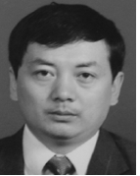
Qing Li, Ph.D.
The Institute of Artificial Intelligence and Robotics,
Xi’an Jiaotong University, Xi’an, China.
Nanning Zheng
Professor and the Director of the Institute of Artificial Intelligence and Robotics
Xi’an Jiaotong University
Hong Cheng, Ph.D
Lecturer
The Institute of Artificial Intelligence and Robotics,
Xi’an Jiaotong University, Xi’an, China.

Slide 3
The paper is about…
SpringRobot: an autonomous vehicle project
Safety warning and driver’s assistant system
Automatic pilot for rural and urban traffic environment
High precise digital map and a combination of sensors
The architecture and strategy of the system
Lane detection
Model for image boundaries
Color feature selection and image preprocessing
Adaptive randomized HT
Experimental result

Slide 4
Background: China’s investment
Chinese government has been increasing funding for improving the traffic infrastructure
Enforcing traffic laws
Educating drivers

Slide 5
Lane changing: problems of state of the art
B-snake based lane model
Using steerable filters to provide robustness to illumination changes and shadows and perform well in picking out both circular reflector road markings
Hough transform based

Slide 6
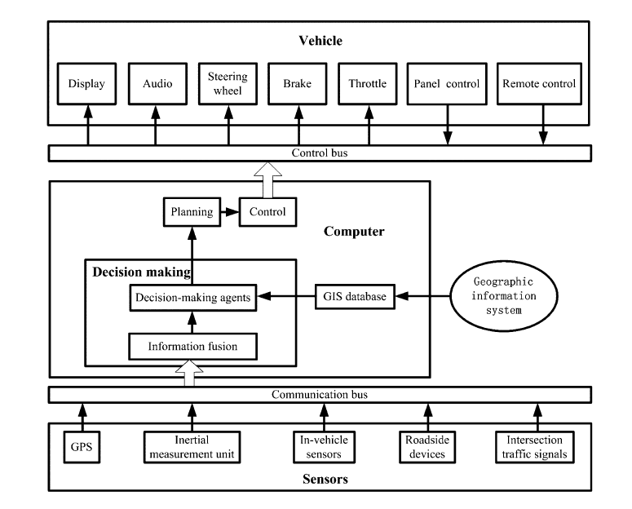
System Architecture - Springrobot

Slide 7
Making assumption of the road structure in real world
Transforming 3-D images to 2-D ones
A circular arc with curvature is approximated by a parabola of the form
x=0.5k’y²+myb’
The circular arcs in the ground plane are transformed into a curve in the image plane
U=k/(v-hz)+b(v-hz)+vp
Now the problem is reduced to estimate parameters k, v, and vp for the left and right lane boundaries
Model of Lane Boundaries

Slide 8
Challenge of lane detection: distinguish the lane from the surrounding environment
Distinct lane: simple detector
Low contrast or camouflage: needs a great deal of prior knowledge of the road: not generalizable
A wide range of feature used including color, texture, and shape
Each feature has a lot of parameters to tune
The paper use color in lane marking
Color Feature Selection and Image Preprocessing

Slide 9
The set of color candidate features are composed of linear combinations of red, green, blue (RGB) channel values.
F={w1R+w2G+w3B}, w_{i}={-2,-1,0,1,2}
All features are normalized into the range of 0– 255.
The best values for lane detection by experiments, w1=1, w2=1, w3=0.
Edge information: The gradient values of input image are calculated using 3*3 Sobel operator with a low threshold
Color Feature Selection and Image Preprocessing (cont.)

Slide 10
Problem of HT: high computational cost
Advantages of the RHT: high parameter resolution, infinite scope of the parameter space, small storage requirements, and high speed.
Problems of RHT: the entire process has to be repeated for every combination of the discrete parameter values
Adaptive Randomized HT

Slide 11
Adaptive RHT: Combines advantages for both HT and RHT
Reduction of 3-D Parametric Space to the 2-D and the One-Dimensional (1-D) Space
Take the derivative of the curve of image space
Relationship among points of the road feature, local feature, and local feature tangent
Adaptive Randomized HT (cont.)

Slide 12
Using Graylevel Edge Maps Instead of Binary-Level Edge Maps
In RHT based on a binary edge map, every edge pixel is sampled uniformly, without considering its probability of being on a certain curve.
In the ARHT, pixels with larger gradient magnitudes are sampled more frequently.
Adaptive Randomized HT (cont.)

Slide 13
Determining Parameters Coarsely and Increasing Quantized Accuracy Relatively by the Multiresolution Strategy
Multiresolution strategy to achieve an accurate solution
Locating global optima with a lower resolution images
Adaptive Randomized HT (cont.)

Slide 14
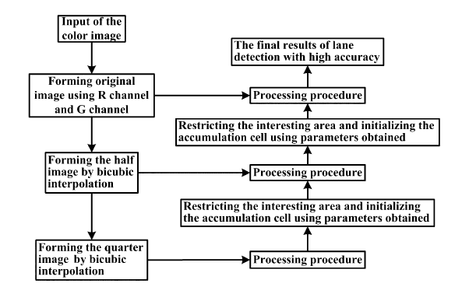
Adaptive Randomized HT in a Nutshell

Slide 15
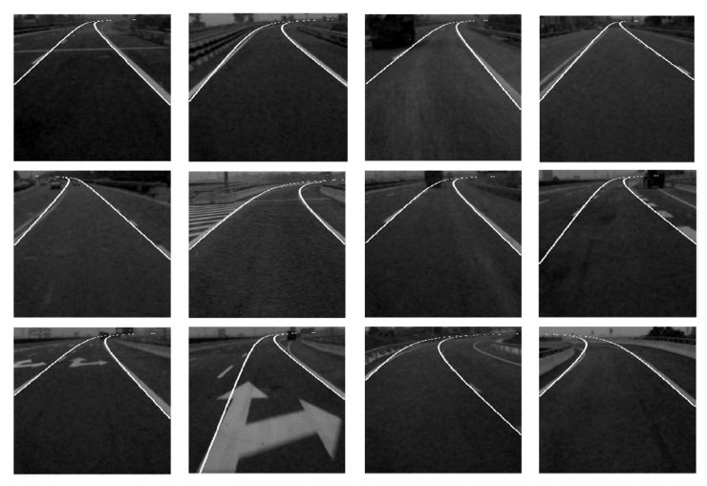
Experiment

Slide 16
Thank you Question?
What do you think overall about the prototype and their techniques?
Do you know any better method than this?
Do you think it is experimentally sound and efficient?
Do you suggest any methodological changes that might make it more robust and efficient?
Do you know any alternative method that you think are better than this? Please feel free to share with all of us.
What lane detection algorithm are used mostly in practices? Do you want to share if you know about any and contrast this method?

