Slide 1
Threat of Adversarial Attacks on Deep Learning in Computer Vision: A Survey
Authors: Naveed Akhtar, Ajmal Mian
March 25th, 2019
Presented by: Hazem Ibrahim
Notes:
Good afternoon everyone, today I am going to be presenting this paper “Threat of Adversarial Attacks on Deep Learning in Computer Vision: A Survey”. I chose this paper firstly because I felt that Adversarial attacks were an interesting topic to cover in this class, and we haven’t really had any presentation that goes into them specifically, but also because this paper gives a really great overview of the types of attacks and their differences but also some defenses against them. I hope you enjoy it.

Slide 2
Agenda
Definition of terms
Adversarial Attacks in Literature for Classification/Recognition
Adversarial Attacks in the Real World
Defenses against Adversarial Attacks
Discussion
Notes:
So this paper is broken down as follows: First we will discuss some definitions of terms that are used in this paper. Then we are going to talk about the history of adversarial attacks in literature in more or less a chronological order. We will be discussing attacks that specifically target classification. The paper also introduces a review of literature that discusses adversarial attacks on other things such as autoencoders, RNNs, and deep reinforcement learning, but since this class is mostly related to driving and image recognition, I won’t be presenting them in this presentation. Then we will get into adversarial attacks in the real world and take a look at some examples there. Then we will discuss some defenses suggested by the authors and will conclude with some final remarks.

Slide 3
Definition of Terms:
Adversarial image: A modified version of a clean image that is intentionally perturbed to confuse a machine learning technique (e.g DNNs)
Black-box attacks: Attacks that feed a model with adversarial examples with limited knowledge of the model itself (training procedure) and no knowledge about the model’s parameters.
White-box attacks: Attacks that have complete knowledge of the targeted model.
Universal Perturbation: Able to fool a given model on any image with high probability.
Fooling ratio: Percentage of images on which a trained model changes its prediction label after the images are perturbed.
Notes:
After the introduction to the paper where they go through the same stuff we have covered in this class a number of times like why are NNs useful and so on, the authors start off with a quick set of definitions to help the reader when reading this paper. I wanted to share some of these terms with you because I personally found them helpful when reading the paper.
The authors presented a number of other definitions as well, but these are the ones I thought were most important for the sake of time and this presentation.

Slide 4
Adversarial Attacks in Literature
Notes:
Just a note, I won’t be going through all the algorithms presented in the paper, but rather I will pick a few from each section and present them.

Slide 5
AAs for Classification
C. Szegedy et al. (2014). ‘‘Intriguing properties of neural networks.’’
Let denote a vectorized clean image
Compute additive perturbation
Solve:
Hard problem -> Approximate solution using L-BFGS.
Find minimum c > 0 for minimizer of the following problem satisfies the condition
Notes:
The first paper discussed is this one by Szegedy called “Intriguing properties of neural networks” where Szegedy first demonstrated the existences of small perturbations to the images such that the perturbed images could fool deep learning models into misclassification.
Firstly, let's assume Ic denotes a vectorized clean image where c denotes that the image is clean. The objective is to calculate the additive perturbation rho that would distort the image very slightly to fool the network. Szegedy proposed to solve the following problem where l here denotes the label of the image and capital C is the deep neural network classifier. The authors proposed to solve this problem for its non-trivial solution where l is different from the original label of Ic. But this becomes a hard problem and hence an approximate solution is sought using a box-strained L-BFGS which is a popular optimization algorithm used for parameter estimation in machine learning. If you're curious what L-BFGS stands for, it means Limited-memory Broyden-Fletcher-Goldfarb-Shanno which I guess are the names of the people that made the algorithm.
The objective in this problem is finding the minimum c>0 for which the minimizer rho of the final equation satisfies the condition C(clean image + perturbation) is equal to the class. In this equation, L computes the loss of the classifier. With a convex loss function, this results in the exact solution, but in DNNs thats typically not the case. In this paper, Szegedy notes that perturbations computed for one neural network were also able to fool multiple networks which really at the time identified a blind-spot in deep learning, since at the time of this discovery, the Computer Vision community was adapting to the impression that deep learning features define the space where perceptual distances are well approximated by Euclidean distances, but these results were contradictory and it triggered a wide interest of research in this area.

Slide 6
AAs for Classification
J. Su, D. V. Vargas, and S. Kouichi. (2017). ‘‘One pixel attack for fooling deep neural networks.’’
Fooled 3 different models on 71% of testing images with 97.47% confidence of wrong labels.
For image , create a set of 400 vectors in such that each vector contains the xy-coordinates and RGB values for an arbitrary candidate pixel.
Differential Evolution:
Randomly modify elements of the vectors to create children
Children compete with parent for fitness
Probabilistic predicted label of the network is used as fitness criterion
Notes:
One of the more extreme adversarial attacks which we have discussed at times in this class are One-Pixel attacks. Originally introduced by Su in 2017 in her paper “One pixel attack for fooling deep neural networks”, Su demonstrated successful fooling of three different network models on 71% of the tested images by changing just one pixel per image where the average confidence of the networks on the wrong labels was about 98%. In their process they used differential evolution which is a method that optimizes a problem by iteratively trying to improve a candidate solution with regard to a given measure of quality. In this case, for an image Ic, they created a set of 400 vectors (not really sure why they chose 400 although its probably explained in the original paper), where each vector contains the xy-coordinates and the RGB values for an arbitrary candidate pixel. From there, they randomly modify the elements of the vectors to create children such that the child competes with its parent for fitness in the next iteration, while the probabilistic predicted label of the network is used as a fitness criterion. The last surviving child is then used to alter the pixel in the image. Notice that by using differential evolution, this enables their approach to generate adversarial examples without having access to any info about the network parameters values or their gradients, the only input their technique needs is the probabilistic labels predicted by the targeted model.

Slide 7
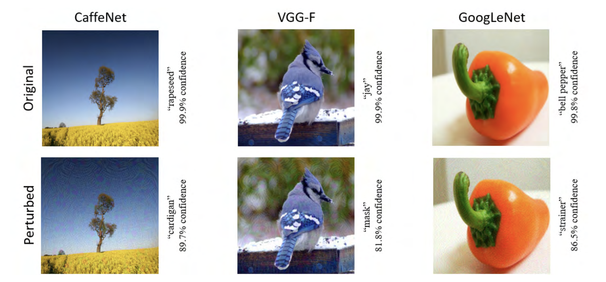
AAs for Classification
S. M. Moosavi-Dezfooli, A. Fawzi, O. Fawzi, and P. Frossard, ‘‘Universal adversarial perturbations”
Assume clean images are sampled from distribution
Perturbation is universal if it satisfies this constraint:
Notes:
Whereas other methods that we talked about try to compute perturbations to fool a network on a single image, the ‘universal’ adversarial perturbations introduced by Moosavi et al in their paper “Universal adversarial perturbations” are able to fool a network on ‘any’ image with a high probability, which makes these perturbations image-agnostic. In addition, these perturbations are considered ‘quasi-imperceptible’ which means they can not be detected by the human eye.
To get into the algorithm, let's assume that clean images are sampled from this distribution Sc. In this case a perturbation rho is considered universal if it satisfies this constraint. Here, capital P denotes the probability, and delta is the fooling ratio. Here we are looking at the L-p norm and zi is a predefined constant. Essentially what were are saying here is that the smaller the value of zi, the harder it is to perceive the perturbation of the image by restricting its L-p norm. So to be completely clear, these perturbations can be considered universal but they have a strong dependence on the parameters selected.
To test, the authors computed the universal perturbations by restricting both the l2 and linfinity norms and showed that perturbations with their norms upper bounded by 4% of the respective image norms already achieved significant fooling ratios of around 0.8 or more for state of the art image classifiers. The process to actually compute a perturbation is iterative, where the algorithm is gradually pushing all the training data points to their respective decision boundaries and the perturbations computed over all the images are gradually accumulated by back-projecting the accumulator to the desired lp ball of radius zi every time. They also showed that a fooling ratio of greater than 50% is achievable by learning a perturbation using only 2000 training images.

Slide 8
AAs for Classification - Summary
Notes:
The authors provided a summary of the different algorithms mentioned in the paper with regards to adversarial attacks for classification. Here notice that the strength is based on the impression of the authors from the reviewed literature but its not based on any exact quantity or quality. Two things that I haven’t really talked about so far which is the targeted/non-targeted field. By targeted here we mean that the attack aims to make the model guess a certain target class where as non-targeted just aims to make the model guess any other class other than the correct one. As for Learning, one-shot vs iterative just means the way in which the algorithm learns. In the first paper presented, the learning was one-shot in which an adversarial perturbation is done by performing a single-step computation. Iterative methods on the other hand perform the same computation multiple times to get a single perturbation which make them generally more computationally expensive.

Slide 9
Adversarial Attacks in Real Life
Notes:
The papers discussed so far assume settings where adversaries directly feed deep neural networks with perturbed images and the effectiveness of the attacks were also evaluated using standard image databases and datasets like ImageNet. While most researchers agree that adversarial examples shown in literature are a real concern for Deep learning in practice, there are two papers which the authors mention that downplay this concern and mention that adversarial examples are only a matter of curiosity with little practical concerns like the paper by Lu in 2017 named “No need to worry about adversarial examples in object detection in autonomous vehicles” and in Graeses paper published in 2016 named “Assessing the threat of adversarial examples on deep neural networks”. I personally didn’t get into those two papers to see why they think this way, but I will now be discussing adversarial attacks in practical real-world conditions.

Slide 10
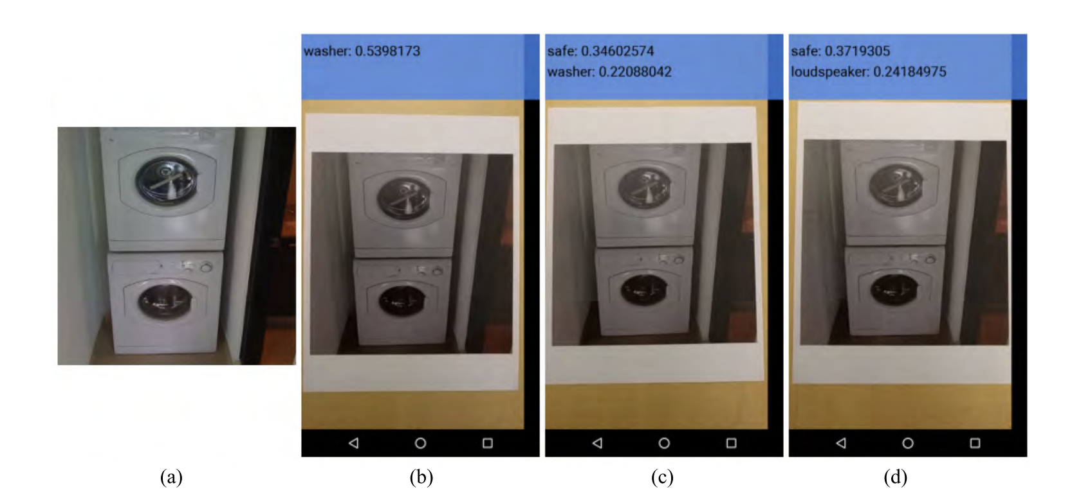
AAs in Real Life
Cell-Phone Attack
A. Kurakin, I. Goodfellow, and S. Bengio. (2016). ‘‘Adversarial examples in the physical world.’’
Printed adversarial images
Tensorflow Camera app using Google’s Inception Model
Large fraction of images were misclassified.
Notes:
The first paper to demonstrate the threats of adversarial attacks in the physical world was presented by Kurakin in his paper “Adversarial examples in the physical world” published in 2016. In this paper, they printed adversarial images and took snapshots from a cell-phone camera. They then fed these images into the TensorFlow Camera Demo app which utilizes Google’s Inception model for object classification. It was shown that a large fraction of the images were misclassified even when perceived through the camera.

Slide 11
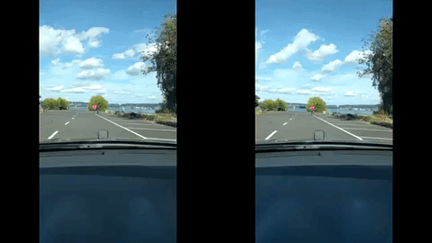
AAs in Real Life
Road-Sign Attack (RP₂)
I. Evtimov et al. (2017). ‘‘Robust physical-world attacks on deep learning models.’’
Perturbations robust to view angles, distance and resolution.
Two attack classes:
Poster-Printing
Sticker Perturbation (Subtle/Camo)
Notes:
In the paper “Robust physical-world attacks on deep learning models” by Evtimov in 2017, the goal was design robust perturbations for the physical world. They proposed the algorithm Robust Physical Perturbations, or RP2, which generated and demonstrated the possibility of attacks that are robust to physical conditions such as variation in view angles, distance and resolution. The perturbations generated achieved a high fooling ratio in practical drive-by settings. Two different attack classes were tested in their work, poster-printing, where the attacker prints a perturbed road sign poster and places it over the real sign, and sticker perturbations, where the printing is done on a paper and the paper is stuck over the real sign. For sticker perturbations, there were two types tested. Subtle perturbations were those that occupied the entire sign, and camouflage perturbations which took the form of a graffiti sticker on the sign. All the different classes were successful in creating perturbations that were robust to natural variations and demonstrate that indeed adversarial attacks can be a threat in the real world. Although since the publishing of this paper, there have been new detectors such as FasterRCNN which are not fooled by these perturbations presented by Evtimov.

Slide 12
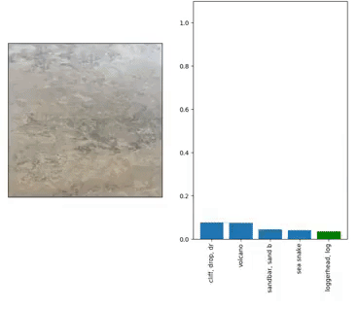
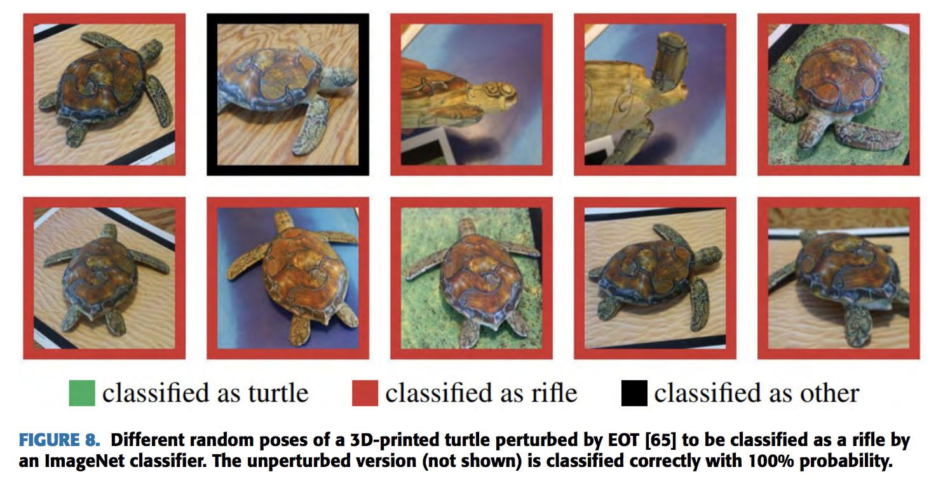
AAs in Real Life
Adversarial 3D Objects
A. Athalye, L. Engstrom, A. Ilyas, and K. Kwok. (2017). ‘‘Synthesizing robust adversarial examples.’’
Constructing 3D objects robust to image/object transformations.
Expectation over Transformation (EOT)
Select specific target class.
Notes:
An argument was made in Zeng’s paper “Adversarial attacks beyond the image space” in 2017 that adversarial perturbations in the image space do not generalize well in the physical space of the real-world. As a counter to this, Athalye introduced in her paper “Synthesizing robust adversarial examples” a method for constructing 3D objects that can fool neural networks across a wide variety of angles and viewpoints. The introduced the Expectation over Transformation framework to construct examples that are adversarial over an entire distribution of image/object transformations. The main idea of the EOT framework us to model perturbations within the optimization procedure. This end-to-end approach is then able to print arbitrary adversarial 3D objects with a specific target class in mind. As an example, you can see on the right here that the turtle they printed was built to be targeted as a rifle.

Slide 13
Defenses against Adversarial Attacks
Notes:
The authors break down the defenses currently used against adversarial attacks into three separate groups. The first approach is using modified training during learning or modified input during testing. The second is to modify the networks themselves by adding more layers/subnetworks or changing the loss and activation functions. The third is using external models as network add-ons when classifying unseen examples. Under each category, the defenses are then further split into defenses which are considered complete defenses, and others which are detection only. In complete defenses, the aim to enable the network to predict the true class label on the adversarial examples, whereas in detection only, the defense is only meant to raise a red flag on potentially adversarial examples to reject them in any further processing.

Slide 14
Modified Training/Input
Brute-force adversarial training
Using adversarial images besides the clean images to train the model.
Adversarial examples can be re-computed for already adversarially trained networks.
Data Compression as Defense
Compressing images to counter perturbations (JPG/JPEG).
Loss of accuracy on clean images vs. removing perturbations.
Foveation Based Defense
Foveation: Applying the neural network in different regions of images.
Notes:
The first method discussed is brute-force adversarial training. Adversarial training means using adversarial images besides the clean images to train the model. Since the introduction of adversarial examples, there has been a general consensus that the robustness of NNs against these examples improves with adversarial training. Its been shown in literature that brute-force training results in regularizing the network to reduce overfitting which in turn improves the robustness of the networks. However, Moosavi-Dezfooli et al showed that effective adversarial examples can again be computed for already trained networks.
The idea behind data compression as defense was introduced in 2016, where Dziugaite demonstrated that by compressing JPG images, they can reverse the drop in classification accuracy to a large extent for certain types of simple attacks. This approach was extended to include JPEG images as well. However, while the results were encouraging, no analysis was provided for stronger attacks, and future papers also demonstrated the existence of adversarial examples which can survive compression. The main limitation with this approach is that with larger compressions, there is a loss in classification accuracy on clean images, whereas smaller compressions often do not adequately remove the adversarial perturbations.
Another type of defense is foveation based defense. By foveation, the authors mean applying the neural network in different regions of the image. While CNN-based classifiers are generally robust to scale and translation variations of objects in the images, this invariance does not extend to adversarial patterns in the images. But, the effectiveness of this type of defense as not be shown against more powerful attacks. To explain this idea further, the authors of the paper that discussed foveation argue that the hypothesis that adversarial perturbations are a consequence of CNNs acting as a linear classifier is wrong, and that CNNs may act linearly in some areas of the image, and may act non-linearly in others. When the neural responses are linear, applying foveation to the adversarial example tends to significantly reduce the effect of the perturbation. This is because, hypothetically, CNNs for ImageNet are robust to changes in scale and translation of the object produced by the foveation, but this property does not generalize to the transformations in the perturbation itself.

Slide 15
Modifying the Network
Gradient Regularization
Penalizing variation resulting in output with respect to change in the input.
Defensive Distillation
Distillation: Transferring knowledge from a complex network to a smaller one.
Feeding class probability vectors of the training data back to train the original model.
DeepCloak
Insert masking layer before layer handling the classification.
Layer is explicitly trained with paris of clean and adversarial images.
Encodes differences between output features of both images and force dominant weights to 0.
Notes:
One method proposed by Ross and Doshi-Velez in 2017 to improve the robustness of deep neural network to adversarial attacks was gradient regularization. In this method, they train differentiable models like deep neural networks while penalizing the degree of variation resulting in the output with respect to change in the input. It was shown that when combined with brute-force adversarial training, this resulted in very good robustness against one-step attacks. However, these methods almost double the training complexity of a network which is already prohibitive in many cases.
The second method is Defensive Distillation. Distillation, introduced by Hinton in 2014, is a training procedure used to transfer knowledge of a more complex network to a smaller network. For the purposes of defense against adversarial attacks, Papernot uses the knowledge of the network to improve its own robustness. The knowledge extracted is in the form of class probability vectors of the training data and it is fed back to train the original model. It was shown that this method improves the resilience of the network to small perturbations in the images.
Another approach is called DeepCloak which was proposed by Gao in 2017 where they insert a masking layer immediately before the layer handling the classification. The added layer is then explicitly trained by forward-passing clean and adversarial pairs of images and it encodes the differences between the output features of the previous layers for those pairs. In the paper, they argue that the most dominant weights in the added layer correspond to the most sensitive features of the network in terms of adversarial manipulation, and therefore those features are masked by forcing the dominant weights to zero.

Slide 16
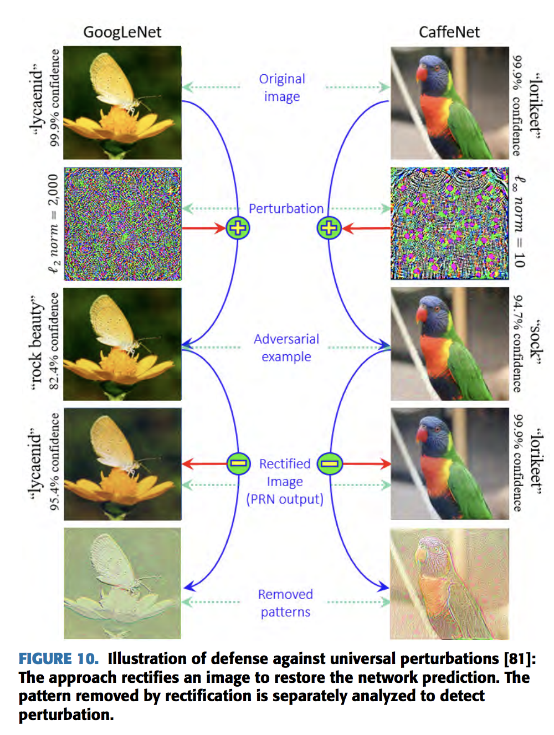
Network Add-Ons
Defense against Universal Perturbations
Adding pre-input layers called Perturbation Rectifying Network (PRN)
Feature Squeezing
Two external models added
Reduce color bit depth of each pixel
Perform spatial smoothing over image
MagNet
Learn manifold of clean images during training.
Compare distance of images in test phase with manifold and accept or reject them.
Notes:
In terms of network add ons, there are also a number of different implementations suggested in literature. The first method is a defense against universal perturbations, proposed by Akhtar in 2017. In this method, additional pre-input layers are added to the network and they are trained to rectify a perturbed image so that the classifier’s prediction is the same as its prediction of the clean version of the image. The extra layers are called Perturbation Rectifying Network, which are trained without updating the parameters of the targeted network. A separate detector is then trained by extracting features from the input-output differences of the PRN for the training images. Then they can use to removed patterns to be separately analyzed for detection.
A detection only method proposed by Xu in 2017 proposed the idea of feature squeezing to detect adversarial perturbations to an image. They added two external models to the classified network, where the models reduce the color bit depth of each pixel in the image and perform spatial smoothing over the image which is done to reduce the variation among pixels. Since common image representations use color bit depths that lead to irrelevant features, the authors hypothesized that reducing bit depth can reduce adversarial opportunity without harming the classifier accuracy. The predictions of the network over the original image and the squeezed image are then compared and if a large difference is found, the image is considered to be an adversarial example.
The final defense i’d like to discuss is MagNet. In this framework, one or more external detectors are used to classify an input image as clean or adversarial. During the training phase, the framework tries to learn the manifold of clean images. In the testing phase, the images that are found to be far from the learned manifold are considered to be adversarial, while images that are close to the manifold but not exactly on it are then reformed to lie on the manifold and fed back into the classifier. The idea is that you attract nearby images close to the manifold and reject further ones which is how they came up with the name MagNet.

Slide 17
Discussion

Slide 18
Discussion
We still don’t know why adversarial examples work!
Does linearity promote vulnerability?
Linearity Hypothesis
Other factors?
Curvature of the decision boundaries
Low flexibility of networks
No consensus
Notes:
After reading this paper, we’re sort of left clueless as to why adversarial examples work.
Throughout the paper, the topic of linearity is brought up. This idea was brought up by Goodfellow, who came up with one of the earlier examples of adversarial attacks where he noted that the examples generated by his attack exploited the linearity of deep network models in higher dimensional space, even though models at the time were thought to be highly non-linear. He hypothesized that the designs of modern DNNs encourage linear behaviour for computational gains and that this could make them susceptible to analytical perturbations. However, Tanay and Griffin demonstrated some image classes that do not suffer from adversarial examples for a linear classifier, which goes against the linearity hypothesis proposed by Goodfellow.
Other factors mentioned by the paper regarding the existence of adversarial networks include the flatness of the decision boundaries, the large local curvature of the decision boundaries and the low flexibility of networks.
With regards to the curvature of the decision boundaries, Fawzi demonstrated that when decision boundaries have a small curvature, classifiers are robust to random noise in high dimensional classification problems. They noted that to improve robustness, imposing geometric constraints on the curvature of the decision boundaries. In addition, Fawzi in another study also noted that the robustness of classifiers to universal perturbations is driven by a key property of their curvature.
Another interesting paper that I came across tried to demonstrate that we can expect to find targeted adversarial examples for a network which distinguishes m classes at a Hamming Distance of m + 1.

Slide 19
Thank you for listening!
Questions?

