Slide 1
Model-Driven Engineering for Mission-Critical IoT Systems
CSC2125 –Topics in Software Engineering, Or Aharoni
Notes:
setting and discussing technological challenges of MC-IOT
critically analysing model-driven engineering as a possible candidate methodology to better support the adoption of MC-IOT.

Slide 2
Internet of Things
Connect Smart object from different domain
Software/ Application
Hardware
Protocols
Storage
Users
Security

Slide 3
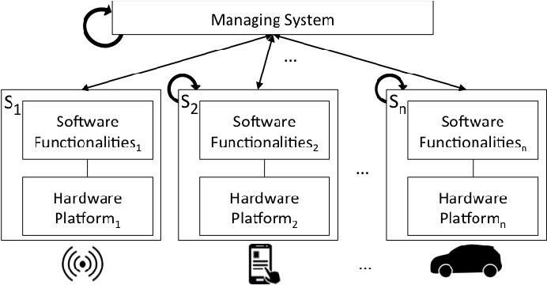
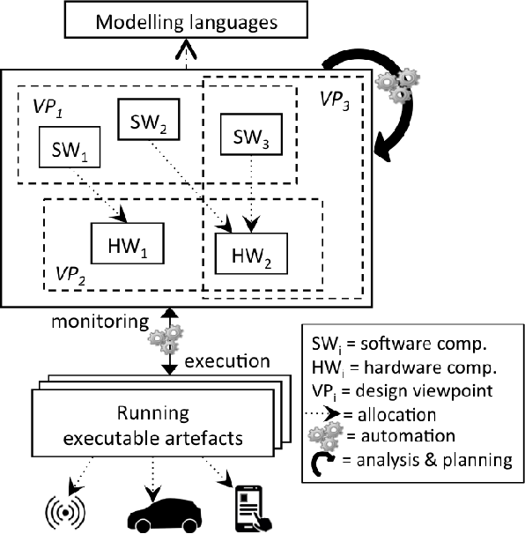
Model Driven Engineering
The model in terms of the user's domain, abstracting away software-technology concepts
MDE helps in tackling challenges and supporting the lifecycle of IoT system.
Metadata
Model
Transformation
MDE4IoT: Supporting the Internet of Things with Model-Driven Engineering

Slide 4
Characteristics of mission critical in IoT systems
Dependability
User can trust a system (reliability and availability).
Max availability - 98.57%,
Probability of failure - 0.45%
Safety
Ability to detect and prevent unintended behavior.
Security
Deal with malicious attacks, system-level trust, and privacy.
Solutions: encryptions, communication protocols, and sensor data protection.
Real-time System
IoT system’s correctness relies on the system components’ functional behavior, ex. output, and the timing of their action, how long is the information is available.
Dependability
Safety
MC-IoT characteristics
Security
Real-Time System
Notes:
Failure of Mission-critical systems can cause significant economic, human, or environmental losses.
In the article they explored project of :
Smart energy
Smart Living
Smart transportation
Smart cities
Smart Healthcare
Smart learning
Security systems

Slide 5
Concept model of mission-critical IoT system
computation
Sensor
Device Context
IoT Application Communicate by protocols
Notes:
Thinks – large variety of devices hosting a number of Resources and running different IoT Applications

Slide 6
MC- IoT system Challenges
MC –IoT System
Heterogeneity
Large scale & Emergent properties
Context Awareness
Dynamic environment
Reusability
Security and Trust
Platform Neutrality (Protocols, HW, SW, etc.)
Large scale
Manually identify critical section is complex and hard to follow
Emergent properties compromise system safety
Dynamic context changes
leads to runtime failure
New system ,unknown, recovered devices
Program, protocols, support reusability
Decentralize architecture
Efficient privacy and trust management
Identify communication and adjust
Semantic reusability
standardization
Automatic scale
Manage and detect actions

Slide 7
Study Case: Applying MDE
Smart surveillance system that aims to detect intruders
Drones;
Moving cameras;
Fixed sensors; and
Human guards observing the entire system.

Slide 8
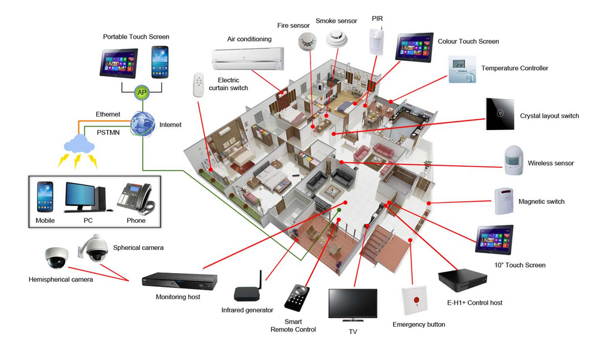
Applying MDE: Heterogeneity
Domain-Specific Modeling Language (DSMLs)
use the same abstract modeling language to configure the surveillance system’s drones and sensors and specify their behavior, no matter who made them
one place heterogeneous systems
Models can become complex and hard to grasp, even for experts.
Currently no precise way to verify the consistency of the implicit

Slide 9
Applying MDE: Large-Scale and Emergent Properties
MC-IoT systems can reach the size of tens or hundreds of distributed things.
How can you deal with a suspicious behavior of a single device - camera, drone, or a sensor – and it became unavailable when it is need.
Models@runtime techniques allows to reallocate the functionality of each device.
Uses abstractions of the runtime system and environment to effectively manage the complexity of evolving behaviors during execution
Notes:
You can view MC-IoT systems as a specialization of dynamically adaptive systems (DASs)
WHAT IS A MODEL@RUN.TIME?
In MDE, a model is an abstraction or reduced representation of a system that is built for specific purposes. The models@run.time community shares this view of what constitutes a model and seeks an understanding of the roles that such models can play at runtime.

Slide 10
Applying MDE: Context Awareness and Uncertainty
Drones can suddenly crash or battery failure, or something blocking camera movement or view.
MC-IoT systems will need more powerful, fully automated mechanisms for selecting the most suitable configuration, as well as self-reconfiguration capabilities

Slide 11
Applying MDE: Dynamic Discoverability of Resources
new drones & sensors might be added to increase surveillance possibilities.
Using Service-oriented modeling and service-oriented architectures (SOAs) allows to define the use of models and model transformations for identifying, specifying, realizing, composing, and orchestrating services.
This could be done by using WADE (Workflows and Agents Development Environment) platform.
WADE – domain independent platform, build on open source middleware (JADE 5).
But it would require global standards

Slide 12
Applying MDE: Reusability
MDE usually is combined with Component-Based Software Engineering
Allowing to define reusable replaceable model entities throughout the system
Involved entities can be modeled as different components, which can be manipulated through dedicated model transformation and analysis tools
“MC-IoT systems have an inherent issue in trading off the use of components, which is common in other domains, with the system’s high variability and the need for self-adaptation.”

Slide 13
Applying MDE: Security and Trust
Model-driven mechanisms grant access on the basis of trust established through negotiation between the service requester and the service provider.
service providers might not know the service requesters’ identity in advance owing to ubiquitous and emergent services.
In the surveillance system example
MDE facilitates the definition and enforcement of user-friendly, precise, and effective security and privacy specification policies.
MDE also looks at how violation of policies may affect the system’s parts.

Slide 14
Strengths
Provide global idea how to look at MC-IoT
Provided an example of surveillance system as a walk through
Weaknesses
Solutions stayed at a high level and in some case it needs to get into further detail.
How to implement the ideas.
Comparison in different IoT area of industry (finance, health, etc.)
MDE and DSMLs only
The solution relays on different research that were made but it did not explain why they decide to use it.

Slide 15
Conclusion
Setting and discussing technological challenges of MC-IOT
Critically analysing model-driven engineering as a possible candidate methodology to better support the adoption of MC-IOT.

Slide 16
Discussion
Is this a good taxonomy paper?
Why did they use MDE?
Is there any other Modeling platform can we use?
Any metrics for the quantifiable criteria?
Are we developing correct system?
Is it performing the way it should?
Dose it comply with standards?

