Slide 1
Cloud Modeling Framework CloudMF
Applying MDE to Tame the Complexity
of Managing Multi-Cloud Applications
Authors: Nicolas Ferry, Hui Song, Alessandro Rossini, Franck Chauvel, Arnor Solberg
Presenter: Mikhail Berezovskiy

Slide 2
Content
IaaS and PaaS. Challenges and Motivation
Cloud Modeling Language
CloudMF Models@run-time
Synthesis and Implementation
Conclusion

Slide 3
IaaS and PaaS Challenges and Motivation

Slide 4
Infrastructure as a Service (IaaS) Platform as a Service (PaaS)
IaaS scenarios:
Test and development
Website hosting
Storage, backup, and recovery
High-performance computing
Big data analysis
PaaS scenarios:
Development framework
Analytics or business intelligence
Additional services

Slide 5
Challenges
It is not easy to move IaaS data from one PaaS provider to another
It is almost impossible to move Service/Image/Environment between providers on the same level
Keep interoperability and prevent vendor lock-in
Changes at design- and run-time
Change PaaS provider
Move service to between providers
Vendor Lock-in
Complexity of executing and management of multi-cloud apps

Slide 6
CloudMF addressing challenges
Cloud MF
Cloud ML
Modeling language, DSL
Models@Run-time environment
Specifying provision and deployment
Simple graphical interface and textual syntaxes
Enacting the provisioning, deployment and adaptation
Support remote access from 3ed parties, including reasoning engines

Slide 7
Motivation. SensApp example
SensApp provides capabilities to register sensors, store their data, and notify clients when new data are pushed
It is designed to seamlessly bridge the gap
between the Internet of things (IoT) and the cloud

Slide 8
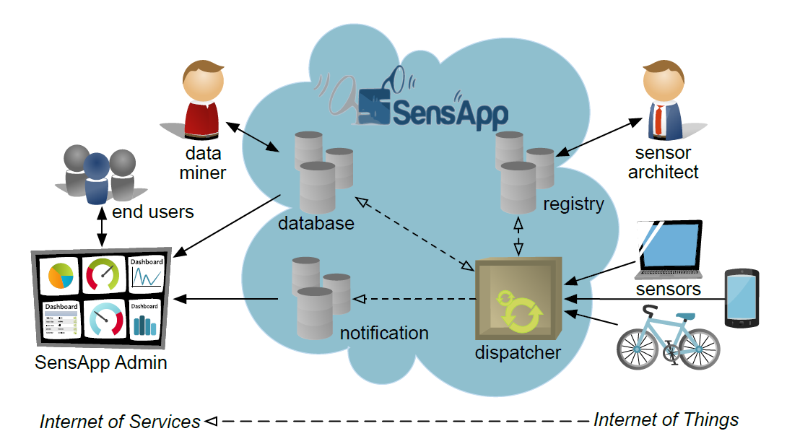
Motivation. SensApp example
VM
VM1
VM2
Move SensApp to another VM, while keep database MongoDB

Slide 9
Requirements for system
Cloud provider independence
Separation of concerns
Reusability
Abstraction
White- and black- box infrastructure
Prevent vendor lock-in
Provider-agnostic
Modularity
Facilitate maintenance and dynamic adoption
Support patterns
Rapid development
Single DSL for IaaS and PaaS
Continuously up-to-date representation of system
Various degrees of control

Slide 10
Cloud Modeling Language

Slide 11
CloudMF demo Components

Slide 12
CloudMF demo Server menu

Slide 13
CloudMF demo Components status after deployment

Slide 14
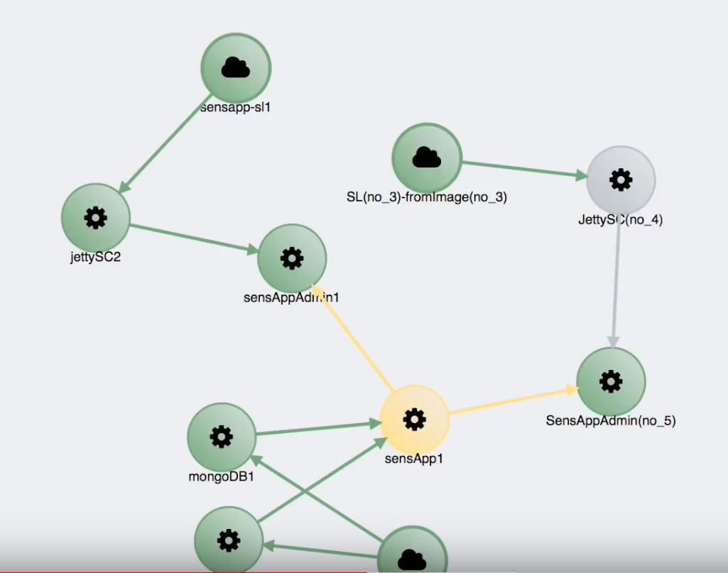
CloudMF demo Scale Out

Slide 15
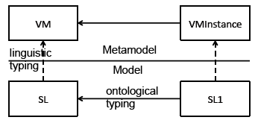
Language key concepts
Provides 2 levels of abstraction
Cloud Provider-Independent Model (CPIM)
Cloud Provider-Specific Model (CPSM)
Component-based approaches
Type-instance pattern
Various formats of notation
JSON
XMI
Web-based interface
Eclipse-based
deployment models can be regarded as assemblies of components exposing ports (or interfaces), and bindings between these ports.
*SL – “Small Linux”

Slide 16
Cloud Provider-Independent Model (CPIM) Metamodel
Provider-Agnostic!
All the parts are components
External Components
Internal Components

Slide 17
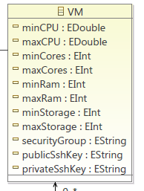
An example of an External Component
Add Amazon Beanstalk Instance
Add Linux VM instance

Slide 18
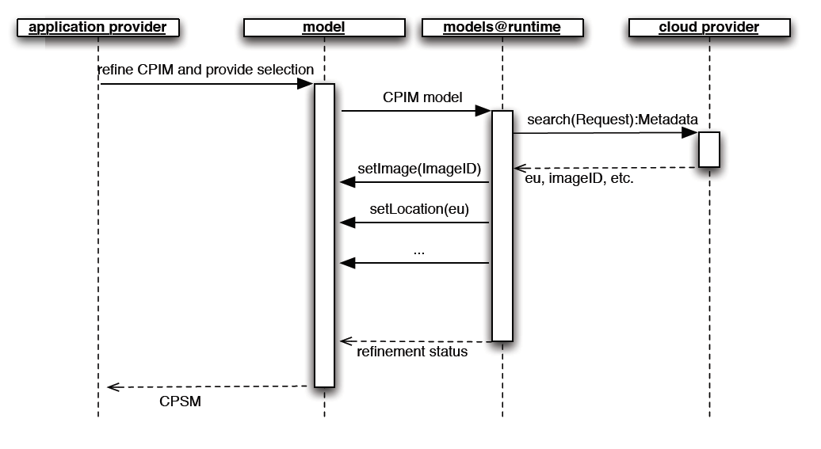
Independent Models to Specific Models CPIM to CPSM
A deployment model at the CPSM level consists of an enrichment of the instances of the corresponding CPIM with cloud provider-specific information
Independent model
Enriched model with provider specifics
Call API at run-time

Slide 19
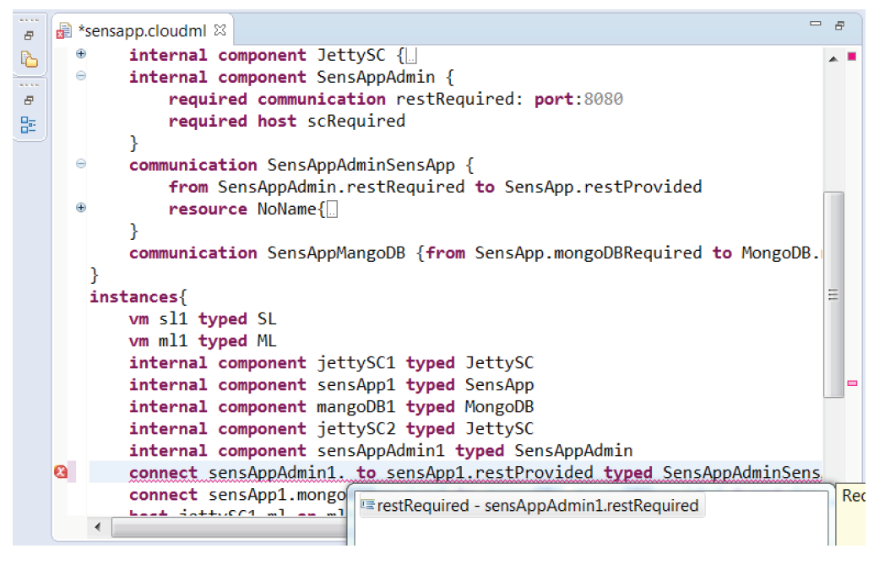
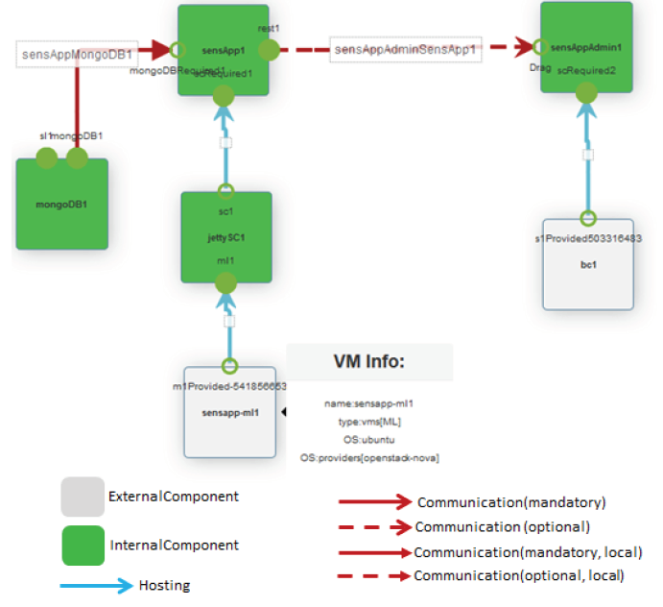
Notation examples
Text-based
Web-based

Slide 20
CloudMF Models@run-time

Slide 21
Models@run-time?
Adaptive systems
Self-healing
Changing requirements
Cyber-physical systems
IoT
Big Data
Models that representing not only design but reflecting current running system and changes

Slide 22
Models@run-time CloudMF
Model@run-time
Reflect current Running System
Become executable artifact for running systems
- provides current state to Reasoning Engine
- provides new state from Reasoning Engine

Slide 23
Models@run-time CloudMF
Provide Cloud Platform Specific Model (CPSM) to Reasoning enginer
Receive target CPSM
Compute difference
Modify or adapt difference

Slide 24
Models@run-time Synchronization with 3ed parties
Notify 3ed party of current state
Models@run-time
3ed Party
Notification
WebSocket
Command
Command to modify current state

Slide 25
Synthesis and Implementation

Slide 26
Requirements (initial)
Cloud provider independence
Separation of concerns
Reusability
Abstraction
White- and black- box infrastructure
Support patterns
Rapid development
Single DSL for IaaS and PaaS
Continuously up-to-date representation of system
Various degrees of control
Modularity
Facilitate maintenance and dynamic adoption
Prevent vendor lock-in
Provider-agnostic

Slide 27
Requirements fulfilment
Cloud provider independence
Separation of concerns
Abstraction
White- and black- box infrastructure
CPIMs and CPSMs ensures that the provisioning and deployment templates are cloud provider-independent
The component-based design of the CloudML meta-model ensures that the provisioning and deployment templates and models are modular and loosely-coupled.
Reusability
The type-instance pattern in the CloudML metamodel ensures that types a can be reused across several models
Framework offers a single domain-specific language and abstraction which enables the management of application on both IaaS and PaaS solutions
models@run-time environment provides an abstract and up-to-date representation of the running system which can be dynamically manipulated
CloudMF has full control of their underlying infrastructure and platforms (IaaS/white-box) and exploitation of advanced and rigid PaaS’s that feature little control from the outside (black-box)

Slide 28
Conclusion

Slide 29
Conclusion
Cloud Modelling Framework (CloudMF) leverages upon model-driven techniques and methods
Supports the cloud provider-independent specification of multi-clouds application including IaaS and PaaS solutions
The associated models@run-time environment provides mechanisms for the dynamic provisioning, deployment, and adaptation of multicloud applications

Slide 30
Thank you!

