Slide 1
CloudSim: a toolkit for modeling and simulation of cloud computing environments and evaluation of resource provisioning algorithms Calheiros et al. - Softw. Pract. Exper. 2011
Presented by Ramy Shahin
March 12th 2018

Slide 2
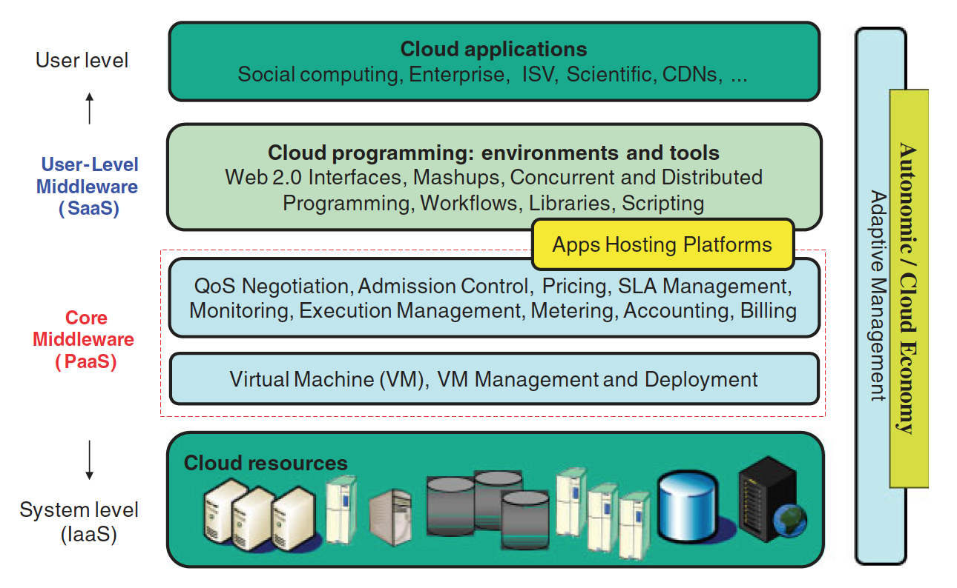
Cloud Computing

Slide 3
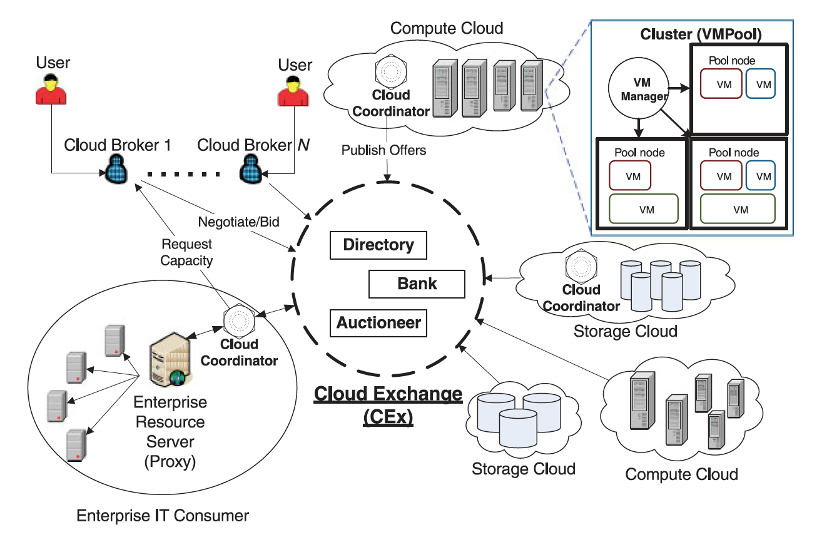
Cloud Federation

Slide 4
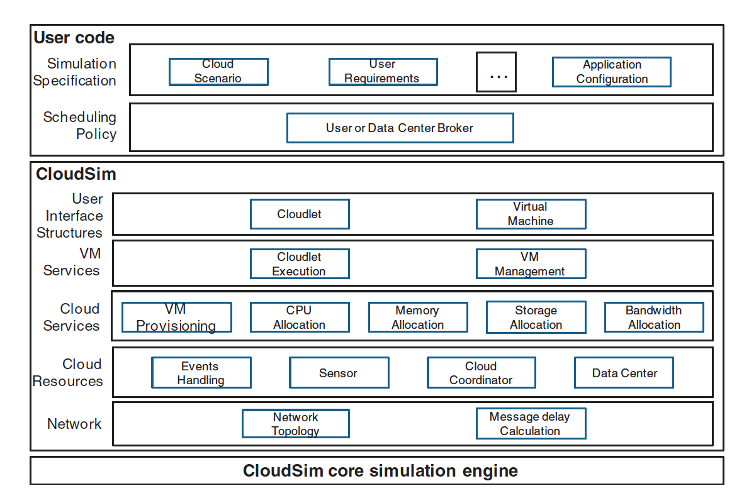
CloudSim
Simulation Scenarios
Resource Management Simulation
Discrete Event Simulation

Slide 5
CloudSim
Different aspects are modeled and simulated:
VM allocation
The cloud market
Network behavior
Federations of clouds
Dynamic workloads
Data center power consumption
Dynamic entity creation

Slide 6
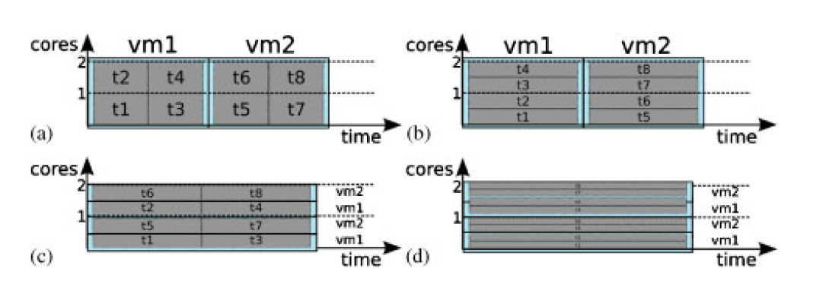
Provisioning Policies
Space-shared for VMs
Space-shared for tasks
Space-shared for VMs
Time-shared for tasks
Time-shared for VMs
Space-shared for tasks
Time-shared for VMs
Time-shared for tasks
Each of vm1 and vm2 require 2 cores:
- t1, t2, t3, t4 run on vm1
- t5, t6, t7, t8 run on vm2

Slide 7
Network Communication Flow
Network topology description in BRITE format
Latency matrix generated per scenario

Slide 8
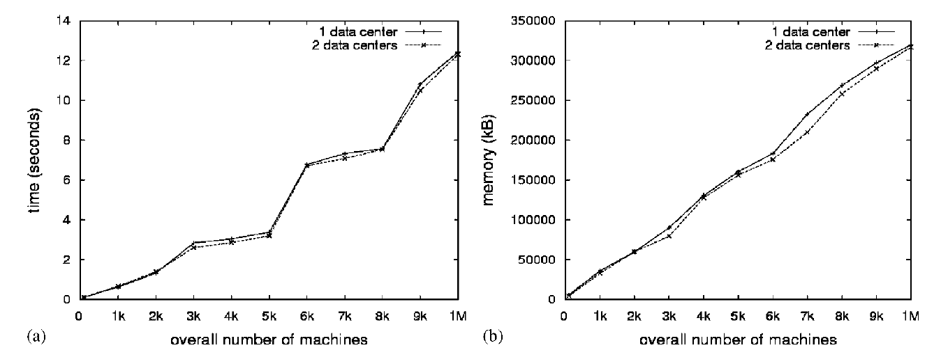
Overhead Evaluation

Slide 9
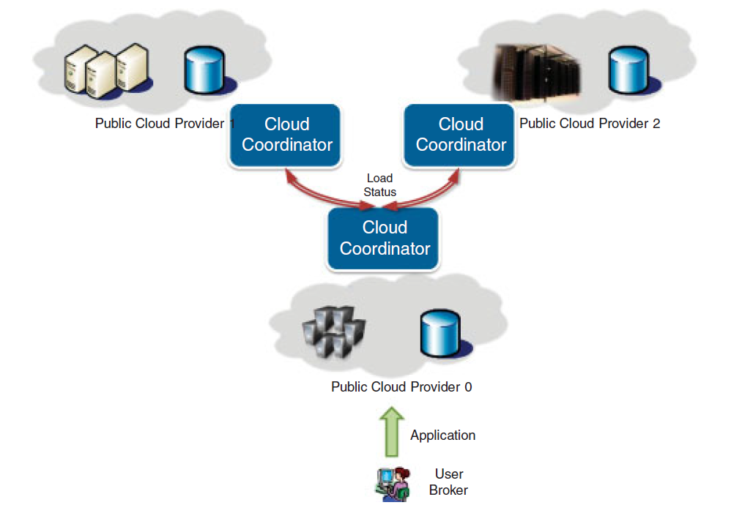
Federation Case Study
Workload migration scenario
25 VMs with 1 cloudlet each

Slide 10
Discussion
Modeling and Simulation: What would make a modeling notation/environment more suitable for simulation?
Domain-Specific Modeling: Taking CloudSim as an example, how much of such a system can be built on top of a general-purpose modeling system? What pieces would require a DSL?
Model/Simulator modularity and interoperability: network topology simulator, cloud simulator, provisioning simulator, federation simulator, etc…

