Slide 1
Lifting Model Transformation to Product Lines
Authors: Rick Salay, Michalis Famelis, Julia Rubin, Alessio Di Sandro, Marsha Chechik
Presenter: Mikhail Berezovskiy

Slide 2
Content
What is Model Transformation and Product Lines
Introduction and motivation to “lifting” transformations into SPL
More about Transformations and Product Lines
Approach to “lifting”
Case study
Evaluation and results
Conclusion

Slide 3
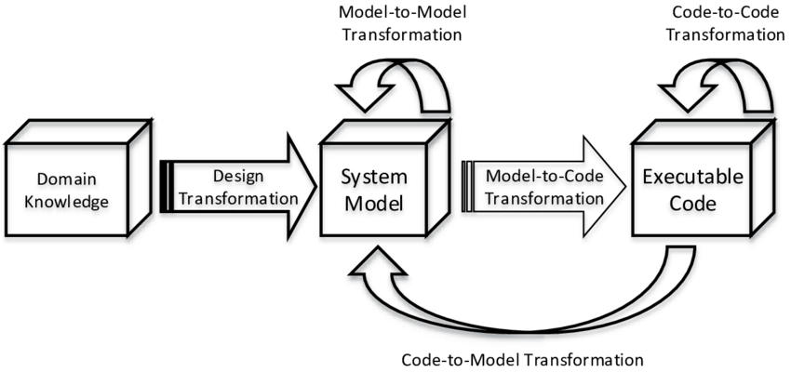
What is Model Transformation?
Wiki:
A model transformation, in model-driven engineering, is an automated way of modifying and creating models.
An example use of model transformation is ensuring that a family of models is consistent, in a precise sense which the software engineer can define.
The aim of using a model transformation is to save effort and reduce errors by automating the building and modification of models where possible.

Slide 4
What is Software Product Lines?
A software product line is a
set of software-intensive systems that share a common, managed set of features satisfying the specific needs
of a particular market segment or mission and that are developed from a common set of core assets in a prescribed way.

Slide 5
Introduction to “lifting”
Product Line
Model Transformation
Product 1
Model of product 1
Target Model of product 1
Product line architecture
Product 2
Model of product n
Target Model of product n
Product n
Need to keep track on along with product line and kept up-to-date
A portfolio of products
Transformations are applicable for individual product

Slide 6
Introduction to “lifting”
Product Line
Model Transformation
Product 1
Model of product 1
Target Model of product 1
Product line architecture
Product 2
Model of product n
Target Model of product n
Product n
Model of product line
Target Model of product line
It’s often desired to apply transformation not only to single product but for entire product line
Concept of “lifting” is integrate Models Transformations inside Product lines, make process automated, seamless and error free

Slide 7
Motivating example
Heat
Delay
Domain Model
[heatEnabled; delayEnabled] /
Heat
HeaterOn()
Heat or Delay
Locking
Waiting
Heat
/HeaterOff()
Here is an example of washing machine state controller with 3 simple states: heat, delay, and dry.
While heat and delay are mutually exclusive.
Delay
/setDelay();
wash.start()
Heat or Delay
/wash.start()
Heat
Washing
entry / TempCheck()
Unlocking
/QuickCool()
Heat
Dry
Dry
/QuickCool()
Drying
Dry

Slide 8
Motivating example
And now we want apply a rule of “fold incoming actions” for our state machine.
Which means If LHS has same transition action (“/a”) then we move action “/a” into state “x” and get “x entry /a”
We have 2 NAC (negative application conditions)
If state is already entered action “a”
If there more than 2 incoming transactions
Not motivated yet to lift transformations into product lines?

Slide 9
Motivating example
Heat
Delay
Domain Model
[heatEnabled; delayEnabled] /
The “fold incoming action” rule is applicable to an arbitrary state machine, it is hardly applicable for entire product line because:
It may miss valid application of the rule. State has entry action.
It may cause inappropriate application of the rule.
The presence conditions may be affected by rule applications.
Heat
HeaterOn()
Heat or Delay
Locking
Waiting
Heat
/HeaterOff()
Delay
/setDelay();
wash.start()
Heat or Delay
#2
#1,3
/wash.start()
Heat
Washing
entry / TempCheck()
Unlocking
/QuickCool()
Heat
Dry
Dry
/QuickCool()
Drying
Dry

Slide 10
Product lines (more)
Definition 1 (Product Line).
A product line P consists of the following parts:
A feature model that consists of a set of features and a propositional formula ΦP defined over these features to specify the relationships between them.
A domain model consisting of a set of model elements.
A mapping from the feature model to the domain model consisting of pairs {E, φE} mapping a domain model element E to a propositional formula φE over features. The formula φE is referred to as the presence condition of the element E.
Example: ΦW = Wash∧¬(Heat∧Delay)

Slide 11
Product lines (more)
Definition 2 (Feature Configuration).
A valid feature configuration ρ of a product line P is a subset of its features that satisfies ΦP
i.e., ΦP evaluates to true when each variable f of ΦP is substituted by true when f ∈ ρ and by false otherwise.
The set of all valid configurations in P is denoted by Conf(P).

Slide 12
Product lines (more)
Definition 3 (Product Derivation).
A product M is derived from the product line P under the feature configuration ρ if M contains those and only those elements from the domain model whose presence conditions are satisfied for the features in ρ.
Keep in mind:
P – product line
ΦP – propositional formula, relationship between features
ρ – feature configuration for specific product
M – product from product line P
Conf(P) – set of all valid configurations in P

Slide 13
Model Transformations (More)
Definition 4 (Transformation rule).
A transformation rule R is a tuple R = [{NAC},LHS,RHS],
where LHS and RHS are the typed graphs called the left-hand and the right-hand sides of the rule, respectively, and {NAC} represents a (potentially empty) set of typed graphs called the negative application conditions.
Cr : The set of model elements that are present both in the LHS and the RHS, i.e., remain unaffected by the rule.
Dr : The set of elements in the LHS that are absent in the RHS, i.e., deleted by the rule.
Ar : The set of elements present in the RHS but absent in the LHS, i.e., added by the rule.
Nr : The set of elements present in any NAC, but not those present in Cr

Slide 14
Model Transformations (More)
Definition 5 (Matching site).
A matching site of a transformation rule R in a model M is a tuple K = [N,C,D],
where C and D are matches of the parts Cr and Dr of the LHS of R in M, and N is the set of all matches of NACs in M relative to C and D.
C – constants, no changes in LHS and RHS
D – deleted items
N – all matches of negative application conditions

Slide 15
Model Transformations (More)
Matching rule K = [N,C,D]
C
N
D

Slide 16
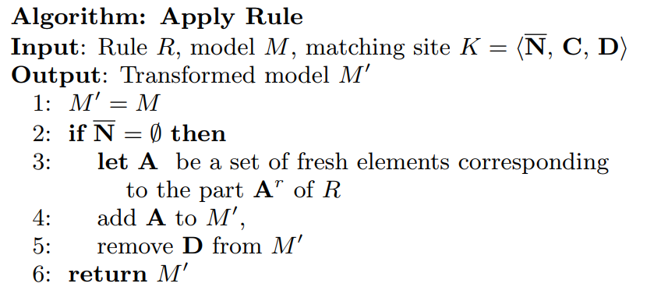
Model Transformations (More)
Definition 6 (Applicability condition).
Given a transformation rule R, a model M, and a matching site
K = [N, C, D], R is applicable at K iff N is empty

Slide 17
Approach. Correctness criteria
Definition 7 (Correctness of lifting).
Let a rule R and a product line P be given.
R ↑ is a correct lifting of R iff
For all rule applications P R↑⇒ P’ , Conf(P’) = Conf(P)
For all configurations ρ in Conf(P), M R⇒ M’ , where M is derived from P, and M’ is derived from P’ under ρ
Still keeping in mind?
P – product line
ΦP – propositional formula, relationship between features
ρ – feature configuration for specific product
M – product from product line P
Conf(P) – set of all valid configurations in P

Slide 18
Approach. Lifting algorithm
Here, φN and C is the conjunction of the presence conditions for elements in C; similarly for φC and N and φD and D .
This definition says that R ↑ is applicable iff the presence conditions guarantee that at this matching site, the rule R matches in at least one product of P.
Specifically, it checks that there exists a product such that all elements of C and D are present and not all elements in any NAC match are present.
Notes:
Note that this definition is silent on two points. First, it does not require that the target feature model be identical to the source feature model; they just need to be equivalent, i.e., have the same set of valid configurations. However, since R is only defined for the domain model, i.e., it does not manipulate features, a reasonable expectation is that it should leave the feature model unchanged. Second, the above definition does not specify exactly how the domain model should change, as long as the set of products is as required. The same set of products can be represented by different domain models and presence condition [36]. A reasonable expectation here is that the domain model should change as little as possible. These “expectations” are not part of the correctness condition since they are not required to preserve the semantics of R; yet, they are “nice to have” properties for an implementation of lifting – see Sec. 4.5.

Slide 19
Approach. Lifting algorithm
Notes:
The general algorithm of a rule application for a lifted rule is given in Fig. 6. In this algorithm, Steps 2-3 check the applicability condition, Steps 4-7 handle elements added by R ↑ , while Steps 8-12 handle elements deleted by R ↑ . Specifically, Step 5 adds each new element to the domain model of P 0 , and Step 6 sets its presence condition to Φapply since such elements are added only to those products where R was applicable. For deletion, Step 9 sets the presence condition as φd ∧ ¬Φapply to guarantee that the element will be absent, i.e., it is deleted “virtually” in the products where R was applicable, and that it remains intact in all other products where it occurred previously. Step 10 checks whether the element is now present in any product and if not, it deletes it “actually” by removing it from the domain model.

Slide 20
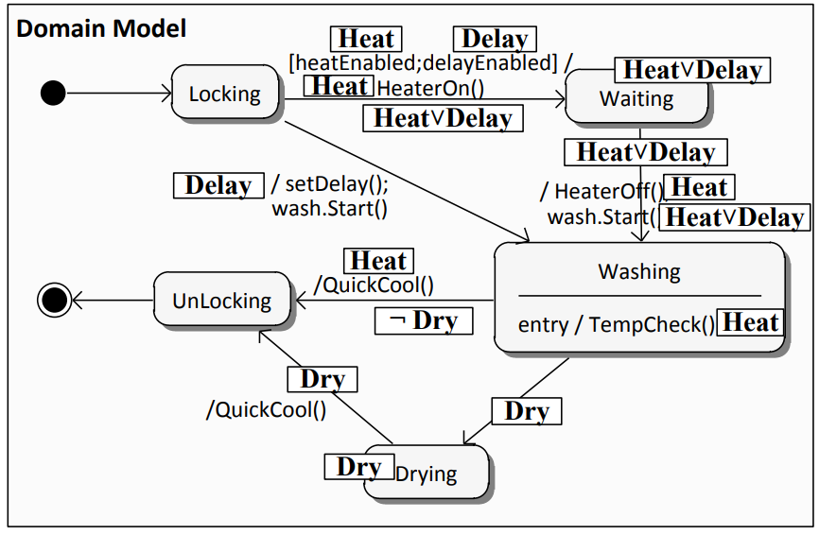
Approach. Illustration

Slide 21
Approach. Analysis
Correctness
Conf(P’) = Conf(P) is satisfied
For any configuration ρ in P that derives a product M, if R is applied to M to produce M’ then M’ is the product derived from P’ under ρ
Matching site K = [N, C, D] since by transitivity, if the rule is correct when applied to each site, then the application to any sequence of sites is also correct. Which is proved to be correct

Slide 22
Approach. Analysis
Termination
An application of a set of classical rules on an input model always terminates, then so does the set of the corresponding lifted rules.
Confluence
Repeatedly applying lifted rules to a product line P has the same effect as repeatedly applying the corresponding classical rules to each product of P.
It always produces product lines with the same set of products.

Slide 23
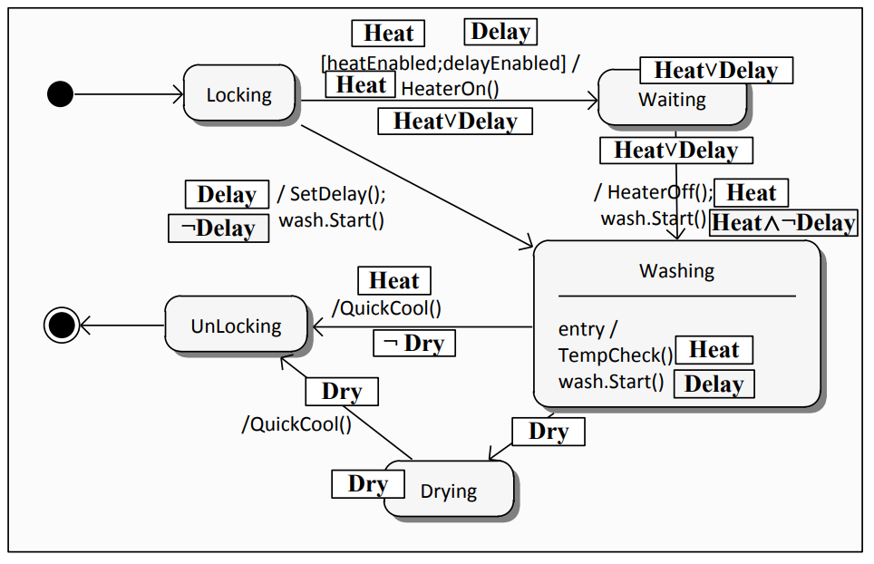
Approach. Minimality
Domain model minimality
The conclusion is that if the domain model was minimal initially then it will remain so after the lifted rule application.
Feature model minimality
A feature is “superfluous” if selecting it does not affect the derived products. A feature model containing superfluous features is not minimal.

Slide 24
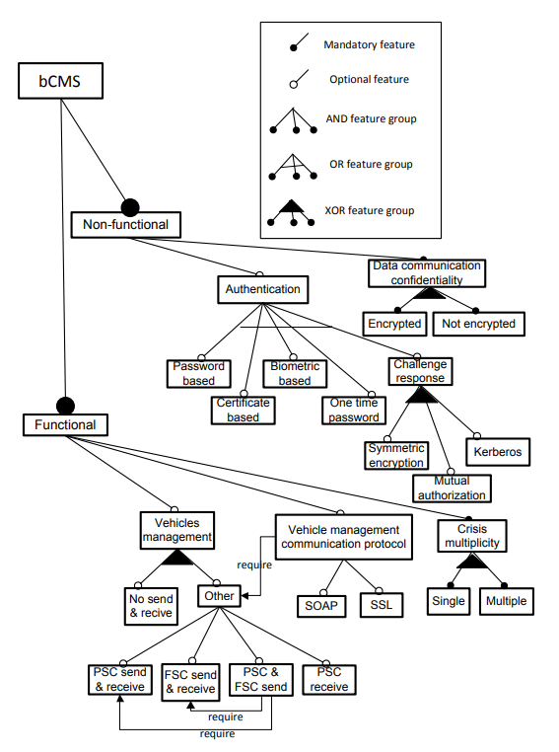
Tools support and application. Case study
Tools: Henshin, Z3 SMT, Model Management Tool Framework (MMTF), SAT solving techniques.
Application: Car Crash Management software product line case study, referred to as bCMS-SPL

Slide 25
Tools support and application. Case study
Conclusion:
Lifting the rules in the bCMS-SPL case study leads to a
2-3 orders of magnitude improvement in performance
if compared to the classical application over all products.

Slide 26
Evaluation. Methodology
Approach performs as well as the traditional graph transformations.
Generation random but realistic inputs to a SAT solver to measure the time required to check SAT and UNSAT.
Varying the Feature Model. Using S.P.L.O.T. (software product line online tool)
Varying the Transformation Rule.
Generating inputs.
Calibrating input generation.

Slide 27
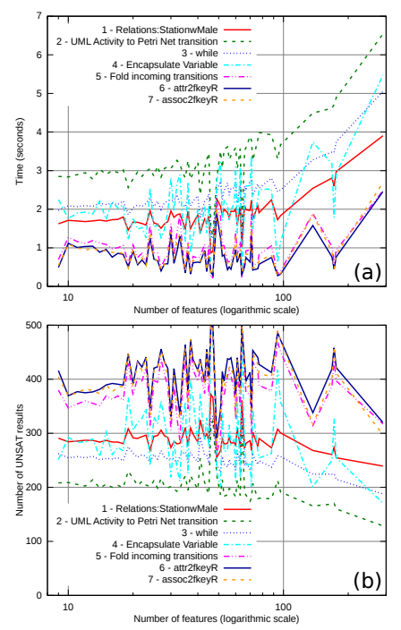
Evaluation. Results
The experiments show that the time required to check the satisfiability of the formulas grows at most linearly for all models, and logarithmically for small to medium sized product lines.
Preliminary results allow us to conclude that approach scales well as the size of the product line and the rules increases.

Slide 28
CONCLUSION
In this paper were introduced an algorithm and tools for automatically lifting classical model transformations to product lines
This allows transformations to be reused with no additional development effort, and maintains a clear separation of concerns between the transformation definition and variability management.
The initial experiments with the technique showed that it scales well.

Slide 29
Thank you!

Slide 30
Question #1
Feature model minimality. A feature is “superfluous” if selecting it does not affect the derived products. A feature model containing superfluous features is not minimal.
Can “superfluous” features cause problems?
Can we handle “superfluous-ity”?

Slide 31
Question #2
“While lifting a transformation is useful, doing so manually is hard and error prone because the lifted transformation must correctly address SPLE constructs and consider all possible product variants derived from the product line model”
While transformation of single product can conflict with product line, inaccurate change of entire product line can break everything?
Does it mean that we need more restrictions and conditions to change entire product line than change single products?

