Slide 1
Graph transformation in a Nutshell
Author:
Reiko Heckel
Presented by :
Azadeh Assadi

Slide 2
Contents
Modeling
Generalization
Type and Instance Graphs
Rules and Transformations
Constraints
Multi-objects
Application Conditions
Control Conditions
Notes:
Use StageCast and the example of developing a PacMan game to illustrate these points

Slide 3
Modeling by example
Modeling:
Generalization
Build models as representations of reality
Rules and transformations

Slide 4
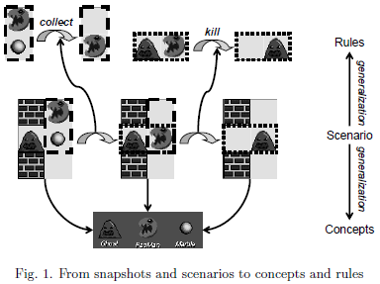
Generalization
Behavioural Generalization:
Looking at extracting rules as it applies to the model and its scope
Rules are specifications of state transformations
Conceptual generalization:
Create types/concepts
Each with instances
Relationship between instance and the type/concept is defined

Slide 5
Type and Instance Graphs
Graph = Vertices (V) + edges (E) where E has s(e) and t(e)
Notes:
So you could put these types together to create a graph

Slide 6
Type and Instance Graphs
Graph = Vertices (V) + edges (E) where E has s(e) and t(e)
Vertices: P:PacMan, G:Ghost, M:Marble, F1:field, F2:field, …

Slide 7
Type and Instance Graphs
Graph = Vertices (V) + edges (E) where E has s(e) and t(e)
Edges: represent the current location of a character/concept as well as the neighborhood relation of fields

Slide 8
Type and Instance Graphs
Type Graph: the type(concept) level and its instance graphs the individual snapshots.
i.e. at any given instance, each of the concepts are associated to one Field

Slide 9
Type and Instance Graphs
Vertices may contain attributes to store values of pre-defined data types
Attributes (a) would have a type-level (T) declaration (a:T)
And an instance-level occurrence or value (v) (a-v)

Slide 10
Rules and Transformations
Rules can be created as one graph instance is transformed into another specific graph instance
In this case, this is how the Collect rule would be created
Notes:
One could then create rules as needed based on two different instances of a graph that would relate to eachother

Slide 11
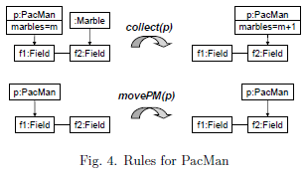
Rules and Transformations
Which can be generalized to this.
The PacMan has two rules, collect(p) and movePM(p) rules

Slide 12
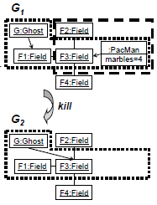
Rules and Transformations
Rules can be created as one graph instance is transformed into another specific graph instance
And this would make the Kill rule

Slide 13
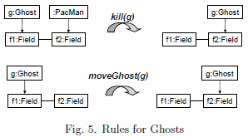
Rules and Transformations
Which can be generalized to this.
The ghosts therefore can have two rules, kill(g) and moveGhost(g) rules

Slide 14
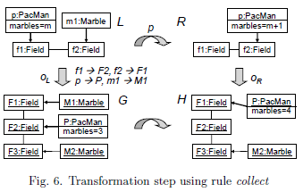
Rules and Transformations
Rules generate transformations by replacing in a given graph an occurrence of the one state with another.
3 steps to go from Pre-state G to post-state H
Find an occurrence oL of the left hand side L in the given graph G

Slide 15
Rules and Transformations
Rules generate transformations by replacing in a given graph an occurrence of the one state with another.
3 steps to go from Pre-state G to post-state H
Find an occurrence oL of the left hand side L in the given graph G
Delete from G all vertices and edges matched by L/R
Notes:
Deletes this edge b/c it no longer exists in R while it did in L

Slide 16
Rules and Transformations
Rules generate transformations by replacing in a given graph an occurrence of the one state with another.
3 steps to go from Pre-state G to post-state H
Find an occurrence oL of the left hand side L in the given graph G
Notes:
Similarly with the Marble

Slide 17
Rules and Transformations
Rules generate transformations by replacing in a given graph an occurrence of the one state with another.
3 steps to go from Pre-state G to post-state H
Find an occurrence oL of the left hand side L in the given graph G
Delete from G all vertices and edges matched by L/R
Notes:
Deletes this edge and vertex b/c it no longer exists in R while it did in L

Slide 18
Rules and Transformations
Rules generate transformations by replacing in a given graph an occurrence of the one state with another.
3 steps to go from Pre-state G to post-state H
Find an occurrence oL of the left hand side L in the given graph G
Delete from G all vertices and edges matched by L/R
Paste to the result a copy of R/L, to arrive at H

Slide 19
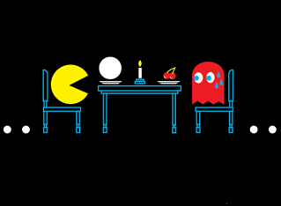
Rules and Transformations
The total behavior of the game then is set by the set of all sequence of consecutive transformation steps G0 → Gn
Based on the rules developed for the game and a valid instance graph G0
Must also make sure that there are no dangling edges as a result of a deletion – i.e. valid transformations must be performed
This Photo by Unknown Author is licensed under CC BY-SA

Slide 20
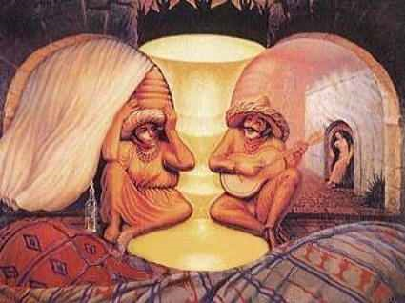
What Do You See?
Notes:
I know I’ve asked this question before, but it’s a good question so I’ll ask it again!
What do you see?
So depending on what features you focus on you can see a few different things. You can either see an old couple facing eachother, you can see two ppl singing and playing music together, Or you see a golden vase in the centre.
Obviously this is an optical illusion and they are interesting in many ways but the point I want to make here with this example that relates to this topic is that your mind transforms images so seamlessly and quickly that you could see any one of the possible illusions at any given time. This ofcourse can’t happen in code and you want to apply controls or constrains to limit variability in interpretation.
e.g. fix the elements to a given feature. Beard not guitar, etc.

Slide 21
Constraints
Dangling edge: caused by the fact that a node in a graph have an unknown number of connections
Can constrain the number of connections
E.g. each Ghost, Pacman, or marble vertex is linked to exactly one Field vertex

Slide 22
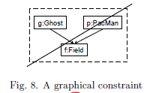
Constraints
Can also represent more complex constraints as graphs – i.e. forbidden subgraph
Therefore constraints restrict the set of admissible instance graphs that can be used to control the transformation process by ruling out transformations leading to non-admissible graphs

Slide 23
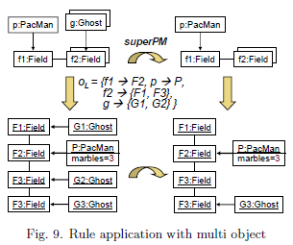
Multi-objects
Notes:
Similar to the simple case will go through the same three steps of find, delete and paste to go from one state to the next having applied the rules – in this case the SuperPM rule which kills al the ghosts in the vicinity of Pacman

Slide 24
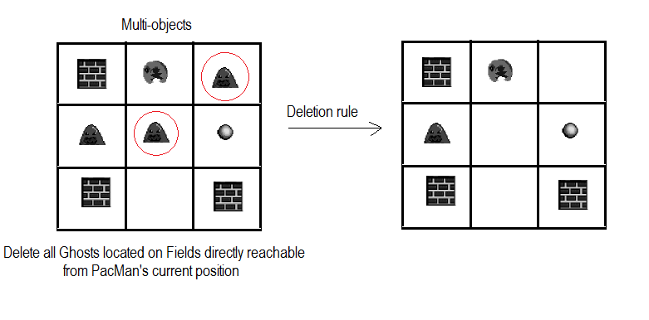
Multi-objects
Notes:
Similar to the simple case will go through the same three steps of find, delete and paste to go from one state to the next having applied the rules – in this case the SuperPM rule which kills al the ghosts in the vicinity of Pacman

Slide 25
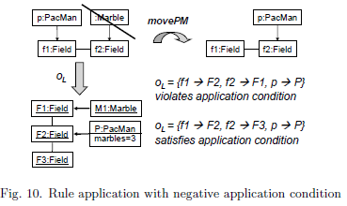
Application conditions
Notes:
Here the graph transformation rule check for empty marble fields
Here the application of the rule depends on the graph G and the chosen occurrence

Slide 26
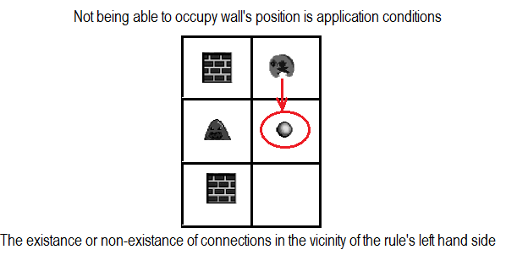
Application conditions
Notes:
At the metamodel level
Generalizes the pre-defined gluing conditions of algebraic (true or false) approach

Slide 27
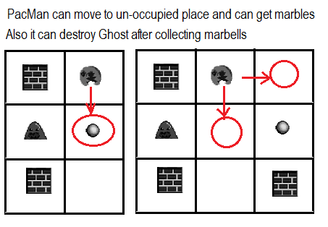
Control conditions
Notes:
On a global level, control structures lead to programmed graph transformations

Slide 28
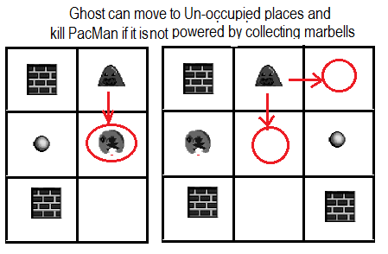
Control conditions
Notes:
On a global level, control structures lead to programmed graph transformations
Can also have node-label controlled (NLC)
Double pushout graph rewriting (DPO graph rewriting): deletion and addition. After a match from the left hand to G is fixed, noted and edges that are not in the right hand side are deleted. Right hand side is then glued in

Slide 29
A Medical Application
A Proof of Concept

Slide 30
A Medical Application
Attributes 1-n
Attributes 1-n
Attributes 1-n

Slide 31
A Medical Application
As long as all the attributes of each of these types are maintained and the concepts appear in this specific order in the transformation, the rhythm can be considered as sinus
The details of each type is learned from the patient

Slide 32
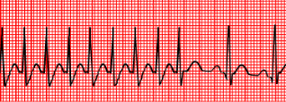
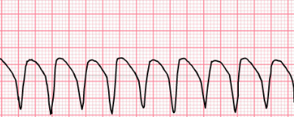
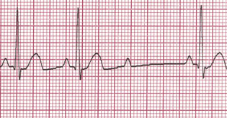
A Medical Application
So when this rhythm appears, because its out of keeping with what is allowed or considered sinus, the rhythm gets labeled as pathological.
**In reality, the permutations of the acceptable variations in the attributes that fall within the realm of normal are nearly infinite
Therefore hard to analyze using this approach alone

Slide 33
For Discussion
Questions?
Where else could this be applied to?

Slide 34
Some Examples
FuJaba: “from UML to JAVA And Back Again”
Open source CAE tool providing developers with support for model-based software engineering and re-engineering
Progres: for PROgrammed graph rewriting system
AGG: “Attributed Graph Grammar” system
Visual programming environment based on graph transformation and Java
Notes:
On a global level, control structures lead to programmed graph transformations

