Slide 1
A General Framework for Formalizing UML with Formal Languages William E. McUmber and Betty H.C. Cheng
ICSE 2001
Presented by Ramy Shahin

Slide 2
UML Models, Metamodels and Megamodels

Slide 3
UML Models, Metamodels and Megamodels
Structural Model

Slide 4
UML Models, Metamodels and Megamodels
Structural Model
Behavioral Model

Slide 5
UML Models, Metamodels and Megamodels
Structural Model
Megamodel
Behavioral Model

Slide 6
UML Models, Metamodels and Megamodels
What does it mean???
Structural Model
Megamodel
Behavioral Model

Slide 7
UML Models, Metamodels and Megamodels
Model
Metamodel

Slide 8
UML Models, Metamodels and Megamodels
Model
Metamodel

Slide 9
UML Models, Metamodels and Megamodels
Model
Metamodel

Slide 10
UML Models, Metamodels and Megamodels
Model
Metamodel

Slide 11
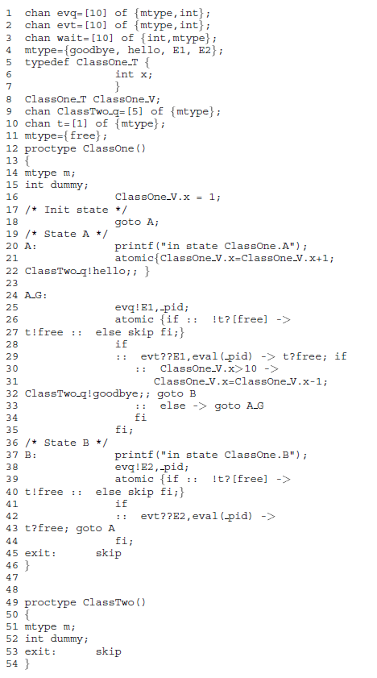
Semantics?
Syntactic, homomorphic transformation

Slide 12
Semantics?
Syntactic, homomorphic transformation
We know the semantics of Promela!

Slide 13
Approach
UML Model
transformation
Promela Model

Slide 14
Approach
UML Metamodel
Homomorphic mapping
Promela Metamodel
UML Model
transformation
Promela Model

Slide 15
Homomorphic Mappings
Homomorphic mappings preserve operations over algebras
For algebra $A$ with operation $⊕$ and algebra $B$ with operation $⊗$, a homomorphism $h:A→B$ satisfies:
$a,b∈A h\left(a⊕b\right)=h\left(a\right)⊗h(b)$
In our case, we want to preserve metamodel relationships

Slide 16
UML Formalization
A UML formalization is a 4-tuple $(S, T, h, R)$ where:
$S$ is the source metamodel
$T$ is the target metamodel
$h:S→T$is a homomorphism from S to T
$R$ is a set of formalization rules

Slide 17
UML Formalization
A UML formalization is a 4-tuple $(S, T, h, R)$ where:
$S$ is the source metamodel
$T$ is the target metamodel
$h:S→T$is a homomorphism from S to T
$R$ is a set of formalization rules

Slide 18
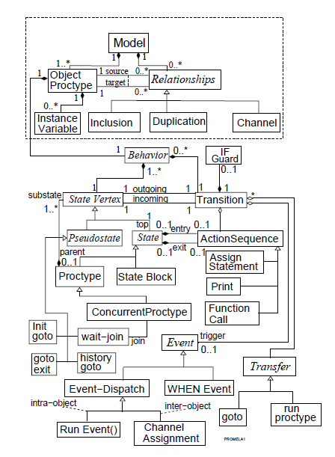
UML Formalization
A UML formalization is a 4-tuple $(S, T, h, R)$ where:
$S$ is the source metamodel
$T$ is the target metamodel
$h:S→T$is a homomorphism from S to T
$R$ is a set of formalization rules

Slide 19
UML Formalization
A UML formalization is a 4-tuple $(S, T, h, R)$ where:
$S$ is the source metamodel
$T$ is the target metamodel
$h:S→T$is a homomorphism from S to T
$R$ is a set of formalization rules

Slide 20
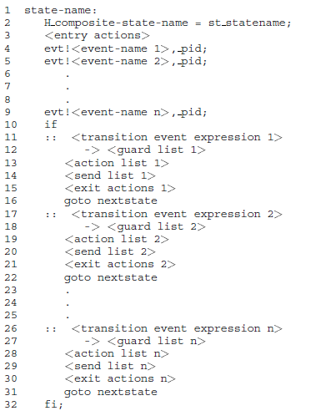
UML Formalization
A UML formalization is a 4-tuple $(S, T, h, R)$ where:
$S$ is the source metamodel
$T$ is the target metamodel
$h:S→T$is a homomorphism from S to T
$R$ is a set of formalization rules

Slide 21
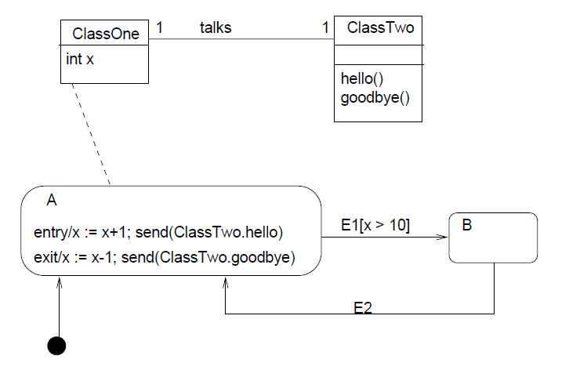
Example

Slide 22
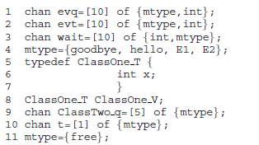
Example
Global declarations rule

Slide 23
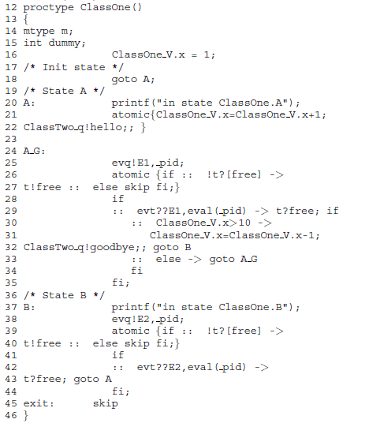
Example
ClassOne mapping

Slide 24
Example
ClassTwo mapping

Slide 25
Rule Promela 1

Slide 26
Rule Promela 2

Slide 27
Questions and Discussion

