Slide 1
Mega-modeling for Big Data Analytics
Authors: Stefano Ceri, Emanuele Della Valle, Dino Pedreschi, and Roberto Trasarti
Presenter: Mikhail Berezovskiy

Slide 2
Drivers
Progress in many areas:
Social and Economic resilience
Health
Transportation
Energy management
This challenge cannot be addressed by simply deploying currently available technology
Modelling, as we know it today, is required to scale up to a higher level
=> MEGA MODELING

Slide 3
What is Mega-Modeling?
Comprehensive theory of
Model construction
Model search
Model fitness evaluation
Model composition
Model Evolution
A new Model of Models
A bit vague?

Slide 4
Pillars of the Mega-Modeling
Mega-Model
Model-Driven Engineering (MDE)
Data mining and “big” data analytics
Integration of data patterns with data and queries
Support of dynamic aspects related to:
Inspection
Adaptation
Integration

Slide 5
Mega-modules for Scientific Big Data Processing
Pipe
Input Data
Data preparation
Data analysis
Data evaluation
Output Data
Input Patterns
Output Patterns

Slide 6
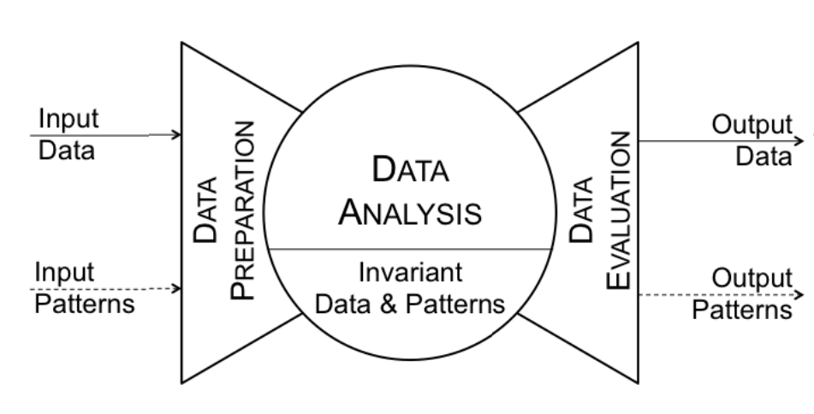
Mega-modules for Scientific Big Data Processing
Notes:
The keywords for the preparation phase are: data sensing, acquisition, integration, transformation, semantic enrichment.
The keywords for the analysis phase are: mining, learning, modeling, simulation, forecast.
The keywords for the evaluation phase are: quality assessment, filtering, significance measurements, presentation, delivery, visualization.

Slide 7
Example. M-Atlas
M-Atlas – mobility data mining
It shows how big masses of people move from regions to regions
It’s a aggregated data from users movement trajectories

Slide 8
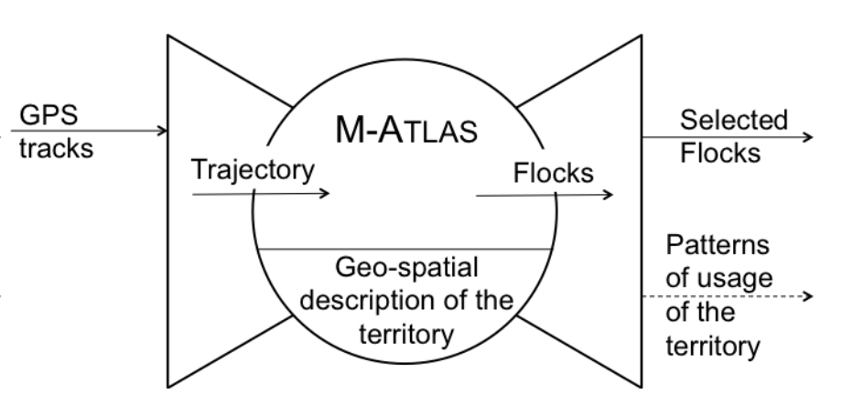
Example. M-Atlas with Mega-Model
Reported flocks have a population above a given threshold and connect specific portions of territory
Several observations of the positions assembled into a single trajectory
Trajectories are assembled and reported as movements of groups of people (flocks)

Slide 9
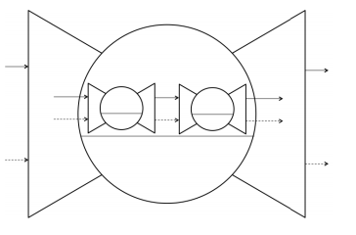
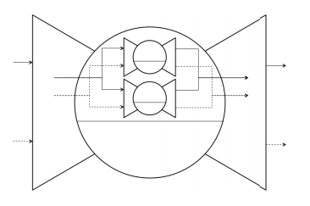
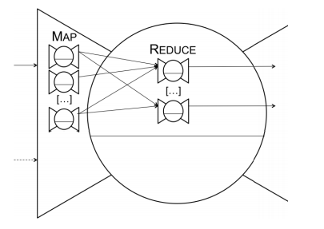
General-Purpose Composition Abstractions
Pipeline decomposition
Parallel decomposition
Map-reduce decomposition

Slide 10
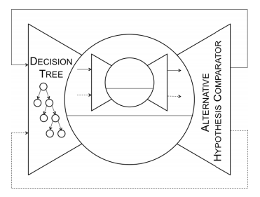
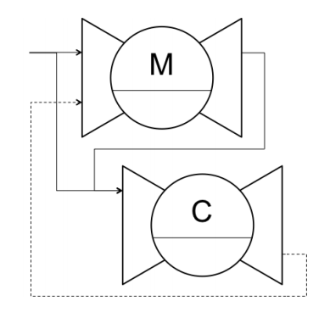
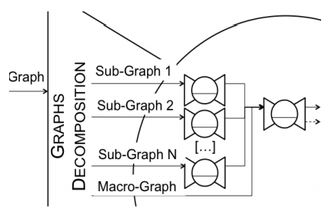
Specific Composition Abstractions
What-if control
Drift control
Component-based graph decomp.

Slide 11
Data Management Mega-Schema
Define a unique mega-schema(?)
Ontology-driven schema design and annotation methods (e.g. medicine and biology)
“Global as view” (GAV) mapping is a belief of beneficial long-term data conversion complexity
Note from authors:
“We do not make assumption on the specific mega-schema syntax…”

Slide 12
Data Management Patterns Optimization
“Schema” of patterns reflects the underlying structure rather than its input and output data
With following assumptions:
There exists a finite number of pattern structures capable of describing all the forms of regularity
Patterns to describe large numbers of Items, all with the same format
Items are structured objects with a schema, and can be typed
Patterns can be described by means of type constructors with Items and numerical attributes expressing their properties
Like this:

Slide 13
Example. Bottari
An augmented reality application for personalized points of interests and restaraunts in Seuol

Slide 14
Conclusion and discussion
Objective of this paper is to rise raise the interest of the community of scientific big data processing on model composition and reuse
Approach is very preliminary and needs formalizations and extinctions
Mega-models as a buildup on top of meta-models, with support of analytical and simulation processes

