Slide 1
The next evolution of MDE - a seamless integration of machine learning into domain modeling
By Thomas Hartmann, Assad Moawad, Francois Fouquet, Yves Le Traon
CSC2125 Computer software engineer – Or Aharoni
Notes:
Weave ML into Domain languadge

Slide 2
Definitions
Intelligent Systems
Domain knowledge - is knowledge about the environment in which the target system operates. (ex. Overload)
Known unknown – unpredictable events at design time
Known Unknown
Known Domain knowledge

Slide 3
Machine Learning
Supervised learning | Unsupervised learning
Online learning | Reinforcement learning
Notes:
The Paper :
Very time that you google something you use ML algorithm.

Slide 4
Machine Learning Categories
Supervised learning Given (x; y)
pairs learn a mapping from x to y. Example: Sentiment analysis.
Classication: categorical output (object recognition, medical diagnosis)
Regression: real-valued output (predicting market prices, customer rating)
Unsupervised learning. Given data points and some structure in the data.
Example: Dimensionality reduction.
Online learning. Supervised learning when the data is given sequentially, by an adversary, No separate train/test phases. Example: Spam ltering.
Reinforcement learning. Learn actions to maximize future rewards. Delayed playos, agent controls what he sees. Example: Flying drones.
Various smaller categories, e.g. active learning, semi-supervised learning.
Notes:
The Paper :
Every time that you google something you use ML algorithm

Slide 5
Learning Methods
Coarse –Grained : extracting commonalities over massive datasets in order to resolve unknown behaviors.
Fine- Grained: apply learning algorithms only on a specific elements of the dataset.

Slide 6
Study Case – Smart Grid
Weave ML into Domain Modeling
Smart Grid are installed at customer houses and constantly measure electric consumption and regular report (Microlearning units)
Concentrator meter sends its data depends on various conditions; e.g. distance\ signal strength
Notes:
The Paper :

Slide 7
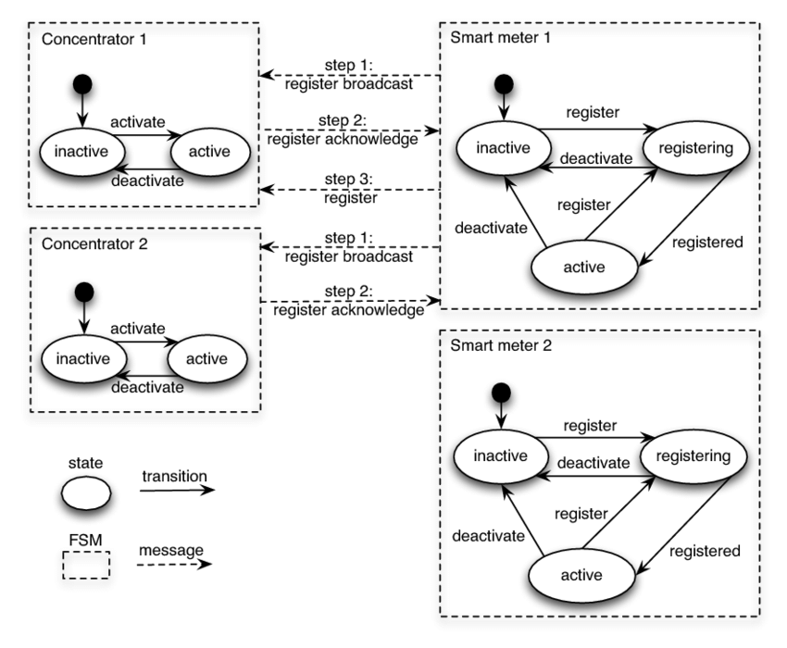
Smart Grid

Slide 8
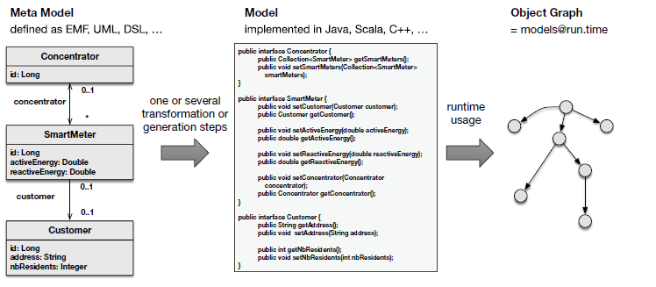
Relation between Meta Model, Model and Object Graph

Slide 9
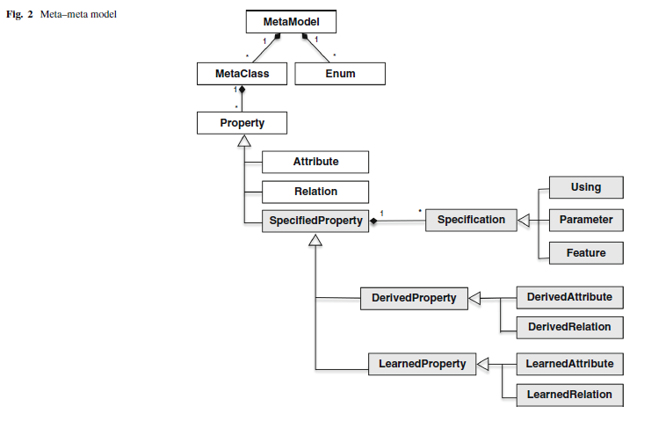
Meta-meta Model
Learning algorithm
Algorithm
Distinguish between state, learned, driven
Infer – do not have a state
Allowed to access properties from other Metaclass or Enum
infer + learned

Slide 10
Microlearning Unit
Attributes
Properties

Slide 11
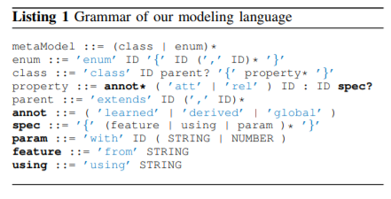
Modeling Language - Syntax
The Syntax grammar reflect OO language.
Taken from Meta-meta modeling.

Slide 12
Modeling Language - Semantic
The Modeling language follows the formal UML class diagram
Extend the UML language on microlearning Units by adding two new kinds of properties: Learned and driven attributes and relations

Slide 13
Evaluation on Testing data – Accuracy
The evaluation is based on more than 6 million records during the training, and more than 700,000 records on the testing.
The training period was more than a year.
The testing period 2 month.
Evaluate : accuracy and performance.
2 concentrators, 300 smart meter
Microlearning accuracy 85%, Coarse-grained learning 72%.

Slide 14
Evaluation – Performance
Show time needed in seconds to load data, vrs time needed to perform the live profiling for different number of users and power records.
Both learning and loading time are leanear.

Slide 15
Strength
Weaknesses
New approached of ML into domain modeling technique that is more accrued.
Complete system and modeling language.
Application for the approach that can be applied to different domains.
Focused on the modeling in microlearning units.
Lack of example in the paper.
Run time environment integration.
Not clear how learned and driven feature works.
Don’t show the different ML algorithms.
Don’t show the parameter that they use for the algorithm.
Don’t show the modeling changes in the training set.

Slide 16
Discussion
In what cases microlearning approach is useful ?
Do you think we need to implement this approach on all ML systems?

