Slide 1
An Implementation of Entity-Relationship Diagram Merging
Wentao He
Department of Computer Science University of Toronto
Toronto, ON, Canada

Slide 2
Introduction
In large scale model-based development, a key problem is to integrate a collection of models into a larger specification.
The problem exists in the domain of entity-relationship model as well.
I created a merge operator in MMTF that merges two entity-relationship models.

Slide 3
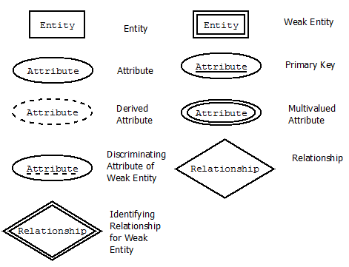
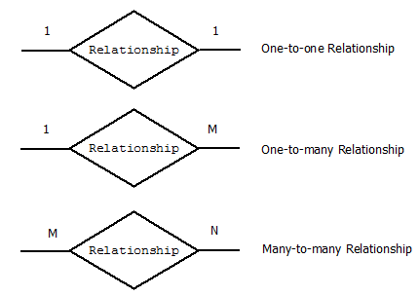
Refresh Your Mind
ER diagram symbols:

Slide 4
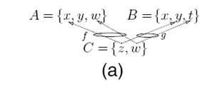
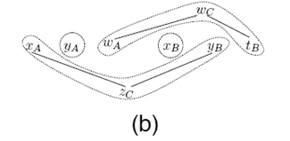
The Merge Algorithm: Merge Sets
Three-way merge example:

Slide 5
The Merge Algorithm: Merge Sets
Algorithm: Set-Merge
Input: Sets S₁, …, S_{n}
Functions f₁, …, f_{k}
Output: Merged set P
Let U be an initially discrete graph with node-set S₁⨄S₂⨄…⨄S_{n};
For every function fi (1 ≤ i≤ k):
For every element a in the domain of fi:
Add to U an undirected edge between the elements corresponding to a and fi(a);
Let P be the set of the connected components of U;
Return P as the result of the merge operation.

Slide 6
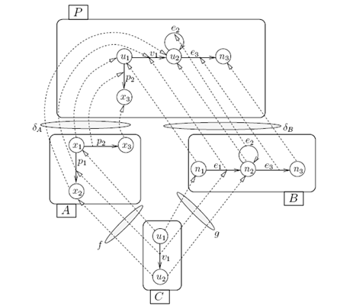
The Merge Algorithm: Merge Graph
Three-way merge example:

Slide 7
The Merge Algorithm: Merge Graph
For a graph interconnection diagram with objects G₁, . . . ,G_{n} and mappings h₁, . . . , h_{k}:
The node-set (resp. edge-set) of P is the result of merging the node-sets (resp. edge-sets) of G₁, . . . ,G_{n} with respect to the node-map (resp. edge-map) functions of h₁, . . . , h_{k}.
Pick among G₁, . . . ,G_{n}, some graph G_{i} that has an edge q which is represented by e. Let s (resp. t) denote the source (resp. target) of q in G_{i}; and let s′ (resp. t′) denote the node that represents s (resp. t) in the node-set of P. We set the source (resp. target) of e in P to s′ (resp. t′).

Slide 8
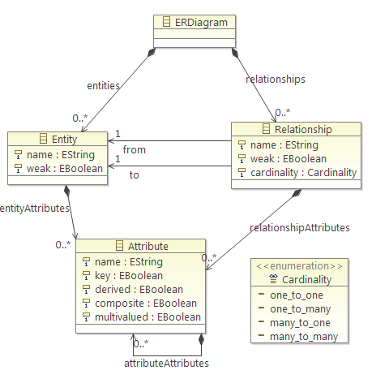
ER Diagram eCore Model

Slide 9
Create the Merge Operator
Steps:
Extend MMTF Operator Executable.
Convert input ER models to ERDiagram typed java objects; parse MMTF ModelRel to a HashMap.
Create connector.
Merge set for Entity, Relationship, Entity Attribute, Relationship Attribute respectively.
Merge graph for Entity, Relationship, Entity Attribute, Relationship Attribute respectively.

Slide 10
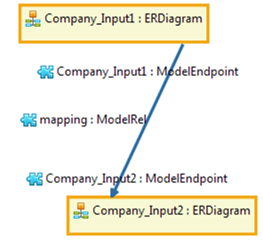
Unit/Integration Testing
Utilized JUnit framework to conduct unit testing.
Executed end-to-end heavy
type examples to conduct
integration testing.
To be demoed …

Slide 11
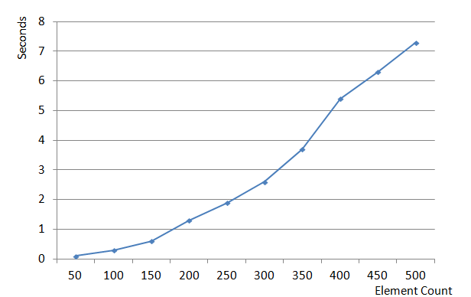
Performance Testing
Performance testing result:

Slide 12
Future Improvements
Visualization:
Conversion between ER model in MMTF and ER diagram is not implemented.
Validations
Current operator is not mature in catching all possible validation errors.

Slide 13
Conclusion
In terms of quality, I believe the merge operator is good, because unit testing, integration testing and performance testing have all been conducted, and results come as expected.
In terms of usability and usefulness, I believe the merge operator can significantly help reduce the ER diagrams merge effort.

Slide 14
Q & A

