Slide 1
An Empirical Study Of Alternative Syntaxes For Expressing Model Uncertainty CSC2125 Project Report
December 19th 2012
Stephanie Santosa and Michalis Famelis

Slide 2
Overview
Introduction
MAV-Text: Annotation Syntax
MAV-Vis: Visual Syntax
Evaluation
Discussion and Conclusion

Slide 3
Introduction
Syntaxes for Expressing Uncertainty

Slide 4
Introduction
Partial Models: modeling and reasoning with uncertainty.
Uncertainty about the content of the models.
Basic idea:
Syntactic annotations to express “Points of Uncertainty”
“MAVO models”
Multiple ways to resolve uncertainty at each PoU.
Representation of a set of possibilities.
Dependencies between PoUs
“May models”

Slide 5
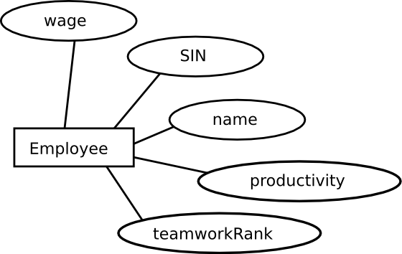
Introduction MAV annotations
Abs uncertainty:
an element may be refined to multiple elements

Slide 6
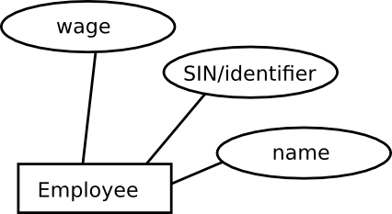
Introduction MAV annotations
Var uncertainty:
an element may be merged to some other element

Slide 7
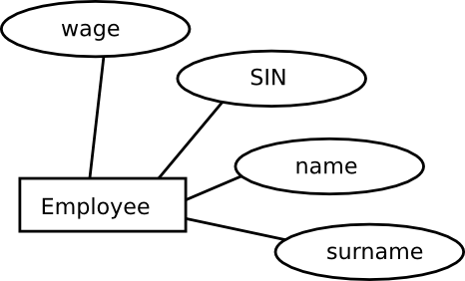
Introduction MAV annotations + May formula
May uncertainty:
an element may be dropped from a refinement
additional “may formula”

Slide 8
Introduction MAV annotations + May formula
May uncertainty:
an element may be dropped from a refinement
Alternative syntax

Slide 9
Introduction
Partial Models are good for automated reasoning.
Property checking [ICSE’12,MoDeVVa’12]
Verification of Refinement [FASE’12,VOLT’12]
Checking correctness of Transformations [MiSE’12]
Change propagation [FASE’13]
But how efficient are they as communication artifacts?
Expression and understanding.
Notation!

Slide 10
Introduction Does this ER model convey what it should?

Slide 11
Introduction A Systematic Study of Partial Model Syntaxes
Step 1: Assessment of existing ad-hoc notation (MAV-Text).
Using Moody’s “Physics of Notations”.
Step 2: Proposal of a new graphical syntax (MAV-Vis).
Again, using Moody’s “Physics of Notations”.
Step 3: User study to evaluate MAV-Text – vs – MAV-Vis.
Speed, Ease, Accuracy
User preferences

Slide 12
Introduction What we do NOT do.
Not a general approach for “MAVOization” of arbitrary concrete syntaxes.
Focus on Class Diagrams, E-R Diagrams.
For partial models with additional formulas:
Not a graphical syntax for arbitrary propositional logic.
Not a set of patterns of how uncertainty usually appears.
Not full MAVO:
Focus on May,Abs,Var (OW annotates the entire model)
No arbitrary combinations of May, Abs, Var

Slide 13
Annotation-Based Syntax: Mav-Text
Syntaxes for Expressing Uncertainty

Slide 14
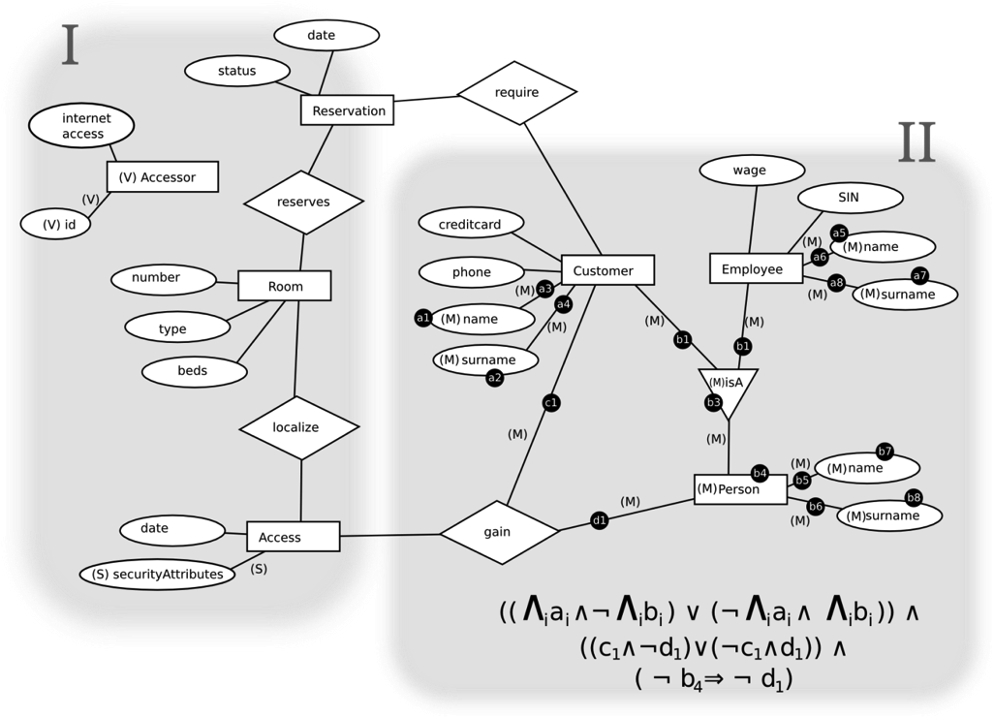
MAV-Text Syntax Introduction to Notations

Slide 15
MAV-Text Syntax Var Uncertainty

Slide 16
MAV-Text Syntax Abs Uncertainty

Slide 17
MAV-Text Syntax May Uncertainty
(M)
d4

Slide 18
MAV-Text Syntax May Uncertainty

Slide 19
MAV-Text Syntax May Uncertainty

Slide 20
MAV-Text Syntax Analysis with Moody’s Principles for Cognitive Effectiveness
Principle | Rating | Issues
Semiotic Clarity | ++ | One-to-one correspondence to meaning
Perceptual Discriminability | -- | Zero visual distance between notations
Semantic Transparency | - | Annotations not easily associated with concepts; Relationships not visible
Complexity Management | - | New annotation for each element with uncertainty No mechanisms for chunking information
Cognitive Integration |  | No specific mechanisms, but May formula contextualizes may elements to overall uncertainty
Visual Expressiveness | -- | All textual encoding - measures to zero-degrees of visual expressiveness
Dual Coding | -- | No dual coding; may formula is separated - spatial contiguity suggests in-place annotations
Graphic Economy | ++ | Not an issue - no use of graphic symbols
Cognitive Fit | +/- | Requires a skill in propositional logic for may formula

Slide 21
MAV-Text Syntax Analysis with Moody’s Principles for Cognitive Effectiveness
Perceptual Discriminablity
Issue: zero visual distance between notations

Slide 22
MAV-Text Syntax Analysis with Moody’s Principles for Cognitive Effectiveness
?
?
?
Semantic Transparency
Annotations not easily associated with concepts; Relationships not visible

Slide 23
MAV-Text Syntax Analysis with Moody’s Principles for Cognitive Effectiveness
Complexity Management
New annotation for each element with uncertainty
No mechanisms for chunking information

Slide 24
MAV-Text Syntax Analysis with Moody’s Principles for Cognitive Effectiveness
Visual Expressiveness
All textual encoding - measures to zero-degrees of visual expressiveness

Slide 25
MAV-Text Syntax Analysis with Moody’s Principles for Cognitive Effectiveness
Dual Coding
No dual coding; may formula is separated - spatial contiguity suggests in-place annotations

Slide 26
MAV-Text Syntax Analysis with Moody’s Principles for Cognitive Effectiveness
?
Cognitive Fit
Requires a skill in propositional logic for may formula

Slide 27
Visual Syntax: Mav-Vis
Syntaxes for Expressing Uncertainty

Slide 28
MAV-Vis Syntax

Slide 29
MAV-Vis Syntax Representing Var

Slide 30
MAV-Vis Syntax Representing Abs

Slide 31
MAV-Vis Syntax Representing May: a color for each PoU

Slide 32
MAV-Vis Syntax Representing May: identify an alternative

Slide 33
MAV-Vis Syntax Representing May: grouping elements in alternatives

Slide 34
MAV-Vis Syntax Representing May: the other alternative

Slide 35
MAV-Vis Syntax Representing May: numbers for different alternatives

Slide 36
MAV-Vis Syntax Representing May: alternative with many parts

Slide 37
MAV-Vis Syntax Representing May: a different PoU

Slide 38
MAV-Vis Syntax Representing May: expressing PoU dependencies

Slide 39
MAV-Vis Syntax Representing May

Slide 40
MAV-Vis Syntax Analysis with Moody’s Principles for Cognitive Effectiveness
Principle | Rating | Issues
Semiotic Clarity | ++ | One-to-one correspondence to meaning
Perceptual Discriminability | ++ | Different retinal variables for each notation.
Semantic Transparency | + | Representations reflective of concepts; Relationships are visible
Complexity Management | ++ | Grouping applies uncertainty to entire submodels (not per element).
Cognitive Integration |  | No specific mechanisms, but May groupings and dot notation contextualize may elements to overall uncertainty
Visual Expressiveness | ++ | Shape: Icons and Piles, Colour for PoU’s, Texture: Dashed line treatment, Size: may dependencies
Dual Coding | ++ | Color and text used together. In-place annotations for spatial contiguity.
Graphic Economy | + | High visual expressiveness keeps cognitively manageable (never exceeds 6 symbols per visual variable)
Cognitive Fit | + | No specialized skills required. Pen-and-paper appropriate.
Notes:
Semiotic Clarity: Had to avoid certain symbols used in base notations to avoid overload

Slide 41
Evaluation
Syntaxes for Expressing Uncertainty

Slide 42
Evaluation Goals
MAV-Text vs MAV-Vis syntaxes
For each type of uncertainty, what is the cognitive effectiveness of reading and writing with each syntax?
What are the most powerful and most problematic aspects?
What notational syntax is preferred?

Slide 43
Evaluation Design and Procedure
Tasks
Free-form writing
Reading and writing: Syntax #1 using a rich scenario
Reading and writing: Syntax #2 using another rich scenario
Post-study questionnaire
Reading tasks
4 PoU’s: 1 Abs, 1 Var, and 2 May with layered dependency
*Circle uncertainty, identify, concretize
Writing tasks
3 PoU’s: 1 Abs, 1 Var, and 1 May with 2 alternatives
*Add uncertainties

Slide 44
Evaluation Design and Procedure
Within-subjects design to allow for comparison and minimize selection bias
Controlled for 2 independent variables, counterbalanced in 2x2 Latin square:
Order of syntaxes (MAV-Vis, MAV-Text)
Model scenarios used (Hotel Admin with UML Class, and School personnel with E-R)
12 Participants, all CS (9 SE, 3 MAVO experts)
Measured cognitive effectiveness: speed, ease, accuracy
Notes:
Extra: The average experience level with MAVO uncertainty was 2.2 out of a 5-point Likert scale, however 3 were experts in MAVO uncertainty, and were already comfortable with MAV-Tex. The average experience level with UML diagrams was 3.3, and the average experience level for E-R diagrams was 2.9.

Slide 45
Evaluation Results and Discussion - Speed
MAV-Text averaged 2:08 min longer to complete (17.8%) than MAV-Vis
Includes overhead of drawing and writing – difference in comprehension speed likely greater
Syntax | Reading (mm:ss) | Writing (mm:ss)
MAV-Text | 14:06 | 9:29
MAV-Vis | 11:58 | 9:42
Use of graphical elements in MAV-Vis improves comprehension
MAV-Vis is only slightly slower for writing – more complexity in elements, but can group

Slide 46
Evaluation Results and Discussion - Ease
ABS | Intuitive | Easy to Remember | Efficient to Read | Efficient to Write | Number Preferred
MAV-Text | 3.2 | 3.3 | 3.3 | 3.6 | 1
MAV-Vis | 4.2 | 4.2 | 4.3 | 3.6 | 10
Pile Metaphor: Well-accepted, good semantic clarity:
“I could get it at first glance”
Strong preference for MAV-Vis
VAR | Intuitive | Easy to Remember | Efficient to Read | Efficient to Write | Number Preferred
MAV-Text | 2.5 | 2.8 | 3.3 | 3.5 | 2
MAV-Vis | 3.3 | 3.7 | 3.8 | 3.2 | 8
Polarized view on appropriateness of cloud icon: “Cloud does not equal var in my head”
Most participants still preferred it over (V) annotation: it “stands out more”

Slide 47
Evaluation Results and Discussion - Ease
May | Intuitive | Easy to Remember | Efficient to Read | Efficient to Write | Number Preferred
MAV-Text | 2.9 | 3.6 | 3.2 | 3.2 | 4
MAV-Vis | 3.8 | 4.1 | 3.9 | 3.8 | 7
Dashed lines preferred in all– including writing: perceived more efficient to change line than use separate annotation?
MAV-Vis preferred, but not by as many
May Grouping | Intuitive | Easy to Remember | Efficient to Read | Efficient to Write | Number Preferred
MAV-Text | 2.8 | 3.2 | 2.6 | 3.3 | 3
MAV-Vis | 3.7 | 3.8 | 3.5 | 3.3 | 8
Tradeoff: “The formula is more commonly known” – it is “powerful” and precise, but MAV-Vis supports “visualizing all the choices simultaneously”
Most preferred MAV-Vis despite familiarity with propositional logic

Slide 48
Evaluation Results and Discussion - Accuracy
MAV-Vis May groupings improved reading accuracy! Info easily missed in the May formula.
Reading comprehension score
 | Abs (score/6) | Var (score/6) | May (score/6) | Total (score/18)
MAV-Text | 3.9 | 5.1 | 2.8 | 11.8
MAV-Vis | 3.9 | 5.2 | 4.2 | 13.3
Writing error counts
 | Syntax (error count) | Comprehension (error count)
MAV-Text | 2.3 | 1.7
MAV-Vis | 3.0 | 1.7
More syntax errors in MAV-Vis – was mostly from colour use. Hard to remember to change pens.

Slide 49
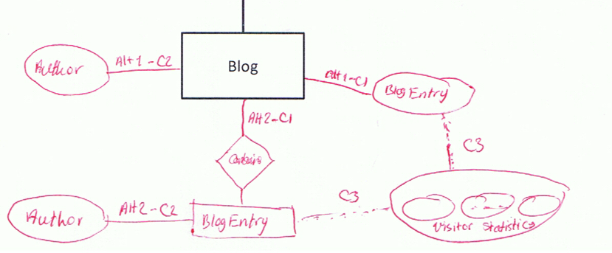
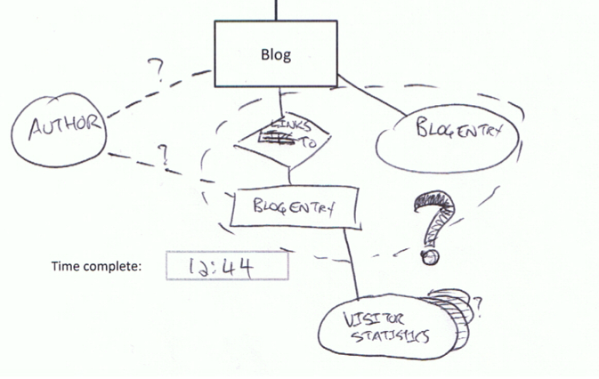
Evaluation Results and Discussion – Free form
What notations come naturally?
Dashed lines and question marks
‘…’ for set
Color schemes: all uncertainties or by uncertainty-type

Slide 50
Evaluation Threats to Validity
12 Participants (no stats)
Experts/ prior exposure to MAVO annotations
Familiarity with propositional logic
Confusion with underlying uncertainty concepts
(both syntaxes affected)
Selection bias from imbalanced knowledge of UML vs E-R
(1 subject reported this)

Slide 51
Conclusion
Syntaxes for Expressing Uncertainty

Slide 52
Summary
Three major contributions:
Assessment of existing notation.
A new, graphical syntax for partial models (MAV-Vis).
Empirical study of the two syntaxes.
Overall, users seem to be more efficient with MAV-Vis,
but also tend to make more errors.
Overall, users tended to prefer MAV-Vis.

Slide 53
Do we have a solution?
Is there a universally better solution?
Expert/Novice?
Learning style?
Representation for Var is an issue
Scalability of MAV-Vis and MAV-Text
Tooling can add power with interactions and visuals
Levels of detail drill-downs for cognitive integration
Hover-highlight concretizations for alternatives
Convert between syntaxes – use for validation

Slide 54
Lessons Learned
In carrying out an empirical study:
Hard to decouple testing the syntax from testing the semantics.
Always do a pilot.
Coming up with a rubric may be hard.
Coming up with efficient teaching materials may be even harder.
Don’t tire out the participants
(they are not easy to come by and you don’t want to scare them)
Bribe them with sugary things!

Slide 55
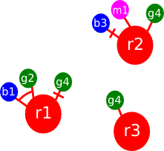
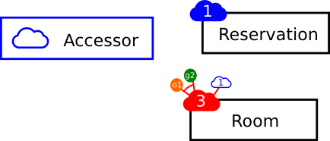
Future Work
Combinations of MAV annotations.
Would require more advanced training
Adding OW partiality
More complex PoU dependency expressions?

Slide 56
Thank You!
Especially to our participants!

