Slide 1
Modeling i*, e3Value and Service Choreographies for Virtual Organization Formation
Mohammad Hossein Danesh

Slide 2
Outline
Introduction
Three Level Modeling Approach
Transformation and Relations
Implementation in MMTF
Case Studies
Conclusion

Slide 3
Introduction
Virtual Organization
Goal Modeling
Value Networks
Service Choreographies

Slide 4
Motivations For Collaboration
Maintaining Competitive Advantage is Difficult
  Rate of Change
  Customer is King
Need for more dynamic
  Business Models & Strategies
  Governance Principles
  Business Processes
  Technological Capabilities
One of The Solutions : Partnerships & Collaboration
Collaborative Networked Organizations
In 10 years most enterprises will be part of CNO
(Camarinha-Matos et. al., 2009)

Slide 5
Virtual Organizations
A Dynamic, Temporal consortium
Autonomous legally independent organizations
Respond to a business opportunity
Partners share risks, costs and benefits
Operation is achieved by coordinating and sharing of skills, resources and competencies
(Danesh et al, 2011)

Slide 6
Service Oriented Virtual Organization
Each Participant has a bag or services
  Service Zone
Collaborative Processes Formed Using Partner Services
Orchestration vs Choreography
Choreograph Services on a Loosely Coupled Infrastructure

Slide 7




Virtual Organization Unified Management Portal
Communication Tools
Business Rule
Business Process
Document Flow
Service Versioning
SLA Monitoring
User Access Control
IBM Cognos BI
Federated
Monitoring
Information
Business
Monitor
P2
R1
IBM BPM
P1
User Federation
IBM SFM Console
Zone
Zone
DC
DC
SOA Infra
IBM ESB
Virtual Hub
IBM ESB
WSRR
SOA Infra
A1
WSRR
Zone
Zone
D1
DC
DC
SLA Monitoring Info.
SOA Infra
IBM ESB
IBM ESB
SOA Infra0
VO Business Rule
B1
WSRR
WSRR
C1
Organizational Services
(Danesh et al, 2012)
VO Collaborative Process

Slide 8
Introduction
Virtual Organization
Goal Modeling
Value Networks
Service Choreographies

Slide 9
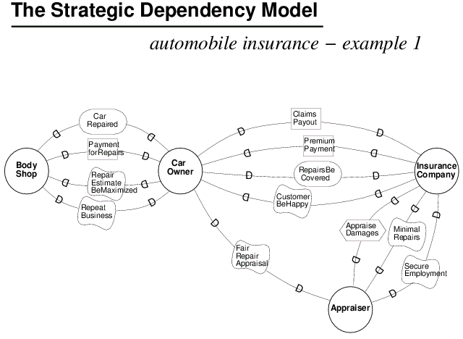
Goal Dependency
Resource Dependency
Task Dependency
Softgoal Dependency
Diagrams From Eric Yu – Presentation on i* Refresher

Slide 10
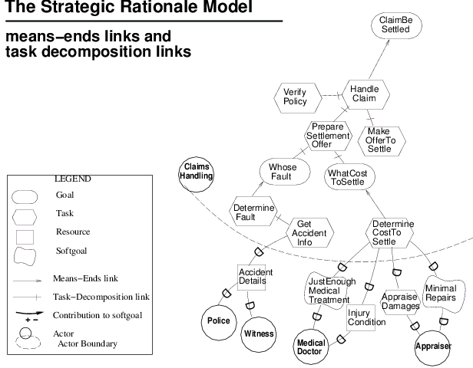
Task Decomposition Link
What are the means for achieving the desired end?
What does the task consist of?
Means-Ends Link
Diagrams From Eric Yu – Presentation on i* Refresher

Slide 11
Introduction
Virtual Organization
Goal Modeling
Value Networks
Service Choreographies

Slide 12

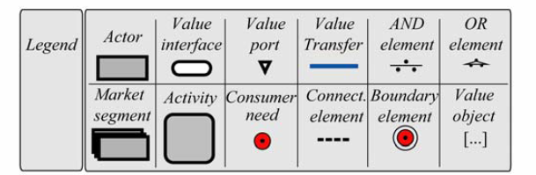
Value Network Coordination (E3 Value)
  E3 Value is a graphical representation of the business model
  It shows the value exchange between business partners with a standardized notation
The most simple value exchange between two entities
(Kort and Gordijn, 2008)

Slide 13
Introduction
Virtual Organization
Goal Modeling
Value Networks
Service Choreographies

Slide 14
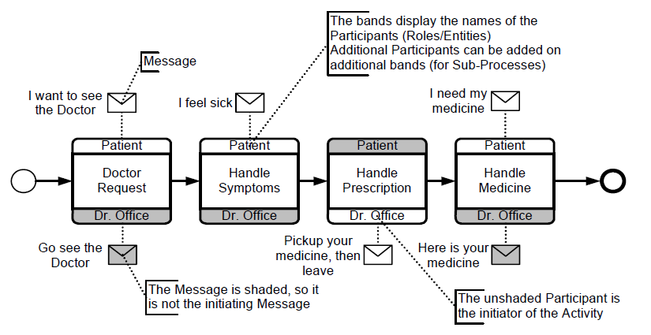
Choreography
Allweyer, 2010)

Slide 15
Outline
Introduction
Three Level Modeling Approach
Transformation and Relations
Implementation in MMTF
Case Studies
Conclusion

Slide 16
Overall collaboration pattern
Partner Interactions
Negotiate messaging exchanges
Roadmap for defining executable collaborative business processes
Overall Business Opportunity
Illustrates the relationship (dependencies) between partners
Illustrates each partners roles
Alternative routine exploration
i* SR Goal Model
BPMN Service Choreography Model
e3Value Business Model
Traceability
Extraction Method
Extraction Method
Modeling Value Exchange
Feasibility Analysis
How To Share Business Benefits
Roadmap on How Partners Should Collaborate

Slide 17
Outline
Introduction
Three Level Modeling Approach
Transformation and Relations
Implementation in MMTF
Case Studies
Conclusion

Slide 18
Transforming Goal Model To Value Network
Rule1: i* Actor → e3Value Actor
Dependency : Depender, Dependee and Depundum
Rule2 : Dependee Actor : Source of Value Transfer
Depender Actor : Dest of Value Transfer
Dependum : Value of Value Transfer
Condition 1: No Duplicate Value Transfer
Relation 1: Actor → One-One → Actor
Relation 2: Dependency → Many-One→ Value Transfer

Slide 19
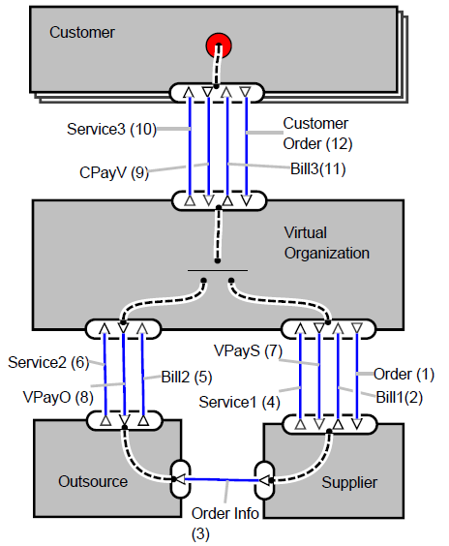
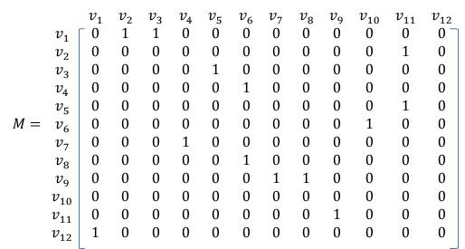
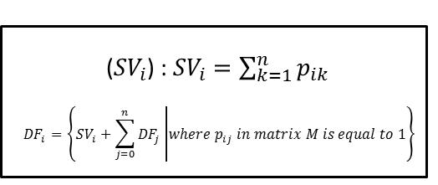
Extracting Service Choreography from Value Network Model
(Kamali et al 2012)

Slide 20
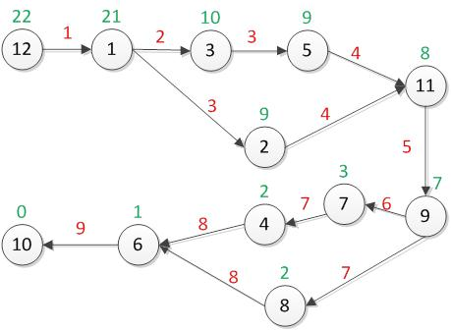
Extracting Service Choreography from Value Network Model
(Kamali et al 2012)

Slide 21
Outline
Introduction
Three Level Modeling Approach
Transformation and Relations
Implementation in MMTF
Case Studies
Conclusion

Slide 22
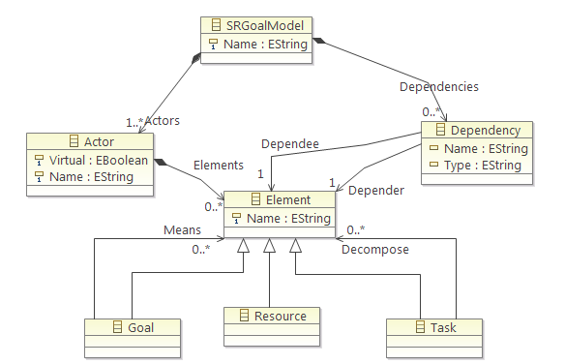
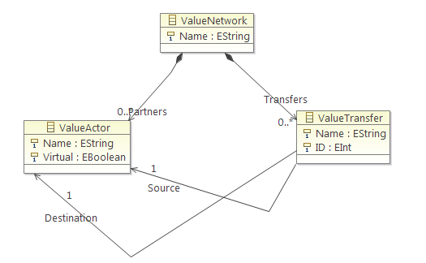
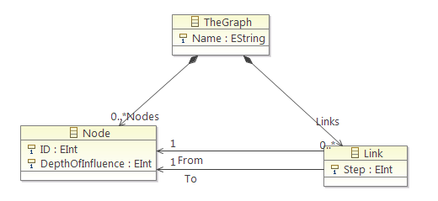
Implementation MMTF

Slide 23
Operator One
Gets an i* and e3Value as Inputs
Generates Value Network
Create Two Relation as Output
  Actor Relation
  Dependency Relation

Slide 24
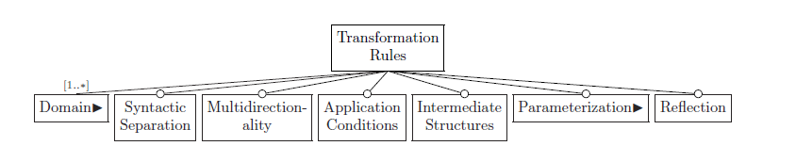

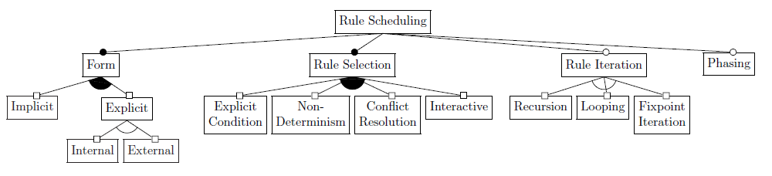

Operator One
i*
e3Value
No Duplicate
Nothing
Except Relations

Slide 25
Operator Two
Input:
  Dependency Relation
  Dependency Graph
Generates Dependency Matrix
Builds Dependency Graph and Compute DFs
Creates a Relation
  Node One-To-One Value Transfer

Slide 26
Operator Two
Dependency Relation
Dependency
Graph
Dependum
No Loop
Matrix
SV
DF
1
2

Slide 27
Outline
Introduction
Three Level Modeling Approach
Transformation and Relations
Implementation in MMTF
Case Studies
Conclusion

Slide 28
Virtual Mobile Operator

Slide 29
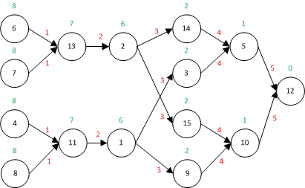

Slide 30
Internet Radio Station
( J. Gordijn et al, 2006)

Slide 31
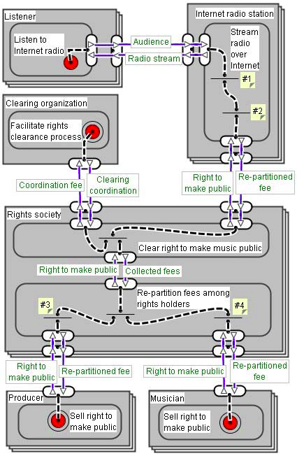
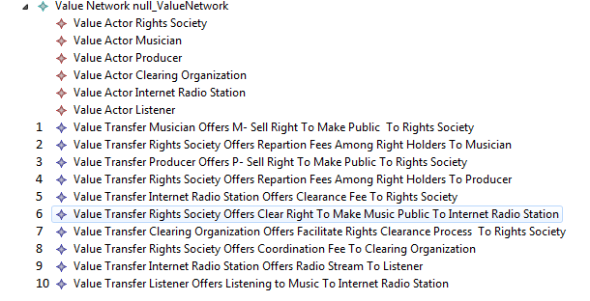
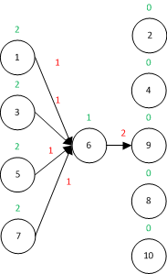
( J. Gordijn et al, 2006)

Slide 32
Outline
Introduction
Three Level Modeling Approach
Transformation and Relations
Implementation in MMTF
Case Studies
Conclusion

Slide 33
Summary
The importance of collaboration
Facilitate VO Formation and Negotiation
Proposition of Three Level Modeling Approach
Definition & Implementation of Model Relations

Slide 34
Limitation & Future Work
Leaf Node Dependency Transfer
  Inheritance
Loops in Value Dependencies
Include Dependency Types
Include Soft Goal

Slide 35
References
L. M. Camarinha-Matos, H. Afsarmanesh, N. Galeano, and A. Molina, “Collaborative networked organizations - Concepts and practice in manufacturing enterprises,” Computers & Industrial Engineering, vol. 57, no. 1, pp. 46–60, Aug. 2009.
M. H. Danesh, B. Raahemi, and M. A. Kamali, “A framework for process management in service oriented virtual organizations,” in 2011 7th International Conference on Next Generation Web Services Practices (NWeSP), 2011, pp. 12–17.
M. H. Danesh, B. Raahemi, S. M. A. Kamali, and G. Richards, “A Distributed Service Oriented Infrastructure for Business Process Management in Virtual Organizations,” presented at the IEEE 25th Canadian Conference on Electrical and Computer Engineering, Montreal, Quebec, 2012
C. Kort and J. Gordijn, “Modeling Strategic Partnerships Using the E3value Ontology: A Field Study in the Banking Industry,” Handbook of ontologies for business interaction, 2008.
T. Allweyer, BPMN 2.0. BoD, 2010.
S. M. A. Kamali, G. Richards, M. H. Danesh, and B. Raahemi, “A framework for performance measurement in service oriented virtual organizations: A value network approach to collaborative performance measurement,” in 7th International Conference on e-Business, ICE-B 2012, July, 2012, pp. 263–271.
J. Gordijn, E. Yu, and B. van der Raadt, “E-service design using i* and e3value modeling,” IEEE Software, vol. 23, no. 3, pp. 26 –33, Jun. 2006.

Slide 36


