Slide 1
The Use of Models in Music Theory Pedagogy for Amateur Musicians
Danielle Watson

Slide 2
Table of Contents
Introduction
The Current State of Music Theory Pedagogy
How Models Will Help
Rationale for Choices
Possible Further Extensions and Other Existing Work

Slide 3
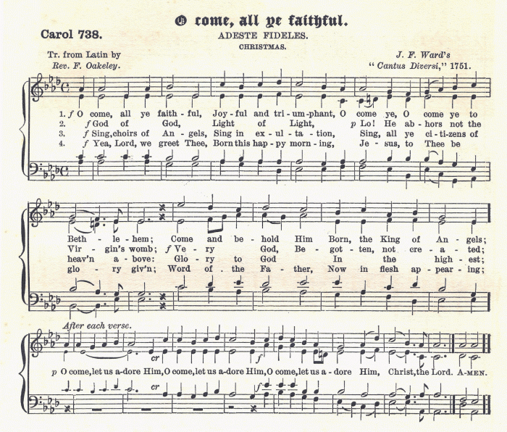
Introduction

Slide 4
The Current State of Music Theory Pedagogy
Most students aren’t interested in music theory
It takes a great deal of time to become proficient at music theory

Slide 5
Why is Music Theory Important?
The use of music theory allows musicians to become better
Unfortunately, most amateur musicians don’t apply music theory to their performance

Slide 6
How Will Models Help?
A proper model helps the student to learn faster
It also can cut down on simple mistakes

Slide 7
Areas of Music Theory
Harmonic Analysis
Identifying Cadences
Four-Part Harmony
Voice Leading

Slide 8
Harmonic Analysis
Harmonic analysis is the identification of chords in a piece of music
This allows the identification of phrases and other important parts of musical structure
Phrasing is an important part of performance practice

Slide 9
Example of a Model
s0
I
IV
iii
s1
I
s5
s2
vi
ii
s3
s4
V
s6

Slide 10
Identifying Cadences
A cadence is one of the most important part of a piece of music
It signals moving to a different section
Identifying cadences is part of four-part harmony

Slide 11
Four Part Harmony
Four part harmony is the use of four voices in order to write out chords
It is a common teaching method
There are a number of strict rules regarding four part harmony which are easy to break
The type of models used in harmonic analysis can also be used here

Slide 12
Voice Leading
Voice leading is a part of four part harmony
Certain types of motion are not allowed, since they weaken the quality of the sound
However, the strongest arrangement of chords would mean breaking the rules of voice leading

Slide 13
Voice Leading
C
C
S1
S2
SF
G
A
A1
A2
AF
E
F
T
F
T1
T2
C
B1
B2
F
BF

Slide 14
Rationale For Choices
Originally my plan was to create a program that would do some of this automatically
There were two problems with this:
It wouldn’t necessarily teach the students anything
It is beyond my abilities

Slide 15
Rationale –cont’d
Working music theory out on paper is what both students and teachers are used to
There are many problems with the quick use of currently available notation software

Slide 16
Rationale –cont’d
The models I am using are based off the FTS (featured transition system)
I chose this system because:
It has a temporal element and uses temporal logic
There is already an implementation in place
It does not require much restructuring to use for music theory

Slide 17
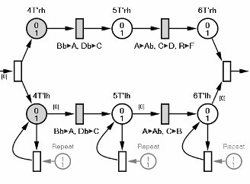
Possible Further Extensions and Other Existing Work
There has been a considerable amount of work done with music analysis and Petri Nets at the University of Milan

Slide 18
Possible Further Extensions and Other Existing Work
An option for extension in this area is the creation of a plugin for existing notation software
Another option is the use of mobile applications
The ideal mobile application would be capable of taking a picture of sheet music, recognizing it as music, and analyzing it for both structure and consistency

Slide 19
Conclusions
The state of music theory pedagogy today is such that students often have difficulty in applying it to the practical part of their studies
The use of models as an aid in teaching will allow for increased comprehension, and will therefore both speed up the learning process and let students apply it to performance practice

