Slide 1
Automated Conceptual Abstraction of Large Diagrams
By Daniel Levy and Christina Christodoulakis
December 2012
(2 days before the end of the world)

Slide 2
Outline
Introduction
Big picture
Clustering Algorithm
Experiment & Results
Conclusion
Notes:
Intro – why do we need to cluster

Slide 3
Outline
Introduction
Big picture
Clustering Algorithm
Experiments & Results
Conclusion
Notes:
Intro – why do we need to cluster

Slide 4
Introduction
So what is this “clustering” you speak of?
Why do we need to cluster?
Reduce cognitive load
Notes:
Large Diagrams are impossible to explain or understand. Board meetings don’t care about details and developers need few details at a time, while managing to keep in context.
- Issues:
a. abstraction of a diagram
b. visualization of the abstraction
c. browsing the diagram
- Work has been done on all three. We focus on (a) and propose a system for (c)

Slide 6
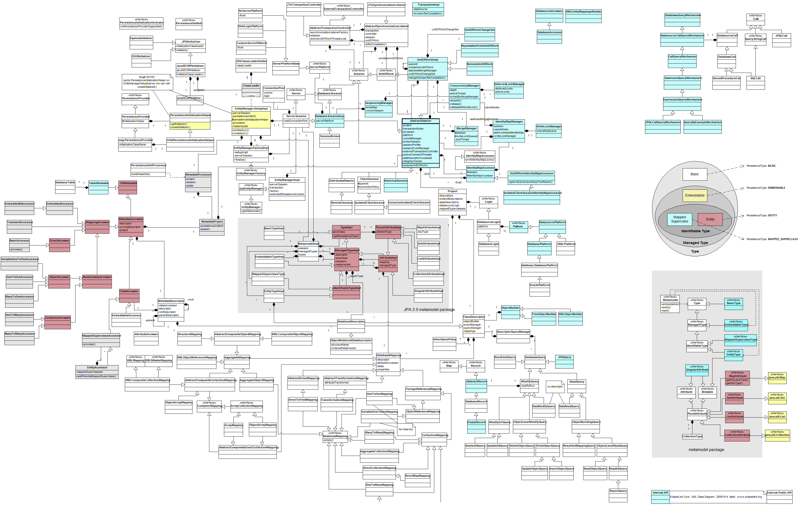

Slide 8
Outline
Introduction
Big picture
Clustering Algorithm
Experiment + Results
Conclusion
Notes:
Intro – why do we need to cluster

Slide 9
Big Picture

Slide 10
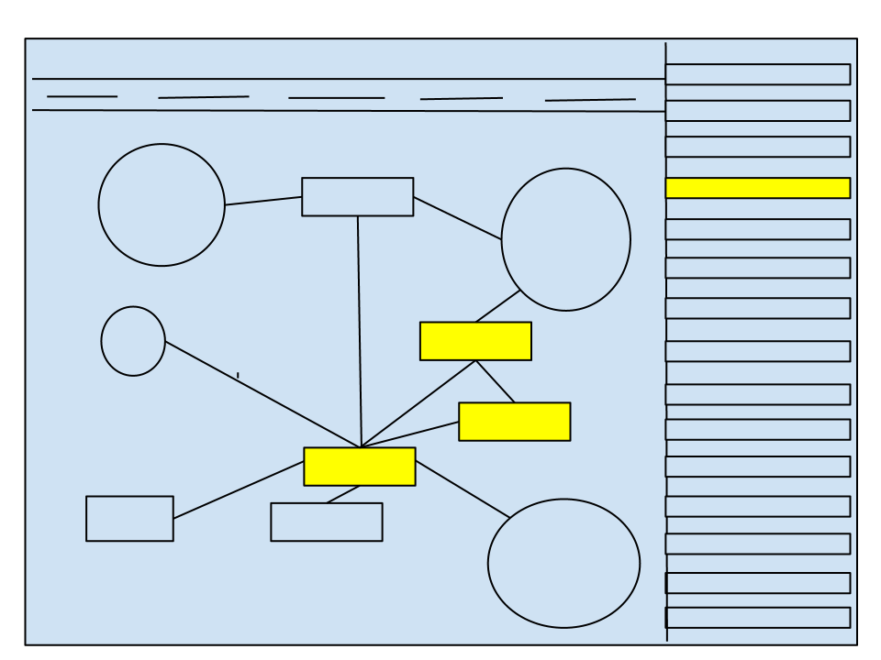
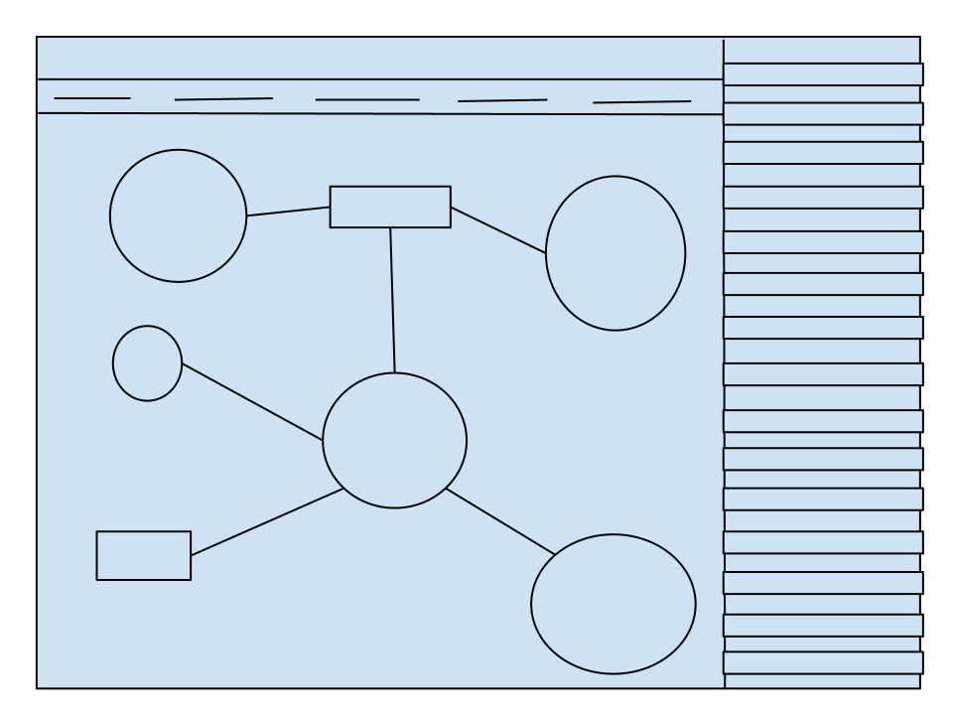
Vision
Notes:
being able to view and browse through a large diagram through various levels of abstraction
Expanding clusters as needed, rearranging clusters,
Combining use case and class diagram browsing

Slide 11
Diagram Abstraction

Slide 12
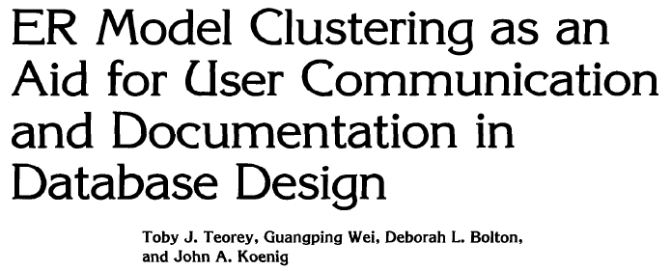
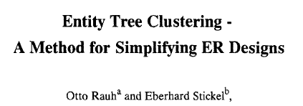
Related Works
Its been done before..
Notes:
Past approaches look at the relationships and semantics of ER or UML Class Diagrams. We look at our diagrams as simple graphs
we cluster the graphs and then rate each candidate cluster given a distance metric calculated using the node names that have been clustered together.

Slide 13
Our Approach
Consider a diagram stripped of semantics, or pre processed using methodologies in previous work
Cluster graph
Evaluate clusters proposed based on closeness of meaning in the node names

Slide 14
Our Approach

Slide 15
Outline
Introduction
Big picture
Clustering Algorithm
Experiment + Results
Conclusion
Notes:
Intro – why do we need to cluster

Slide 16
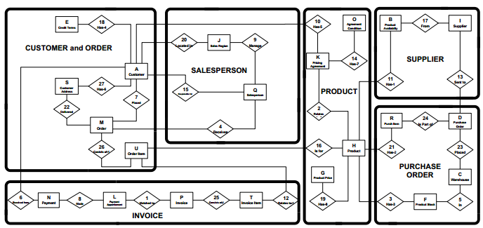
Min-Cut
Notes:
Krugers algorithm

Slide 17
Naïve Min-Cut Algorithm

Slide 18
Combinations / Creating partitions
4
4
E
E
A
A
1
2
N
2
N
B
B
3
3
C
C
*Must result in exactly 2 partitions
*Assume there exist additional nodes
Notes:
Find edge sets that create 2 partitions
Go through all sets - 1,2,3,12,13,23,123

Slide 19
4
4
E
E
A
A
1
1
2
N
N
B
B
3
C
C
Notes:
3 partitions

Slide 20
Minimum sets
2
D
D
2
1
C
A
A
C
B
B
3
2
D
2
D
1
C
A
B
C
A
3
B
3

Slide 21
Cycles
D
D
1
2
2
A
B
A
3
B
3
D
D
1
2
2
A
A
B
B
3
Notes:
Why do we need 2 partitions /minimum set of min-cuts

Slide 22
Listing the min-cuts
C
1
2
A
4
B
D
3
5
E

Slide 23
Listing the min-cuts
C
1
2
A
4
B
D
3
5
E

Slide 24
Listing the min-cuts
C
1
2
A
4
B
D
3
5
E

Slide 25
Listing the min-cuts
C
1
2
A
4
B
D
3
5
E

Slide 26
Listing the min-cuts
C
1
2
A
4
B
D
3
5
E

Slide 27
Outside-in approach
C
1
2
A
4
B
D
3
C
5
1
2
E
A
B
D
3
E
Notes:
There is still a min-cut form D to E

Slide 28
Outside-in approach
C
1
2
A
4
B
D
3
C
5
1
2
E
A
B
D
3
5
E
Notes:
There is still a min-cut form D to E

Slide 29
C
1
2
A
4
B
D
3
C
5
1
2
E
A
4
B
D
3
E
Notes:
Test if we should combine E and D or just leave E as not a cluster
There are some flaws which we will discuss in future works

Slide 30
C
1
2
A
4
B
D
3
5
E
Notes:
Test if we should combine E and D or just leave E as not a cluster
There are some flaws which we will discuss in future works

Slide 31
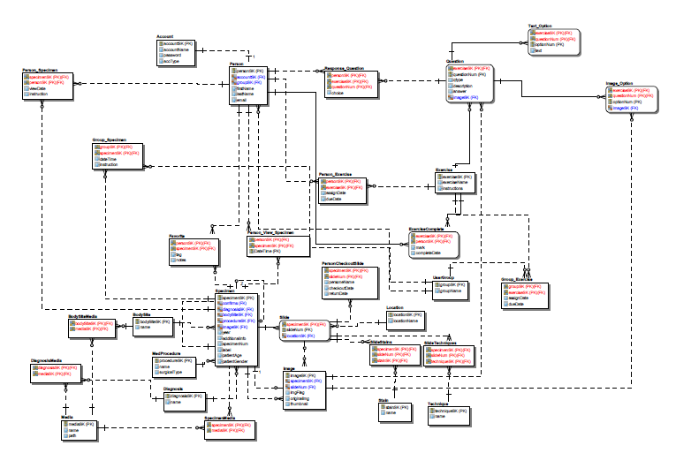

Slide 32
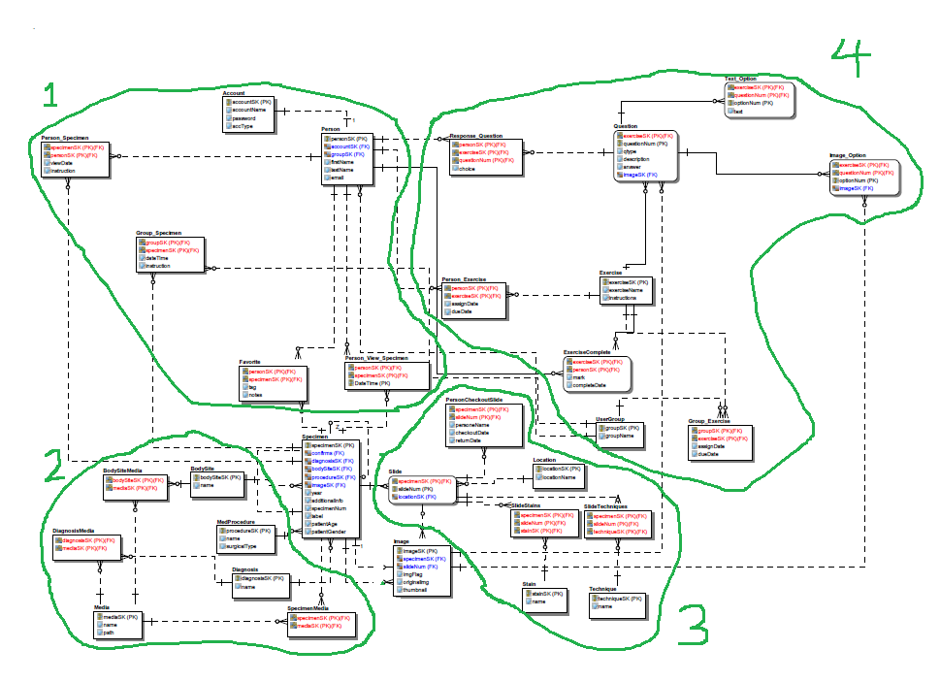
Notes:
Separate 1 and 4 and find min-cuts again

Slide 33
Cluster Distance Measure
We use RiTa WordNet getDistance() function
We calculate pairwise distances between nodes.
Select for each node the smallest distance between it and another node
Sum all minimum distances
Average over all nodes in candidate cluster

Slide 34
Outline
Introduction
Big picture
Clustering Algorithm
Experiments + Results
Conclusion
Notes:
Intro – why do we need to cluster

Slide 35
Experiment 1

Slide 36
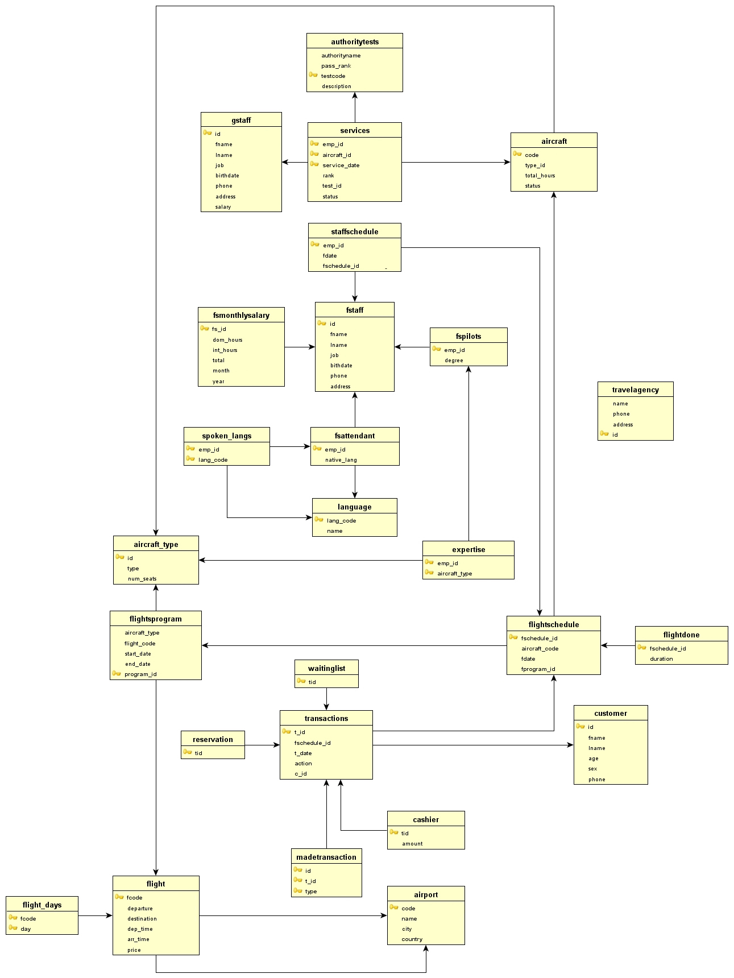
Experiment #1
Notes:
Christina Experiment 1

Slide 37
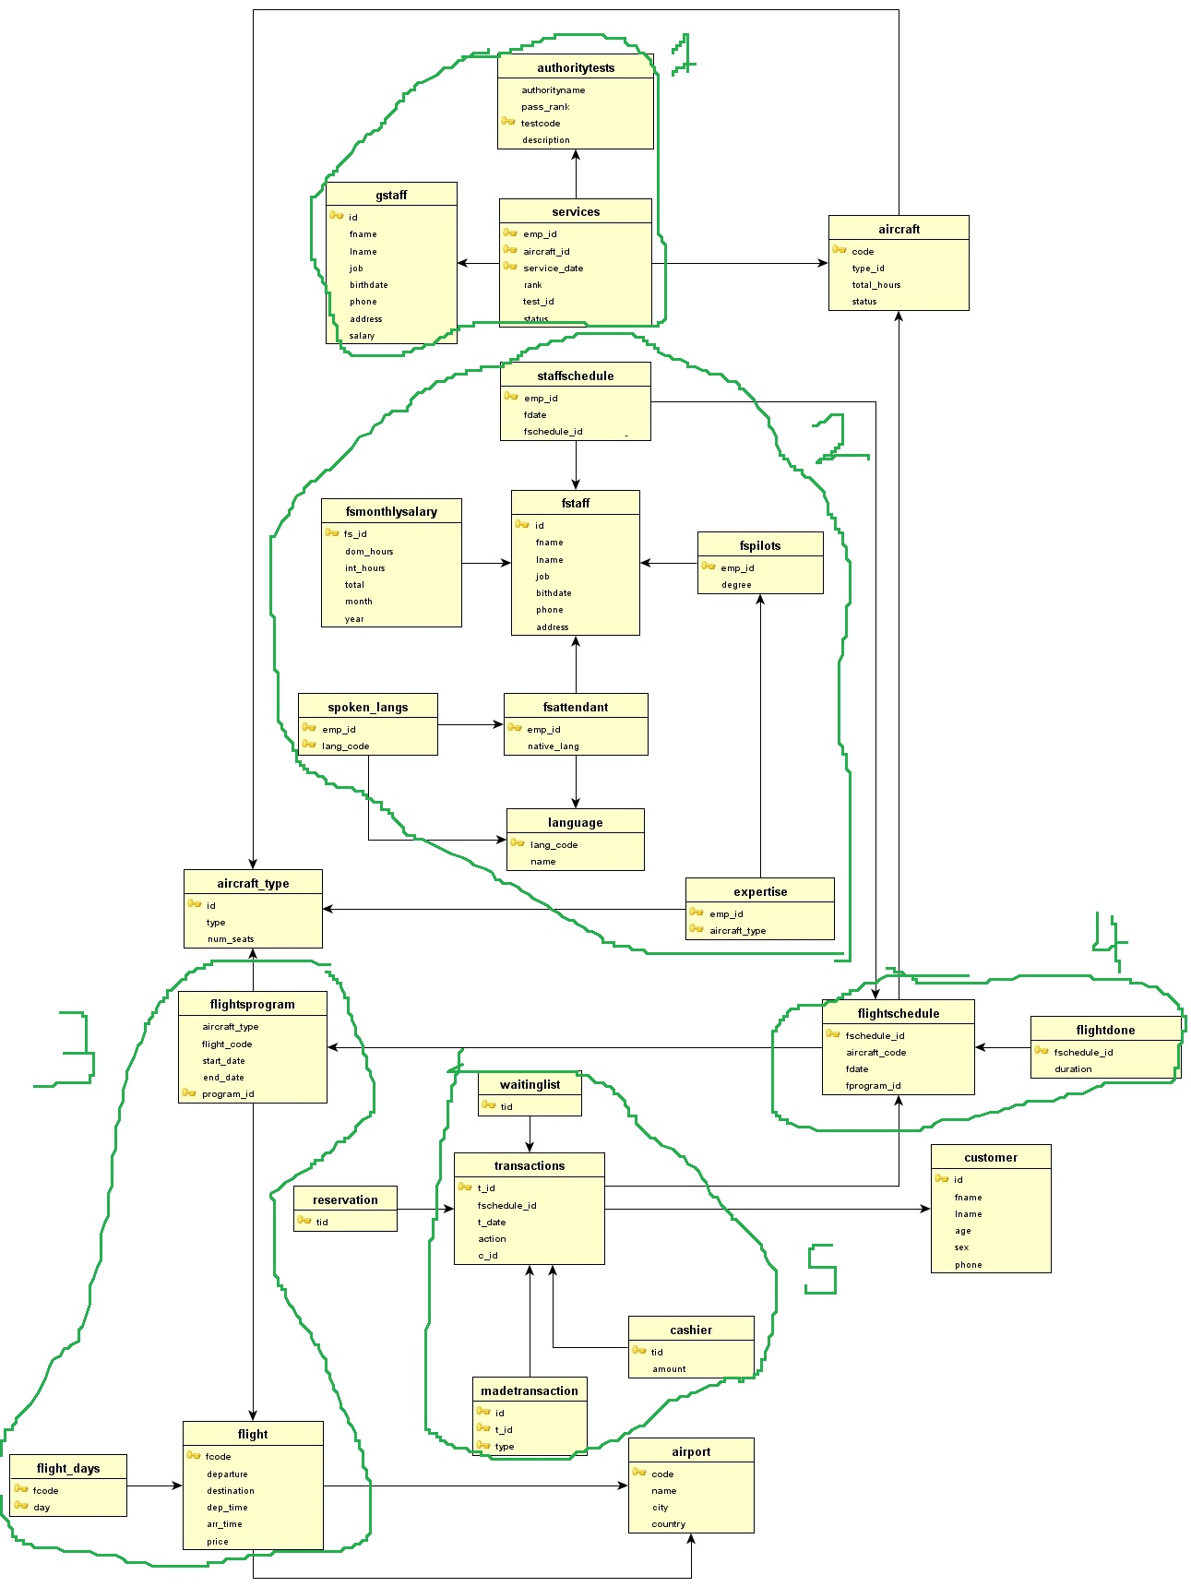
Experiment # 1
User 1 abstraction

Slide 38
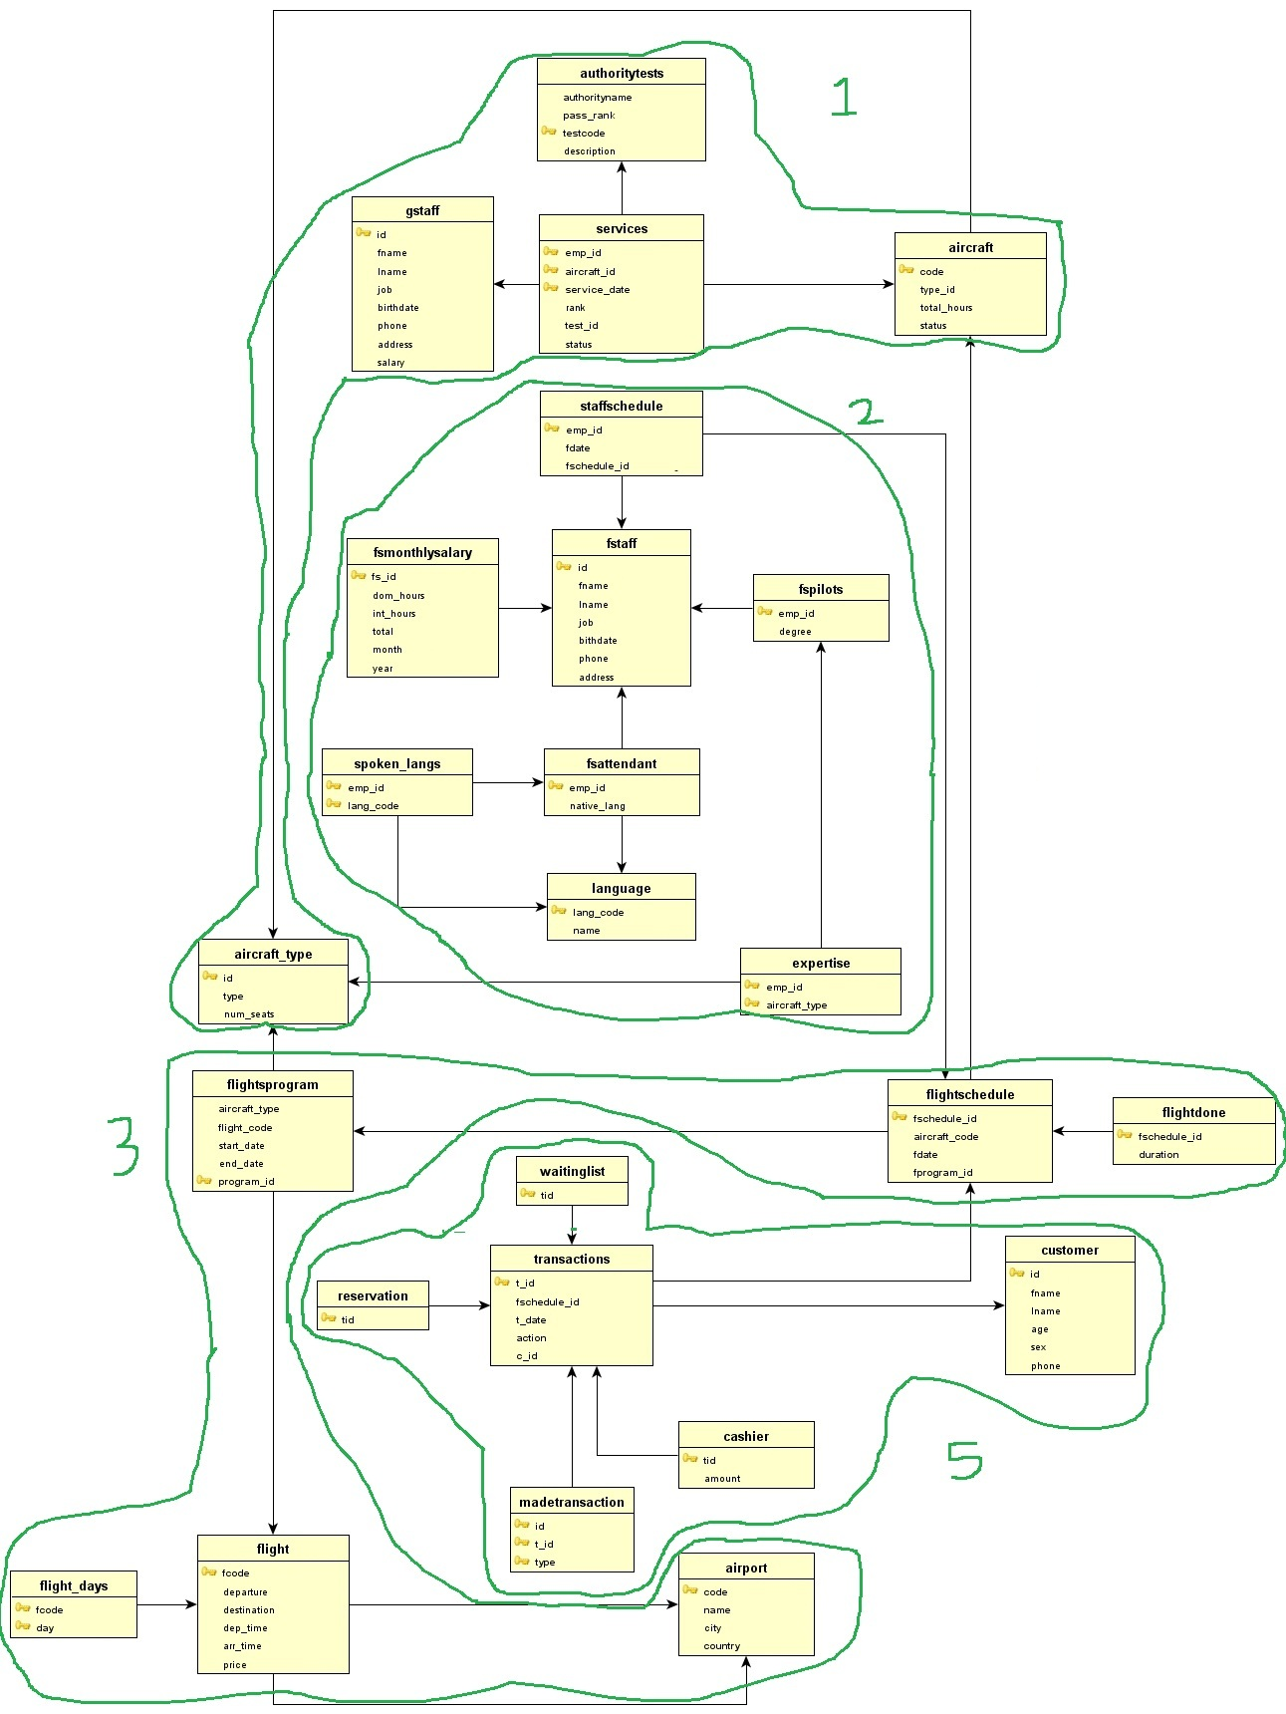
Experimentation
User 2 abstraction

Slide 39
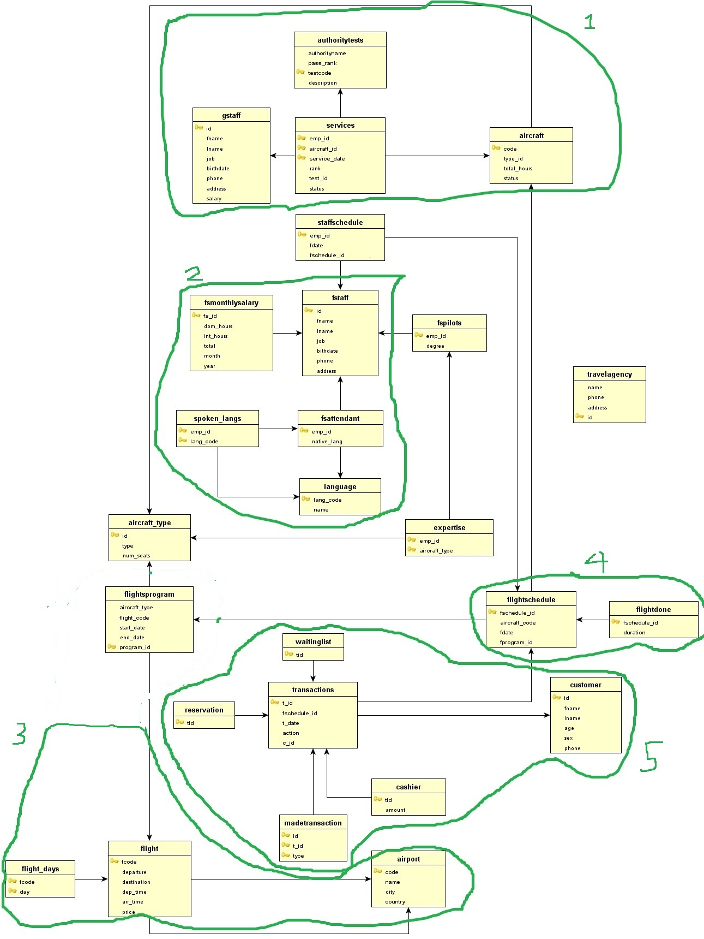
Experiment # 1
automated abstraction

Slide 40
Experiment 2

Slide 41
Experiment #2

Slide 42
Simplified version

Slide 43
Notes:
Separate 1 and 4 and find min-cuts again

Slide 44
Outline
Introduction
Big picture
Clustering Algorithm
Experiments + Results
Conclusion
Notes:
Intro – why do we need to cluster

Slide 45
Conclusions
Surprised at how similar manual clustering and automated clustering were.
Suggested improvements:
Automatic distance threshold
Creating subgraphs
Strictness of clustering (min # of clusters
Advanced min-cut discovery

Slide 46
Questions?
Merry Christmas!

