Slide 1
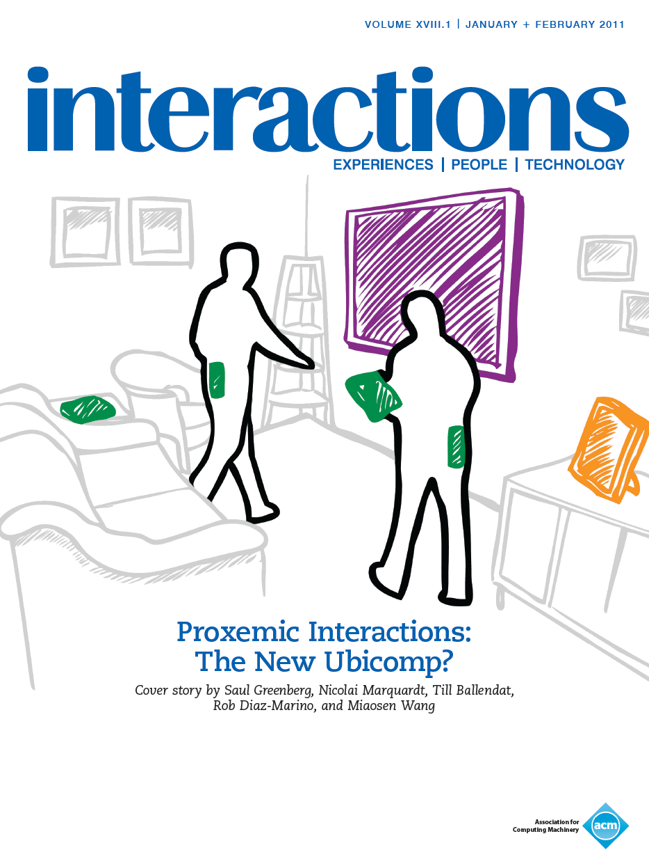
Notes:
At a seminar such as this, addressed to a broad audience, I believe its best to have you imagine what could be in store for us in the future, as opposed to revisiting established work. So, for today, I’m going to highlight a fairly recent research interest of mine that I call Proxemic Interactions, which I wrote about as an ACM Interactions cover story. And I should warn you – my talk is intended to raise more questions and provoke thought about what could be, rather than solve or produce definitive answers.

Slide 2
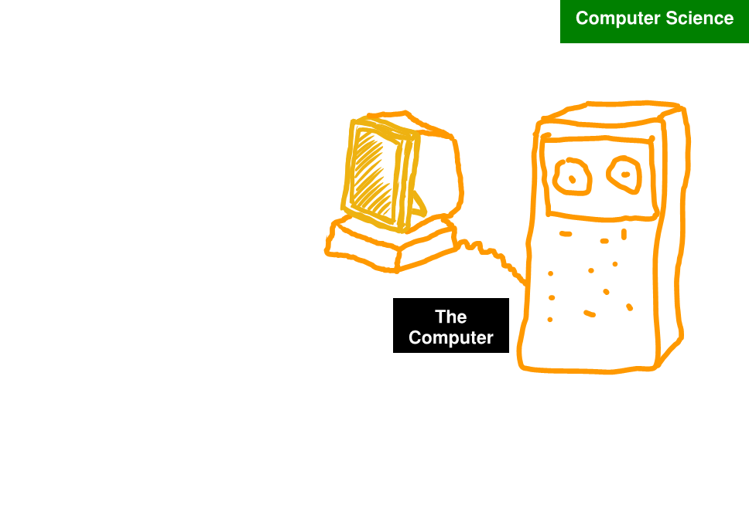
Late ’70s
Notes:
But to think about the future, we have to also think about history of HCI, which mirrored my own particular research interest.
When I first started, Computer Science was all about designing computer systems, about making them dance for us.

Slide 3
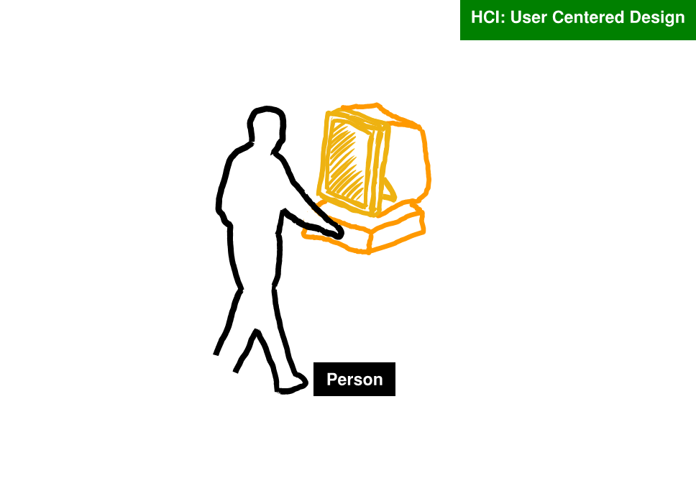
Early ‘80s
Notes:
I was fortunate enough to attend the very first ACM CHI conference, where I and others realized that it was the interaction between the person and the computer that created the system, thus user centered design became my focus.

Slide 4
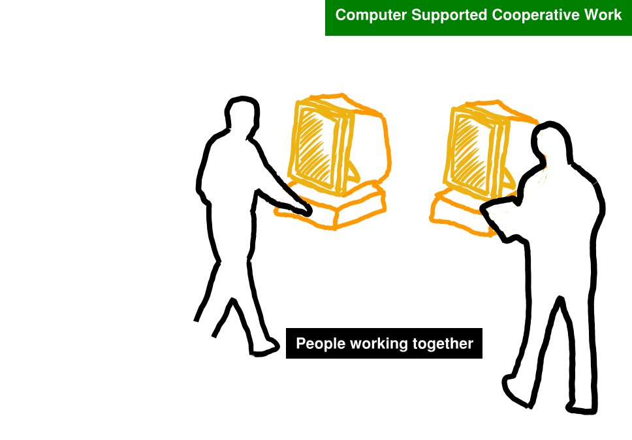
Late ‘80s – ‘90s
Notes:
In the later 80s, the field of CSCW emerged, where the view of the system grew to include multiple people working together via computers. This broader view kept my interests for well over a decade.

Slide 5
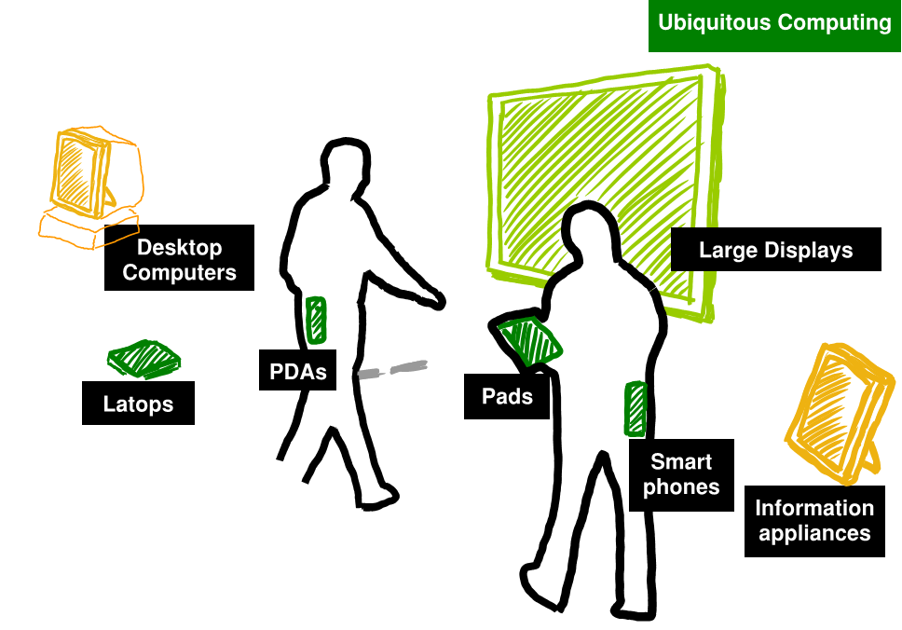
Late ‘90s
Notes:
But as technology changed, so did the idea of what was a computer. Ubiquitous computing arose, and all of a sudden I and the community were researching how multiple people interacted with multiple technologies in a seamless manner

Slide 6
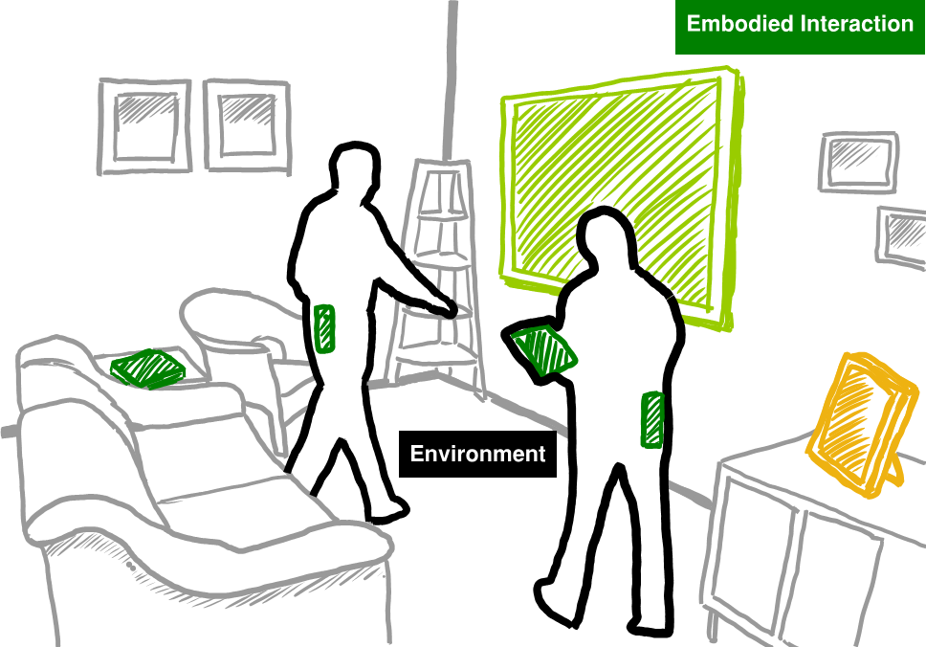
’00 - now
Notes:
Yet even that wasn’t a complete picture, for it did not include people’s everyday environment. And thus Embodied interaction emerged:

Slide 7
’00 - now
Embodied Interaction
situates technology and interaction in the
real world context to facilitate natural social
practice Paul Dourish
Where the Action is 2001
Notes:
… where it situates technology and interaction in the real world context to facilitate natural social practice. My presentation today fits within this, for we will see how social theory is applied to interaction design and computer science to help a person mediate their everyday interactions with other people and a myriad of other technologies.

Slide 8
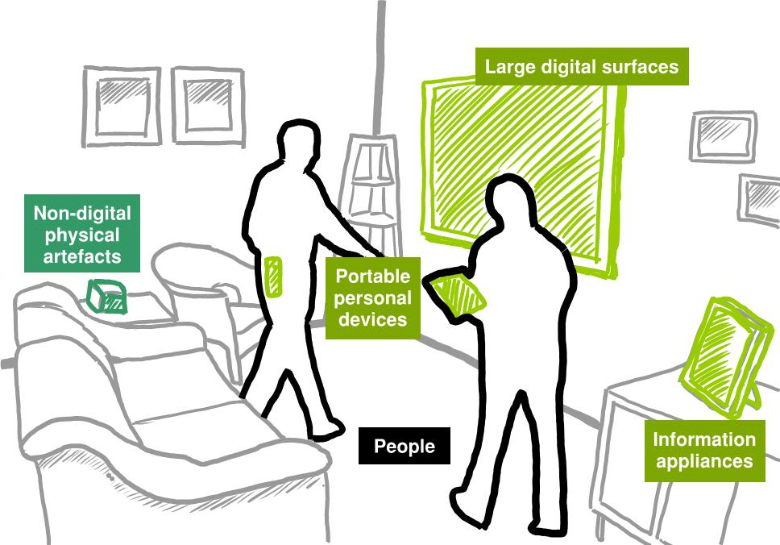
Imagine: A Proxemic Ecology people, surfaces, objects, devices, fixed features
Sketch conception: Nicolai Marquardt
Notes:
Ubiquitous Computing, or ubicomp envisages an ecology of devices. The problem is that its incredibly difficult to interconnect and use these devices in an integrated manner.
I want you to imagine a new ubicomp: An ecology of devices with knowledge of proxemics (distance, orientation and identity) of nearby people and other devices and of other non-digital objects
In this sketch, for example, we see people – who are carrying digital devices - moving in and out of a room with a large digital touch surface.
What could we do if the surface knew exactly who and where people were in a room?
How can we ease the connection and information exchange between the surface and people’s devices, or between devices and the various information appliances in the room?
More importantly, how can we exploit this knowledge to design natural user interfaces that promote embodied interaction?

Slide 9
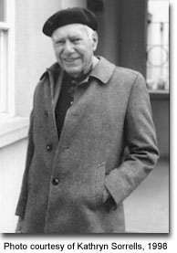
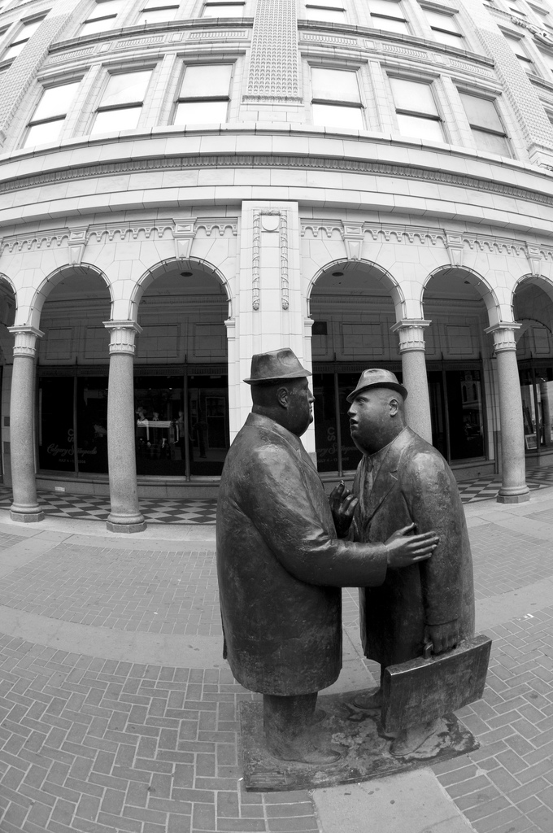
Proxemics – Edward Hall
Cultural perspectives of how people perceive/manage inter-personal space
Notes:
What we are really talking about is exploiting social sciences as a method to drive the design of interactive systems, where we take advantage of people’s natural expectations of spatial relations.
Lets start in the ‘60s, where anthropologist Edward Hall defined the notion of proxemics, that is, people’s cultural perspectives of space.
In particular, Hall was interested in how people managed their interpersonal space - their proxemity - from one another

Slide 10
Proxemics
Correlates physical to social distance
Notes:
He came out with a variety of statements.
In particular, he correlates physical distance to social distance.
This is something we all know tacitly, especially when its violated. (DO IT and/or SHOW VIDEO. BUXTON STORY.).

Slide 11

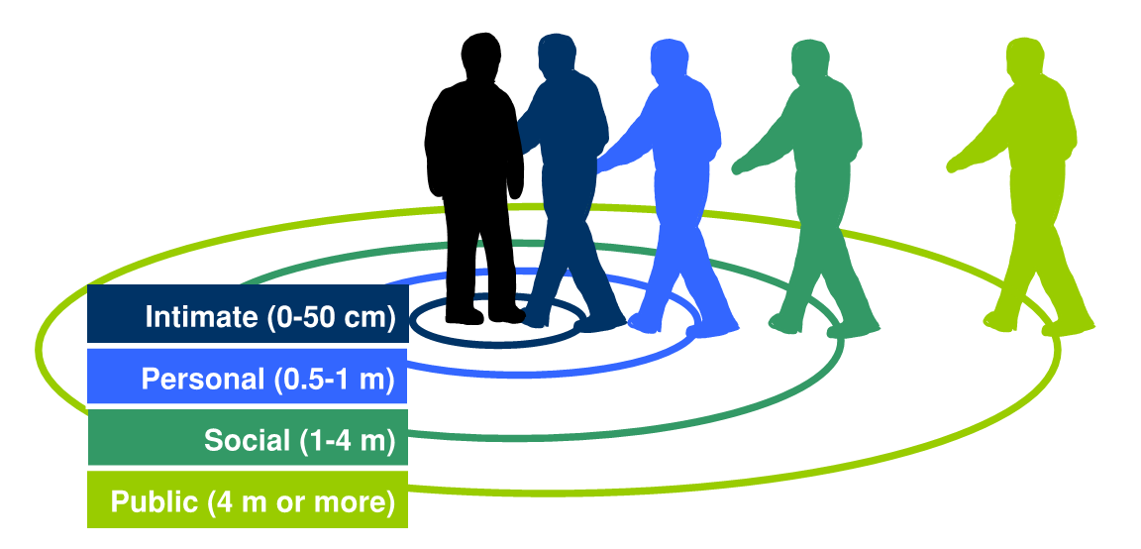
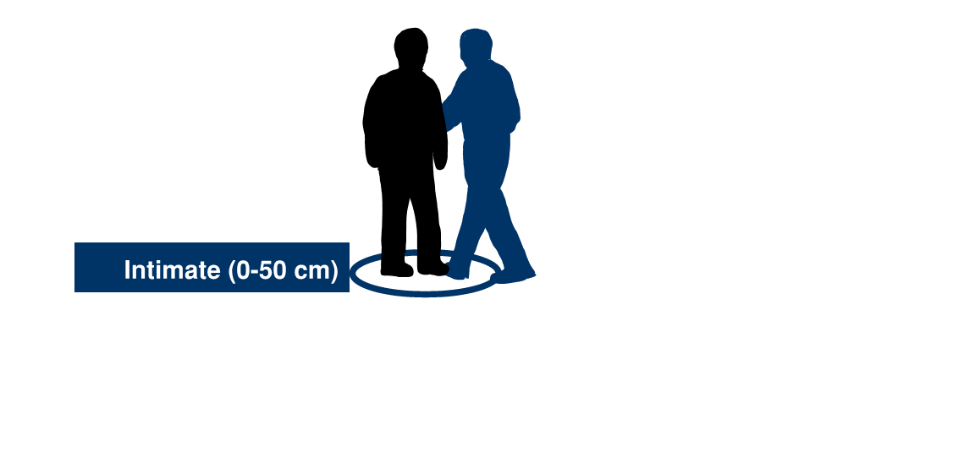
Proxemics
Correlates physical to social distance
Notes:
More formally, he described a series of zones around people. Starting from the inside, we have the intimate zone

Slide 12
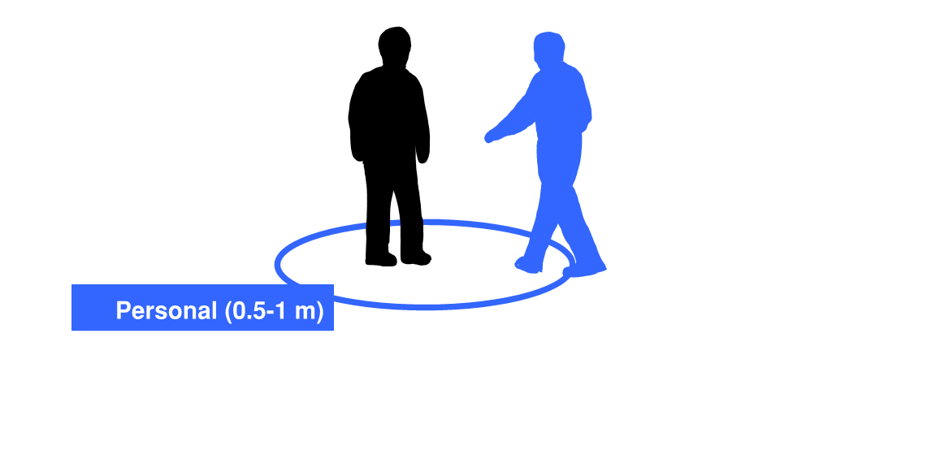
Proxemics
Correlates physical to social distance
Notes:
The personal zone is where close friends and colleagues are situated relative to one another as they converse. This wonder statue…

Slide 13
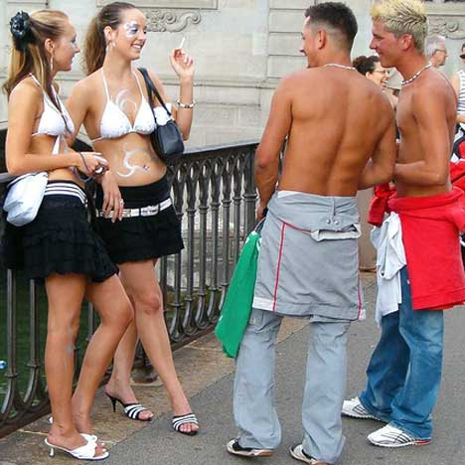
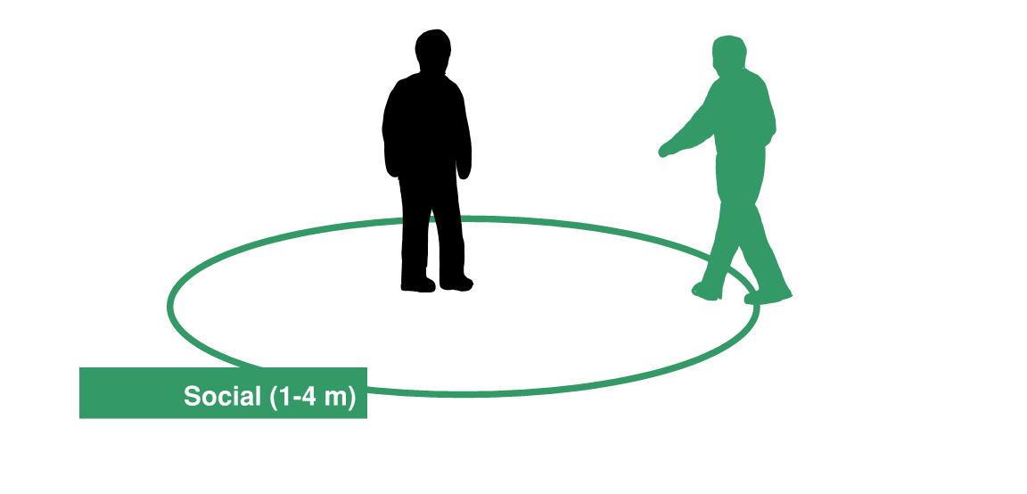
Proxemics
Correlates physical to social distance
Notes:
The social zone is where acquaintances usually sit. .. This wonderful photo in the top corner shows this really well… The 2 girls and 2 guys are in each others personal zone, but the girls and guys are separated in their social zone…. The guys, of course, are trying really hard to get into the girl’s personal zone..

Slide 14

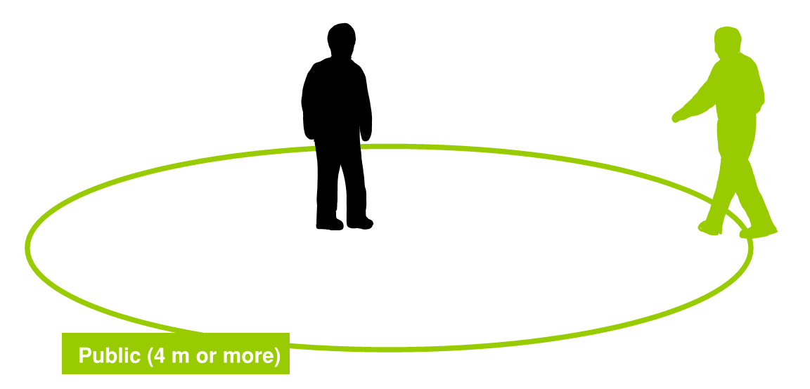
Proxemics
Correlates physical to social distance
Notes:
And finally, we have the public zone reserved for things like strangers occupying a space, for public presentations such as these… and so on (violate it).

Slide 15
Proxemics
Correlates physical to social distance
Notes:
Real life is not that simple
i.e., defense mechanisms, (gaze and eye contact, posture, body language, muscle tensing, taboos about touch, etc.).. IN this room for example, people would normally try to separate themselves from others by a few empty seats. When we can’t we do things like face forward, hold our arms inside, and so on.,
Still, spatial distance is a reasonable first approximation of social distance

Slide 16
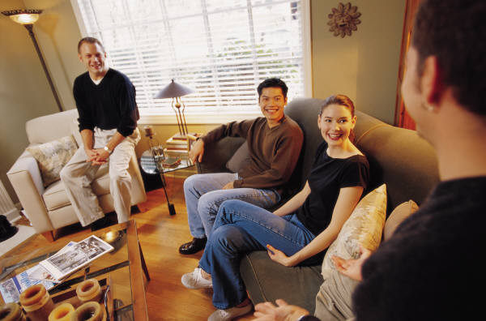
Proxemics
Includes fixed features (territories)
semi-fixed features (sociofugal/sociopetal)
Notes:
Hall also had two other primary notions
-fixed features (territories) e.g., doorways, room and other boundaries
-semi-fixed (whether it invites sociopetal (interactions) or sociofugal (privacy, separation) e.g., back to back chairs, kitty corner, etc.

Slide 17
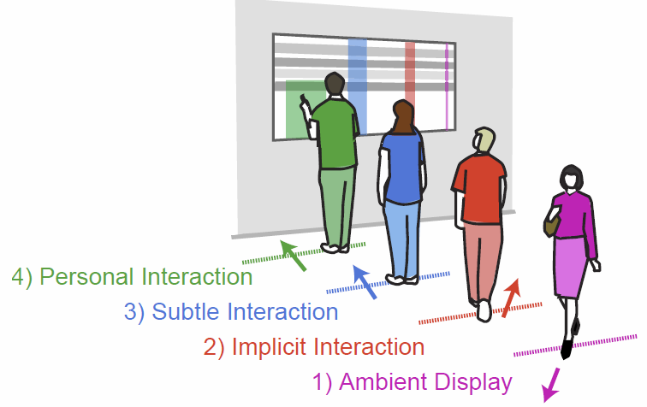
Applying Proxemics to Design
Public Ambient Displays [Vogel et al. 2004]
Notes:
So the question from an interface design perspective is this: How can we apply this theory of proxemics to design, that is, to proxemic interactions? This is what my work is all about.
I should mention that others have applied some of Hall’s theories to proxemic interactions. The one that inspired me came from the University of Toronto, from Vogel and Balakrishnan’s notable work in 2004 that described 4 interaction zones around the semi-fixed feature of a digital surface.

Slide 18
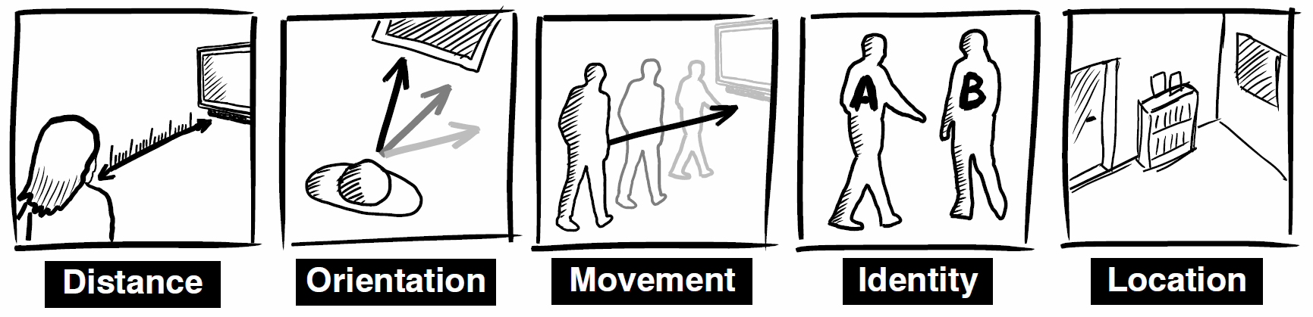
Notes:
Within the last year, I decided to tackle proximity as a first class research project.
One of the questions we had to answer was how to operationalize proxemics as metrics we could capture from our environment. The result was these 5 dimensions:
Distance between objects, relative orientation of one object to another, movement between objects, identity of objects, and contextual information about a location,

Slide 19
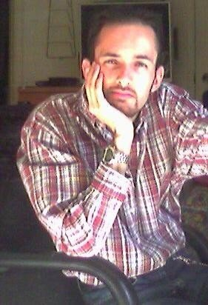
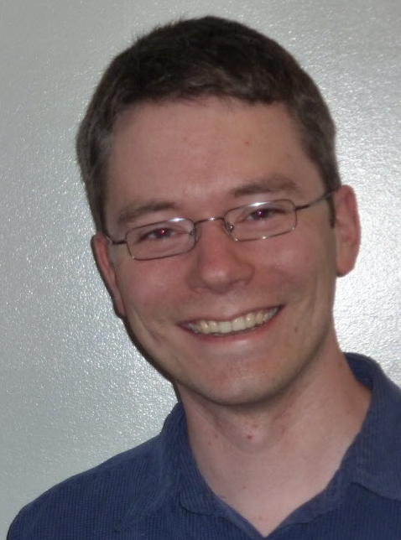
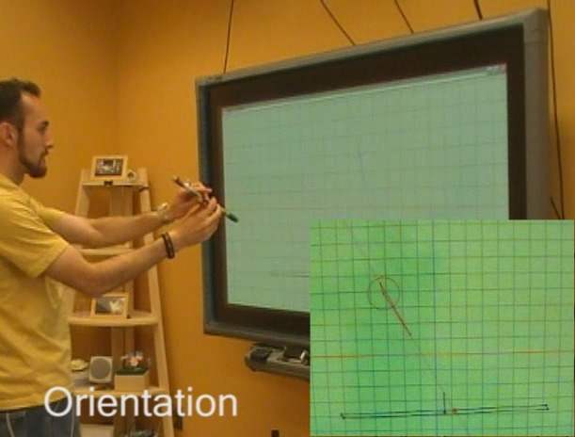
Proximity Toolkit rapidly programming proxemic interactions
Rob
Diaz
Nicolai Marquardt
Capture
  position
  orientation
  identity
  movement
  location
Derive
  touch
  relationships
  ray casting
  zone collisions
Notes:
We then created a platform that would capture this information, and an API that would let us rapidly program proxemic interactions.
The result was the Proximity Toolkit. Based on a high-end motion tracking system and more recently the Kinect, we captured those 5 dimensions...
And we used that to derive higher-level data, such as ..
Lets look at a video that illustrates the proximity toolkit., as well as a very simple application that has a character on a vertical surface respond to a person’s proximity.

Slide 20
A Proxemic Ecology people, surfaces, objects, devices, fixed features
Sketch conception: Nicolai Marquardt
Notes:
Now that we had a toolkit, we began experimenting with a proxemic ecology. Our own testbed mirrors what you see here: a simulated home living room with a large touch sensitive SMART . We developed a digital media player running on the surface to act as our driver application that we would use to experiment with interaction methods and uncover issues.

Slide 21
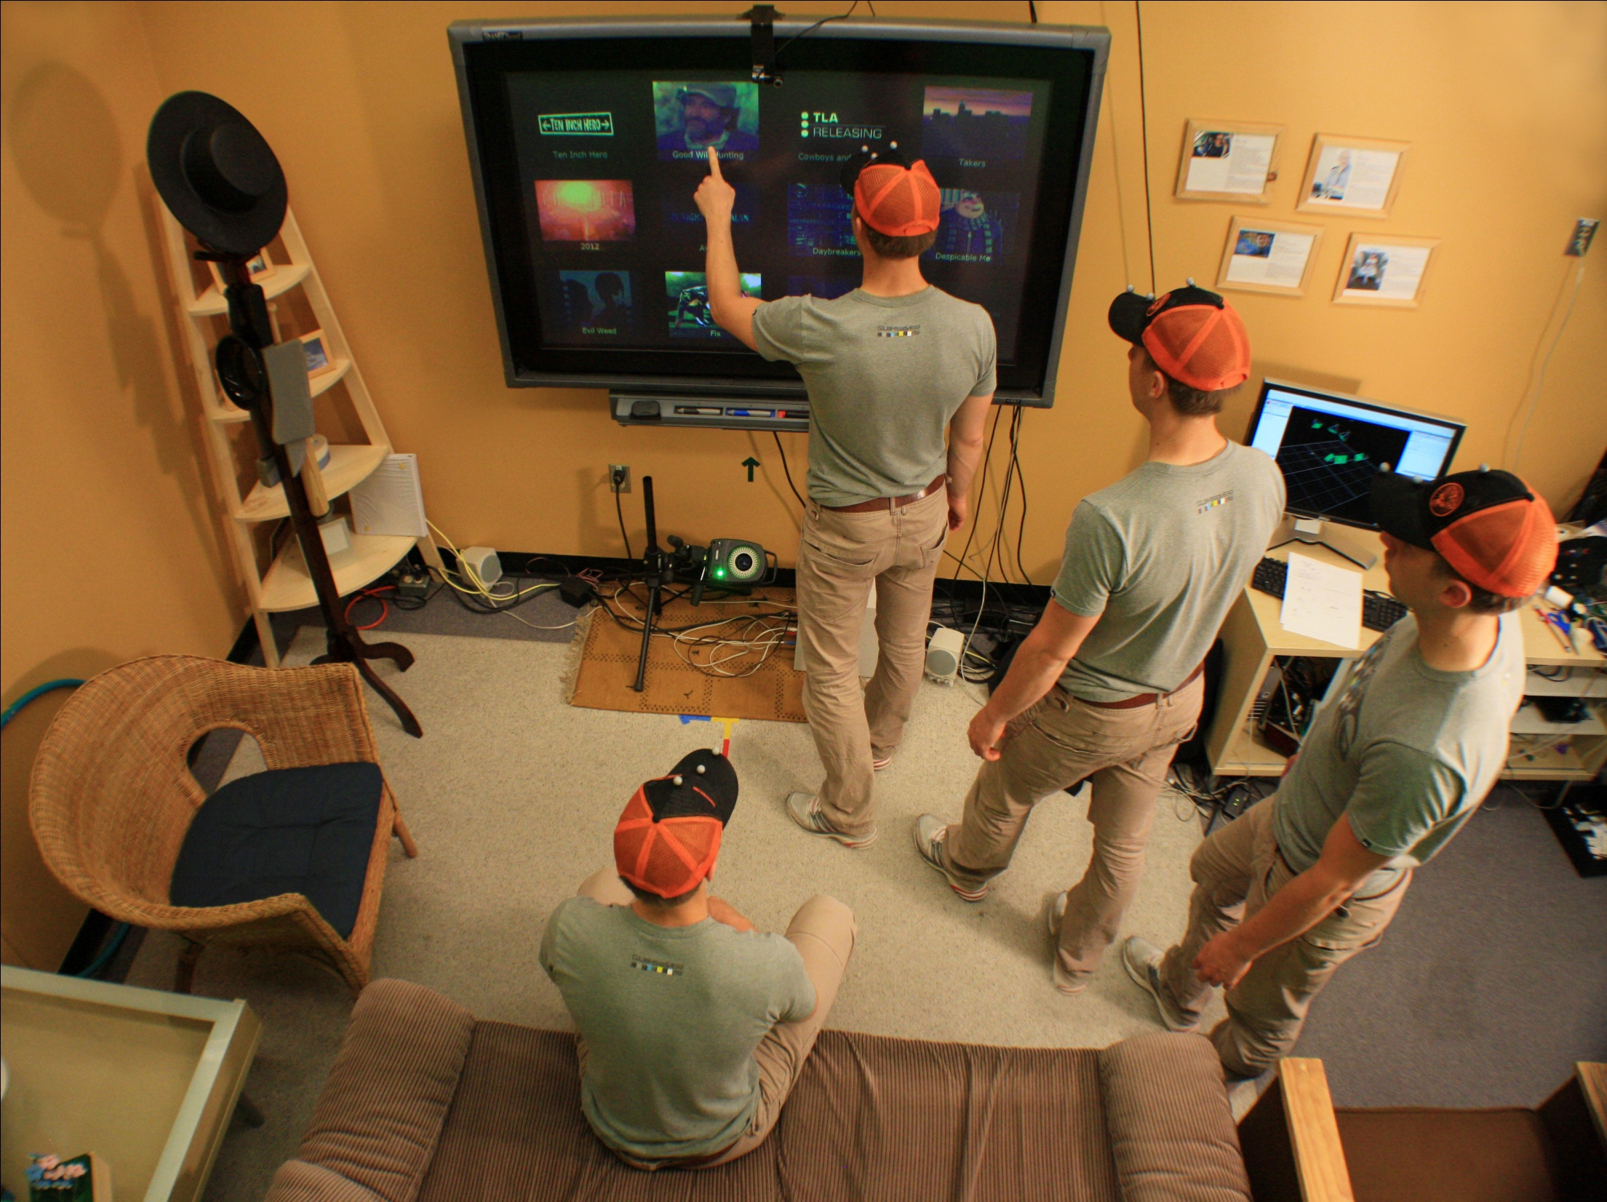
Surface reacts to proximity of a person
Touch
Approach
Enter
Sit
Photo: Till Ballendat, Nic Marquardt
Notes:
What I am going to do now is show you a series of scenes of how our ecology and this proxemic media player reacts to proxemics. I’ll start by showing how the surface reacts to the proximity of a person, how they enter, approach, touch and watch it.

Slide 22

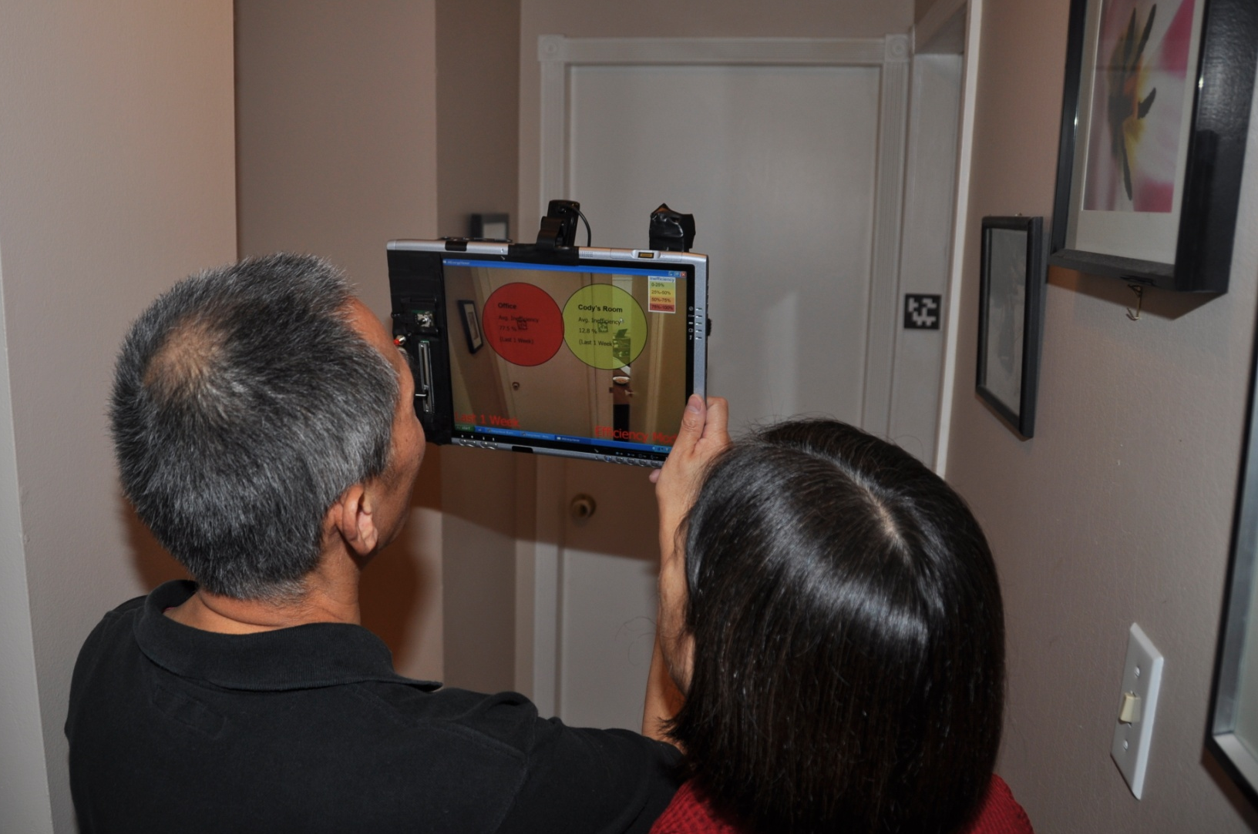
Energy Viewer

Slide 23
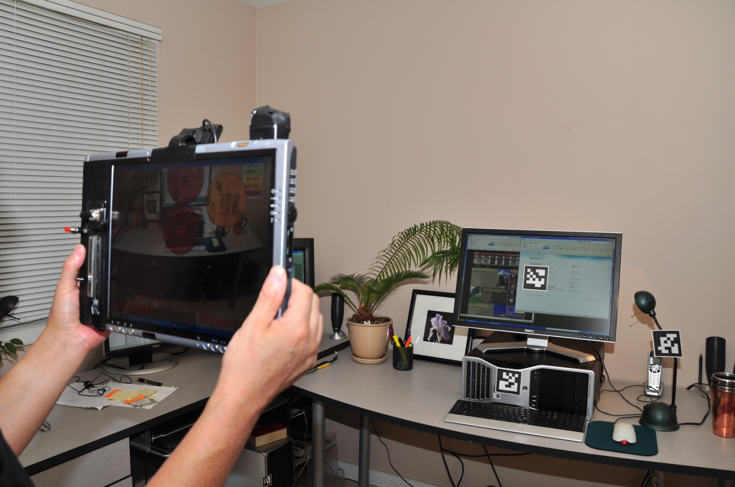

Slide 24
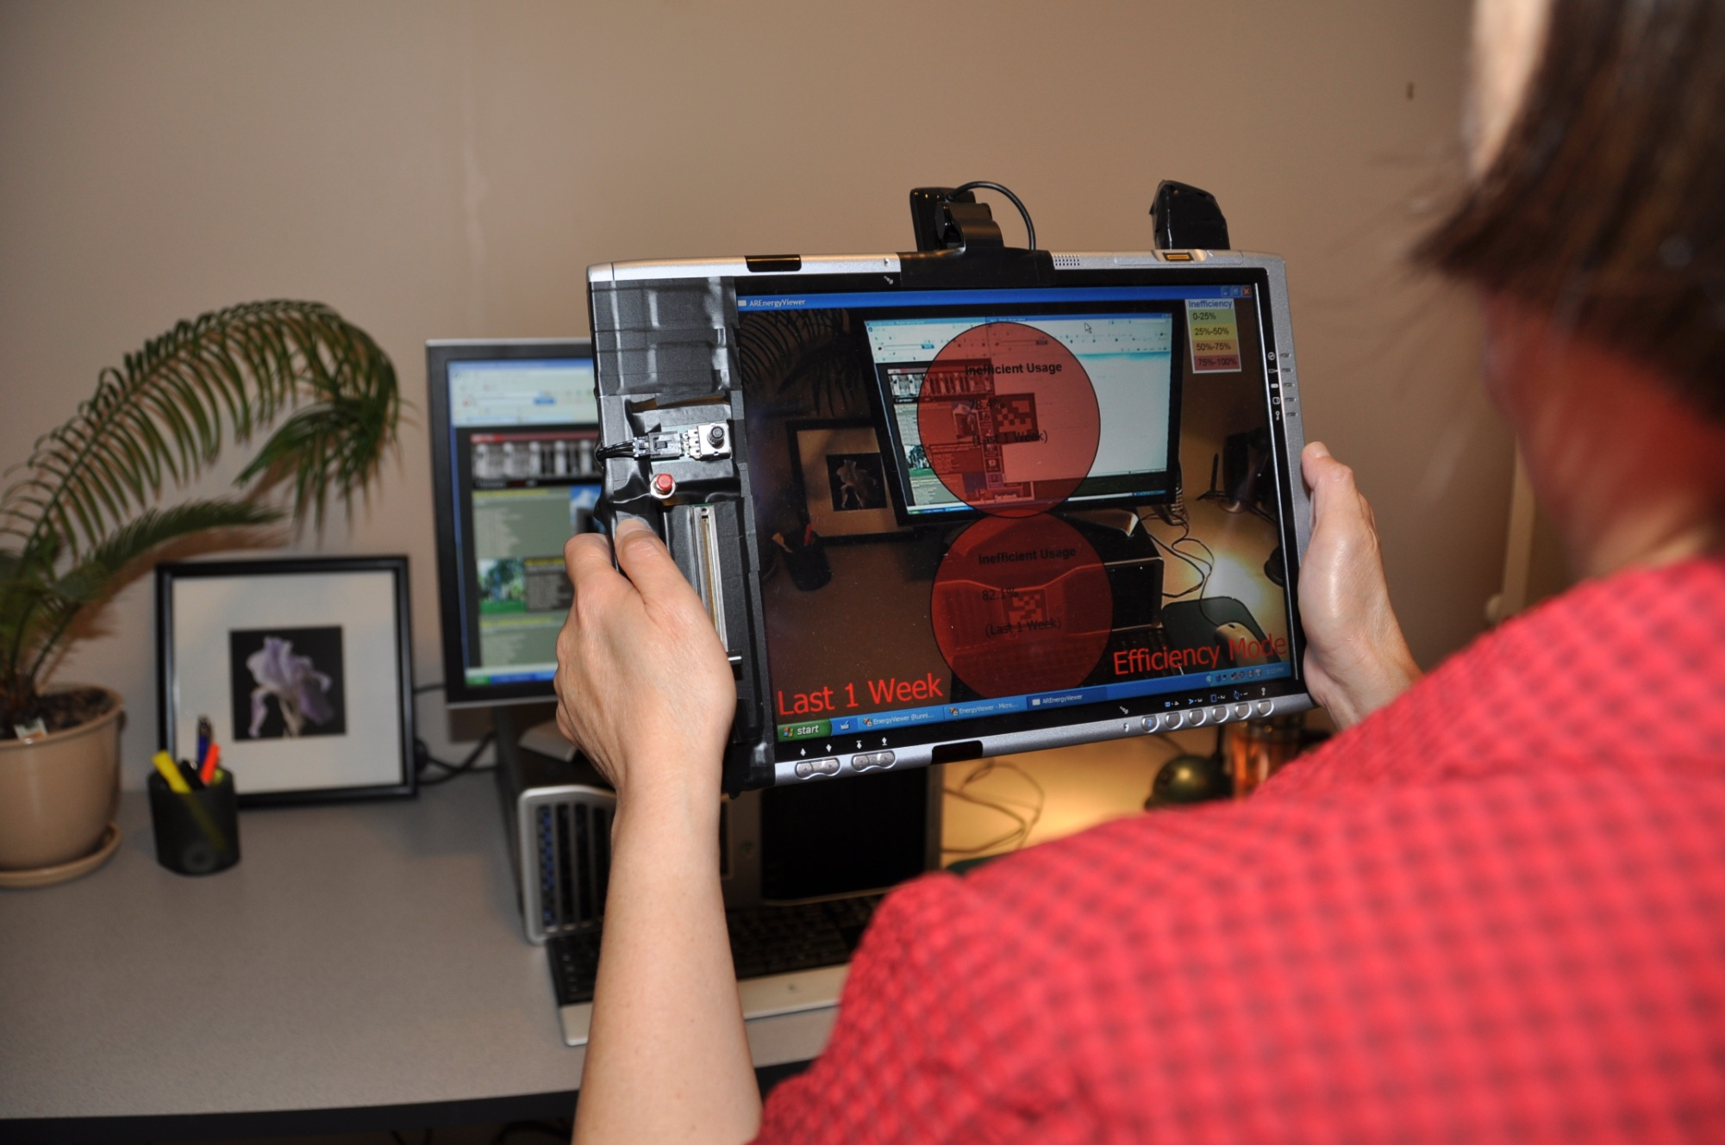

Slide 25
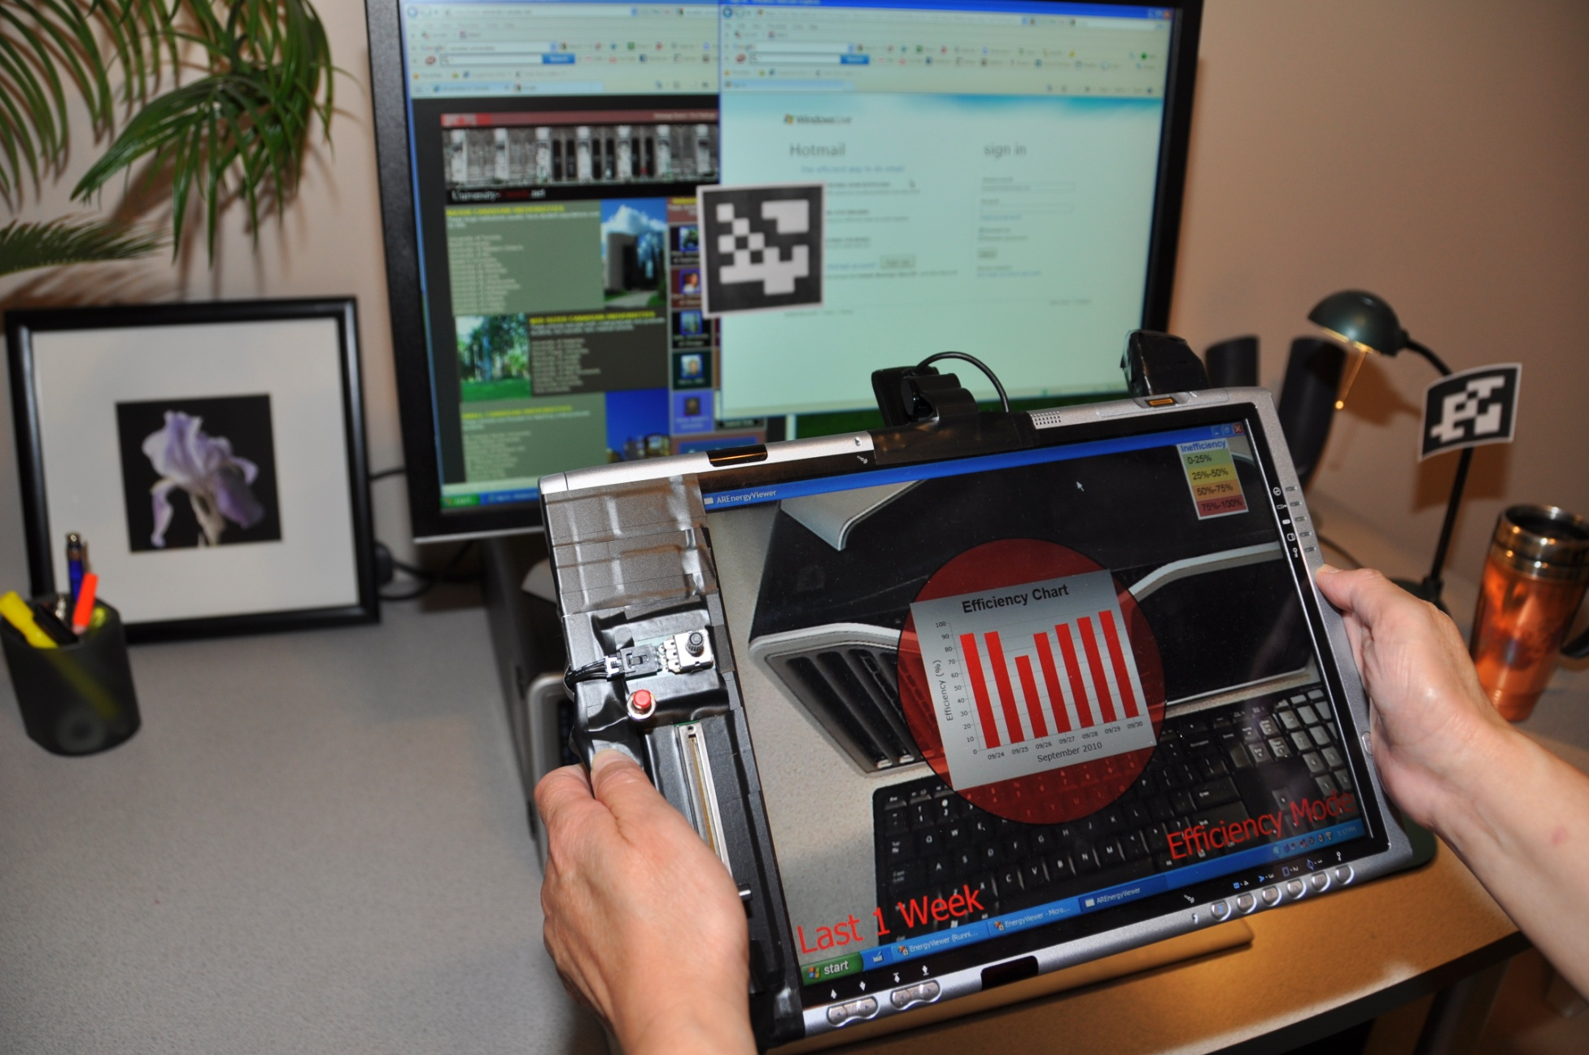

Slide 26
The Proxemics Literature
Social theory -Hall, Sommer, Altman,
Watson...
People to large surfaces –Ju, Vogel, Brignull, Inkpen,
Shoemaker, Walther-Franks...
People to mobiles/desktops –Butler, Harrison, Dey, Kratz,
Smith, Swindells, Inkpen ...
Attentive user interfaces –Vertegaal, Horvitz, Huberman...
Device to device –Gellersen, Hinckley, Ramos,
Holmquist, Merrillm Want ...
Multi-display environments –Rekimoto, Wilson, Streitz,
Hinckley ...
...
Notes:
Very rich literature, starting with social theory.
In HCI, many somewhat isolated efforts apply proxemics to technology. For example,
How people`s proximity to large display surfaces, mobile devices and desktop computers can mediate interaction
how devices react to other devices in their immediate vicinity, including multiple displays
Our own work builds on these

Slide 27
Selected Challenges
High vs. low fidelity vs. limited sensing
Rules of behaviour
HCI of proxemics
Ethical concerns

Slide 28
Potential Essay Topics
What potential effects can you see such advertising have on one of the following:
Social Interactions in Public Spaces
Personal Behaviour
Targeted Advertising

Slide 29
Imagine: A Proxemic Ecology people, surfaces, objects, devices, fixed features
Sketch conception: Nicolai Marquardt
Notes:
Imagine: An ecology of devices with knowledge of proxemics
(distance, orientation and identity)
of nearby people and other devices
How can we exploit this knowledge to design user interfaces for embodied interaction?
I’ve shown you some examples, but this is only the beginning.
And my challenge to you, is to consider what you would do , what you could design, for this future that contains multiple people and interacting devices of all forms.

Slide 30
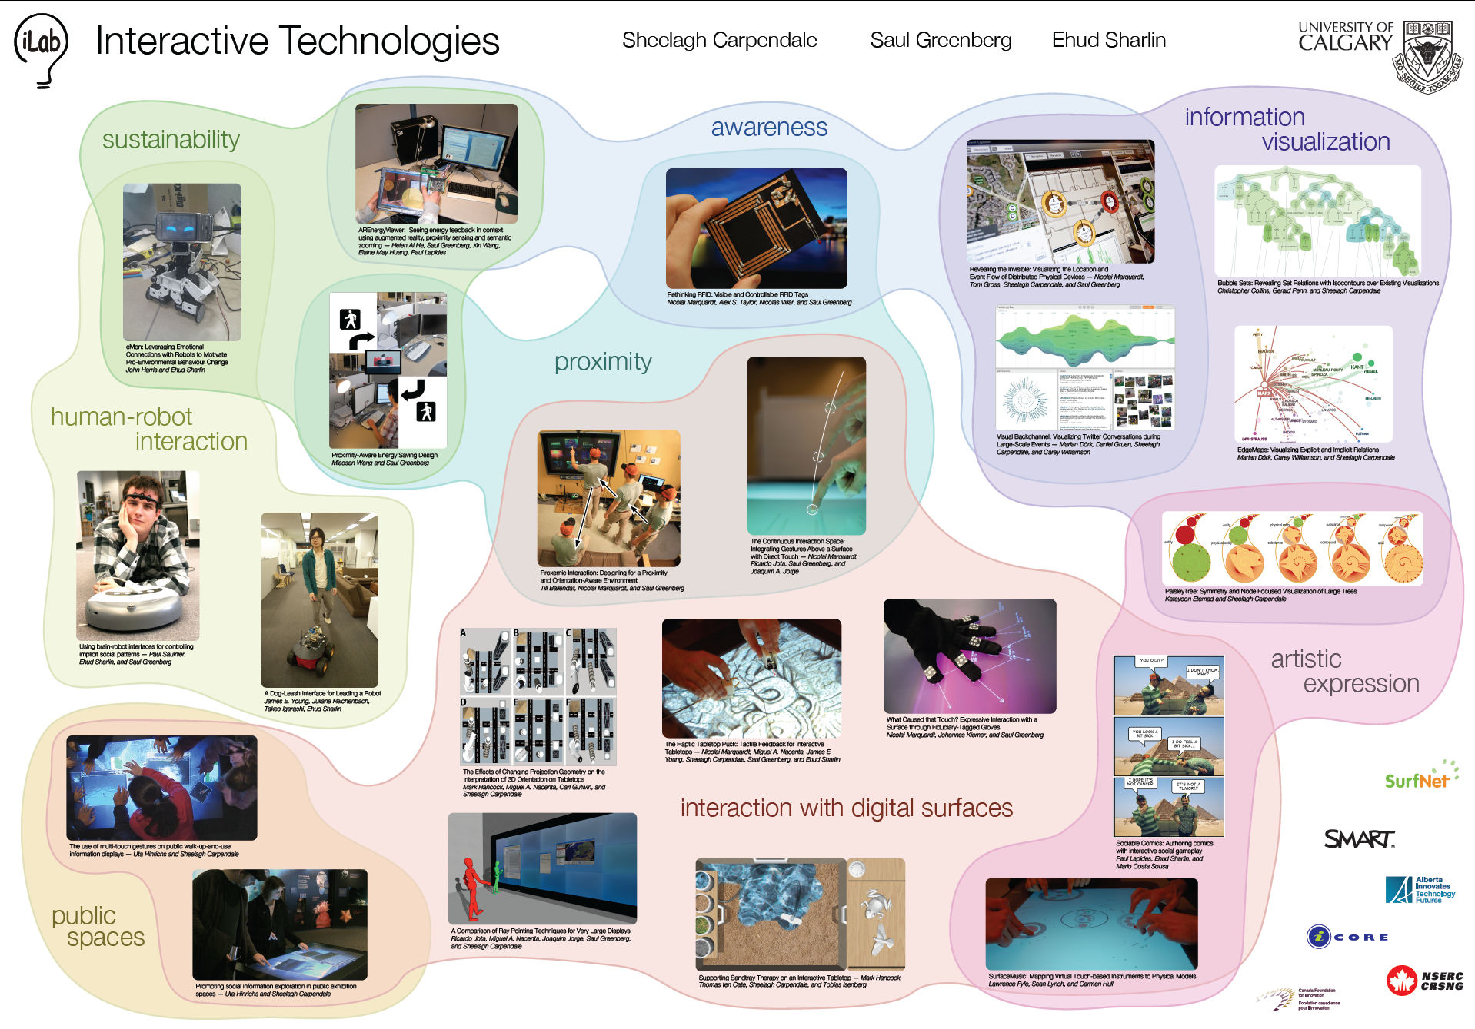
Notes:
I am a faculty member of the Interactions Laboratory, where our team – 4 faculty with about 25+ grads, ras, and postdocs - pursue myriads of projects dealing with interactive technologies including basic HCI, ubicomp, information visualization and human-robot interaction .

