Slide 1
naiveBayesCall
An efficient model-based base-calling algorithm
for high-throughput sequencing
Wei-Chun Kao and Yun S. Song, UC Berkeley
Presented by: Frank Chun Yat Li

Slide 2
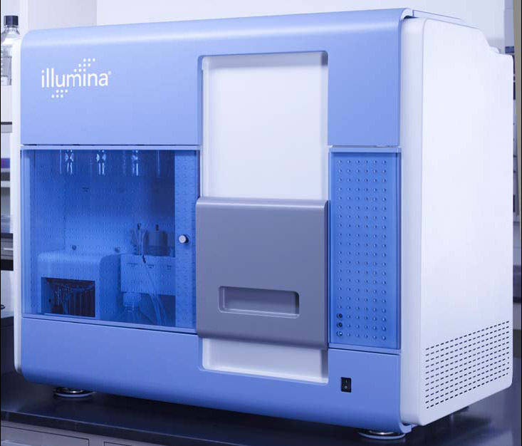
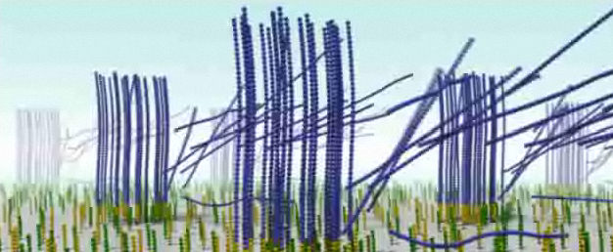
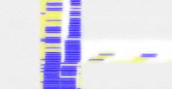
Introduction

Slide 3
Extracting the DNA Sequence
Image Analysis
Translate image data into fluorescence intensity data
Base-calling
From the intensities infer the DNA sequence

Slide 4
Base-calling Algorithms
Bustard
Ships with Illumina’s Genome Analyzer
Very efficient and based on matrix inversion
But error rate very high in the later cycles
Alta-Cyclic
More accurate
But needs large amounts of labelled training data
BayesCall
Most accurate
Little training data
But computation time is very high, not practical

Slide 5
navieBayesCall
Builds upon BayesCall
An order of magnitude faster
Comparable error rate

Slide 6
Review of BayesCall’s Model
L total cycles
e_{i} elementary 4X1 column matrix, eg:
Goal is to produce the sequence of the k^{th} cluster S_{k}
(S_{k}) = (S_{1,k}, … S_{L,k}) with S_{t,k} Є { e_{A}, e_{C}, e_{G}, e_{T} }
S_{k} is initialized to have uniform distribution of e_{i}
If the distribution of the Genome is known S_{k} can initialize to that to improve accuracy

Slide 7
Terminology
Active template density A_{t,k}
Model of the density of the k^{th} cluster that is still active at cycle t
I_{t,k} is a 4 X 1 matrix of the 4 intensities

Slide 8
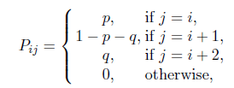
Terminology
Phasing of each DNA strand is modelled by a L X L matrix P, where
p = probability of phasing (no new base is synthesized)
q = probability of prephasing (2 new bases are synthesized instead of 1)
Q_{j,t} is the probability of the template terminating at location j after t cycles
Q_{j,t} = [P^{t}]_{0,j}

Slide 9
Punch Line
From A_{t,k} and Q_{j,t}, we can estimate the concentration of active DNA strands in a cluster at cycle t
Named
See formula (2) in the paper
With , model other residual effects that propagate from one cycle to the next
Named
See formula (3) in the paper
Punch line
Observed fluorescence intensities is a 4D normal distribution

Slide 10
naiveBayesCall
Try to apply the Viterbi algorithm to this domain
Problem 1: high order Markov model because of all the prephasing and phasing effects, so very computationally expensive
Problem 2: the densities A_{k} = (A_{1,k}, … , A_{L,k}) is a series of continuous random variables and the Viterbi algorithm does not handle continuous variables

Slide 11
Problem 1 Solution
If we provide a good initialization of S_{k}, then the algorithm can home in on the solution a lot faster
The authors came up with a hybrid algorithm using modeling in BayesCall and approach in Bustard to come up with the initializations quickly
See section 3.1 in the paper
Problem 2 Solution
A_{t,k} can be estimated using Maximum a Posteriori (MAP) estimation
See forumlaes (10), (11), (12)

Slide 12
naiveBayesCall Algorithm

Slide 13
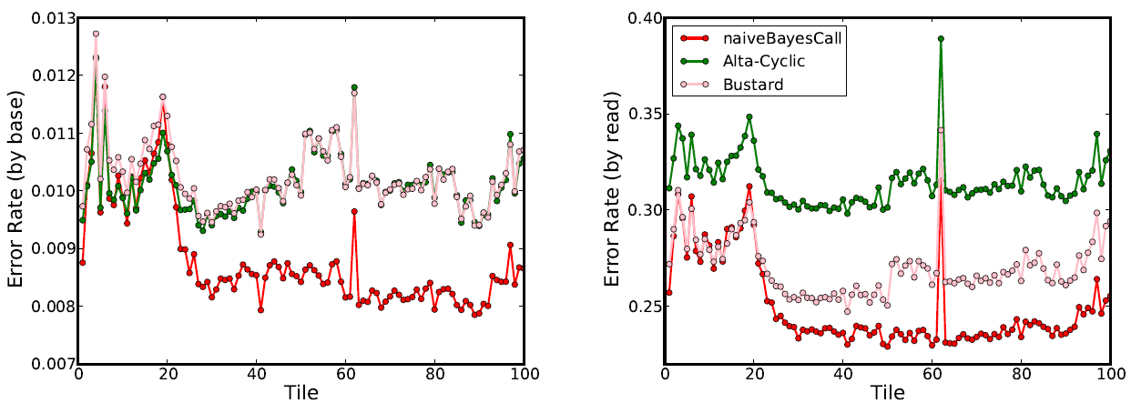
Results
Data came from sequencing PhiX174 virus.
All 4 algorithms were ran against the data (Bustard, Alta-Cyclic, BayesCall, naiveBayesCall)
naiveBayesCall is more accurate from 21+ bp

Slide 14
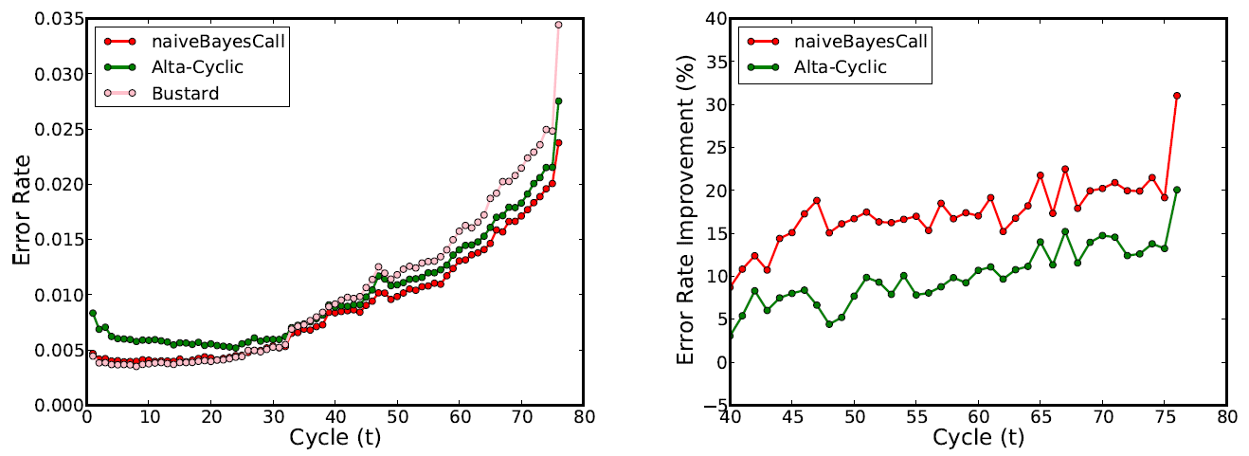
Improvements
naiveBayesCall accuracy is higher than Alta-Cyclic from all cycles
Error rate is also lower than Bustard’s at later cycles

Slide 15
What is the Point?
Each run of the sequencer costs $$
With lower error rate, we can run the sequencer longer and still obtain accurate data
less runs!

