Slide 1
Stegosploit
By Arjun and Brandon
Notes:
Introduce self + topic
Ask if anyone heard of it
New topic in infosec, discovered in 2015 by Saumil Shah

Slide 2
Outline
Terminology
Background
Vulnerability + Exploits
Impact
Mitigation
Notes:
Say Outline
Background = the technical component of stegosploit, relevant information
Impact on real world, developers, users etc
How to stop it or prevent it

Slide 3
What is Steganography?
Comes from the Greek words steganos (to conceal) and graphein (writing)
Hiding a secret message within a medium such as a picture, document or video
How is it different from Cryptography?
Cryptography attempts to hide the meaning of a message
Steganography attempts to hide the entire message in plain sight
Notes:
Comes from the Greek words steganos (to conceal) and graphein (writing)
Hiding a secret message within a medium such as a picture, document or video
How is it different from Cryptography?
TLDR = Hiding in plain sight
Say analogy white ink on white text document vs encoded black ink on white text document

Slide 4
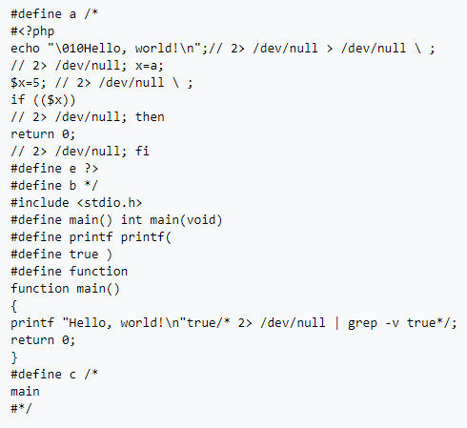
What is a Polyglot?
Two or more data formats in a single container that coexist without breaking each others syntax or specifications
Code written that can be interpreted as C, Bash script, and PHP
Bash returns “\010Hello, world!\n Line 5: a=5: command not found Hello, world!”
PHP returns “#define a /* Hello, world!”
C returns “Hello, world!”
Notes:
Ask class to read and analyze segment of code
Ask if written in C…wait... then PHP… wait…. then Bash
Explain that script can be executed in all those ways and their outputs

Slide 5
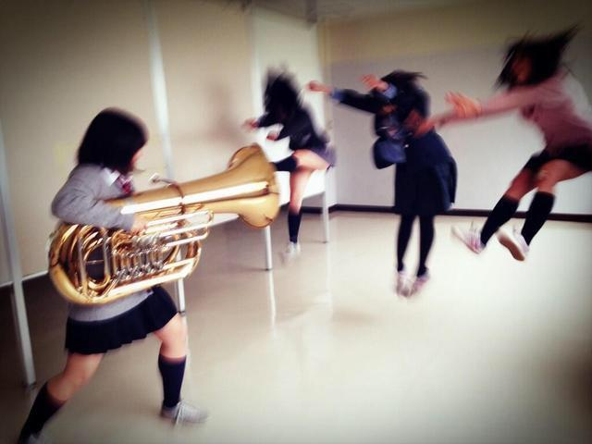
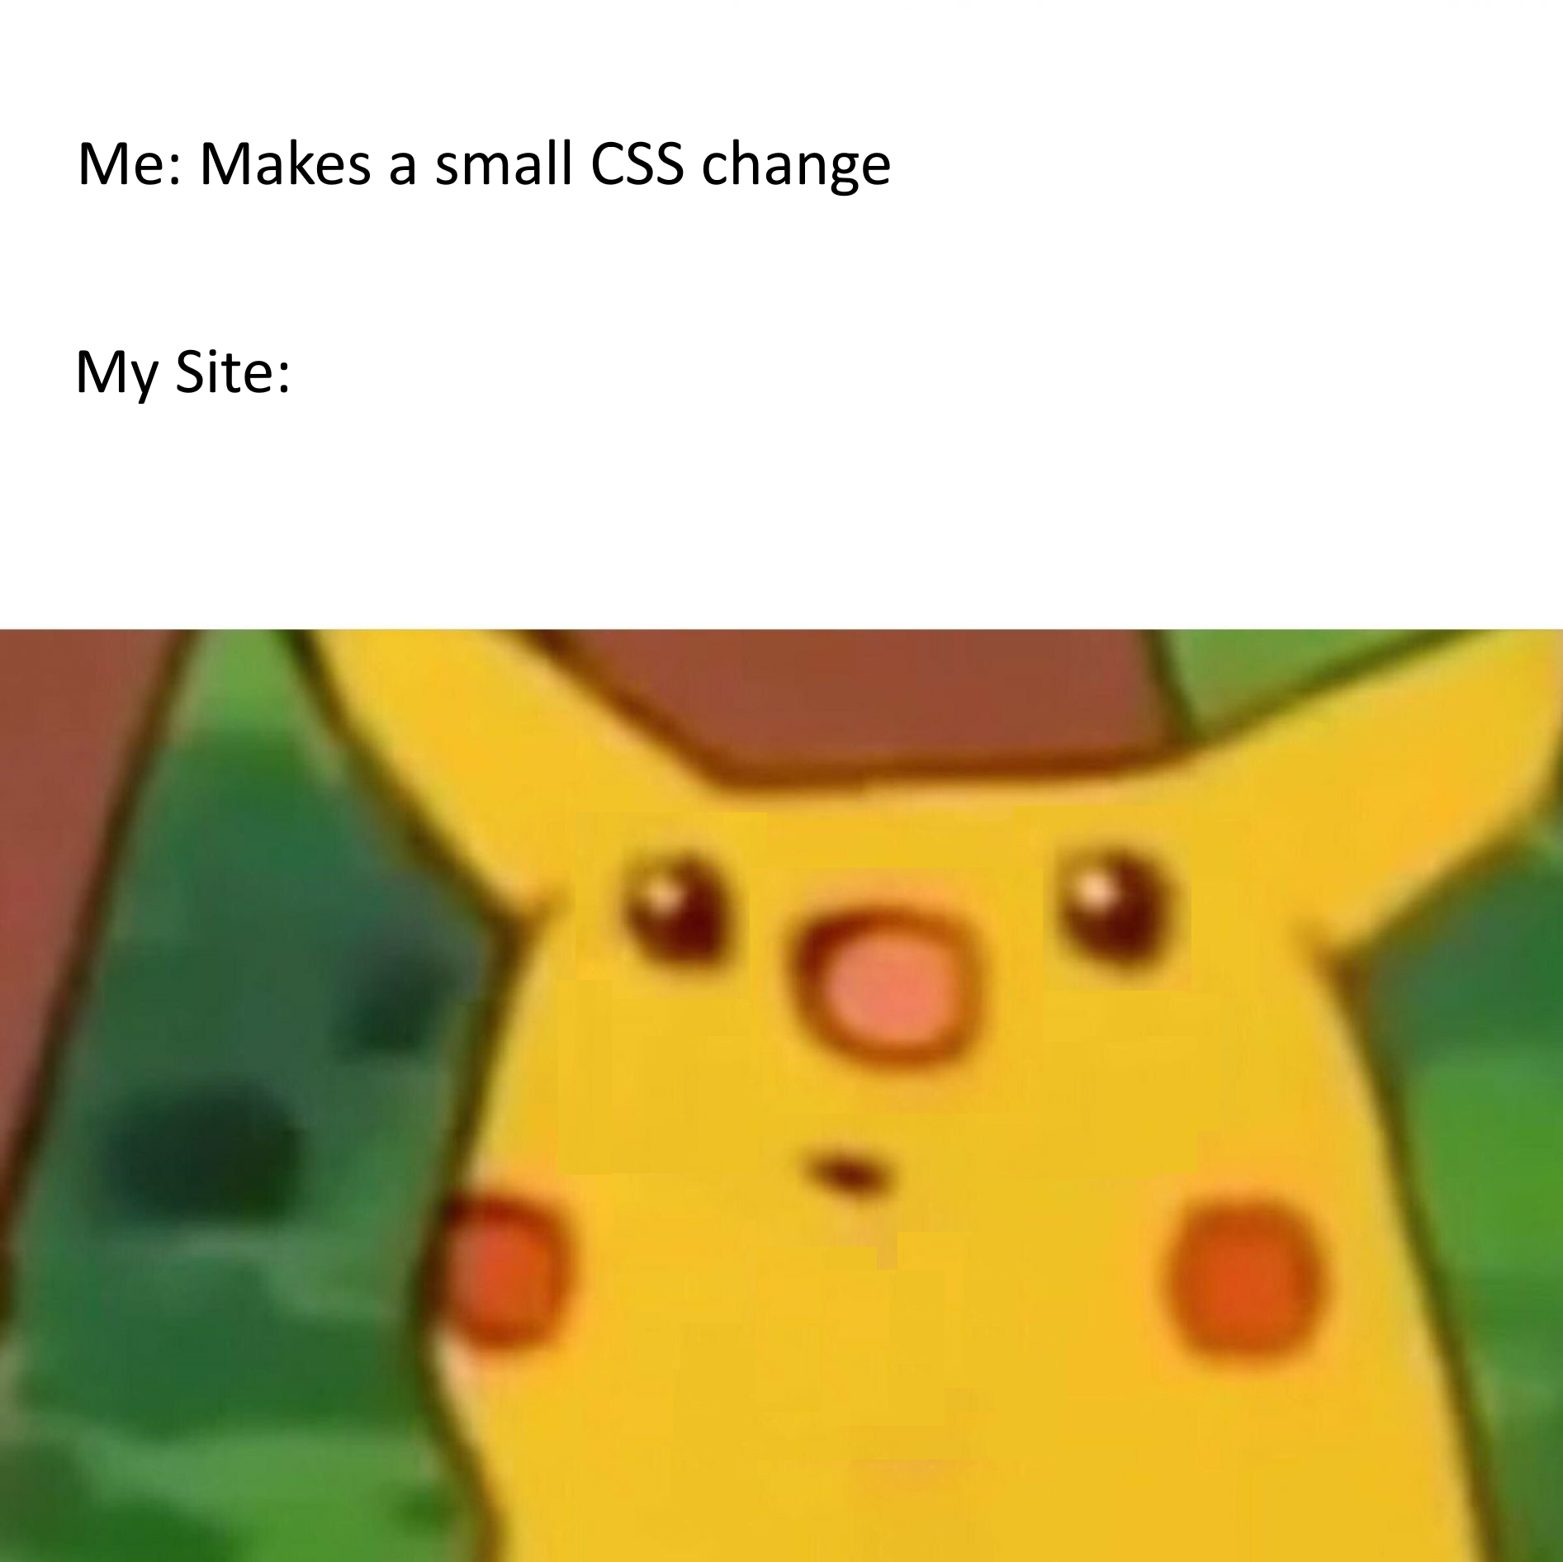
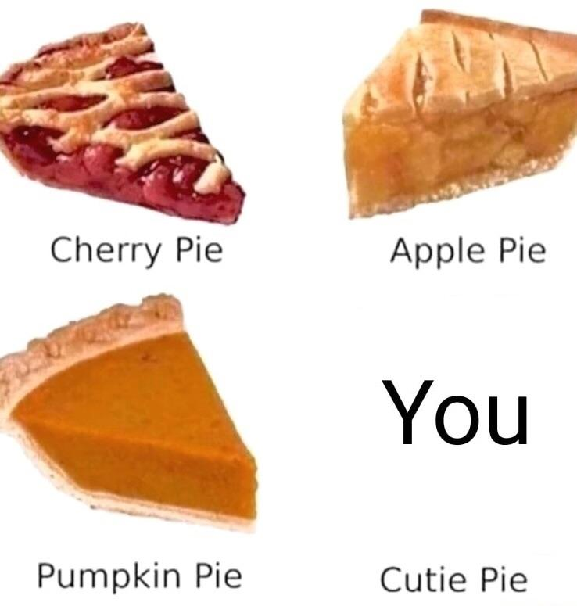
Images are Innocent?
Notes:
Tell story of browsing Reddit
Computer crashing and turns white
Quote appears on computer

Slide 6
“A good exploit is one that’s delivered with style.” - Saumil Shah
Notes:
After researching picture exploits, stumble upon stegosploit

Slide 7
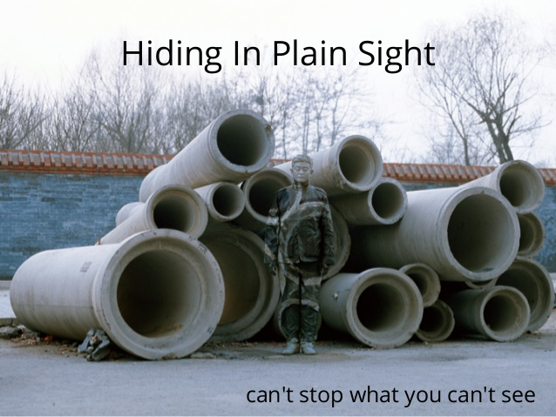

Slide 8
Stegosploit = Steganography + Polyglot
Stegosploit is …
NOT an exploit
NOT an XSS attack or webshell
NOT a manipulation of EXIF data
BUT...
Stegosploit is a way to deliver web browser exploits using pictures.
Notes:
Recall those terms we introduced by quick explain of steganography and polyglot
Stegosploit uses both
Stegosploit is …
NOT an exploit
NOT an XSS attack or webshell
NOT a manipulation of EXIF data
Stegosploit way to deliver web browser exploits with pictures

Slide 9
Stegosploit goals
No extra data sent over the network
The image looks “normal” and not deformed or distorted
The exploit code within should not seen within the image file as a string
The image decodes itself and executes the exploit without ANY user interaction aka “autorun”
Notes:
Make sure you aren’t detected over the network
Users aren’t cautious when they see normal image; no distortion or deformity
Read off slide
User click should be enough

Slide 10
What’s the difference?
<script src=”boy.jpg”></script>
<img src=”boy.jpg”>
Sees and interprets jpg as a bunch of Code
Sees and interprets jpg as a bunch of Pixels
Notes:
Lets look at two different pieces of code. I’ll give you 20-30 seconds
Who thinks that both images will display?
Key point is that the first image is displayed as an image but it is interpreted as code
Second image is displayed as image but is interpreted as pixels

Slide 11
Let’s start the Stegosploit!
Notes:
Brandon asks Arjun

Slide 12
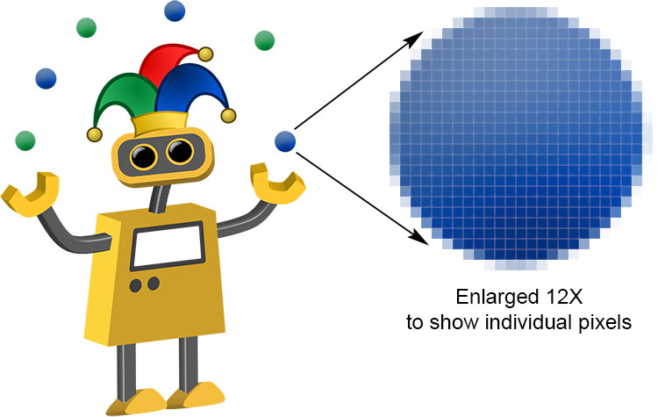
Closer Look at Pixels
Pixel = specific number converted into bits (bitmap) that tell computer what colour the pixel should be
Bitmap = sequence of bits defining the colour of each pixel
More bits = more possible tone of colour
Notes:
Pixel = specific number converted into bits (bitmap) that tell computer what colour the pixel should be
Bitmap = sequence of bits defining the colour of each pixel
More bits = more possible tone of colour

Slide 13
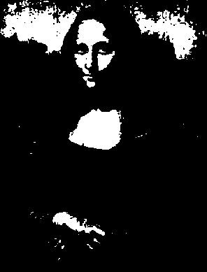
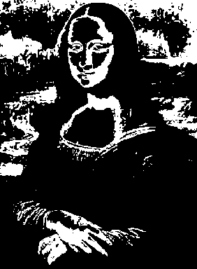
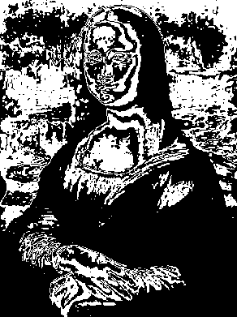
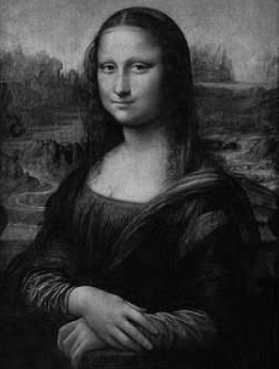
Closer Look at Pixels
Images are a composition of bits and made with a bitmap
Top left bit (Bit 7) = More Shape, Less Detail
Bottom Right Bit (Bit 0)= More Detail, Less Shape
Notes:
Images are a composition of bits and made with a bitmap
Top left bit (Bit 7) = More Shape, Less Detail
Bottom Right Bit (Bit 0)= More Detail, Less Shape

Slide 14
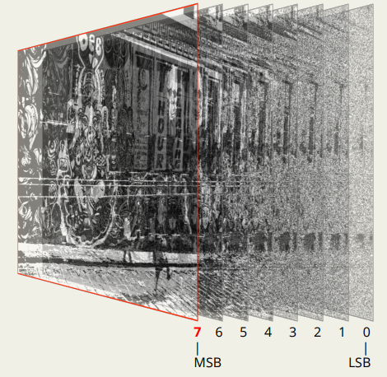
Encoding Exploit Code
Exploit code converted to bitstream
Pixel bits of layer *your choice* are overwritten with exploit bitstream
Notes:
Exploit code converted to bitstream
Pixel bits of layer *your choice* are overwritten with exploit bitstream

Slide 15
DEMO #1: Encoding Exploit into pixel data of JPG and PNG
Notes:
cd /mnt/d/University\ Year\ 4/CSC427/stegosploit/stegosploit/
python -m SimpleHTTPServer 8001
# OPEN image_layer_analysis.html
# Load in monaLisa.png
# OPEN iterative_encoding.html

Slide 16
PNG Encoding vs JPG Encoding
PNG = Lossless compression
Picture Is saved at best quality with all pixels intact
Only need to encode it with exploit once
JPG = Lossy Compression, meaning quality of pic is reduced
Pixels are approximated to nearest neighbours
JPG Exploit Fix…. Iterative Encoding!
Lets just keep on encoding the image until our exploit code sticks and is not messed up by the nearest neighbours loss
Notes:
PNG = Lossless compression
Picture Is saved at best quality with all pixels intact
Only need to encode it with exploit once
JPG = Lossy Compression, meaning quality of pic is reduced
Pixels are approximated to nearest neighbours
JPG Exploit Fix…. Iterative Encoding!

Slide 17
But wait how do we decode?!?

Slide 18
HTML5 Canvas to the Rescue!
Read image pixel data using JS
In-Browser decoding of steganographically encoded images
Rebuild JS exploit code from pixel data, in memory
Simple array and bit manipulation operations
Notes:
Read image pixel data using JS
In-Browser decoding of steganographically encoded images
Rebuild JS exploit code from pixel data, in memory
Simple array and bit manipulation operations

Slide 19
IMAJs = Images + Javascript
We can make polyglot pictures by encoding them with Javascript or Actionscript code
By taking advantage of that vulnerability, we are able to deliver exploits via images like bmp, jpeg, and png’s
First coined by Saumil Shah at SyScan 2015, Singapore
Notes:
We can make polyglot pictures by encoding them with Javascript or Actionscript code
By taking advantage of that vulnerability, we are able to deliver exploits via images like bmp, jpeg, and png’s
First coined by Saumil Shah at SyScan 2015, Singapore

Slide 20
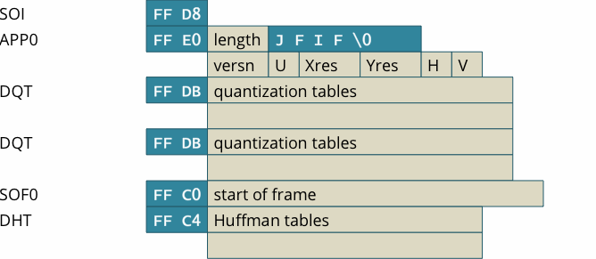
JPG/PNG Headers
A JPG is composed of many different headers
Interested in how we can put our decoder code into JPG
JPG will decode the exploit and run it!
Notes:
Explain JPG headers
Talk about length attribute in APP0 header
Talk about null values after increasing length
A JPG is composed of many different headers
Interested in how we can put our decoder code into JPG
JPG will decode the exploit and run it!

Slide 21
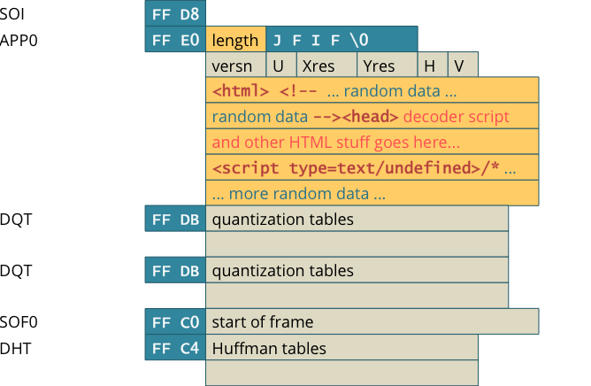
Lets Just Change the Length and Add Our Code!
Notes:
Change length
Add our decoder code to it
We have a polyglot! Can be seen as image or run as code

Slide 22
Demo 2: Decoding, creating Polyglot and Running Exploit
Notes:
# Show polyglot.png in notepad; have word wrap on in format
#./imajs/html_in_png.pl exploits/decoder_cve_2014_0282.html ./alert.PNG alert1.png
# Run Exploit via python pythonServer.py
# Click polyglot.png to show exploit works

Slide 23
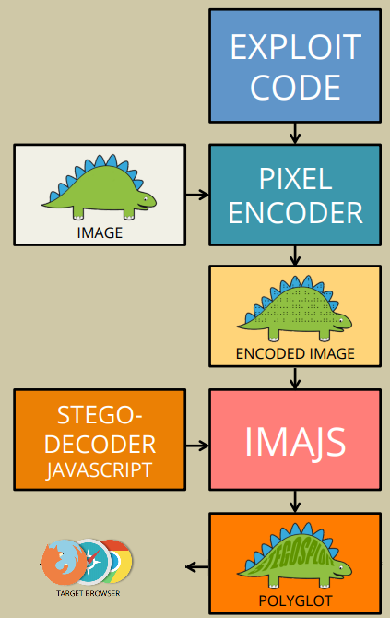
Putting it all Together
STEP 1) Have some exploit code you want to run and any image of your choice
STEP 2) Encode the code into the image. Using Steganography!
STEP 3) Turn encoded exploit image into a polyglot by changing image headers length + add decoder code
STEP 4) Send the polyglot image through the network then into the browser. Make sure that you are only sending the image data and no extra “baggage”!
STEP 5) Have the image load into the vulnerable browser
STEP 6) Image now decodes itself and is executed as javascript
STEP 7) $$$
Notes:
STEP 1) Have some exploit code you want to run and any image of your choice
STEP 2) Encode the code into the image. Using Steganography!
STEP 3) Turn encoded exploit image into a polyglot by changing image headers length + add decoder code
STEP 4) Send the polyglot image through the network then into the browser. Make sure that you are only sending the image data and no extra “baggage”!
STEP 5) Have the image load into the vulnerable browser
STEP 6) Image now decodes itself and is executed as javascript
STEP 7) $$$

Slide 24
Reaching the target browser
As an attacker, we have the following options for sending the HTML+Image polyglot to the victim's browser:
Host the image on an attacker controlled web server and send its URL link to the victim.
Host the entire exploit on a URL shortener.
Upload the image on 3rd party websites and provide direct links.
Notes:
As an attacker, we have the following options for sending the HTML+Image polyglot to the victim's browser:
Host the image on an attacker controlled web server and send its URL link to the victim.
Host the entire exploit on a URL shortener.
Upload the image on 3rd party websites and provide direct links.

Slide 25
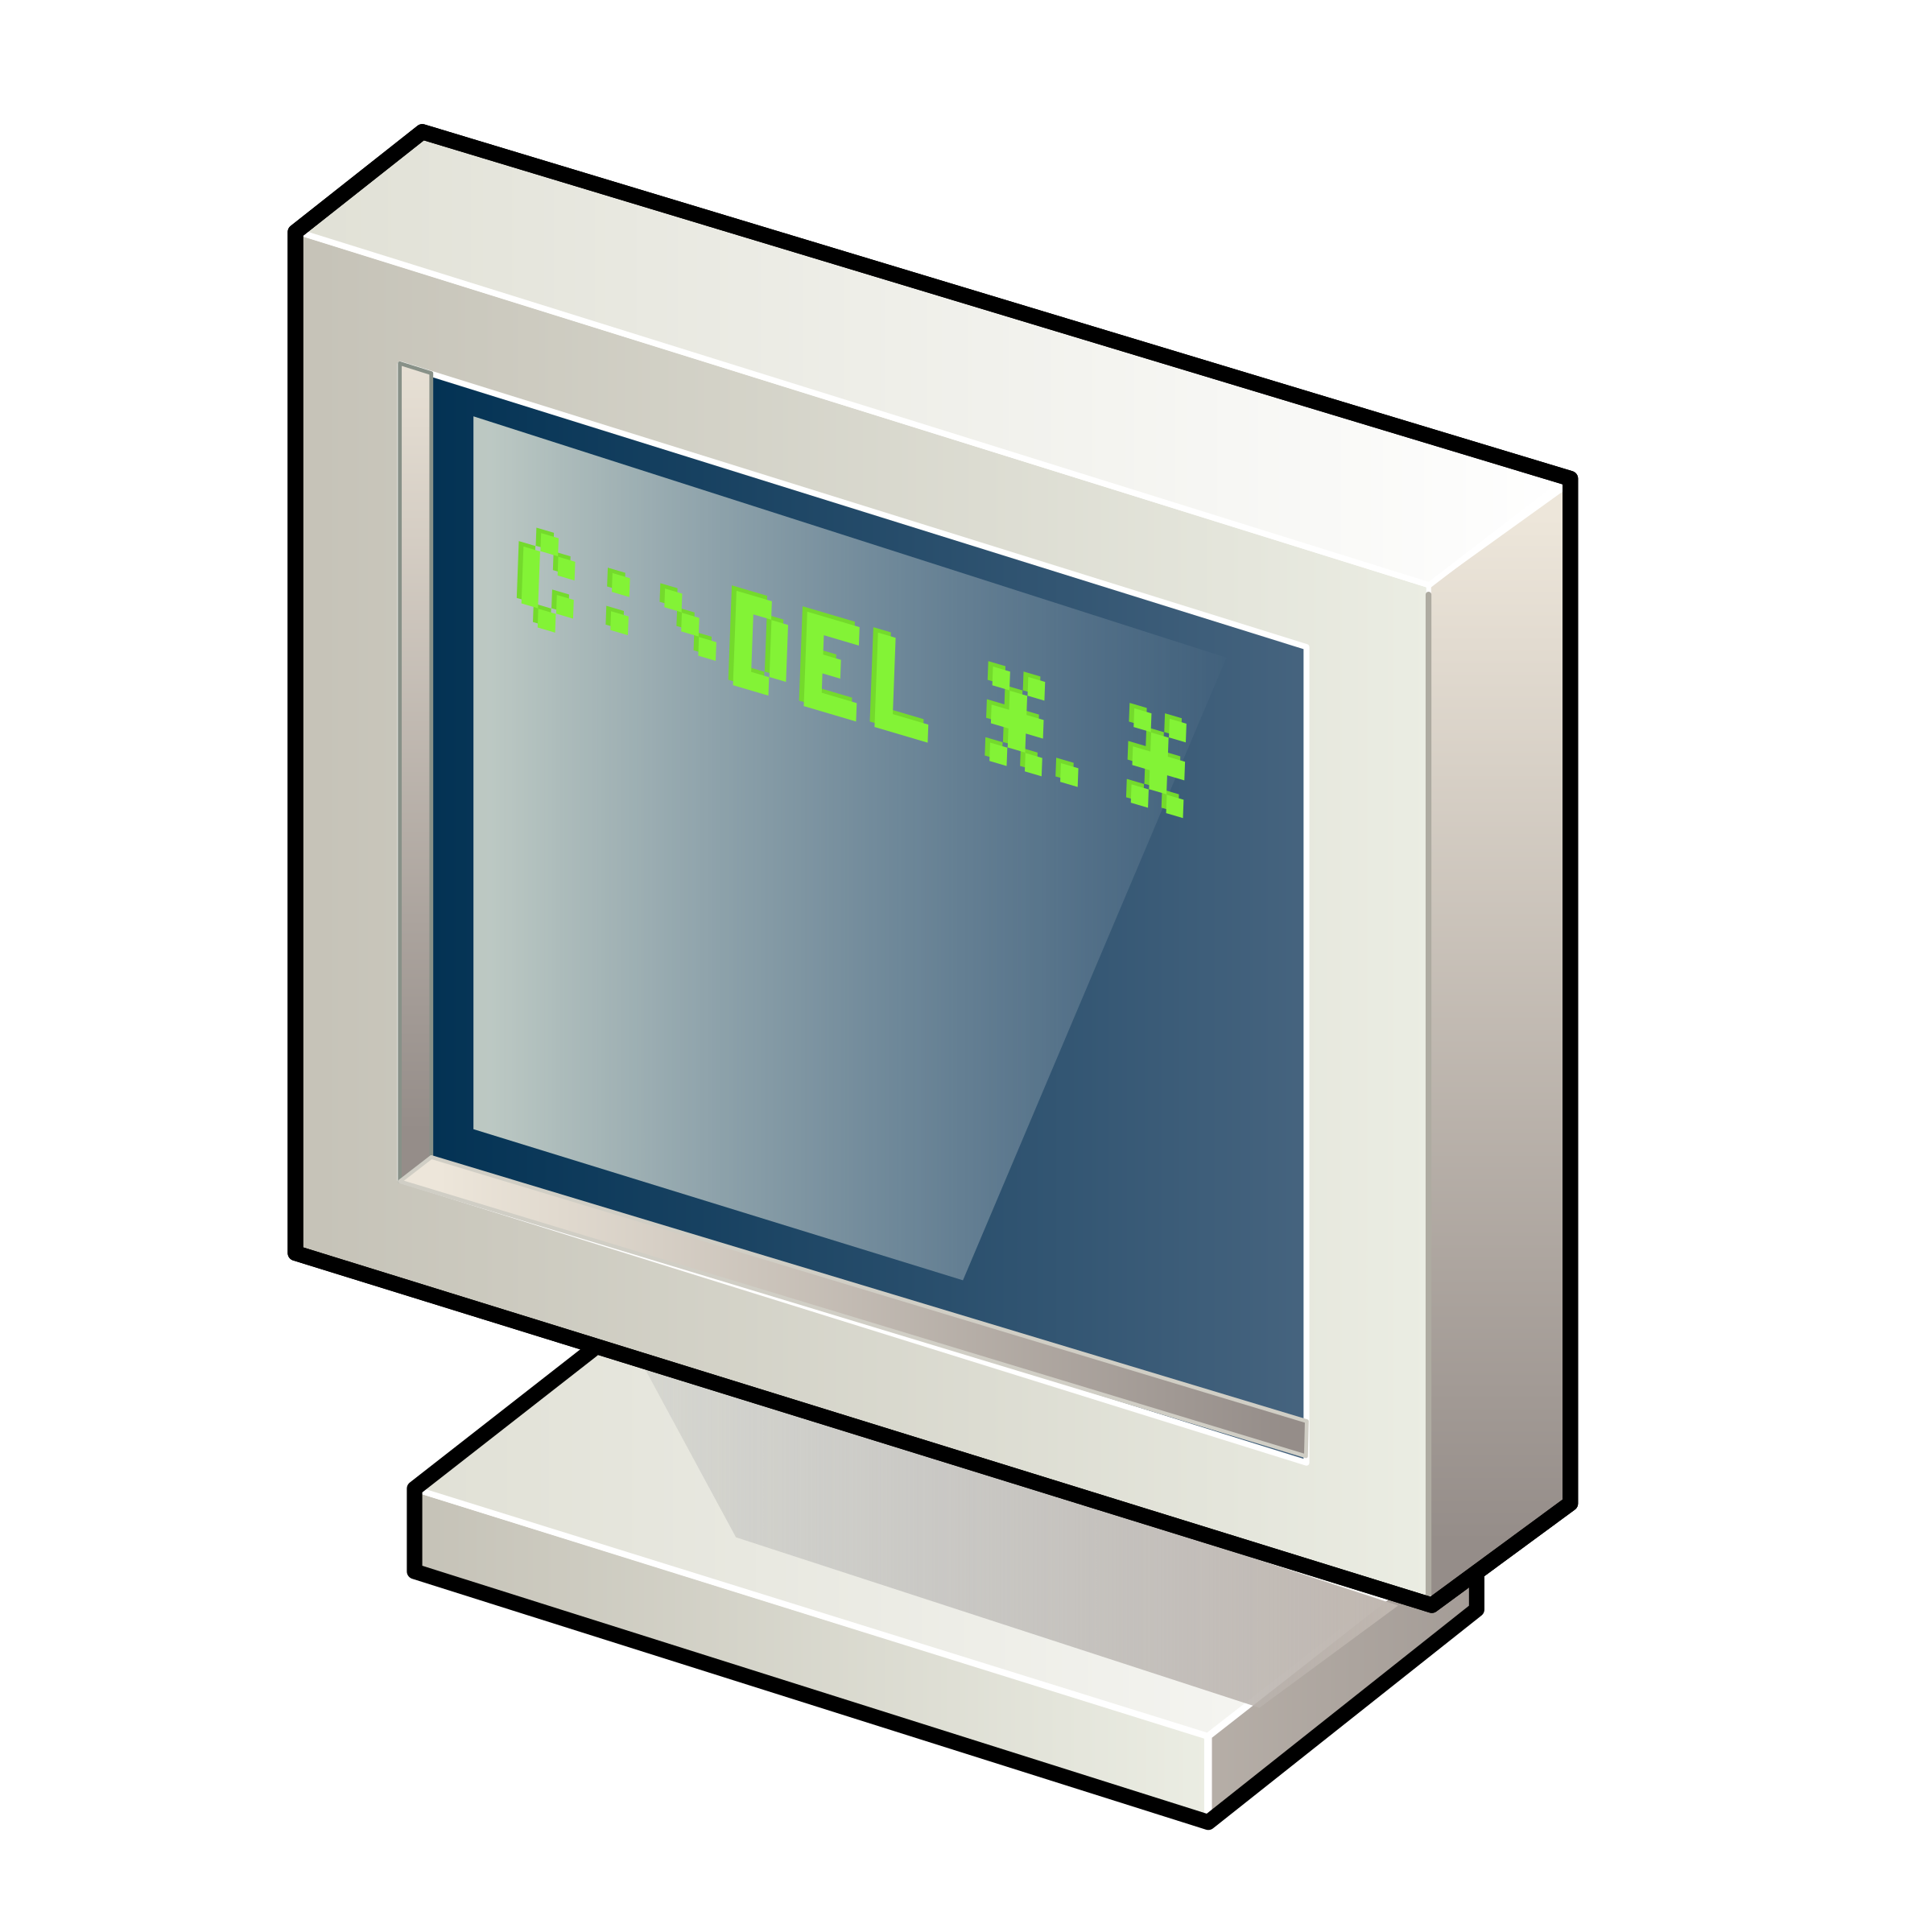
Real World Impact
As of now, there are no reports of Stegosploit affecting anyone at a large scale
Fair new and undiscovered potential
Current implementation of Stegosploit is difficult to use
A lot of things need to align for Stegosploit to work!
Target website needs to allow images to be uploaded by users
The website does not corrupt the data inside the image
The website loads the uncorrupted image uploaded by user
Different browsers read images differently
Notes:
Current implementation of Stegosploit is difficult to use
A lot of things need to align for Stegosploit to work!
Target website needs to allow images to be uploaded by users
The website does not corrupt the data inside the image
The website loads the uncorrupted image uploaded by user
Different browsers read images differently

Slide 26
Potential Exploits Run with Stegosploit
Firefox 3.5 Font Tags Buffer Overflow (CVE-2009-2478)
Exploit: https://www.exploit-db.com/exploits/9137/
Heap spray vulnerability
Remote code execution
This exploit tries to run shell
Microsoft Internet Explorer 8/9/10 - 'CInput' Use-After-Free Crash
Exploit: https://www.exploit-db.com/exploits/33860
Use after Free crash vulnerability
The use of heap allocated memory after it has been freed or deleted leads to undefined system behavior

Slide 27
Demo 3: The True Power of Stegosploit
Full Demo by Saumil Shah - displaying the full potential of Stegosploit
https://youtu.be/6lYUtIZHlJA?t=1815 (30:15 - 37:15)
Notes:
34:30 - 37:15 if no time

Slide 28
Mitigation
Detection can be difficult since Stegosploit is a new vector for attacking
Anti-viruses need to analyze images / videos outside of the normal means of detection
Sanitize user input: Change file formats from JPG to PNG then back to JPG
This lowers the quality of image
Damages potential steganographic contents
Resize the image
Same idea!
Is the original size of image / video smaller than the image provided
Malicious code, be careful!
Re-encode the whole image! (Best Solution)
Notes:
Detection can be difficult since Stegosploit is a new vector for attacking
Anti-viruses need to analyze images / videos outside of the normal means of detection
Sanitize user input: Change file formats from JPG to PNG then back to JPG
This lowers the quality of image
Damages potential steganographic contents
Resize the image
Same idea!
Is the original size of image / video smaller than the image provided
Malicious code, be careful!
Re-encode the whole image! (Best Solution)
New vector of attacking; images are deemed innocent as default
Anti viruses can’t just use static behaviour analysis, maybe dynamic behaviour analysis? Too much resources though

Slide 29
Mitigation - Browsers, W3C and Users
W3C need to be strict like compilers
For example, if you miss a semicolon, the compiler says too bad!
Browsers on the other hand... Don’t just ignore improper syntax!!
Browsers need to reject things that do not follow strict standards
As a user, avoid going on unsecure websites
Have an updated browser that has MIME type checking
Notes:
W3C need to be strict like compilers
For example, if you miss a semicolon, the compiler says too bad!
Browsers on the other hand... Don’t just ignore improper syntax!!
Browsers need to reject things that do not follow strict standards
As a user, avoid going on unsecure websites
Have an updated browser that has MIME type checking

Slide 30
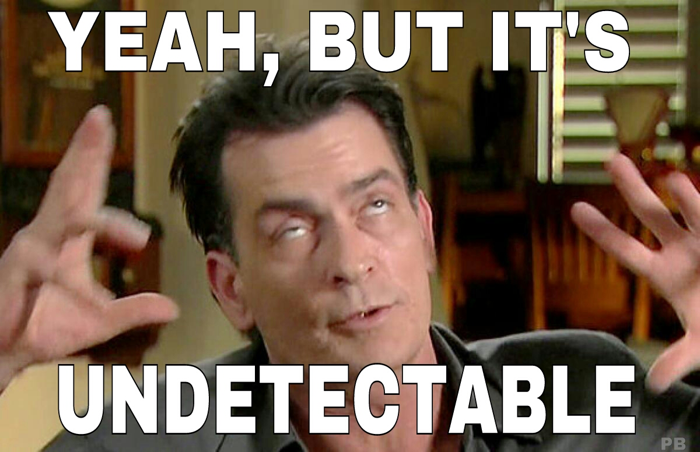
On the Bright Side
Many of the main websites reencode images
This helps prevent any Stegosploit since it corrupts the data
Websites like Google, FaceBook, and Twitter all reencode of the images
Notes:
Never trust the user, big companies already know this, so sanitize user input and reencode images from users

Slide 31
References
http://stegosploit.info/
https://www.alchemistowl.org/pocorgtfo/pocorgtfo08.pdft
https://youtu.be/np0mPy-EHII
https://www.sans.org/reading-room/whitepapers/stenganography/steganalysis-detecting-hidden-information-computer-forensic-analysis-1014
https://www.blackhat.com/docs/eu-15/materials/eu-15-Shah-Stegosploit-Exploit-Delivery-With-Steganography-And-Polyglots.pdf
https://www.slideshare.net/saumilshah/stegosploit-hacking-with-pictures
https://www.youtube.com/watch?v=6lYUtIZHlJA

Slide 32
Questions?

