Slide 1
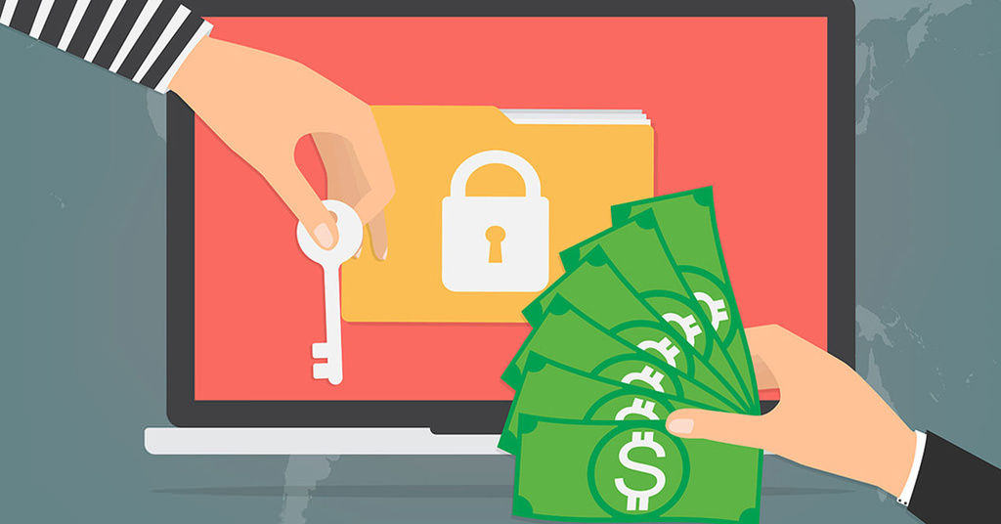
Ransomware
Bryan & Zuhair

Slide 2
What Is Ransomware?
Ransomware is a type of malicious software that threatens to publish the victim's data or perpetually block access to it unless a ransom is paid

Slide 3
Stats
80 million ransomware attacks in first six months of 2018 - SonicWall Cyber Threat Report 2018
More than 200% increase since same period in 2017
CryptoWall extorted $18 m
CryptoLocker extorted $30m
Notes:
https://www.helpnetsecurity.com/2018/07/11/2018-sonicwall-cyber-threat-report/

Slide 4
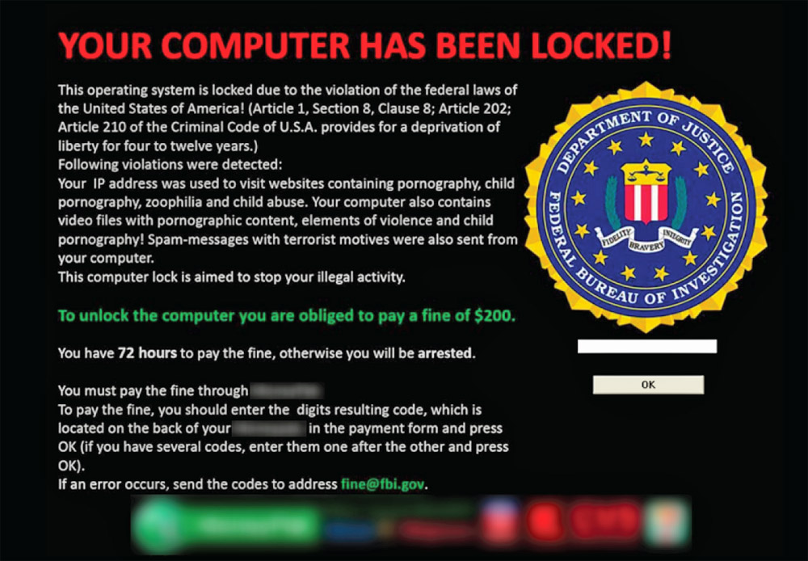

Slide 5
How Does It Work?

Slide 6
Origin
First know extortion malware attack was AIDS Trojan in 1989, created by evolutionary biologist Dr. Joseph Popp
Hid files on hard drive and encrypted their names
The user was asked to pay $189 to "PC Cyborg Corporation" in order to obtain a repair tool
Not designed very well, decryption key could be extracted from the code of the Trojan

Slide 7
Origin
Concept of encrypting ransomware introduced by Young and Yung at Columbia University.
Critiqued AIDS reliance on symmetric crypto alone.
Hypothesized the notion of electronic money.
Demoed hybrid encryption on a Macintosh SE/30
American Cryptographer Moti Yung

Slide 8
Origin
Examples of extortionate ransomware became prominent in May 2005
By mid-2006, Trojans began utilizing more sophisticated RSA encryption schemes, with ever-increasing key-sizes.
Gpcode
TROJ.RANSOM.A
Archiveus
Krotten
Cryzip
MayArchive
Encrypting ransomware returned to prominence in late 2013 with the propagation of CryptoLocker

Slide 9
Types of Ransomware
Scareware
Leakware
Encrypting Ransomware

Slide 10
ScareWare
Malware that claims to cause or have caused harm to the user/computer, but does not
In July 2013, a 21 year old man whose computer coincidentally did contain illegal content, turned himself in

Slide 11
Leakware
Threatens to publish stolen information from the victim's computer system

Slide 12
Encrypting Ransomware

Slide 13
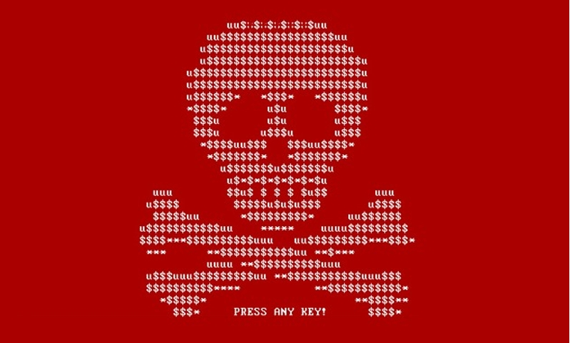
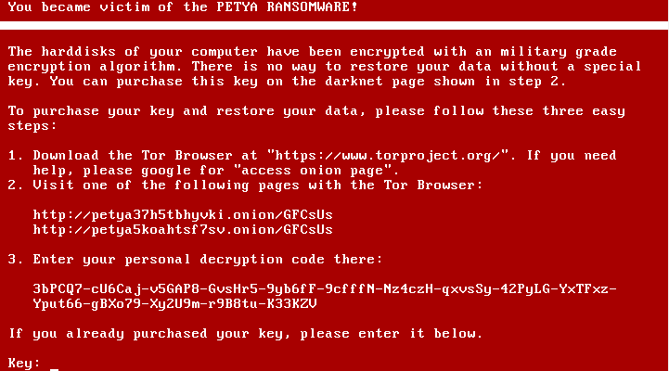
Petya
Originally spread as PDF email attachment
Infected the Master Boot Record (MBR) and encrypted the Master File Table (MFT)
Did not encrypt the files themselves.
If Petya did not get Administration Rights, it loaded Mischa, another cryptovirus to encrypt user files and executables.
A Variant known as “NotPetya” launched a cyber attack in June 2017
It caused a reported over $10 Billion in damages

Slide 14
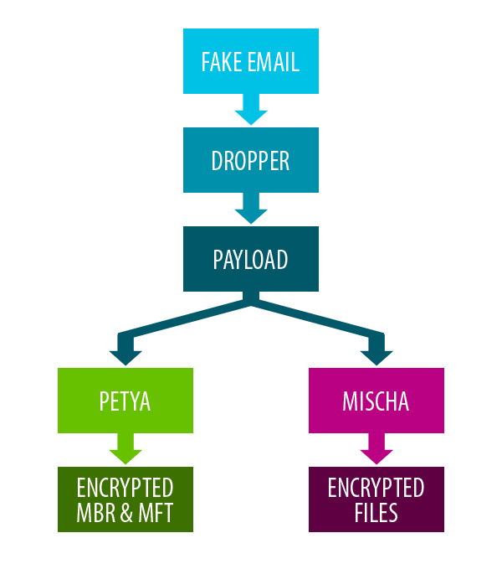
DECISION TREE: PETYA
Attack Vector: Fake PDF email attachment
When executed the dropper XORs the payload, setup.dll
The Payload checks if it has admin rights
If it has admin rights it runs Petya
Petya modifies the MBR and forces a reboot. Then Encrypts the MFT
If not it runs Mischa
Mischa begins to encrypt your files

Slide 15
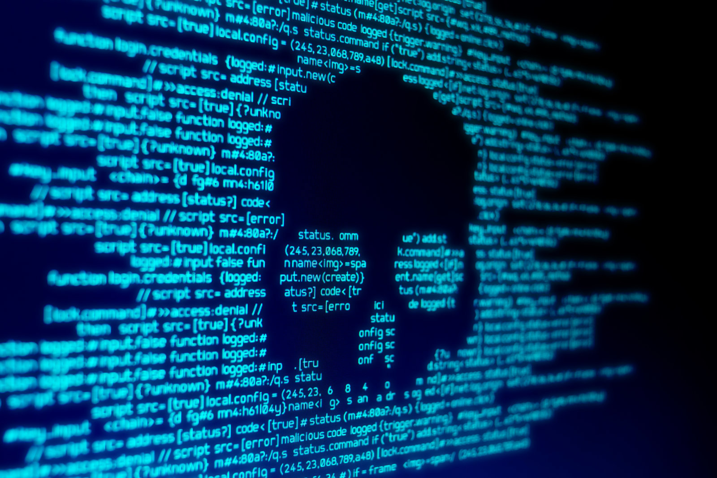
Demo Time
8a241cfcc23dc740e1fadc7f2df3965e
Notes:
Petya infection demo

Slide 16
INFILTRATING THE Master boot record
While in windows in windows the MBR is infected
This is why administrator rights are required
It moves the original MBR and encrypts it to restore if the ransom is paid
It replaces with MBR with its own to boot the Peyta payload it has installed on the disk
Once the MBR has been replaced the running process issues a reboot command

Slide 17
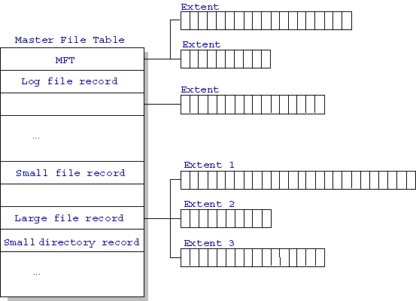
Master FILE TABLE
It is the master index of where all files on the disk
Without this we cannot lookup where a file exists on the disk
Files are made up of many separate blocks on the disk.
These blocks are not guaranteed to appear sequentially
It is nearly impossible to find and connect all the blocks that belong to a specific file without the MFT

Slide 18
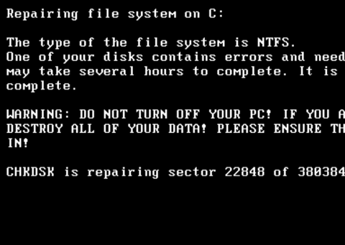
ENCRYPTING THE MFT
When the computer restarts the victim is presented with a fake CHKDSK
This is actually Petya
Your MFT is now being encrypted.
The MFT is encrypted with a randomly generated key using SALSA20
This key is then encrypted with Petya's Public Key and saved.
The system then reboots a third and final time

Slide 19
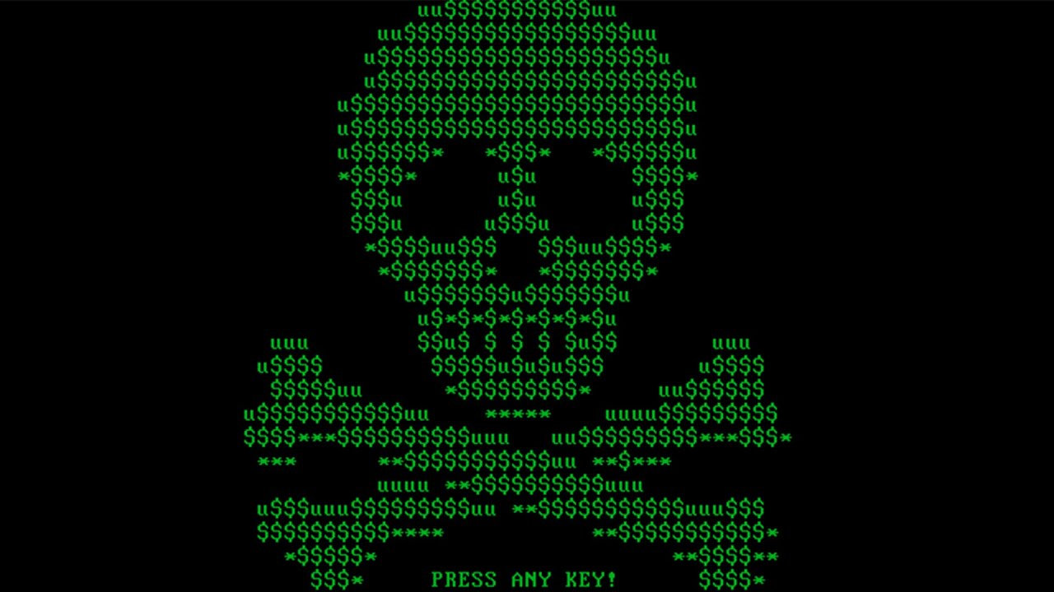
YOUR FILES ARE HOSTAGE

Slide 20
Demo Time
8a241cfcc23dc740e1fadc7f2df3965e
Notes:
Petya Decryption

Slide 21
DECRYPTION Explanation
Since the salsa20 symmetric key was encrypted with an asymmetric encryption method, we required the attacker's private key to restore the salsa20 symmetric key
Once we have our salsa20 symmetric key, Petya confirms that the key is correct using a verification block it planted while encrypting the MFT
If it confirms the verification block, the MFT is decrypted with the key thus restoring access to your files
Petya then restores the MBR back for windows and your system is set "free"

Slide 22
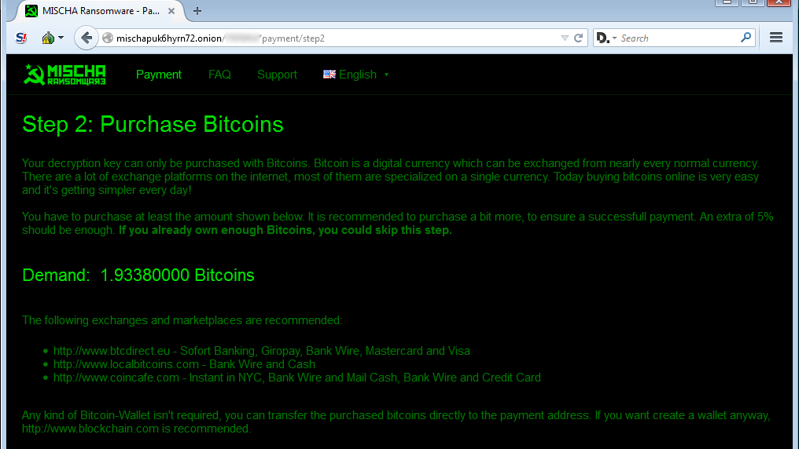
MISCHA

Slide 23
Demo Time
8a241cfcc23dc740e1fadc7f2df3965e
Notes:
Mischa Infection

Slide 24
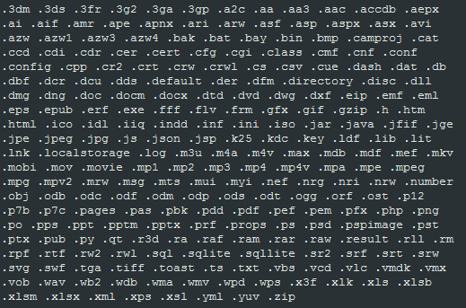
MISCHA
Mischa's encryption process is executed by a dll file
It uses an exploit called Reflective DLL Injection to attach itself to a system process (conhost.exe, taskhost.exe, explorer.exe, etc)
This way it is harder to detect that Mischa is running on the system
From there the process begins encrypting your files
Misha encrypts 241 different file types contained in a whitelist with the payload.

Slide 25
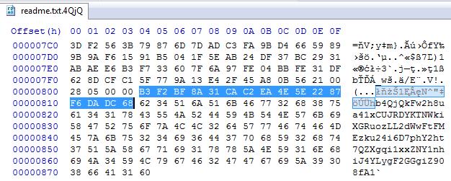
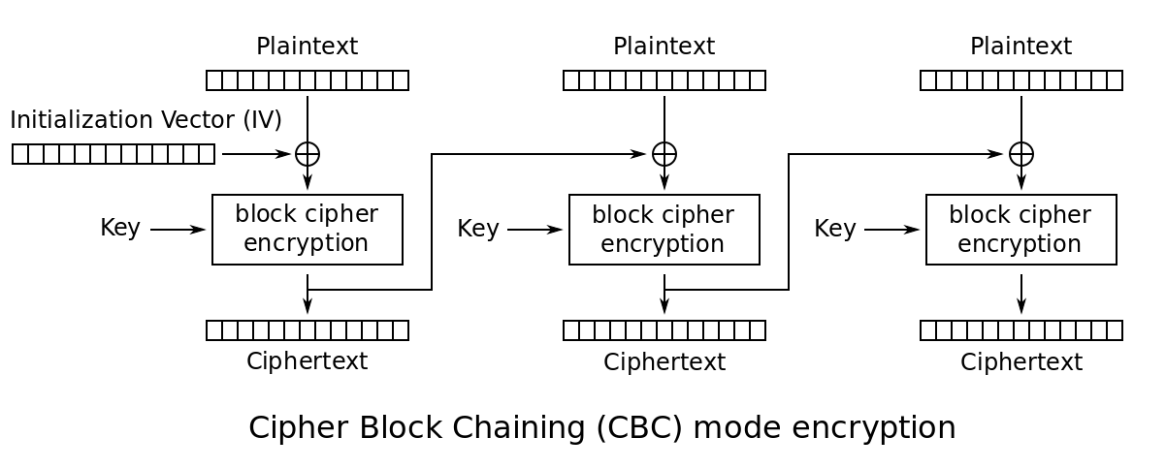
FILE ENCRYPTION METHOD
File Length IV
Files are encrypted using a Cipher Block Chain (CBC)
Each file is encrypted with a unique Initialization Vector (IV)
The IV and the encrypted key are stored at the end of each file
Encrypted key

Slide 26
MISCHA ConT'd
Like Petya, the key for the CBC is encrypted using a asymmetric key encryption
The unencrypted key can be found in memory for as long as Mischa executes
In order to retrieve our symmetric key to decrypt the CBC we must have the attacker's private key
Once Mischa has finished encrypting a folder it drops a text and html file instructing its victim on how to decrypt their files, along with a copy of the encrypted key

Slide 27
Demo Time
8a241cfcc23dc740e1fadc7f2df3965e
Notes:
Mischa Decryption

Slide 28
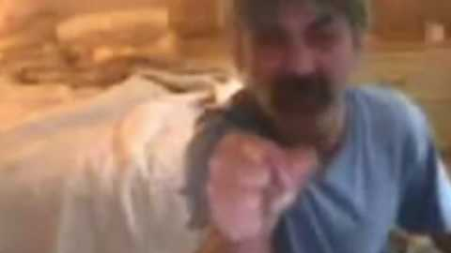
Back-TRACE it?
There is no communication between payload and attacker
Payment domain is .onion
Bitcoin transactions can be anonymized
Public Key is hard coded in the payload

Slide 29
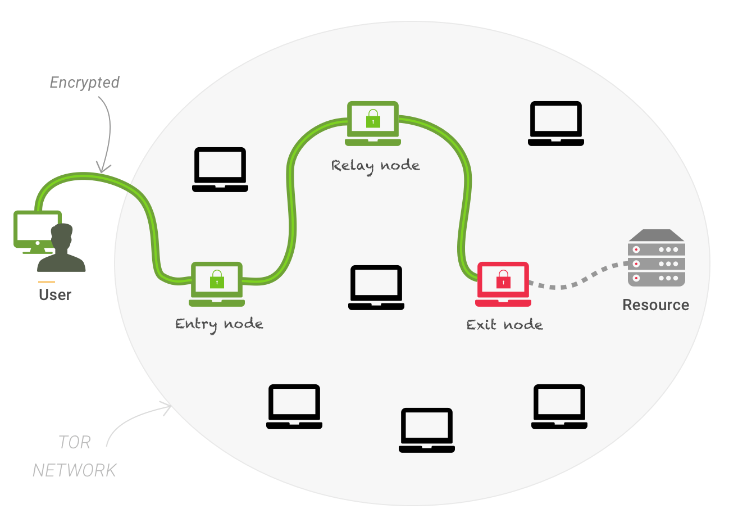
.ONION & TOR NETWORK
Anonymous network
Both Clients and Hosts cannot be identified
Works by using every user on the network as a possible relay node
.onion are special domains that cannot be outside of the tor network

Slide 30
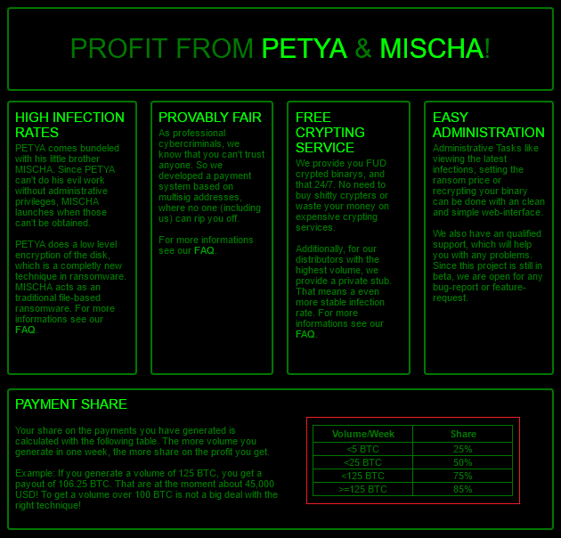
CRYPTOLOCKERS as a service

Slide 31
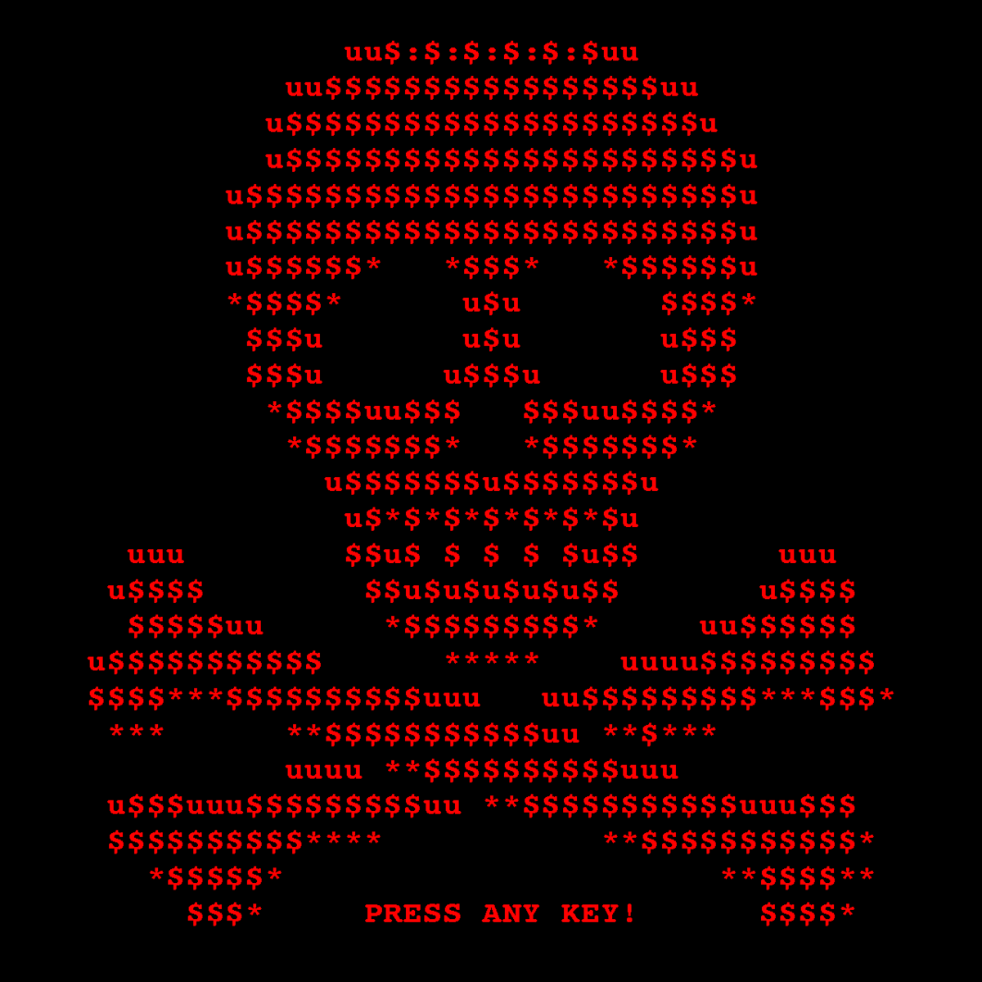
NOTPetya
Cyber attack launched in June 2017
Was a new variant of Petya that used Eternal Blue to initially spread
This variant of Petya also encrypted user files before invoking its corruption of the MFT
Infected computers would spread the virus across its local network
It used a Credential Theft exploit similar to Mimikatz to obtain account names and passwords on the infected system
NotPetya was Malware disguised as Ransomware.
The virus made the encrypted MFT unrecoverable.
NOT PETYA

Slide 32
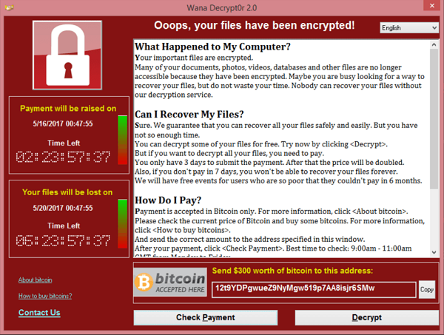
wannacry
Worldwide cyberattack in May 2017
150 Countries with an estimated over $8 Billion in damages
Used exploit known as Eternal Blue to infect windows machines
Over 200,000 infected victims
Kill-Switch was discovered and stopped further infections
$300 - $600 Ransom

Slide 33
ETERNAL BLUE
An Exploit Developed by the NSA that was leaked by a hacking group known as Shadow Brokers
Allowed Remote Code Execution through a vulnerability in the SMBv1 on Windows.
Security Patch was issued by Microsoft in March 2017
Exploit can be found under CVE-2017-0411 and MS17-010

Slide 34
Payments
Some researchers estimate that ransomware is a billion-dollar industry
CryptoWall alone extorted ~$18 million by 2016
Lots of attacks unrecorded
Criminals typically demand ransom in cryptocurrency such as Bitcoin

Slide 35
Payments
Bitcoin transactions are pseudonymous: payments are made from one 32-character address to another, which are recorded in the blockchain, which is the digital ledger of all bitcoin transactions.
Bitcoin is particularly useful here because it’s fast, reliable, and verifiable.
The hacker can simply watch the public blockchain to know if and when a victim has paid up
The hacker can even make a unique payment address for each victim and automate the process of unlocking their files upon a confirmed bitcoin transaction to that unique address.
However, the open, transparent, nature of bitcoin blockchain transactions means that the global community is closely watching the ransom money
Notes:
https://www.bankinfosecurity.com/ransomware-where-does-bitcoin-money-go-a-10747
https://coincenter.org/link/why-ransomware-criminals-use-bitcoin-and-why-that-could-be-their-undoing

Slide 36
Payments
One challenge for criminals who run ransomware campaigns, however, remains converting bitcoins into cash.
Virtual currency exchanges are coming under increasing scrutiny from regulators, and many exchanges now follow anti-money laundering and know-your-customer requirements.
Reveton Ransomware: In February 2013, a Russian citizen was arrested in Dubai by Spanish authorities for his connection to a crime ring that had been using Reveton; ten other individuals were arrested on money laundering charges.

Slide 37
Payments
In 2018, U.S government publicly attributed cryptocurrency addresses to 2 Iranian hackers behind the SamSam ransomware.
Ali Khorashadizadeh - 1AjZPMsnmpdK2Rv9KQNfMurTXinscVro9V
Mohammad Ghorbaniyan - 149w62rY42aZBox8fGcmqNsXUzSStKeq8C
Combined value of 6000 bitcoins or US $23 million
Thinking about making a ransomware payment? If so, you may want to think twice before doing so as it could land you in trouble for violating U.S. government sanctions.

Slide 38
Defenses
The usual: Windows Defender, Antiviruses
Careful inspection of software before installation
Disable Windows from hiding file extensions
Keeping system backups/snapshots, preferably remotely
Some ransomwares have very specific kill switches: e.g. Petya will fail if you have a perf.c file in your windows installation directory.
In case your computer gets encrypted: Look for a leaked decryption key/tool

Slide 39
Cryptojacking
ransomware infections have fallen 30% over the past 12 months
cryptojacking infections have increased 44.5% over the same time period

Slide 40
What Is Cryptojacking?
Cryptojacking (AKA cryptomining) is a malware that hides on a computer and uses the machine’s resources to mine cryptocurrency.

Slide 41
Ransomware
Bryan & Zuhair

