Slide 1
DoS Attacks
By Mohammad Ali and Ahmed El-Shafie

Slide 2
What are DoS Attacks?
A type of cyber-attack where an attacker’s goal is to make a online service unavailable.
Usually done by overloading systems with fake requests
Prevents systems from serving legitimate requests.
Attackers perform this attack on high-profile servers for revenge, blackmail, activism, etc.

Slide 3
Distributed DoS
A serious type of Dos attack where a perpetrator uses thousands of unique IP addresses to flood or crash a service running on a host.
The incoming traffic originates from different sources making the attack hard to stop.
It is also difficult to distinguish between traffic from legitimate users and attackers.
Notes:
Ingress filtering does not work.
Forging ip addresses may make even harder to stop this attack.
Usually results in terabits of traffic per second

Slide 4
Botnets and Distributed DoS
What are botnets?
A network of connected computers that can be used to perform tasks that the owner of the network wants.
How are they used to carry out Distributed DoS attacks?
Amplifies DoS attacks
Typically, malware is used to add a computer to the botnet.
Grum, 2008-2012, responsible for 18% of spam in 2009.

Slide 5
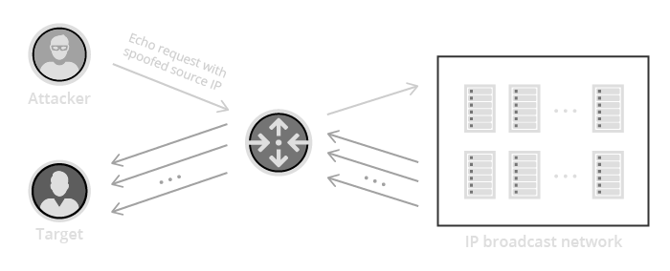
Techniques of Distributed DoS
Smurf Attacks: Large number of ICMP packets sent with a spoofed IP source address to a IP broadcast address.
If the network is large enough, the victim will be flooded with response packets.
Server will be too busy
allocating for and loading
incoming spam packets
to serve legitimate
Users. (Memory and time
being wasted)

Slide 6
Techniques of Distributed DoS
During a handshake protocol, a client would send the server a SYN packet, server responds with ACK packet, client responds back.
SYN flood: Attacker sends SYN requests to a victim’s system in an attempt to make the system
unresponsive.
Consumes system resources with half-open connections.
Using up ports and memory allocated to expected ACK.
Notes:
Describe what’s supposed to happen normally (handshake and connection), then describe what attacker does. Be specific as to what system resources are being used up.
the half-open connections created by the malicious client bind resources on the server and may eventually exceed the resources available on the server.

Slide 7
TCP Handshake Protocol
Host A sends a TCP SYNchronize packet to Host B
Host B receives A's SYN
Host B sends a SYNchronize-ACKnowledgement
Host A receives B's SYN-ACK
Host A sends ACKnowledge
Host B receives ACK.
TCP socket connection is ESTABLISHED
SYN flood takes advantage of this by sending SYN packets with no further reply.
Notes:
Describe what’s supposed to happen normally (handshake and connection), then describe what attacker does. Be specific as to what system resources are being used up.
the half-open connections created by the malicious client bind resources on the server and may eventually exceed the resources available on the server.

Slide 8
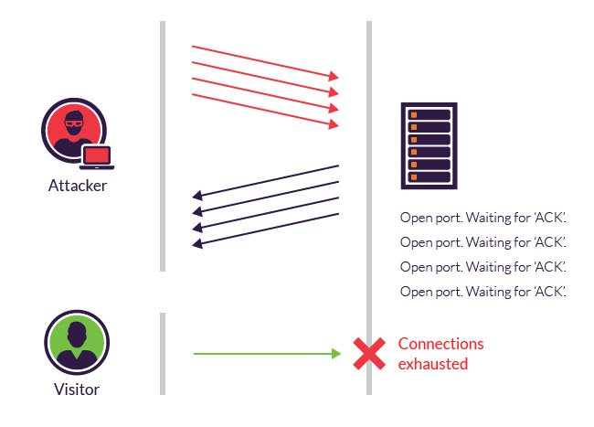
Notes:
Describe what’s supposed to happen normally (handshake and connection), then describe what attacker does. Be specific as to what system resources are being used up.
the half-open connections created by the malicious client bind resources on the server and may eventually exceed the resources available on the server.

Slide 9
Ping of Death
Uses the ping command which test for the availability of a service or network resource
Sends small data packets to the network resource and waits for response.
Attackers can send ICMP ping packets as fast as possible expecting a response back which can consume the target system’s resources.

Slide 10
Ping of Death cont.
Attackers usually fragment a packet into 65500 bytes which is the maximum size of a packet.
When the target system puts the packet together, it may cause a buffer overflow and make the attacker execute malicious code or crash the system.
Can also be used to flood the network resource with traffic.
Nemesy
ping localhost -t -l 65500
Notes:
Add -f for flood feature.

Slide 11
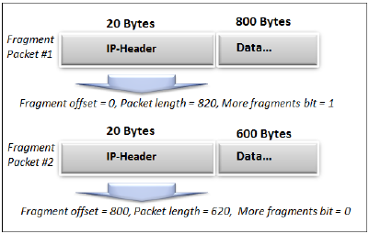
Teardrop
Attacker sends large data packets
TCP/IP breaks packets into smaller fragments
Attacker manipulates data fragments as they are sent to overlap with each other.
This is done by changing the “fragment offset” field in a packet.
Causes old vulnerable systems to crash.
Notes:
Explain steps in more detail, explain what fragment offset is.

Slide 12
DNS Flood and Amplification
DNS Amplification: Similar to Smurf Attack.
Attacker spoofs with target IP and sends DNS request packets that look no different from real requests.
DNS servers send back larger responses to target IP, crashing the target.
Notes:
Explain briefly what DNS is to help make it easier to understand

Slide 13
DNS Flood and Amplification
DNS Flood: Attacker attempts to crash the DNS server with thousands of symmetrical requests.
Often done using botnets.
Since we are not doing a smurf-like attack here the spoofed IP addresses do not need to be real.
Notes:
Explain briefly what DNS is to help make it easier to understand

Slide 14
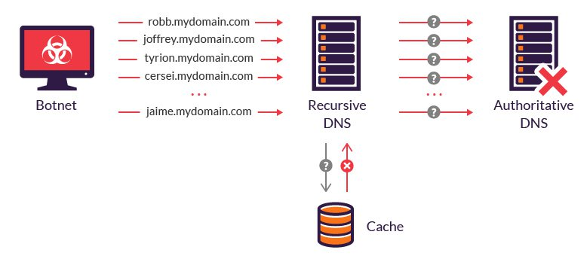
Notes:
Explain briefly what DNS is to help make it easier to understand

Slide 15
Low and Slow attacks
Low and Slow attacks are a type of DoS attack that relies upon sending a small stream of traffic for a long period of time.
Hogging ports
Very hard to distinguish from legitimate traffic.
Slowloris and R-u-d-y use this technique to flood a web server.
Notes:
What system resources specifically?
Unlike more traditional brute-force attacks, low and slow attacks require very little bandwidth and can be hard to mitigate, as they generate traffic that is very difficult to distinguish from normal traffic. Because they don’t require a lot of resources to pull off, low and slow attacks can be successfully launched using a single computer; two of the most popular tools for launching a low and slow attack are called Slowloris and R.U.D.Y.

Slide 16
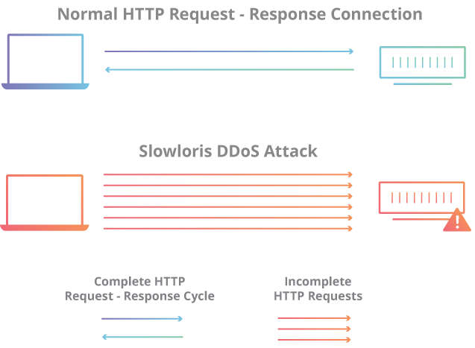
Notes:
What system resources specifically?

Slide 17
APDoS
Advanced Persistent DoS attacks involve several attack vectors used to take a system down.
Usually involves HTTP layer floods followed by SQLi and XSS attacks
Also accompanied by SYN floods to generate enormous amounts of traffic.
Attackers usually use Botnets to generate such traffic.
Switch between attacks to evade detection.
Notes:
Botnets are a quick and efficient way to amplify traffic.
Can be used to do SQL injections and Cross-Site Request Forgery, web scraping, and web application DDoS

Slide 18
ReDoS
Regular Expression DoS attacks exploit Web apps that use regex implemented using NFA.
A naive regex algorithm would try all possible paths until a match is found.
Catastrophic Backtracking
For example, (a+)+ is an “Evil” regex since its NFA has a lot of possible paths.
Causes system to hang if large evil regex is inputted.
Notes:
This is an extreme case where the naïve algorithm is problematic, because it must pass on many many paths, and then fail.

Slide 19
ReDoS cont.
Evil regexes typically contain repetition (+, *) and grouping.
If attacker has control over regex, he can create his own evil regex and use it.
If not, the attacker can search the system and find and exploit already existing evil regexes.
Notes:
Explain briefly how attacker can inject regex

Slide 20
Famous DoS Attack - GitHub
5:21-5:26pm Feb 28, 2018
Peak at 1.35 Tbps, 126.9 million packets per second
Memcached Attack
Attackers spoofed GitHub IP address and made requests to public and vulnerable Memcached server on UDP

Slide 21
General DoS Prevention
Increase load tolerance of server
Increase bandwidth
Increase load management efficiency
Block unnecessary and/or malicious IP addresses
Use software that has built-in Anti-DDoS tools
Snort software has a file “ddos.rules” that can detect
various types of DoS.

Slide 22
ReDoS Prevention
Use safe Regex libraries.
Timeout if regex evaluation takes too long
Avoid evil regex that contain the following:
Grouping with repetition
Inside the repeated group:
Repetition
Alternation with overlapping

Slide 23
Links
ReDoS: https://www.owasp.org/index.php/Regular_expression_Denial_of_Service_-_ReDoS
GitHub DDoS: https://githubengineering.com/ddos-incident-report/
Memcached Attack in more detail: https://www.cloudflare.com/learning/ddos/memcached-ddos-attack/
ReDos Prevention in more detail:
https://www.regular-expressions.info/redos.html

