Slide 1
EternalBlue

Slide 2
Timeline
Before: It is discovered and developed by the NSA (U.S. National Security Agency)
April 14, 2017: it is released into by the Shadow Brokers hacker group
https://github.com/misterch0c/shadowbroker
April 24, 2017: it is used by Adylkuzz
a botnet cryptominer that puts a bot on your computer to mine Monero coin
May 12, 2017: it is used in the WannaCry ransomware
A ransomware that encrypted the files on a victim’s computer and would only be decrypted if a ransom is paid

Slide 3
cont’d
June 27, 2017: it is used in the NotPetya attack
A ransomware that would load on boot and tell the user to pay otherwise their files would be wiped
September 22, 2017: Retefe the banking Trojan adds a component that uses EternalBlue
October, 2017: WannaMine uses EternalBlue as a part of how it gets into Windows computers
March 20, 2017: This presentation

Slide 4
How was EternalBlue used
The attacks would use EternalBlue to self-propagate
EternalBlue targets a vulnerability in the SMB protocol to get into Windows though port 445 or TCP
WannaCry would randomly check IP addresses over a LAN about 25 address/second to find other computers with port 445 open

Slide 5
Server Message Block (SMB)
The SMB protocol is used for file sharing over a network by Windows
It uses multiple ports, but port 445 is used for file sharing over TCP
For a SMB message requires is sent there is a max buffer size for a message and when it is greater than this, the rest of the message is sent as a Secondary Trans 2 request

Slide 6
Secondary Trans2 Request
There are two functions that handle the packets being sent
SMB_COM_NT_TRANSACT
SMB_COM_TRANSACTION2
The secondary part is when it exceeds the SMB MaxBufferSize and these have their own functions that split up the packets
SMB_COM_NT_TRANSACT_SECONDARY
SMB_COM_TRANSACTION2_SECONDARY

Slide 7
Lets dive into EternalBlue
3 main bugs behind the exploit
Wrong casting
Wrong Parsing Function
Non-paged pool allocation

Slide 8
Wrong casting
Word (unsigned int):
Max value: 0xffff ~ 2^16
DWord (signed int):
Max value: 0xffffffff ~ 2^32
A packet has the SMB header, and a list of file extended attributes (Fea) for data
Fea, are a key value pair with attribute name: attribute value
SrvOs2FeaListSizetoNT:
Will recalculate the OS2Fea->SizeOfListInBytes variable

Slide 9
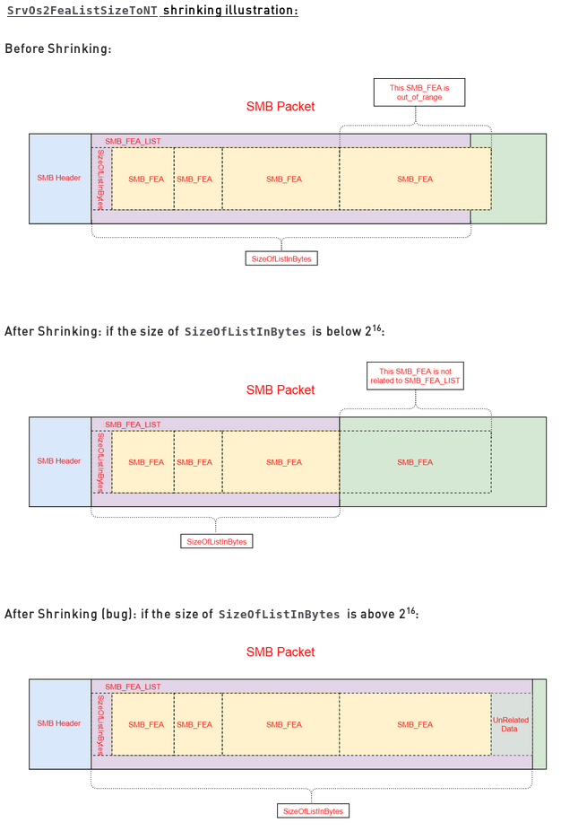
Now the list is smaller and can fit the data into a packet
Now here rather than shrinking it, the size increased

Slide 10
Wrong Parsing Function
If SMB_COM_NT_TRANSACT ION2_SECONDARY is called after SMB_COM_NT_TRANSACT
Since SMB_COM_NT_TRANSACT handles larger values (DWord) then the packet will be parsed as a Word by SMB_COM_NT_TRANSACTION2_SECONDARY
Looking back at bug 1, that extra part is now ignored leaving it on the heap
There are no check to see if SMB_COM_NT_TRANSACTION2 or SMB_COM_NT_TRANSACT is called first
Together this causes an out of bounds (OOB) write

Slide 11
Non-paged pool allocation
Non-paged pool
Where Window stores objects for processes, threads, mutexes, etc
It has certain rules that when broken cause a IRQL_NOT_LESS_OR_EQUAL error that can crash your computer
There’s a certain bug that when you want to setup the session and send it as extended security, the flag for extended security won’t be turned on and the bytesize is wrong cause there to be a hole in the memory
Using these 3 bugs we will get a buffer overrun

Slide 12
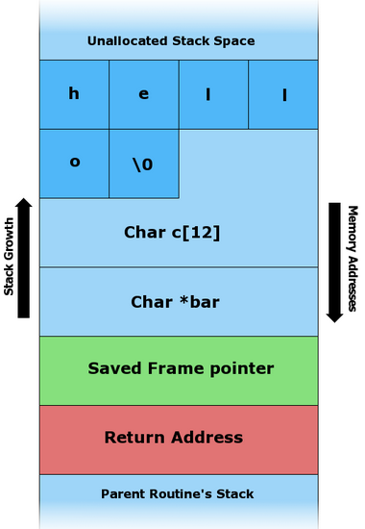
Quick Review of Buffer Overrun
Buffer Overrun on the stack
Make a buffer that will push the stack
Overwrite the return address with a new location in memory, which contains your shellcode

Slide 13
Heap Buffer Overrun
Heap Spraying
You put a pointer to the shellcode within chunks of data filled with nops so that it is pushed towards something useful that is run within the heap
These chunks are then put all over the heap
Once this computer starts trying to read this pointer, the shellcode does it’s thing and is the same as a stack overrun

Slide 14
How is it used in EternalBlue
There is a srvnet struct that is used and when closed will run a handler function
So the pool is sprayed with these srvnet structs by opening multiple connections, this increases our chances of getting a overrun
Once the hole is created somewhere in the pool, it will leave space for the OS2Fea and NTFea conversion to fill up and overwrite one of the srvnet structs and change it’s handler function to our shellcode

Slide 15
This is what EternalBlue is
BufferOverun using the SMB protocol
So now let’s take a look at the actual Overrun
Thanks to metasploit/rapid7 and ElevenPaths https://github.com/rapid7/metasploit-framework/blob/master/modules/exploits/windows/smb/ms17_010_eternalblue.rb
https://github.com/ElevenPaths/Eternalblue-Doublepulsar-Metasploit
Let’s take a look at what happens when we run wireshark and run the exploit

Slide 16
Mitigation
Eternal Blues: http://omerez.com/eternalblues/
DoublePulsar check: https://github.com/countercept/doublepulsar-detection-script
It has been patched, so keep Windows updated
Disable SMB and close port 445

Slide 17
Sources
https://www.fireeye.com/blog/threat-research/2017/06/petya-ransomware-spreading-via-eternalblue-exploit.html
https://www.fireeye.com/blog/threat-research/2017/05/threat-actors-leverage-eternalblue-exploit-to-deliver-non-wannacry-payloads.html
https://www.fireeye.com/blog/threat-research/2018/02/cve-2017-10271-used-to-deliver-cryptominers.html
https://www.fireeye.com/blog/threat-research/2017/05/wannacry-malware-profile.html
https://www.scmagazine.com/eternalblue-used-in-wannacry-now-with-nitol-backdoor-and-gh0st-rat/article/666426/
https://isc.sans.edu/forums/diary/ETERNALBLUE+Windows+SMBv1+Exploit+Patched/22304/
http://www.wired.co.uk/article/what-is-eternal-blue-exploit-vulnerability-patch
https://www.rapid7.com/db/modules/exploit/windows/smb/ms17_010_eternalblue
https://www.fireeye.com/blog/threat-research/2017/05/smb-exploited-wannacry-use-of-eternalblue.html
https://www.fireeye.com/blog/products-and-services/2017/05/wannacry-ransomware-campaign.html
https://msdn.microsoft.com/en-us/library/windows/desktop/aa365233(v=vs.85).aspx
https://support.microsoft.com/en-ca/help/2696547/how-to-detect-enable-and-disable-smbv1-smbv2-and-smbv3-in-windows-and
https://en.wikipedia.org/wiki/Server_Message_Block
https://blog.skyboxsecurity.com/top-malware-in-2018-what-to-watch-for/
https://www.cisecurity.org/top-10-malware-january-2018/
https://www.theinquirer.net/inquirer/news/3025754/nsa-leaked-hack-eternalblue-back-and-powering-wannamine-cryptojacking-malware
https://blog.malwarebytes.com/cybercrime/2017/05/how-did-wannacry-ransomworm-spread/
https://en.wikipedia.org/wiki/Heap_spraying
https://isc.sans.edu/forums/diary/WannaCryWannaCrypt+Ransomware+Summary/22420
https://github.com/misterch0c/shadowbroker/blob/master/windows/specials/Eternalblue-2.2.0.0.xml
https://support.microsoft.com/en-us/help/2696547/how-to-detect-enable-and-disable-smbv1-smbv2-and-smbv3-in-windows-and
https://wiki.wireshark.org/SMB2
https://research.checkpoint.com/eternalblue-everything-know/
https://github.com/rapid7/metasploit-framework/blob/master/modules/exploits/windows/smb/ms17_010_eternalblue.rb
http://resources.infosecinstitute.com/heap-overflow-vulnerability-and-heap-internals-explained/#gref

