Slide 1
Poweliks
CSC427 DmitriY & James

Slide 2
Defining Poweliks
“Poweliks is the name of a malicious program. This particular program is a Windows Trojan but what makes it noteworthy is that it does not rely on the presence of a Windows binary file (an executable file on disk) to maintain its infection of a computer.” - sophos.com

Slide 3
SANS Internet Storm Center
“POWELIKS hides its malicious code inside Windows Registry Key. Malware that does not exist in the file system are one of the reasons why memory forensics is important.” – isc.sans.edu

Slide 4
Presentation Outline
Background Info of Windows Environment
Architecture of Poweliks
Demo
Defense against Poweliks
Consequences of Poweliks

Slide 5
Background Information of Windows Environment

Slide 6
Windows Registry Introduction
“The registry is a database in Windows that contains important information about system hardware, installed programs and settings, and profiles of each of the user accounts on your computer.” - Microsoft

Slide 7
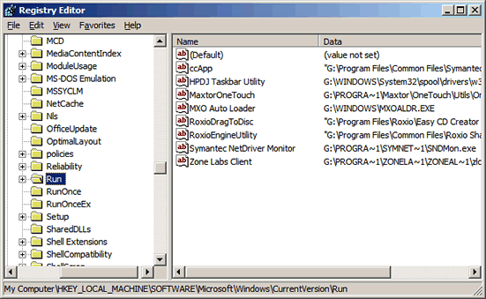
Registry Startup Programs
The registry can be used to start programs.
Example Key Location:
HKCU\Software\Microsoft\Windows\CurrentVersion\Run

Slide 8
RUNDLL32
RUNDLL32.EXE <dllname>,<entrypoint> <optional arguments>
RUNDLL32.EXE is a program to execute a function from a DLL file

Slide 9
Scripting in Windows
Batch Scripts
JScript & VBScript
PowerShell

Slide 10
Architecture of Poweliks

Slide 11
Exploiting Freedom of RUNDLL32
RUNDLL32 allows us to to run ANY DLL function!!!
Isn’t there an infamous browser notorious for security issues that conveniently ships with Windows?!
Command to execute javascript as IE:
RUNDLL32 javascript:"\..\mshtml,RunHTMLApplication ";alert("foo");

Slide 12
Running JS through RUNDLL32
Running javascript this way is much worse since it isn’t being run inside the context of a browser which has a security sandbox.
“Zone security is off, and cross-domain script access is allowed, we have read/write access to the files and system registry on the client machine.” – thisissecurity.net

Slide 13
Poweliks at a High Level
Selects a Registry Startup Program location
Places an encoded RUNDLL32 command in this spot
This RUNDLL32 command executes unprotected javascript in IE
Unprotected javascript in IE can create ActiveXObjects
ActiveXObjects can read & write to registry and to the file system
DLLs can be encoded to live inside the registry in different keys

Slide 14
Demo

Slide 15
Defense against Poweliks

Slide 16
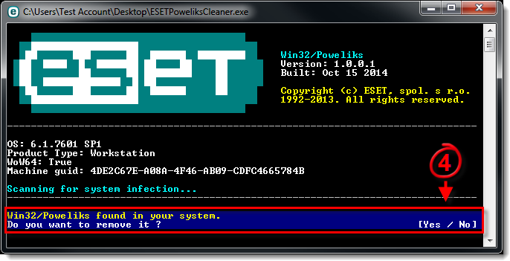
ESET Poweliks Remover
Notes:
http://www.bleepingcomputer.com/virus-removal/remove-poweliks-trojan

Slide 17
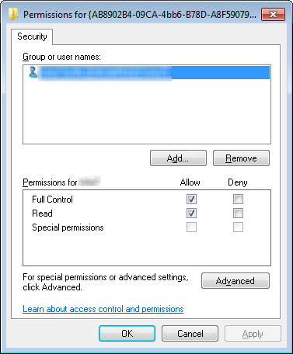
Registry Permissions
Poweliks malware can further hide itself by removing permissions for users.
Notes:
http://blog.trendmicro.com/trendlabs-security-intelligence/poweliks-levels-up-with-new-autostart-mechanism/

Slide 18
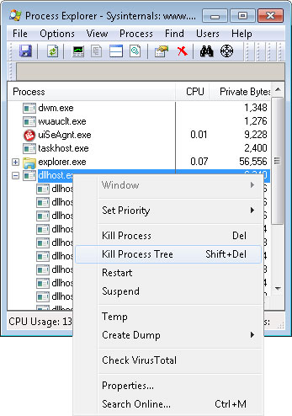
CLSID Registry Keys
“This CLSID is for Window’s thumbnail cache, which Windows calls whenever a thumbnail for any file is needed – for images, audio, etc.
As such, when a CLSID is called, it will execute the registry entry to show the thumbnail of the file as well as the entry of POWELIKS in this key.
POWELIKS uses dllhost.exe and also dllhst3g.exe to load itself on the system. Each dllhost.exe indicates a running POWELIKS.”
- trendmicro.com
Notes:
http://blog.trendmicro.com/trendlabs-security-intelligence/poweliks-levels-up-with-new-autostart-mechanism/

Slide 19
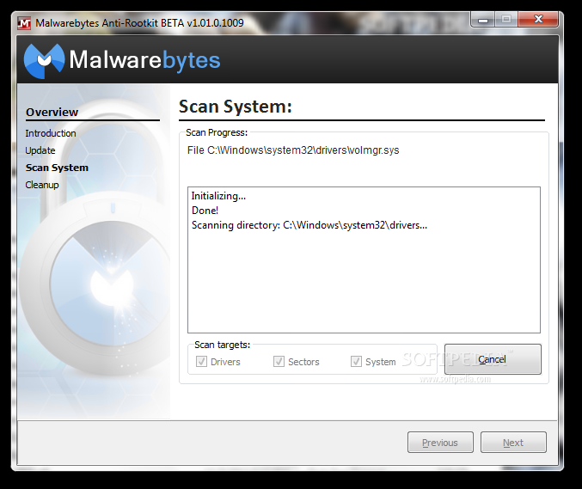
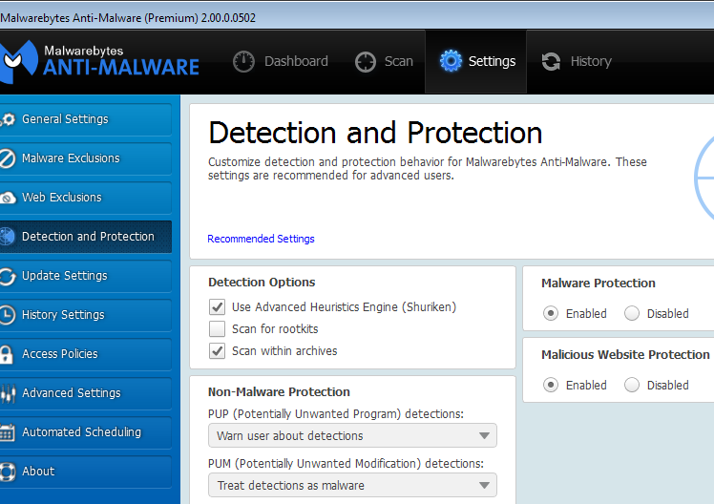
Malwarebytes
Notes:
http://www.bleepingcomputer.com/virus-removal/how-to-use-malwarebytes-anti-rootkit

Slide 20
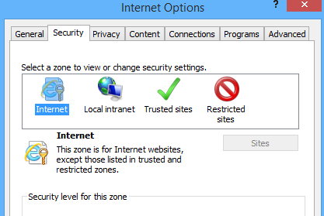
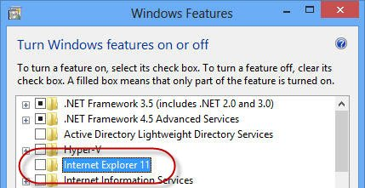
Managing Internet Explorer
“Beginning January 12, 2016, only the most current version of Internet Explorer available for a supported operating system will receive technical supports and security updates. Internet Explorer 11 is the last version of Internet Explorer, and will continue to receive security updates, compatibility fixes, and technical support on Windows 7, Windows 8.1, and Windows 10.” - Microsoft
Notes:
https://www.microsoft.com/en-us/WindowsForBusiness/End-of-IE-support

Slide 21
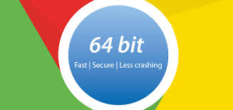
Installing a More Secure Browser
An alternative browser like Chrome should be used.
Powershell Script:
(new-object System.Net.WebClient).DownloadFile('http://dl.google.com/chrome/install/375.126/chrome_installer.exe', 'c:/temp/chrome.exe');. c:/temp/chrome.exe /silent /install;rm c:/temp -rec
Notes:
http://www.bleepingcomputer.com/virus-removal/how-to-use-malwarebytes-anti-rootkit

Slide 22
Consequences of Poweliks

Slide 23
POP QUIZ
For Poweliks, what are possible infection vectors?
USB drive with an elusive “install.exe”
An email containing an attachment
Viewing a web address with IE
MS Word Document

Slide 24
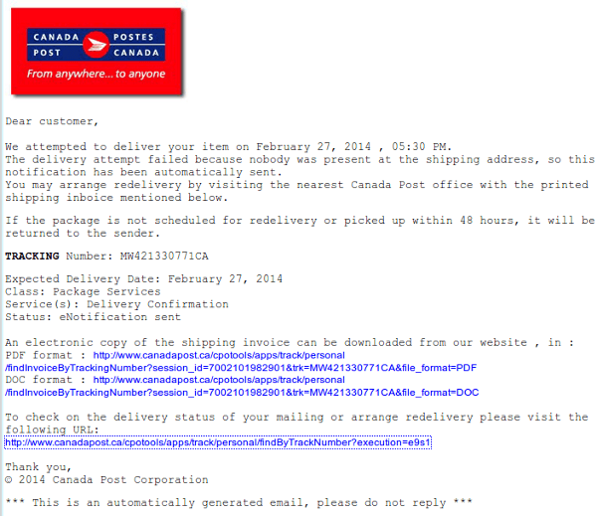
Notes:
https://techhelplist.com/index.php/spam-list/483-scheduled-package-delivery-failed-date-multi-malware

Slide 25
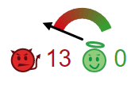
Shocking Phishing Emails
Mostly legitimate looking except for the subtle spelling mistake
Contained an “innocent looking” Word Document download which contained malware according to scans by VirusTotal
Detection Ratio : 37/54 (~68.5%)
Notes:
https://techhelplist.com/index.php/spam-list/483-scheduled-package-delivery-failed-date-multi-malware

Slide 26
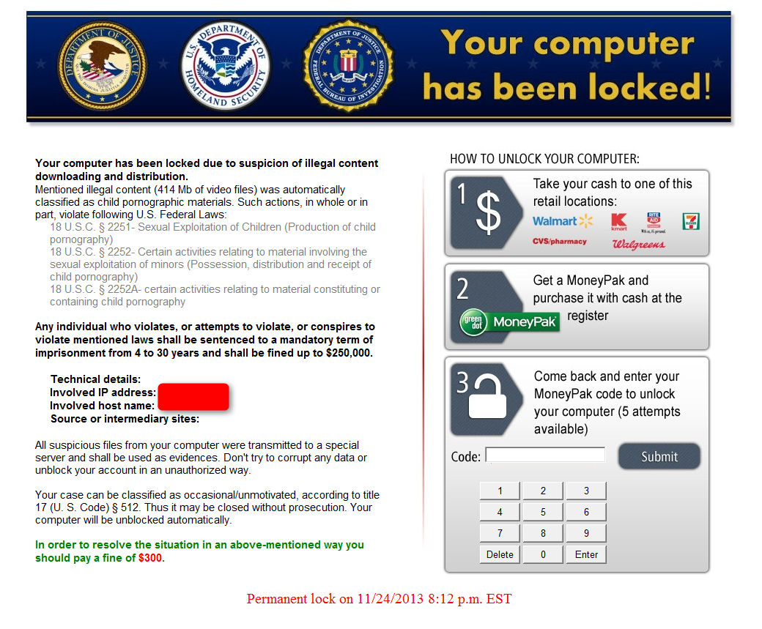
Malware Evolution
Upgrades to existing malware:
Kovter
Phasebot
Angler Exploit Kit
Notes:
https://www.damballa.com/kovter-ransomware-grows/
http://blog.trendmicro.com/trendlabs-security-intelligence/without-a-trace-fileless-malware-spotted-in-the-wild/
http://journeyintoir.blogspot.ca/2015/01/triaging-system-infected-with-poweliks.html

Slide 27
References & Further Reading
Windows Environment
http://windows.microsoft.com/en-ca/windows-vista/what-is-the-registry
https://support.microsoft.com/en-us/kb/164787
https://msdn.microsoft.com/en-us/library/windows/desktop/aa376977(v=vs.85).aspx
Poweliks
https://www.sophos.com/en-us/support/knowledgebase/121370.aspx
https://isc.sans.edu/forums/diary/Fileless+Malware/19619/
http://thisissecurity.net/2014/08/20/poweliks-command-line-confusion/
http://blog.trendmicro.com/trendlabs-security-intelligence/without-a-trace-fileless-malware-spotted-in-the-wild/
https://www.linkedin.com/pulse/survey-file-less-malware-approach-using-javascript-ruwan-geeganage

