Slide 1
A Neural Network Approach to Efficient Valuation of Large VA Portfolios
Presenter: amir Hejazi
Supervisor: Kenneth R. Jackson

Slide 2
Outline
Variable Annuity
Research Questions & Existing Solutions
Spatial Interpolation Framework
Neural Network Approach
Conclusion & Future Work

Slide 3
Variable Annuity (VA)
Unit-linked life and savings insurance product (segregated funds)
Consists of two phases
Accumulation Phase
Withdrawal Phase

Slide 4
Variable Annuity (VA)
Guarantee types
GMIB: guarantees stream of income for life
GMWB: guarantees ability to withdraw up to a pre-determined percentage of benefit base for several years
GMDB: guarantees a lump-sum payment upon death
GMAB: guarantees a lump-sum payment on the maturity of contract
…
Source of revenue for writers
Rider Charge
Administrative Expense Charge
Surrender Charge
Insurance Charge
Investment Management Charge

Slide 5
Research Questions
Policy holder’s view
Optimal strategy to maximize the value of contract
Fair valuation of contract
Insurer’s view
Hedging and Risk Management
Individual Contract
Portfolio of contracts

Slide 6
Existing Solutions
Suggested payoffs, mostly, have no closed-form formulas
Almost all suggested methods are computationally expensive
Results for one VA cannot be re-used for another VA
Extending methodologies of individual VA contracts
Replicating Portfolios
Nested Monte Carlo (MC) Simulations
Computationally expensive
Accuracy/computational complexity trade-off
Computationally expensive

Slide 7
Reducing Nested Simulations Time
Reducing outer loop scenarios
Reducing inner loop scenarios (e.g. LSMC)
Reducing inputs to the simulation
Representative contracts
Meta-modelling via Spatial Interpolation methods (e.g. Kriging)
Accuracy/computational complexity trade-off
Pre-processing by an actuarial system (manual input)

Slide 8
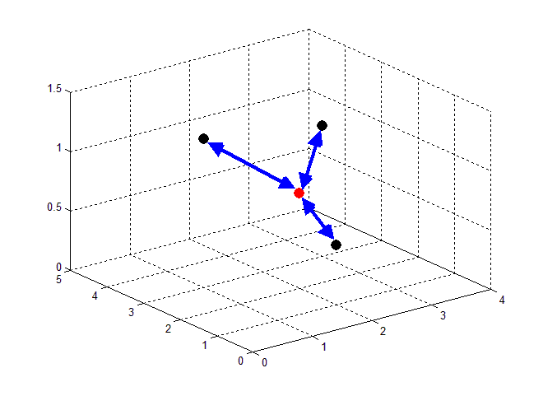
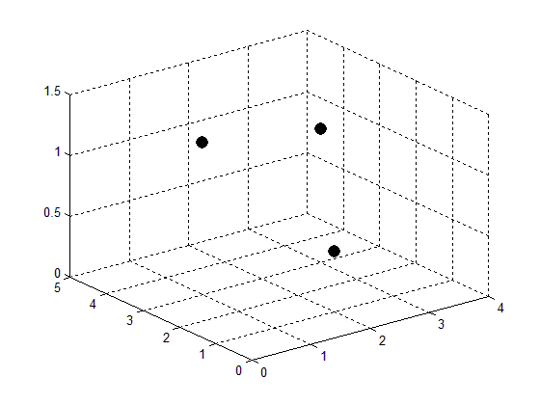
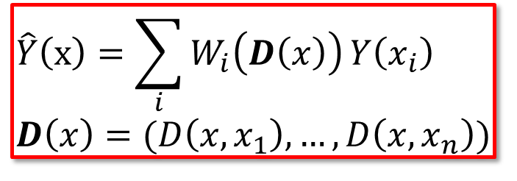
Spatial Interpolation Framework
Framework
Sample VA Space
Find value of interest at each sample point via MC simulations
Interpolate value of interest for the portfolio
$$\hat{Y}\left(x\right)=\sum_{i}{W_{i}\left(D\left(x\right)\right)}Y\left(x_{i}\right) \\ D\left(x\right)=(D\left(x, x_{1}\right), …, D\left(x, x_{n}\right))$$

Slide 9
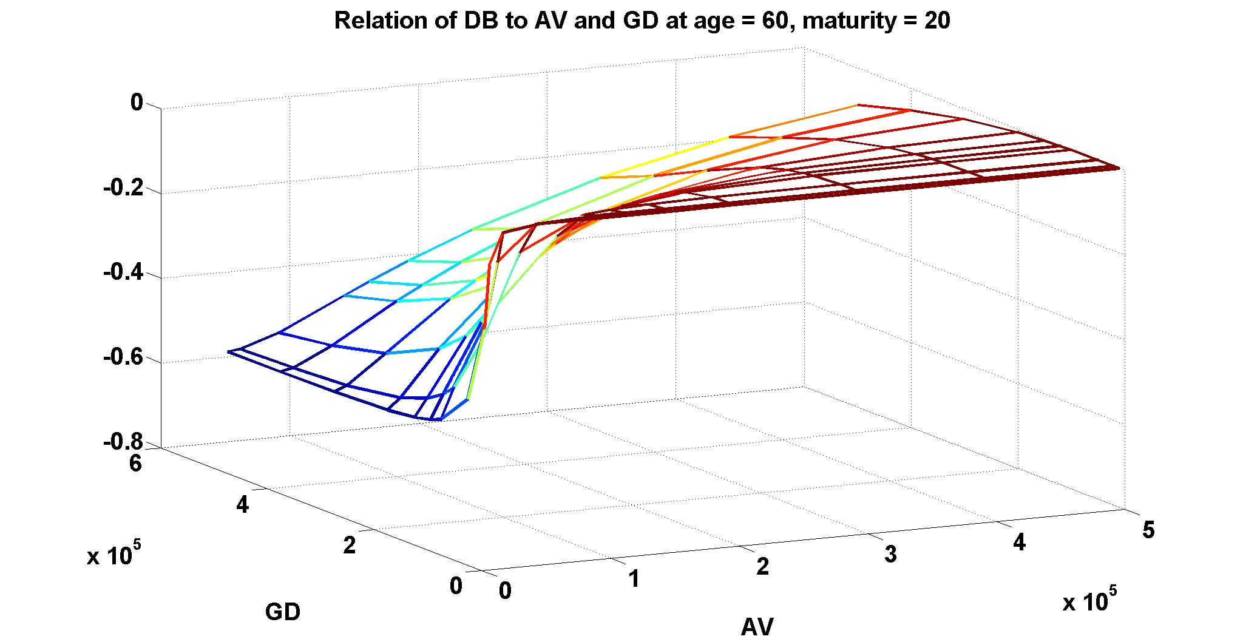
Spatial Interpolation Framework
Main Factors
Sampling method (e.g. K-means, LHS)
Distance function (e.g. K-prototype)
Interpolation method
Stochastic Interpolation (Kriging)
Deterministic Interpolation (IDW, RBF)

Slide 10
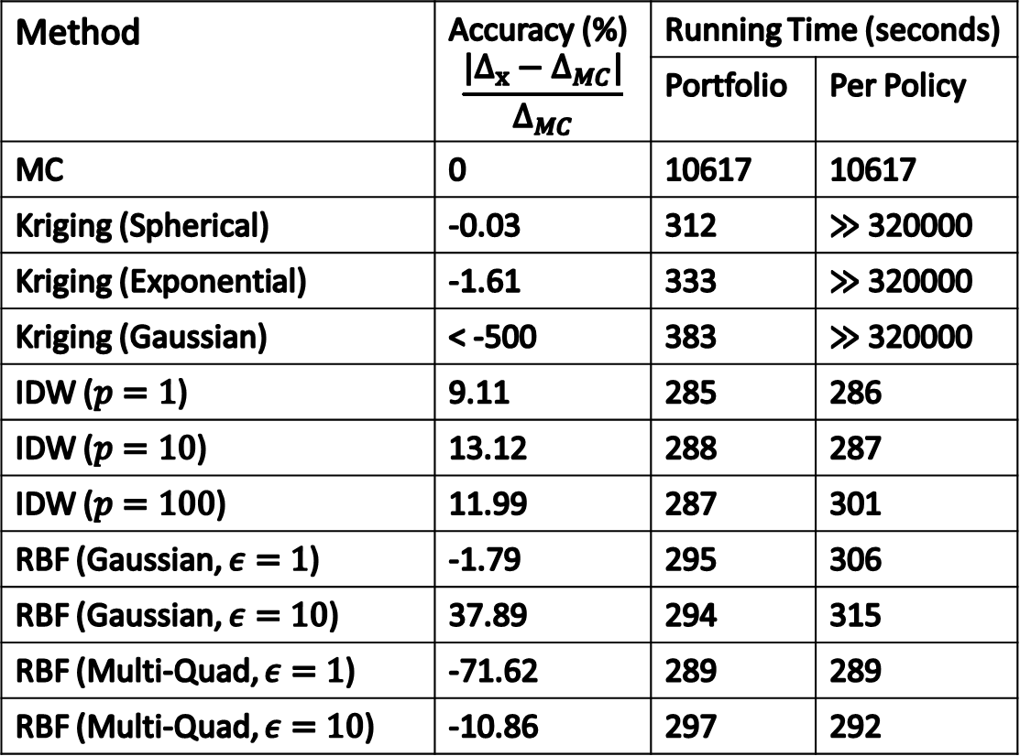
Performance
Method | Accuracy (%) $$\frac{|Δ_{x}−Δ_{MC}|}{Δ_{MC}}$$ | Running Time (seconds)
 |  | Portfolio | Per Policy
MC | 0 | 10617 | 10617
Kriging (Spherical) | -0.03 | 312 | $≫$ 320000
Kriging (Exponential) | -1.61 | 333 | $≫$ 320000
Kriging (Gaussian) | < -500 | 383 | $≫$ 320000
IDW ($p=1$) | 9.11 | 285 | 286
IDW ($p=10$) | 13.12 | 288 | 287
IDW ($p=100$) | 11.99 | 287 | 301
RBF (Gaussian, $ε=1$) | -1.79 | 295 | 306
RBF (Gaussian, $ε=10$) | 37.89 | 294 | 315
RBF (Multi-Quad, $ε=1$) | -71.62 | 289 | 289
RBF (Multi-Quad, $ε=10$) | -10.86 | 297 | 292

Slide 11
Performance
Method | Accuracy | Efficiency | Granularity
Kriging
IDW
RBF
✓
✓
✗
✗
✓
✓
✗
✓
✓

Slide 12
Performance
Second order stationarity assumption doesn’t hold
Using Random Samples of Smaller Sizes
Changing the Distance Function
Method | Accuracy (%)
Kriging (Spherical) | -0.03
Kriging (Exponential) | -1.61
Kriging (Gaussian) | < -500
The accuracy of almost all methods deteriorates
Makes methods sensitive to the choice of representative contracts
Increases the accuracy of IDW methods
Creates Instability for other methods

Slide 13
Ideas
Efficiency and granularity of IDW/RBF: Extension of Nadaraya-Watson estimator
Non-manual choice of distance function: learn distance from features
Accuracy of Kriging: Train to minimize Mean Squared Error (MSE)

Slide 14
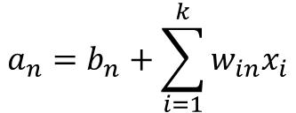
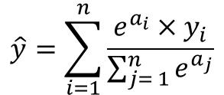
Neural Network
$$a_{n}=b_{n}+\sum_{i=1}^{k}{w_{in}x_{i}}$$
$$(x_{1},⋯, x_{k})$$
$$\frac{e^{a_{n}}}{\sum_{i= 1}^{n}{e^{a_{i}}}}$$
$$e^{a_{n}}$$
$$a_{n}$$
$$o_{n}$$
$$(y_{1}, y_{2}, ⋯, y_{n})$$
$$\hat{y}=\sum_{i=1}^{n}{\frac{e^{a_{i}}×y_{i}}{\sum_{j= 1}^{n}{e^{a_{j}}}}}$$
$$a_{2}$$
$$o_{2}$$
$$a_{1}$$
$$o_{1}$$

Slide 15
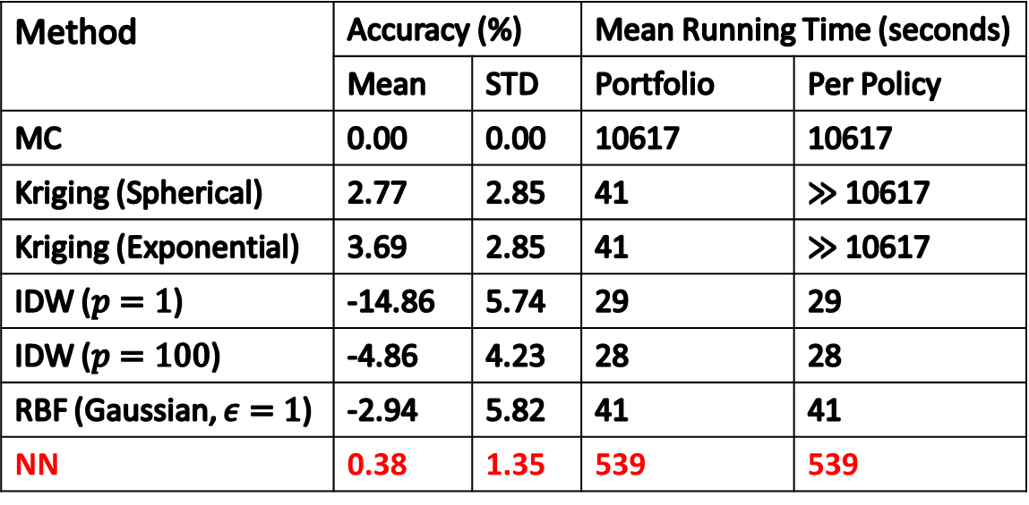
Performance – Delta Estimation
Method | Accuracy (%) |  | Mean Running Time (seconds)
 | Mean | STD | Portfolio | Per Policy
MC | 0.00 | 0.00 | 10617 | 10617
Kriging (Spherical) | 2.77 | 2.85 | 41 | $≫$ 10617
Kriging (Exponential) | 3.69 | 2.85 | 41 | $≫$ 10617
IDW ($p=1$) | -14.86 | 5.74 | 29 | 29
IDW ($p=100$) | -4.86 | 4.23 | 28 | 28
RBF (Gaussian, $ε=1$) | -2.94 | 5.82 | 41 | 41
NN | 0.38 | 1.35 | 539 | 539

Slide 16
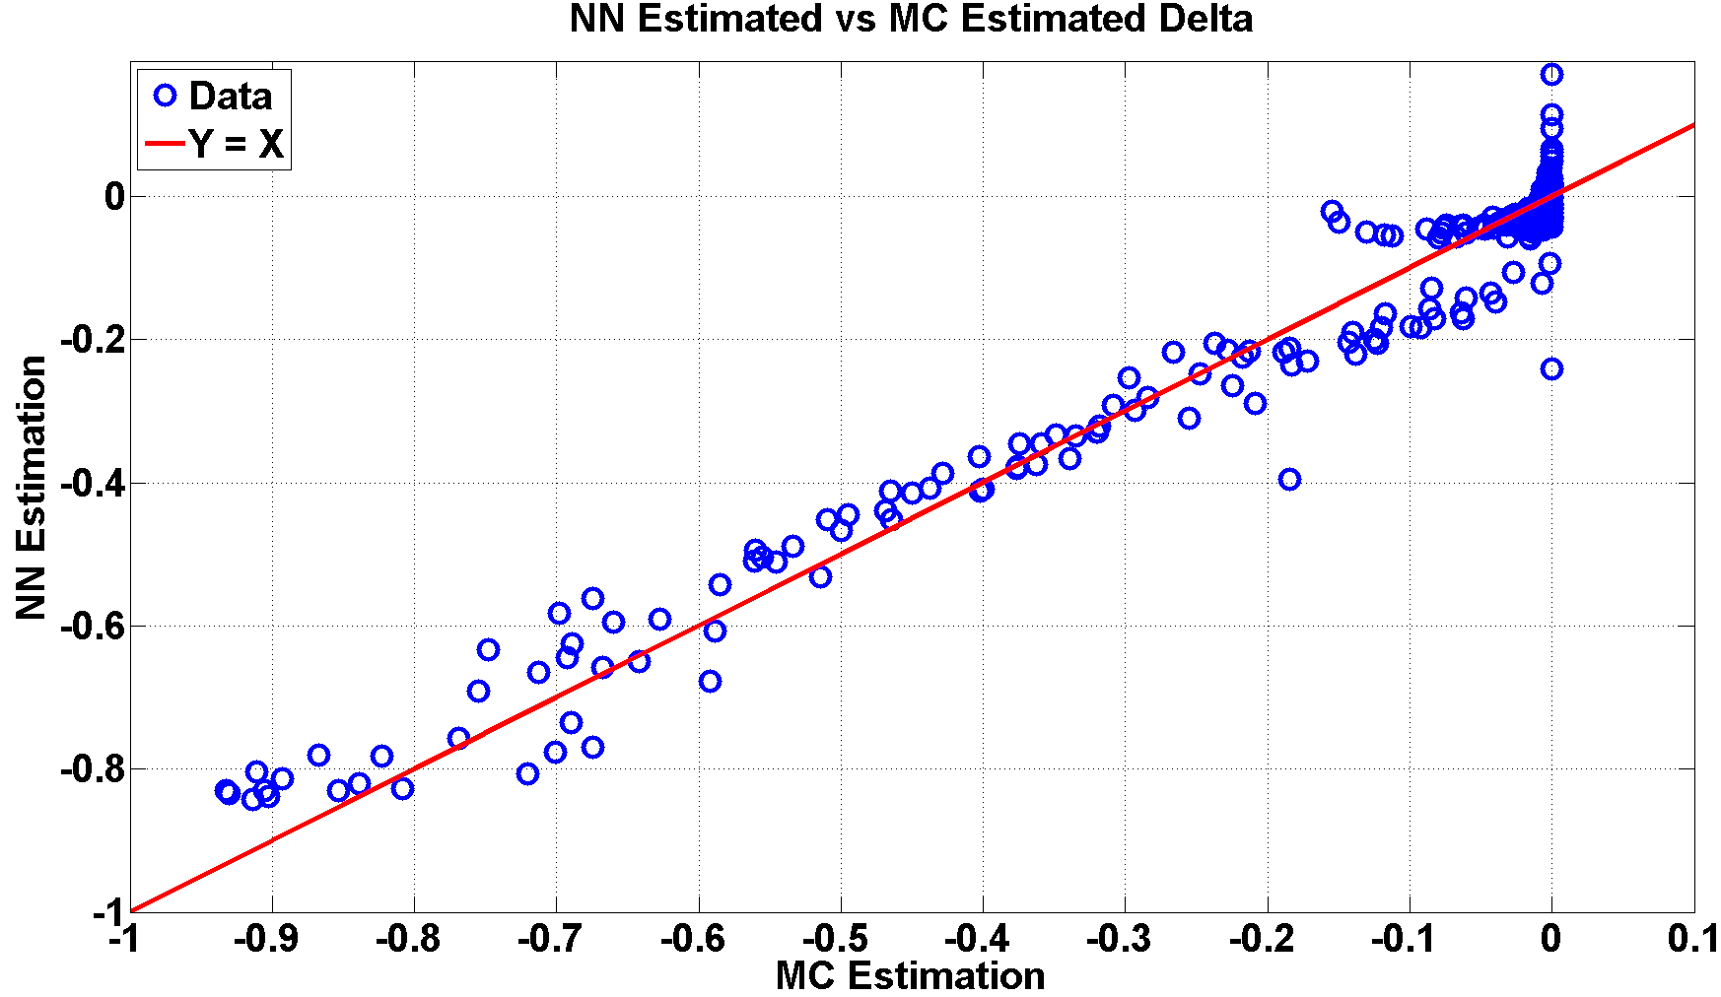
Performance – Delta Estimation

Slide 17
Other Applications
Other Greeks
Higher-order Greeks may require more features and more representative contracts
Replace MC simulations with other methods (e.g., HBJ models)
Efficiency of the proposed neural network method will further improve
Efficient Estimation of Solvency Capital Requirement (SCR)
Average Speed up of 6x with a serial implementation of the neural network

Slide 18
Conclusion
A neural network approach to estimate key risk metrics is
Accurate
Granular
Efficient
Neural network avoids manual input by learning the choice of distance function

Slide 19
Future Work
Study performance of neural network approach assuming a multi-asset model for investments that back VAs
Develop a parallel implementation of the neural network
Study the choice of the interpolation scheme to find the probability distribution of liability in one year to increase the accuracy of the neural network in estimation of SCR
Study effective strategies to exploit the closeness of the sample points representing various states of more complex models of financial markets to reduce the training time of the neural network when estimating SCR

Slide 20
Thank You, Any Questions?

