Slide 1
Handout # 6:
Programming Software-Defined Networks
CSC 2229 – Software-Defined Networking
Professor Yashar Ganjali
Department of Computer Science
University of Toronto
yganjali@cs.toronto.edu
http://www.cs.toronto.edu/~yganjali
Some slides courtesy of J. Rexford (Princeton), N. Foster (Cornell) and N. Feamster (Georgia Tech), all used with permission.

Slide 2
Announcements
Final project proposal
  Due: Friday, January 31st (5PM)
In class presentations
  Volunteer?
Today:
  Programming software-defined networks
  Final project ideas

Slide 3



Programming SDNs
The Good
  Network-wide visibility
  Direct control over the switches
  Simple data-plane abstraction
The Bad
  Low-level programming interface
  Functionality tied to hardware
  Explicit resource control
The Ugly
  Non-modular, non-compositional
  Challenging distributed programming
Images by Billy Perkins

Slide 4
Programming OpenFlow is Not Easy
OpenFlow and NOX make it possible to implement exciting new network services
  Unfortunately, they do not make it easy.
Combining different applications is not straightforward
OpenFlow provides a very low-level abstraction
We have a two-tier architecture
Network of switches is susceptible to race conditions

Slide 5
Problem 1: Anti-Modularity
Combining different applications is challenging
Example: monitor + route + firewall + load balancing
  How these applications will work together?
  How are messages from switches delivered to these applications
  How are messages from these apps aggregated to be sent to switches?
  Do OpenFlow and NOX provide a way for each app to perform its job without impacting other apps?
Question: How can we combine these applications?

Slide 6
Combining Many Networking Tasks
Monolithic application
Monitor + Route + FW + LB
Controller Platform
Hard to program, test, debug, reuse, port, …
Notes:
But, real networks perform a wide variety of tasks
Routing, network monitoring, firewalls, server load balancing, etc.

Slide 7
Modular Controller Applications
A module for each task
Monitor
Route
FW
LB
Controller Platform
Easier to program, test, and debug
Greater reusability and portability

Slide 8
Beyond Multi-Tenancy
Each module controls a different portion of the traffic
...
Slice 1
Slice 2
Slice N
Controller Platform
Relatively easy to partition rule space, link
bandwidth, and network events across modules
Notes:
Simple case: multi-tenancy
Each module controls a different subset of the traffic
Relatively easy to partition traffic, rule space, and bandwidth resources
We want to write a single application out of modules that affect the handling of same traffic

Slide 9
Modules Affect the Same Traffic
Each module partially specifies the handling of the traffic
Monitor
Route
FW
LB
Controller Platform
How to combine modules into a complete application?

Slide 10
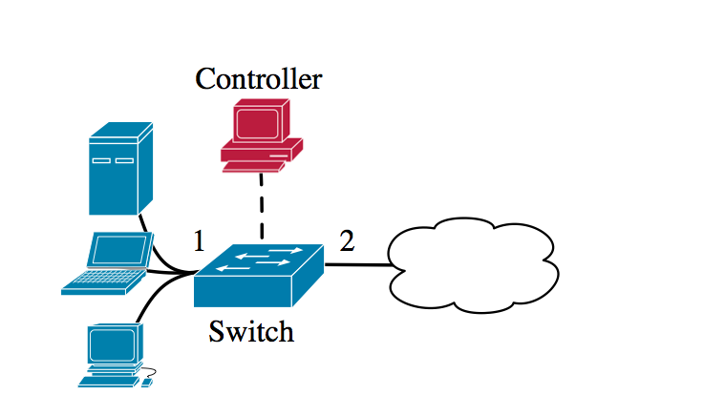
Anti-Modularity Example
Consider a simple network
Want to add two applications
Simple repeater
  Port 1 → Port 2
  Port 2 → Port 1
Web monitor
  Packet and byte counts
  Incoming web traffic

Slide 11
NOX Events and Commands
Events:
  switch_join(switch): triggered when switch joins the network
  stats_in(switch , xid , pattern , packets , bytes ), triggered when switch returns the packets and bytes counters in response to a request for statistics about rules contained in pattern
Commands:
  install(switch, pattern, priority, timeout, actions): installs a rule in the flow table of switch
  query_stats(switch, pattern): issues a request for statistics from all rules contained in pattern on switch

Slide 12
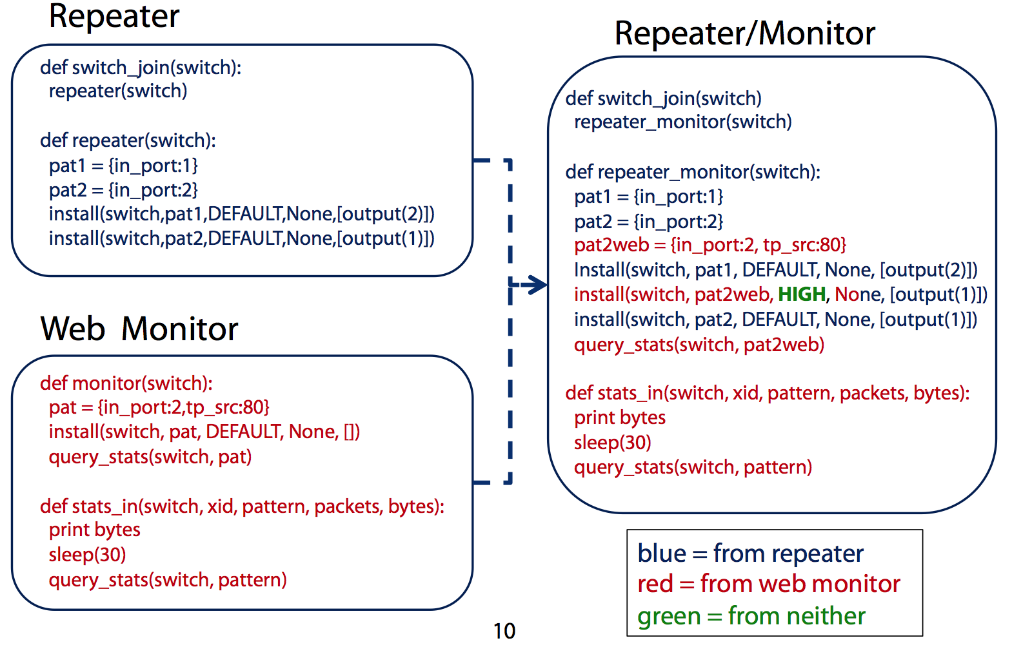
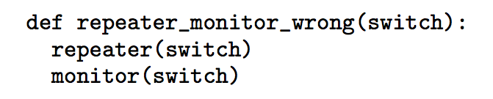
Anti-Modularity Example
Overlapping rules
- repeater first: no counting web traffic
- Monitor first: no repeating

Slide 13
Anti-Modularity Example

Slide 14
Programming OpenFlow is Not Easy
OpenFlow and NOX now make it possible to implement exciting new network services
  Unfortunately, they do not make it easy.
Combining different applications is not straightforward
OpenFlow provides a very low-level abstraction
We have a two-tier architecture
Network of switches is susceptible to race conditions

Slide 15
Problem 2: Low-Level API
OpenFlow is a low-level programming interface
  Derived from the features of the switch hardware
  Rather than ease of use
Programmer must describe low-level details that do not affect the overall behavior of the program
Example: to implement simple set difference we require
  Multiple rules
  Priorities
  All need to be managed by the programmer
Focusing on the big picture not easy

Slide 16
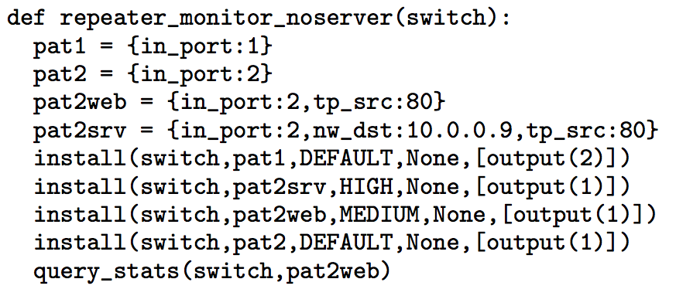
Low-Level API Example
Extend the repeater and monitoring
  Monitor all incoming web traffic except traffic destined to 10.0.0.9 (on internal network)
We need to express a logical “difference” of patterns
  OpenFlow can only express positive constraints

Slide 17
Programming OpenFlow is Not Easy
OpenFlow and NOX now make it possible to implement exciting new network services
  Unfortunately, they do not make it easy.
Combining different applications is not straightforward
OpenFlow provides a very low-level abstraction
We have a two-tier architecture
Network of switches is susceptible to race conditions

Slide 18
Problem 3: Two-Tiered System
Control program manages networks by
  Installing/uninstalling switch-level rules
Programmer needs to specify communication patterns between controller and switches
  Deal with tricky concurrency issues
Controller does not have full visibility
  Sees only packets that the switches do not know how to handle.
  Previously installed rules
    Reduce the load on the controller
    Make it difficult to reason
Detour: proactive vs. reactive rule installation

Slide 19
Two-Tiered Programming Example
Extending the original repeater
  Monitor the total amount of incoming traffic
  By destination host
Cannot install all the rules we need in advance
  Address of each host is unknown a priori
The controller must dynamically install rules for the packets seen at run time

Slide 20
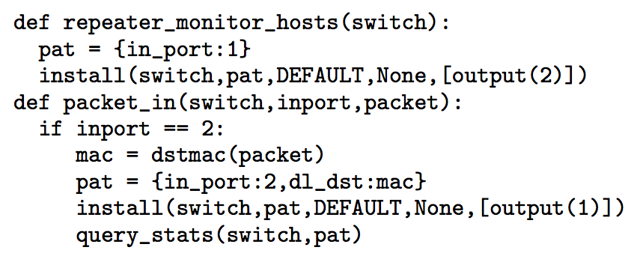
Two-Tiered Programming Example
Two programs depended on each other
Complex concurrency issues can arise
Reading/understanding the code is difficult
Details are sources of significant distraction

Slide 21
Programming OpenFlow is Not Easy
OpenFlow and NOX now make it possible to implement exciting new network services
  Unfortunately, they do not make it easy.
Combining different applications is not straightforward
OpenFlow provides a very low-level abstraction
We have a two-tier architecture
Network of switches is susceptible to race conditions

Slide 22
Problem 4: Race Conditions
Race conditions can cause complications
  We have a distributed system
    Of switches
    And controllers
Example 1: rule install delay
  One new flow
  Multiple packets

Slide 23
Race Conditions Example
Example 2: firewall application
  Running on multiple switches
  Allow A initiate a flow to B
    Two way
  But, block flows started by B

Slide 24
Race Conditions Example
Example 2: firewall application
  Running on multiple switches
  Allow A initiate a flow to B
    Two way
  But, block flows started by B

Slide 25
Northbound API
Programming abstraction for applications
Hides low-level details
Helps orchestrate and combine applications
Example uses
  Path computation
  Loop avoidance
  Routing
  Security
Northbound API
Southbound API

Slide 26
Who Will Use the Northbound API?
Service providers
Sophisticated network operators
  Or, enthusiastic network administrators
Vendors
Researchers
Or anyone who wants to add new capabilities to their network

Slide 27
Benefits of the Northbound API
Vendor independence
Ability to quickly modify or customize control applications through simple programming
Example applications:
  Large virtual switch
  Security applications
  Resource management and control
  Middlebox integration

Slide 28
Frenetic Language
Declarative Design
  What the programmer might want
  Rather than how the hardware implements it.
Modular Design
  Primitives have limited network-wide effects and semantics
  Independent of the context in which they are used.
Single-tier Programming
  See-every-packet abstraction
Race-free Semantics
  Automatic race detection and packet suppression
Cost control
  Core query logic can be executed on network switches

Slide 29
Network Control Loop
Compute Policy
Read
state
Write
policy
OpenFlow
Switches

Slide 30
Language-Based Abstractions
Writing/combining modules
Query abstractions
Update abstractions
OpenFlow
Switches

Slide 31
Frenetic Language
Abstractions for querying network state
  An integrated query language
    Select, filter, group, sample sets of packets or statistics
    Designed so that computation can occur on data plane
Abstractions for specifying a forwarding policy
  A functional stream processing library (based on FRP)
    Generate streams of network policies
    Transform, split, merge, filter policies and other streams
Implementation
  A collection of Python libraries on top of NOX

Slide 32
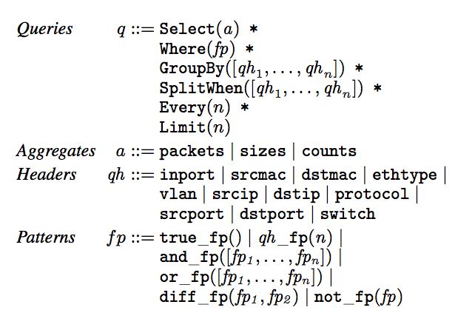
Frenetic Queries

Slide 33
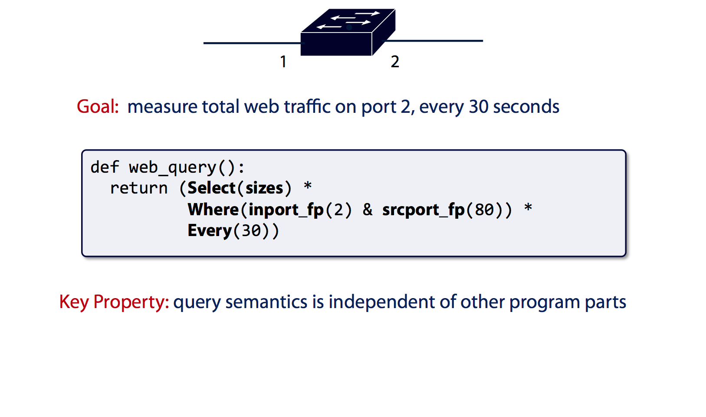
Frenetic Queries

Slide 34
Policy in OpenFlow
Defining “policy” is complicated
  All rules in all switches
  Packet-in handlers
  Polling of counters
Programming “policy” is error-prone
  Duplication between rules and handlers
  Frequent changes in policy (e.g., flowmods)
  Policy changes affect packets in flight

Slide 35
Frenetic Forwarding Policies
Rules are created using the Rule Constructor, which takes a pattern and a list of actions as arguments
Network policies associate rules with switches
  Dictionaries mapping switches to list of rules
Policy events are infinite, time-indexed streams of values, just like the events generated from queries
  Programs control the installation of policies in a network over time by generating policy events
Listeners are event consumers
  Print: send to console
  Send: transfer packet to switch and apply actions
  Register: apply network wide policy

Slide 36
Power of Policy as a Function
Composition
  Parallel: Monitor + Route
  Sequential: Firewall >> Route
A >> (B + C) >> D
(A >> P) + (B >> P) (A + B)>>P

Slide 37
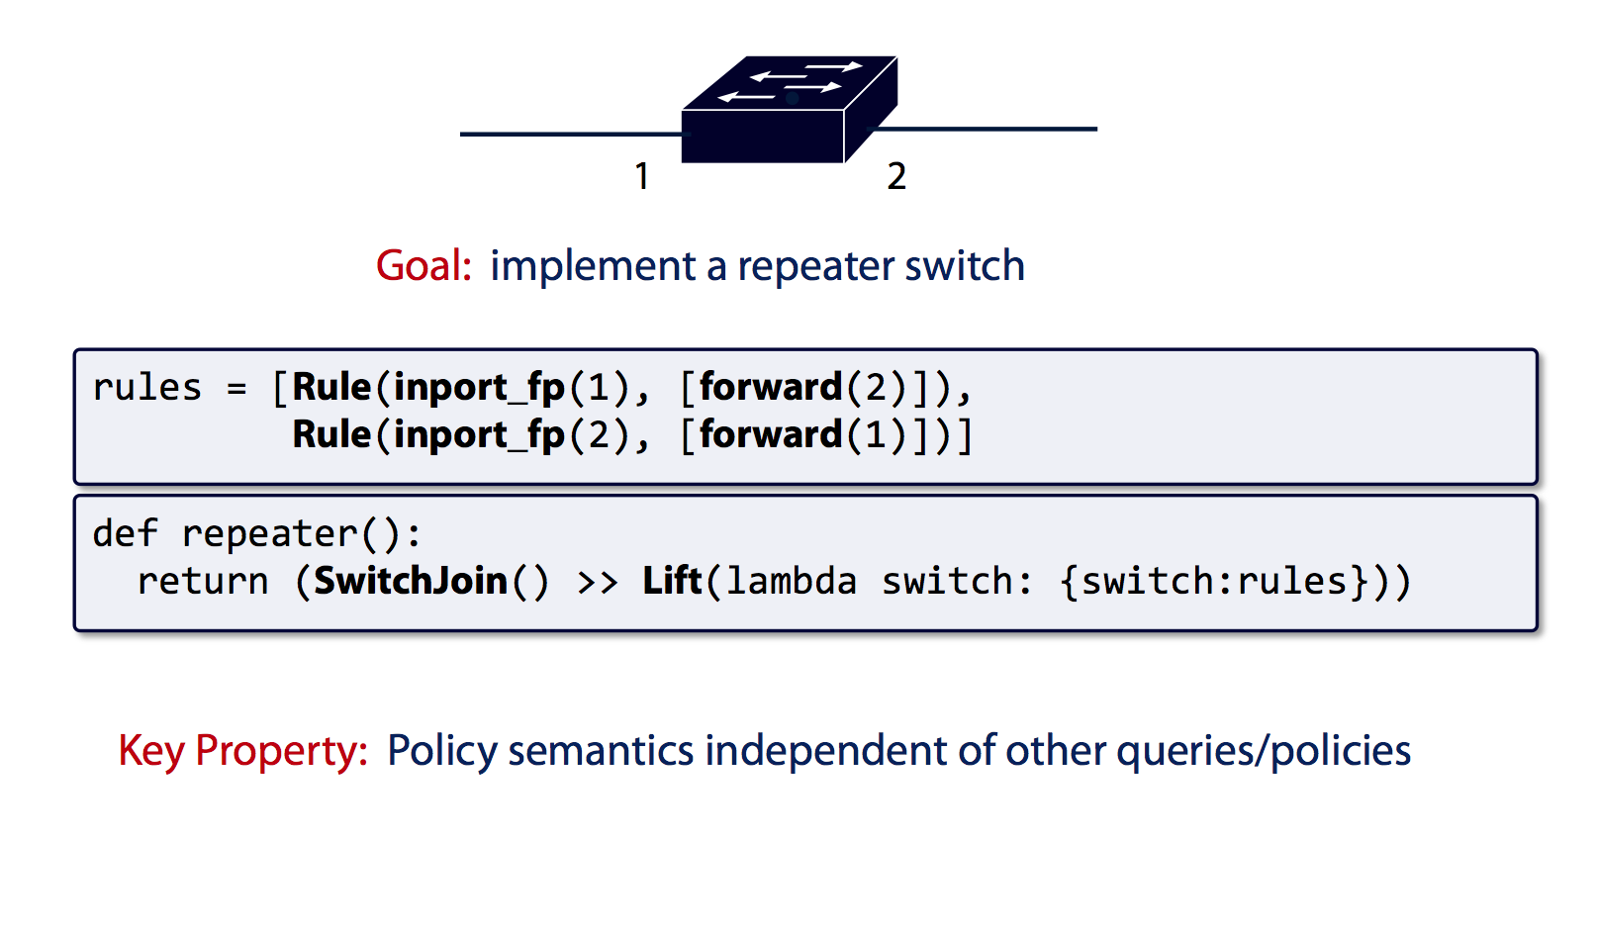
Frenetic Forwarding Policies

Slide 38
Parallel Composition
dstip = 1.2.3.4 → fwd(1)
dstip = 3.4.5.6 → fwd(2)
srcip = 5.6.7.8 → count
Monitor on source
+
Route on destination
Controller Platform
Notes:
From ICFP’11 and POPL’12

Slide 39
Parallel Composition
dstip = 1.2.3.4 → fwd(1)
dstip = 3.4.5.6 → fwd(2)
srcip = 5.6.7.8 → count
Monitor on source
+
Route on destination
Controller Platform
srcip = 5.6.7.8, dstip = 1.2.3.4 → fwd(1), count
srcip = 5.6.7.8, dstip = 3.4.5.6 → fwd(2), count
srcip = 5.6.7.8 → count
dstip = 1.2.3.4 → fwd(1)
dstip = 3.4.5.6 → fwd(2)
Notes:
From ICFP’11 and POPL’12

Slide 40
Sequential Composition
srcip = 0*, dstip=1.2.3.4 → dstip=10.0.0.1
srcip = 1*, dstip=1.2.3.4 → dstip=10.0.0.2
dstip = 10.0.0.1 → fwd(1)
dstip = 10.0.0.2 → fwd(2)
Load Balancer
>>
Routing
Controller Platform
Notes:
Load balancer splits traffic sent to public IP address over multiple replicas, based on client IP address, and rewrites the IP address

Slide 41
Sequential Composition
srcip = 0*, dstip=1.2.3.4 → dstip=10.0.0.1
srcip = 1*, dstip=1.2.3.4 → dstip=10.0.0.2
dstip = 10.0.0.1 → fwd(1)
dstip = 10.0.0.2 → fwd(2)
Load Balancer
>>
Routing
Controller Platform
srcip = 0*, dstip = 1.2.3.4 → dstip = 10.0.0.1, fwd(1)
srcip = 1*, dstip = 1.2.3.4 → dstip = 10.0.0.2, fwd(2)
Notes:
Load balancer splits traffic sent to public IP address over multiple replicas, based on client IP address, and rewrites the IP address

Slide 42
Dividing the Traffic Over Modules
Predicates
  Specify which traffic traverses which modules
  Based on input port and packet-header fields
Web traffic
dstport = 80
Load Balancer
>>
Routing
Non-web
dstport != 80
Monitor
+
Routing

Slide 43
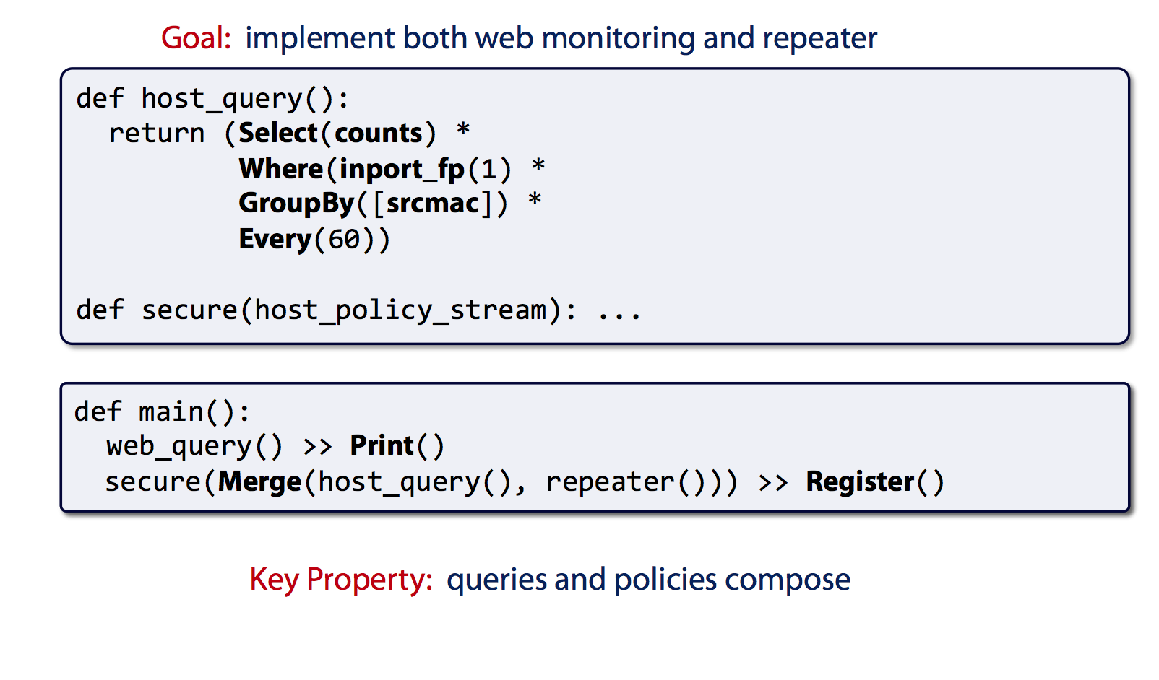
Program Composition

Slide 44
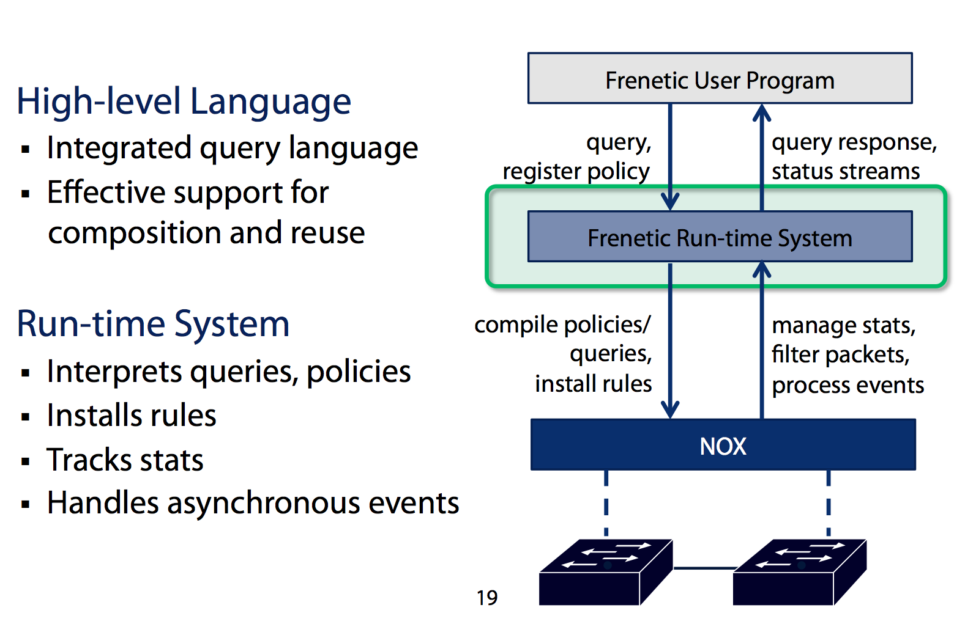
Frenetic Runtime System

