Slide 1
Handout # 4: Scaling Controllers in SDN - HyperFlow
CSC 2229 – Software-Defined Networking
Professor Yashar Ganjali
Department of Computer Science
University of Toronto
yganjali@cs.toronto.edu
http://www.cs.toronto.edu/~yganjali
Joint work with Amin Tootoonchian.

Slide 2
Announcements
Final project guidelines and schedule posted on class website.
Groups of 1 to 3 students
Project proposal (2 pages + references)
Due: Fri. January 31 (5PM)
Skim 15-16 papers, quickly read 4-5, deep read 2-3
Select a problem, question the assumptions, evaluations…
Come and talk to me during the office hour

Slide 3
Announcements
In class presentations
In two weeks?
In three weeks from now?
Email me with your preferences
Papers [3] and [4] posted
Please read before the next class

Slide 4
Software Defined Network (SDN)
Control Program A
Control Program B
Network OS
Packet
Forwarding
Packet
Forwarding
Packet
Forwarding
Packet
Forwarding
Packet
Forwarding

Slide 5
Network OS
Network OS: distributed system that creates a consistent, up-to-date network view
Runs on servers (controllers) in the network
Control program: operates on view of network
Input: global network view (graph/database)
Output: configuration of each network device

Slide 6
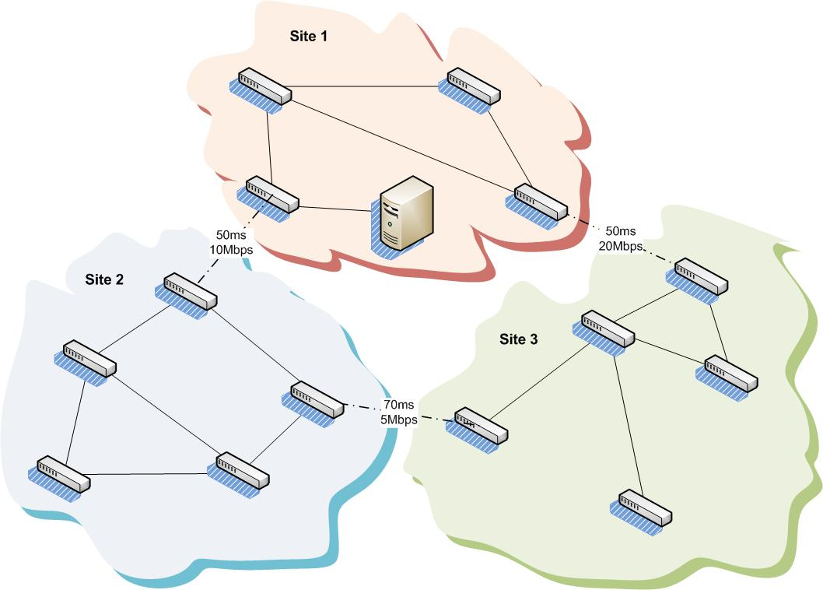
Scalability in Control Plane
Original SDN design suffered from scalability problems
Network growth →
More traffic; and
Higher CPU load for controller
Geographic distribution →
Increased setup latencies
Trivial solution: deploy multiple controllers!

Slide 7
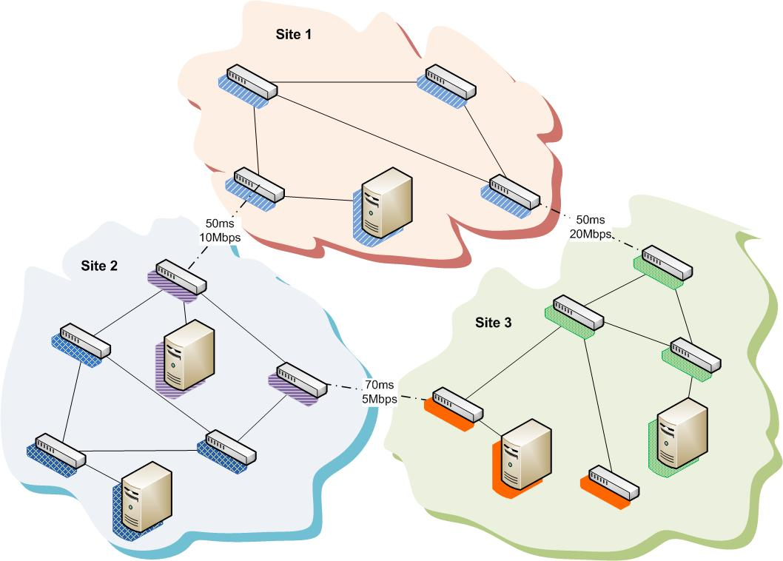
Simplicity vs. Scalability
Trade-off between
Simplicity
Scalability
OpenFlow had chosen simplicity
Network control logic is centralized
Question: Can we have the best of both worlds?
Idea: distributed the control plane but keep the network control logic centralized.

Slide 8
Why Not Direct Synchronization?
Requires significant modifications to controller apps.
The synchronization procedure must handle state conflicts.
Synchronization traffic grows with the number of apps.

Slide 9
HyperFlow
Our approach:
Push all state to all controllers
Make each controller think it is the only controller
Synchronize state among controllers
With minor modifications to applications
Key idea: capture controller events which affect controller state
Controller events: e.g., OpenFlow messages (Packet_in_event, …)
Observation: the number of such events is very small
Replay these events on all other controllers
Improved scalability, preserved simplicity.

Slide 10
HyperFlow Design
HyperFlow has two major components:
Controller component:
An event logger, player, and OpenFlow command proxy.
Implemented as a C++ NOX application.
Event propagation system:
A publish/subscribe system.
Switches are connected to nearby controllers
Upon controller failure:
Switches are reconfigured to connect to another controller

Slide 11
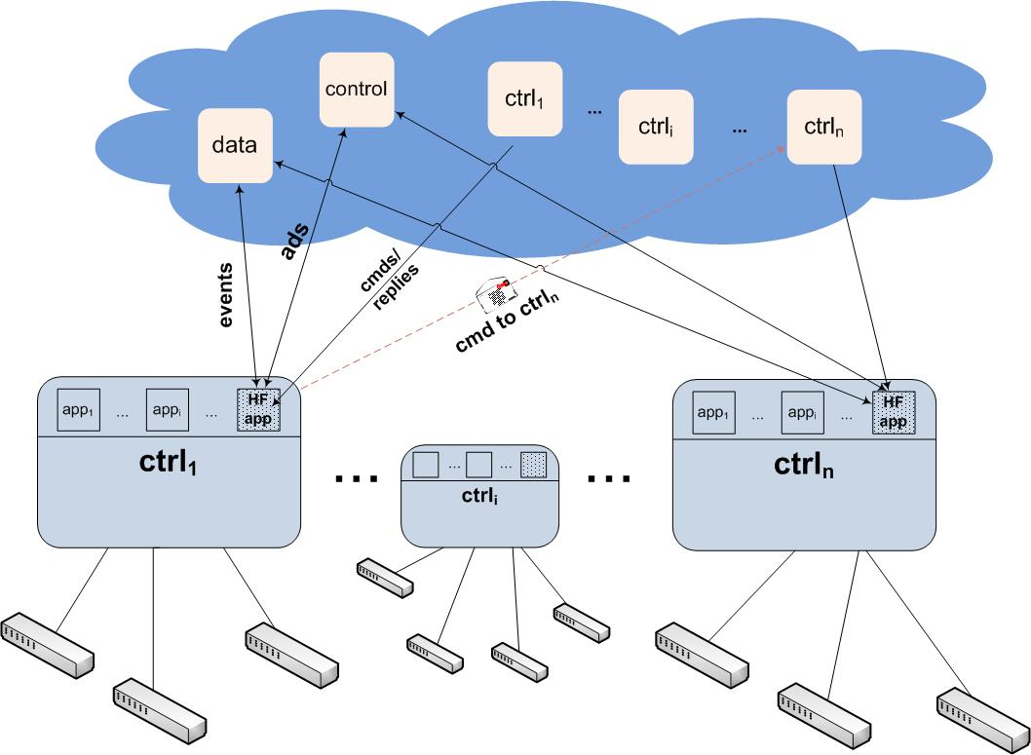
HyperFlow Architecture
Event Propagation
System
Logger, Player, and
Command Proxy

Slide 12
HyperFlow Controller Component
Event logger captures & serializes some control events.
Only captures events which alter the controller state.
Serializes and publishes the events to the pub/sub.
Event player de-serializes & replays captured events.
As if they occurred locally.
If we need to modify a switch remotely
Command proxy sends commands to appropriate switches.
Sends the replies back to the original sender.

Slide 13
Event Propagation System
The pub/sub system has a network-wide scope.
It has three channel types:
Control channel: controllers advertise themselves there.
Data channel: events of general interest published here.
Direct messaging channels: send commands and replies to a specific controller.
Implemented using WheelFS, because:
WheelFS facilitates rapid prototyping.
WheelFS is resilient against network partitioning.

Slide 14
Are Controllers in Sync?
Question: How rapidly can network changes occur in HyperFlow?
Yet guarantee a bounded inconsistency window.
The bottleneck could be either:
The control bandwidth.
The publish/subscribe system.
The publish/subscribe system localizes the HyperFlow sync traffic.
The control bandwidth problem could be alleviated.
How many events can HyperFlow exchange with the publish/subscribe system per sec?

Slide 15
How Often Can the Network Change?
Benchmarked WheelFS:
The number of 3KB-sized files HyperFlow can serialize & publish:
233 such events/sec → not a concern
The number of 3KB-sized files HyperFlow can read & deserialize:
987 such events/sec (multiple publishers)
However, HyperFlow can handle far larger number of events.
During spikes inconsistency window is not bounded.
Switch, host, link changes
Typically 10s of events/sec for thousands of hosts
Number of network changes on average must be
< 1000 events/sec.

Slide 16
Detour: OpenBoot
Controllers fail or are disrupted
Updating or patching controller, installing new applications, and bugs
Controller failure can cause disruptions in network operation
Reconstruction of state, and convergence takes time
OpenBoot: zero-downtime control plane service
Based on the same idea of HyperFlow
Log controller events
Plus, check-pointing
In case of failure
Replay all events to recover state

Slide 17
Summary
HyperFlow enables deploying multiple controllers.
Keeps network control logic centralized.
Yet, provides control plane scalability.
It synchronizes network-wide view among controllers.
By capturing, propagating & playing a few ctrl events.
It guarantees bounded window of inconsistency:
If network changes occur at a rate < 1000 event/sec.
It is resilient to network partitioning.
It enables interconnection of OpenFlow islands.

