Slide 1
Handout # 2: Course Logistics and Introduction
CSC 2229 – Software-Defined Networking
Professor Yashar Ganjali
Department of Computer Science
University of Toronto
yganjali@cs.toronto.edu
http://www.cs.toronto.edu/~yganjali

Slide 2
Today
Outline
What this course is about
Logistics
Course structure, evaluation
What is expected from you
What you want to know
Overview
Packet switching systems
Software-Defined Networking

Slide 3
CSC229: Software-Defined Networking
Graduate level course
Introduction to Software-Defined Networking (SDN)
SDN challenges and opportunities
Course components
Lectures
Research papers
Research project
Theory + Practice
Switching systems are simple enough for us to prove something about them
Yet they are complex enough to work in practice

Slide 4
Outline – Part I
Introduction
Packet switch systems
Evolution of the Internet, and Internet routers
Basic architectural components
Some example architectures
Software-Defined Networking
Innovation in computer networks
Control vs. data plane

Slide 5
Outline – Part II
SDN Challenges and Opportunities
Controller and switch design
Reliability, efficiency, and scalability
Architecture
Programming, correctness, and debugging
SDN security
New abstractions, state management
Network services
Network function virtualization
Network optimization

Slide 6
Logistics
Class location: moved to BA5205 starting the 2nd week
Office hours
Mon. 12 PM - 1 PM, BA5238
Or by appointment
Course web page
http://www.cs.toronto.edu/~yganjali/courses/csc2229/
Please check regularly for announcements.
Class mailing list
Based on e-mail address you provide in class.
Send me an e-mail if you don’t receive a welcome message from that list by the end of today.
Please post (course-related!) questions to this list.

Slide 7
Logistics
Prerequisites
Any introductory course on networking
Algorithms
Basic probability theory
Papers
Will be listed on class web page
Please read suggested papers BEFORE class

Slide 8
Logistics
Grading
Active participation in class and discussions: 10%
Paper presentations: 30%
Final project: 60%
Proposal: 5% - 1-2 pages
Intermediate report: 10% - 3 pages
Presentation: 15% - Last week of classes
Final report: 30% - 6 pages
Deadlines
5% deduction for each day of delay, up to 4 days.
Exception: final report deadline is hard.

Slide 9
Logistics
Final Project
Groups of three students
Project topic
Choose from the offered list; or
Talk to me and define your own

Slide 10
Logistics
Academic Integrity
All submissions must present original, independent work.
We take academic offenses very seriously.
Please read
“Guideline for avoiding plagiarism”
http://www.cs.toronto.edu/~fpitt/documents/plagiarism.html
“Advice about academic offenses”
http://www.cs.toronto.edu/~clarke/acoffences/

Slide 11
Logistics
Accessibility Needs
The University of Toronto is committed to accessibility. If you require accommodations or have any accessibility concerns, please visit http://studentlife.utoronto.ca/accessibility as soon as possible.

Slide 12
Acknowledgements
Special thanks to:
Prof. Nick McKeown, Stanford University
Prof. Balaji Prabhakar, Stanford University
Prof. Jennifer Rexford, Princeton University
Prof. Nick Feamster, University of Chicago

Slide 13
Questions?
What else do you like to know
about this course?

Slide 14
Introduction to Packet Switching
Background
What is a router?
Router architecture
Packet processing in routers
IP address lookup
Packet buffering
Switching
Router architectures
The evolution
Software-Defined Networking

Slide 15
What is Routing?
R3
R1
A
R4
D
B
E
D
R2
C
Destination
Next Hop
R5
F
D
R3
E
R3
F
R5

Slide 16
What is Routing?
R3
R1
A
R4
D
1
4
16
32
Ver
HLen
T.Service
Total Packet Length
B
Fragment ID
Flags
Fragment Offset
E
D
20 bytes
TTL
Protocol
Header Checksum
R2
C
Source Address
Destination
Next Hop
R5
Destination Address
F
D
R3
Options (if any)
E
R3
Data
F
R5

Slide 17
What is Routing?
R3
R1
A
R4
D
B
E
R2
C
R5
F

Slide 18
Points of Presence (POPs)
POP3
POP2
POP1
A
POP4
D
B
POP5
E
C
POP6
POP7
POP8
F

Slide 19
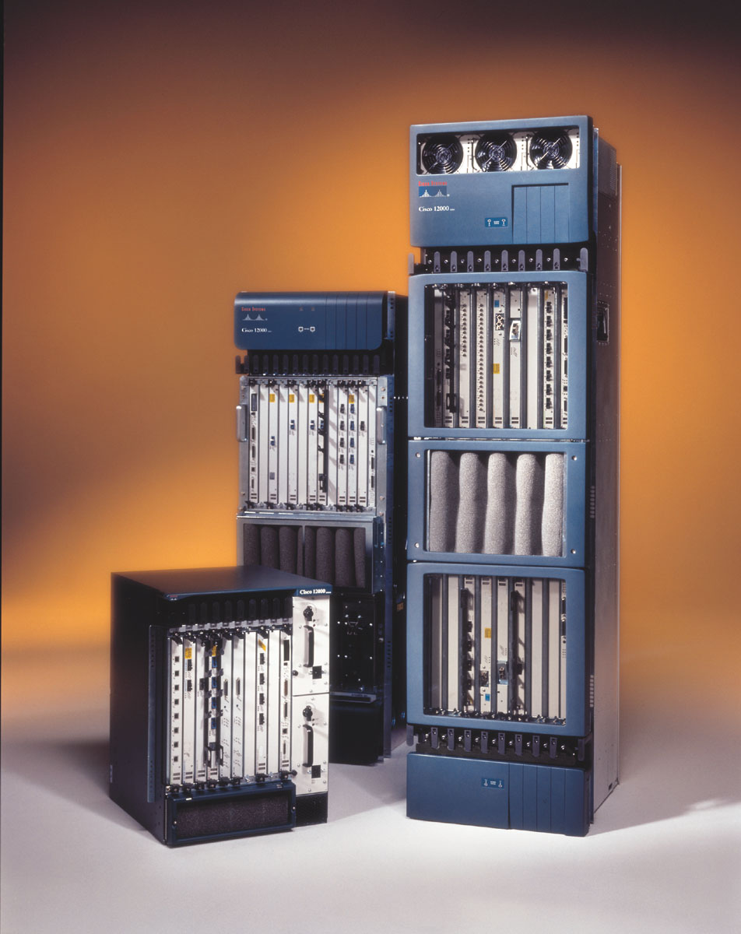
Where High Performance Routers are Used
R2
(2.5 Gb/s)
(2.5 Gb/s)
R1
R6
R5
R4
R3
R7
R9
R8
R10
R11
R12
R14
R13
R16
R15
(2.5 Gb/s)
(2.5 Gb/s)

Slide 20
What a Router Looks Like
Cisco CRS-X
23”
Capacity: 6.4Tb/s Power: 15.2kW
7ft
3ft
Notes:
Weight ~800 Kg

Slide 21
Basic Architectural Components of an IP Router
Routing
Protocols
Routing
Table
Control Plane
Data-path
per-packet
processing
Forwarding
Table
Switching

Slide 22
Packet Switching – Simple Router Model
“4”
Link 1, ingress
Choose
Egress
Link 1, egress
Link 2
Link 2, ingress
Choose
Egress
Link 2, egress
R1
“4”
Link 1
Link 3
Link 3, ingress
Choose
Egress
Link 3, egress
Link 4
Link 4, ingress
Choose
Egress
Link 4, egress

Slide 23
Introduction to Packet Switching
Background
What is a router?
Router architecture
Packet processing in routers
IP address lookup
Packet buffering
Switching
Router architectures
The evolution
Software-Defined Networking

Slide 24
Per-packet Processing in an IP Router
1. Accept packet arriving on an incoming link.
2. Lookup packet destination address in the forwarding table, to identify outgoing port(s).
3. Manipulate packet header: e.g., decrement TTL, update header checksum.
4. Send packet to the outgoing port(s).
5. Buffer packet in the queue.
6. Transmit packet onto outgoing link.

Slide 25
Generic Router Architecture
Header Processing
Data
Hdr
Lookup
IP Address
Update
Header
Queue
Packet
Data
Hdr
IP Address
Next Hop
Address
Table
Buffer
Memory
~1M prefixes
Off-chip DRAM
~1M packets
Off-chip DRAM

Slide 26
Generic Router Architecture
Data
Hdr
Data
Header Processing
Hdr
Buffer
Manager
Lookup
IP Address
Update
Header
Address
Table
Buffer
Memory
Data
Hdr
Data
Header Processing
Hdr
Buffer
Manager
Lookup
IP Address
Update
Header
Address
Table
Buffer
Memory
Data
Hdr
Data
Hdr
Header Processing
Buffer
Manager
Lookup
IP Address
Update
Header
Address
Table
Buffer
Memory

Slide 27
Why are Fast Routers Difficult to Make?
It’s hard to keep up with Moore’s Law:
The bottleneck is memory speed.
Memory speed is not keeping up with Moore’s Law.
Moore’s Law is too slow:
Routers need to improve faster than Moore’s Law.

Slide 28
Router Performance Exceeds Moore’s Law
Growth in capacity of commercial routers:
Capacity 1992 ~ 2Gb/s
Capacity 1995 ~ 10Gb/s
Capacity 1998 ~ 40Gb/s
Capacity 2001 ~ 160Gb/s
Capacity 2003 ~ 640Gb/s
Capacity 2007 ~ 4Tb/s
Capacity 2010 ~ 16Tb/s
Capacity 2020 ~ 1Pb/s?
Average growth rate: 2x / 18 months.

Slide 29
Introduction to Packet Switching
Background
What is a router?
Router architecture
Packet processing in routers
IP address lookup
Packet buffering
Switching
Router architectures
The evolution
Software-Defined Networking

Slide 30
Generic Router Architecture
Header Processing
Buffer
Manager
Lookup
IP Address
Lookup
IP Address
Update
Header
Address
Table
Buffer
Memory
Address
Table
Header Processing
Buffer
Manager
Lookup
IP Address
Lookup
IP Address
Update
Header
Address
Table
Buffer
Memory
Address
Table
Header Processing
Buffer
Manager
Lookup
IP Address
Lookup
IP Address
Update
Header
Address
Table
Buffer
Memory
Address
Table

Slide 31
IP Address Lookup
Why it’s thought to be hard:
It’s not an exact match: it’s a longest prefix match.
The table is large: about 850,000 entries today, and growing.
The lookup must be fast: about 4-5ns for a 100Gb/s line.

Slide 32
IP Lookups find Longest Prefixes
128.9.172.0/24
128.9.16.0/21
128.9.172.0/21
65.0.0.0/8
142.12.0.0/19
128.9.0.0/16
0
128.9.16.14
2³²-1
Routing lookup: Find the longest matching prefix (aka the most specific route) among all prefixes that match the destination address.

Slide 33
IP Address Lookup
Why it’s thought to be hard:
It’s not an exact match: it’s a longest prefix match.
The table is large: about 850,000 entries today, and growing.
The lookup must be fast: about 4-5ns for a 100Gb/s line.

Slide 34
Address Tables are Large
Source: http://www.cidr-report.org/

Slide 35
IP Address Lookup
Why it’s thought to be hard:
It’s not an exact match: it’s a longest prefix match.
The table is large: about 850,000 entries today, and growing.
The lookup must be fast: about 4-5ns for a 100Gb/s line.

Slide 36
Lookups Must be Fast
Line rates have been constantly growing over time.
100Gb/s to 500Gb/s
Packet sizes have not changed
Max: 1500 bytes (9000 jumbo packets)
Average: around 250 bytes
Min: 40 bytes
Time to process each packet around a few nano-seconds

Slide 37
Introduction to Packet Switching
Background
What is a router?
Router architecture
Packet processing in routers
IP address lookup
Packet buffering
Switching
Router architectures
The evolution
Software-Defined Networking

Slide 38
Generic Router Architecture
Header Processing
Queue
Packet
Buffer
Manager
Lookup
IP Address
Update
Header
Buffer
Memory
Address
Table
Buffer
Memory
Header Processing
Queue
Packet
Buffer
Manager
Lookup
IP Address
Update
Header
Buffer
Memory
Address
Table
Buffer
Memory
Header Processing
Queue
Packet
Buffer
Manager
Lookup
IP Address
Update
Header
Buffer
Memory
Address
Table
Buffer
Memory

Slide 39
Fast Packet Buffers
Example: 40Gb/s packet buffer
Size = RTT*BW = 10Gb; 40 byte packets
Write Rate, R
Buffer
Manager
Read Rate, R
1 packet
every 8 ns
1 packet
every 8 ns
Buffer
Memory
Use SRAM?
+ fast enough random access time, but
- too low density to store 10Gb of data.
Use DRAM?
+ high density means we can store data, but
- too slow (50ns random access time).
Notes:
How fast?
Get into the motivation – say OC768 line rate buffering is a goal.
- Just mention directly the amount of buffering required.
Why is it not possible today?
Why is it intersting….
Talks abut SRAM/DRAM.

Slide 40
Introduction to Packet Switching
Background
What is a router?
Router architecture
Packet processing in routers
IP address lookup
Packet buffering
Switching
Router architectures
The evolution
Software-Defined Networking

Slide 41
Generic Router Architecture
Data
1
1
Hdr
Header Processing
Queue
Packet
Lookup
IP Address
Update
Header
Address
Table
Buffer
Memory
Data
2
2
N times line rate
Hdr
Header Processing
Queue
Packet
Lookup
IP Address
Update
Header
Address
Table
Buffer
Memory
N times line rate
Data
Hdr
Header Processing
N
N
Queue
Packet
Lookup
IP Address
Update
Header
Address
Table
Buffer
Memory

Slide 42
Generic Router Architecture
Data
Hdr
Header Processing
Lookup
IP Address
Update
Header
Queue
Packet
1
1
Address
Table
Buffer
Memory
Data
Hdr
Data
Hdr
Header Processing
Data
Queue
Packet
2
2
Hdr
Lookup
IP Address
Update
Header
Address
Table
Buffer
Memory
Scheduler
Data
Hdr
Header Processing
Lookup
IP Address
Update
Header
Queue
Packet
N
N
Address
Table
Buffer
Memory
Data
Hdr

Slide 43
A Router with Output Queues
The best that any queueing system can achieve.

Slide 44
A Router with Input Queues Head of Line Blocking
The best that any queueing system can achieve.

Slide 45
Head of Line Blocking

Slide 46
Virtual Output Queues

Slide 47
A Router with Virtual Output Queues
The best that any queueing system can achieve.

Slide 48
Generic Router Architecture
Data
1
1
Hdr
Header Processing
Queue
Packet
Lookup
IP Address
Update
Header
Address
Table
Buffer
Memory
Data
2
2
N times line rate
Hdr
Header Processing
Queue
Packet
Lookup
IP Address
Update
Header
Address
Table
Buffer
Memory
N times line rate
Data
Hdr
Header Processing
N
N
Queue
Packet
Lookup
IP Address
Update
Header
Address
Table
Buffer
Memory

Slide 49
Introduction to Packet Switching
Background
What is a router?
Router architecture
Packet processing in routers
IP address lookup
Packet buffering
Switching
Router architectures
The evolution
Software-Defined Networking

Slide 50
First Generation Routers
Shared Backplane
CPU
Buffer
Memory
Route
Table
CPU
Line Interface
Memory
Line
Interface
Line
Interface
Line
Interface
MAC
MAC
MAC
Typically <0.5Gb/s aggregate capacity

Slide 51
Second Generation Routers
CPU
Route
Table
Buffer
Memory
Line
Card
Line
Card
Line
Card
Buffer
Memory
Buffer
Memory
Buffer
Memory
Fwding
Cache
Fwding
Cache
Fwding
Cache
MAC
MAC
MAC
Typically <5Gb/s aggregate capacity

Slide 52
Third Generation Routers
Switched Backplane
Line
Card
CPU
Card
Line
Card
Local
Buffer
Memory
Local
Buffer
Memory
CPU
Line Interface
Routing
Table
Memory
Fwding
Table
Fwding
Table
MAC
MAC
Typically <50Gb/s aggregate capacity

Slide 53
Fourth Generation Routers/Switches Optics inside a router for the first time
Optical links
100s
of metres
Switch Core
Linecards
0.3 - 10Tb/s routers in development

Slide 54
Introduction to Packet Switching
Background
What is a router?
Router architecture
Packet processing in routers
IP address lookup
Packet buffering
Switching
Router architectures
The evolution
Software-Defined Networking

Slide 55
Software Defined Networks
Control Plane
Control Plane
Data Plane
Data Plane
Control Plane
Control Plane
Data Plane
Data Plane

Slide 56
Software Defined Networks – Cont’d
Controller
OpenFlow
Protocol
PC
OpenFlow Switch
SSL
Data Plane
Data Plane
Data Plane
Data Plane

Slide 57
Final Comments/Questions
What other line rate functionalities can you think of (other than packet forwarding)?
Are they performance bottleneck in today’s networks?
How would they evolve over time?
Do they belong on data path?
Control and management complexity
What control functionalities do we have in networks today?
How do we manage those?
What can we do to simplify this?

