Slide 1

Evolutionary Algorithms and Artificial Intelligence
Paul Grouchy
PhD Candidate
University of Toronto Institute for Aerospace Studies
pgrouchy@gmail.com

Slide 2
Intro to Evolutionary Algorithms (EAs)
Program flow of a Genetic Algorithm (GA):
  Randomly initialize population of “genomes”
  Evaluate “fitness” of all genomes
  Select high-fitness genomes to become “parents”
  Produce new population of “offspring” genomes from “parent” genomes
  End of a single “generation”

Slide 3
Intro to Evolutionary Algorithms (EAs)
Toy problem: Maximize the sum of 5 bits
Genome:
Fitness
(sum of bits)
0 | 1 | 1 | 0 | 0
2

Slide 4
Intro to Evolutionary Algorithms (EAs)
Toy problem: 1 generation
0 | 1 | 0 | 0 | 0
0 | 1 | 1 | 0 | 0
0 | 1 | 0 | 0 | 1
0 | 0 | 0 | 1 | 0
fitness: 1
fitness: 2
fitness: 2
fitness: 1

Slide 5
Intro to Evolutionary Algorithms (EAs)
Toy problem: 1 generation
0 | 1 | 1 | 0 | 0
0 | 0 | 0 | 1 | 0
Parents
crossover point
crossover point
0 | 1 | 1 | 1 | 0
0 | 1 | 0 | 0 | 0
0 | 0 | 0 | 0 | 0
Offspring
mutation

Slide 6
Intro to Evolutionary Algorithms (EAs)
Mutation
Generation t+1
0 | 1 | 1 | 0 | 1
0 | 1 | 0 | 0 | 1
select and reproduce parents based on fitness values
Crossover
0 | 1 | 1 | 0 | 0
0 | 1 | 0 | 1 | 1
evaluate fitness of each genome using fitness function
0 | 1 | 1 | 1 | 1
Generation t

Slide 7
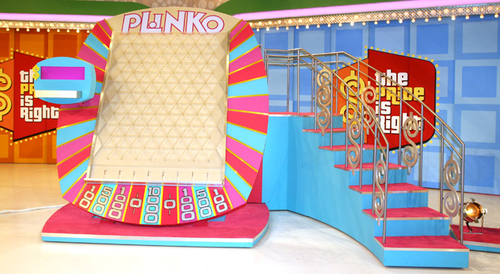
Intro to Evolutionary Algorithms (EAs)

Slide 8
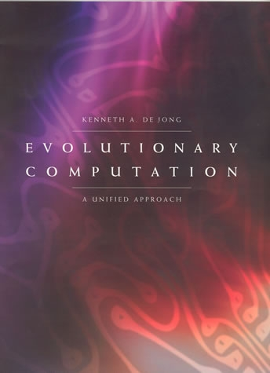
Intro to Evolutionary Algorithms (EAs)
Evolutionary Computation: A Unified Approach (2006)
Kenneth De Jong

Slide 9
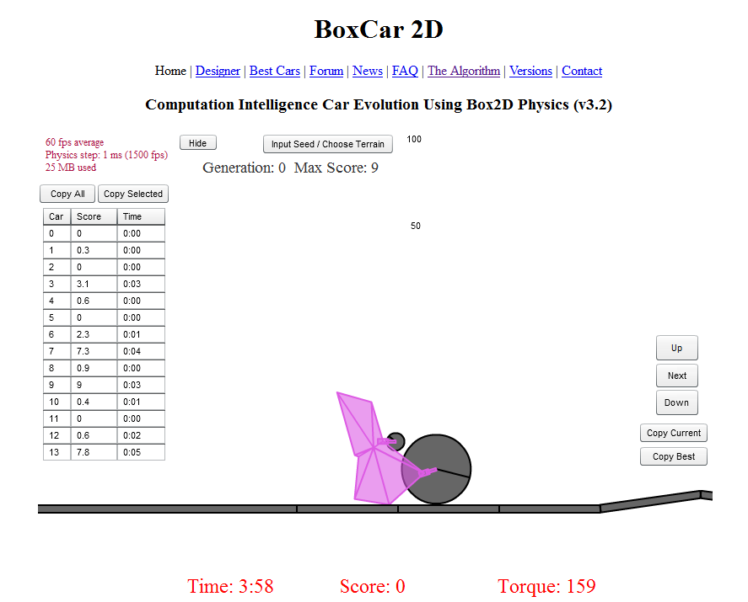
EAs as AIs
http://boxcar2d.com/

Slide 10
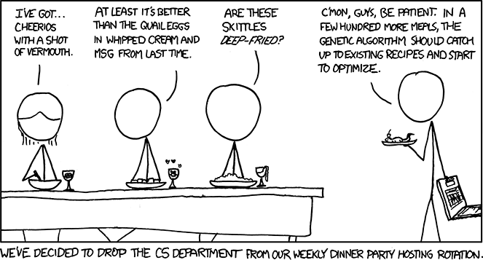
https://xkcd.com/720/

Slide 11
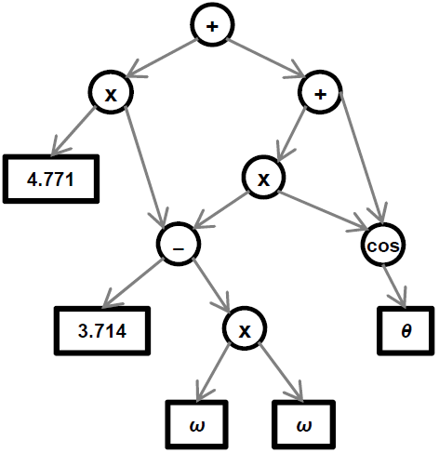

EAs as AIs
Eureqa (http://creativemachines.cornell.edu/eureqa)
  Based on Genetic Programming (GP):

Slide 12
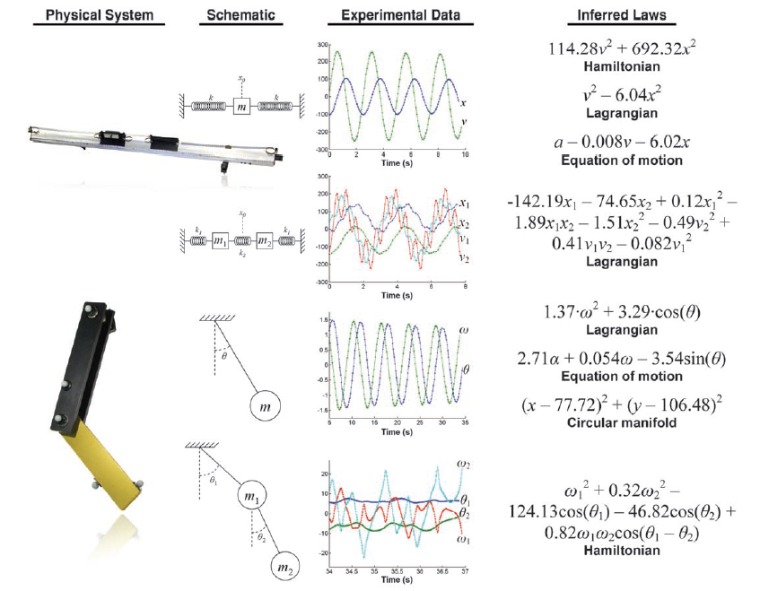
EAs as AIs
Eureqa (http://creativemachines.cornell.edu/eureqa)

Slide 13
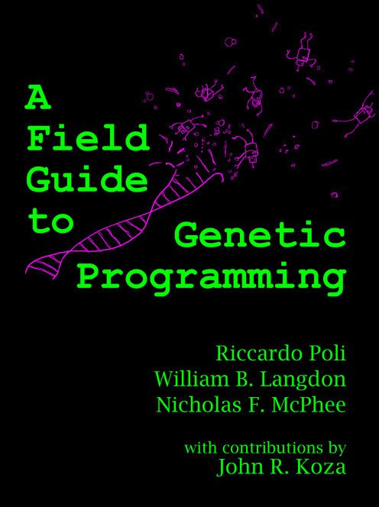
EAs as AIs
http://www.gp-field-guide.org.uk/
(FREE!)

Slide 14
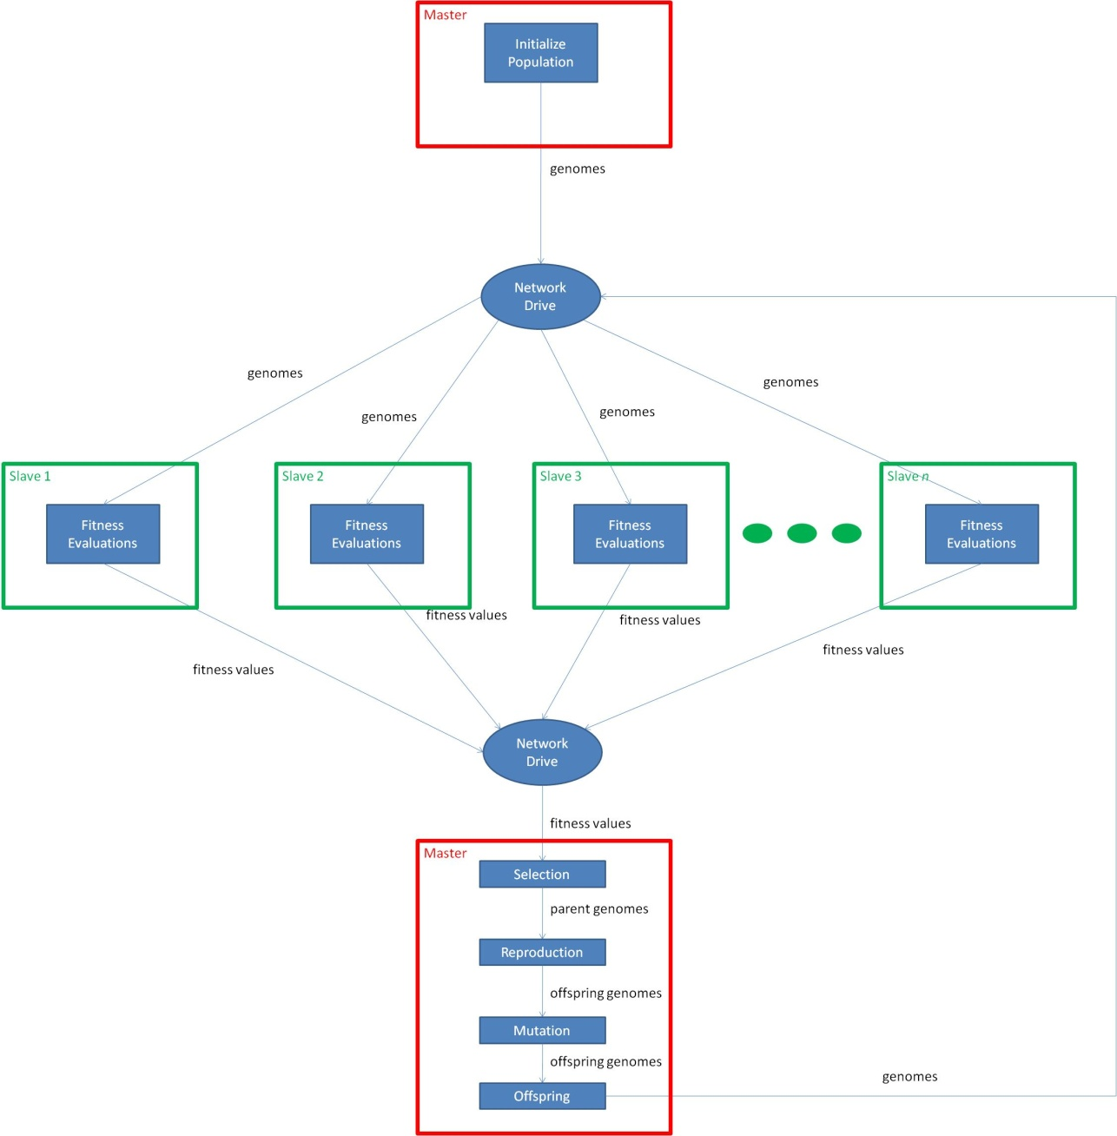
EAs are Embarrassingly Parallelizable

Slide 15
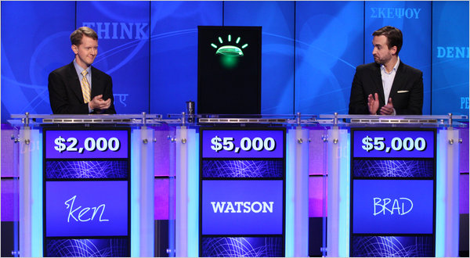
AI vs. AGI
AI:

Slide 16
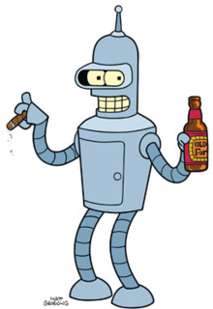
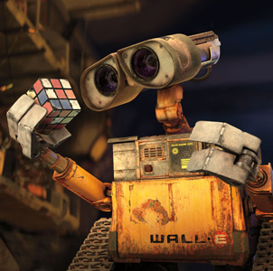
AI vs. AGI
Artificial General Intelligence (AGI):

Slide 17
AI vs. AGI
Artificial General Intelligence (AGI):

Slide 18
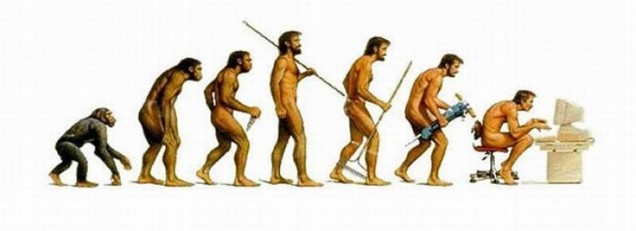
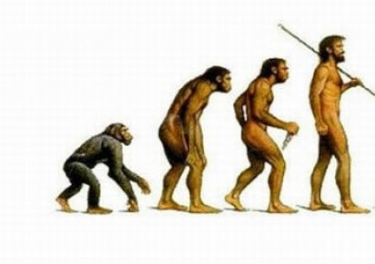

EAs to evolve AIs

Slide 19
EAs to evolve AIs
Generation t+1
select and reproduce parents based on fitness values
evaluate fitness of each genome using fitness function
Generation t

Slide 20
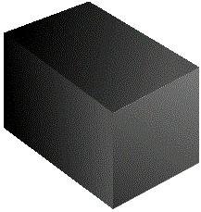
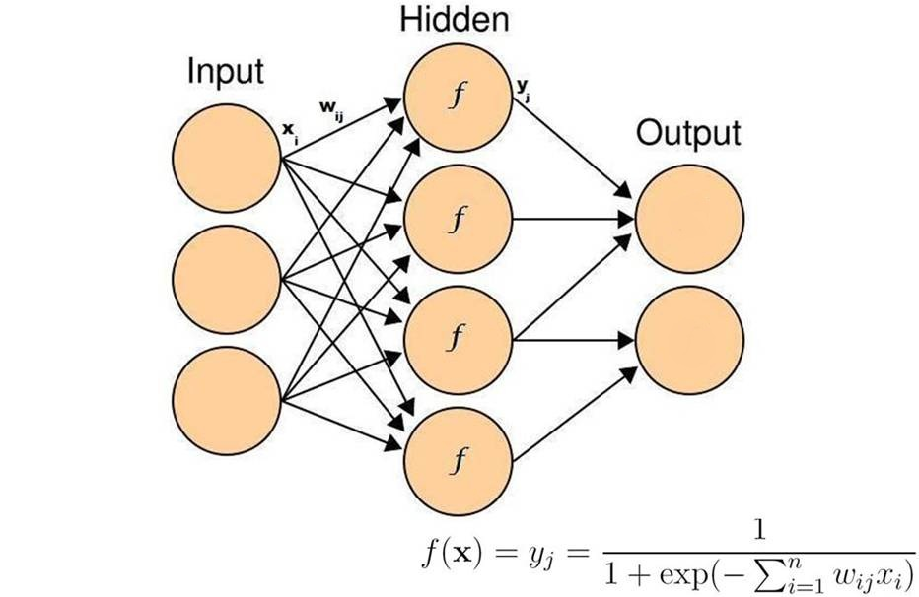
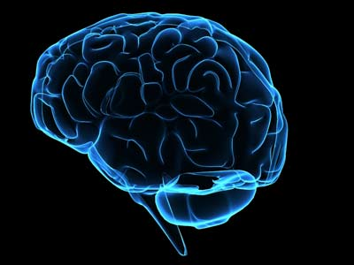
EAs to evolve AIs
Inputs
Outputs

Slide 21
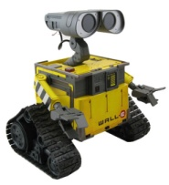
EAs to evolve AIs
0.32 | 1.10 | -0.21 | … | 0.11
=
select and reproduce parents based on fitness values
evaluate fitness of each genome using fitness function

Slide 22
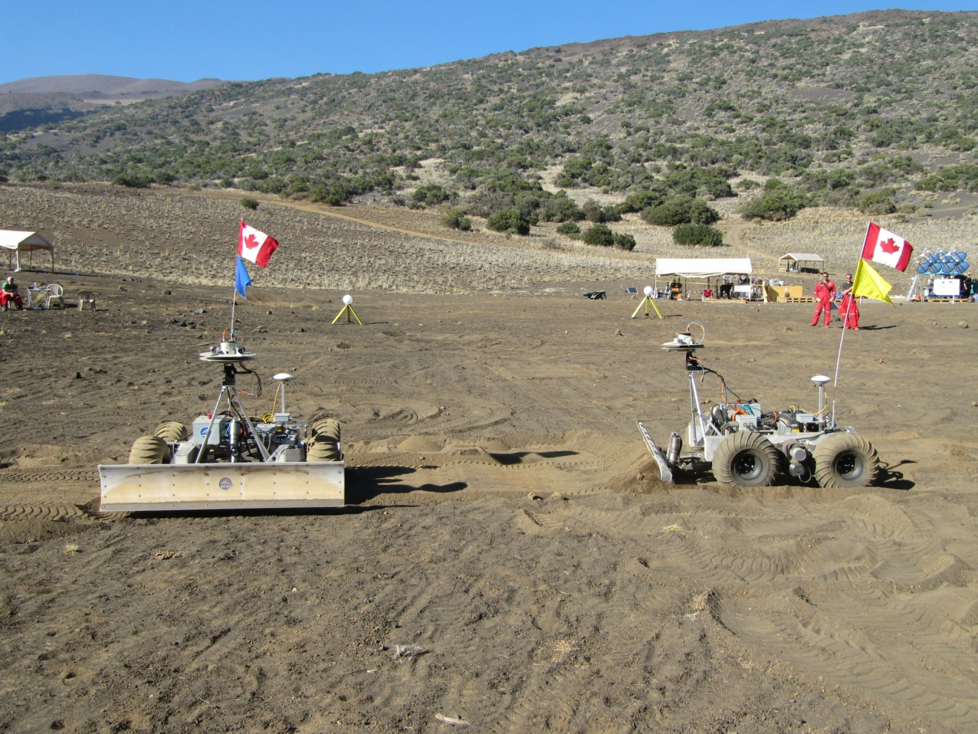
EAs to evolve AIs

Slide 23
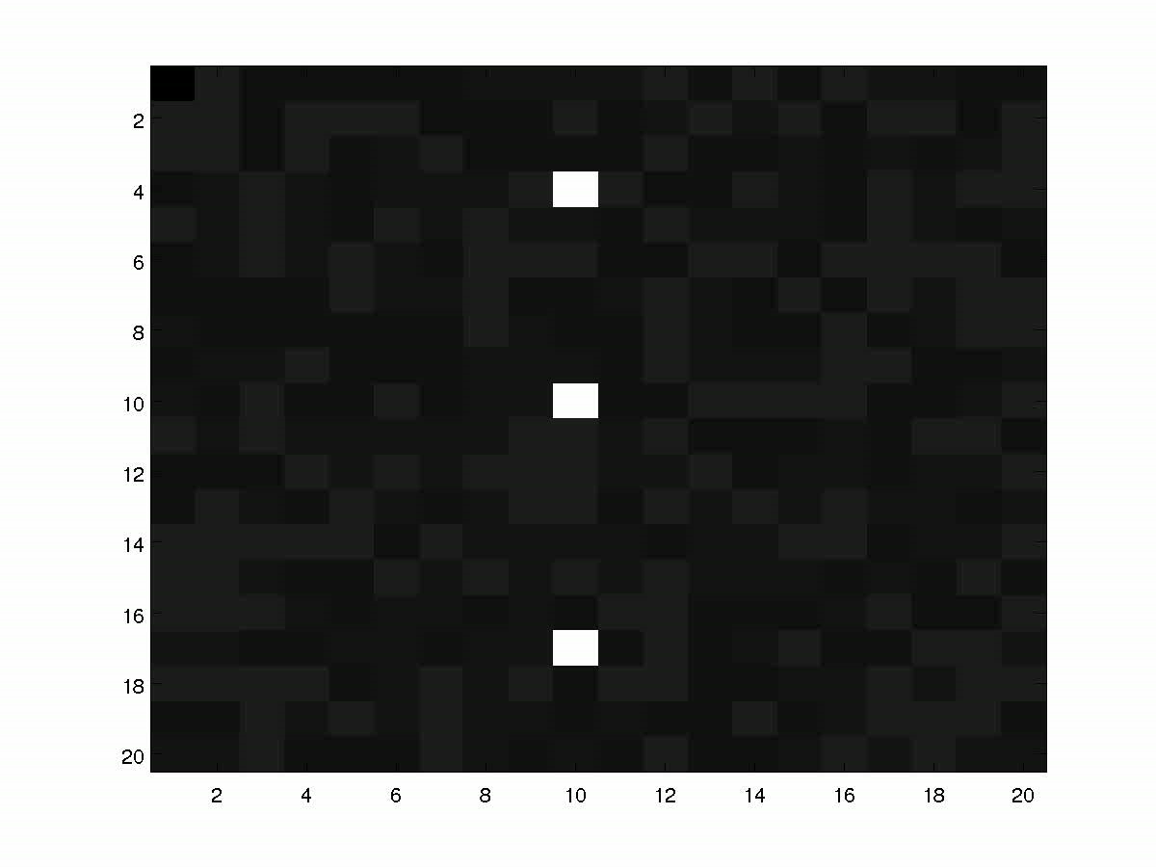
EAs to evolve AIs

Slide 24
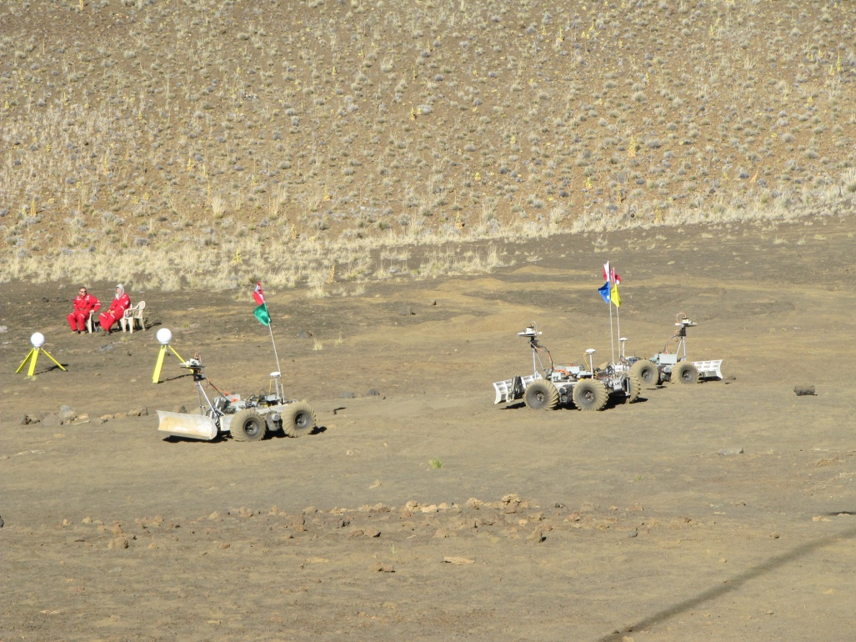
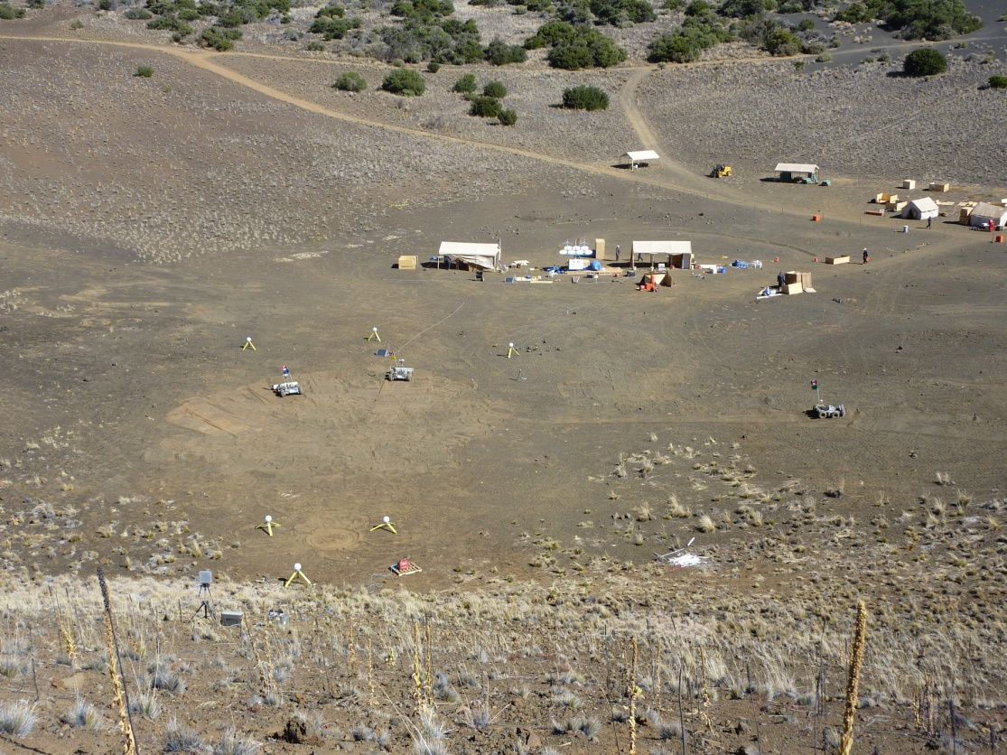
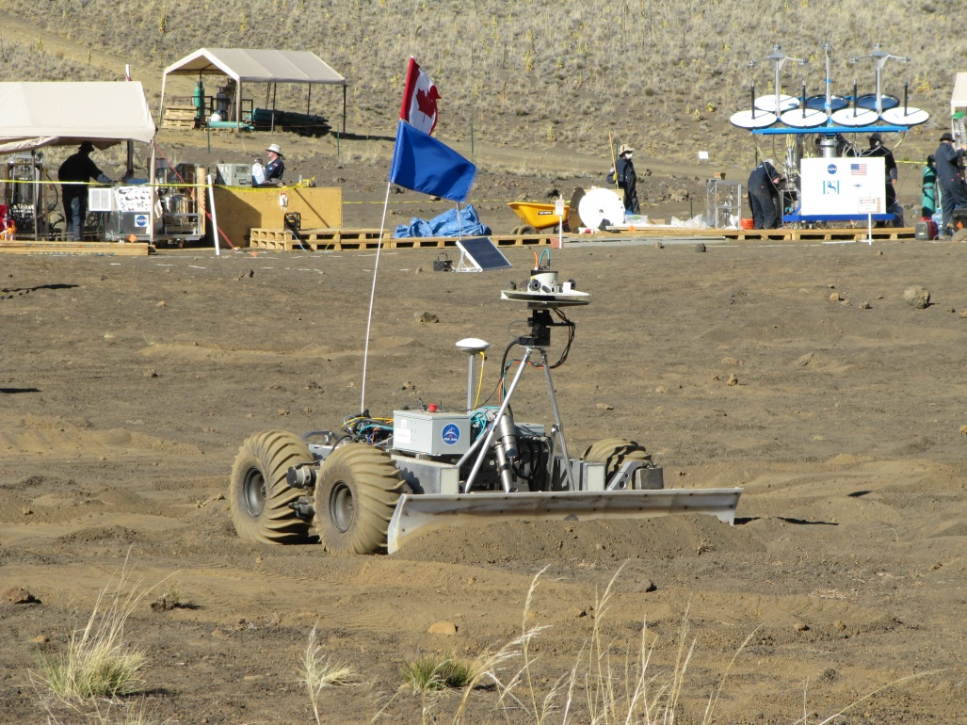
EAs to evolve AIs

Slide 25
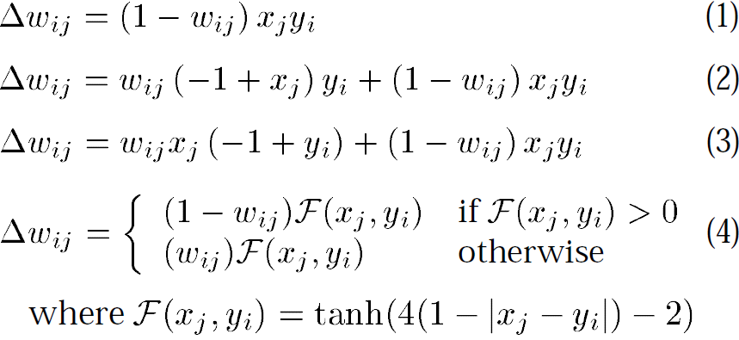
Learning and Generalizability
[Urzelai & Floreano, 2001]

Slide 26
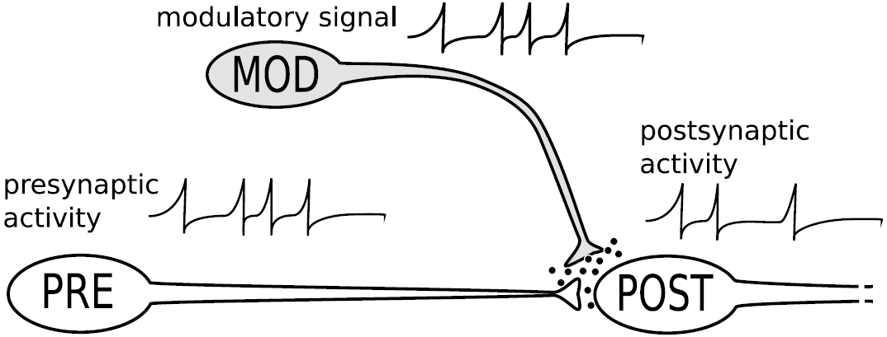
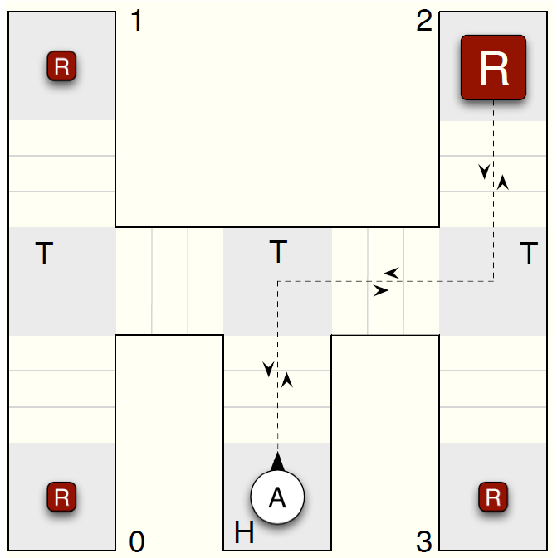
Learning and Generalizability
[Soltoggio et al., 2007]

Slide 27
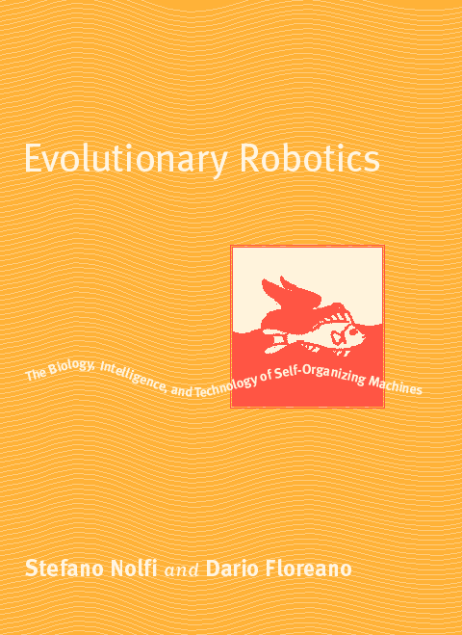
EAs to evolve AIs

Slide 28
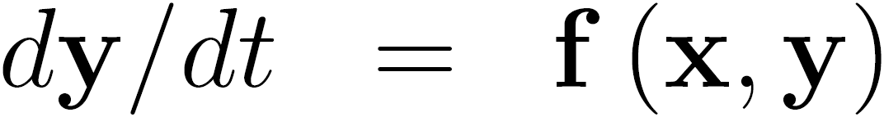
Can we evolve an abstraction of a brain?
0D3v0
Ordinary Differential Equation Evolution

Slide 29
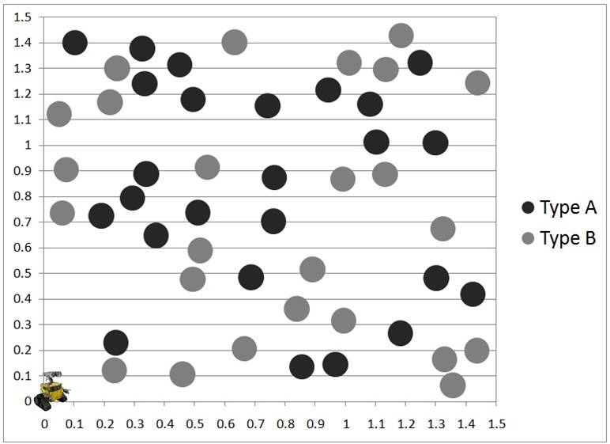
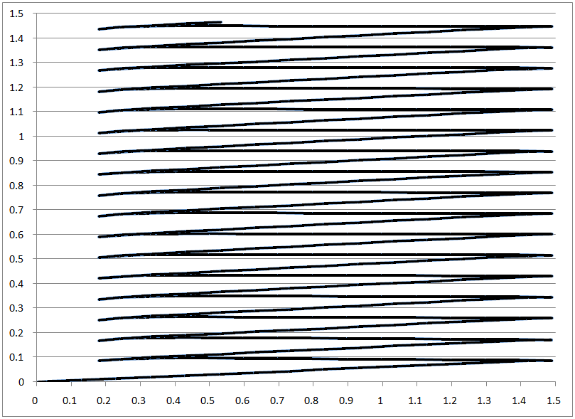
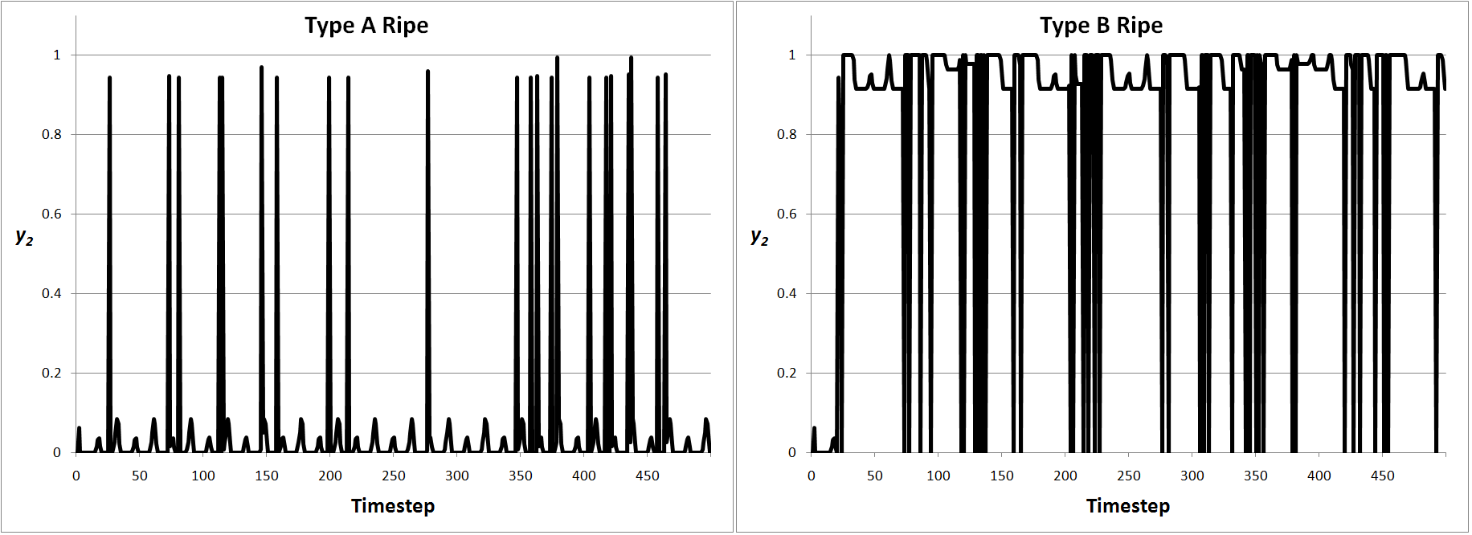
Learning Capabilities
Simulation environment
Typical evolved forage path
Typical evolved “eat” output

Slide 30
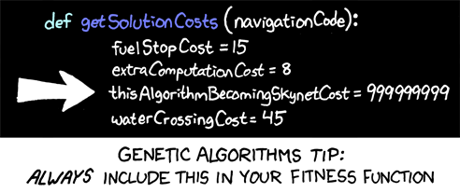
https://xkcd.com/534/

Slide 31
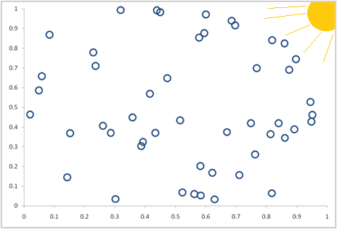
ALife/Evolution of Communication Sim
(x,y)
(Δx,Δy)
c_{in}
c_{out}

Slide 32
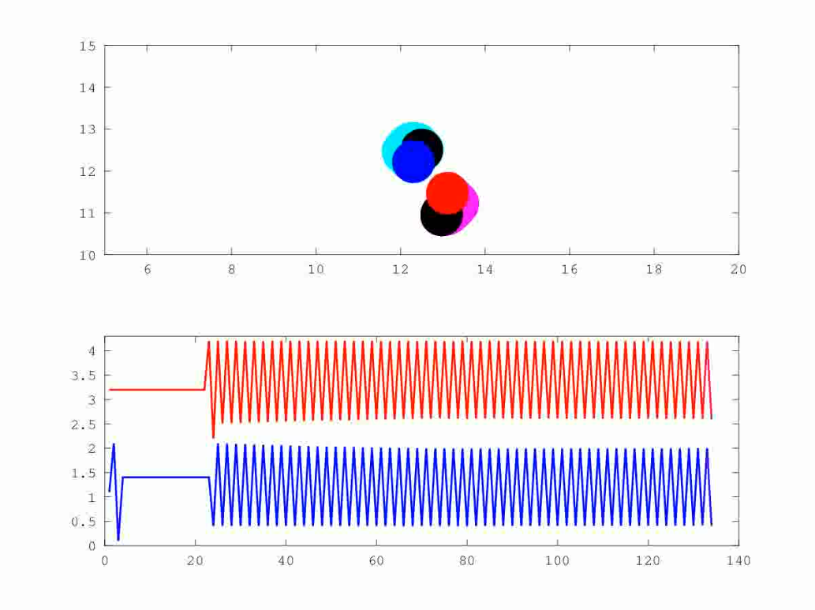
ALife/Evolution of Communication Sim

Slide 33

ALife/Evolution of Communication Sim

Slide 34
ALife/Evolution of Communication Sim

Slide 35
ALife/Evolution of Communication Sim

Slide 36
ALife/Evolution of Communication Sim

Slide 37
ALife/Evolution of Communication Sim

Slide 38
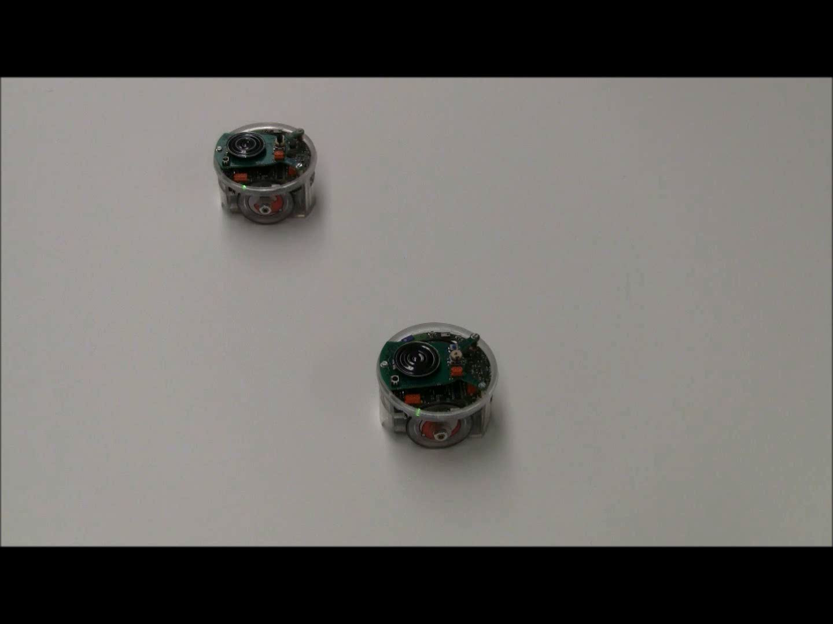
ALife/Evolution of Communication Sim

Slide 39
THANK YOU!!!
Paul Grouchy
PhD Candidate
University of Toronto Institute for Aerospace Studies
pgrouchy@gmail.com

