Slide 1
Getting to the root of concurrent binary search tree performance
Maya Arbel-Raviv, Technion
Trevor Brown, IST Austria
Adam Morrison, Tel Aviv U

Slide 2
Motivation
Optimistic concurrent search trees are crucial in many applications
  (e.g., in-memory databases, internet routers and operating systems)
We want to understand their performance
We study BSTs because there are many variants,
making comparisons easier

Slide 3
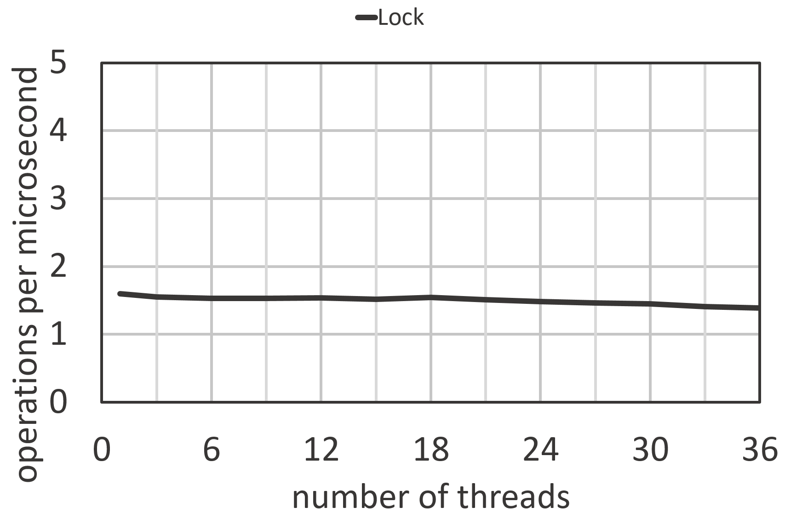
BST protected by a global lock
Synthetic experiment:
Insert 100,000 keys, then
n threads perform searches

Slide 4
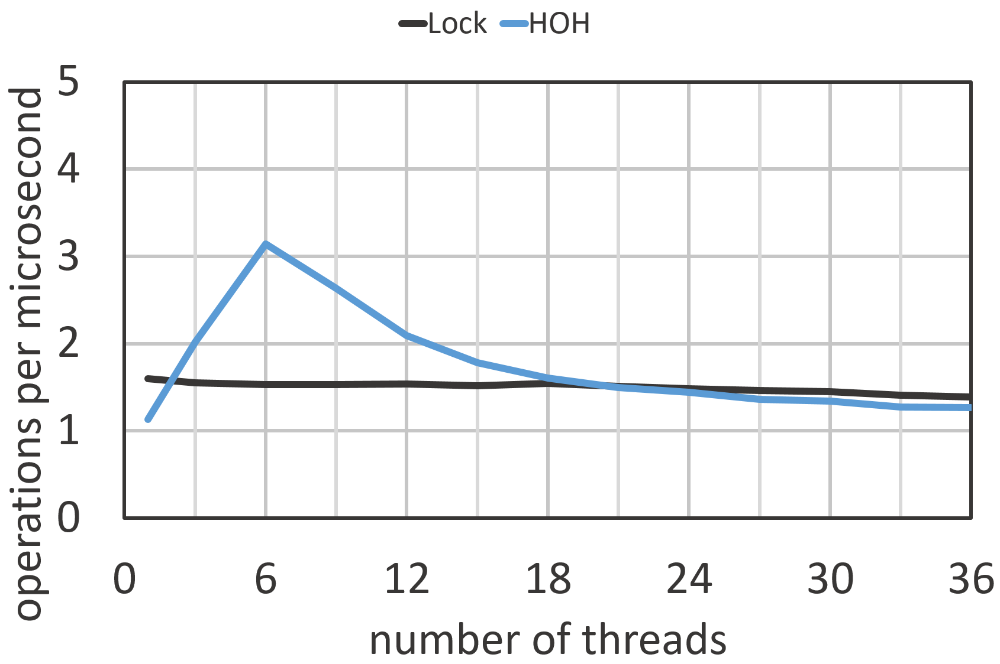
Hand-over-hand locking (HOH)
Same experiment

Slide 5

Locking and cache coherence
Evict this cache line for all threads!
a
Evict this cache line for all threads!
m
Algorithm | L2 misses / search | L3 misses / search
Global lock | 15.9 | 3.9
HOH | 25.1 | 7.7

Slide 6
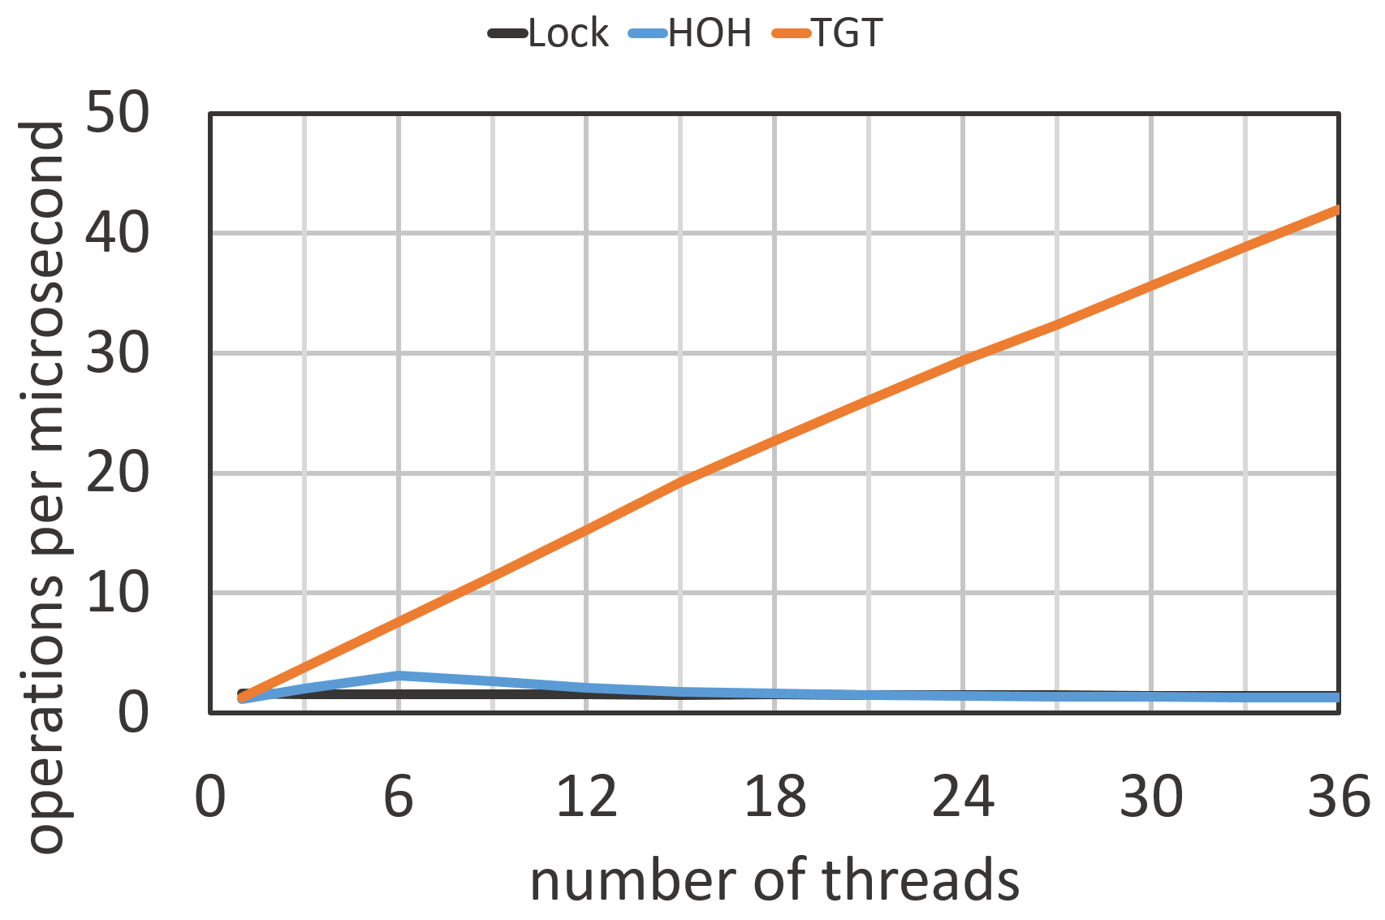
Achieving high performance
NO locking while searching!
Example: Unbalanced DGT BST
  Standard BST search
  No synchronization!

Slide 7
State of the art BSTs
Not covered: lock-free balanced BSTs …
BST | Balanced? | Tree type | Search overhead
BCCO | Y | Internal* | Read per-node
DVY |  | Internal*
AA |  | Internal | Write per-search
DGT |  | External
Blocking
HJ |  | Internal | Read per-node
RM |  | Internal | Read per-search
NM |  | External
EFRB |  | External
Lock-free
Notes:
* Technically, these are partially external, but when trees are prefilled with 100% insertion, as in the workloads we are considering, they are actually internal.

Slide 8
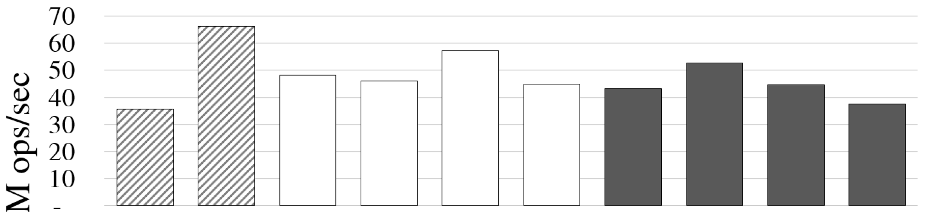
How do they perform?
Experiment: 100% searches with 64 threads
Balanced
Internal
External
BCCO1 | BCCO2 | HJ | DVY | RM | AA | NM1 | NM2 | DGT | EFRB
Read per-node | Read per-node | Read per-node |  | Read per-search | Write per-search
Search overhead

Slide 9
Basic implementation issues
Bloated nodes
  Why does node size matter?
  Larger nodes → fewer fit in cache → more cache misses
Scattered fields
  Why does node layout matter?
  Searches may only access a few fields
  Scattered fields → more cache lines → more cache misses
Incorrect usage of C volatile
  Missing volatiles → correctness issue
  Unnecessary volatiles → performance issue

Slide 10
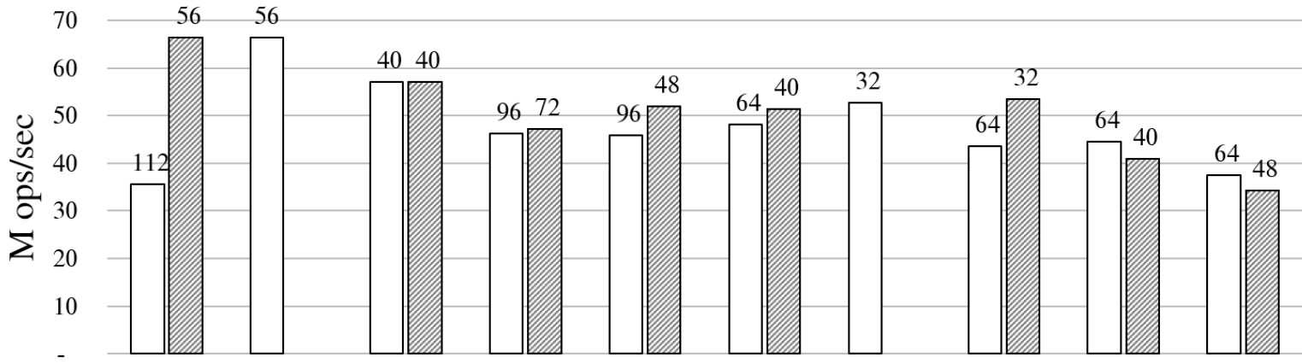

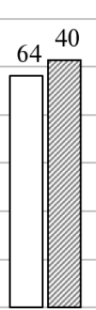
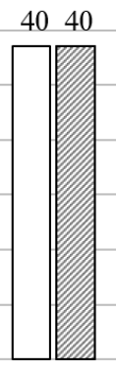
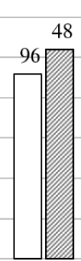
impact of fixing these issues
Balanced
Internal
External
BCCO1 | BCCO2 | HJ | DVY | RM | AA | NM1 | NM2 | DGT | EFRB
Read per-node | Read per-node | Read per-node |  | Read per-search | Write per-search
X |  | X | X |  | X |  | X | X | X
X |  |  | X
 |  | X | X |  | X | X | X | X | X
Search overhead
Bloated nodes
Scattered fields
Incorrect C volatile

Slide 11
How a fast allocator works
Jemalloc: threads allocate from private arenas
Each thread has an arena for each size class:
  8, 16, 32, 48, 64, 80, 96, 112, 128, 192, 256, 320, 384, 448, 512, …
Jemalloc per-thread allocation
malloc(48)
malloc(36)
malloc(40)
malloc(44)
malloc(32)
malloc(17)
malloc(40)
…
malloc(33)
8
<---- 4096 byte page ---->
16
Arenas
0
32
32
...
48
0
48
96
144
192
4048
64

Slide 12
Cache line crossings
8
These nodes cross cache lines!
16
0
16
32
48
32
0
32
64
96
48
0
48
96
144
Fixing bloated nodes can worsen performance!
64
0
64
128
192
Cache line
Cache line
Cache line
Cache line
Not a big deal if the tree
fits in the cache
If the tree does not fit in cache,
double cache misses for half of your nodes!

Slide 13
cache sets
Hashing a cache line to a bucket:
physical address mod 4096
Cache is sort of like a hash table
Maps addresses to buckets (4096 for us)
Buckets can only contain up to c elements (64 for us)
If you load an address, and it maps to a full bucket
  A cache line is evicted from that bucket
“Mod 4096” is not a good hash function
  Patterns in allocation can lead to patterns in bucket occupancy

Slide 14
Cache set usage in HJ BST
Insert creates a node and a descriptor (to facilitate lock-free helping)
Node size class: 64 Descriptor size class: 64
Which cache sets will these nodes map to?
  Cache indexes used: 0, 2, 4, … (only even numbered indexes)
  Taken modulo 4096, these can only map to even numbered cache sets!
  Only half of the cache can be used to store nodes!
64
0
64
128
192
256
320
Cache line
Cache line
Cache line
Cache line
Cache line
Cache line

Slide 15
Simple fix: random allocations
Hypothesis: problem is the rigid even/odd allocation behaviour
Idea: break the pattern with an occasional dummy 64 byte allocation
Fixes the problem!
  Reduces unused cache sets to 1.6%
  Improved search performance by 41%
  … on our first experimental system, which was an AMD machine.
  However, on an Intel system, this did not improve search performance!
0
64
128
192
256
320
0
64
dummy
192
256
320

Slide 16
The difference between systems
Intel processors prefetch more aggressively
  Adjacent line prefetcher: load one extra adjacent cache line
    Not always the next cache line (can be the previous one)
  Smallest unit of memory loaded is 128 bytes (two cache lines)
    This is also the unit of memory contention

Slide 17
Effect of prefetching on HJ BST
The occasional dummy allocations break up the even/odd pattern
But…
Whenever search loads a node, it also loads the adjacent cache line
  This is a descriptor or a dummy allocation!
  This is useless for the search
  Only half of the cache is used for nodes
0
64
dummy
192
256
320
Fix: add padding
to nodes or descriptors
so they are in
different size classes

Slide 18
Segregating memory for different object types
1. Previously described solution
  Add padding so objects have different size classes
2. A more principled solution
  Use multiple instances of jemalloc
  Each instance has its own arenas
  Allocate different object types from different jemalloc instances
3. An even better solution
  Use an allocator with support for segregating object types

Slide 19
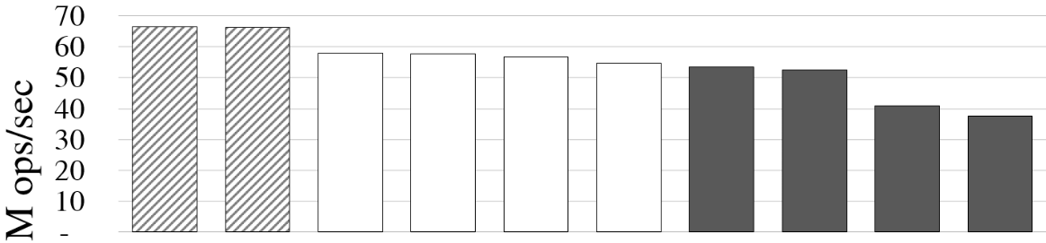
Performance after all fixes
Balanced
Internal
External
BCCO1 | BCCO2 | HJ | DVY | RM | AA | NM1 | NM2 | DGT | EFRB
Read per-node | Read per-node | Read per-node |  | Read per-search | Write per-search
Search overhead
node size class
32 bytes
node size class
48 bytes

Slide 20
Application benchmarks
In-memory database DBx1000 [Yu et al., VLDB 2014]
  Yahoo! Cloud Serving Benchmarks
  TPC-C Database Benchmarks
Used each BST as a database index
  Merges the memory spaces of DBx1000 and the BST!
  Creates similar memory layout issues (e.g., underutilized cache sets)
  And new ones (e.g., scattering of nodes across many pages)
  Even accidentally fixes memory layout issues in DBx1000
See paper for details

Slide 21
Recommendations
When designing and testing a data structure
  Understand your memory layout!
  How are nodes laid out in cache lines? Pages?
  What types of objects are near one another?
When adding a data structure to a program
  You are merging two memory spaces
  Understand your new memory layout!
New tools needed?
http://tbrown.pro
Tutorials, code, benchmarks
Companion talk:
Good data structure experiments are R.A.R.E
Notes:
24:30 first run --- cut 1/5th
20:30 second run (after cuts)

